Slide 1
IPC - Shared Memory
Dr. B
CS392: Systems Programming
Spring 2020

Slide 2
IPC Interfaces We Have Learned
Wait/Signal
One way communication
Work in a passive manner
Can communicate limited information
Pipe
One way communication
Can achieve active communication
Can communicate a large volume of information
Inefficient (need plenty of IO system calls)

Slide 3
Shared memory
Shared memory allows two or more processes to share a given region of memory
This is the fastest way for processes to exchange data
No data copying required
Nor system calls
This achieves bi-directional communications

Slide 4
Shared memory
Shared memory can be attached to different addresses.
Processes that have this memory segment attached will have access to it.

Slide 5
Behind Shared Memory
Memory seen by a process is virtual memory
Every piece of virtual memory is mapped to a piece of physical memory – This is how a process actually accesses data in the RAM
How to achieve shared memory: Make different processes have a piece of virtual memory map to the same piece of physical memory
Memory seen by a process

Slide 6
API to Create Share Memory
Create using int shmget(key_t key, size_t size, int flag);
key – identification of the shared memory
So different processes can find the shared memory
size – the size of the shared memory to be created
Rounded up to be a multiple of PAGE_SIZE (usually 4096)
flag – Flags to control the behaviors of this interface
To create a shared memory, use IPC_CREATE, IPC_EXCL and mode permissions (e.g., 0666)
How to create a key?
key_t ftok(const char *pathname, int proj_id);
The ftok() function uses the identity of the file named by the given pathname (which must refer to an existing, accessible file) and the least significant 8 bits of proj_id (which must be nonzero) to generate a key_t type System V IPC key
The same leads to the same key

Slide 7
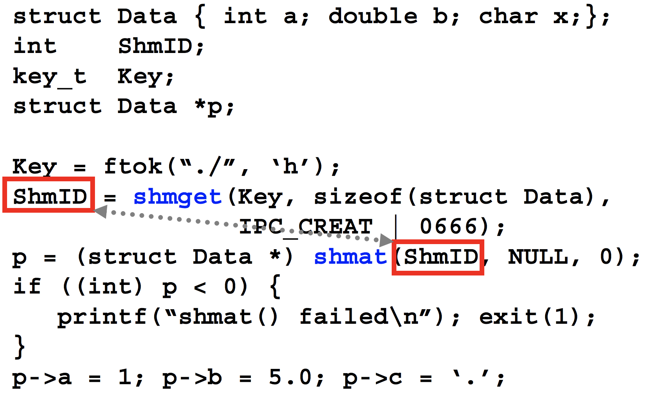
API to Create Share Memory
Process 1

Slide 8
Attaching to Shared Memory
void *shmat(int shmid, const void *addr, int flag);
Attach shared memory segment to process
shmid – ID returned from shmget
addr == NULL
The OS picks an address and attaches shared memory there
addr != NULL
Attach to the specific address addr. It should be a page aligned address unless flag SHM_RND is specified, which rounds it
flag – control the behaviors of shmat () (https://linux.die.net/man/2/shmat)

Slide 9
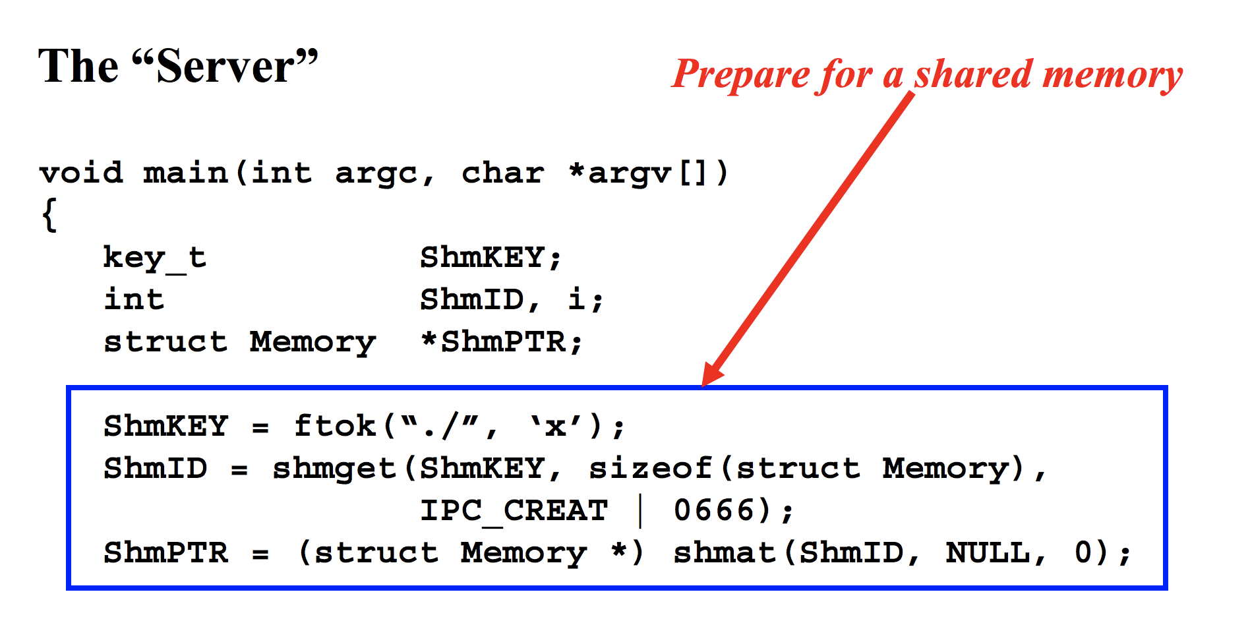
Attaching to Shared Memory
Process 1

Slide 10
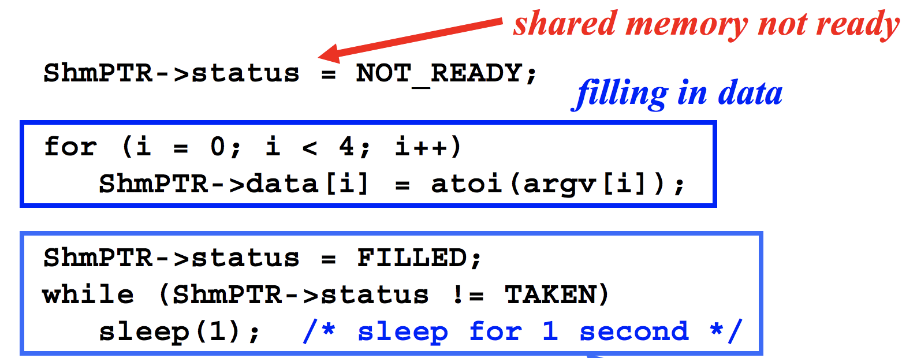
Now You Can Access the Shared Memory
Process 1

Slide 11
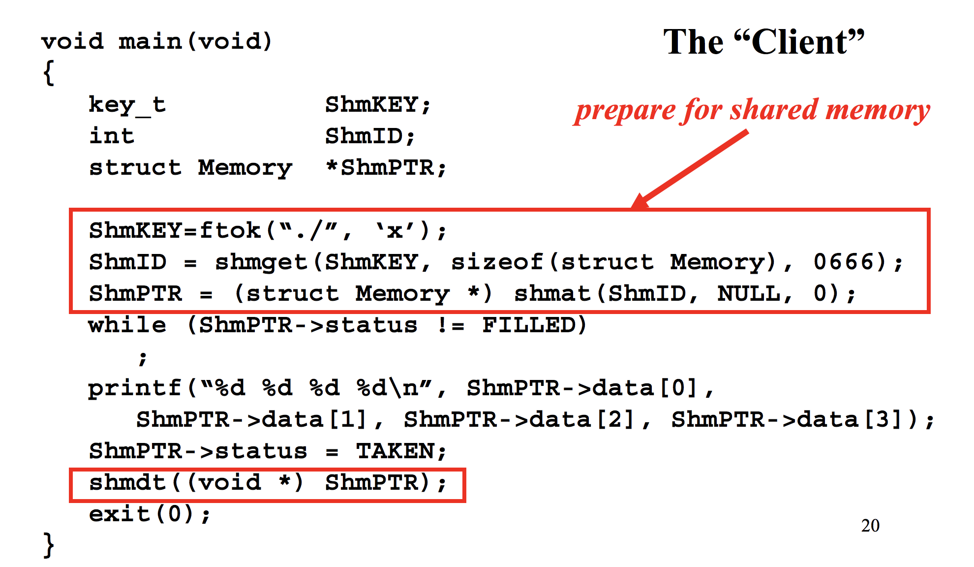
Attach&Access from Another Process
Process 2

Slide 12
Detaching Memory
int shmdt(const void *shmaddr);
Detach segment at address shmaddr

Slide 13
Detach from the Other Process
Process 2

Slide 14
Deleting Shared Memory
int shmctl(int shmid, int cmd, struct shmid_ds *buf );
cmd - IPC_RMID
IPC_RMID – remove the memory segment

Slide 15
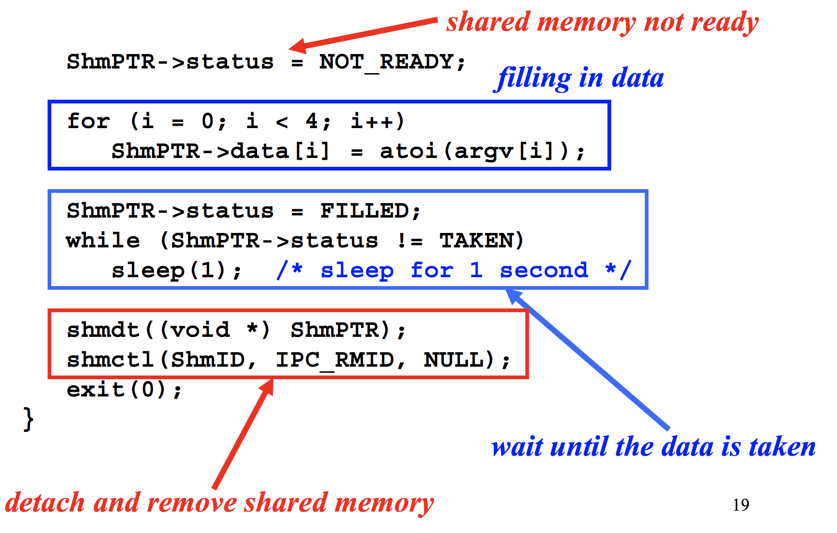
Detaching and Removing Memory
Process 1

Slide 16
How to Ensure Synchronization
How to prevent race between different processes?
E.g., how to prevent two processes from accessing the same data at the same time

