Slide 1
Command Line
Dr. B
CS 392 Systems Programming
Spring 2020

Slide 2
Configuring lubuntu
Even if you are already running Linux, you should install VirtualBox.
https://www.virtualbox.org/wiki/Downloads
Install the correct version for your host OS.
Install the extension pack as well.
Download the OVA file
https://drive.google.com/open?id=1CJE92yy-7kFyZCHXiYcPBMXVz0rc36fQ
After installing VirtualBox
Go to File -> Import Appliance.
Navigate to the ova file on your local file system.
Select it and press the Import button at the bottom of the dialog box.

Slide 3
Sharing Files Between Host OS and VM
The VM is set up to use D:\shared as the default shared directory.
You are welcome to change it, if this path does not meet your needs.

Slide 4
Console (Terminal) Environment
A system console internal to the Linux kernel
Console refers to the device
Terminal typically means the environment
Send text output to the user (monitor) and receive text input from the user (keyboard)
By default, we interact with the shell in Linux

Slide 5
Add cs392 User
Log into the cs385 account. The password is password.
I know, it’s very secure!
To create a new user, open a terminal and terminal type:
sudo adduser cs392
Enter the password of your choosing
You may leave all the fields (full name, room number, etc., blank)
Add sudo access for the cs392 user:
sudo usermod -aG sudo cs392
Add access to the shared folder:
sudo usermod -aG vboxsf cs392
ln –s /mnt/shared
sudo means “super user do”
su means “switch user”

Slide 6
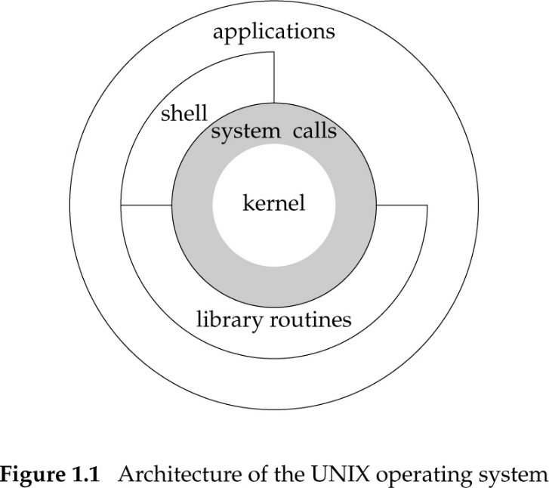
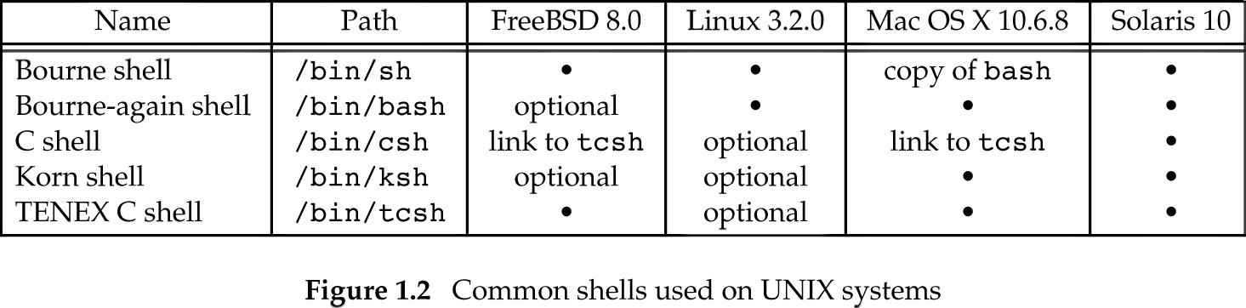
Working with the Shell
In our VM, the default shell is bash: https://www.gnu.org/software/bash/manual/bashref.html#What-is-a-shell_003f

Slide 7
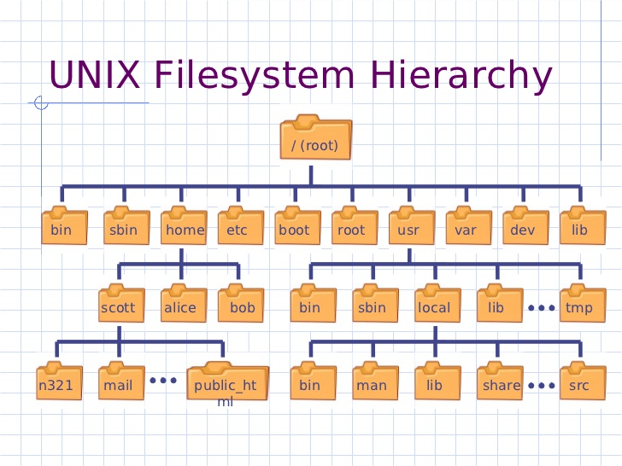
Getting Started
When you first login, the shell places you in your home directory
/home/<username>

Slide 8
File Paths Explained (1/4)
/bin : The /bin directory contains the essential user binaries (programs) that must be present when the system is mounted in single-user mode.
/boot : The /boot directory contains the files needed to boot the system – for example, the GRUB boot loader’s files and your Linux kernels are stored here. The boot loader’s configuration files aren’t located here, though – they’re in /etc with the other configuration files.
/dev : Linux exposes devices as files, and the /dev directory contains a number of special files that represent devices. This directory also contains pseudo-devices, which are virtual devices that don’t actually correspond to hardware. For example, /dev/random produces random numbers.
/etc : The /etc directory contains configuration files, which can generally be edited by hand in a text editor.
/home : Home directory of the users. Every time a new user is created, a directory in the name of user is created within home directory which contains other directories like Desktop, Downloads, Documents, etc.

Slide 9
File Paths Explained (2/4)
/lib : The /lib directory contains libraries needed by the essential binaries in the /bin and /sbin folder. Libraries needed by the binaries in the /usr/bin folder are located in /usr/lib.
/lost+found : This directory is installed during installation of Linux, useful for recovering files which may be broken due to an unexpected shut-down.
/media : Temporary mount directory is created for removable devices such as /media/cdrom.
/mnt : Temporary mount directory for mounting file system.
/opt : Optional is abbreviated as opt. Contains third party application software.

Slide 10
File Paths Explained (3/4)
/proc : A virtual and pseudo file-system which contains information about the system and running process with a particular process ID, aka pid.
/root : This is the home directory of root user and should never be confused with ‘/’.
/run : The /run directory, which is fairly new, gives applications a standard place to store transient files they require like sockets and process IDs.
/sbin : The /sbin directory is similar to the /bin directory. It contains essential binaries that are generally intended to be run by the root user for system administration.
/srv : The /srv directory contains “data for services provided by the system.” If you were using the Apache HTTP server to serve a website, you’d likely store your website’s files in a directory inside the /srv directory.

Slide 11
File Paths Explained (4/4)
/sys : Modern Linux distributions include a /sys directory as a virtual filesystem, which stores and allows modification of the devices connected to the system.
/tmp : Applications store temporary files in the /tmp directory. These files are generally deleted whenever your system is restarted and may be deleted at any time by utilities such as tmpwatch.
/usr : The /usr directory contains applications and files used by users, as opposed to applications and files used by the system.
/var : Stands for variable. The content of this directory is expected to grow. This directory contains log, lock, spool, mail, and temp files.

Slide 12
First Commands
The shell enables you to execute various commands
Available commands and options may differ across systems.
All examples shown in the lecture will work in lubuntu.
Basic commands:
pwd - print path of current/working directory
ls - list directory contents

Slide 13
Two Types of Commands
Shell Built-in Commands
The shell implements them
Small in number
E.g., cd
User Commands
Programs installed in the system
Usually in /bin or /usr/bin
Frequently used
Many in number
Your shell needs to know where to find them

Slide 14
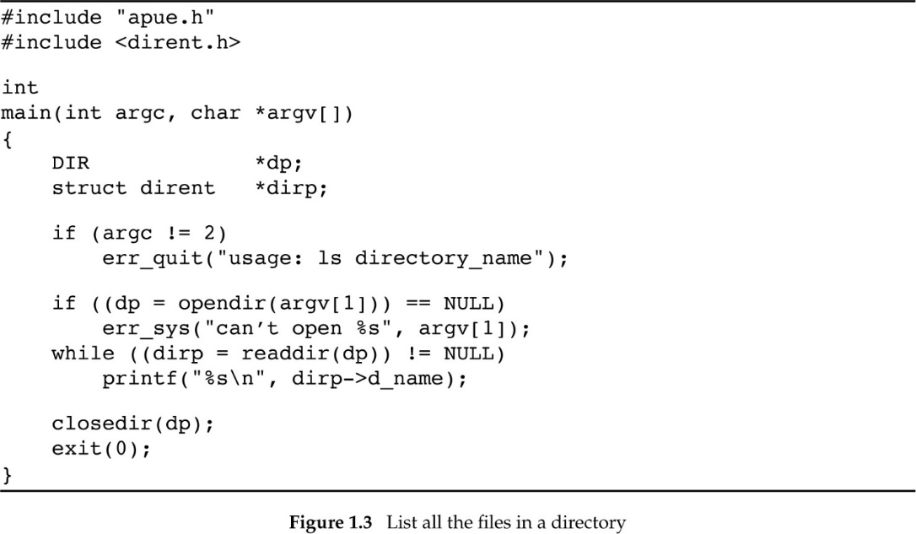
ls
Program that lists directory contents
Find the location of ls (-b binary, -m manual, -s source)
whereis -b ls
LS does not work. Any idea why?
It’s not so hard to build a simple version in C.

Slide 15
Shell Variables
Start with symbol $
Example:
echo $PATH
/opt/bin:/usr/local/bin:/usr/sbin:/usr/bin:/sbin:/bin:/usr/games
The PATH variable contains a list of pathnames, where the shell searches for user commands
BTW, UNIX is case sensitive!

Slide 16
Directory Management
mkdir <directory name> -- Create a directory
cd <directory name> -- Change current directory
.. has a special meaning, it refers to the parent directory in the hierarchy
. has a special meaning, it refers to the current directory
rmdir <directory name> -- Delete empty directory
These commands have many options that can make your life easier.

Slide 17
Creating a File
Create an empty file
touch <file path name>
Try this:
touch -d "2004-02-29 16:21:42" hw1.c
date -r hw1.c
Use a command-line editor in VM (warning read on the editors first!)
vim
Emacs (not installed by default)
Copy a local file
cp <source pathname> <destination pathname>
Moving/renaming a file
mv <source pathname> <destination pathname>

Slide 18
Viewing a File
cat <pathname> -- Just display contents in terminal
less <pathname> -- Display and paginate contents in terminal
more <pathname> -- Display and paginate (simpler) contents in terminal. More is actually less!
head <pathname> -- Display first few lines of file in terminal
tail <pathname> -- Display last few lines of file in terminal

Slide 19
Deleting a File
rm <filename> -- Delete file
WARNING: Deleted files are lost forever! Really, you will lose that file forever!

Slide 20
Time
Calendar time
Time since the epoch 00:00:00 January 1, 1970, UTC
Process time
Clock ticks
50, 60, or 100 ticks/second
Measuring execution time
$ time -p ./myslowprogram
real 0.10
user 0.06
kernel 0.02

Slide 21
Time
Calendar time
Time since the epoch 00:00:00 January 1, 1970, UTC
Process time
Clock ticks
50, 60, or 100 ticks/second
Measuring execution time
$ time –p ./myslowprogram
real 0.09
user 0.06
kernel 0.02
Clock time or wall time
Time due to program instructions
Time due to kernel instructions

Slide 22
Job Control in Bash
Appending & after a command puts the process in the background
<executable> arg1 arg2 … &
User command ps --- reports a snapshot of the current processes
Bash job control
fg --- move background job to foreground
Typing CTRL+C --- cancel/terminate foreground job
Typing CTRL+Z --- suspend/pause foreground job
bg --- move suspended job to background and resume
PID TTY TIME CMD
19575 pts/0 00:00:00 bash
21041 pts/0 00:00:00 ps

Slide 23
Standard I/O and Redirection
Every process has a standard input (stdin), output (stdout), and error (stderr)
Shells offer power full I/O redirections capabilities:
program1 | program2
Redirect program1’s stdout to program2’s stdin
program1 < myfile
Program1’s stdin is myfle
program1 > myfile
Program1’s output overwrites myfile
program1 >> myfile
Program1’s output is appended to myfile
And many more…

Slide 24
man
man is the most useful user command
Try man man
You do not need to supply the exact user command or man page you are interested in
Multiple results may exist
For example, try man open, then man 2 open
2 corresponds to the man pages section
man -k <term> searches for term in man pages and returns page with their section
Example: open (2)

Slide 25
Manual Page Sections
1 Executable programs or shell commands
2 System calls (functions provided by the kernel)
3 Library calls (functions within program libraries)
4 Special files (usually found in /dev)
5 File formats and conventions eg /etc/passwd
6 Games
7 Miscellaneous (including macro packages and conventions), e.g., man(7), groff(7)
8 System administration commands (usually only for root)
9 Kernel routines [Non standard]
Google is yet another man (maybe easier?)

