Slide 1
Prologue: how many things are wrong?
type Contact = {
FirstName: string
MiddleInitial: string
LastName: string
EmailAddress: string
IsEmailVerified: bool
}
How many things are wrong with this design?
// true if ownership of // email address is confirmed
Find out ->
Domain Driven Design with the F# type system

Slide 2
Prologue: which values are optional?
type Contact = {
FirstName: string
MiddleInitial: string
LastName: string
EmailAddress: string
IsEmailVerified: bool
}
Which values are optional?

Slide 3
Prologue: what are the constraints?
type Contact = {
FirstName: string
MiddleInitial: string
LastName: string
EmailAddress: string
IsEmailVerified: bool
}
Must not be more than 50 chars
What are the constraints?

Slide 4
Prologue: what groups are atomic?
type Contact = {
FirstName: string
MiddleInitial: string
LastName: string
EmailAddress: string
IsEmailVerified: bool
}
Must be updated as a group
Which fields are linked?

Slide 5
Prologue: domain logic?
type Contact = {
FirstName: string
MiddleInitial: string
LastName: string
EmailAddress: string
IsEmailVerified: bool
}
What is the domain logic?
Must be reset if email is changed

Slide 6
Prologue: F# can help
Which values are optional?
type Contact = {
FirstName: string
MiddleInitial: string
LastName: string
EmailAddress: string
IsEmailVerified: bool
}
What are the constraints?
Which fields are linked?
Any domain logic?
F# can help with all these questions!

Slide 7
Domain Driven Design with the F# type system
Scott Wlaschin
@ScottWlaschin
fsharpforfunandprofit.com
/ddd

Slide 8

What is DDD and F#?
What is DDD?
What is F#?
“F# is a mature, open source, cross-platform, functional-first programming language which empowers users and organizations to tackle complex computing problems with simple, maintainable and robust code.” — fsharp.org
"Focus on the domain and domain logic rather than technology" -- Eric Evans
"#fsharp is C# and python with extra awesome" --me

Slide 9
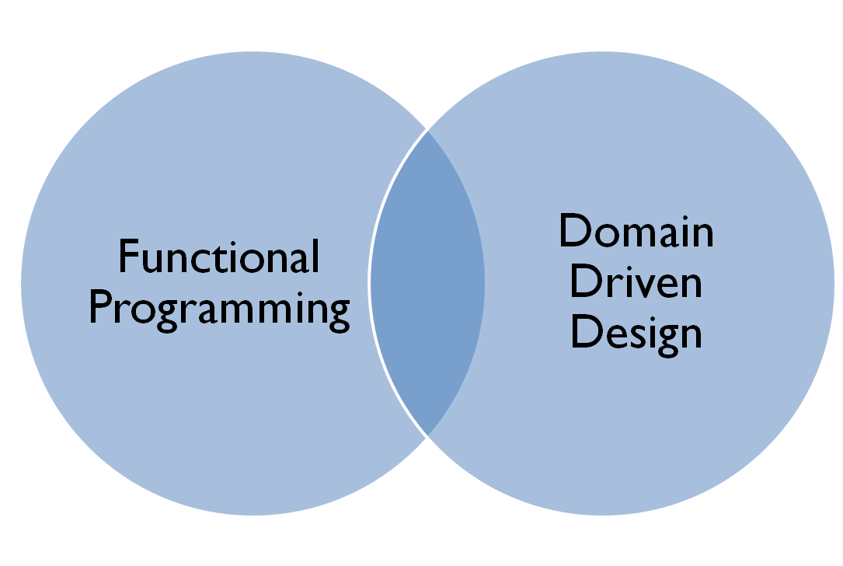
This talk

Slide 10
What I’m going talk about:
Functional programming for real world applications
F# vs. C# for domain driven design
Understanding the F# type system
Designing with types

Slide 11
Functional programming for real world applications

Slide 12
Functional programming is...
I’ve heard that...
... good for mathematical and scientific tasks
... good for complicated algorithms
... really good for parallel processing
... but you need a PhD in computer science ☹
All true...
So not true...

Slide 13
Functional programming is good for...
really ^
Boring
Line Of Business
Applications
(BLOBAs)

Slide 14
Must haves for BLOBA development...
Express requirements clearly
Rapid development cycle
High quality deliverables
F# is concise! Easy to communicate.
F# has a REPL and many conveniences to avoid boilerplate
F# type system ensures correctness
Fun
"fun" is a keyword in #fsharp

Slide 15

#fsharp <3 #bloba development!

Slide 16
F# vs. C# for Domain Driven Design
Values vs. Entities

Slide 17
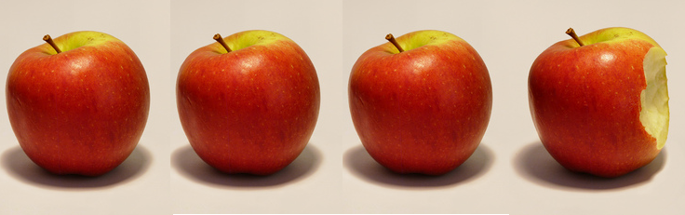
Values vs. Entities
My apple!
Value objects – can’t tell them apart
Entity object – has identity
Photo credit: http://www.flickr.com/photos/anacooke/

Slide 18

Values vs. Entities
My apple!
Still my apple!
An Entity’s properties may change over its lifetime but it preserves its identity
Photo credit: http://www.flickr.com/photos/anacooke/

Slide 19
Values vs. Entities
Examples of Values:
Personal name
Email address
Postal address
Product code
uneaten apple
Examples of Entities:
Customer
Order
Product
half eaten apple

Slide 20
How do you implement a Value object?
Equality based on comparing all properties
PersonalName: FirstName = "Alice"
LastName = "Adams"
PersonalName: FirstName = "Alice"
LastName = "Adams"
Equal
→ Therefore must be immutable
stop talking and show me some code!

Slide 21
Value object definition in C#
class PersonalName
{
public PersonalName(string firstName, string lastName)
{
this.FirstName = firstName;
this.LastName = lastName;
}
public string FirstName { get; private set; }
public string LastName { get; private set; }
}
use "private set" for immutability

Slide 22
Value object definition in C# (extra code for equality)
class PersonalName
{
// all the code from above, plus...
public override int GetHashCode()
{
return this.FirstName.GetHashCode() + this.LastName.GetHashCode();
}
public override bool Equals(object other)
{
return Equals(other as PersonalName);
}
public bool Equals(PersonalName other)
{
if ((object) other == null)
{
return false;
}
return FirstName == other.FirstName && LastName == other.LastName;
}

Slide 23
Value object definition in F#
type PersonalName = {FirstName:string; LastName:string}

Slide 24
Value object definition in F# (extra code for equality)
This page intentionally left blank
the best code is no code at all

Slide 25
How do you implement an Entity object?
Equality based on some sort of id
Person: Id = 1
Name = "Alice Adams"
Person: Id = 1
Name = "Bilbo Baggins"
Equal
X
→ Generally has mutable content

Slide 26
Entity object definition in C# (part 1)
class Person
{
public Person(int id, PersonalName name)
{
this.Id = id;
this.Name = name;
}
public int Id { get; private set; }
public PersonalName Name { get; set; }
}
removed private set

Slide 27
Entity object definition in C# (part 2)
class Person
{
// all the code from above, plus...
public override int GetHashCode()
{
return this.Id.GetHashCode();
}
public override bool Equals(object other)
{
return Equals(other as Person);
}
public bool Equals(Person other)
{
if ((object) other == null)
{
return false;
}
return Id == other.Id;
}
}
Compare on Id now...

Slide 28
Entity object definition in F# with equality override
[<CustomEquality; NoComparison>]
type Person = {Id:int; Name:PersonalName} with
override this.GetHashCode() = hash this.Id
override this.Equals(other) =
match other with
| :? Person as p -> (this.Id = p.Id)
| _ -> false
...compare by Id
If its a person...
No null checking!

Slide 29
Entity object definition in F# with no equality allowed
[<CustomEquality; NoComparison>]
type Person = {Id:int; Name:PersonalName}
[<NoEquality; NoComparison>]

Slide 30
Entity immutability
[<NoEquality; NoComparison>]
type Person = { ... ... ... }
immutable
The only way to create an object
let tryCreatePerson name = // validate on construction // if input is valid return something // if input is not valid return error
✓
✗
All changes must go through this checkpoint
Great for enforcing invariants in one place

Slide 31

Even the entities are immutable

Slide 32
Entity object definition in F# with mutability
[<NoEquality; NoComparison>]
type Person = {Id:int; mutable Name:PersonalName}
In #fsharp, “mutable” is a code smell

Slide 33
Reviewing the C# code so far...
Can you tell values from entities at a glance?
: IValue
: IEntity
class PersonalName
{
public PersonalName(string firstName, string lastName)
{
this.FirstName = firstName;
this.LastName = lastName;
}
public string FirstName { get; private set; }
public string LastName { get; private set; }
public override int GetHashCode()
{
return this.FirstName.GetHashCode() + this.LastName.GetHashCode();
}
public override bool Equals(object other)
{
return Equals(other as PersonalName);
}
public bool Equals(PersonalName other)
{
if ((object) other == null)
{
return false;
}
return FirstName == other.FirstName && LastName == other.LastName;
}
}
class Person
{
public Person(int id, PersonalName name)
{
this.Id = id;
this.Name = name;
}
public int Id { get; private set; }
public PersonalName Name { get; set; }
public override int GetHashCode()
{
return this.Id.GetHashCode();
}
public override bool Equals(object other)
{
return Equals(other as Person);
}
public bool Equals(Person other)
{
if ((object) other == null)
{
return false;
}
return Id == other.Id;
}
}
Adding a marker interface doesn't stop you from getting the logic wrong!

Slide 34
Reviewing the C# code so far...
Is this a reasonable amount of code to write?
Could a non-technical person understand it?
: IValue
: IEntity
class PersonalName
{
public PersonalName(string firstName, string lastName)
{
this.FirstName = firstName;
this.LastName = lastName;
}
public string FirstName { get; private set; }
public string LastName { get; private set; }
public override int GetHashCode()
{
return this.FirstName.GetHashCode() + this.LastName.GetHashCode();
}
public override bool Equals(object other)
{
return Equals(other as PersonalName);
}
public bool Equals(PersonalName other)
{
if ((object) other == null)
{
return false;
}
return FirstName == other.FirstName && LastName == other.LastName;
}
}
class Person
{
public Person(int id, PersonalName name)
{
this.Id = id;
this.Name = name;
}
public int Id { get; private set; }
public PersonalName Name { get; set; }
public override int GetHashCode()
{
return this.Id.GetHashCode();
}
public override bool Equals(object other)
{
return Equals(other as Person);
}
public bool Equals(Person other)
{
if ((object) other == null)
{
return false;
}
return Id == other.Id;
}
}

Slide 35
Reviewing the F# code so far...
Is this a reasonable amount of code to write?
Could a non-technical person understand it?
type PersonalName = {
FirstName : string;
LastName : string }
[<StructuralEquality;NoComparison>]
[<NoEquality; NoComparison>]
type Person = { Id : int;
Name : PersonalName }

Slide 36
Comparing C# vs. F#
 | C# | F#
Value objects? | Non-trivial | Easy
Entity objects? | Non-trivial | Easy
Value objects by default? | No | Yes
Immutable objects by default? | No | Yes
Can you tell Value objects from Entities at a glance? | No | Yes
Understandable by non-programmer? | No | Yes
Very important thing for DDD!

Slide 37
F# for Domain Driven Design
Communicating a domain model

Slide 38

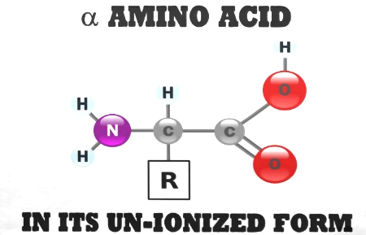
Communication is hard...
U-N-I-O-N-I-Z-E
U-N-I-O-N-I-Z-E
U-N-I-O-N-I-Z-E

Slide 39
Communication in DDD: “Bounded Context”
Bounded context
Business
Supermarket
Sales
Marketing
Chemistry
Email System
Warehouse
Finance
unionize
Spam
Product
Customer
un-ionize
Spam
Product
Customer

Slide 40
Communication in DDD: “Ubiquitous Language”
Chemistry
Sales
Warehouse
Ion Atom Molecule Polymer Compound Bond
Product Promotion Customer Tracking
Product Stock Transfer Depot Tracking
Ubiquitous Language

Slide 41
module CardGame =
type Suit = Club | Diamond | Spade | Heart
type Rank = Two | Three | Four | Five | Six | Seven | Eight
| Nine | Ten | Jack | Queen | King | Ace
type Card = Suit * Rank
type Hand = Card list
type Deck = Card list
type Player = {Name:string; Hand:Hand}
type Game = {Deck:Deck; Players: Player list}
type Deal = Deck –› (Deck * Card)
type PickupCard = (Hand * Card) –› Hand
Bounded context
Ubiquitous language

Slide 42
'|' means a choice -- pick one from the list
module CardGame =
type Suit = Club | Diamond | Spade | Heart
type Rank = Two | Three | Four | Five | Six | Seven | Eight
| Nine | Ten | Jack | Queen | King | Ace
type Card = Suit * Rank
type Hand = Card list
type Deck = Card list
type Player = {Name:string; Hand:Hand}
type Game = {Deck:Deck; Players: Player list}
type Deal = Deck –› (Deck * Card)
type PickupCard = (Hand * Card) –› Hand
Bounded context
Ubiquitous language
'*' means a pair. Choose one from each type
list type is built in
X -> Y means a function - input of type X - output of type Y

Slide 43
module CardGame =
type Suit = Club | Diamond | Spade | Heart
type Rank = Two | Three | Four | Five | Six | Seven | Eight
| Nine | Ten | Jack | Queen | King | Ace
type Card = Suit * Rank
type Hand = Card list
type Deck = Card list
type Player = {Name:string; Hand:Hand}
type Game = {Deck:Deck; Players: Player list}
type Deal = Deck –› (Deck * Card)
type PickupCard = (Hand * Card) –› Hand
Is this a reasonable amount of code to write?
Could a non-technical person understand it?

Slide 44
module CardGame =
type Suit = Club | Diamond | Spade | Heart
type Rank = Two | Three | Four | Five | Six | Seven | Eight
| Nine | Ten | Jack | Queen | King | Ace
type Card = Suit * Rank
type Hand = Card list
type Deck = Card list
type Player = {Name:string; Hand:Hand}
type Game = {Deck:Deck; Players: Player list}
type Deal = Deck –› (Deck * Card)
type PickupCard = (Hand * Card) –› Hand
"persistence ignorance"
Domain driven, not database driven!
"The design is the code, and the code is the design."
This page looks like pseudo-code, but is actually real compilable code.

Slide 45
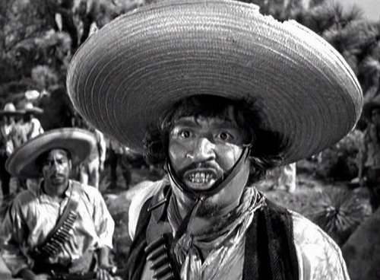
We don’t need no Stinking UML DIAGRAMs

Slide 46
Understanding the F# type system
An introduction to “algebraic” types

Slide 47
Understanding the F# type system
An introduction to “composable” types

Slide 48

Composable types

Slide 49
Creating new types in F#
New types in F# are constructed by combining other types using two basic operations:
type typeW = typeX "times" typeY
type typeZ = typeX "plus" typeY

Slide 50
Creating new types in F#
1 2 3 4
2 3 4
5
AddOne
(a function)
AddOne int –› int

Slide 51
Representing pairs
(1,2)
(2,3)
(3,4)
(4,5)
3
5
7
9
AddPair ? –› int
Type: ?
Type: Integer
How can we represent this type?

Slide 52
Representing pairs
(1,2)
(2,3)
(3,4)
(4,5)
1
2
3
4
2
3
4
5
=
×
One from this pile...
And one from this pile...

Slide 53
Representing pairs
(true, false)
(true, true)
(false, false)
(false, true)
true false
true false
=
×
One from this pile...
And one from this pile...

Slide 54
Representing pairs
pair of ints
written int * int
pair of bools
written bool * bool

Slide 55
Using tuples for data
Alice, Jan 12th
Bob, Feb 2nd
Carol, Mar 3rd
Set of people
Set of dates
=
×
How to represent this?

Slide 56
Using tuples for data
Alice, Jan 12th
Bob, Feb 2nd
Carol, Mar 3rd
Set of people
Set of dates
=
×
type Birthday = Person * Date

Slide 57
Representing a choice
Temp F
true
false
IsFever ? –› bool
or
Temp C
Type: ?
How can we represent this type?

Slide 58
Representing a choice
One from this pile...
98˚ F 99˚ F 100˚ F 101˚ F
Temp F
=
+
or
Temp C
37.0˚ C 37.5˚ C
38.0˚ C 38.5˚ C
Or one from this pile...

Slide 59
Representing a choice
98˚ F 99˚ F 100˚ F 101˚ F
Tag these with “F”
Temp F
=
type Temp =
| F of int
| C of float
+
or
Temp C
37.0˚ C 37.5˚ C
38.0˚ C 38.5˚ C
Tag these with “C”

Slide 60
Using choices for data
type PaymentMethod =
| Cash
| Cheque of int
| Card of CardType * CardNumber
No extra data needed
Check no.
2 pieces of extra data

Slide 61
Working with a choice type
type PaymentMethod =
| Cash
| Cheque of int
| Card of CardType * CardNumber
let printPayment method =
match method with
| Cash –› printfn “Paid in cash"
| Cheque checkNo –› printfn “Paid by cheque: %i" checkNo
| Card (cardType,cardNo) –› printfn “Paid with %A %A" cardType cardNo

Slide 62
What are types for in F#?
An annotation to a value for type checking
type AddOne: int –› int
Domain modelling tool
type Deal = Deck –› (Deck * Card)
both at once!
#fsharp has “compile time unit tests”

Slide 63

TYPE ALL THE THINGS

Slide 64
Designing with types
What can we do with this type system?

Slide 65
Required vs. Optional
type PersonalName =
{
FirstName: string;
MiddleInitial: string;
LastName: string;
}
required
optional
required
How can we represent optional values?

Slide 66
Null is not the same as “optional”
“a” “b” “c”
“a” “b” “c” null
1 2
3
Length string –› int
Type: String

Slide 67

Spock, set phasers to null!
That is illogical, Captain

Slide 68
Null is not the same as “optional”
“a” “b” “c” null
1 2
3
Length string –› int
is null really a string?
Type: String

Slide 69

“null is the Saruman of static typing”

Slide 70
Null is not allowed in F#
“a” “b” “c” null
1 2
3
Length string –› int
X
null is not allowed as a value!
Type: String

Slide 71
A better way for optional values
Tag these with “SomeString”
“a” “b” “c”
“a” “b” “c”
=
type OptionalString =
| SomeString of string
| Nothing
+
or
missing
Tag with “Nothing”

Slide 72
Defining optional types
type OptionalString =
| SomeString of string
| Nothing
type OptionalInt =
| SomeInt of int
| Nothing
Duplicate code?
type OptionalBool =
| SomeBool of bool
| Nothing

Slide 73
The built-in “Option” type
type Option<'T> =
| Some of 'T
| None
generic type
type PersonalName =
{
FirstName: string
MiddleInitial: string
LastName: string
}

Slide 74
The built-in “Option” type
type Option<'T> =
| Some of 'T
| None
generic type
type PersonalName =
{
FirstName: string
MiddleInitial: Option<string>
LastName: string
}

Slide 75
The built-in “Option” type
type Option<'T> =
| Some of 'T
| None
generic type
type PersonalName =
{
FirstName: string
MiddleInitial: string option
LastName: string
}
nice and readable!

Slide 76
Single choice types
type Something = | ChoiceA of A
One choice only? Why?
type Email = | Email of string
type CustomerId = | CustomerId of int

Slide 77
Wrapping primitive types
Is an EmailAddress just a string?
Is a CustomerId just a int?
Use single choice types to keep them distinct
type EmailAddress = EmailAddress of string
type PhoneNumber = PhoneNumber of string
Distinct types
type CustomerId = CustomerId of int
type OrderId = OrderId of int
Also distinct types

Slide 78
Creating the EmailAddress type
let createEmailAddress (s:string) =
if Regex.IsMatch(s,@"^\S+@\S+\.\S+$")
then (EmailAddress s)
else ?
What to return if not valid?
createEmailAddress: string –› EmailAddress

Slide 79
Creating the EmailAddress type
let createEmailAddress (s:string) =
if Regex.IsMatch(s,@"^\S+@\S+\.\S+$")
then (EmailAddress s)
else ?
let createEmailAddress (s:string) =
if Regex.IsMatch(s,@"^\S+@\S+\.\S+$")
then Some (EmailAddress s)
else None
createEmailAddress: string –› EmailAddress
createEmailAddress: string –› EmailAddress option

Slide 80
Constrained strings
type String50 = String50 of string
let createString50 (s:string) =
if s.Length <= 50
then Some (String50 s)
else None
createString50 : string –› String50 option

Slide 81
Constrained numbers
What’s wrong with this picture?
Qty:
–
999999
+
Add To Cart
How could this happen?

Slide 82
Constrained numbers
How many people ever do this?
New type just for this domain
type OrderLineQty = OrderLineQty of int
let createOrderLineQty qty =
if qty >0 && qty <= 99
then Some (OrderLineQty qty)
else None
createOrderLineQty: int –› OrderLineQty option

Slide 83
The challenge, revisited
type Contact = {
FirstName: string
MiddleInitial: string
LastName: string
EmailAddress: string
IsEmailVerified: bool
}

Slide 84
The challenge, revisited
type Contact = {
FirstName: string
MiddleInitial: string option
LastName: string
EmailAddress: string
IsEmailVerified: bool
}

Slide 85
The challenge, revisited
type Contact = {
FirstName: String50
MiddleInitial: String1 option
LastName: String50
EmailAddress: EmailAddress
IsEmailVerified: bool
}

Slide 86

I SEE WHAT YOU DID THERE

Slide 87
The challenge, revisited
type PersonalName = {
FirstName: String50
MiddleInitial: String1 option
LastName: String50 }
type Contact = {
Name: PersonalName
Email: EmailContactInfo }
type EmailContactInfo = {
EmailAddress: EmailAddress
IsEmailVerified: bool }

Slide 88
Encoding domain logic
type EmailContactInfo = {
EmailAddress: EmailAddress
IsEmailVerified: bool }
anyone can set this to true
Rule 1: If the email is changed, the verified flag must be reset to false.
Rule 2: The verified flag can only be set by a special verification service

Slide 89
Encoding domain logic
"there is no problem that can’t be solved by wrapping it in a type"
type VerifiedEmail = VerifiedEmail of EmailAddress
type VerificationService = (EmailAddress * VerificationHash) –› VerifiedEmail option
type EmailContactInfo =
| Unverified of EmailAddress
| Verified of VerifiedEmail

Slide 90
The challenge, completed
type EmailAddress = ...
type VerifiedEmail =
VerifiedEmail of EmailAddress
type EmailContactInfo =
| Unverified of EmailAddress
| Verified of VerifiedEmail
type PersonalName = {
FirstName: String50
MiddleInitial: String1 option
LastName: String50 }
type Contact = {
Name: PersonalName
Email: EmailContactInfo }
The ubiquitous language is evolving along with the design
(all this is compilable code, BTW)

Slide 91
Making illegal states unrepresentable
New rule: “A contact must have an email or a postal address”
type Contact = { Name: Name Email: EmailContactInfo Address: PostalContactInfo
}
New!
This design does not meet the requirements

Slide 92
Making illegal states unrepresentable
New rule: “A contact must have an email or a postal address”
type Contact = { Name: Name Email: EmailContactInfo option Address: PostalContactInfo option
}
Could both be missing?
This design does not meet the requirements either!
"Make illegal states unrepresentable!" – Yaron Minsky

Slide 93
Making illegal states unrepresentable
“A contact must have an email or a postal address”
implies:
email address only, or
postal address only, or
both email address and postal address
only three possibilities

Slide 94
Making illegal states unrepresentable
“A contact must have an email or a postal address”
type ContactInfo =
| EmailOnly of EmailContactInfo
| AddrOnly of PostalContactInfo
| EmailAndAddr of EmailContactInfo * PostalContactInfo
type Contact = { Name: Name ContactInfo : ContactInfo }
requirements are now encoded in the type!
only three possibilities

Slide 95
Making illegal states unrepresentable
“A contact must have an email or a postal address”
BEFORE: Email and address separate
AFTER: Email and address merged into one type
type Contact = { Name: Name Email: EmailContactInfo Address: PostalContactInfo
}
type Contact = { Name: Name ContactInfo : ContactInfo }
type ContactInfo =
| EmailOnly of EmailContactInfo
| AddrOnly of PostalContactInfo
| EmailAndAddr of EmailContactInfo * PostalContactInfo

Slide 96

F# is almost as awesome as this

Slide 97
Making illegal states unrepresentable
Is this really what the business wants?
“A contact must have an email or a postal address”

Slide 98
Making illegal states unrepresentable
Better rule perhaps?
“A contact must have an email or a postal address”
“A contact must have at least one way of being contacted”
type ContactInfo =
| Email of EmailContactInfo
| Addr of PostalContactInfo
type Contact = { Name: Name PrimaryContactInfo: ContactInfo SecondaryContactInfo: ContactInfo option }

Slide 99
Stuff I haven’t had time to cover:
just scratching the surface today...
Services
States and transitions
CQRS
The functional approach to use cases
Domain events
Error handling
And much more...

Slide 100

F# is low risk
Enterprise development
Mobile development
F# on over 2 billion devices
F# is the safe choice for functional-first development
credit: @7sharp9 @MattDrivenDev

Slide 101
Thank you!
fsharpforfunandprofit.com/ddd
fsharp.org/testimonials
tryfsharp.org
try F# in your web browser!
@ScottWlaschin
#fsharp on Twitter

