Slide 1


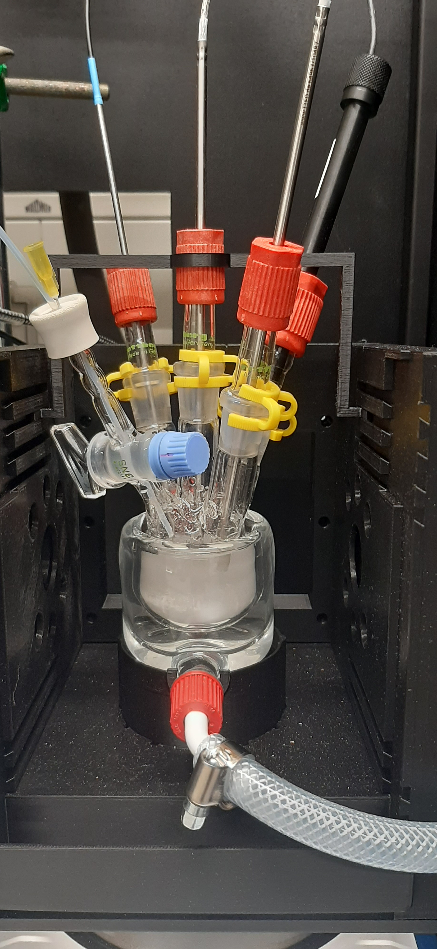





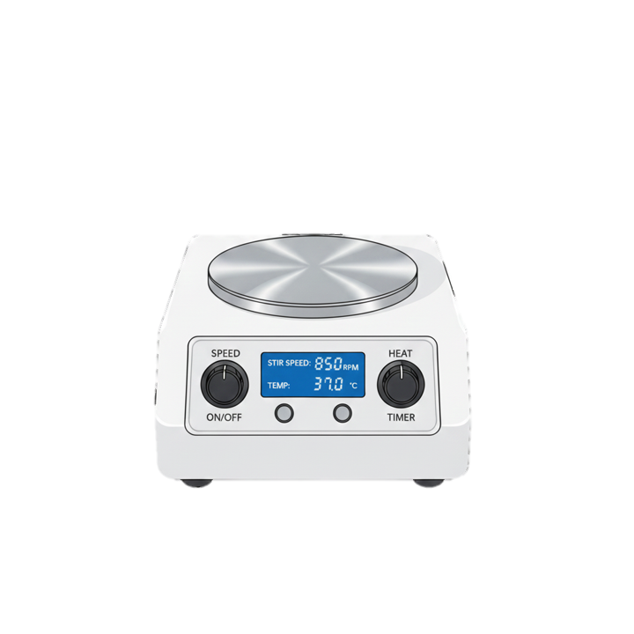
A
B
PT1000
O₂
sensor
H₂
sensor
PT100
O₂ meter
365 nm
LED
H₂ meter

