Slide 1
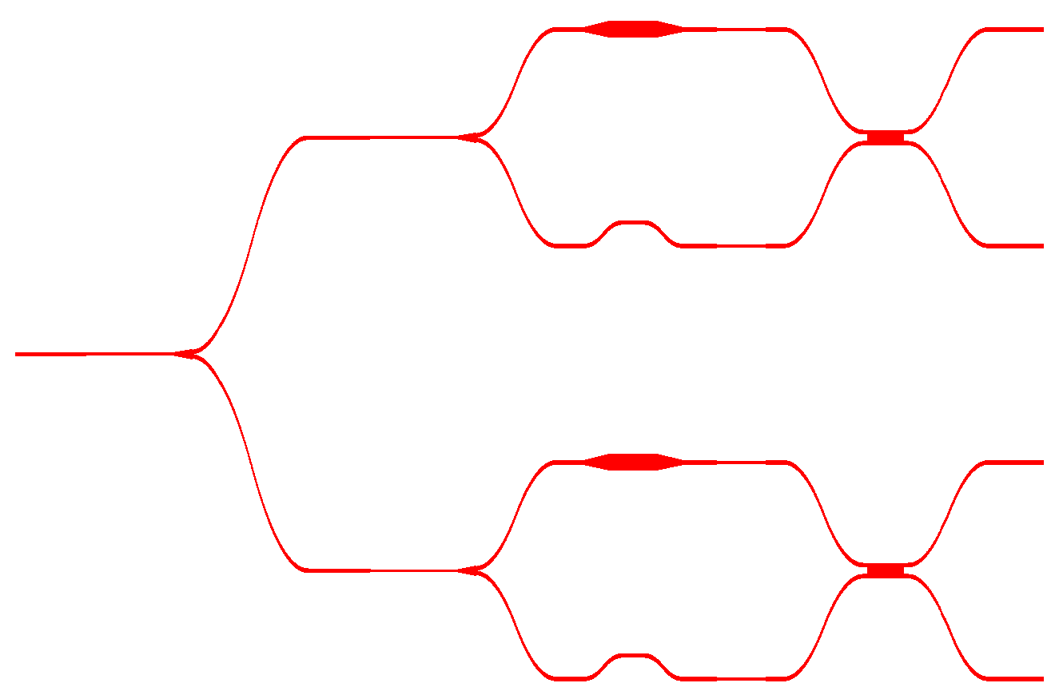
birefringent
waveguide
H
V
D
A
H/V/D/A
λ/2 plate film

