Slide 1
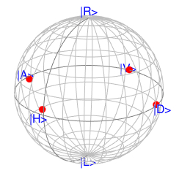
mirror
LD-H
LD-V
PC
PBS Module
lens
Power
meter
PBS
LD-D
BS
LD-A
HWP
(a)
LD-H
PBS Module
Polari-meter
LD-V
LD-D
LD-A
(b) (c)

