Slide 1
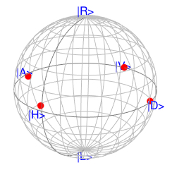
LD-H
PBS Module
Polarimeter
LD-V
LD-D
LD-A
(a) (b)

