Slide 1
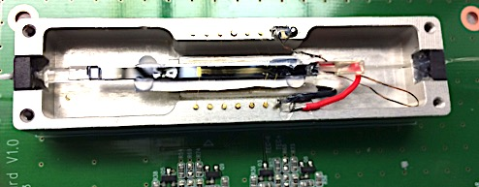
half-wave plate
PBS chip
4 ch. PMF array
SMF
module control board
pins for micro-heater,
TEC, thermistor

