Slide 1
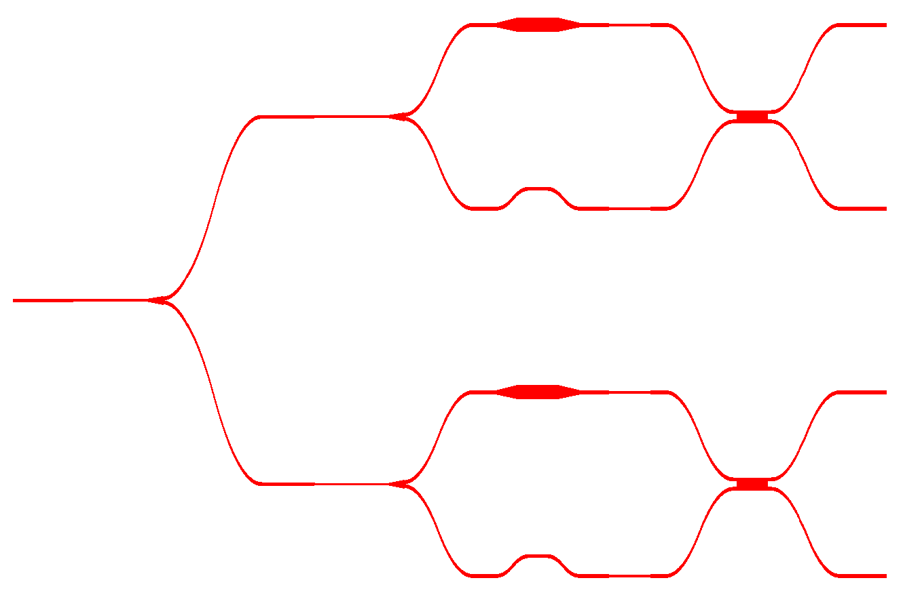



birefringent
waveguide
2 X 2 MMI
upper PBS
H
V
D
A
H/V/D/A
3 dB
splitter
λ/2 plate film
lower PBS
(a)
(b)

