Slide 1


Before we start...
Jonas Schöley
jschoeley@health.sdu.dk
Max-Planck Odense Center on the Biodemography of Aging
Department of Public Health
University of Southern Denmark

Slide 2
Scope of the seminar
What? Life-table measures
How? R and ggplot2
Why? Visualization theory

Slide 3
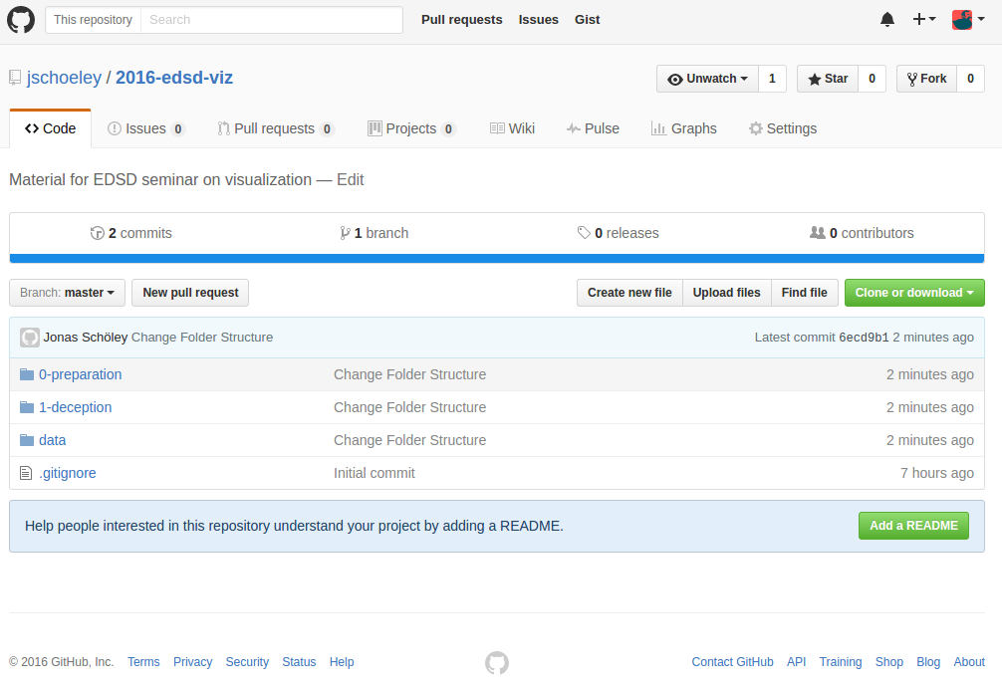
What? Life-table measures
github.com/jschoeley/2016-edsd-viz

Slide 4

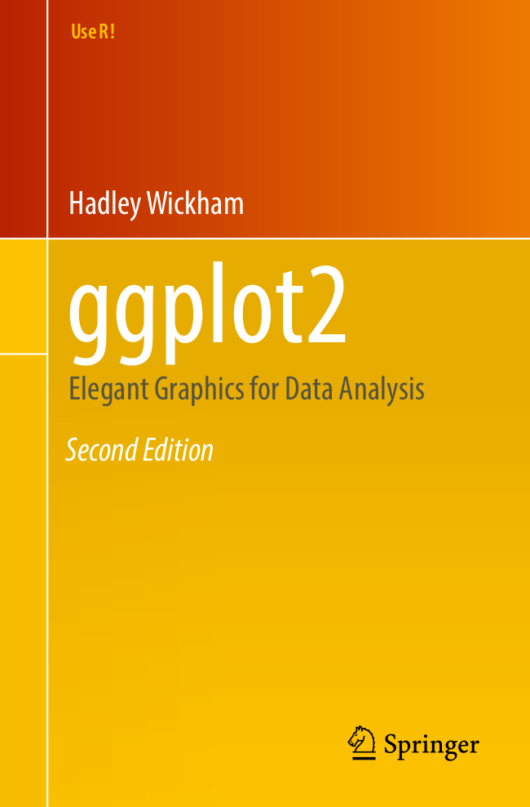
How? ggplot2 – Elegant Graphics for Data Analysis
install.packages(“ggplot2”)

Slide 5
How? ggplot2 – Elegant Graphics for Data Analysis
ggplot2 course material
github.com/jschoeley/2016-maxo-ggplot
ggplot2 cheatsheet
rstudio.com/wp-content/uploads/2015/03/ggplot2-cheatsheet.pdf

Slide 6
Why? Visualization theory
We’ll discuss
1 Deceptive visualizations
2 Effective use of color
3 Spatial data

Slide 7
Slides available online at
github.com/jschoeley/2016-edsd-viz
Jonas Schöley
jschoeley@health.sdu.dk
Twitter: @rettungstweet

