Slide 1


How to deceive with visualization
Jonas Schöley
jschoeley@health.sdu.dk
Max-Planck Odense Center on the Biodemography of Aging
Department of Public Health
University of Southern Denmark

Slide 2
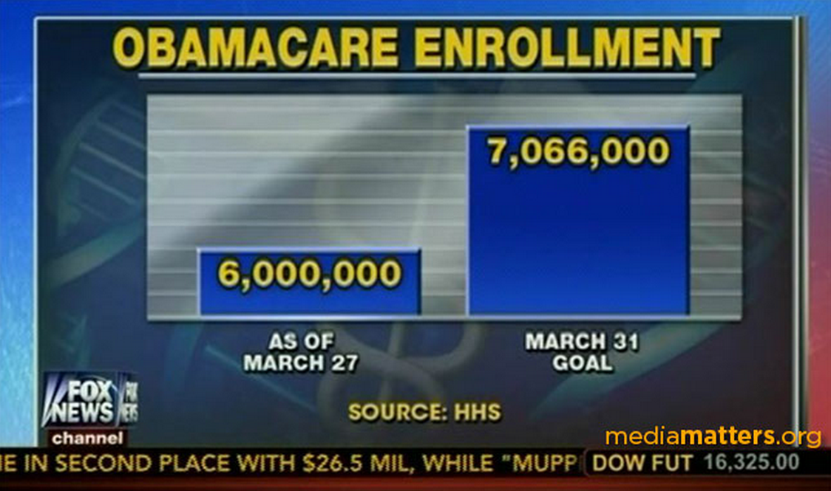
Manipulating Proportions
Fox News.

Slide 3
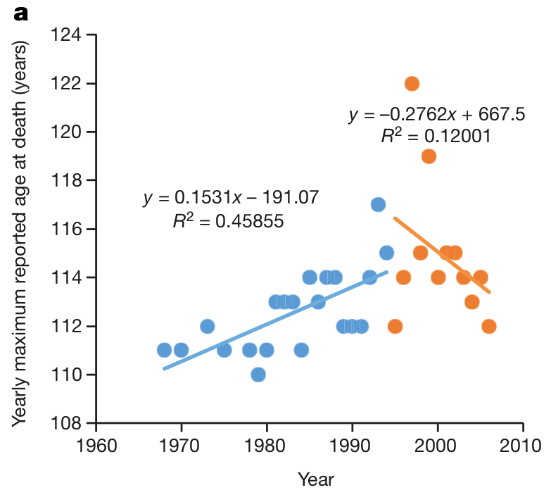
Leading the eye
Dong, Xiao, Brandon Milholland, and Jan Vijg. 2016.
“Evidence for a Limit to Human Lifespan.”
Nature Publishing Group 538: 5–7. doi:10.1038/nature19793.

Slide 4
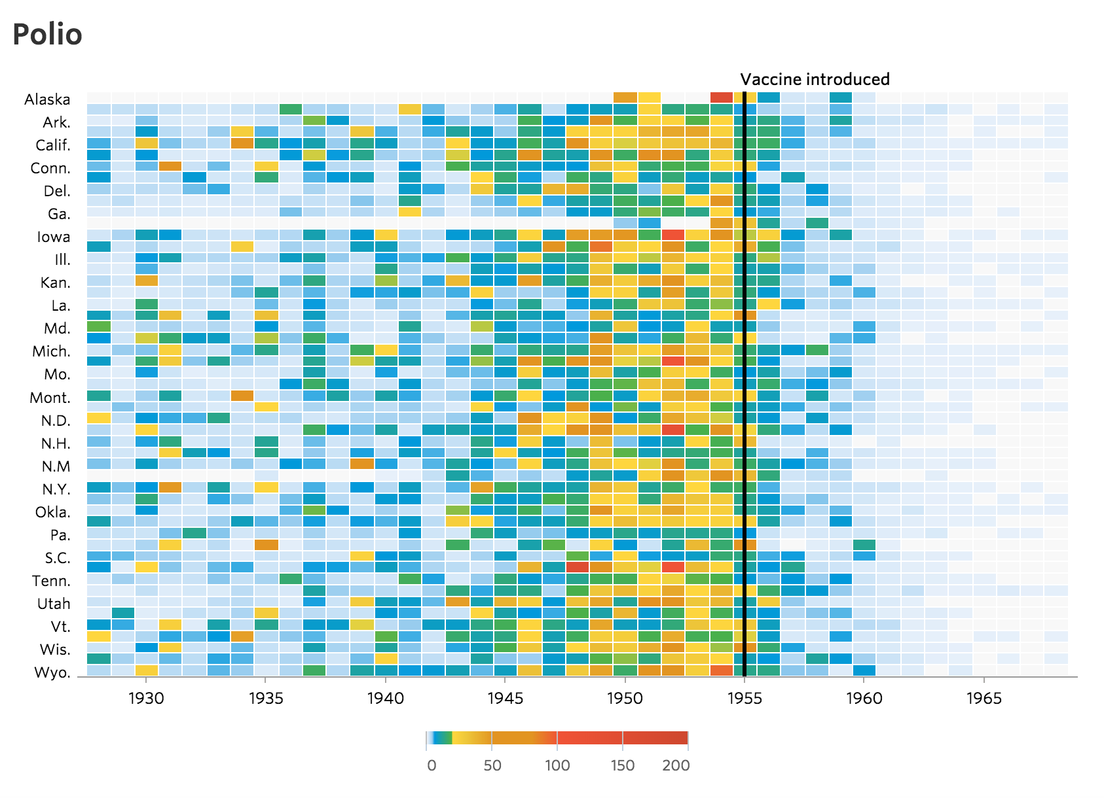
What makes a good color scale?
Wall Street Journal 2015.

Slide 5
Deception
Deception:
Communicating a finding which is
not supported by your data

Slide 6
Slides available at
github.com/jschoeley/2016-edsd-viz
Jonas Schöley
jschoeley@health.sdu.dk
Twitter: @rettungstweet

