Slide 1


Effective use of color
Jonas Schöley
jschoeley@health.sdu.dk
Max-Planck Odense Center on the Biodemography of Aging
Department of Public Health
University of Southern Denmark

Slide 2
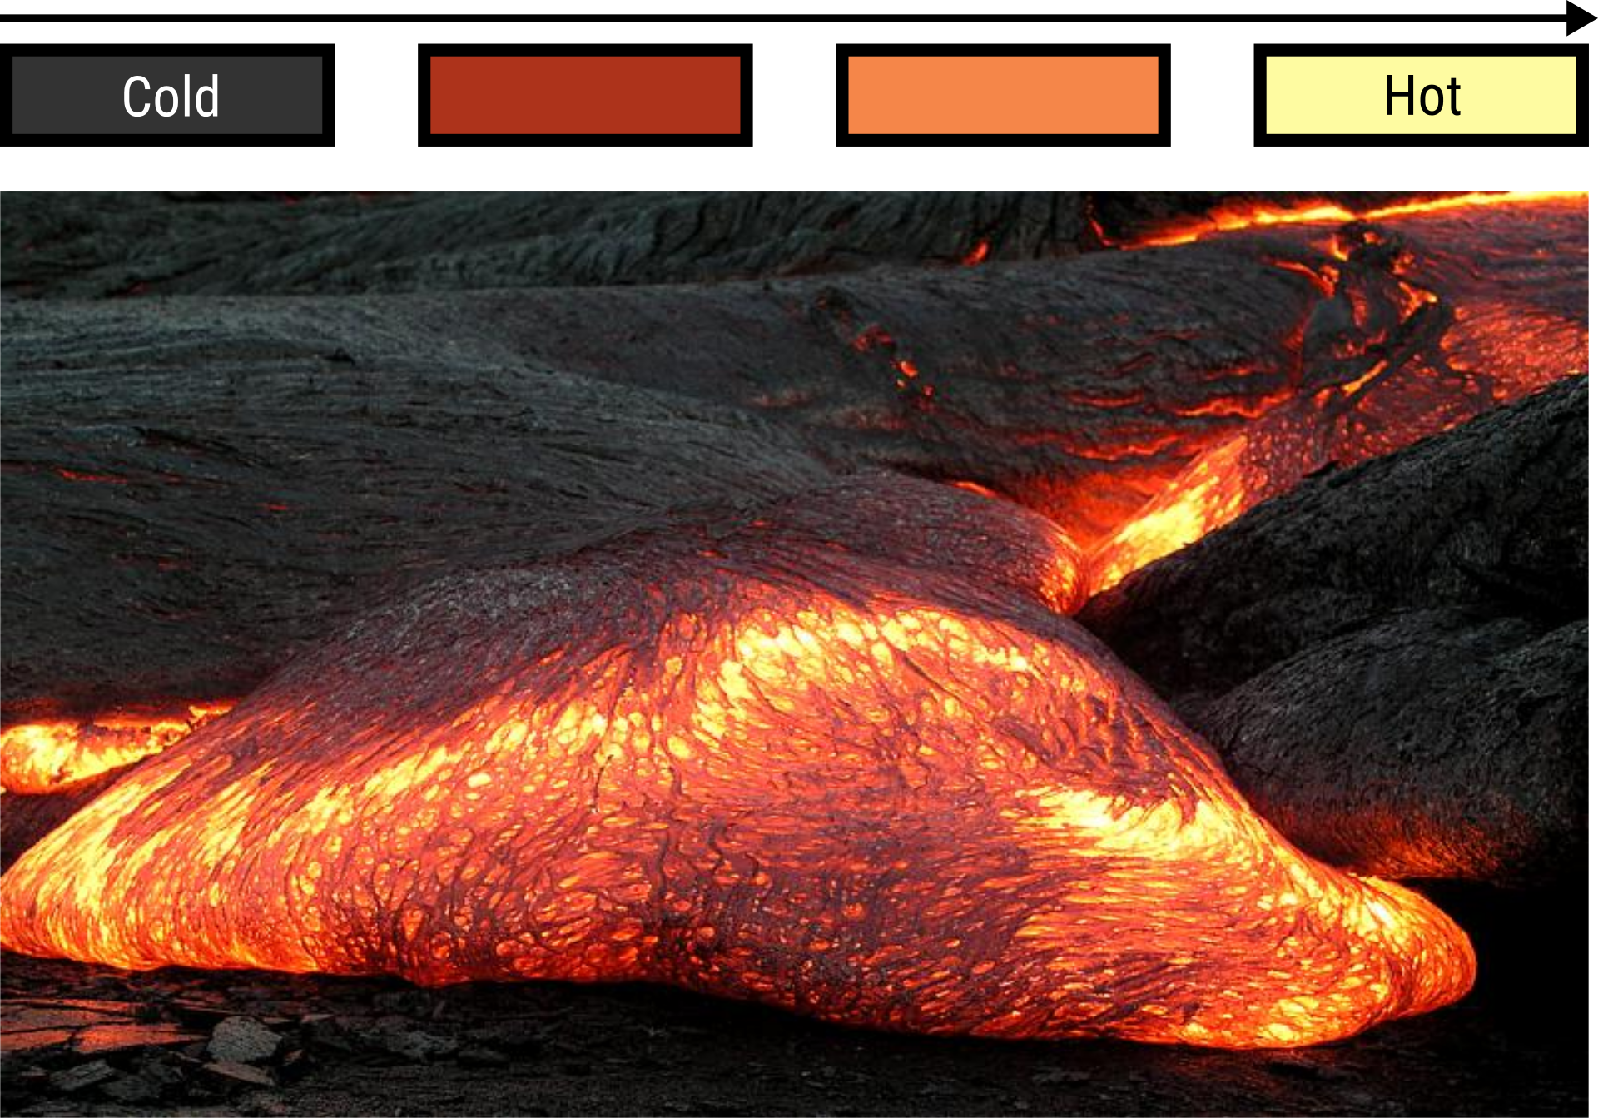
Color-coding magnitudes
Hawaii Volcano Observatory (2003). http://hvo.wr.usgs.gov/multimedia/archive/2003/May/20030503-0021_DAS_large.jpg

Slide 3
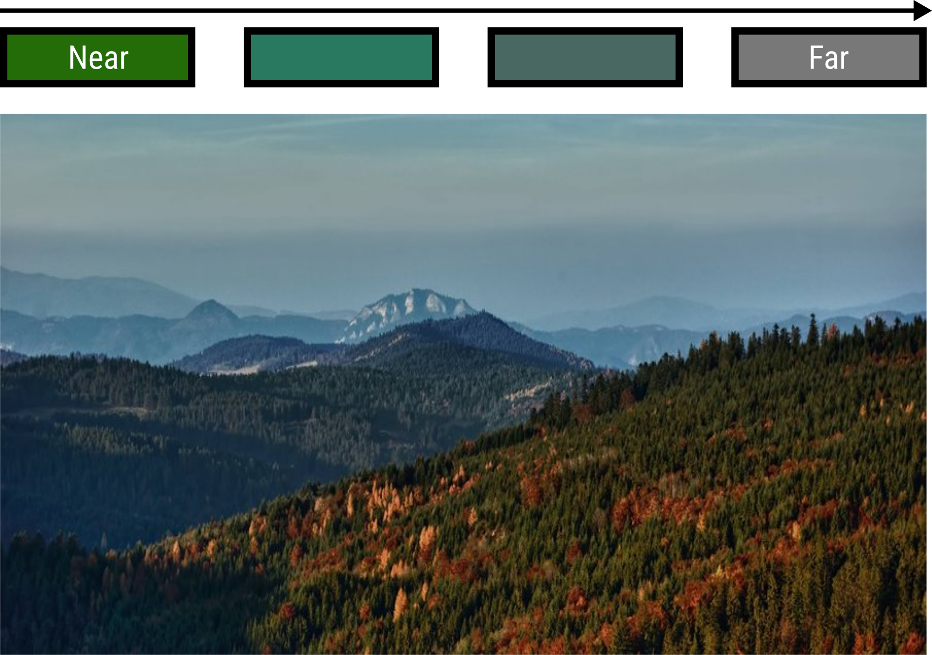
Color-coding magnitudes
Milan Cernak (2011). “Pieniny from Magura”.

Slide 4
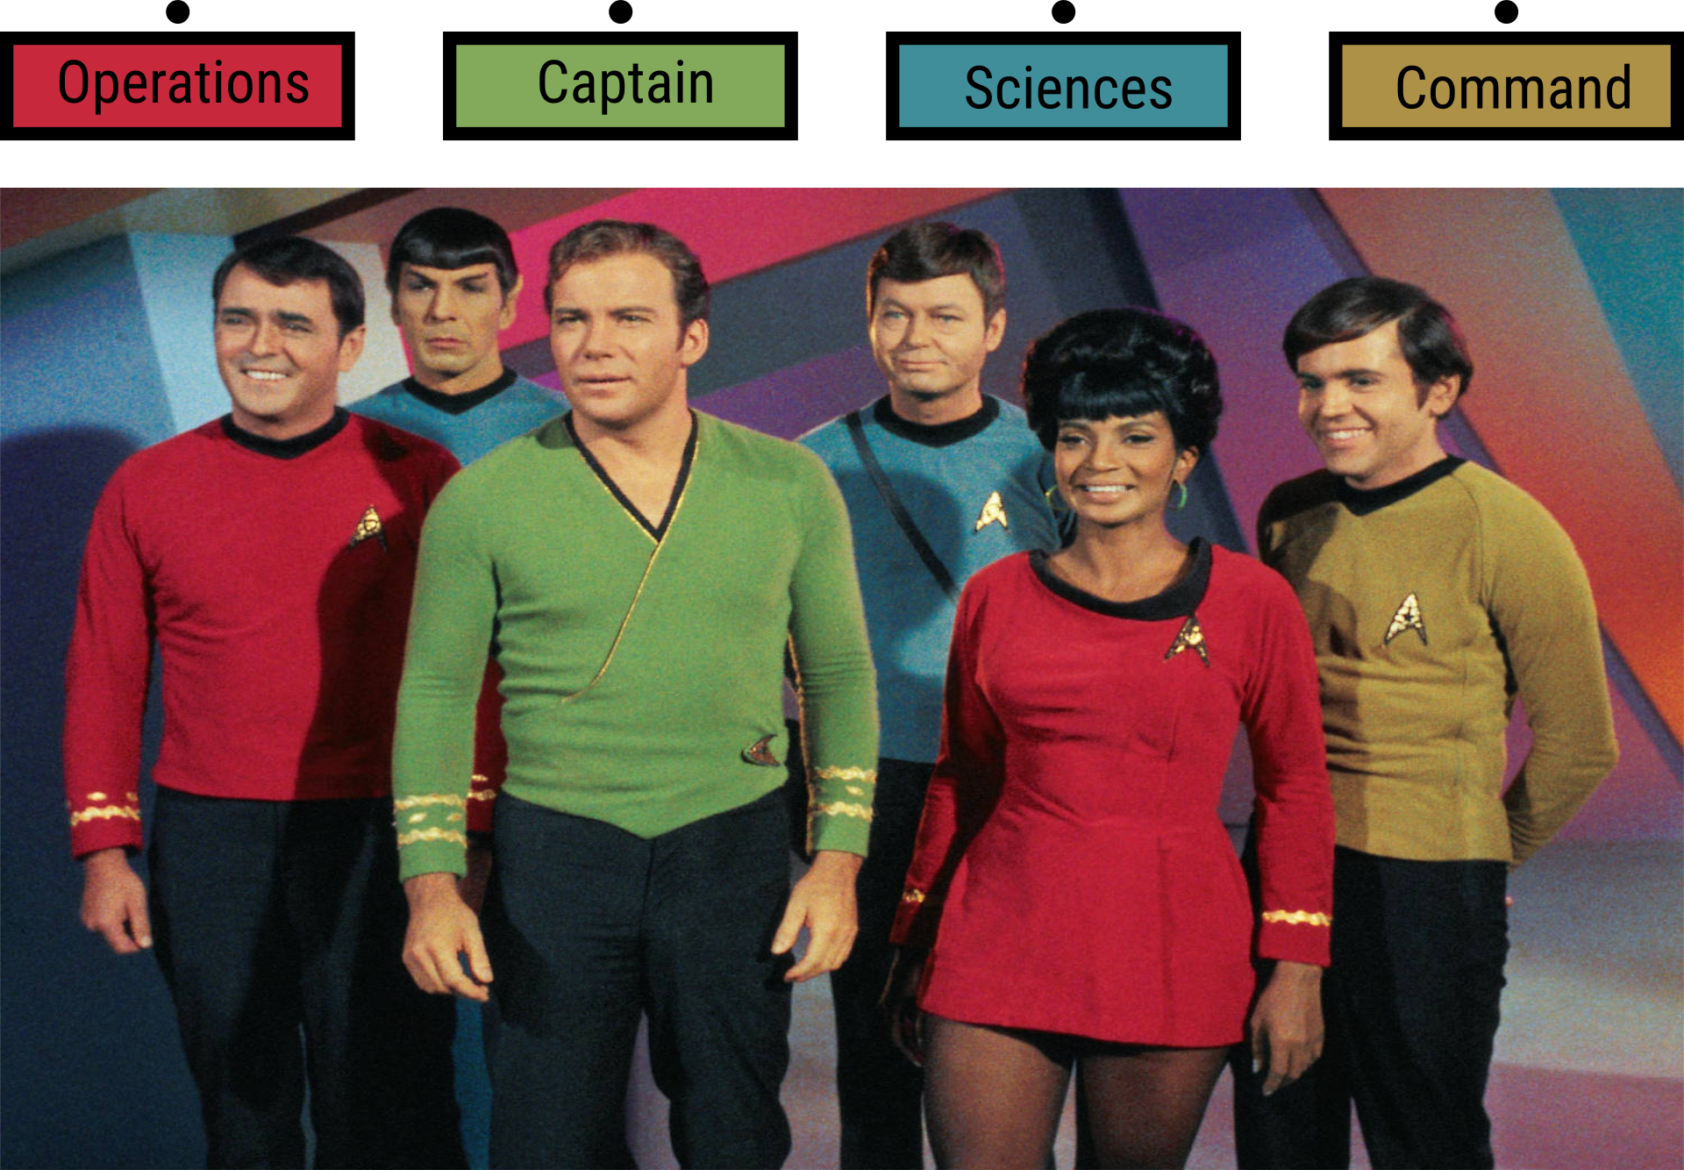
Color-coding categories
CBS Television.

Slide 5
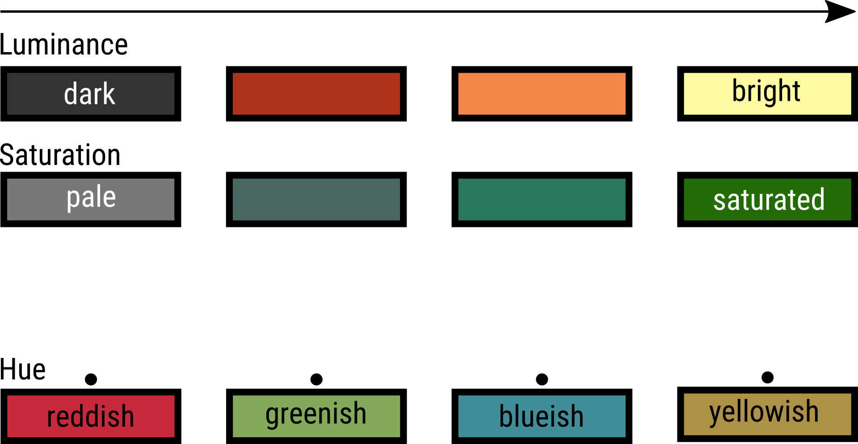
Perceptual color dimensions

Slide 6
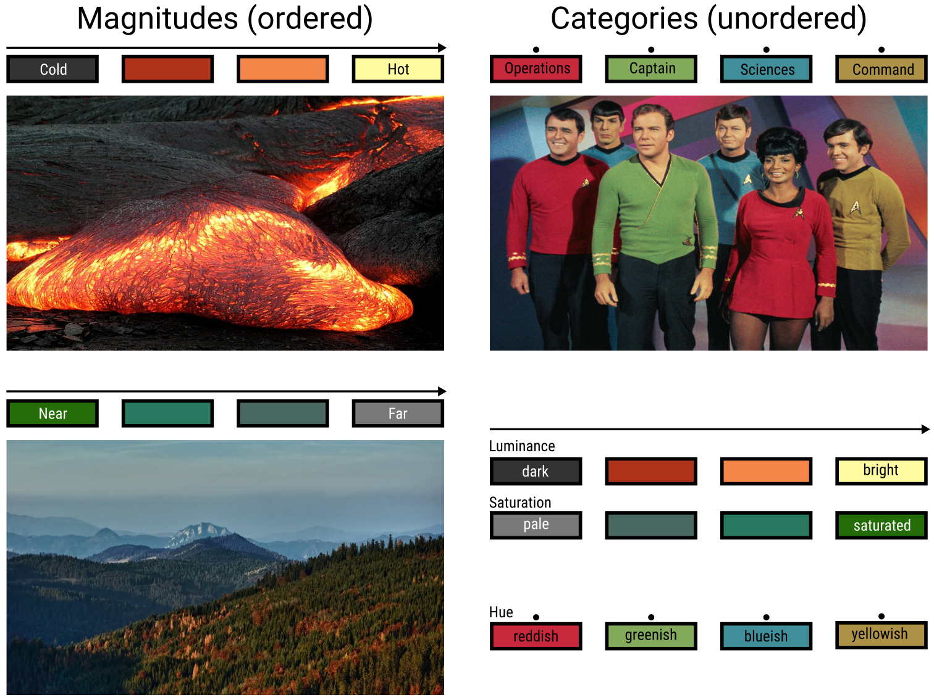
Matching color- and data dimensions

Slide 7
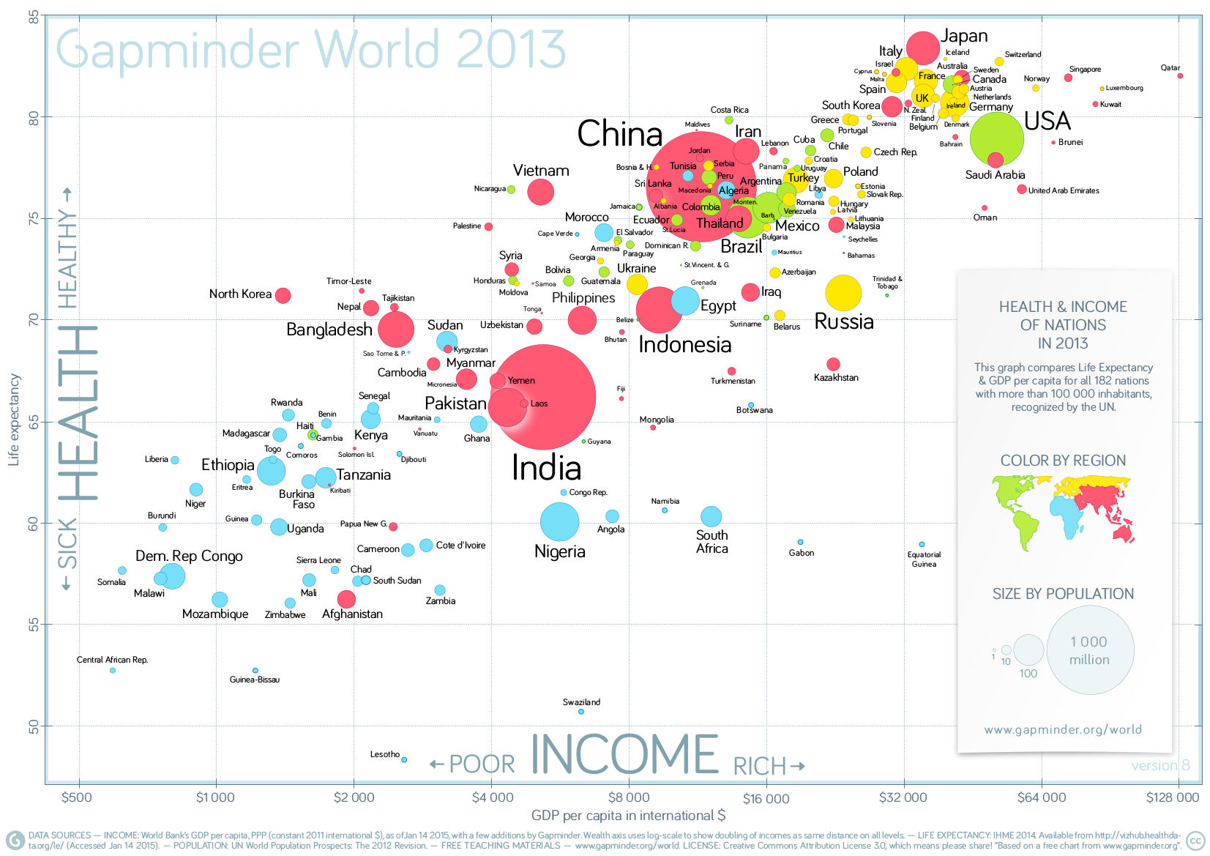
Color-coding categories
Gapminder World (2014). http://www.gapminder.org/downloads/gapminder-world-poster-2013/

Slide 8
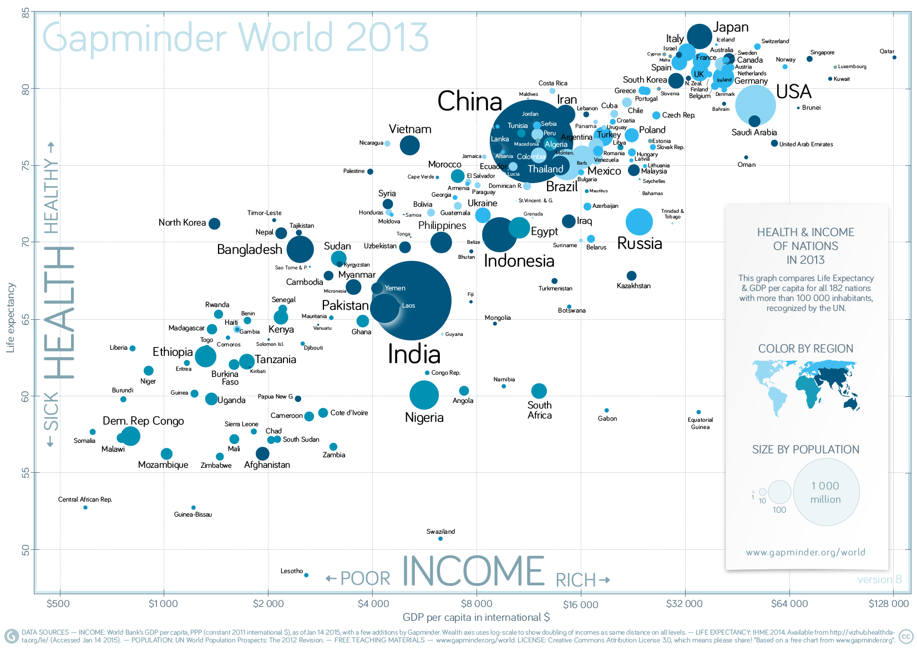
Ineffective color-coding
Redrawn from Gapminder World (2014).

Slide 9
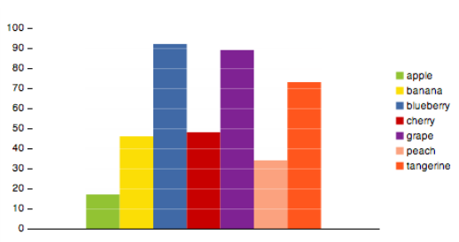
Semantically resonant colors
Sharon Lin et al. (2013). “Selecting Semantically-Resonant Colors for Data Visualization”. In: Computer Graphics Forum 32.3, pp. 401–410.

Slide 10
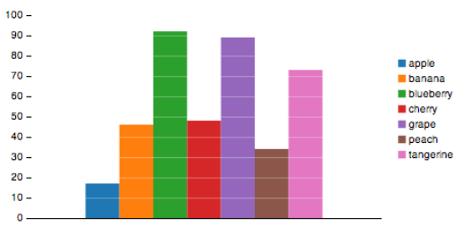
Semantically resonant colors
Sharon Lin et al. (2013).

Slide 11
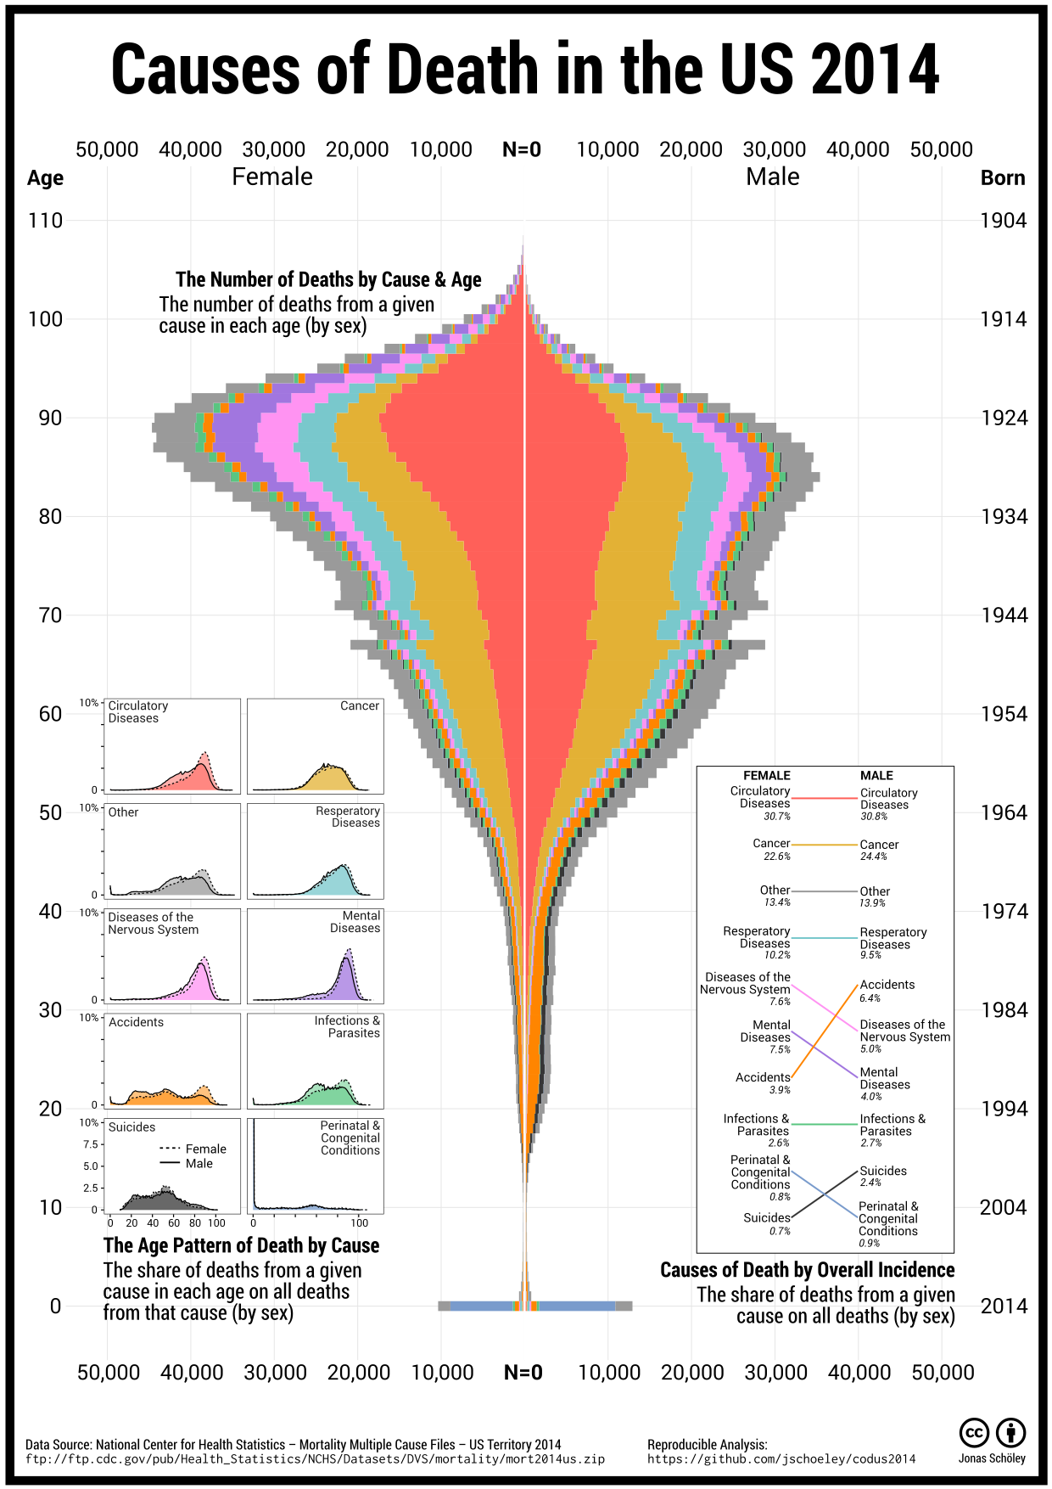
How would you color death?
Jonas Schöley (2016). github.com/jschoeley/codus2014

Slide 12
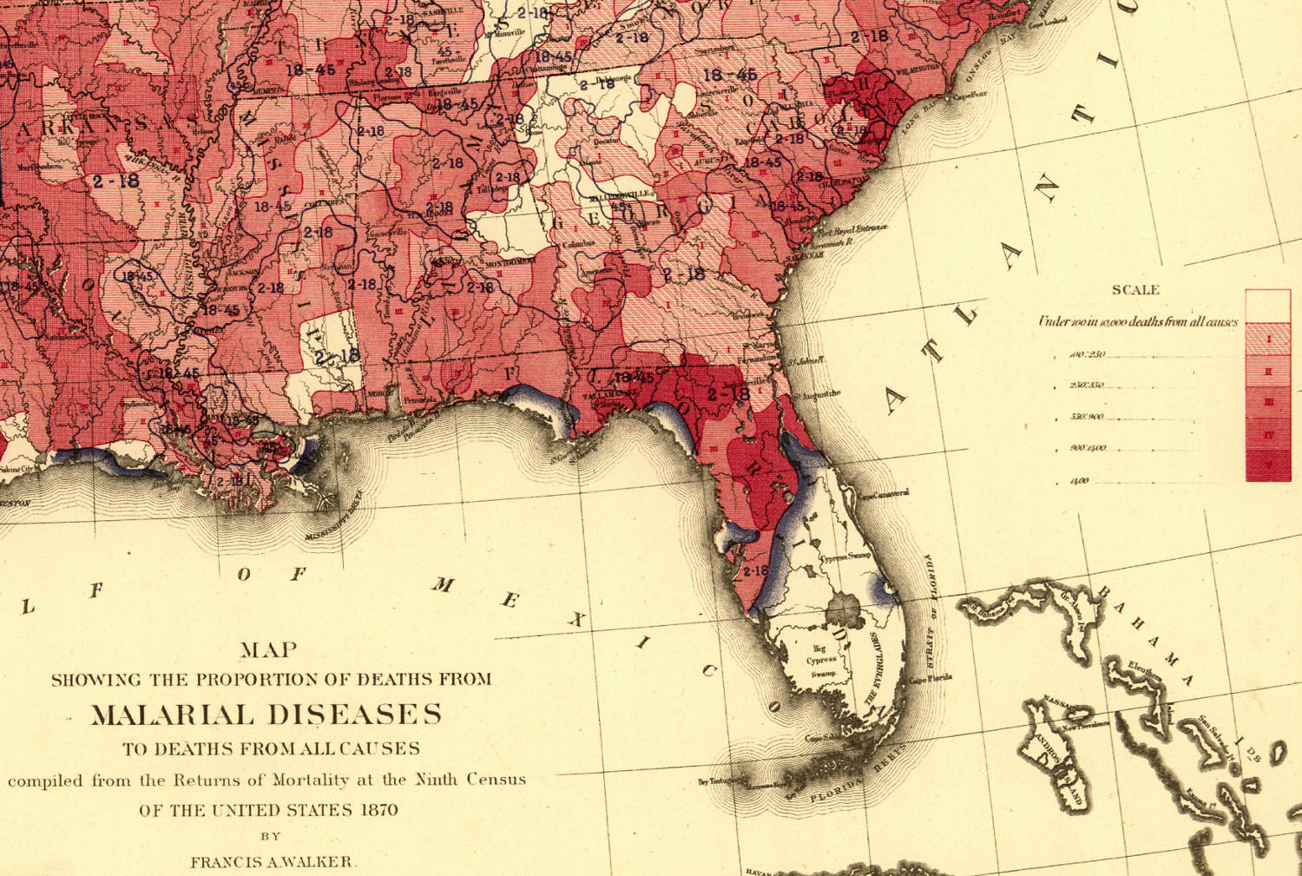
Color-coding magnitudes
Cutout from Francis Walker (1874). “Statistical Atlas of the United States”. https://www.loc.gov/item/05019329/

Slide 13
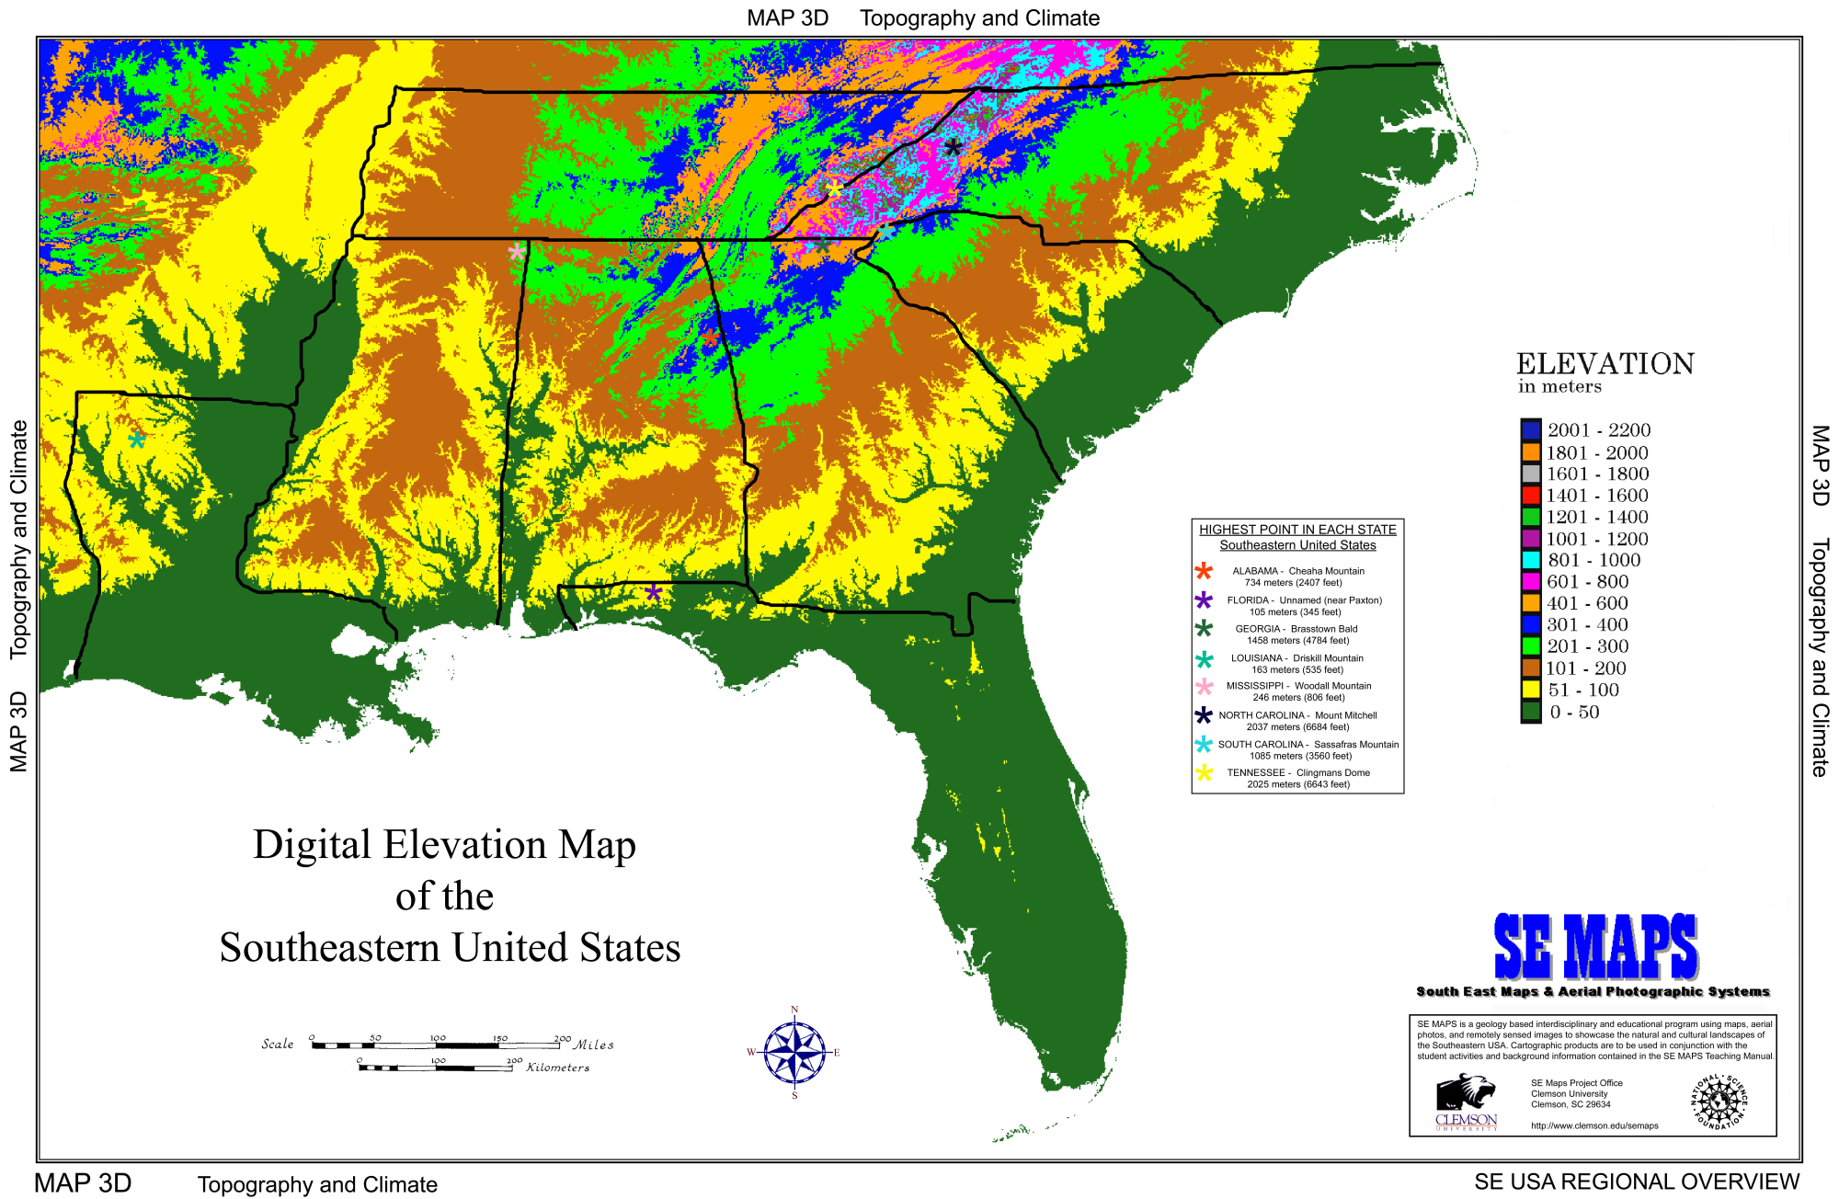
Ineffective color-coding
South East Maps & Aerial Photographic Systems. http://www.clemson.edu/ces/geolk12/semaps/seregional/hires/digielmap.jpg

Slide 14
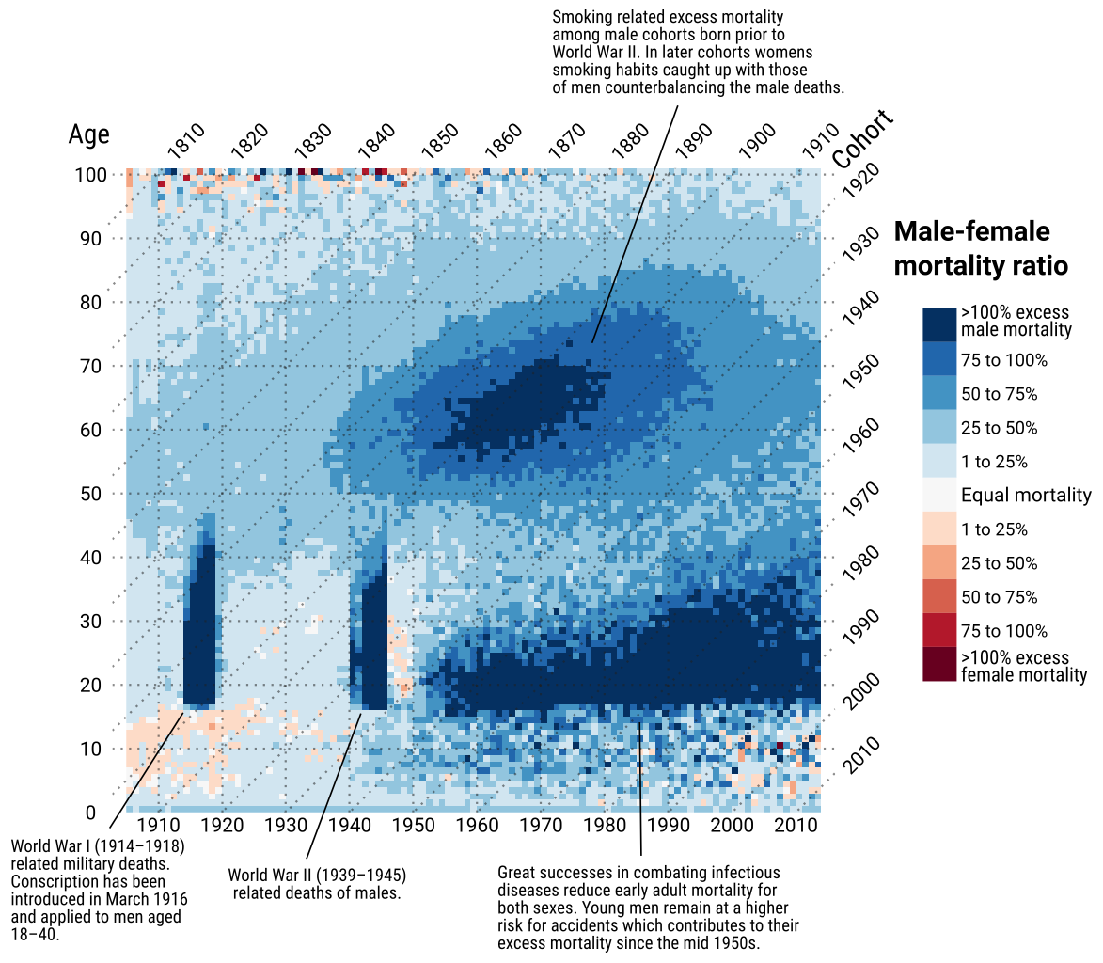
Color-coding divergent magnitudes
Jonas Schöley & Frans Willekens (2016). “Visualizing compositional data on the Lexis surface.” Data: HMD.

Slide 15
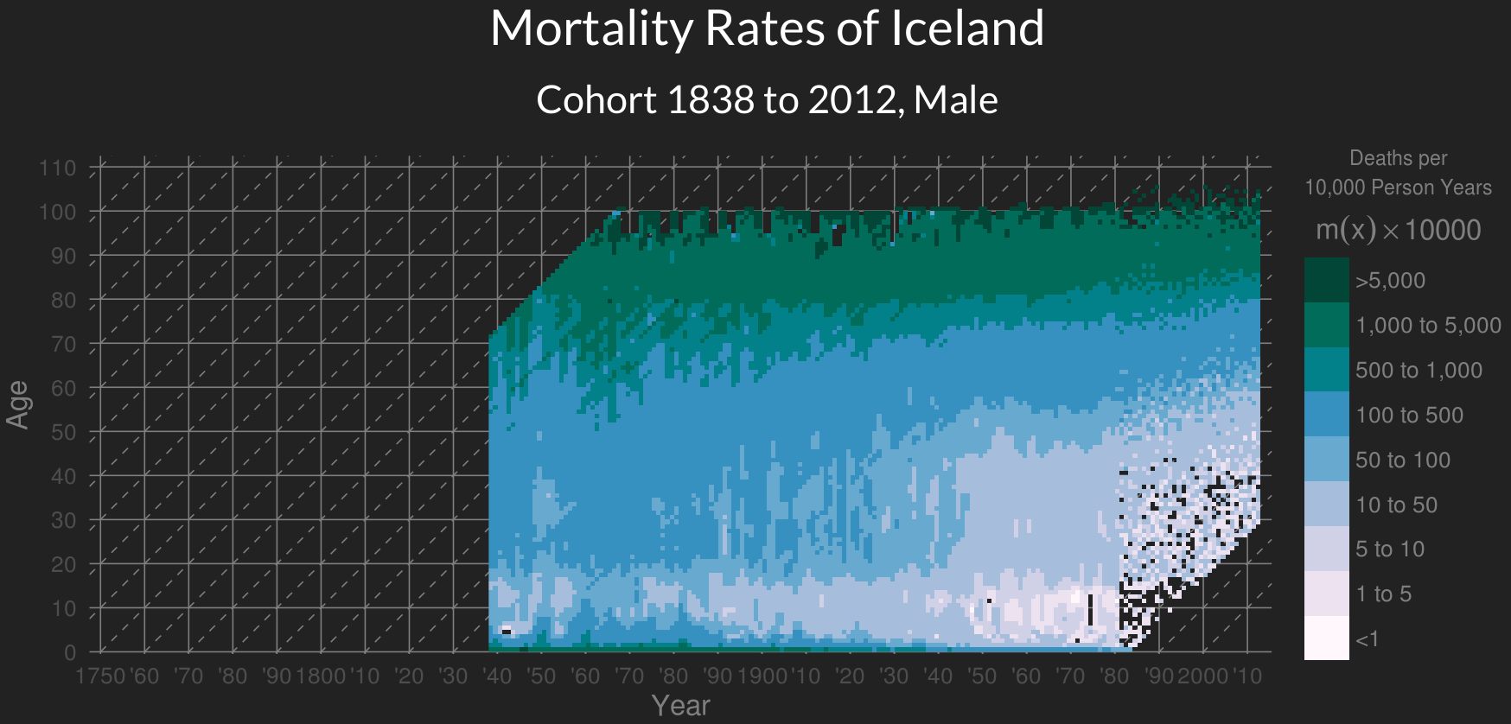
Discrete color scales
Jonas Schöley (2016). “The Human Mortality Explorer”. jschoeley.shinyapps.io/hmdexp

Slide 16
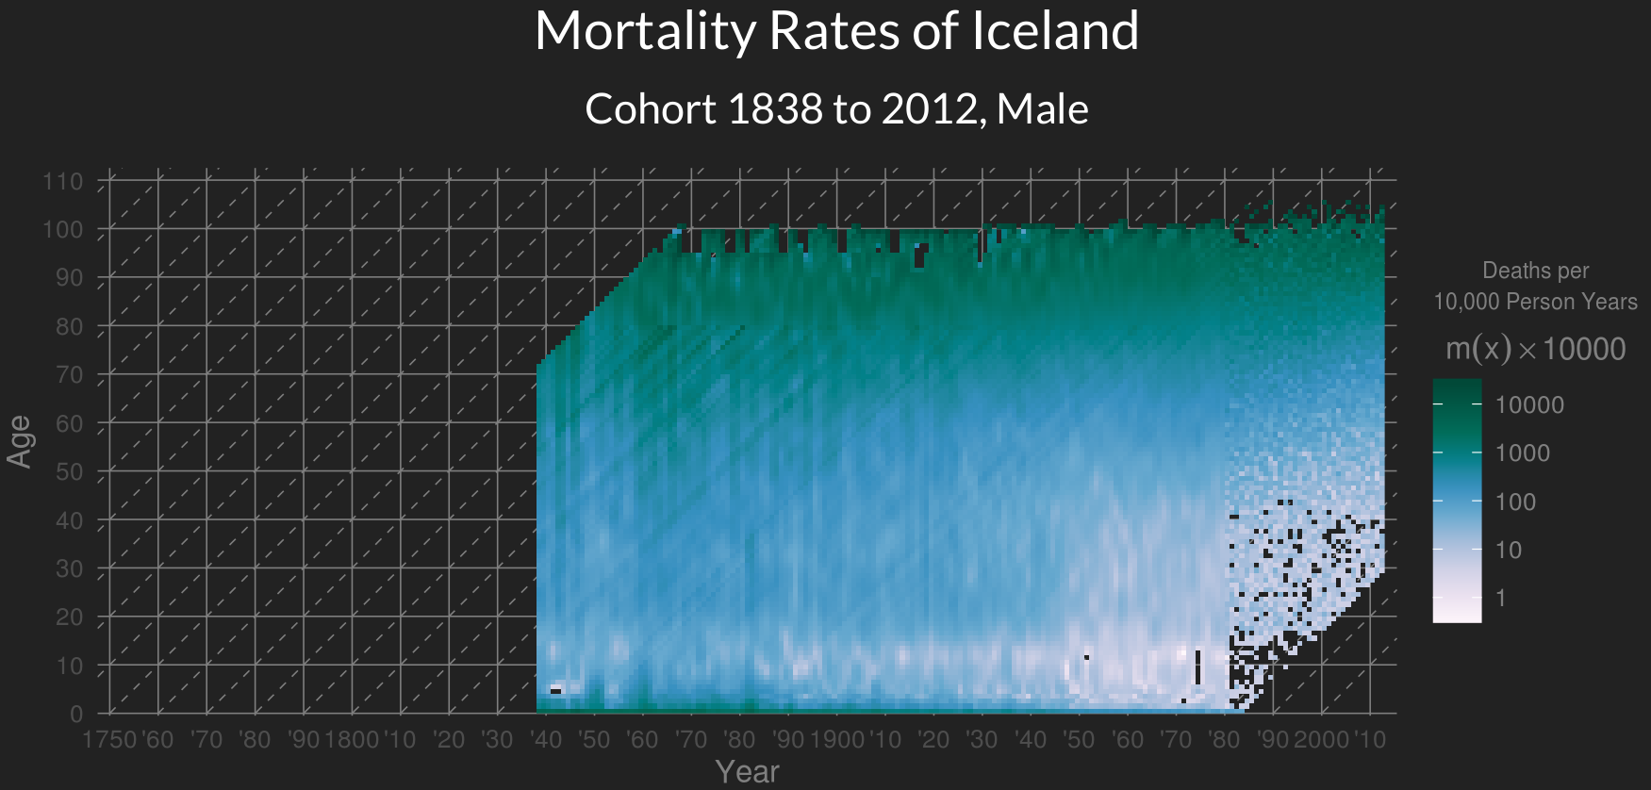
Continous color scales
Jonas Schöley (2016). “The Human Mortality Explorer”. jschoeley.shinyapps.io/hmdexp

Slide 17
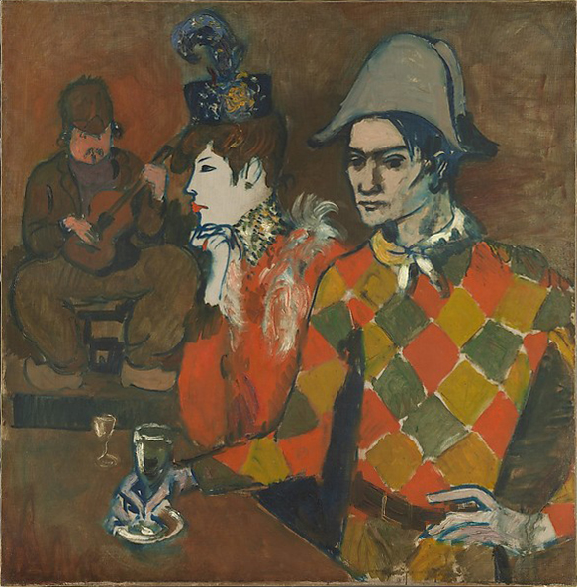
Separating foreground & background
Pablo Picasso (1905). “Au Lapin Agile”.

Slide 18
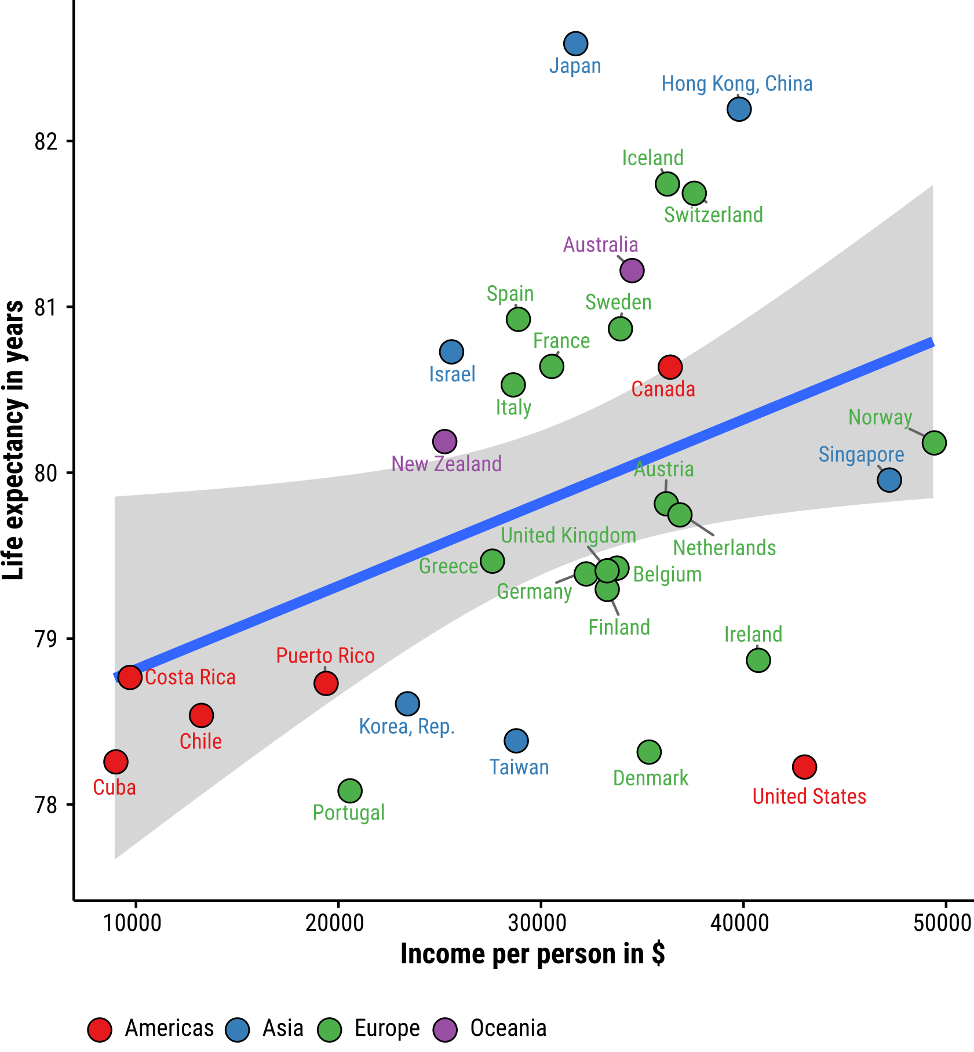
Separating foreground & background
Data: gapminder.org – displayed are data for the year 2007.

Slide 19
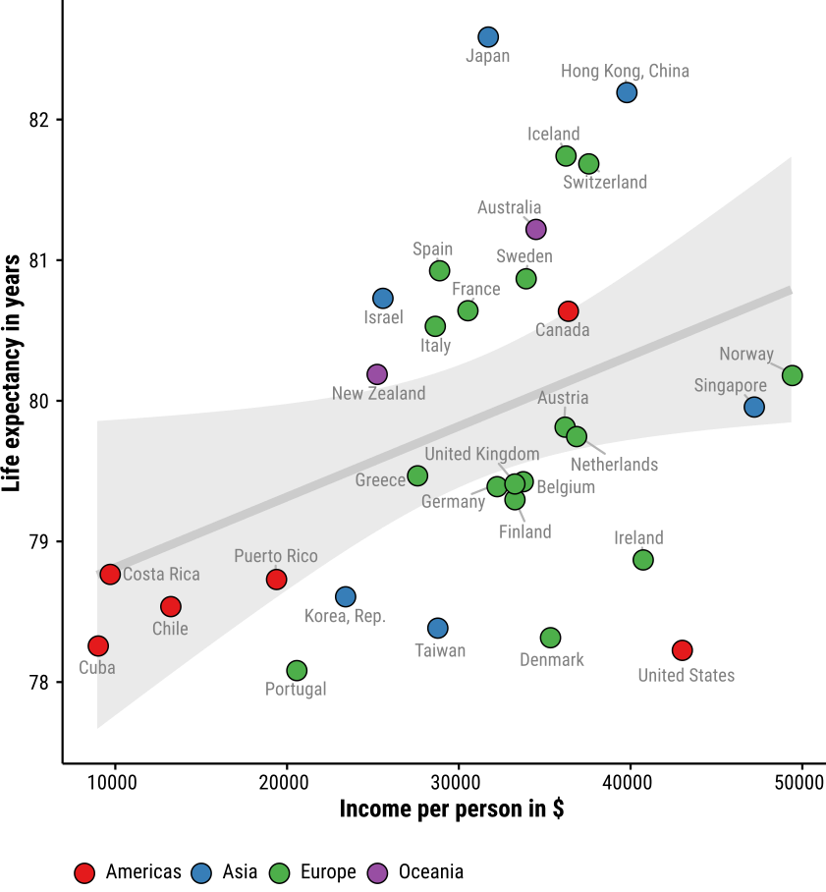
Separating foreground & background
Data: gapminder.org – displayed are data for the year 2007.

Slide 20
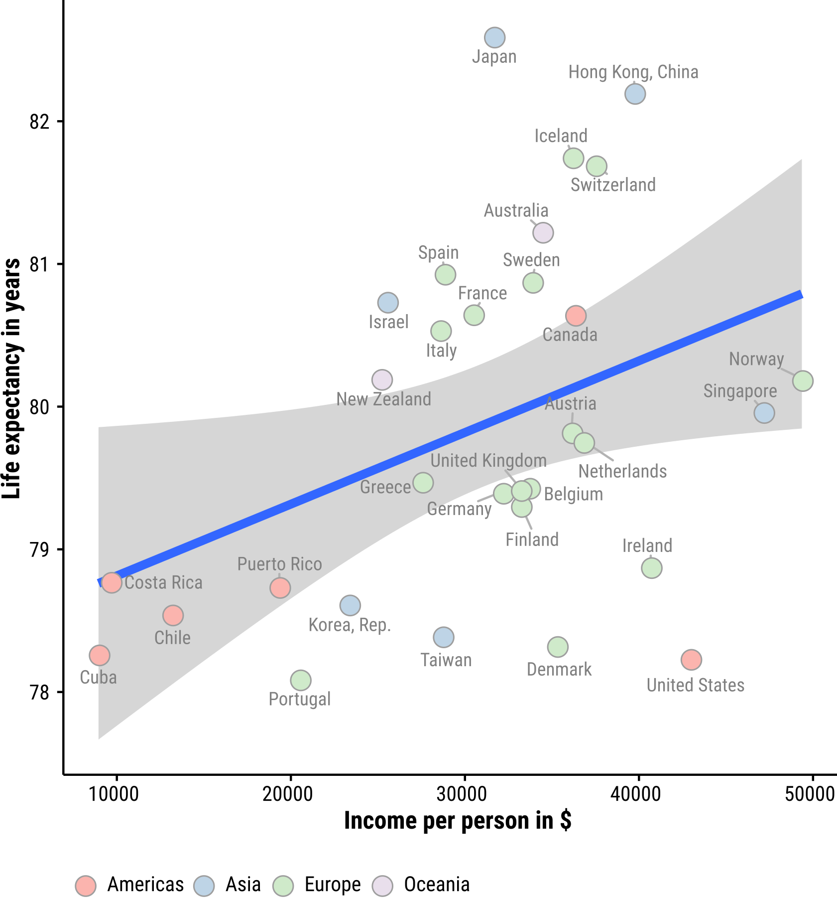
Separating foreground & background
Data: gapminder.org – displayed are data for the year 2007.

Slide 21
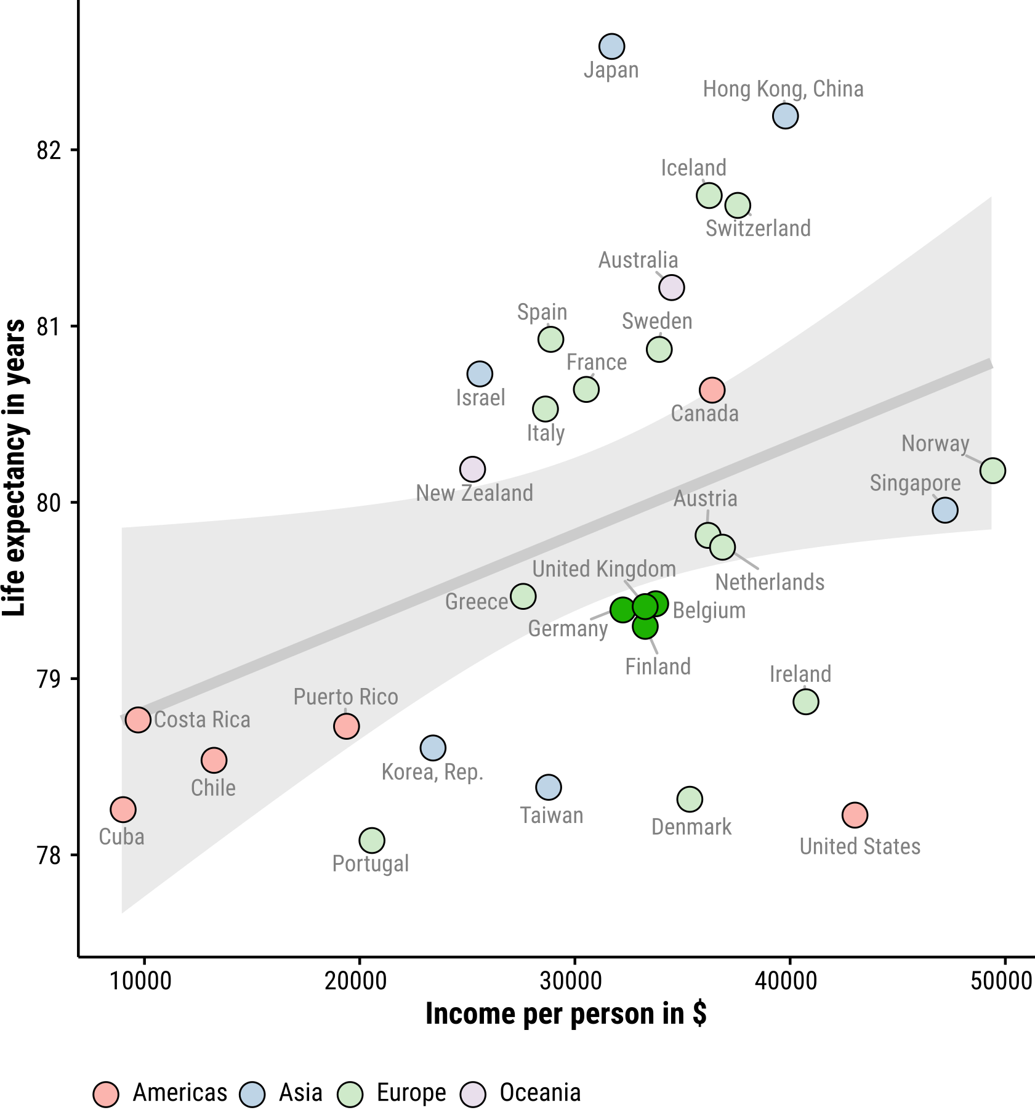
Separating foreground & background
Data: gapminder.org – displayed are data for the year 2007.

Slide 22
Further reading
Brilliant color advice from NASA earthobservatory.nasa.gov/blogs/elegantfigures/2013/08/05/subtleties-of-color-part-1-of-6
Seminal paper on construction of qualitative, sequential, divergent color scales Brewer, Cynthia A. 1994. “Guidelines for Use of the Perceptual Dimensions of Color for Mapping and Visualization.” In SPIE, edited by Jan Bares, 2171:54–63. doi:10.1117/12.175328.
Color scales for data-viz colorbrewer2.org

Slide 23
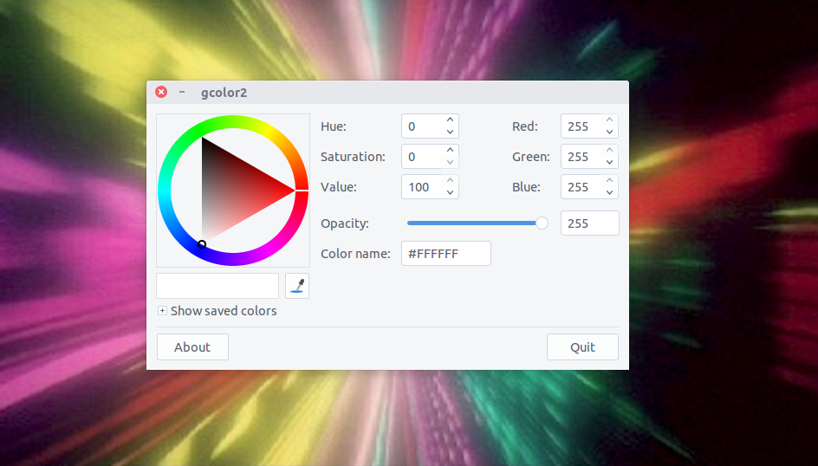
You take control!

Slide 24
Slides available at
github.com/jschoeley/2016-edsd-viz
Jonas Schöley
jschoeley@health.sdu.dk
Twitter: @rettungstweet

