Slide 1


Maps
Jonas Schöley
jschoeley@health.sdu.dk
Max-Planck Odense Center on the Biodemography of Aging
Department of Public Health
University of Southern Denmark

Slide 2
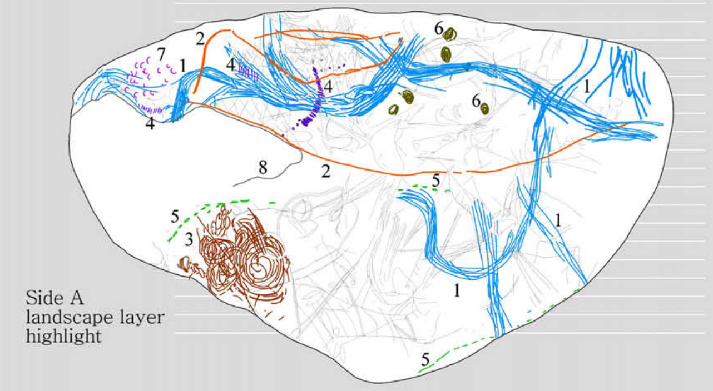
Cartography as ancient dataviz
Utrilla etal (2009). “A palaeolithic map from 13,660 calBP: engraved stone blocks from the Late Magdalenian in Abauntz Cave (Navarra, Spain).” Journal of Human Evolution, 57:99–111.

Slide 3
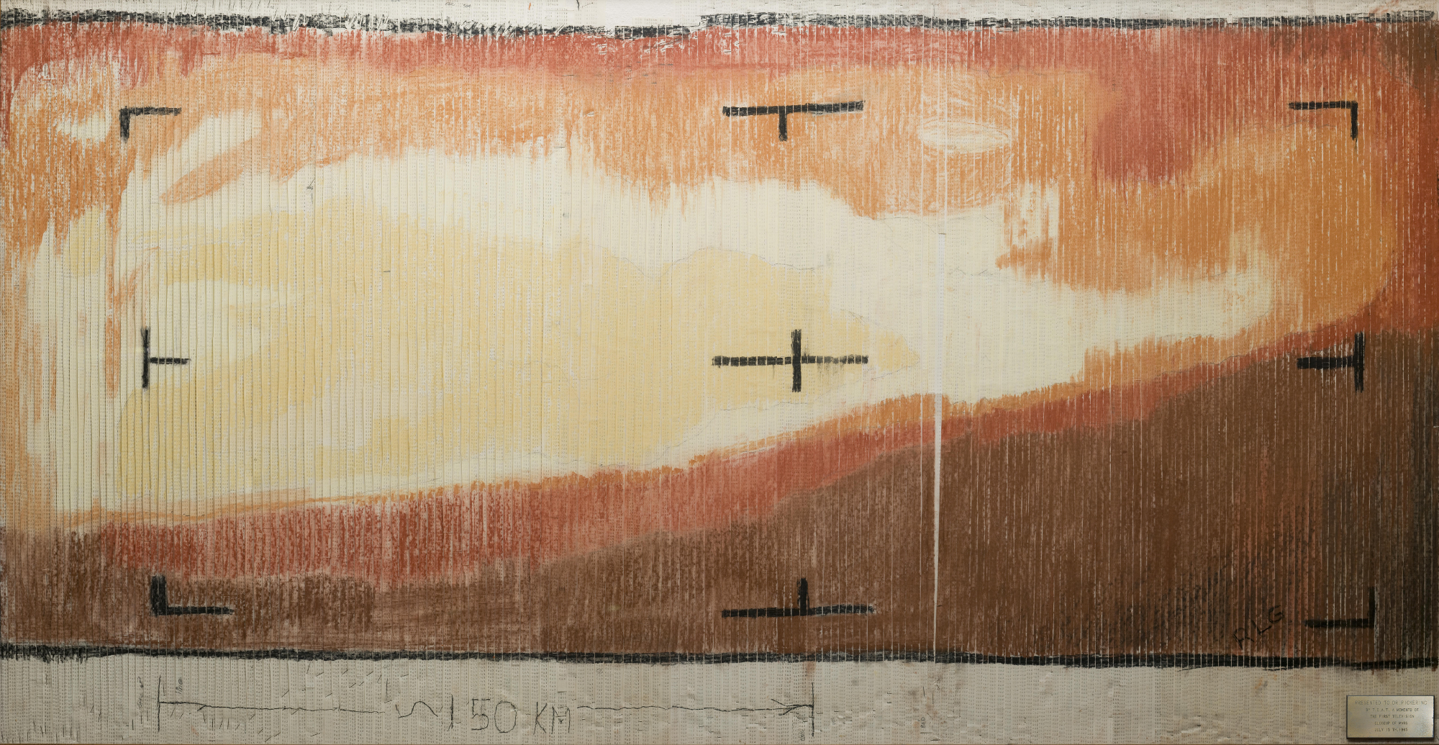
Geography is data
NASA.

Slide 4
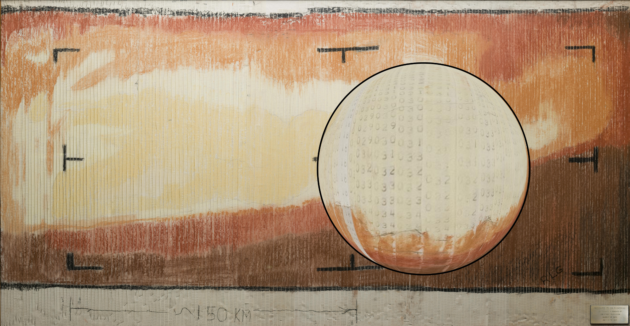
Geography is data
NASA.

Slide 5
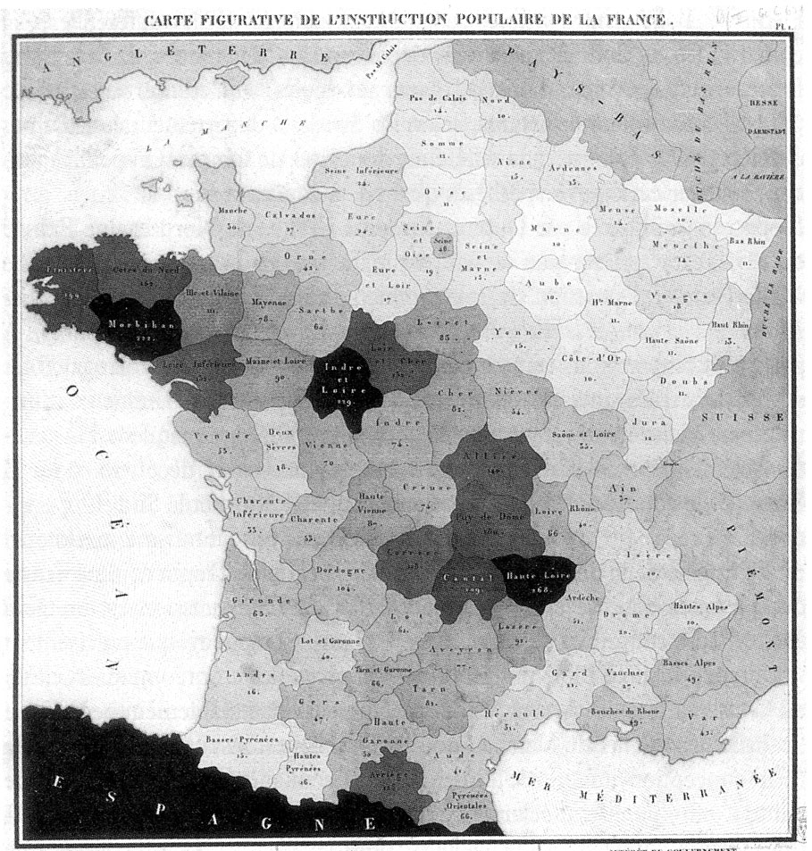
From geography as data to data by geography
Carte figurative de l’instruction populaire de la France.

Slide 6
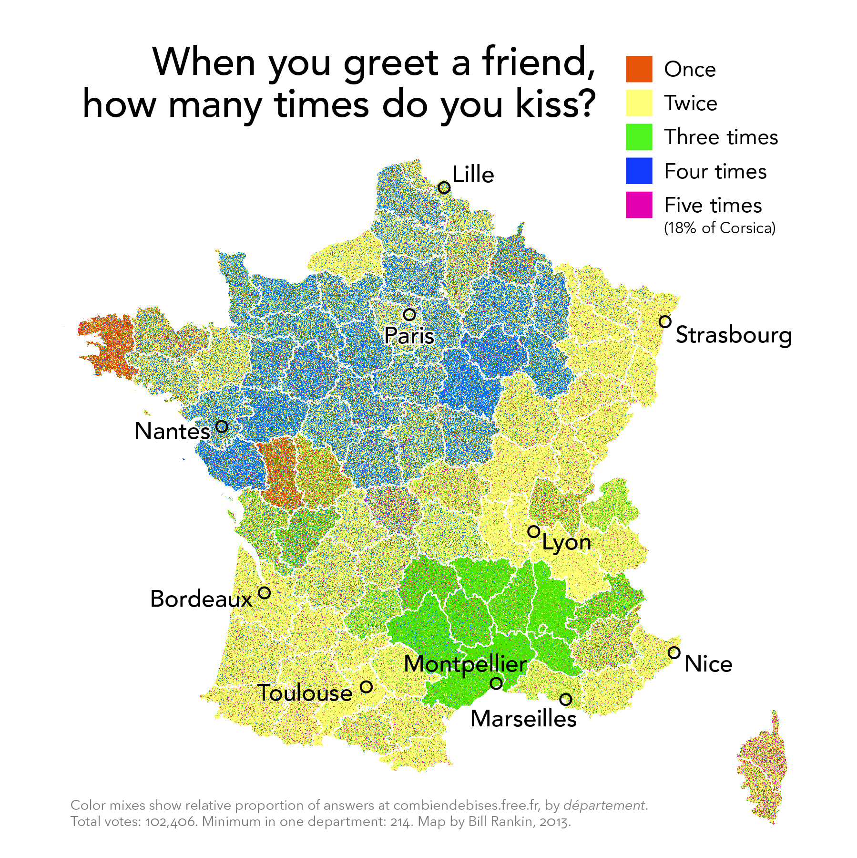
From geography as data to data by geography
radicalcartography.net

Slide 7
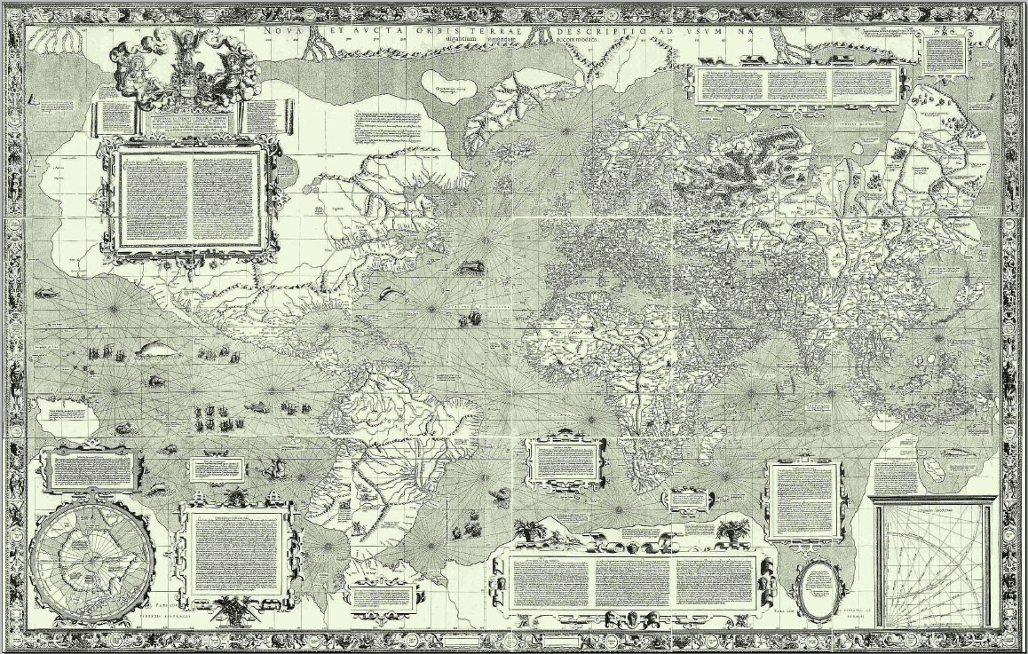
The Mercator world map...
Carta do Mundo de Mercator (1569).

Slide 8
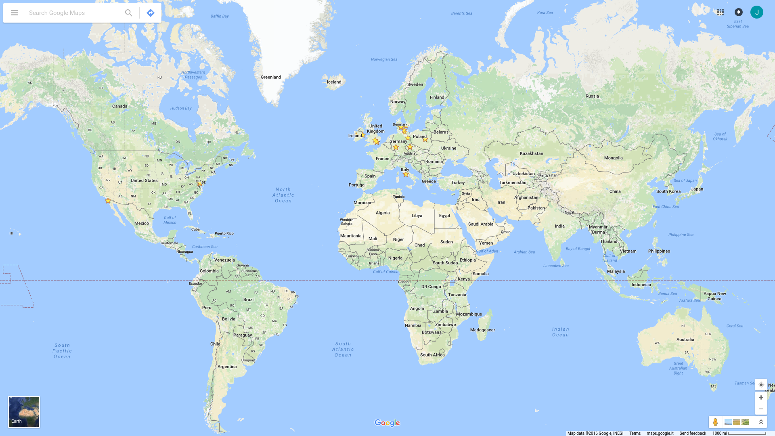
Google uses Mercator projection
Google Maps.

Slide 9
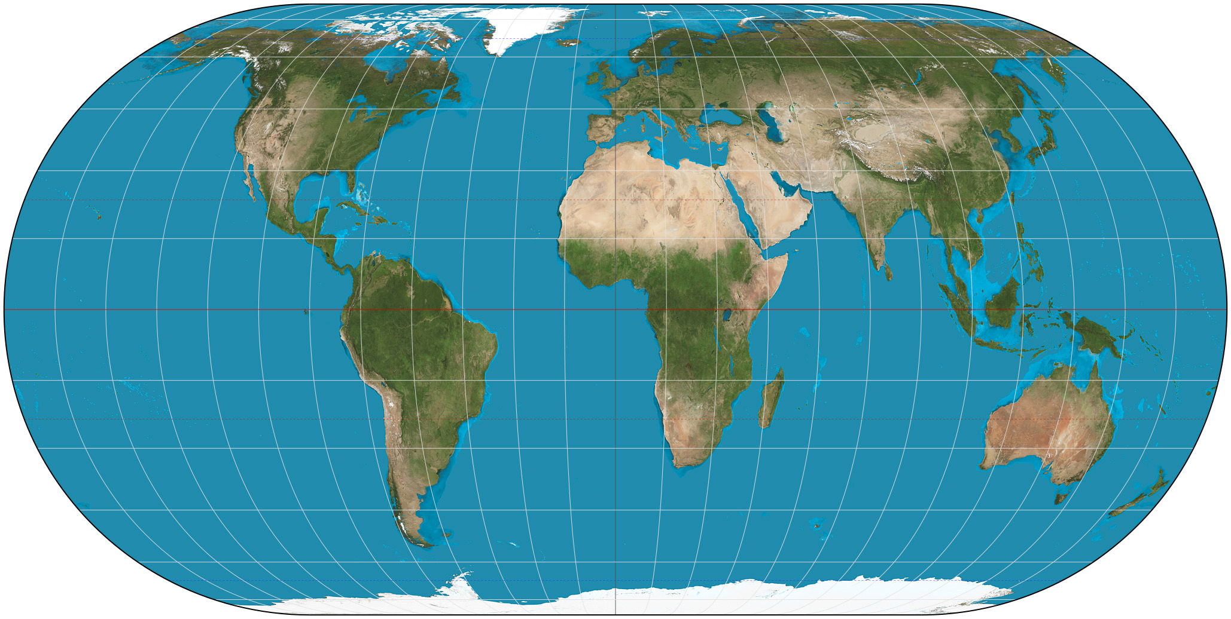
The truth: Europe is tiny, Africa is huge
Eckert IV projection.

Slide 10
Slides available at
github.com/jschoeley
Jonas Schöley
jschoeley@health.sdu.dk
Twitter: @rettungstweet

