Slide 1


Introducing Shiny
Jonas Schöley
jschoeley@health.sdu.dk
Max-Planck Odense Center on the Biodemography of Aging
Department of Public Health
University of Southern Denmark

Slide 2
What’s “Shiny”?
1 A graphical user-interface for your R program
2 Your R program as a web-page
3 A web-application framework for R

Slide 3
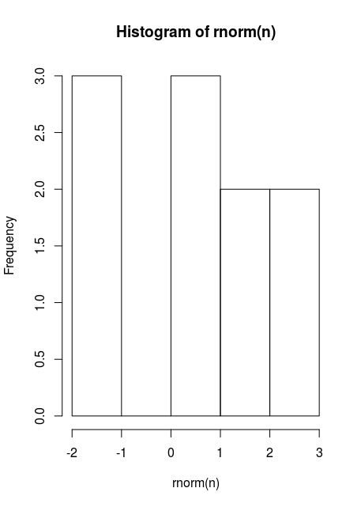
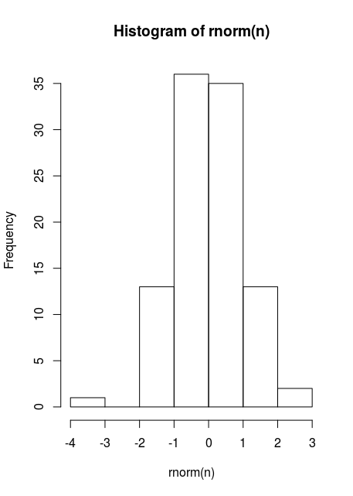
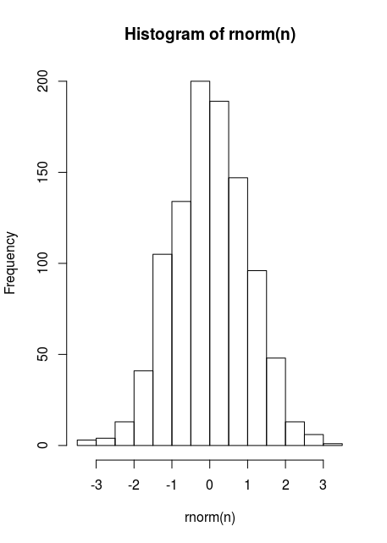
A graphical user-interface for your R program
n = 10
hist(rnorm(n))
n = 100
hist(rnorm(n))
n = 1000
hist(rnorm(n))

Slide 4
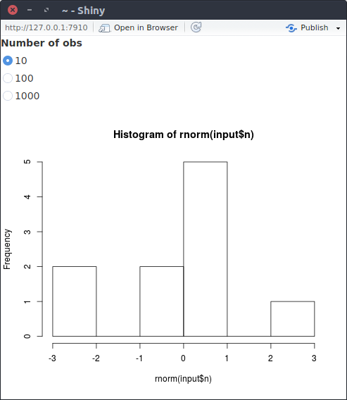
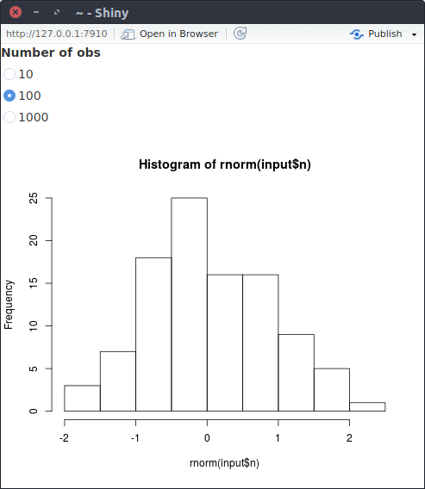
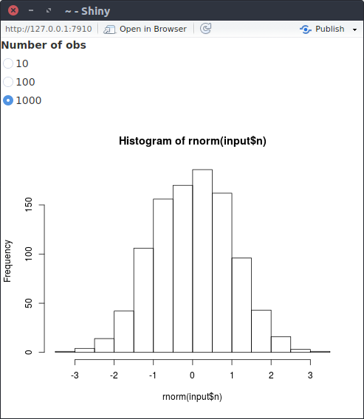
A graphical user-interface for your R program
library(shiny)
ui <- bootstrapPage(
radioButtons(inputId = "n", label = "Number of obs", choices = list(10, 100, 1000)),
plotOutput(outputId = "plot")
)
server <- function(input, output) {output$plot <- renderPlot(hist(rnorm(input$n)))}
shinyApp(ui = ui, server = server)

Slide 5
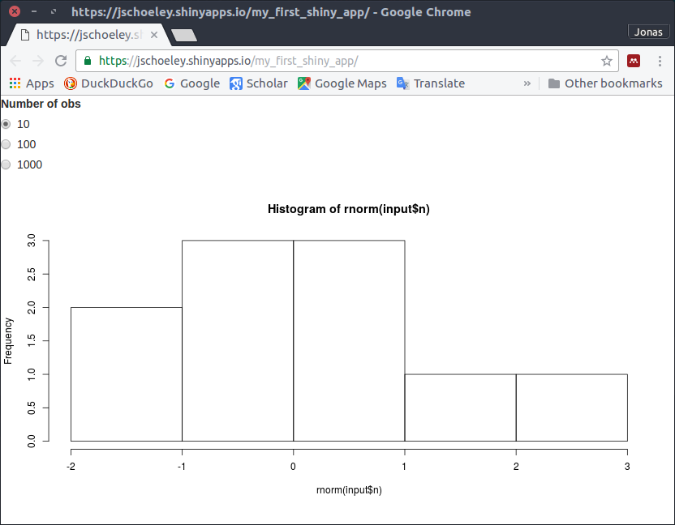
Your R program as a web-page

Slide 6
Shiny: A web-application framework for R
sends user input
to server
Web browser
displaying
web-page
Web server
running
R+Shiny
sends UI updates
to user
listens for user input
performs R calculations
builds web-page
listens for updates from server
renders web-page

Slide 7
Programing Shiny
1 Building a user interface (UI)
2 Connecting R code with the UI

Slide 8
Programing Shiny
library(shiny)
ui <- bootstrapPage(
radioButtons(inputId = "n",
label = "Number of obs",
choices = list(10, 100, 1000)),
plotOutput(outputId = "plot")
)
server <- function(input, output) {
output$plot <- renderPlot(
hist(rnorm(input$n))
)
}
shinyApp(ui = ui, server = server)

Slide 9
Programing Shiny: Building a User Interface
1 Building a user interface (UI)
library(shiny)
ui <- bootstrapPage(
radioButtons(inputId = "n",
label = "Number of obs",
choices = list(10, 100, 1000)),
plotOutput(outputId = "plot")
)
server <- function(input, output) {
output$plot <- renderPlot(
hist(rnorm(input$n))
)
}
shinyApp(ui = ui, server = server)

Slide 10
Programing Shiny: Building a User Interface
Create an empty web-page
learn about more sophisticated layouts at
shiny.rstudio.com/articles/layout-guide.html
library(shiny)
ui <- bootstrapPage(
radioButtons(inputId = "n",
label = "Number of obs",
choices = list(10, 100, 1000)),
plotOutput(outputId = "plot")
)
server <- function(input, output) {
output$plot <- renderPlot(
hist(rnorm(input$n))
)
}
shinyApp(ui = ui, server = server)

Slide 11
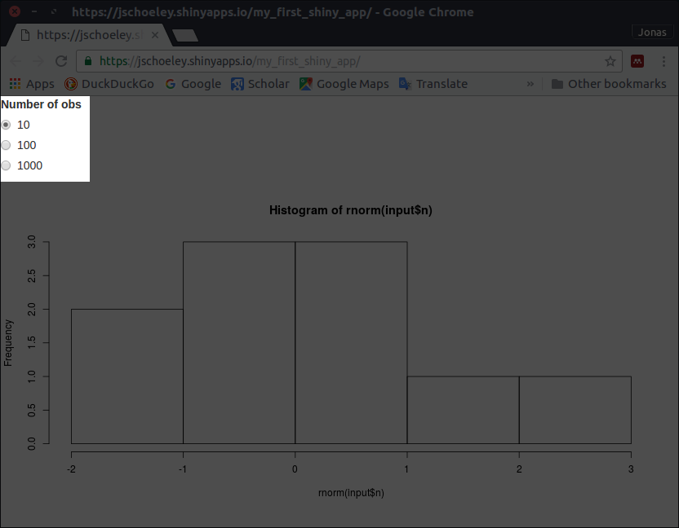
Programing Shiny: Building a User Interface
library(shiny)
ui <- bootstrapPage(
radioButtons(inputId = "n",
label = "Number of obs",
choices = list(10, 100, 1000)),
plotOutput(outputId = "plot")
)
server <- function(input, output) {
output$plot <- renderPlot(
hist(rnorm(input$n))
)
}
shinyApp(ui = ui, server = server)

Slide 12
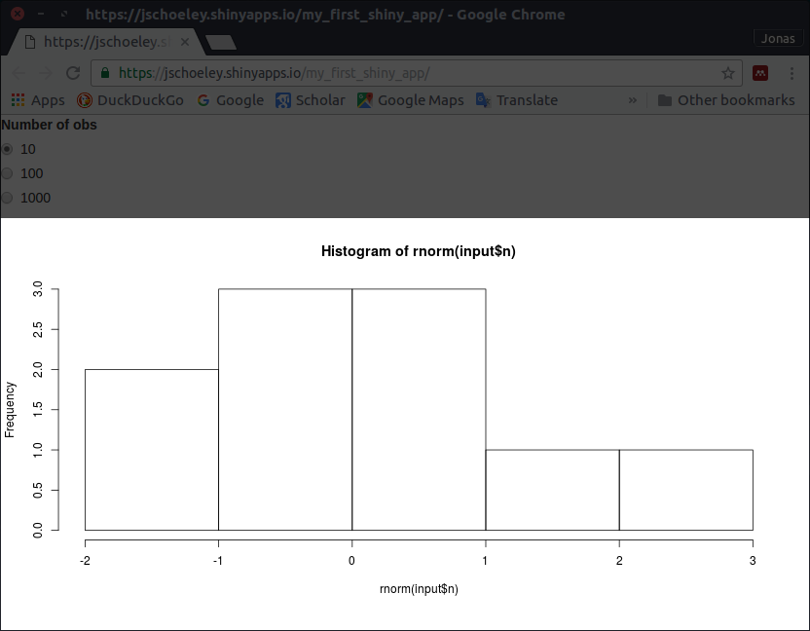
Programing Shiny: Building a User Interface
library(shiny)
ui <- bootstrapPage(
radioButtons(inputId = "n",
label = "Number of obs",
choices = list(10, 100, 1000)),
plotOutput(outputId = "plot")
)
server <- function(input, output) {
output$plot <- renderPlot(
hist(rnorm(input$n))
)
}
shinyApp(ui = ui, server = server)

Slide 13
Programing Shiny: Building a User Interface
Don’t forget the comma
the UI specification is one large nested function
call with different UI elements as parameters
library(shiny)
ui <- bootstrapPage(
radioButtons(inputId = "n",
label = "Number of obs",
choices = list(10, 100, 1000)),
plotOutput(outputId = "plot")
)
server <- function(input, output) {
output$plot <- renderPlot(
hist(rnorm(input$n))
)
}
shinyApp(ui = ui, server = server)

Slide 14
Programing Shiny: Connecting R to the UI
library(shiny)
ui <- bootstrapPage(
radioButtons(inputId = "n",
label = "Number of obs",
choices = list(10, 100, 1000)),
plotOutput(outputId = "plot")
)
server <- function(input, output) {
output$plot <- renderPlot(
hist(rnorm(input$n))
)
}
shinyApp(ui = ui, server = server)
2 Connecting R code with the UI

Slide 15
Programing Shiny: Connecting R to the UI
R communicates with the UI using 2 lists
the input list contains the values of all input
elements of the UI, the output list contains
the objects which R sends to the UI
library(shiny)
ui <- bootstrapPage(
radioButtons(inputId = "n",
label = "Number of obs",
choices = list(10, 100, 1000)),
plotOutput(outputId = "plot")
)
server <- function(input, output) {
output$plot <- renderPlot(
hist(rnorm(input$n))
)
}
shinyApp(ui = ui, server = server)

Slide 16
Programing Shiny: Connecting R to the UI
library(shiny)
ui <- bootstrapPage(
radioButtons(inputId = "n",
label = "Number of obs",
choices = list(10, 100, 1000)),
plotOutput(outputId = "plot")
)
server <- function(input, output) {
output$plot <- renderPlot(
hist(rnorm(input$n))
)
}
shinyApp(ui = ui, server = server)

Slide 17
Programing Shiny: Connecting R to the UI
library(shiny)
ui <- bootstrapPage(
radioButtons(inputId = "n",
label = "Number of obs",
choices = list(10, 100, 1000)),
plotOutput(outputId = "plot")
)
server <- function(input, output) {
output$plot <- renderPlot(
hist(rnorm(input$n))
)
}
shinyApp(ui = ui, server = server)

Slide 18
Programing Shiny: Connecting R to the UI
The “actual” R code
R calculates new output once new input arrives
library(shiny)
ui <- bootstrapPage(
radioButtons(inputId = "n",
label = "Number of obs",
choices = list(10, 100, 1000)),
plotOutput(outputId = "plot")
)
server <- function(input, output) {
output$plot <- renderPlot(
hist(rnorm(input$n))
)
}
shinyApp(ui = ui, server = server)

Slide 19
Programing Shiny: Wrapping Things Up
library(shiny)
ui <- bootstrapPage(
radioButtons(inputId = "n",
label = "Number of obs",
choices = list(10, 100, 1000)),
plotOutput(outputId = "plot")
)
server <- function(input, output) {
output$plot <- renderPlot(
hist(rnorm(input$n))
)
}
shinyApp(ui = ui, server = server)

Slide 20
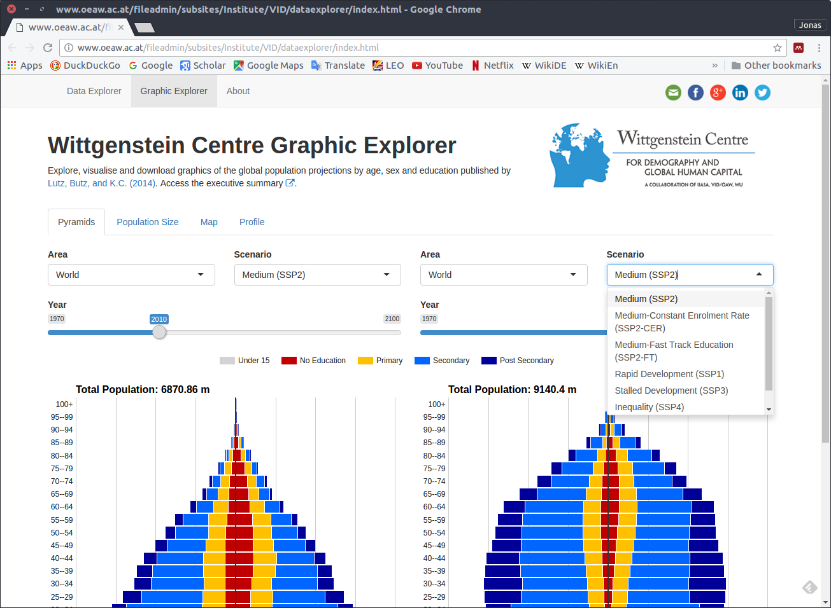
Who Uses It?
Wittgenstein Centre for Demography and Global Human Capital, (2015). Wittgenstein Centre Data Explorer Version 1.2. Available at: http://www.wittgensteincentre.org/dataexplorer

Slide 21
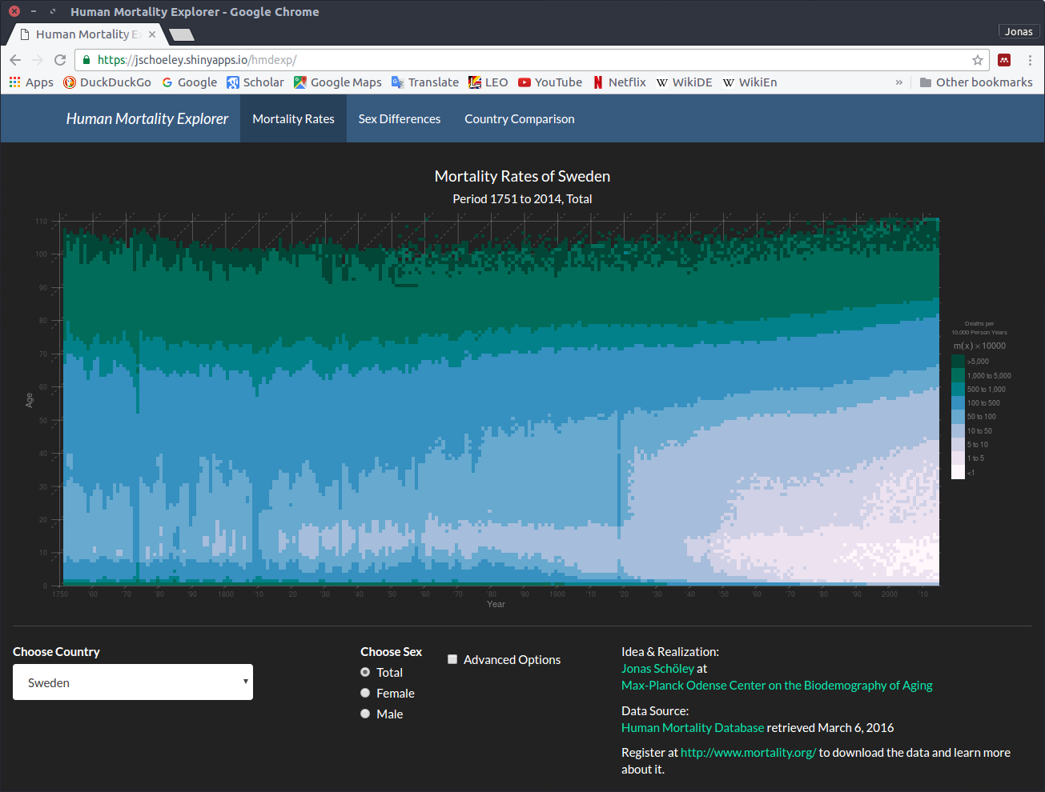
Who Uses It?
Jonas Schöley (2016): “The Human Mortality Explorer”. https://jschoeley.shinyapps.io/hmdexp/

Slide 22
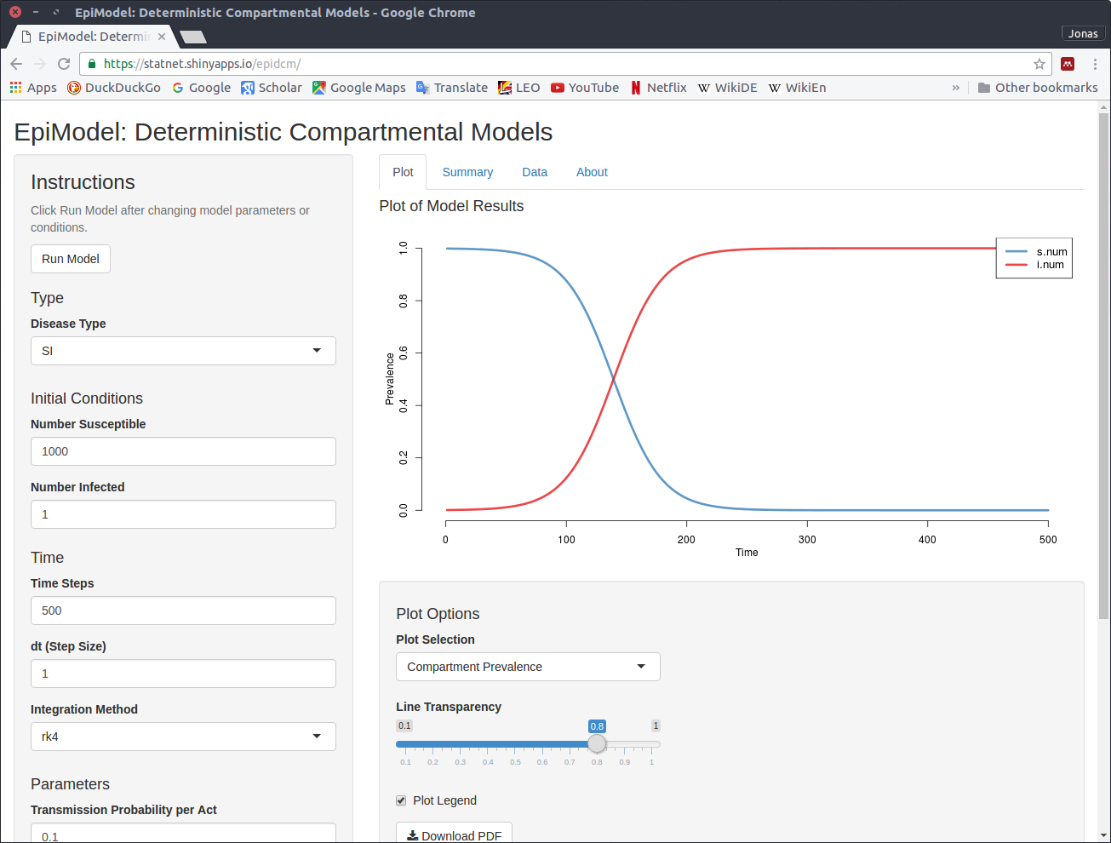
Who Uses It?
EpiModel: Deterministic Compartmental Models. https://statnet.shinyapps.io/epidcm/

Slide 23
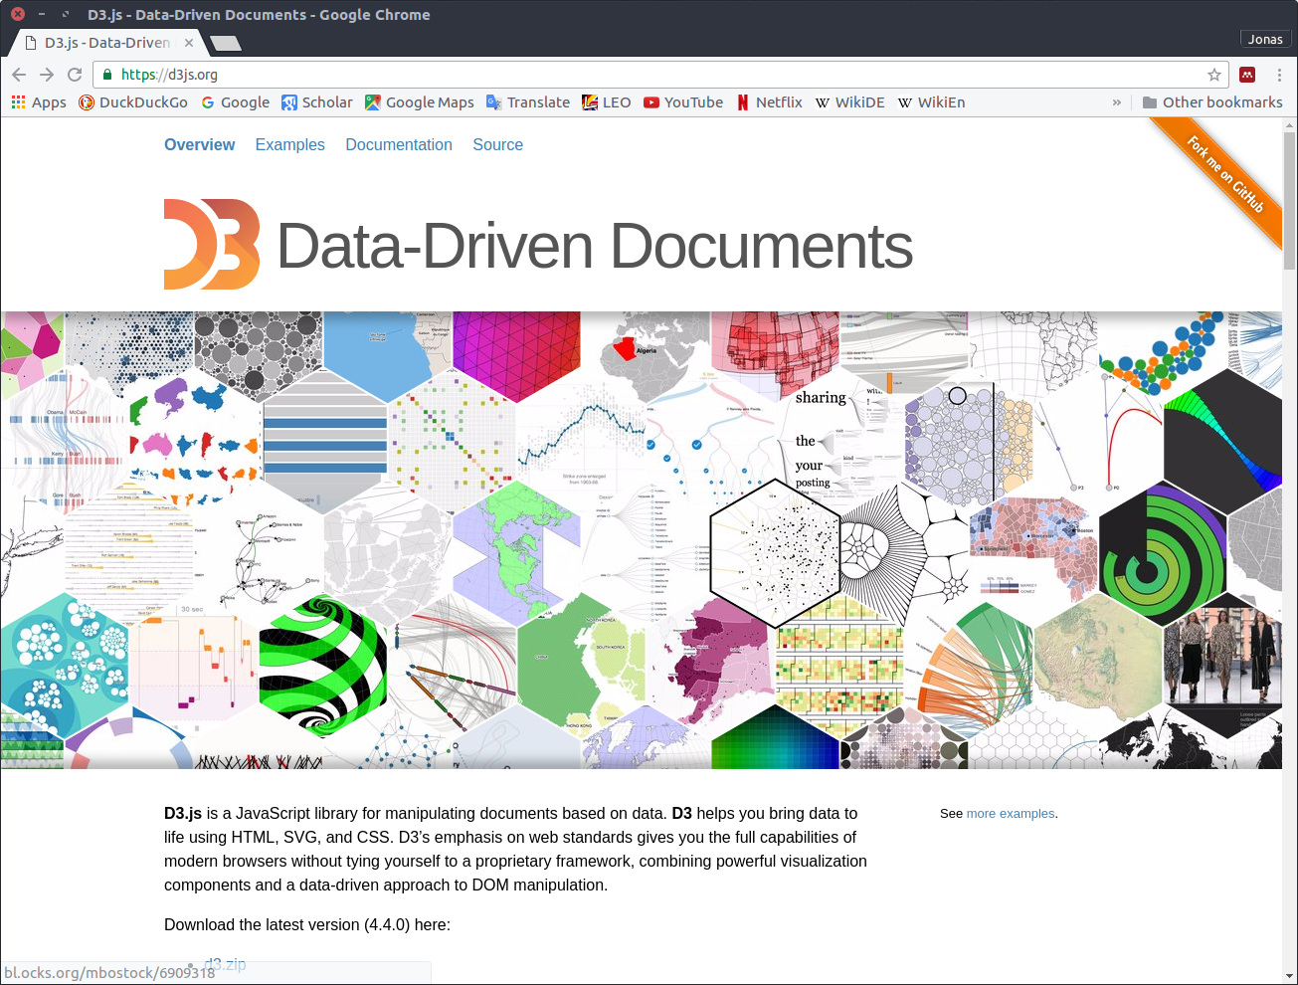
Alternatives: D3.js
+ fast
+ does not require R/Shiny web server
+ can be easily embedded into an existing web-page
+ large user base
- requires knowledge of JavaScript, HTML, CSS
- does not provide statistical computing features of R

Slide 24
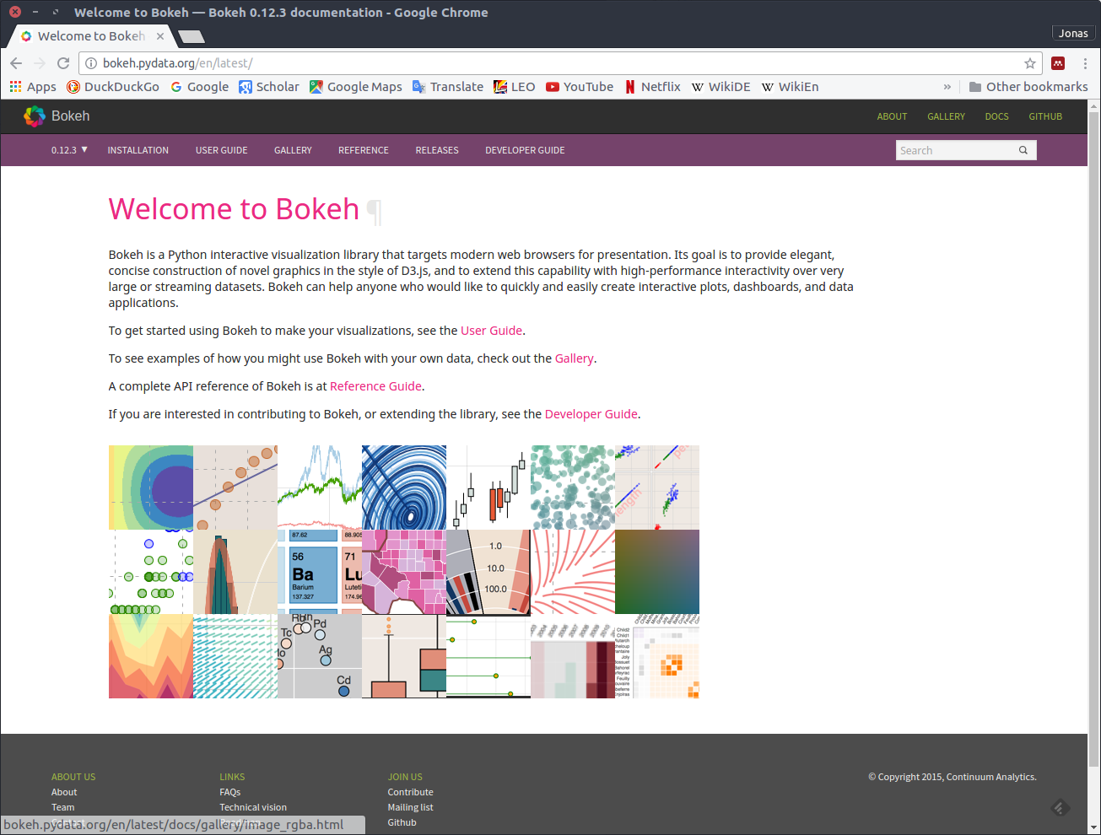
Alternatives: Bokeh
+ Python
- does not provide statistical computing features of R

Slide 25
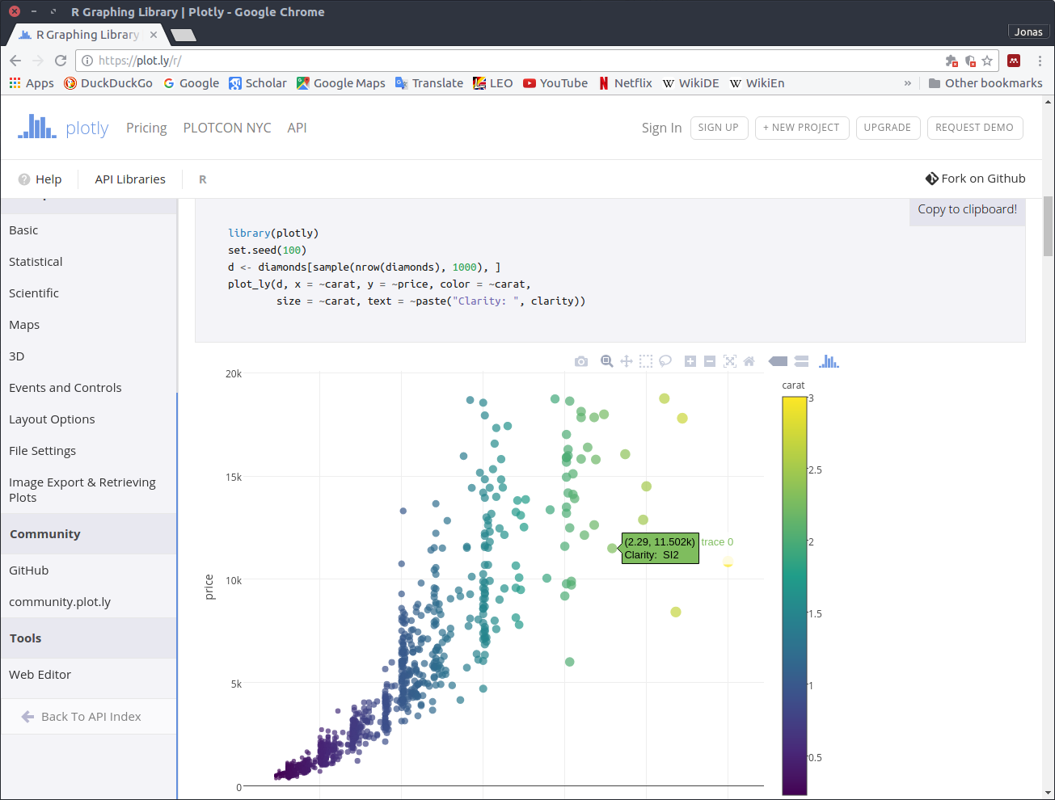
Alternatives: plotly
+ very user-friendly
+ provides basic interactivity for an existing ggplot without any user-effort (ggplotly)
- web-server offerings are commercial

Slide 26
Slides available at
github.com/jschoeley/2016-mpidr-intro_shiny
Jonas Schöley
jschoeley@health.sdu.dk
Twitter: @rettungstweet

