Slide 1




The path to open science
Jonas Schöley
@jschoeley
0000-0002-3340-8518
schoeley@demogr.mpg.de

Slide 2
Benefits of reproducibility and open science
Some personal experiences

Slide 3
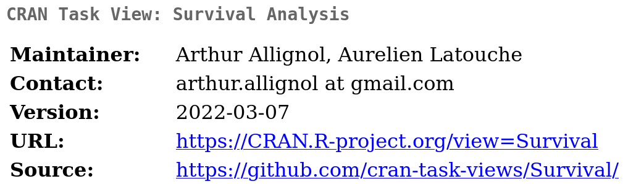
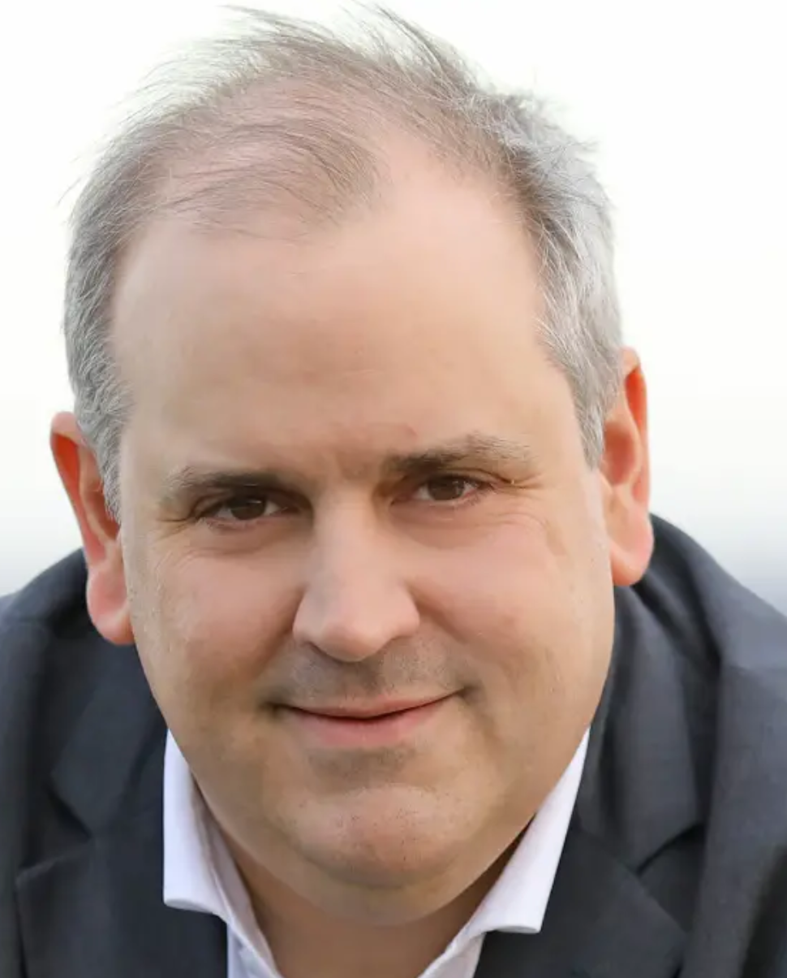
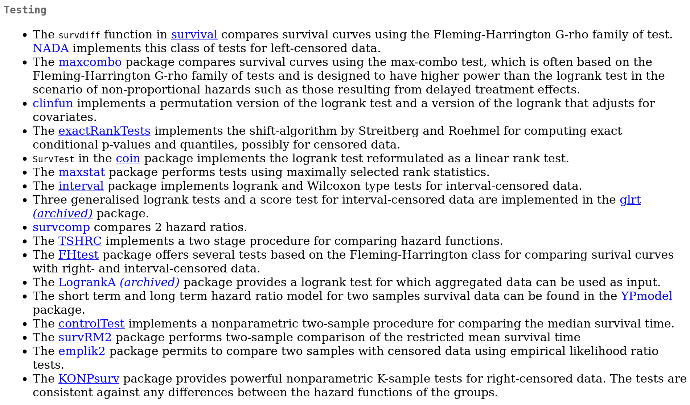
LogrankA
Together with
Roland Rau
@Demographie

Slide 4
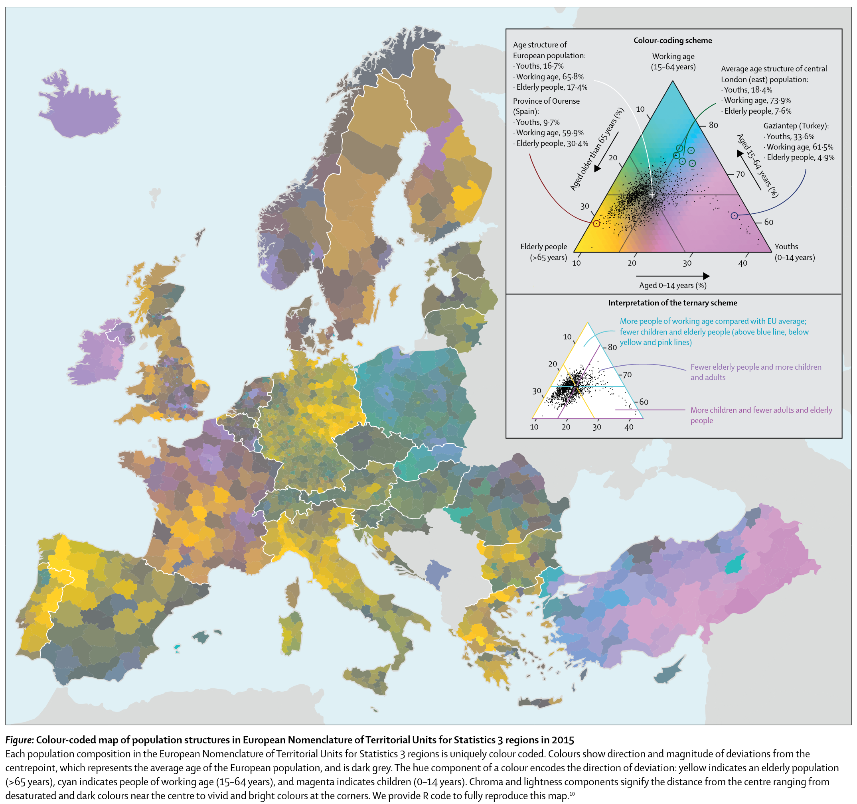

tricolore
Together with
Ilya Kashnitsky
@ikashnitsky
Kashnitsky & Schöley (2018). Regional population structures at a glance. 10.1016/S0140-6736(18)31194-2

Slide 5
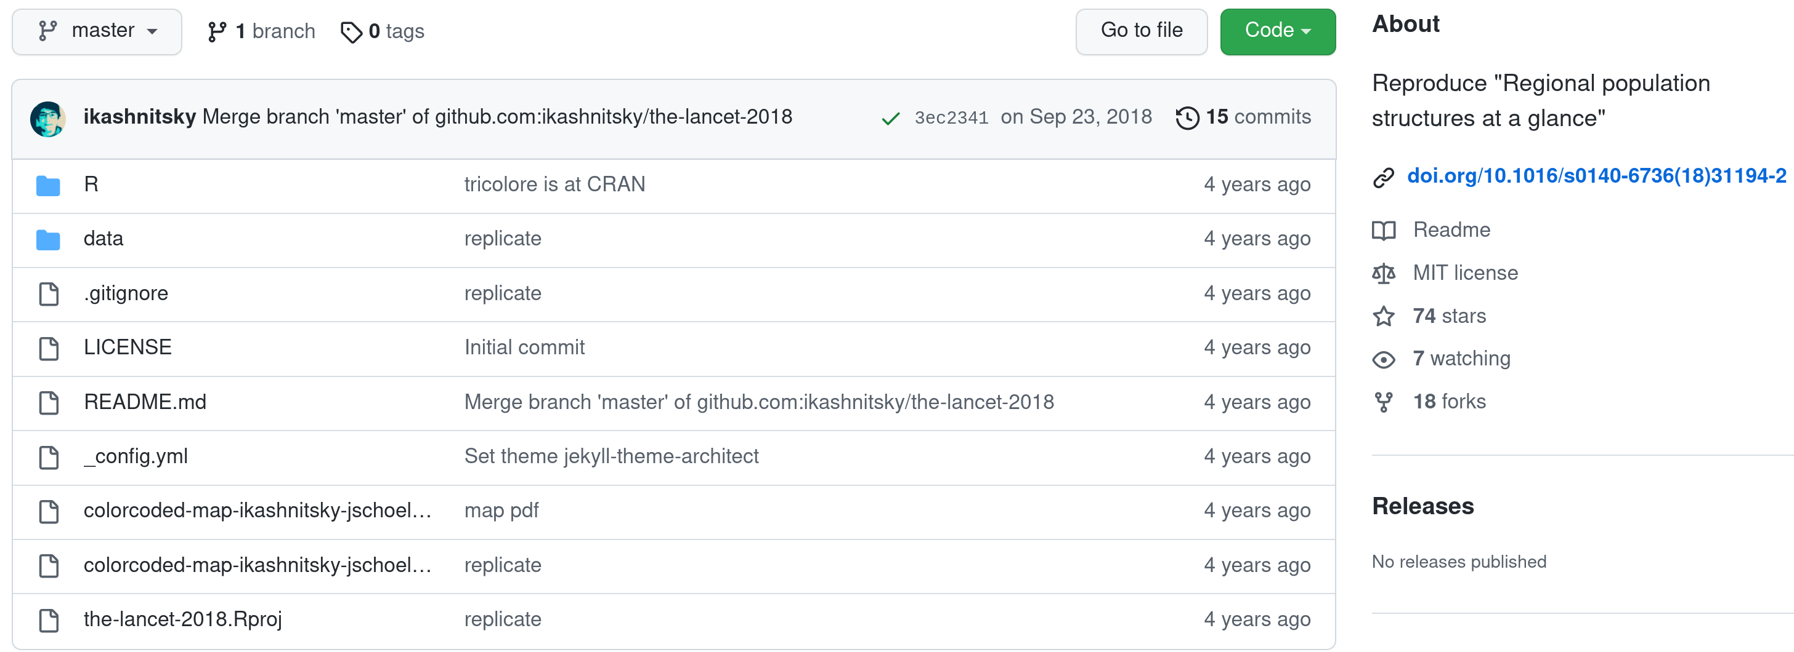
tricolore
Together with
Ilya Kashnitsky
@ikashnitsky
Kashnitsky & Schöley (2018). Regional population structures at a glance. 10.1016/S0140-6736(18)31194-2

Slide 6
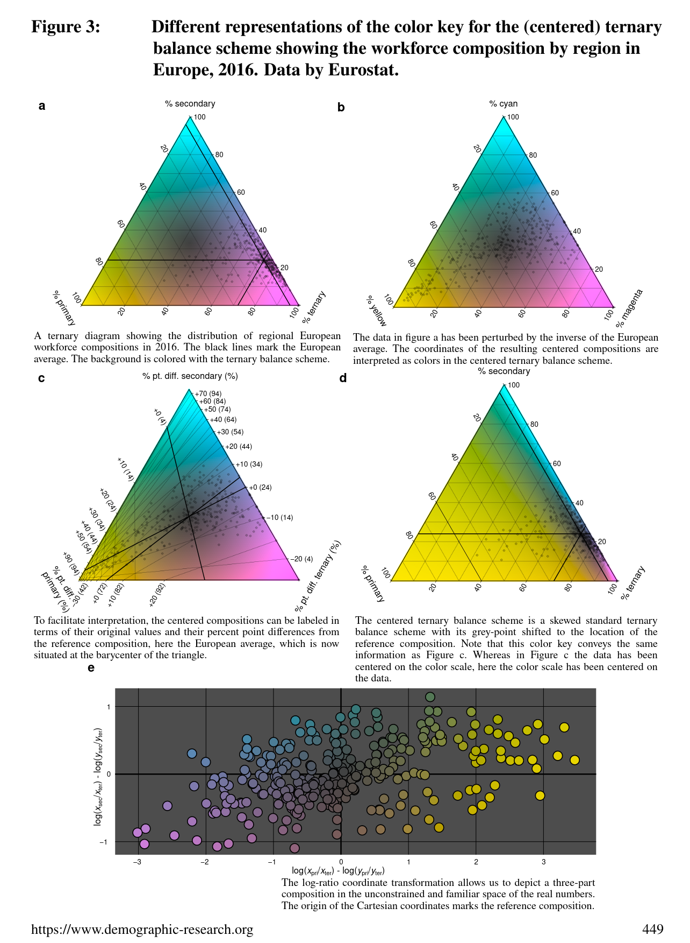
tricolore
Together with
Ilya Kashnitsky
@ikashnitsky
Kashnitsky & Schöley (2018). Regional population structures at a glance. 10.1016/S0140-6736(18)31194-2

Slide 7

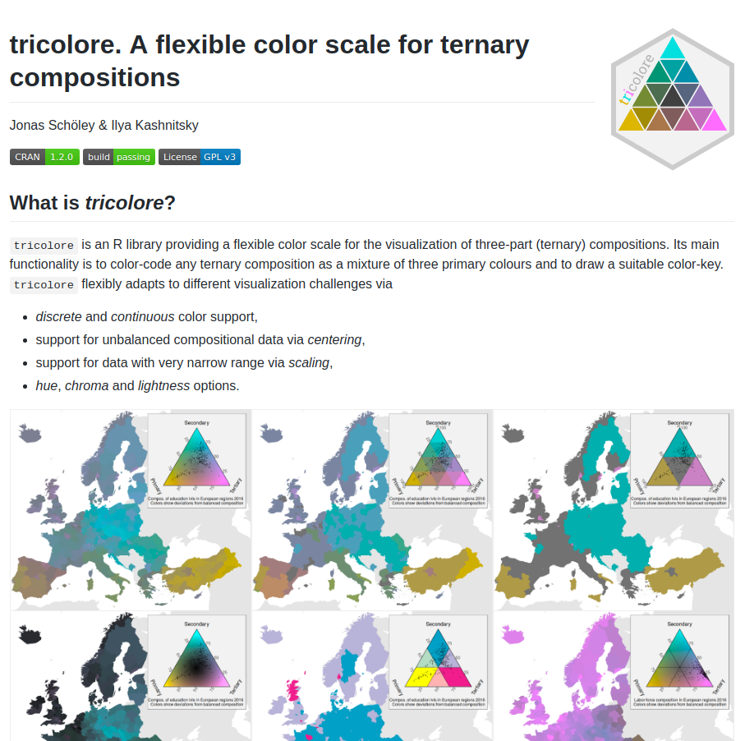
tricolore
Together with
Ilya Kashnitsky
@ikashnitsky
Kashnitsky & Schöley (2018). Regional population structures at a glance. 10.1016/S0140-6736(18)31194-2

Slide 8
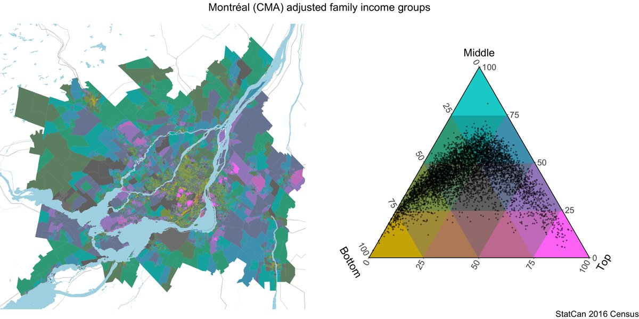
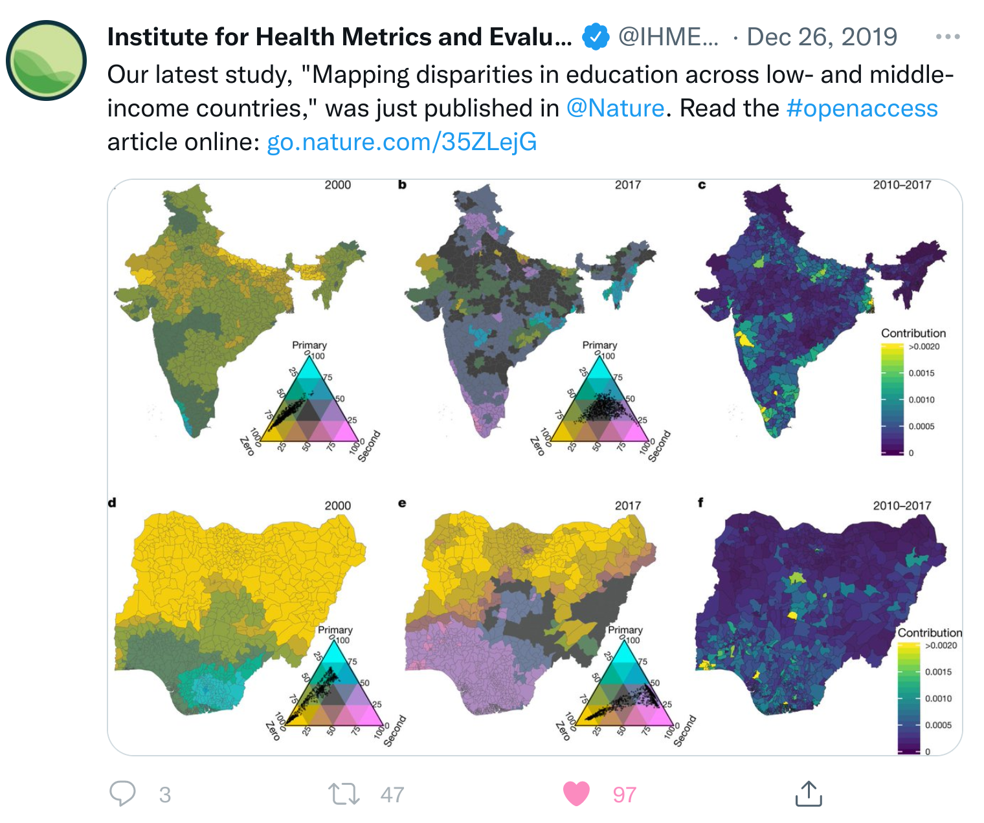
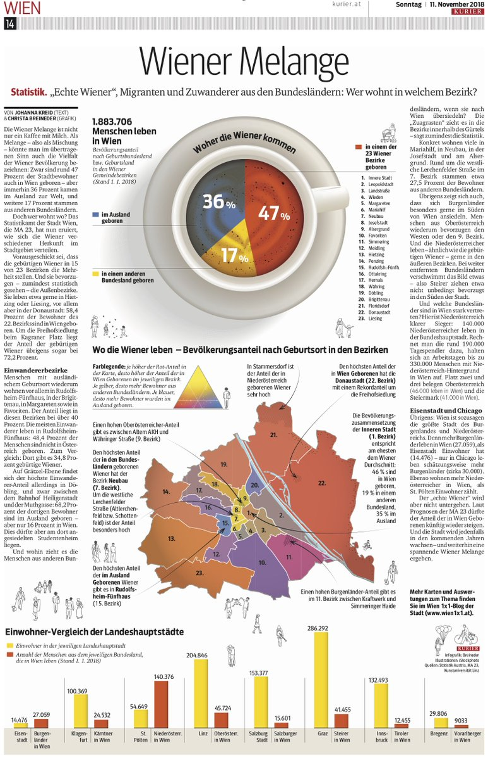
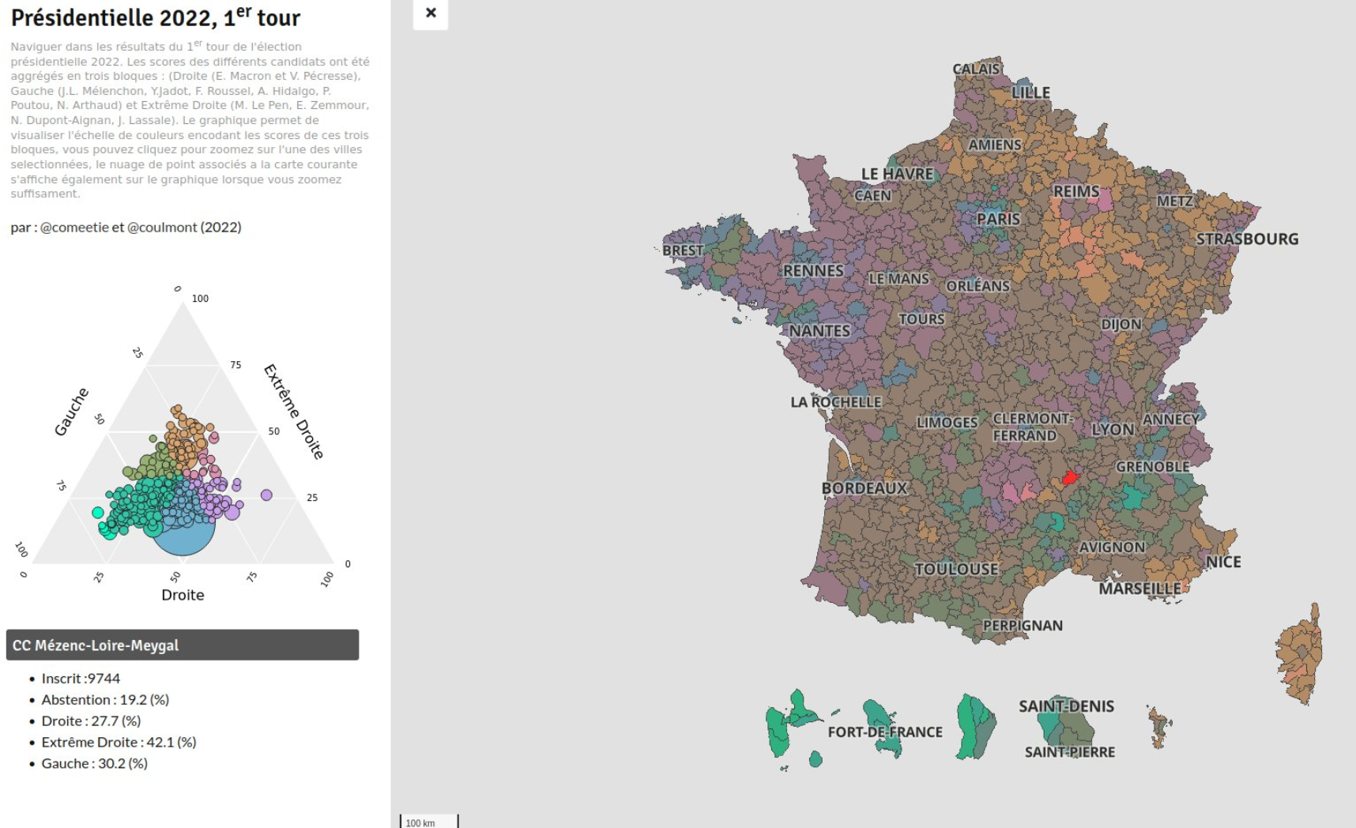
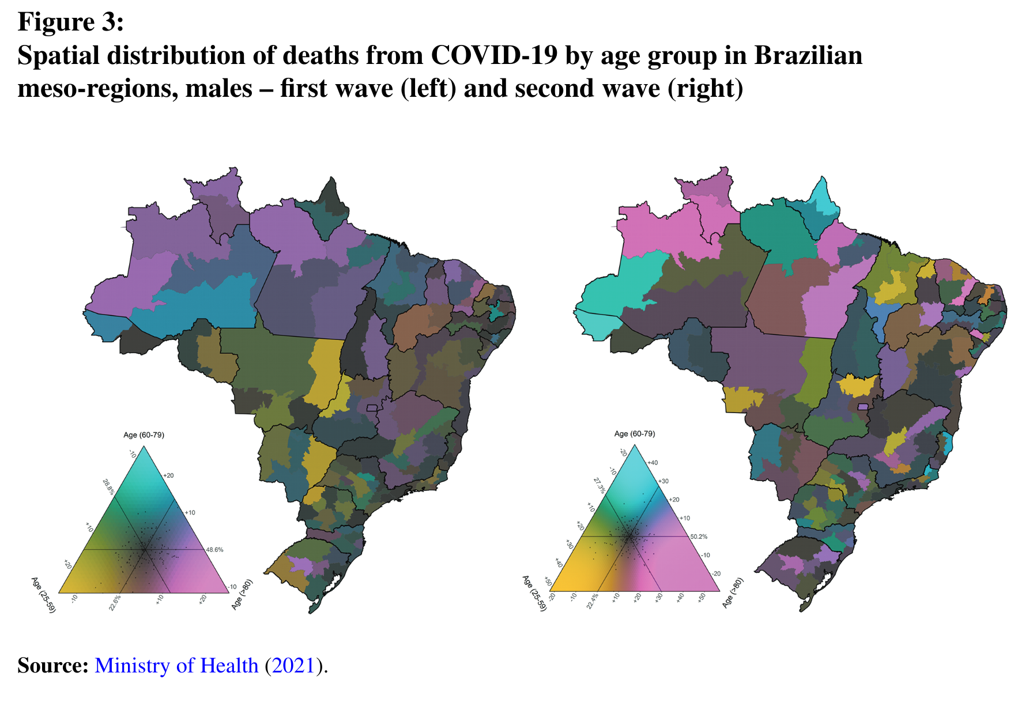
tricolore
Income distribution in Canadian cities
LMIC education disparity
Vienna’s population by origin
French election results
Regional age distribution of COVID deaths
In Brazil
Kashnitsky & Schöley (2018). Regional population structures at a glance. 10.1016/S0140-6736(18)31194-2

Slide 9
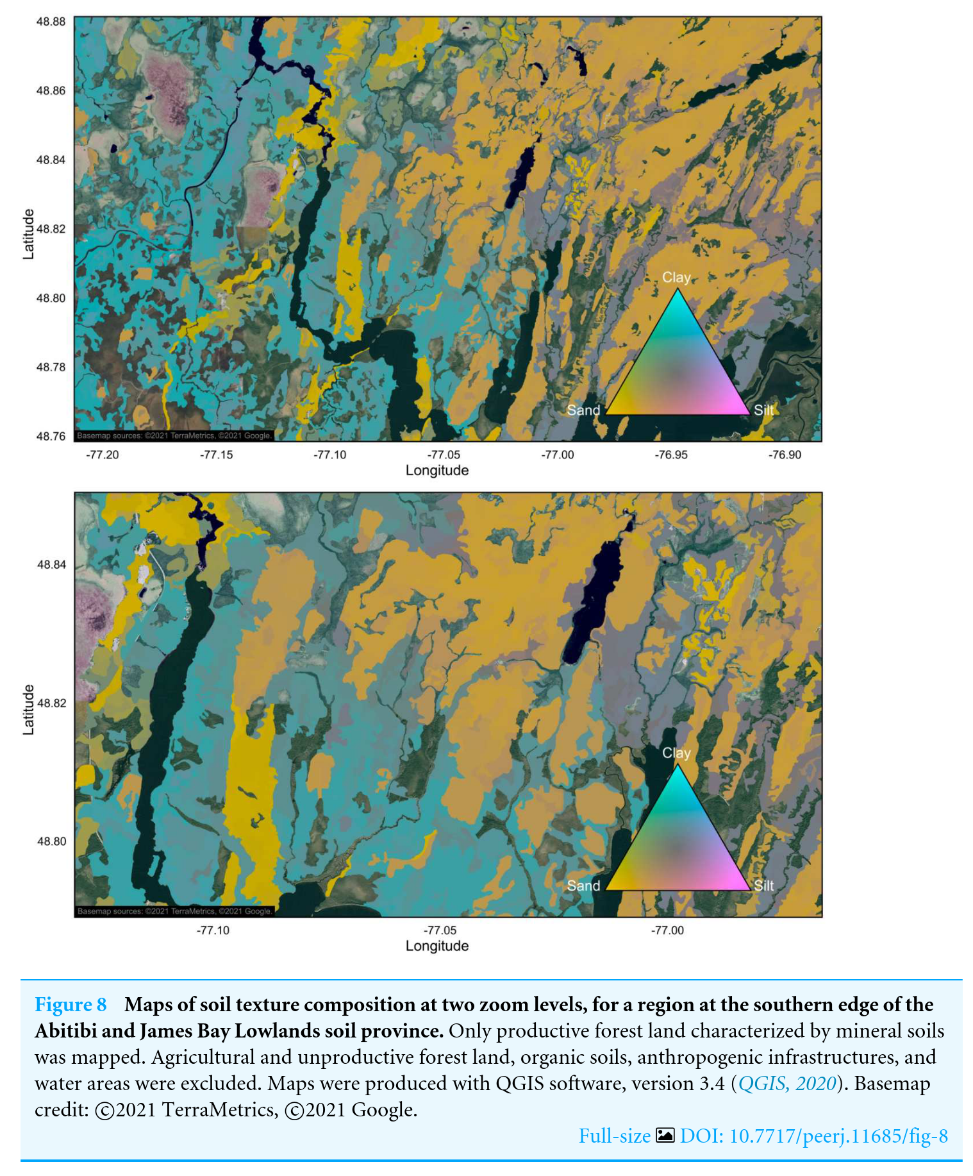
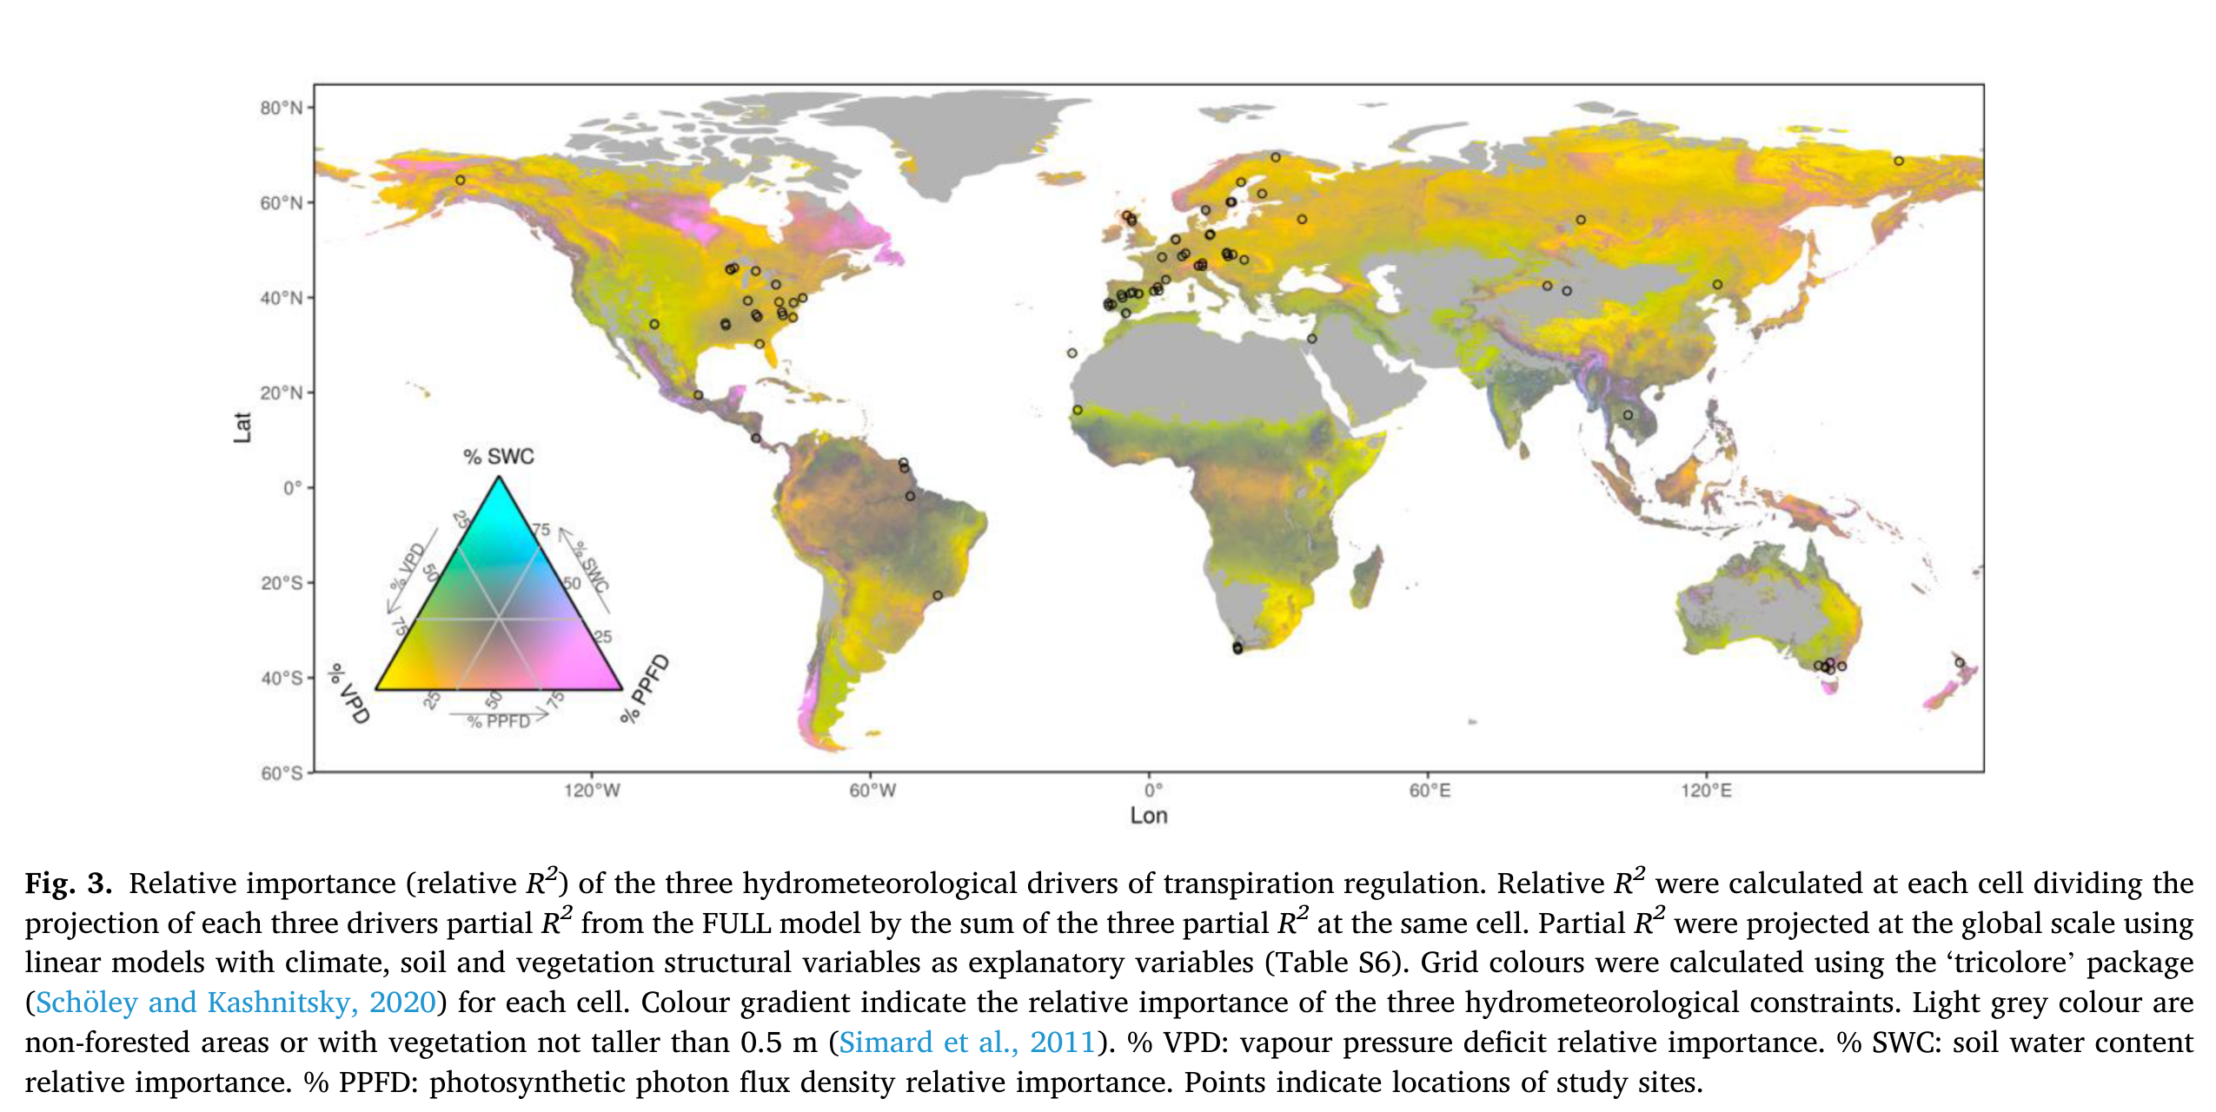
tricolore
Soil composition
Agricultural and Forest Meteorology
Kashnitsky & Schöley (2018). Regional population structures at a glance. 10.1016/S0140-6736(18)31194-2

Slide 10
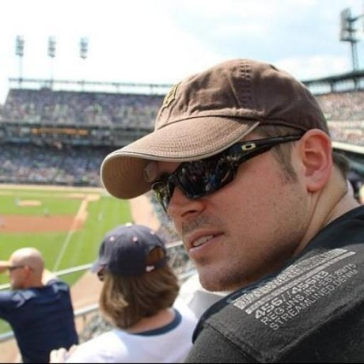
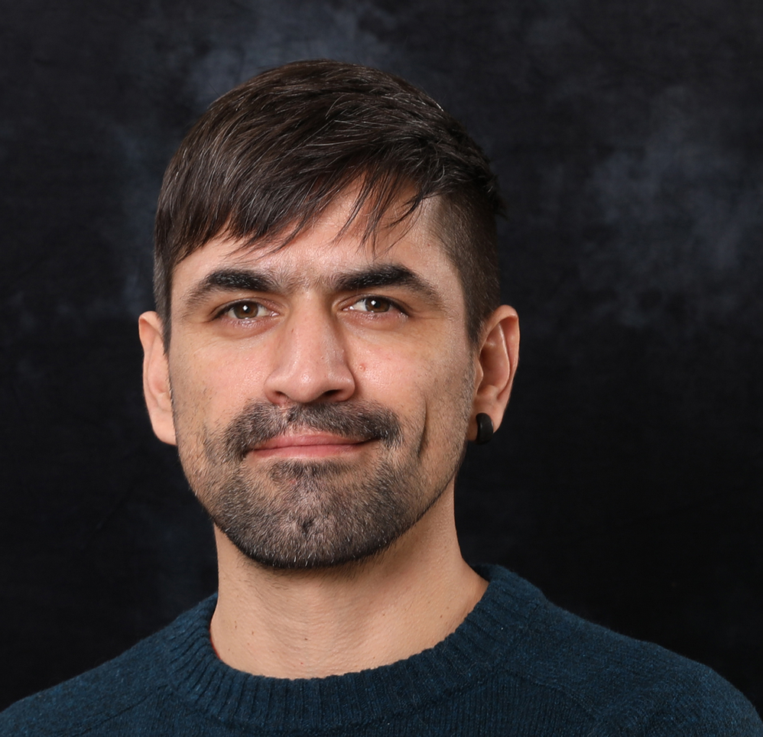
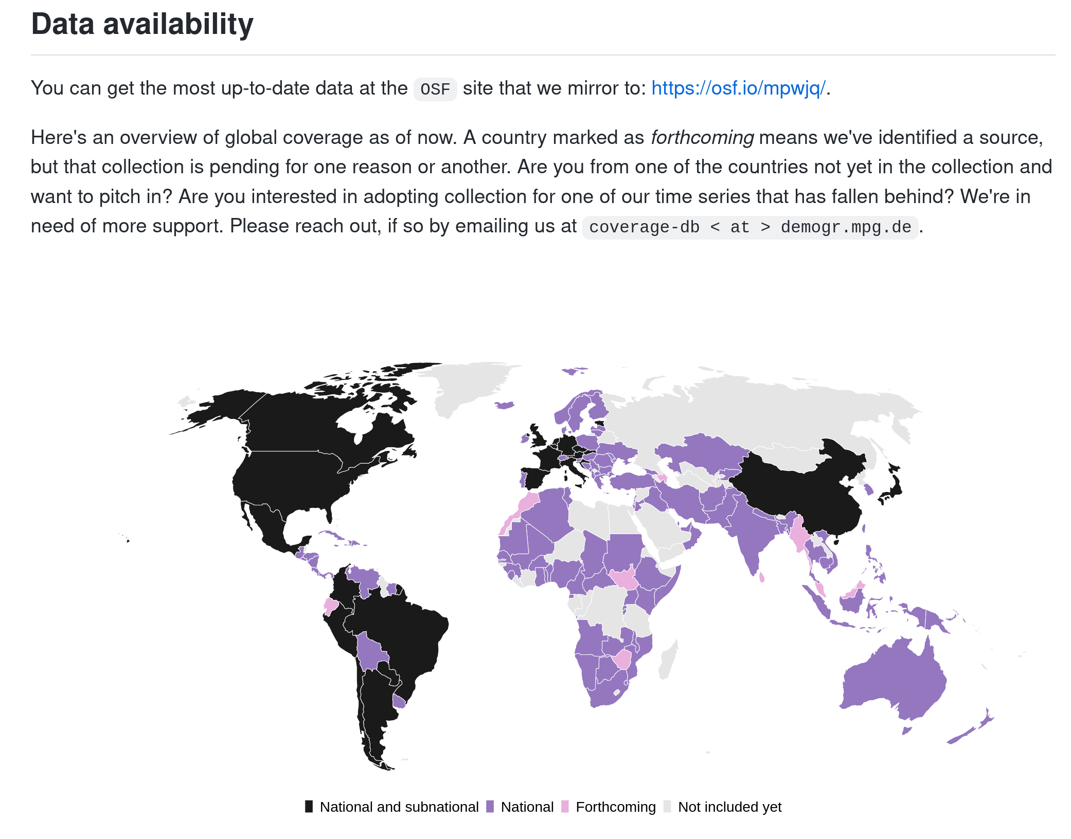
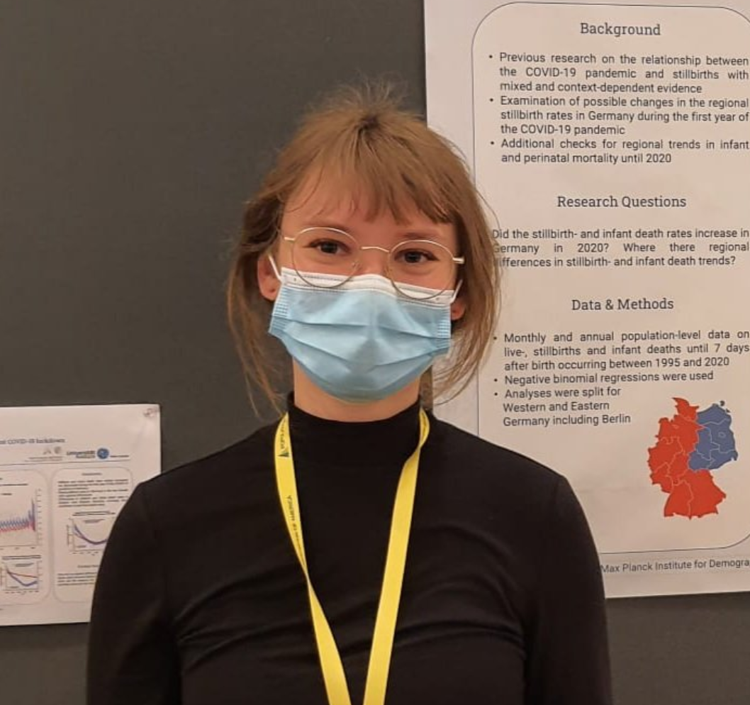
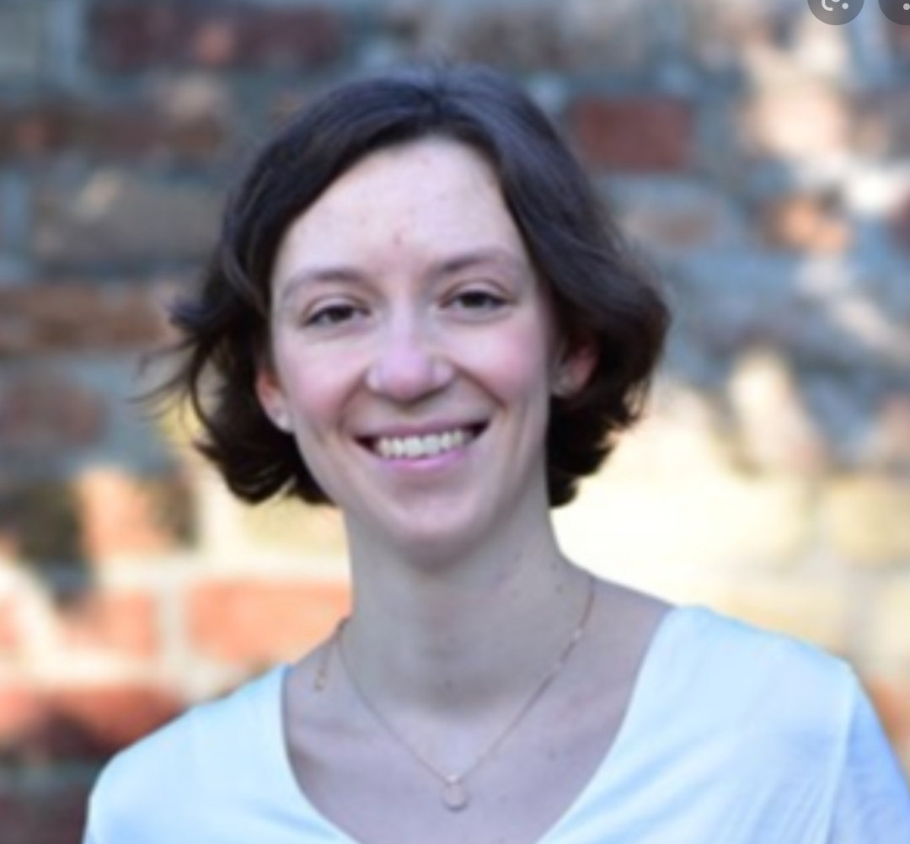
Reproducible Demographers
Tim Riffe @timriffe1 & Enrique Acosta @Acosta_Kike_ &
Maxi Kniffka @MaxiKniffka & Jessica Donzowa @jdonzowa
Created a fully reproducible data base of
age specific COVID-19 statistics.

Slide 11
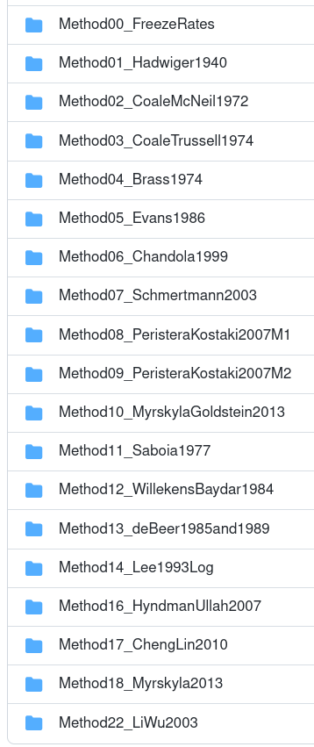
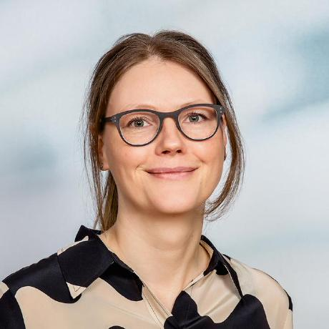
Reproducible Demographers
Christina Bohk
Bohk et al. (2018). Forecast accuracy hardly improves
with methods complexity when completing cohort fertility.
10.1109/5.771073
Implemented, shared and compared 22
fertility forecasting methods
github.com/fertility-forecasting/validate-forecast-methods/tree/master/basic-scripts-forecast-methods

Slide 12

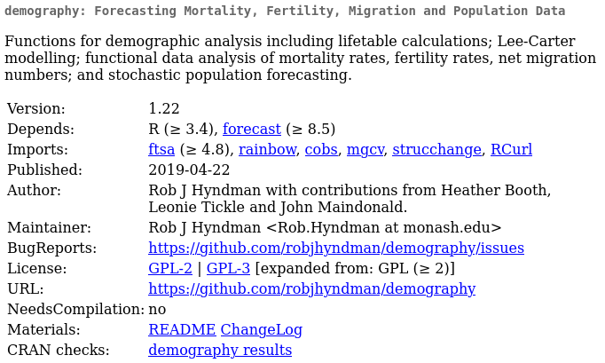



Reproducible Demographers
Rob Hyndman
Author of countless R packages widely applied
in demography.
github.com/robjhyndman

Slide 13
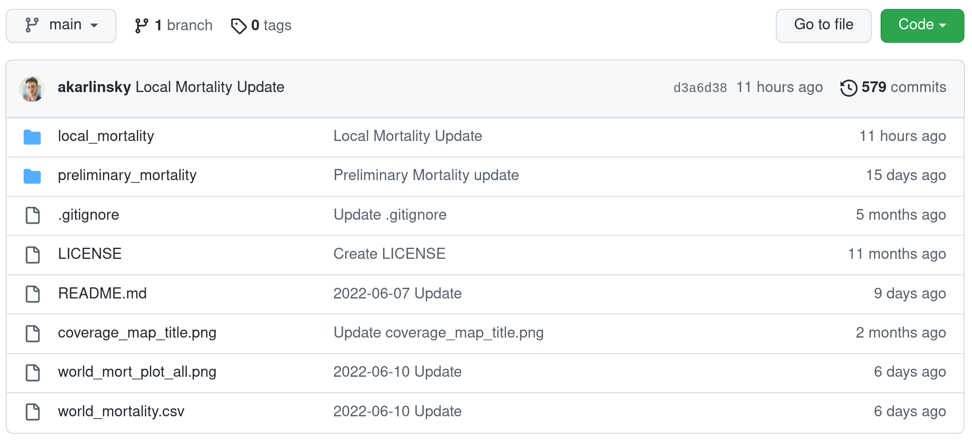
Consuming open science
Karlinsky & Kobak (2022). World Mortality Database. github.com/akarlinsky/world_mortality

Slide 14
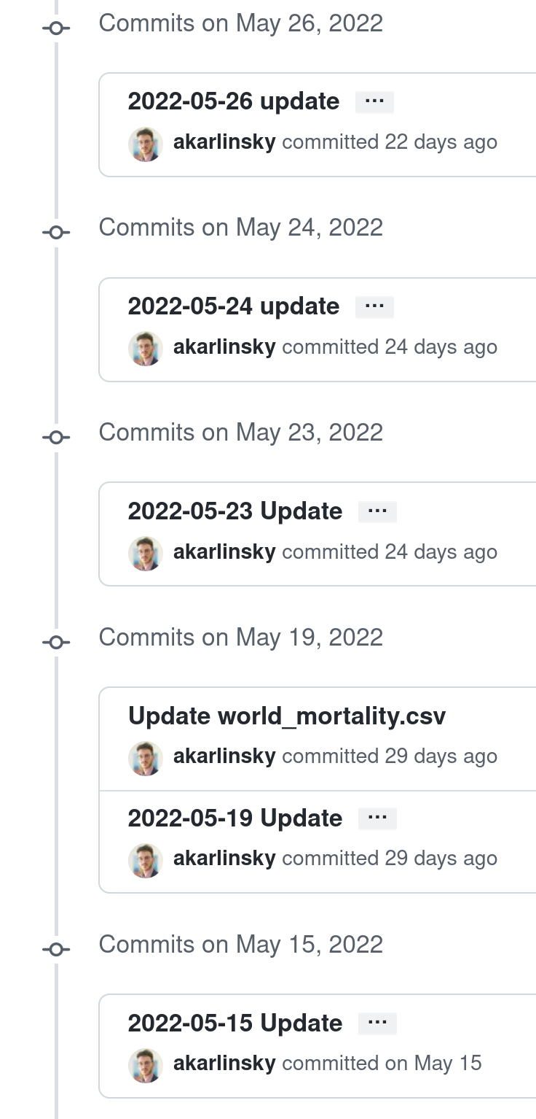
Consuming open science
Karlinsky & Kobak (2022). World Mortality Database. github.com/akarlinsky/world_mortality

Slide 15
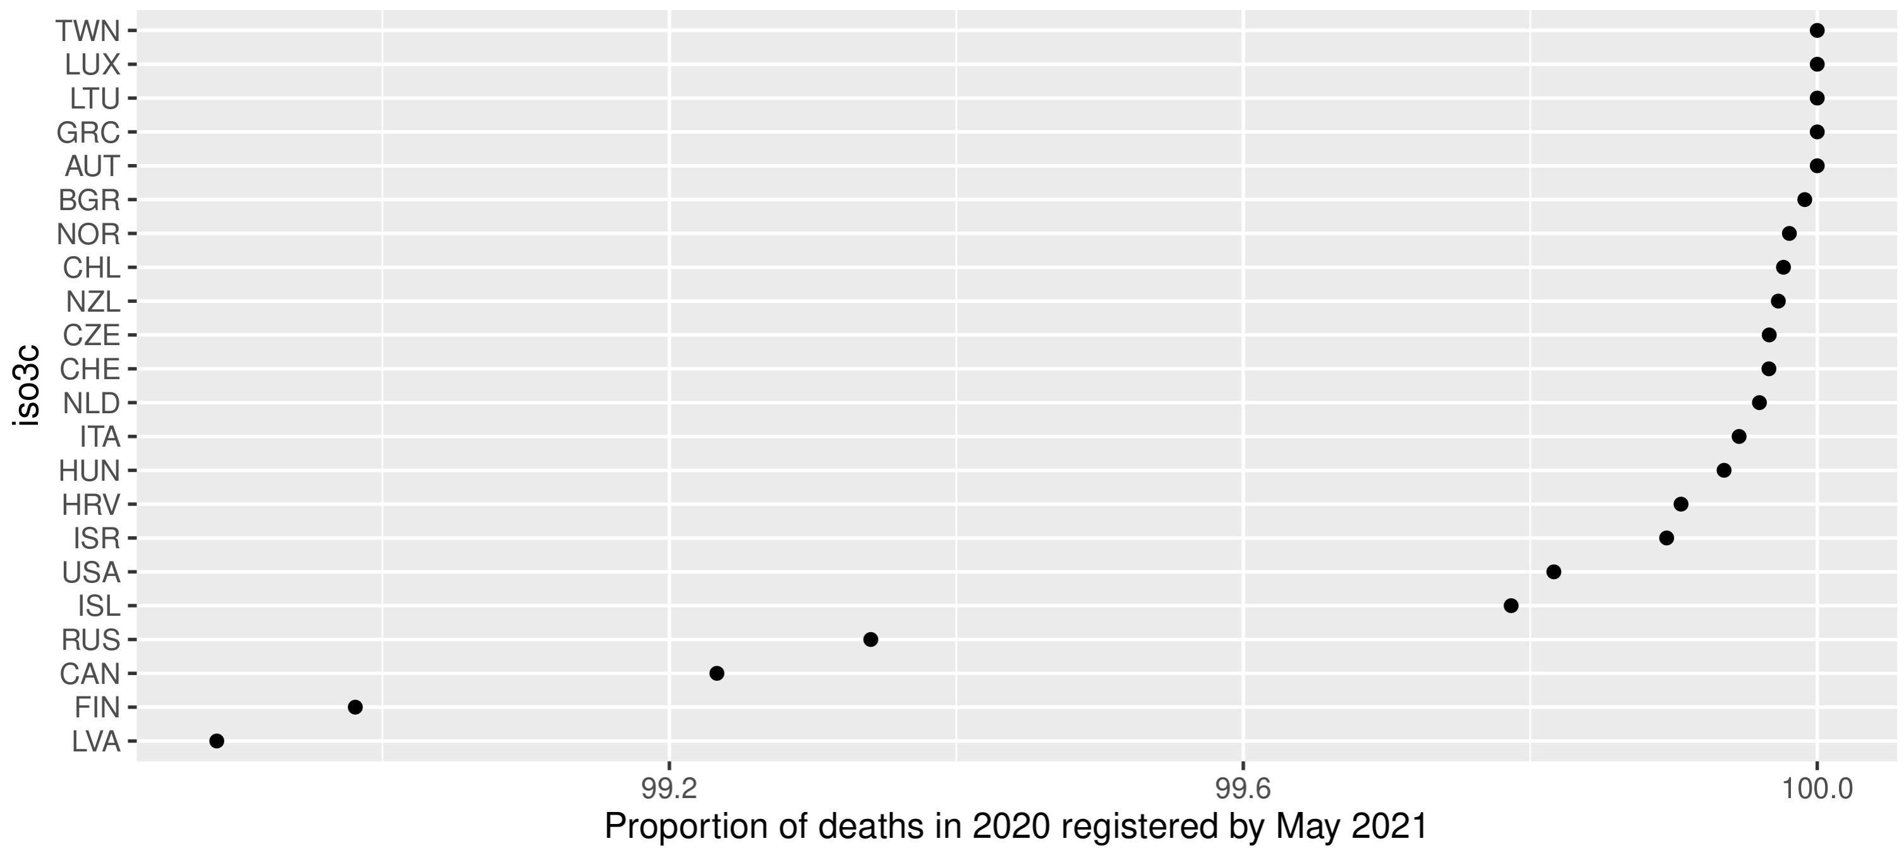
Consuming open science
Derived from Karlinsky & Kobak (2022). World Mortality Database. github.com/akarlinsky/world_mortality

Slide 16
Consuming open science

Slide 17
Reproducibility & replicability
Given your data and your analysis
I arrive at your results
Given your research question,
my data and my analysis
I arrive at your results

Slide 18




Implementing reproducibility & replicability
Ensure everyone
can run your analysis
Share and version your analysis
Share your data
Archive your data
Get DOIs

Slide 19
Demonstrating the reproducible workflow
Sharing a statistical model

Slide 20
Demonstrating the reproducible workflow
Life expectancy changes in 2021

Slide 21
Roadblocks to open science
My code sucks

Slide 22
Roadblocks to open science
I can’t share my data

Slide 23
Roadblocks to open science
Others will copy my stuff

Slide 24
Roadblocks to open science
My co-authors are not on-board

Slide 25
Reproducible analysis
github.com/jschoeley
Jonas Schöley
@jschoeley
0000-0002-3340-8518
schoeley@demogr.mpg.de

