Slide 1

What is tidy R?
Jonas Schöley
jschoeley@health.sdu.dk
Department of Public Health
University of Southern Denmark

Slide 2
Let’s write a program
Here’s 7,826 life-tables...
...fit a (Gompertz) curve to each life-table...
...and make a scatter plot of all estimated a and b parameters.

Slide 3
Base R
# load data
load('data/hmd/hmd_counts.RData')
# select ages 30 to 80, drop total counts, drop NAs
hmd_sub <-
na.omit(subset(hmd_counts, age >= 30 & age < 80 & sex != 'Total'))
# split the data by sex, country and year
hmd_split <-
split(hmd_sub, list(hmd_sub$sex, hmd_sub$country, hmd_sub$period),
drop = TRUE)
# run a linear regression on each subset
hmd_regress <-
lapply(hmd_split,
function (lt) glm(round(nDx, 0) ~ I(age-30) + offset(log(nEx)),
family = 'poisson', data = lt))
# extract the coefficients from each regression model
hmd_coef <- t(sapply(hmd_regress, coef))
# plot a versus b coefficients
plot(x = hmd_coef[,1], y = hmd_coef[,2],
main = 'Gompertz correlation', xlab = 'a', ylab = 'b')

Slide 4
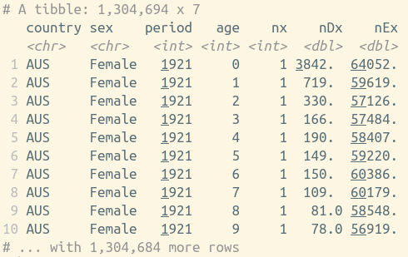
Base R
# load data
load('data/hmd/hmd_counts.RData')
# select ages 30 to 80, drop total counts, drop NAs
hmd_sub <-
na.omit(subset(hmd_counts, age >= 30 & age < 80 & sex != 'Total'))
# split the data by sex, country and year
hmd_split <-
split(hmd_sub, list(hmd_sub$sex, hmd_sub$country, hmd_sub$period),
drop = TRUE)
# run a linear regression on each subset
hmd_regress <-
lapply(hmd_split,
function (lt) glm(round(nDx, 0) ~ I(age-30) + offset(log(nEx)),
family = 'poisson', data = lt))
# extract the coefficients from each regression model
hmd_coef <- t(sapply(hmd_regress, coef))
# plot a versus b coefficients
plot(x = hmd_coef[,1], y = hmd_coef[,2],
main = 'Gompertz correlation', xlab = 'a', ylab = 'b')

Slide 5
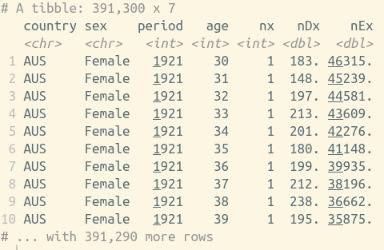
Base R
# load data
load('data/hmd/hmd_counts.RData')
# select ages 30 to 80, drop total counts, drop NAs
hmd_sub <-
na.omit(subset(hmd_counts, age >= 30 & age < 80 & sex != 'Total'))
# split the data by sex, country and year
hmd_split <-
split(hmd_sub, list(hmd_sub$sex, hmd_sub$country, hmd_sub$period),
drop = TRUE)
# run a linear regression on each subset
hmd_regress <-
lapply(hmd_split,
function (lt) glm(round(nDx, 0) ~ I(age-30) + offset(log(nEx)),
family = 'poisson', data = lt))
# extract the coefficients from each regression model
hmd_coef <- t(sapply(hmd_regress, coef))
# plot a versus b coefficients
plot(x = hmd_coef[,1], y = hmd_coef[,2],
main = 'Gompertz correlation', xlab = 'a', ylab = 'b')

Slide 6
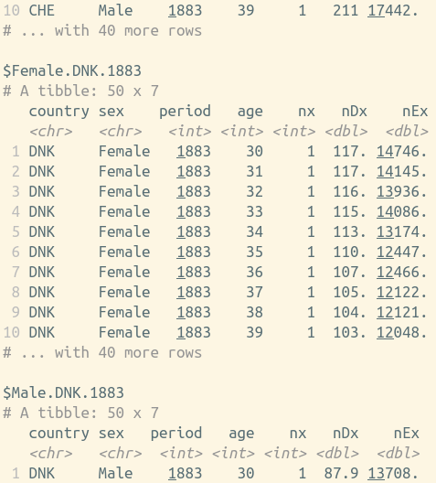
Base R
# load data
load('data/hmd/hmd_counts.RData')
# select ages 30 to 80, drop total counts, drop NAs
hmd_sub <-
na.omit(subset(hmd_counts, age >= 30 & age < 80 & sex != 'Total'))
# run a linear regression on each subset
hmd_regress <-
lapply(hmd_split,
function (lt) glm(round(nDx, 0) ~ I(age-30) + offset(log(nEx)),
family = 'poisson', data = lt))
# extract the coefficients from each regression model
hmd_coef <- t(sapply(hmd_regress, coef))
# plot a versus b coefficients
plot(x = hmd_coef[,1], y = hmd_coef[,2],
main = 'Gompertz correlation', xlab = 'a', ylab = 'b')
# split the data by sex, country and year
hmd_split <-
split(hmd_sub, list(hmd_sub$sex, hmd_sub$country, hmd_sub$period),
drop = TRUE)

Slide 7
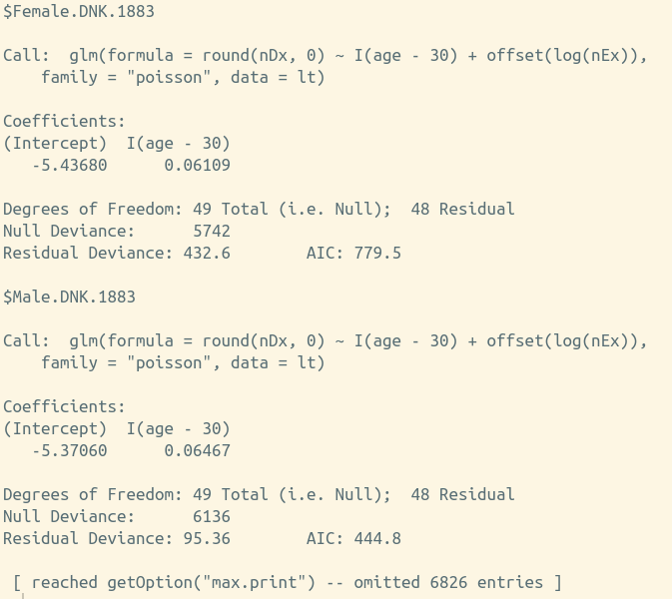
Base R
# load data
load('data/hmd/hmd_counts.RData')
# select ages 30 to 80, drop total counts, drop NAs
hmd_sub <-
na.omit(subset(hmd_counts, age >= 30 & age < 80 & sex != 'Total'))
# split the data by sex, country and year
hmd_split <-
split(hmd_sub, list(hmd_sub$sex, hmd_sub$country, hmd_sub$period),
drop = TRUE)
# extract the coefficients from each regression model
hmd_coef <- t(sapply(hmd_regress, coef))
# plot a versus b coefficients
plot(x = hmd_coef[,1], y = hmd_coef[,2],
main = 'Gompertz correlation', xlab = 'a', ylab = 'b')
# run a linear regression on each subset
hmd_regress <-
lapply(hmd_split,
function (lt) glm(round(nDx, 0) ~ I(age-30) + offset(log(nEx)),
family = 'poisson', data = lt))

Slide 8
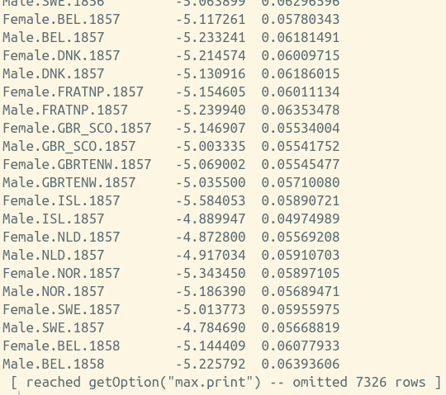
Base R
# load data
load('data/hmd/hmd_counts.RData')
# select ages 30 to 80, drop total counts, drop NAs
hmd_sub <-
na.omit(subset(hmd_counts, age >= 30 & age < 80 & sex != 'Total'))
# split the data by sex, country and year
hmd_split <-
split(hmd_sub, list(hmd_sub$sex, hmd_sub$country, hmd_sub$period),
drop = TRUE)
# run a linear regression on each subset
hmd_regress <-
lapply(hmd_split,
function (lt) glm(round(nDx, 0) ~ I(age-30) + offset(log(nEx)),
family = 'poisson', data = lt))
# extract the coefficients from each regression model
hmd_coef <- t(sapply(hmd_regress, coef))
# plot a versus b coefficients
plot(x = hmd_coef[,1], y = hmd_coef[,2],
main = 'Gompertz correlation', xlab = 'a', ylab = 'b')

Slide 9
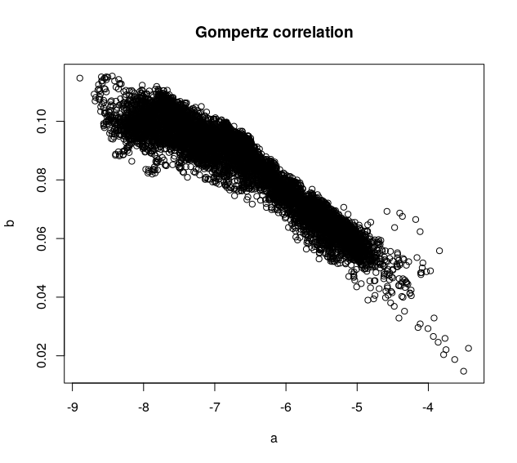
Base R
# load data
load('data/hmd/hmd_counts.RData')
# select ages 30 to 80, drop total counts, drop NAs
hmd_sub <-
na.omit(subset(hmd_counts, age >= 30 & age < 80 & sex != 'Total'))
# split the data by sex, country and year
hmd_split <-
split(hmd_sub, list(hmd_sub$sex, hmd_sub$country, hmd_sub$period),
drop = TRUE)
# run a linear regression on each subset
hmd_regress <-
lapply(hmd_split,
function (lt) glm(round(nDx, 0) ~ I(age-30) + offset(log(nEx)),
family = 'poisson', data = lt))
# extract the coefficients from each regression model
hmd_coef <- t(sapply(hmd_regress, coef))
# plot a versus b coefficients
plot(x = hmd_coef[,1], y = hmd_coef[,2],
main = 'Gompertz correlation', xlab = 'a', ylab = 'b')

Slide 10
Base R
# load data
load('data/hmd/hmd_counts.RData')
# select ages 30 to 80, drop total counts, drop NAs
hmd_sub <-
na.omit(subset(hmd_counts, age >= 30 & age < 80 & sex != 'Total'))
# split the data by sex, country and year
hmd_split <-
split(hmd_sub, list(hmd_sub$sex, hmd_sub$country, hmd_sub$period),
drop = TRUE)
# run a linear regression on each subset
hmd_regress <-
lapply(hmd_split,
function (lt) glm(round(nDx, 0) ~ I(age-30) + offset(log(nEx)),
family = 'poisson', data = lt))
# extract the coefficients from each regression model
hmd_coef <- t(sapply(hmd_regress, coef))
# plot a versus b coefficients
plot(x = hmd_coef[,1], y = hmd_coef[,2],
main = 'Gompertz correlation', xlab = 'a', ylab = 'b')

Slide 11
Tidy R
library(tidyverse)
# load data
load('data/hmd/hmd_counts.RData')
hmd_counts %>%
# select ages 30 to 80, drop total counts
filter(age >= 30, age < 80, sex != 'Total') %>%
# drop NAs
drop_na() %>%
# for each period...
group_by(period, country, sex) %>%
# ...run a Poisson regression of deaths versus age
do(lm = glm(round(nDx, 0) ~ I(age-30) + offset(log(nEx)),
family = 'poisson', data = .)) %>%
# extract the regression coefficients
mutate(a = coef(lm)[1], b = coef(lm)[2]) %>%
# plot a versus b coefficients and label with year
ggplot() +
geom_point(aes(x = a, y = b), shape = 1, size = 3) +
labs(title = 'Gompertz correlation')

Slide 12
Assignment
# load data
load('data/hmd/hmd_counts.RData')
# select ages 30 to 80, drop total counts, drop NAs
hmd_sub <-
na.omit(subset(hmd_counts, age >= 30 & age < 80 & sex != 'Total'))
# split the data by sex, country and year
hmd_split <-
split(hmd_sub, list(hmd_sub$sex, hmd_sub$country, hmd_sub$period),
drop = TRUE)
# run a linear regression on each subset
hmd_regress <-
lapply(hmd_split,
function (lt) glm(round(nDx, 0) ~ I(age-30) + offset(log(nEx)),
family = 'poisson', data = lt))
# extract the coefficients from each regression model
hmd_coef <- t(sapply(hmd_regress, coef))
# plot a versus b coefficients
plot(x = hmd_coef[,1], y = hmd_coef[,2],
main = 'Gompertz correlation', xlab = 'a', ylab = 'b')

Slide 13
Pipes
library(tidyverse)
# load data
load('data/hmd/hmd_counts.RData')
hmd_counts %>%
# select ages 30 to 80, drop total counts
filter(age >= 30, age < 80, sex != 'Total') %>%
# drop NAs
drop_na() %>%
# for each period...
group_by(period, country, sex) %>%
# ...run a Poisson regression of deaths versus age
do(lm = glm(round(nDx, 0) ~ I(age-30) + offset(log(nEx)),
family = 'poisson', data = .)) %>%
# extract the regression coefficients
mutate(a = coef(lm)[1], b = coef(lm)[2]) %>%
# plot a versus b coefficients and label with year
ggplot() +
geom_point(aes(x = a, y = b), shape = 1, size = 3) +
labs(title = 'Gompertz correlation')

Slide 14
Various data structures
Dataframe
# load data
load('data/hmd/hmd_counts.RData')
# select ages 30 to 80, drop total counts, drop NAs
hmd_sub <-
na.omit(subset(hmd_counts, age >= 30 & age < 80 & sex != 'Total'))
# split the data by sex, country and year
hmd_split <-
split(hmd_sub, list(hmd_sub$sex, hmd_sub$country, hmd_sub$period),
drop = TRUE)
# run a linear regression on each subset
hmd_regress <-
lapply(hmd_split,
function (lt) glm(round(nDx, 0) ~ I(age-30) + offset(log(nEx)),
family = 'poisson', data = lt))
# extract the coefficients from each regression model
hmd_coef <- t(sapply(hmd_regress, coef))
# plot a versus b coefficients
plot(x = hmd_coef[,1], y = hmd_coef[,2],
main = 'Gompertz correlation', xlab = 'a', ylab = 'b')
List
Matrix

Slide 15
A single data structure: The Dataframe
Dataframe
library(tidyverse)
# load data
load('data/hmd/hmd_counts.RData')
hmd_counts %>%
# select ages 30 to 80, drop total counts
filter(age >= 30, age < 80, sex != 'Total') %>%
# drop NAs
drop_na() %>%
# for each period...
group_by(period, country, sex) %>%
# ...run a Poisson regression of deaths versus age
do(lm = glm(round(nDx, 0) ~ I(age-30) + offset(log(nEx)),
family = 'poisson', data = .)) %>%
# extract the regression coefficients
mutate(a = coef(lm)[1], b = coef(lm)[2]) %>%
# plot a versus b coefficients and label with year
ggplot() +
geom_point(aes(x = a, y = b), shape = 1, size = 3) +
labs(title = 'Gompertz correlation')

Slide 16
Various indexing styles
NSE
# load data
load('data/hmd/hmd_counts.RData')
# select ages 30 to 80, drop total counts, drop NAs
hmd_sub <-
na.omit(subset(hmd_counts, age >= 30 & age < 80 & sex != 'Total'))
# split the data by sex, country and year
hmd_split <-
split(hmd_sub, list(hmd_sub$sex, hmd_sub$country, hmd_sub$period),
drop = TRUE)
# run a linear regression on each subset
hmd_regress <-
lapply(hmd_split,
function (lt) glm(round(nDx, 0) ~ I(age-30) + offset(log(nEx)),
family = 'poisson', data = lt))
# extract the coefficients from each regression model
hmd_coef <- t(sapply(hmd_regress, coef))
# plot a versus b coefficients
plot(x = hmd_coef[,1], y = hmd_coef[,2],
main = 'Gompertz correlation', xlab = 'a', ylab = 'b')
List index
Matrix index

Slide 17
A single indexing style: Non-standard evaluation
NSE
library(tidyverse)
# load data
load('data/hmd/hmd_counts.RData')
hmd_counts %>%
# select ages 30 to 80, drop total counts
filter(age >= 30, age < 80, sex != 'Total') %>%
# drop NAs
drop_na() %>%
# for each period...
group_by(period, country, sex) %>%
# ...run a Poisson regression of deaths versus age
do(lm = glm(round(nDx, 0) ~ I(age-30) + offset(log(nEx)),
family = 'poisson', data = .)) %>%
# extract the regression coefficients
mutate(a = coef(lm)[1], b = coef(lm)[2]) %>%
# plot a versus b coefficients and label with year
ggplot() +
geom_point(aes(x = a, y = b), shape = 1, size = 3) +
labs(title = 'Gompertz correlation')

Slide 18
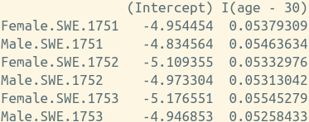
Important information stored in row names
# load data
load('data/hmd/hmd_counts.RData')
# select ages 30 to 80, drop total counts, drop NAs
hmd_sub <-
na.omit(subset(hmd_counts, age >= 30 & age < 80 & sex != 'Total'))
# split the data by sex, country and year
hmd_split <-
split(hmd_sub, list(hmd_sub$sex, hmd_sub$country, hmd_sub$period),
drop = TRUE)
# run a linear regression on each subset
hmd_regress <-
lapply(hmd_split,
function (lt) glm(round(nDx, 0) ~ I(age-30) + offset(log(nEx)),
family = 'poisson', data = lt))
# extract the coefficients from each regression model
hmd_coef <- t(sapply(hmd_regress, coef))
# plot a versus b coefficients
plot(x = hmd_coef[,1], y = hmd_coef[,2],
main = 'Gompertz correlation', xlab = 'a', ylab = 'b')

Slide 19
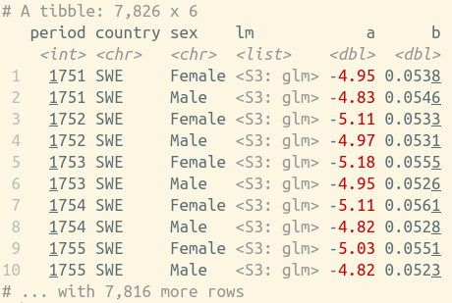
Every variable in its own column
library(tidyverse)
# load data
load('data/hmd/hmd_counts.RData')
hmd_counts %>%
# select ages 30 to 80, drop total counts
filter(age >= 30, age < 80, sex != 'Total') %>%
# drop NAs
drop_na() %>%
# for each period...
group_by(period, country, sex) %>%
# ...run a Poisson regression of deaths versus age
do(lm = glm(round(nDx, 0) ~ I(age-30) + offset(log(nEx)),
family = 'poisson', data = .)) %>%
# extract the regression coefficients
mutate(a = coef(lm)[1], b = coef(lm)[2]) %>%
# plot a versus b coefficients and label with year
ggplot() +
geom_point(aes(x = a, y = b), shape = 1, size = 3) +
labs(title = 'Gompertz correlation')

Slide 20
Tidy principles
Readability
Modularity
Consistency

Slide 21
A typical data analysis workflow
Visualize
Import
Tidy
Transform
Communicate
Model

Slide 22
The tidyverse
Visualize
Import
Tidy
Transform
Communicate
Model

Slide 23
github.com/jschoeley/ced18-tidyr
Jonas Schöley
jschoeley@health.sdu.dk
Twitter: @jschoeley

