Slide 1

Visualization as a design process
Jonas Schöley
jschoeley@health.sdu.dk
Department of Public Health
University of Southern Denmark

Slide 2
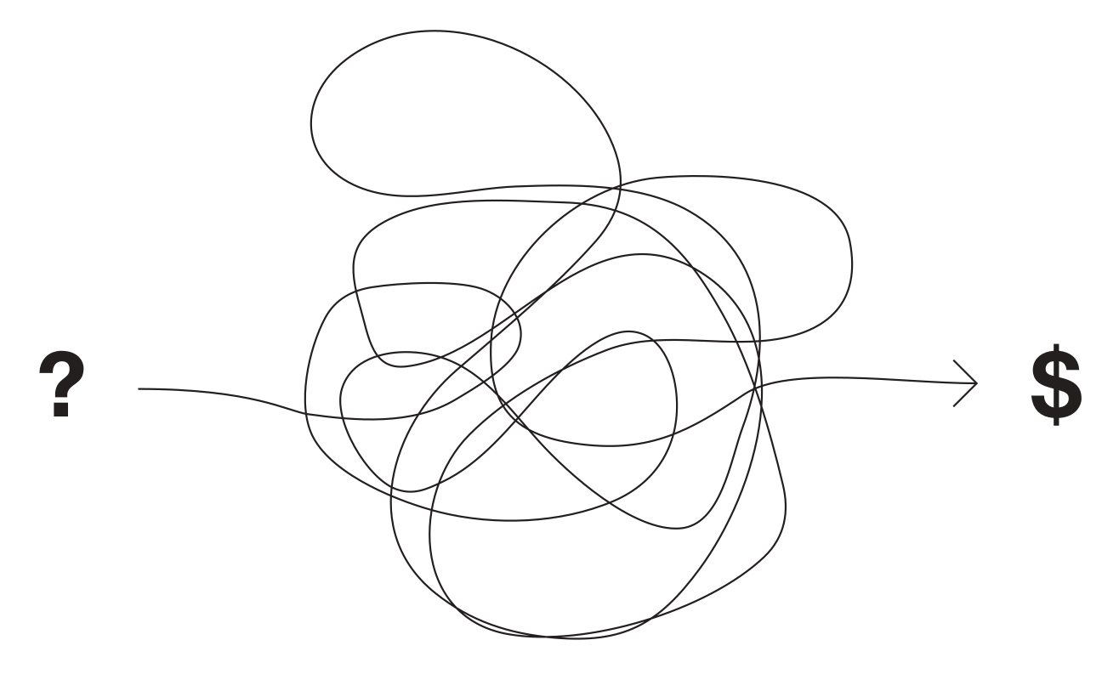
What is a design process?
Tim Brennan (~1990) via Dubberly (2008). How do you design? A Compendium of Models.

Slide 3
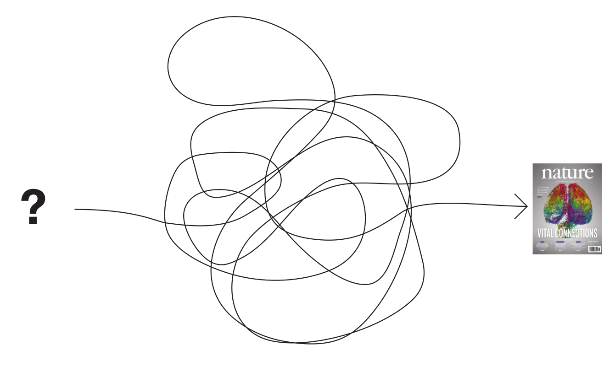
What is a design process?
Tim Brennan (~1990) [adapted for the academic design process].

Slide 4
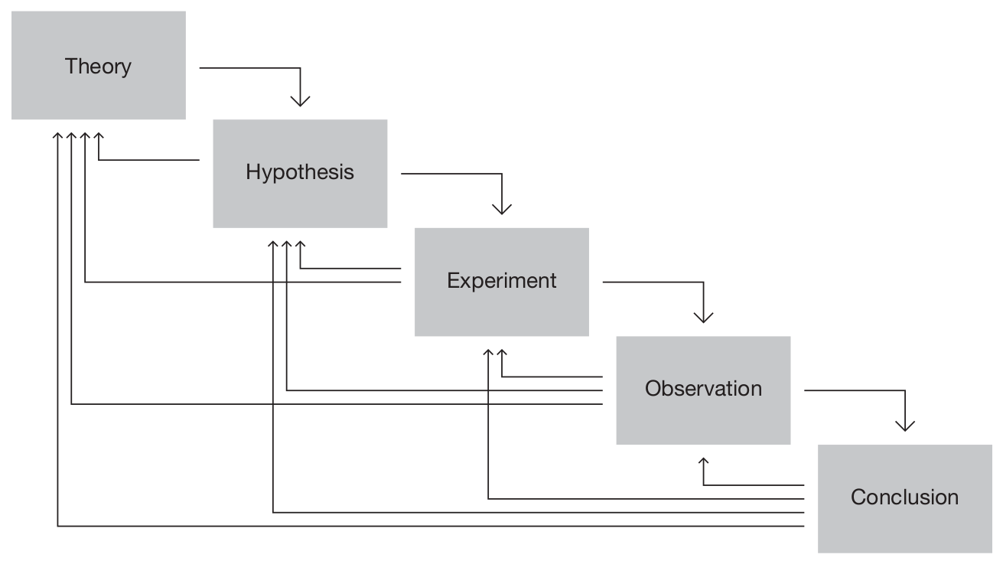
The scientific (design) process
Dubberly (2008). How do you design? A Compendium of Models.

Slide 5
Analysis, genesis, synthesis
State I
Analysis
Genesis
Synthesis
State II
Analysis
Genesis
Synthesis
State III
… … … … … … … … … … … … … …
Final state
Doblin, J. (1987). A Short, Grandiose Theory of Design. STA Design Journal.

Slide 6
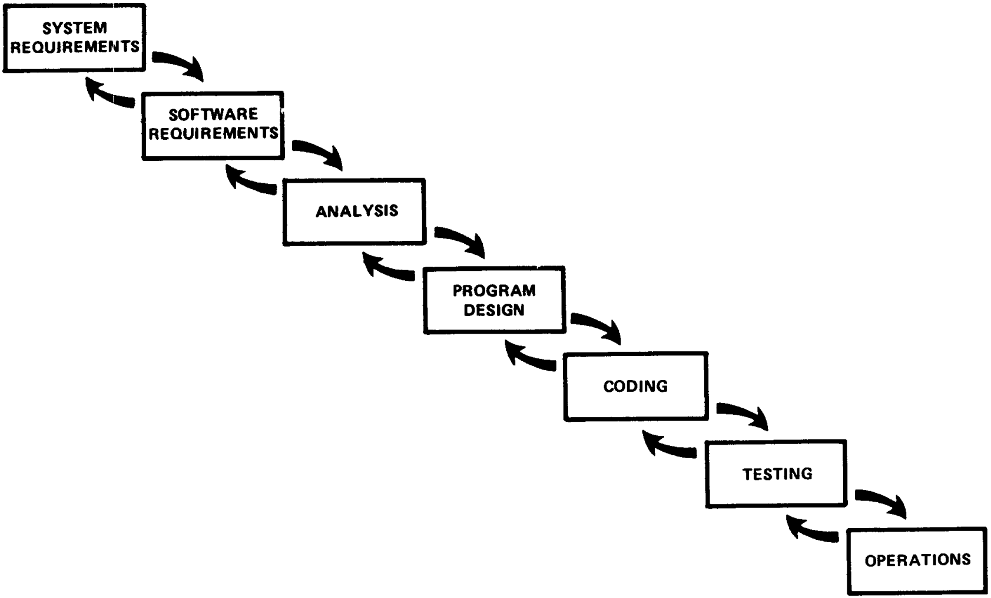
The “Waterfall” life-cycle
Royce, W. W. (1970). Managing the development of large software systems. Electronics, 26 (August), 1–9.

Slide 7
The essence of every design process
Iteration until converging
on a predefined goal

Slide 8
Different domains, different design goals

Slide 9
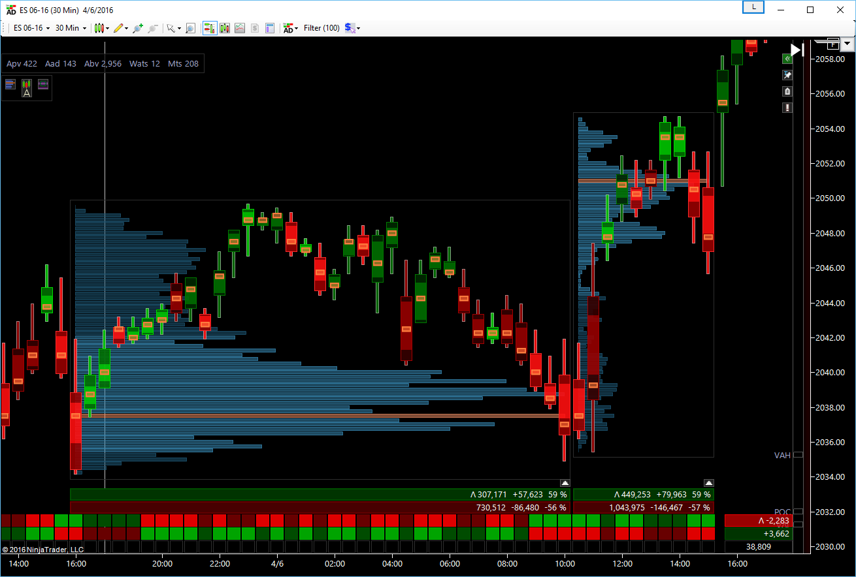
Trader terminal
Auction Dashboard™ composite volume profile view.

Slide 10
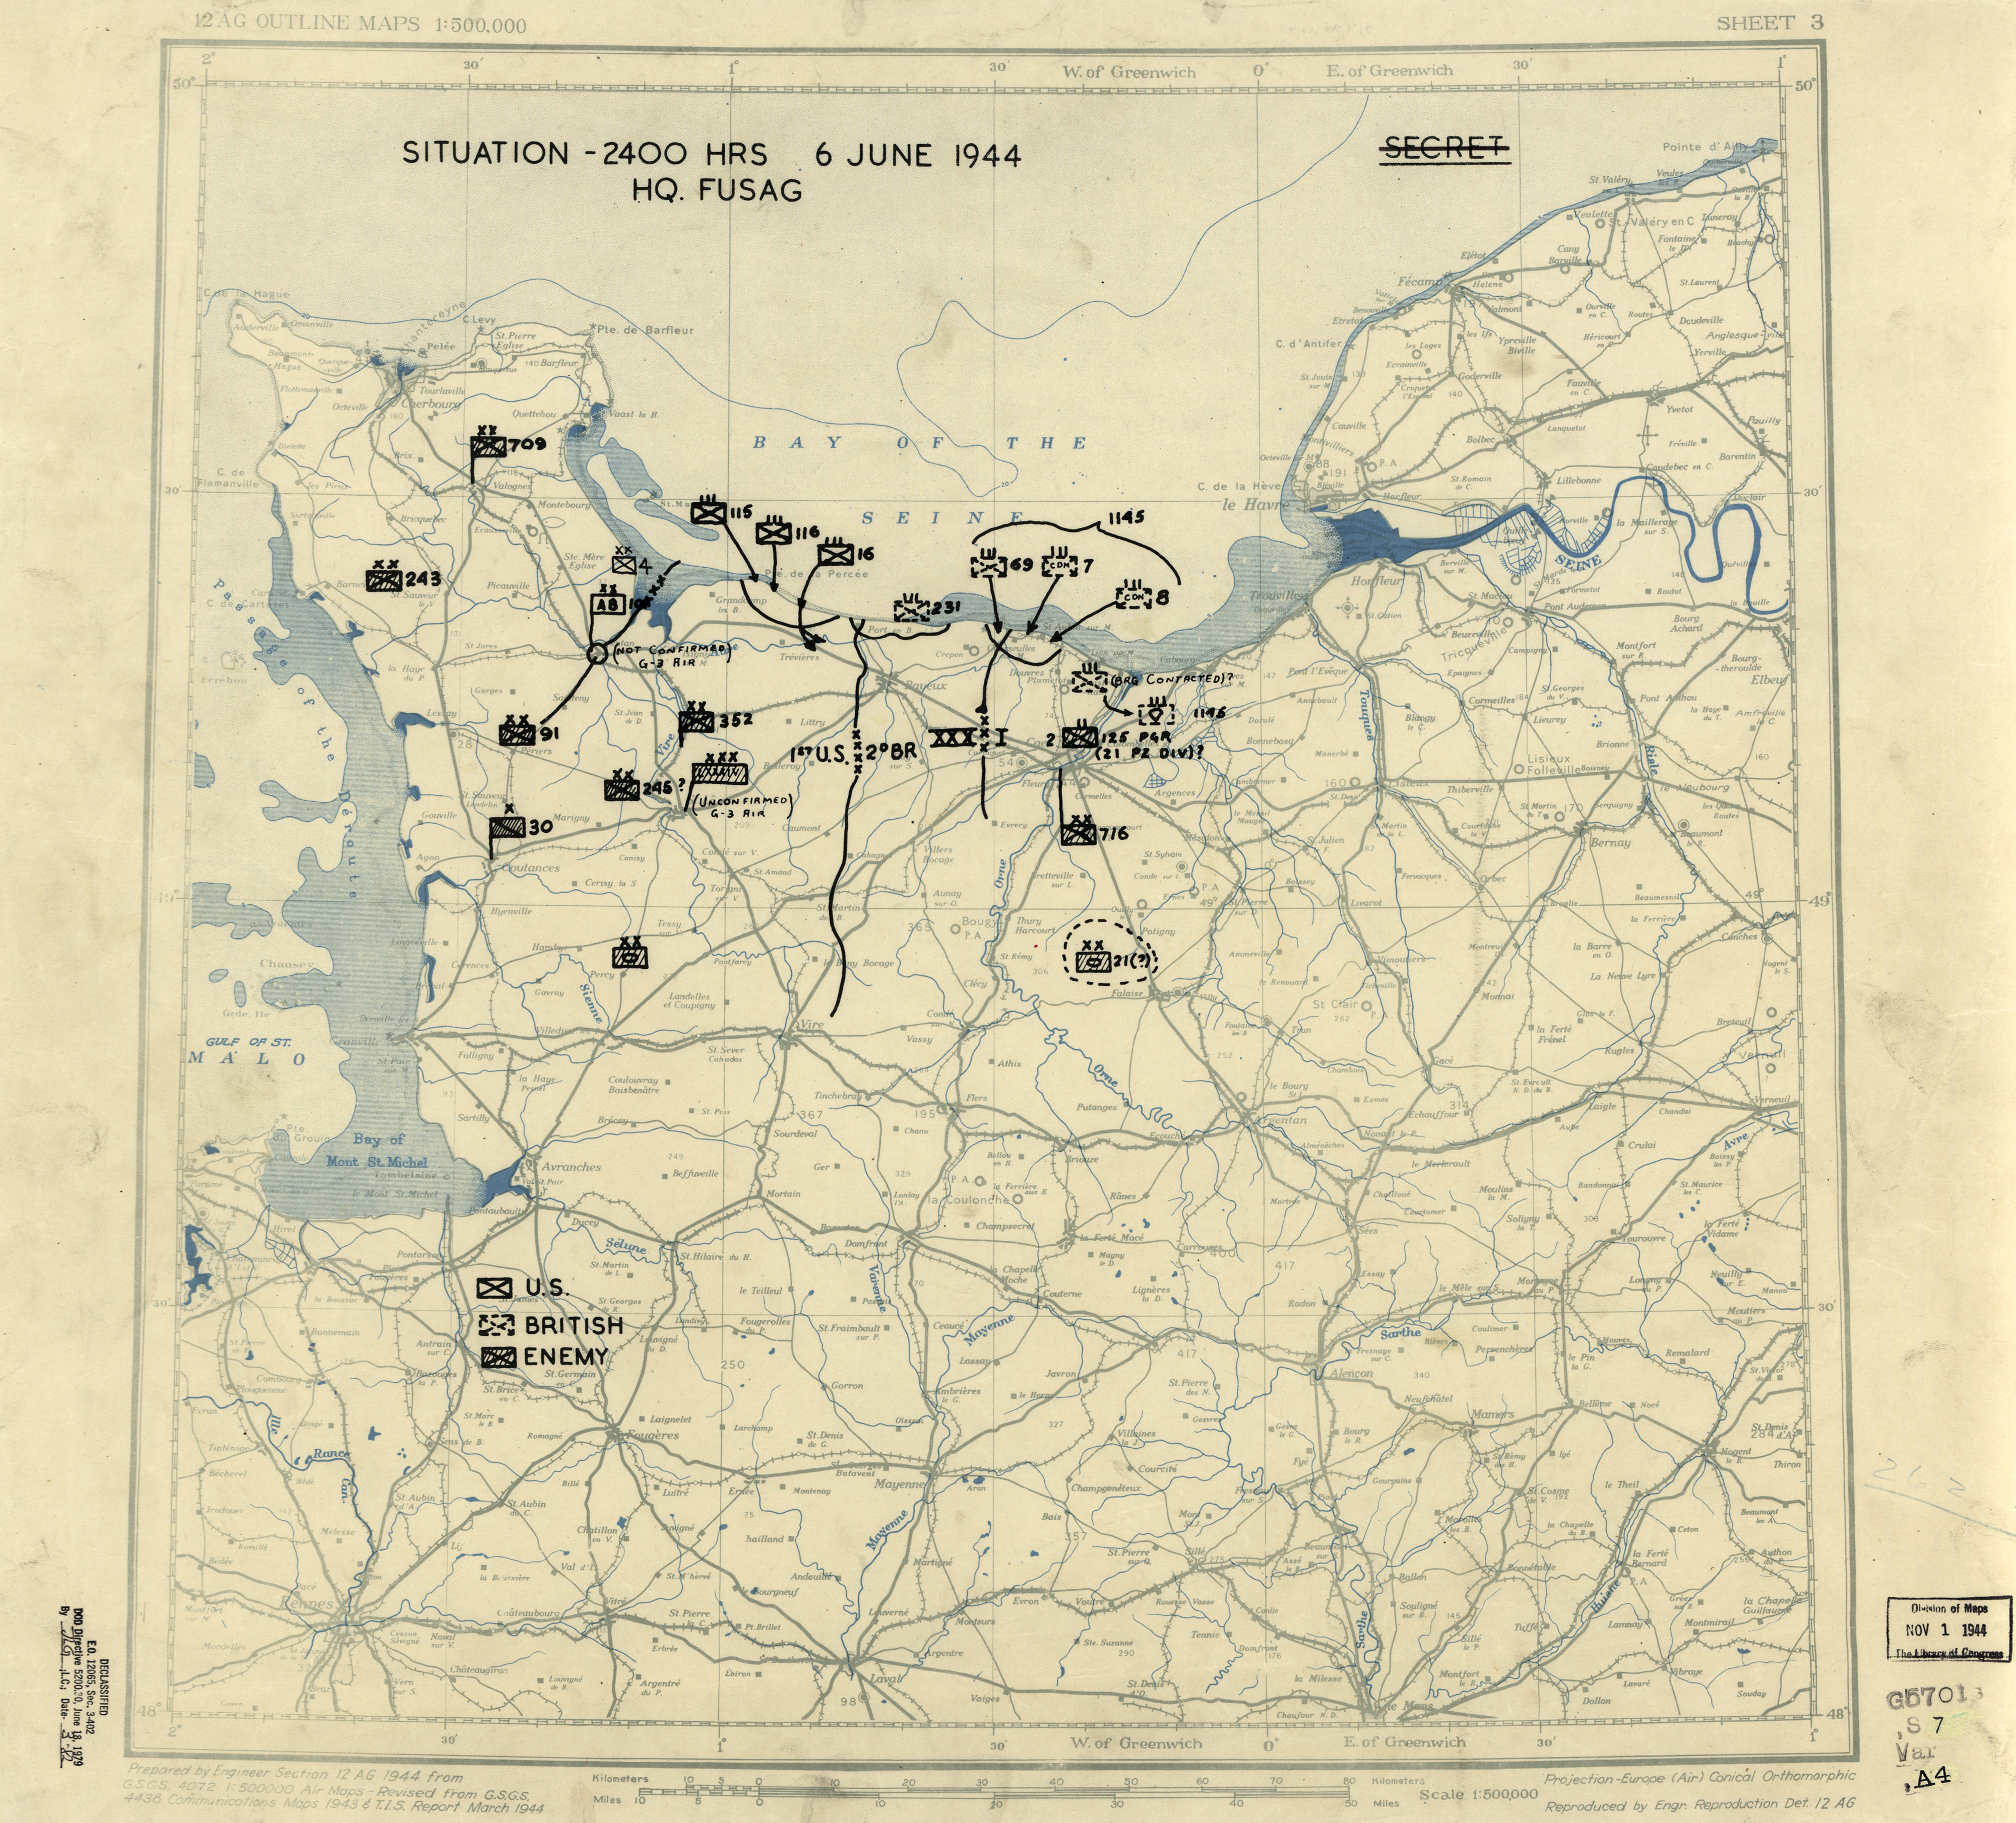
Situation room
Official U.S. 12th army position map at 2400 hours on D-Day.

Slide 11
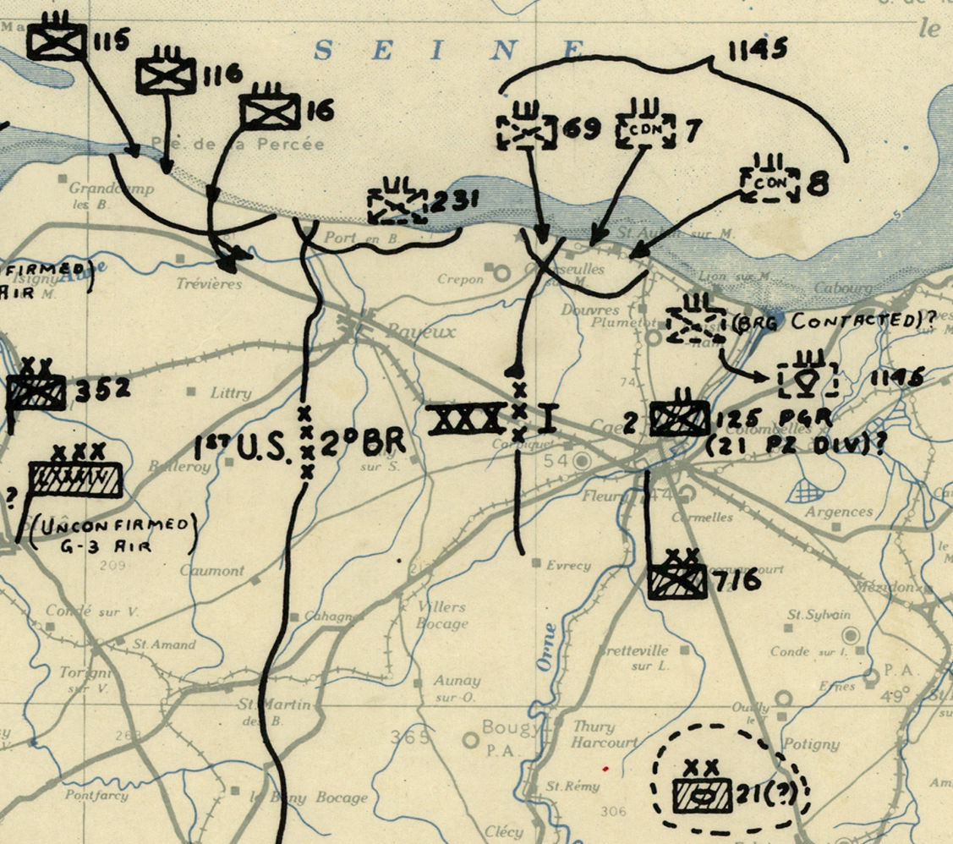
Situation room
Official U.S. 12th army position map at 2400 hours on D-Day.

Slide 12
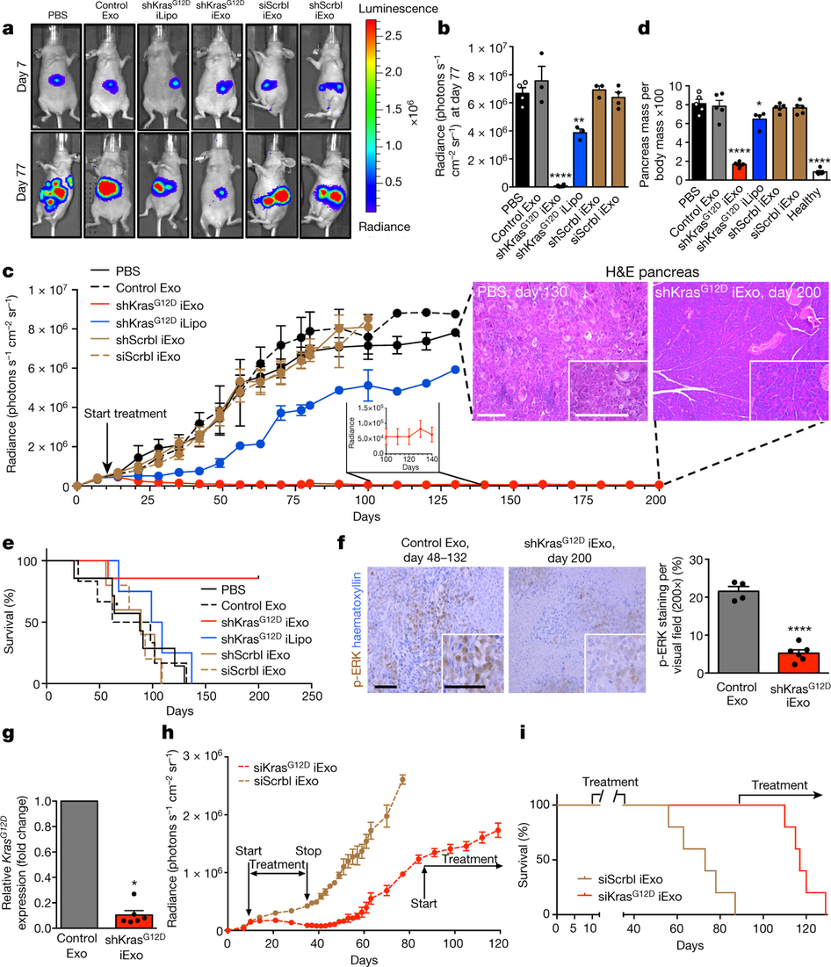
High-gloss science
Kamerkar (2017). Exosomes facilitate therapeutic targeting of oncogenic KRAS in pancreatic cancer. Nature.

Slide 13
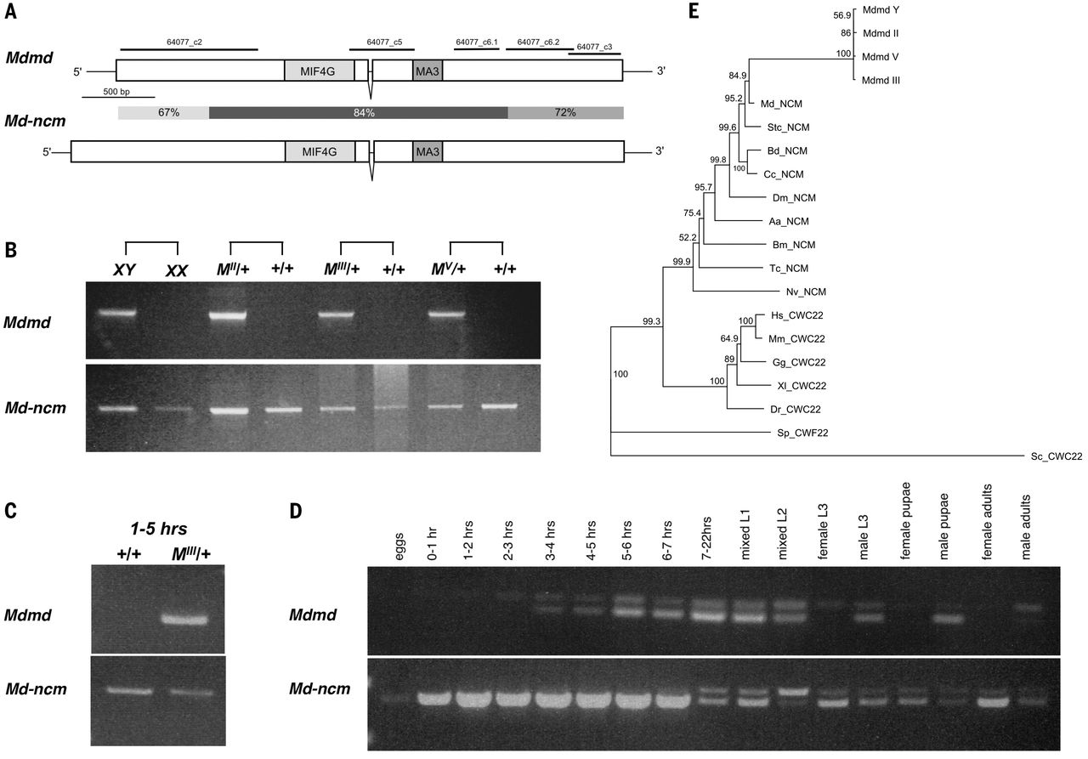
Molecular biology
Sharma etal. (2017). Male sex in houseflies is determined by Mdmd, a paralog of the generic splice factor gene CWC22. Science, 356(6338), pp. 642-645.

Slide 14
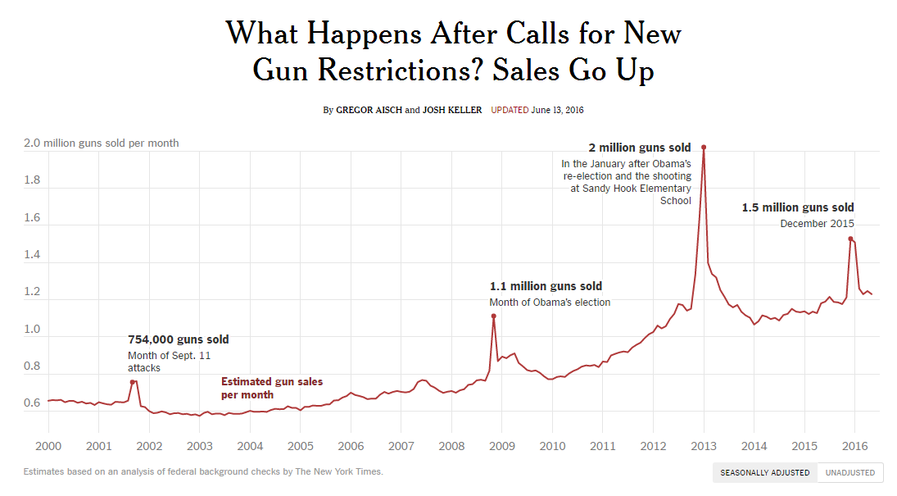
News graphics
Gregor Aisch and Josh Keller (2016). What Happens After Calls for New Gun Restrictions? Sales Go Up. New York Times.

Slide 15
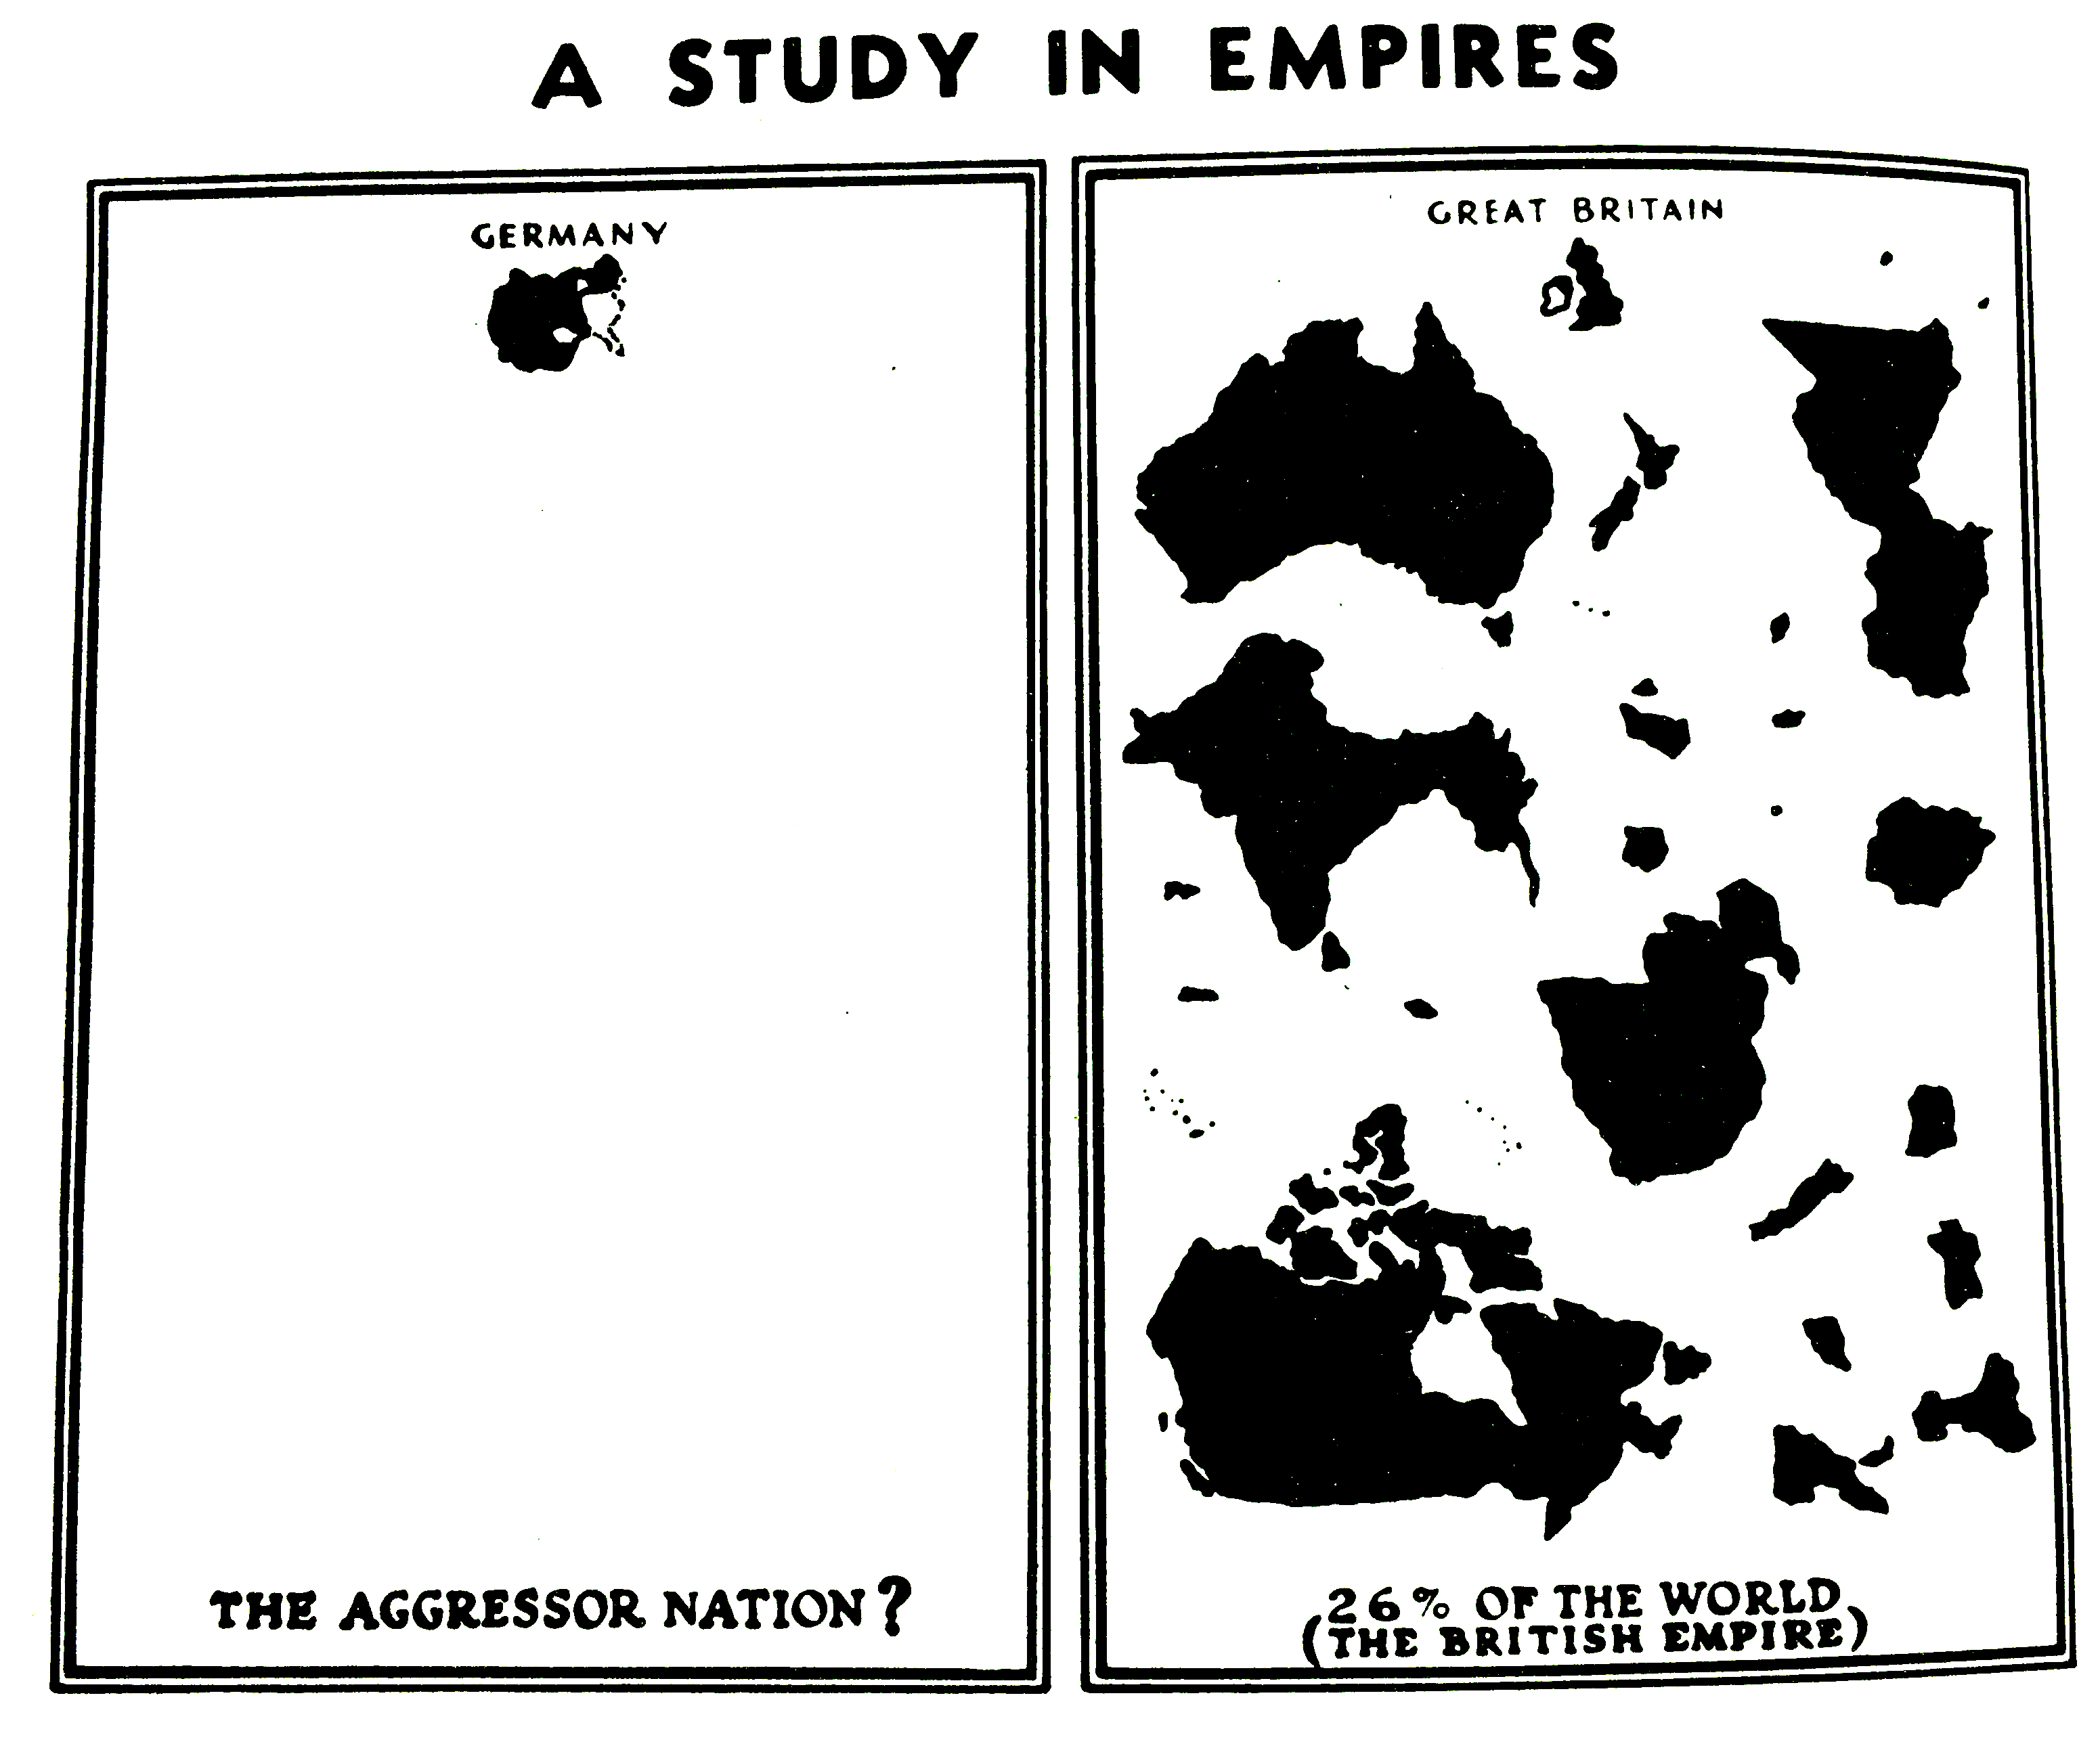
Propaganda
German Library of Information (1940). A study in empires. Facts in Review 2 (5).
Reprinted in Monmonier (1996). How to Lie with Maps.

Slide 16
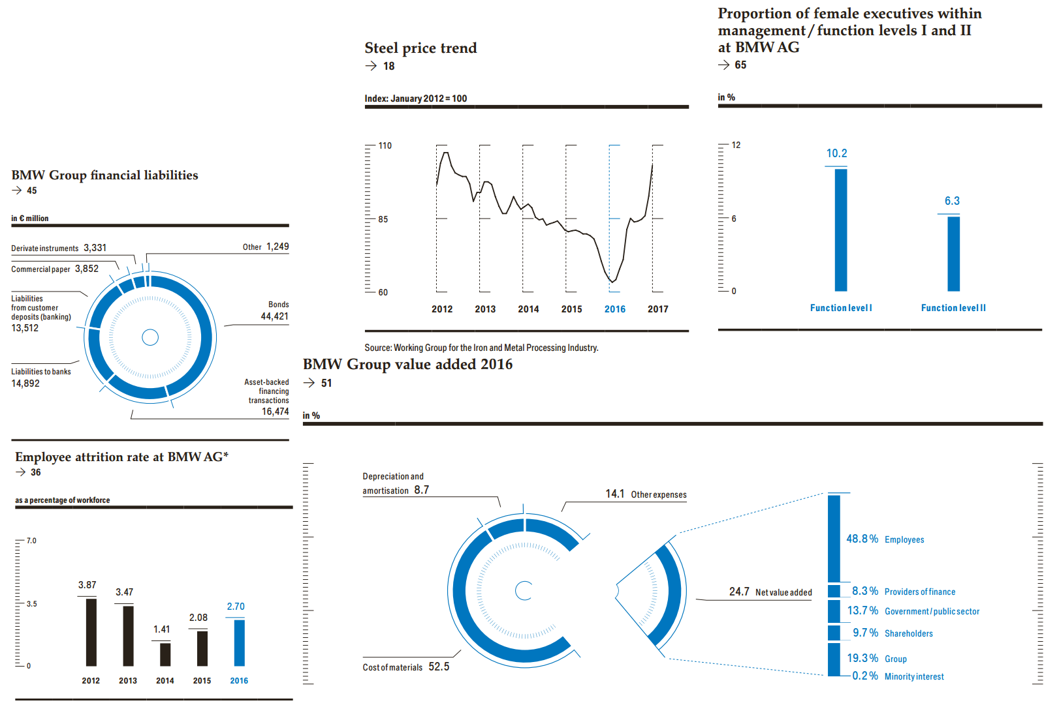
The executive report
BMW Group (2016). Annual report 2016.
[excerpt].

Slide 17
Visualization design goals

Slide 18
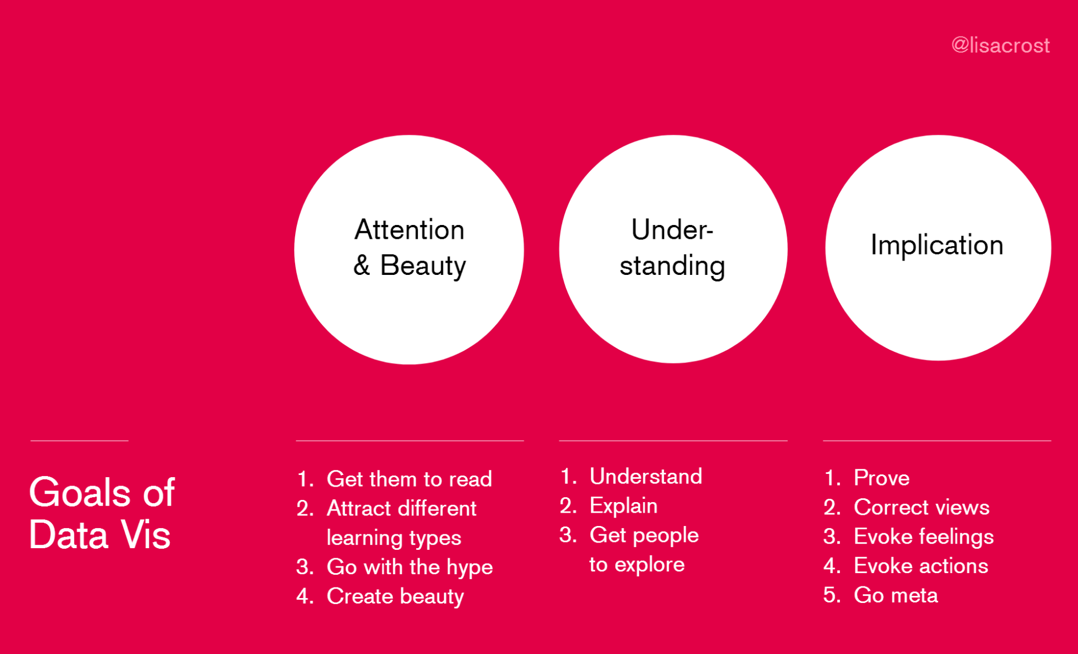
General goals
Rost (2017). Why do we visualize data? INCH conference presentation.

Slide 19
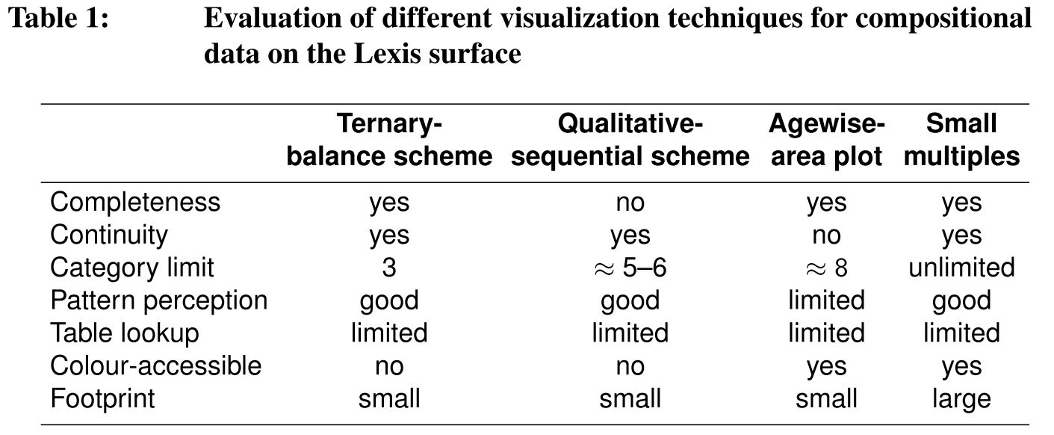
Specific goals
Schöley & Willekens (2017). Visualizing compositional data on the Lexis surface.

Slide 20
Clarity & effectiveness

Slide 21
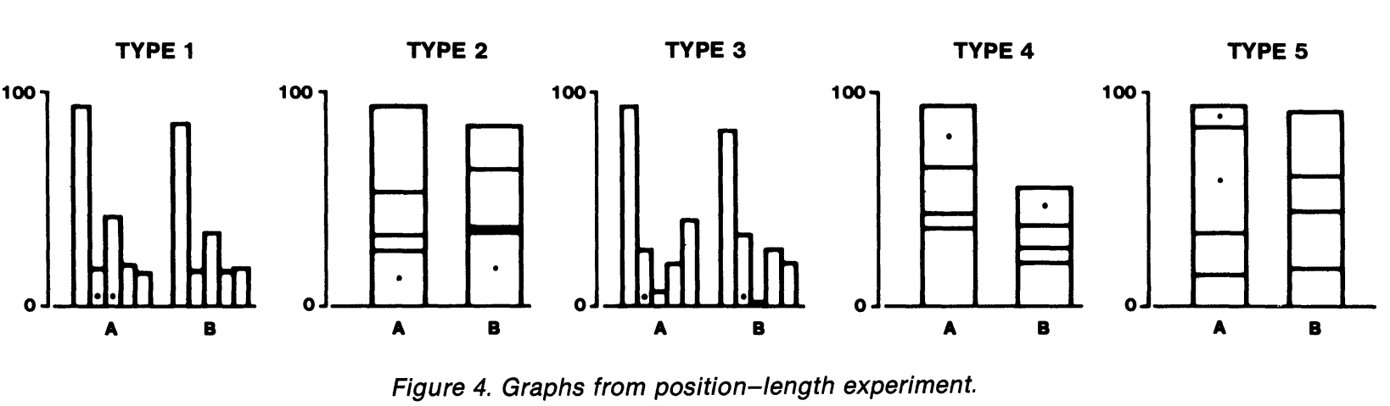
Testable hypothesis in viz research
Cleveland, W. S., & McGill, R. (1984). Graphical Perception: Theory, Experimentation, and Application to the Development of Graphical Methods. Journal of the American Statistical Association, 79(387), 531.

Slide 22
Attention & Engagement

Slide 23
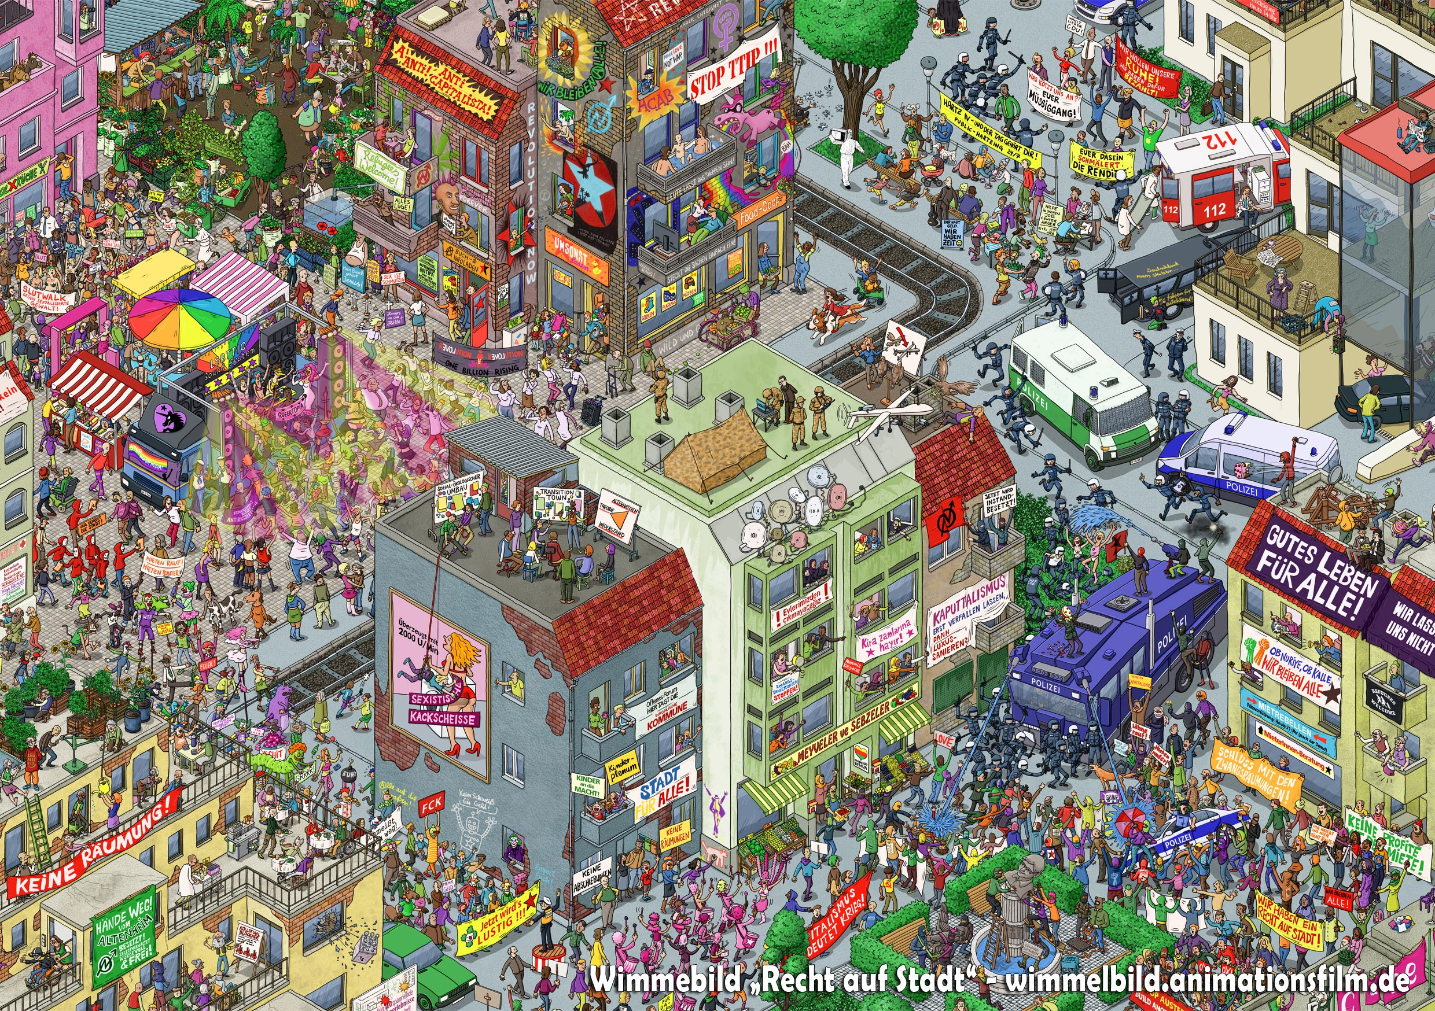
“Wimmelbilder”
Markus Wende (2016). Wimmelbild “Recht auf Stadt” [cutout].

Slide 24
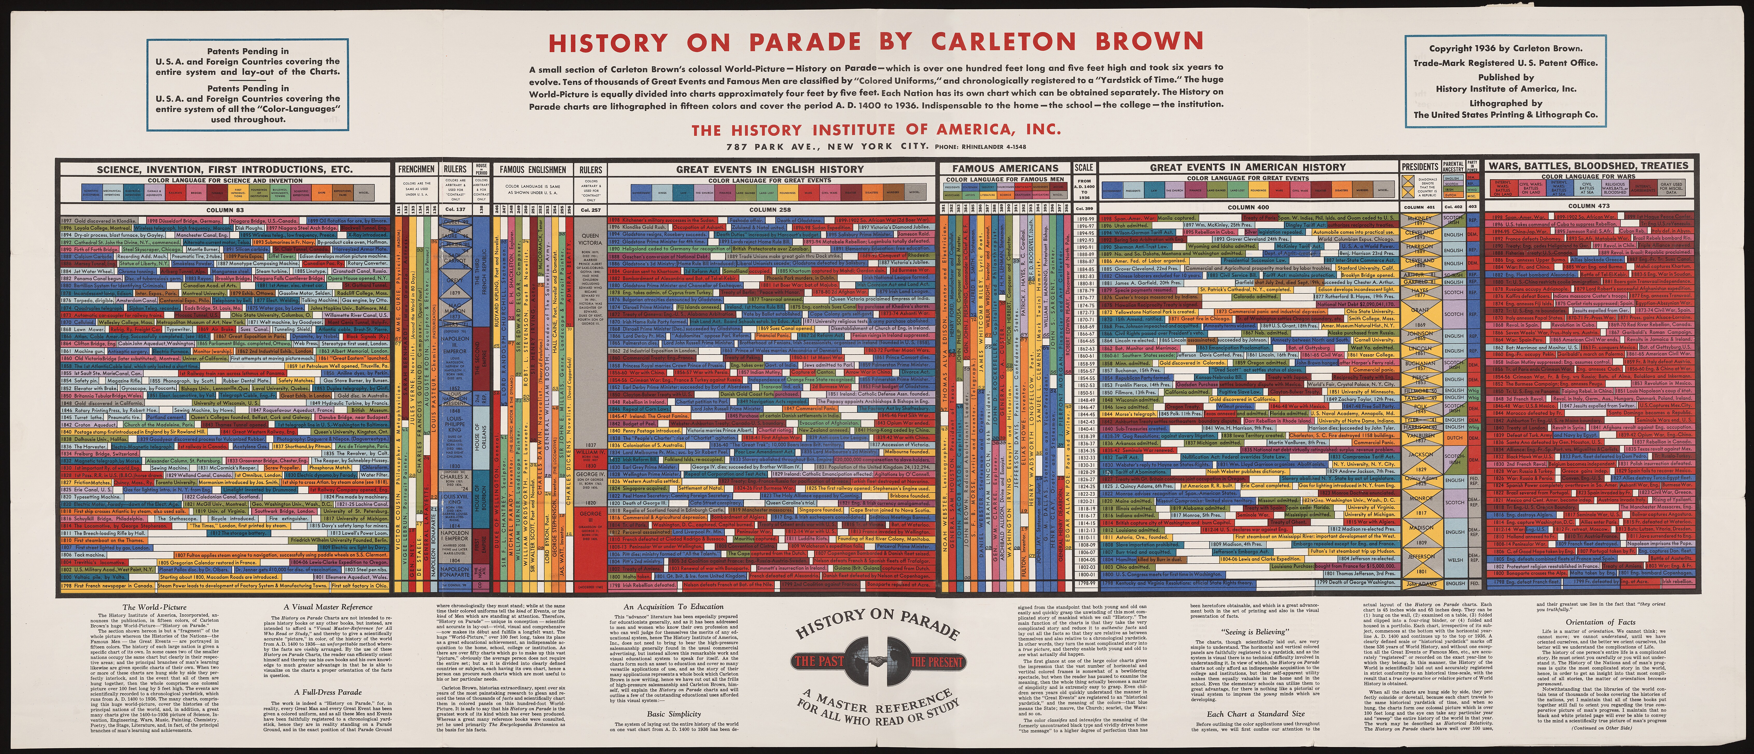
Macro view
Carleton Brown (1936). History on parade by Carleton Brown. History Institute of America, Inc.

Slide 25
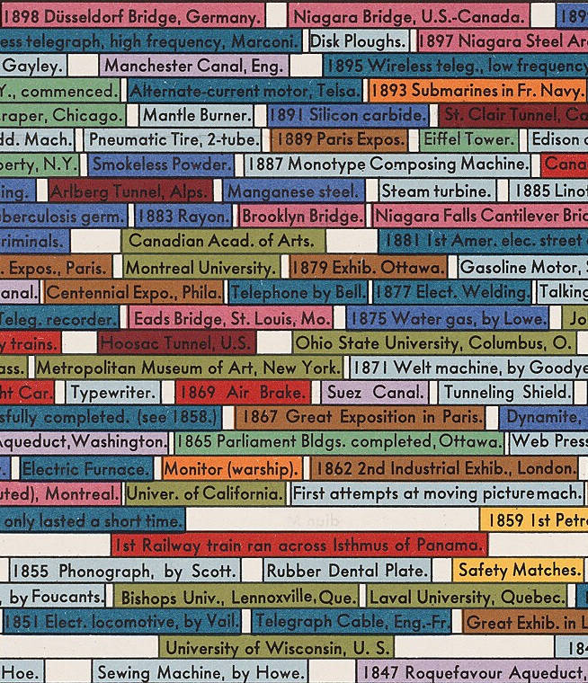
Micro view
Carleton Brown (1936). History on parade by Carleton Brown. History Institute of America, Inc.

Slide 26
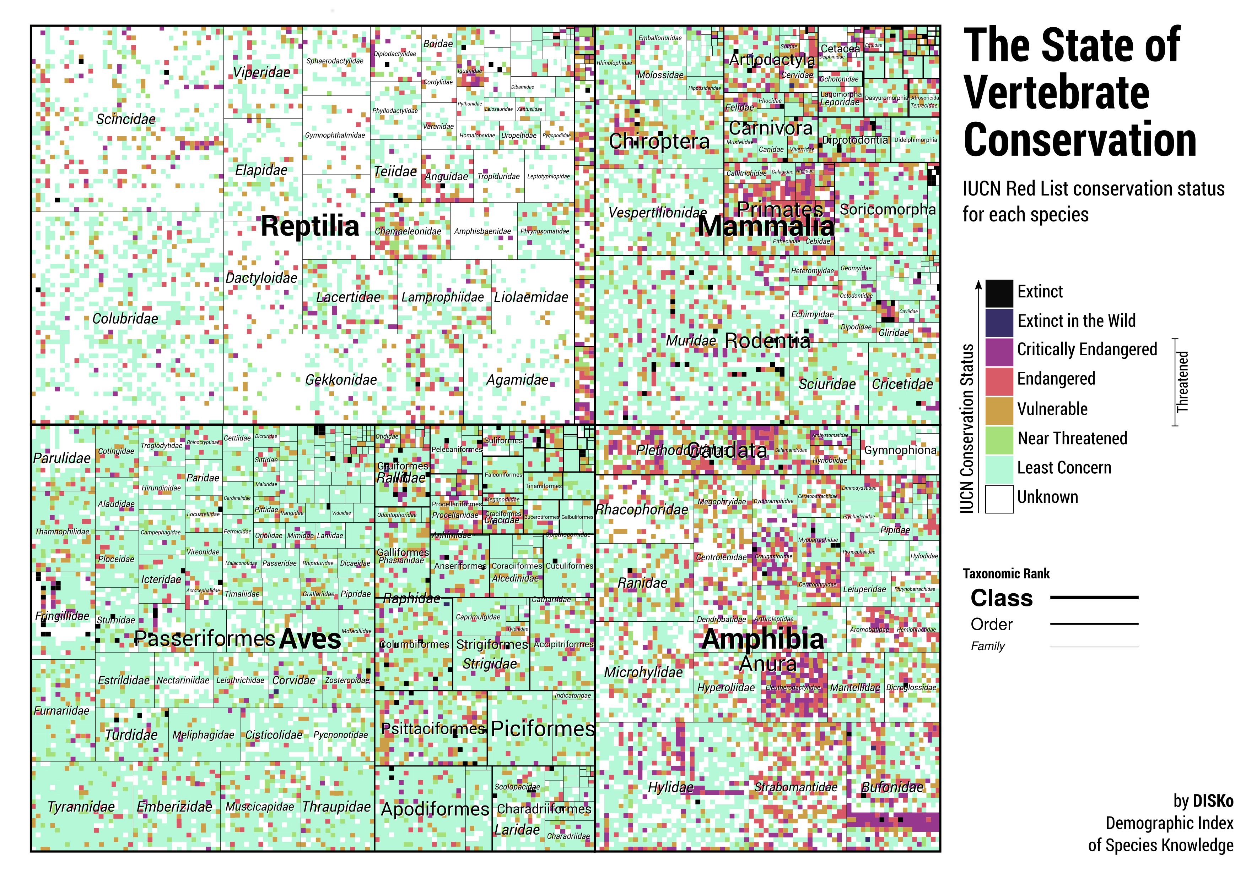
Macro view

Slide 27
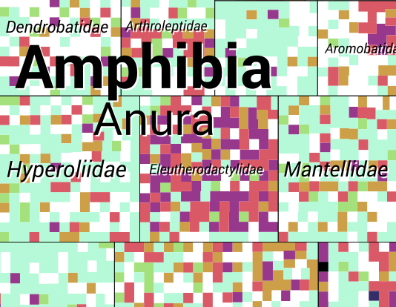
Micro view

Slide 28
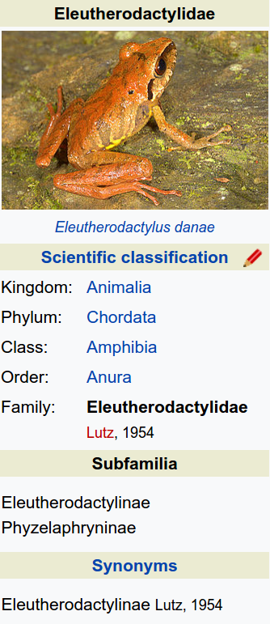
Micro-micro view (drill down)
en.wikipedia.org/wiki/Eleutherodactylidae

Slide 29
Precision

Slide 30
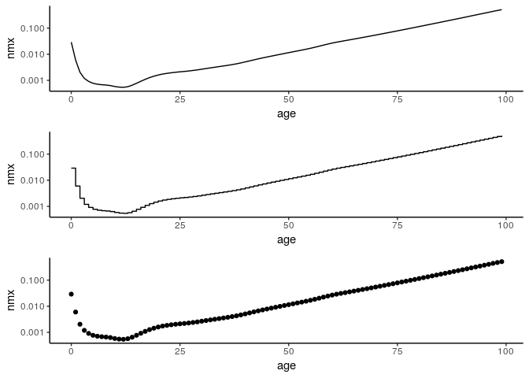
Are those the same?

Slide 31
Truthfulness, persuasion
Truthful persuasion?

Slide 32
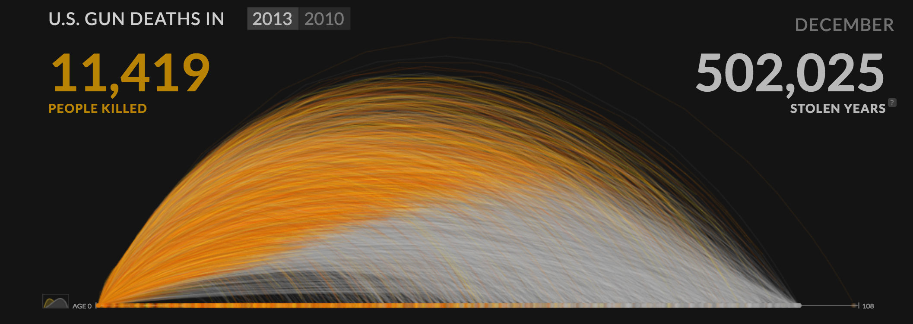
Micro data, intuitive units
http://guns.periscopic.com/

Slide 33
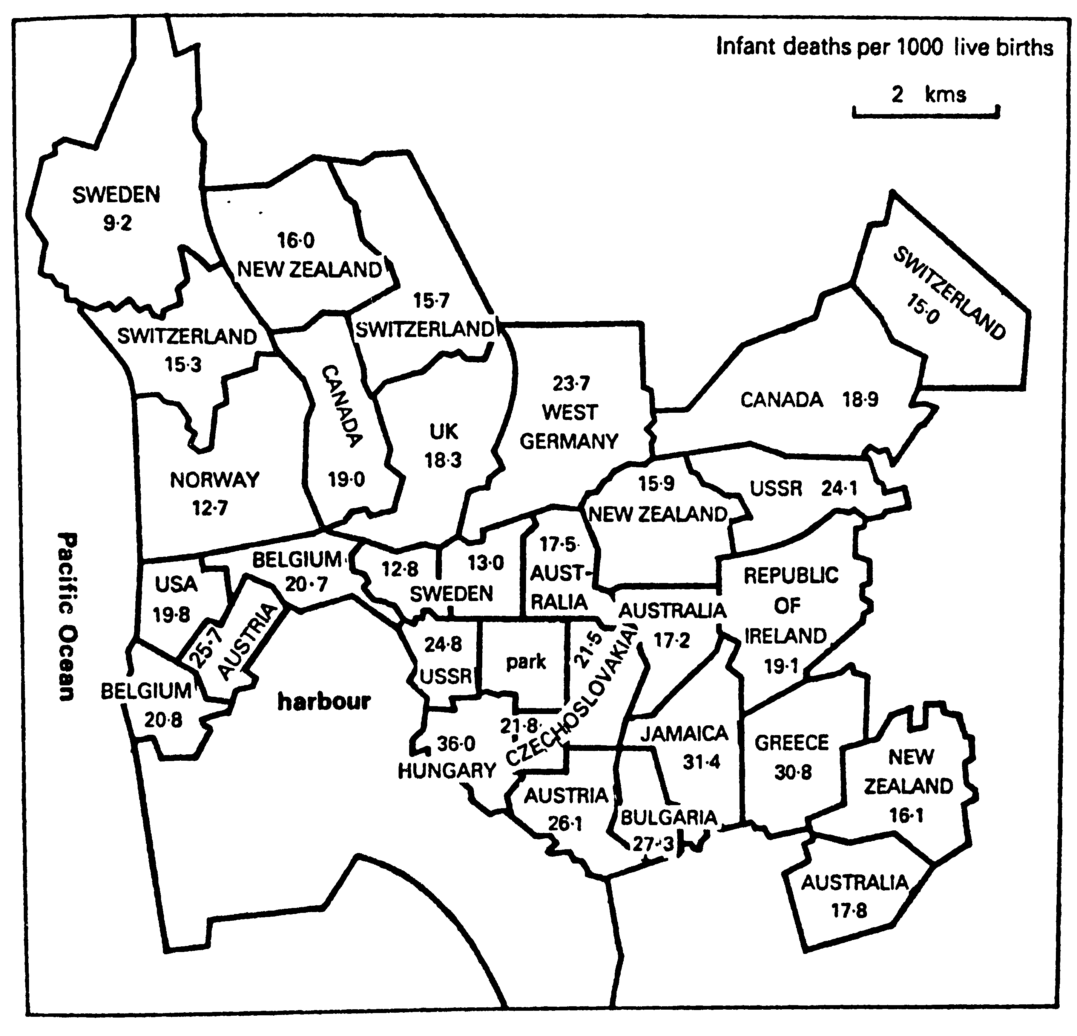
Intuitive comparisons
Infant mortality rates for parts of
San Diego, California expressed in national rates of comparable nations.
Monmonier (1996). How to lie with maps.

Slide 34
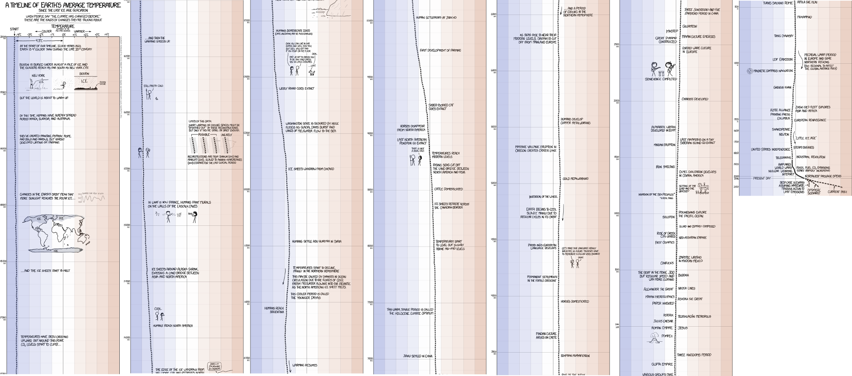
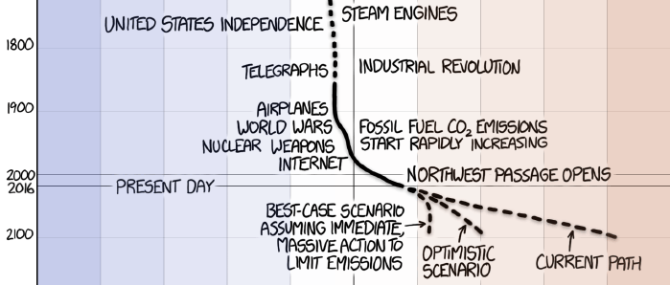
Overwhelm with data, make relevant comparisons
https://xkcd.com/1732/

Slide 35
Competing design goals

Slide 36
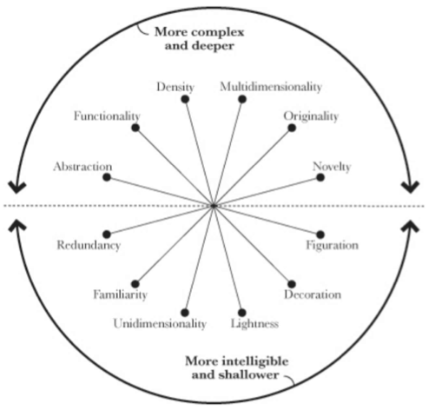
Trade-off in viz design
Cairo, A. (2012). The Functional Art.

Slide 37
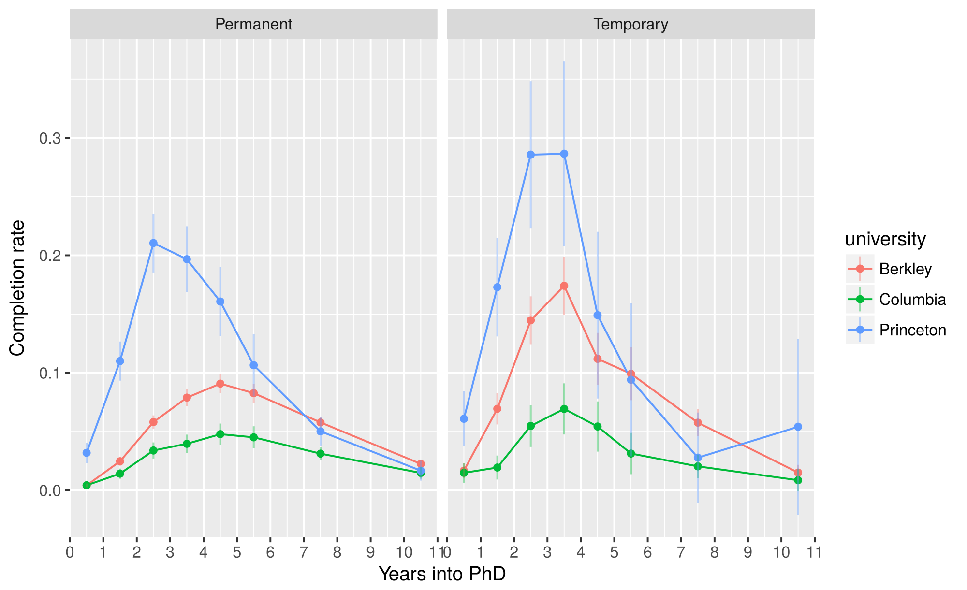
Precision versus clarity

Slide 38
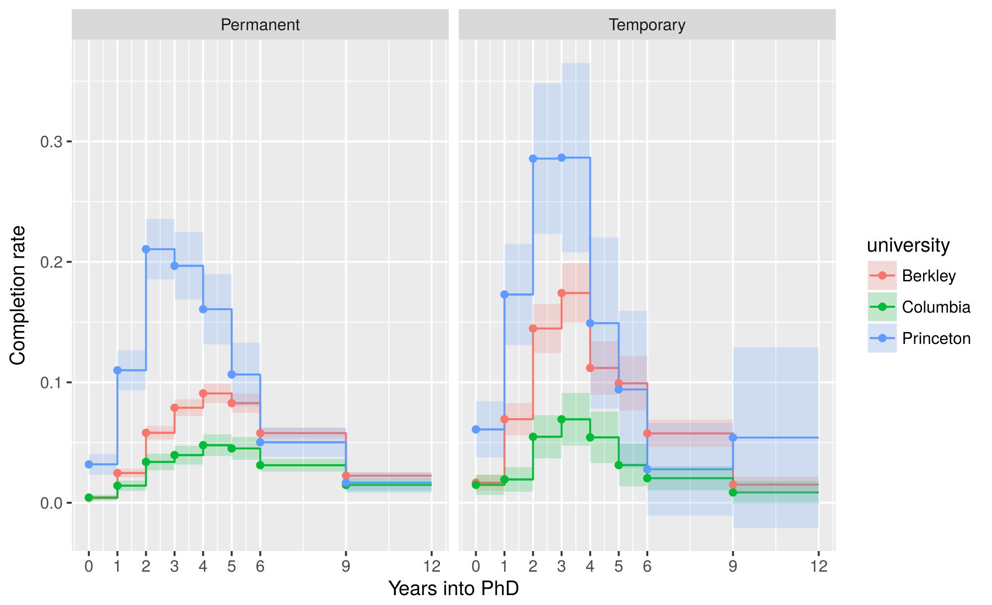
Precision versus clarity

Slide 39
Precision versus clarity

Slide 40
Engagement & density versus effectiveness

Slide 41
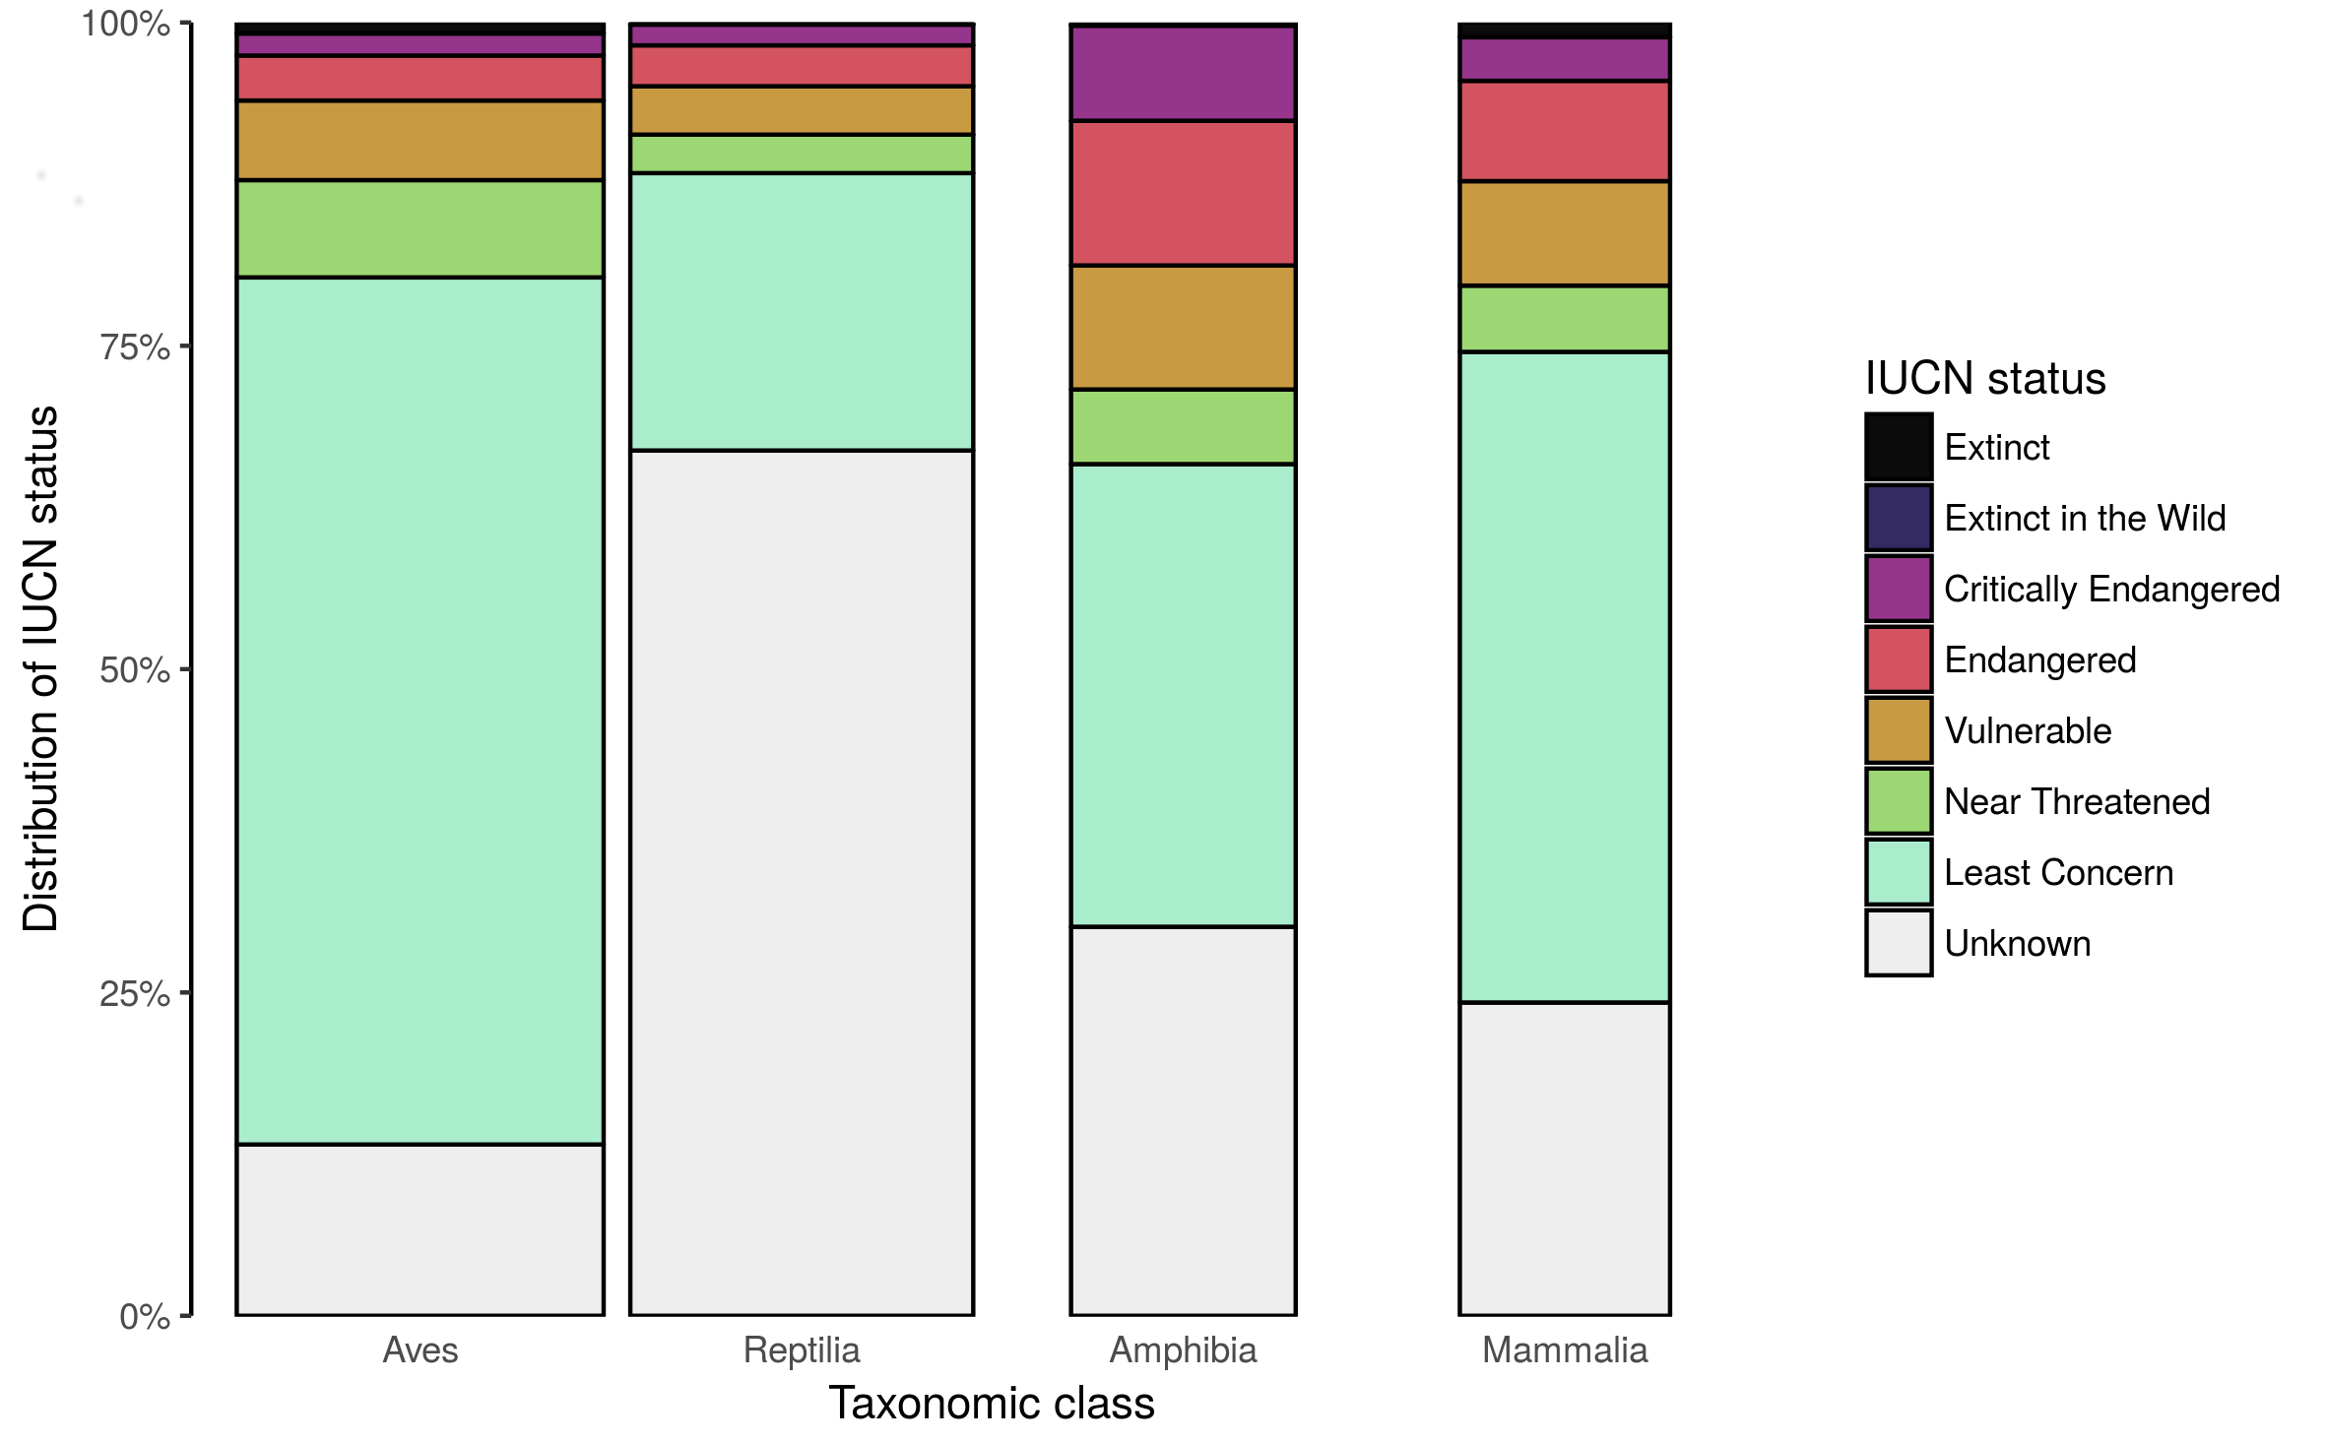
Engagement & density versus effectiveness

Slide 42
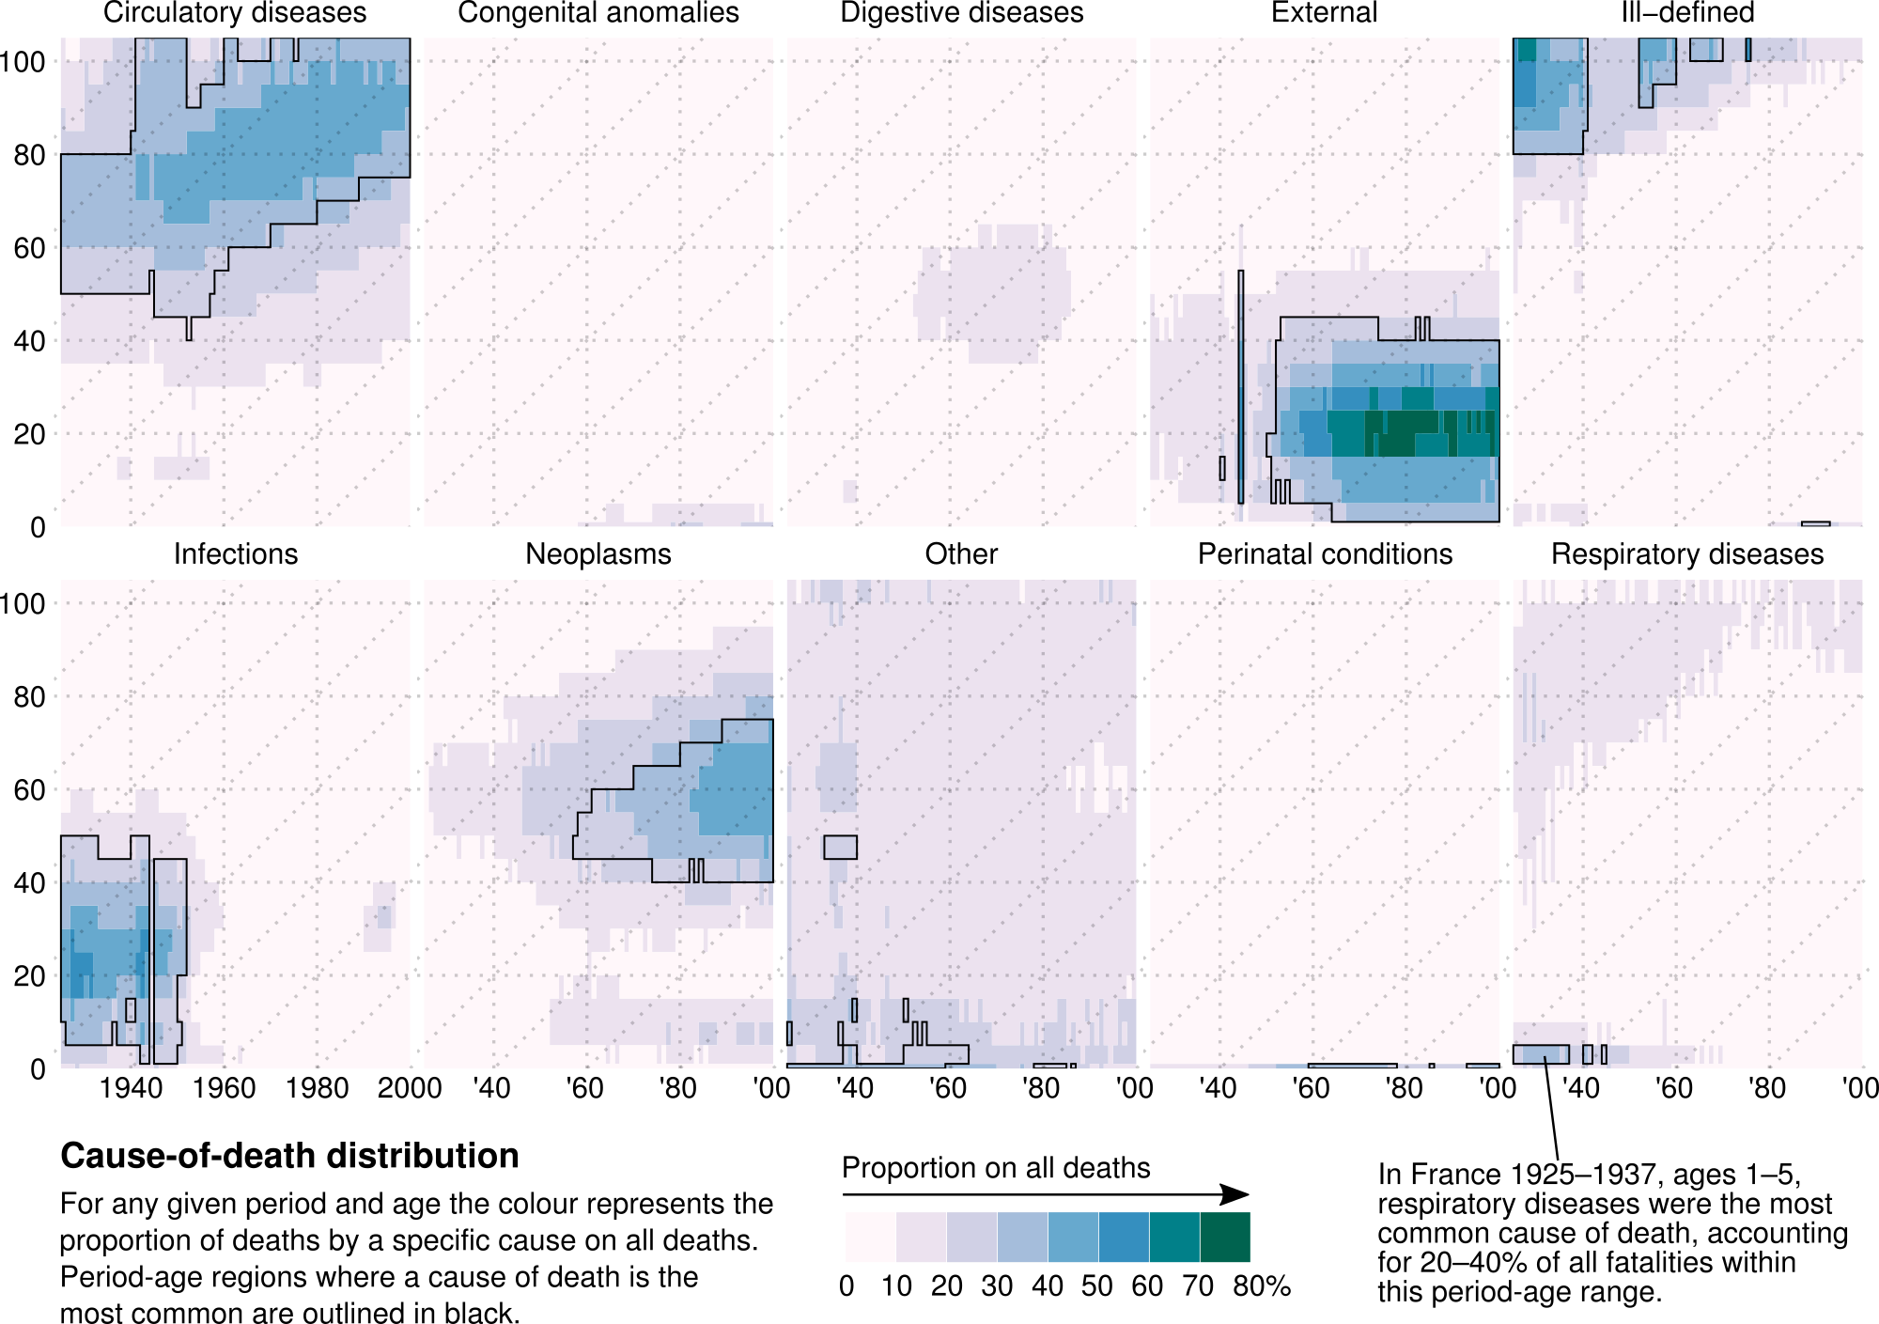
4 plots of the same data
Schöley & Willekens (2017). Visualizing compositional data on the Lexis surface.

Slide 43
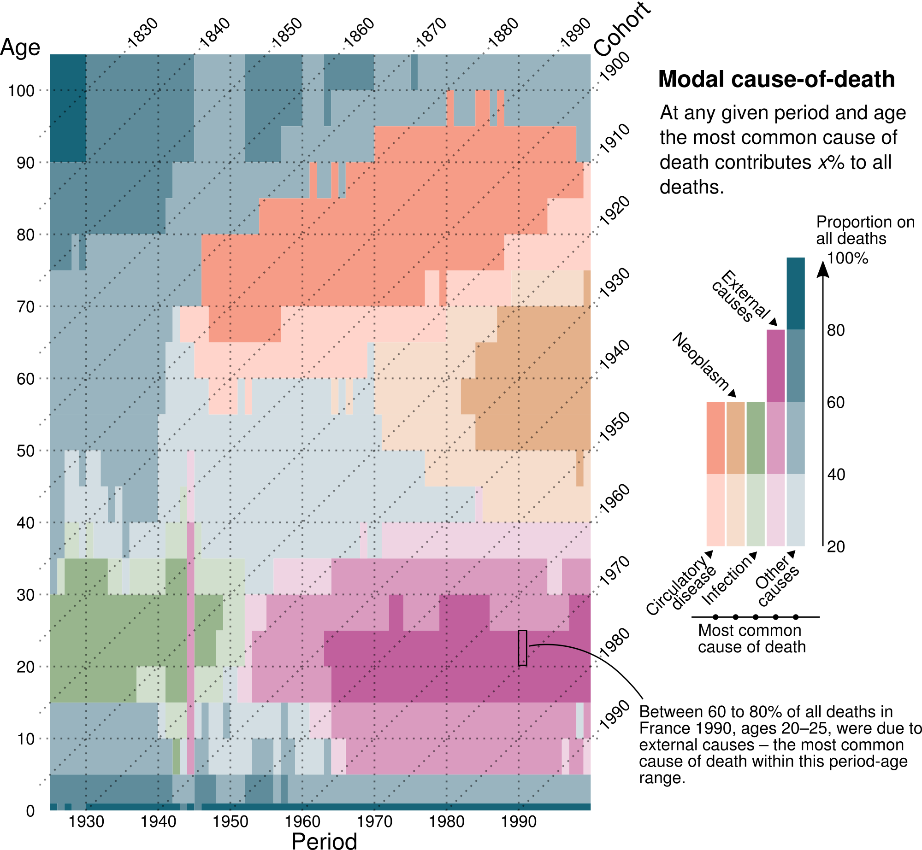
4 plots of the same data
Schöley & Willekens (2017). Visualizing compositional data on the Lexis surface.

Slide 44
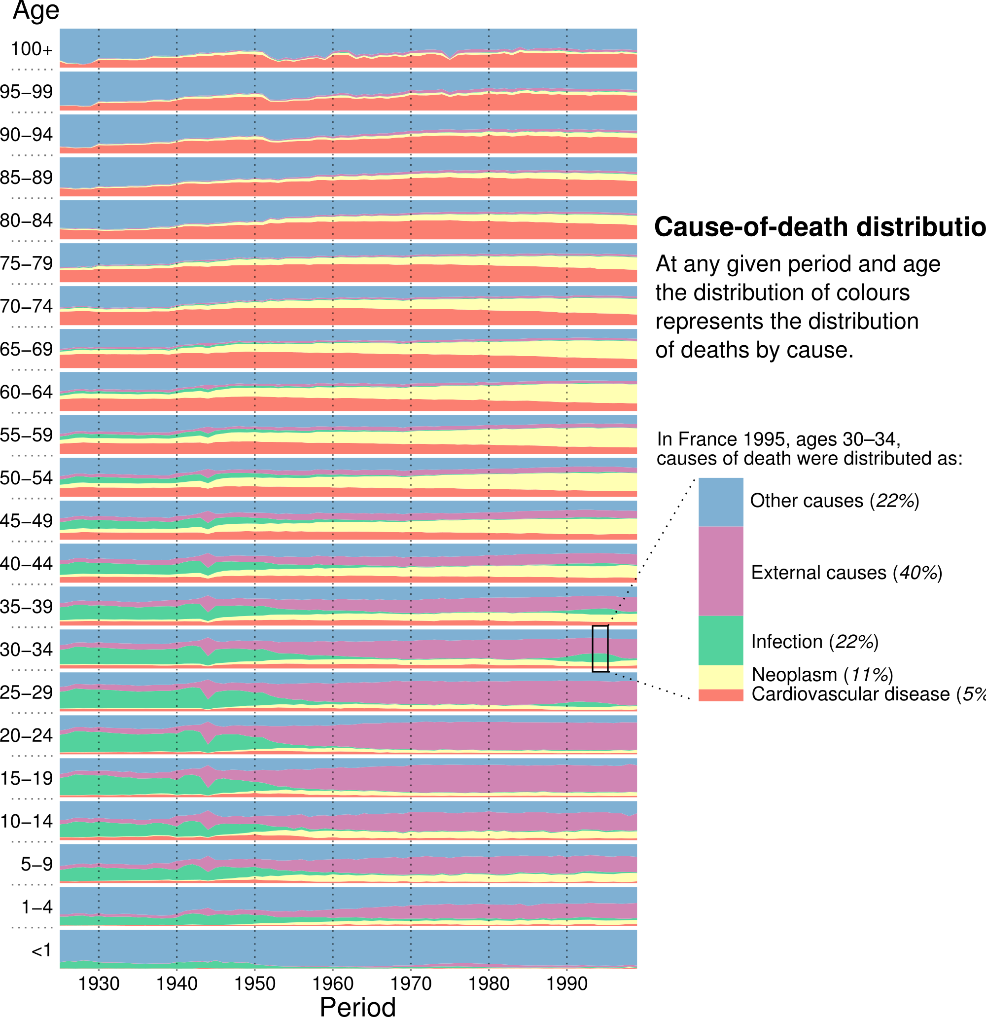
4 plots of the same data
Schöley & Willekens (2017). Visualizing compositional data on the Lexis surface.

Slide 45
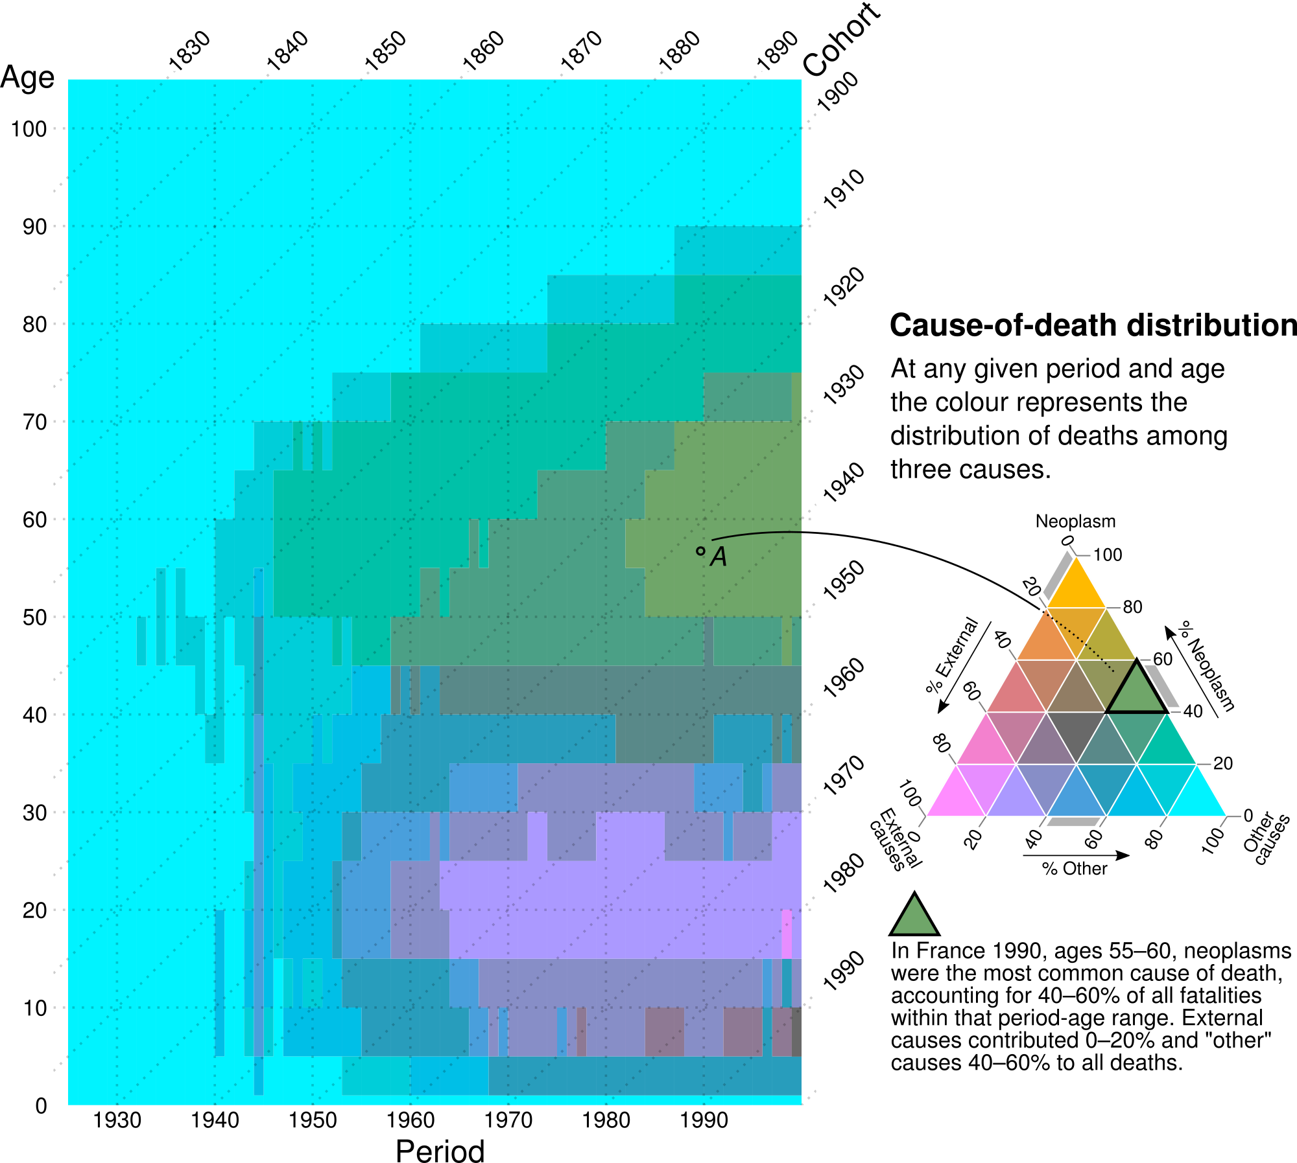
4 plots of the same data
Schöley & Willekens (2017). Visualizing compositional data on the Lexis surface.

Slide 46
Design for your audience

Slide 47
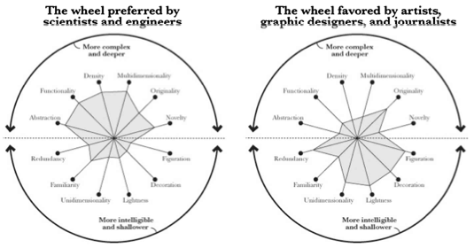
Different audience, different priorities
Cairo, A. (2012). The Functional Art.

Slide 48

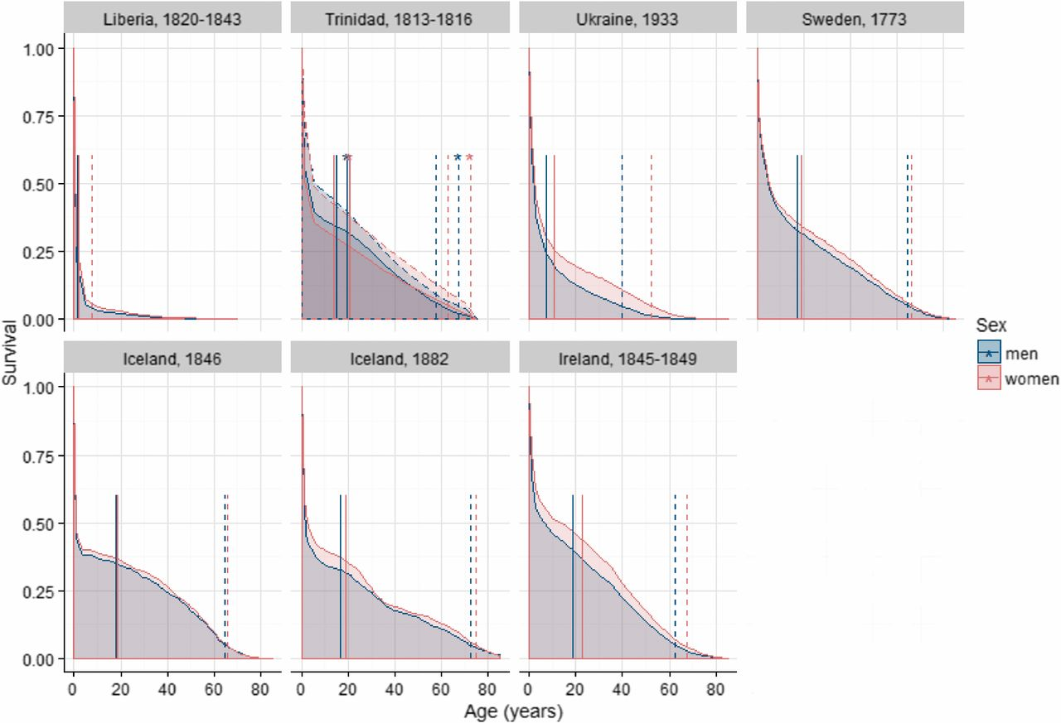
Different audience, different priorities
Zarulli etal. (2017). Women live longer than men even during severe famines and epidemics.

Slide 49
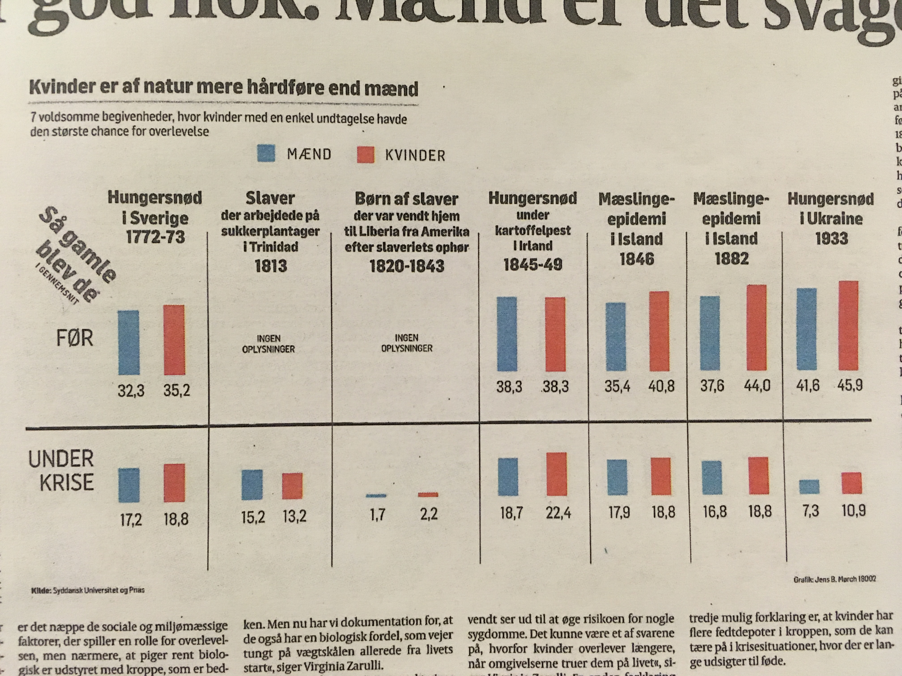

Different audience, different priorities
Politiken (2018). Den er god nok: Mænd er det svage køn.

Slide 50

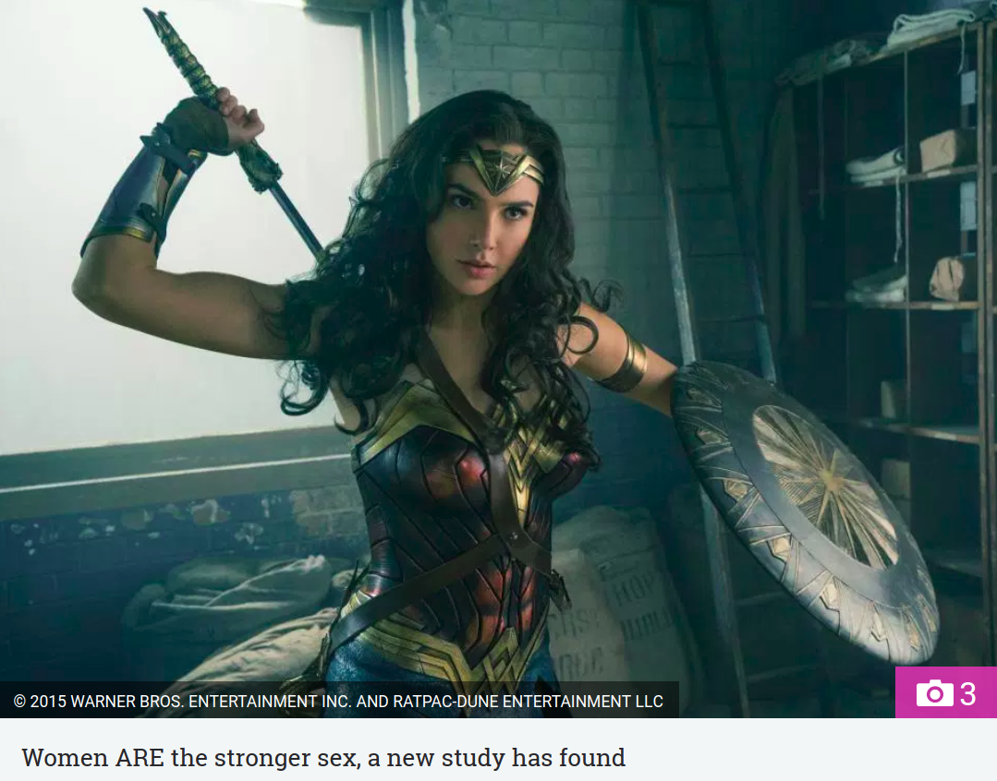
Different audience, different priorities

Slide 51
Design for the medium

Slide 52
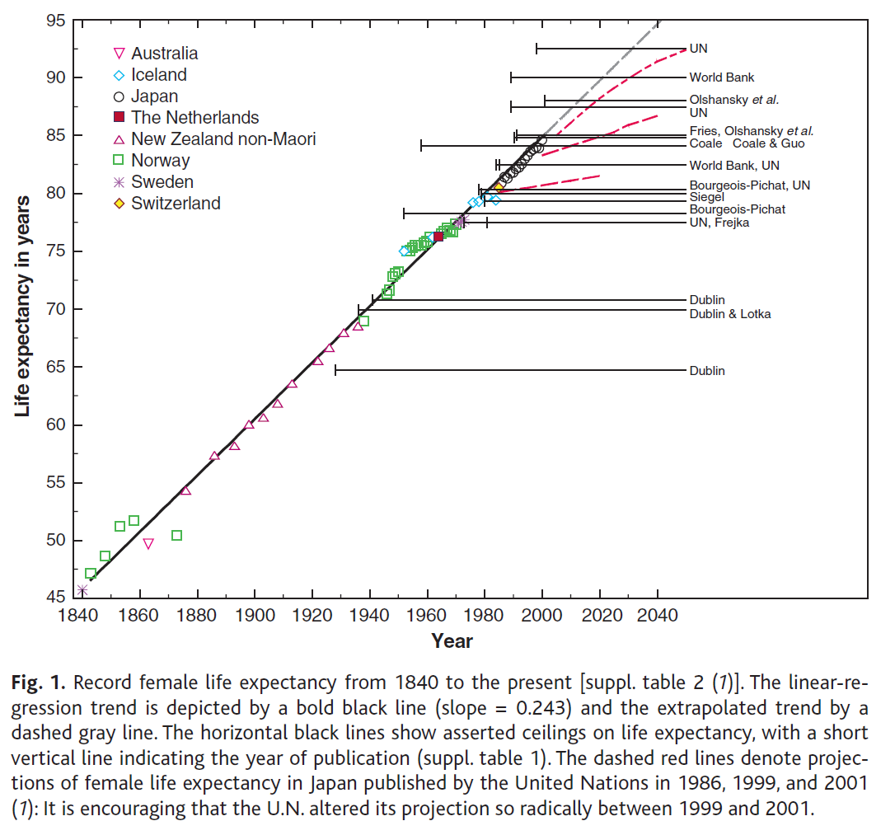
Articles, Presentations, Posters, Tweets...

Slide 53
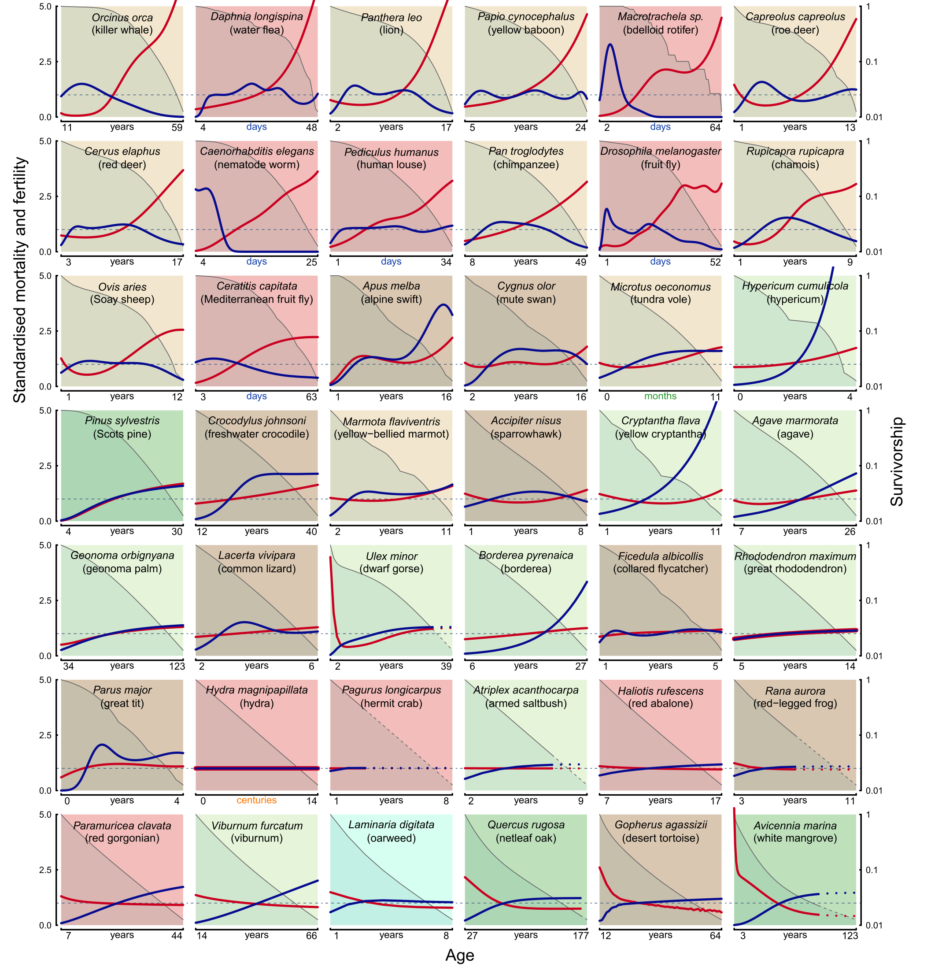
Articles, Presentations, Posters, Tweets...
Jones etal. (2014). Diversity of ageing across the tree of life. [excerpt]

Slide 54
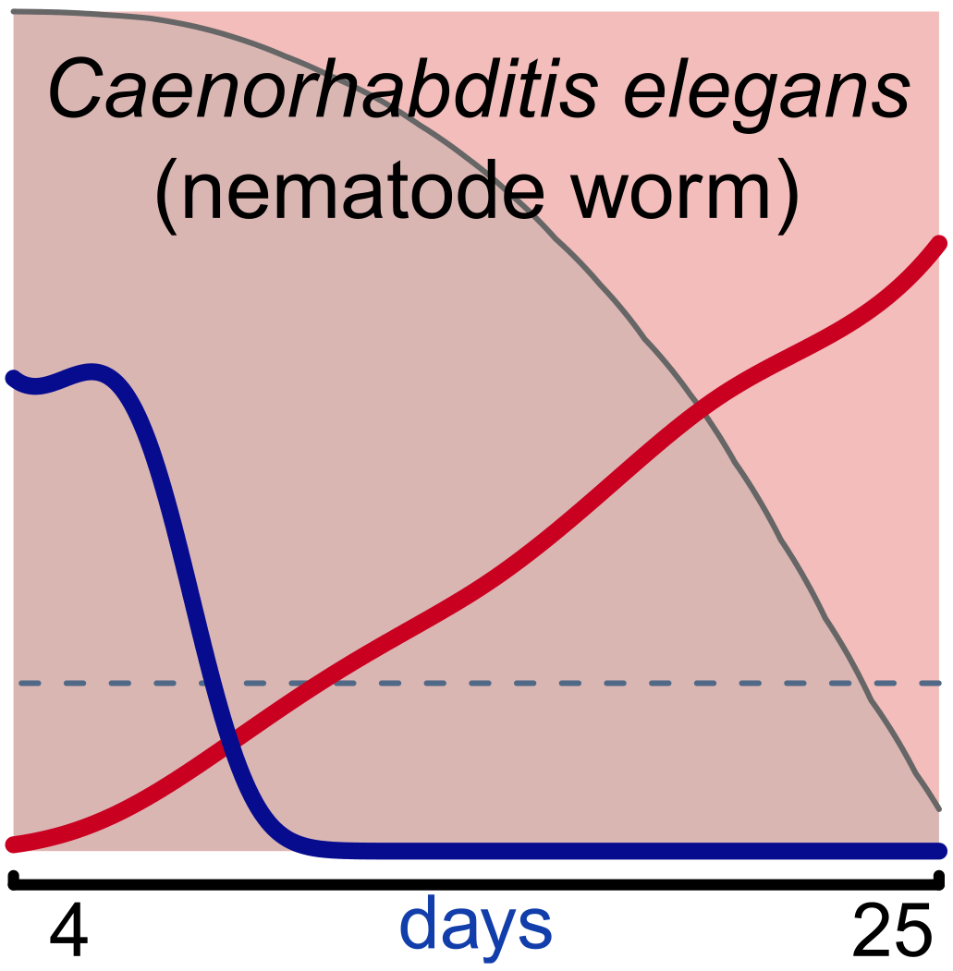
Articles, Presentations, Posters, Tweets...

Slide 55
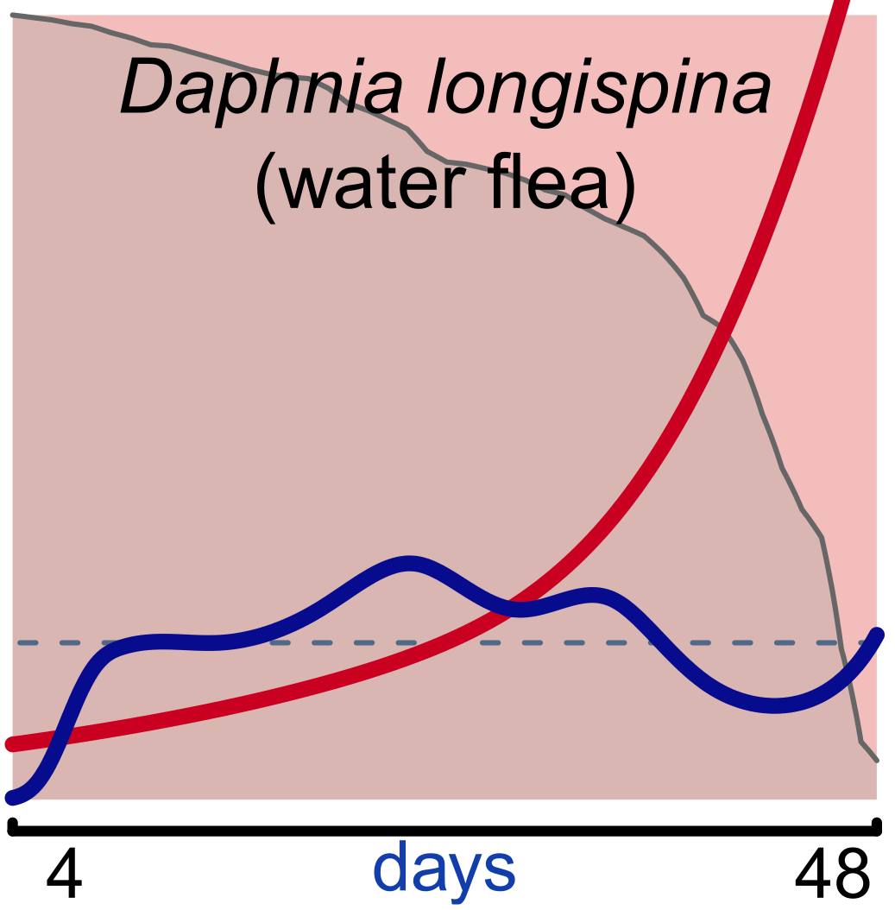
Articles, Presentations, Posters, Tweets...

Slide 56
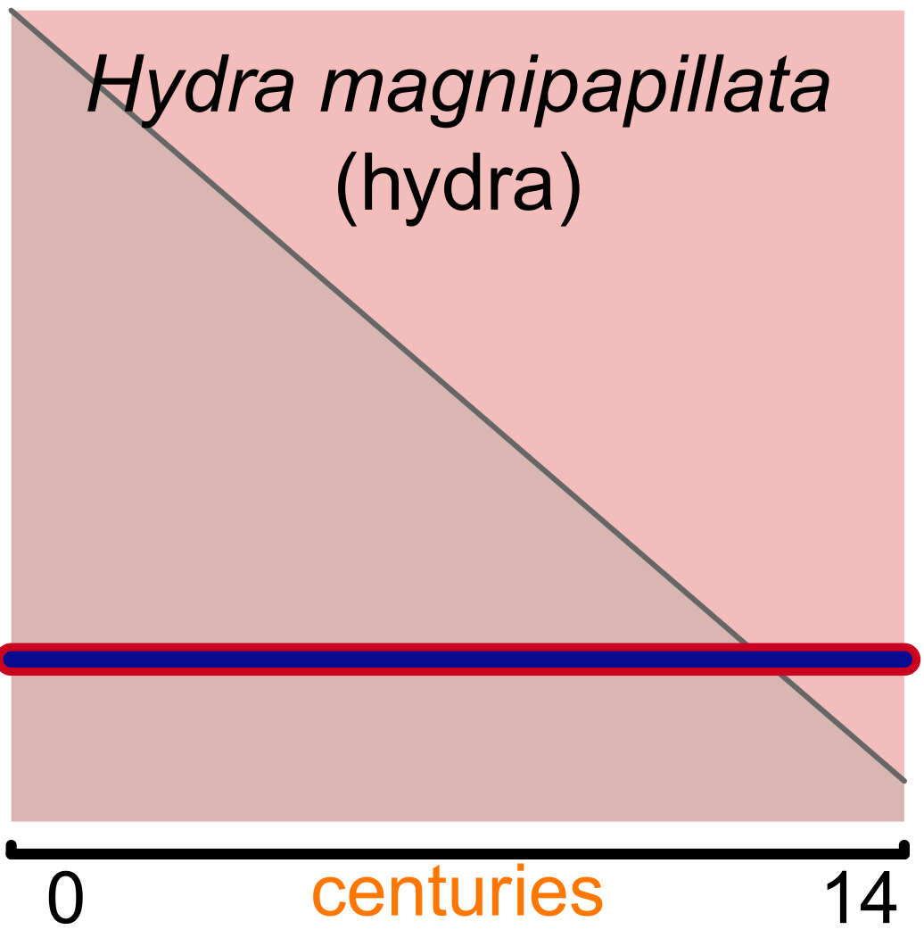
Articles, Presentations, Posters, Tweets...

Slide 57
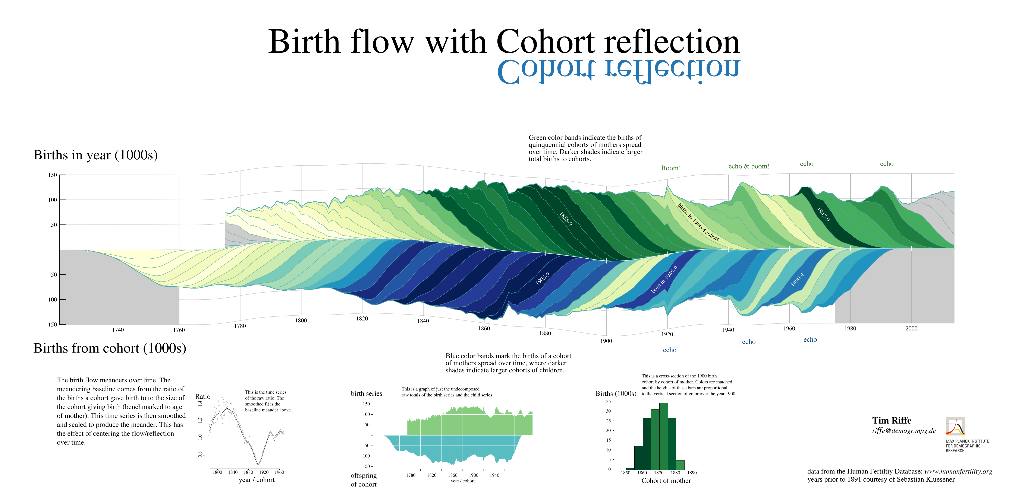
Articles, Presentations, Posters, Tweets...
Tim Riffe (2017). Birth flow with Cohort reflection.

Slide 58
Two useful techniques

Slide 59

Indirect versus direct annotation

Slide 60

Indirect versus direct annotation

Slide 61
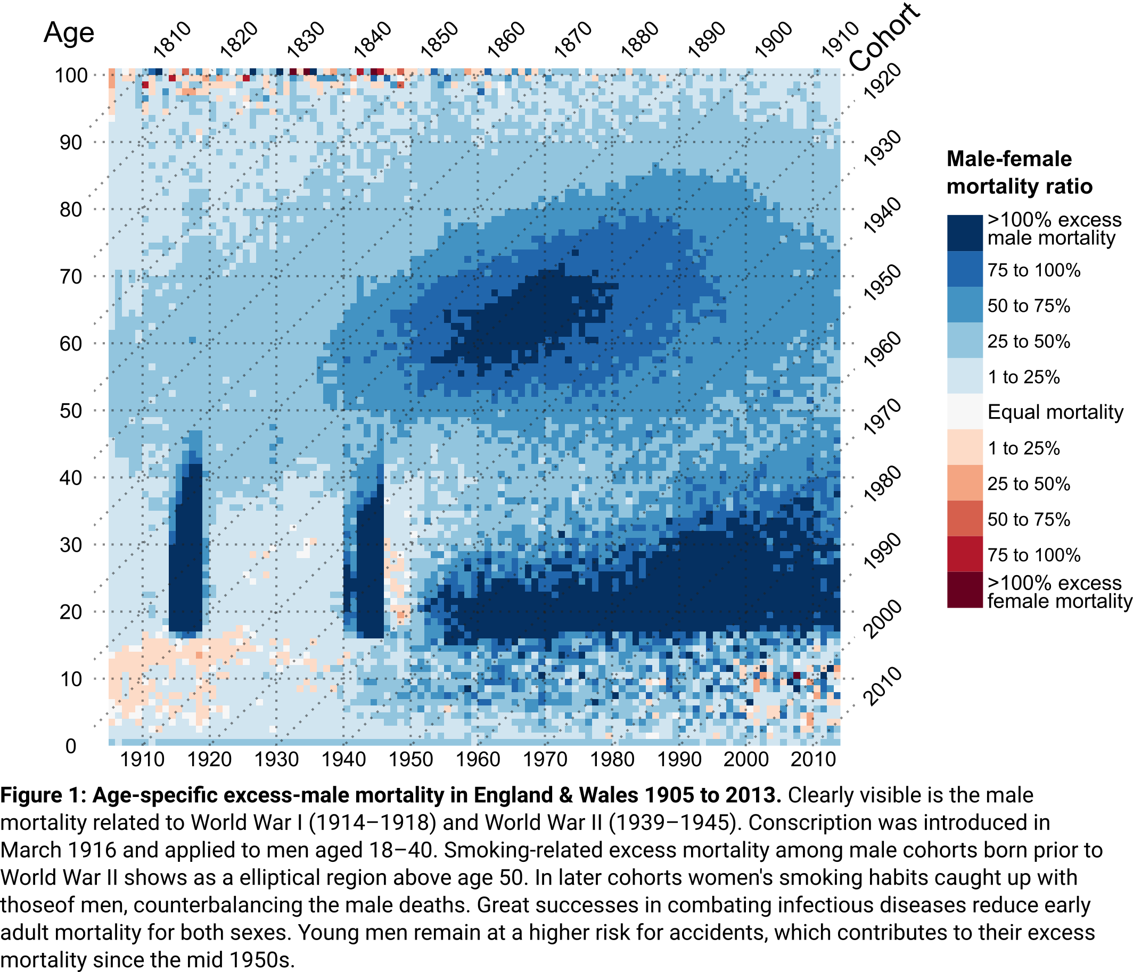
Indirect versus direct annotation

Slide 62
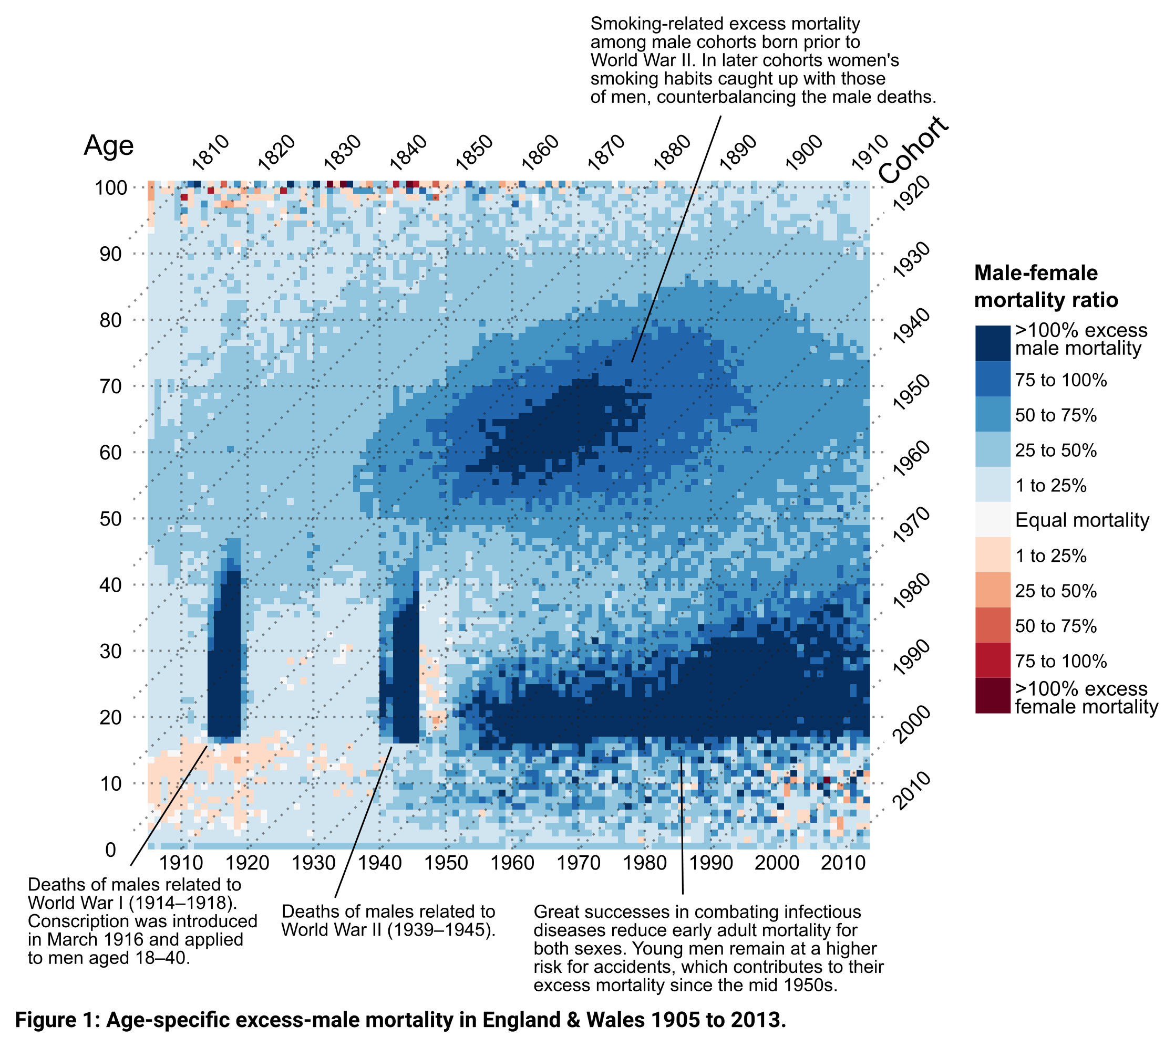
Indirect versus direct annotation

Slide 63
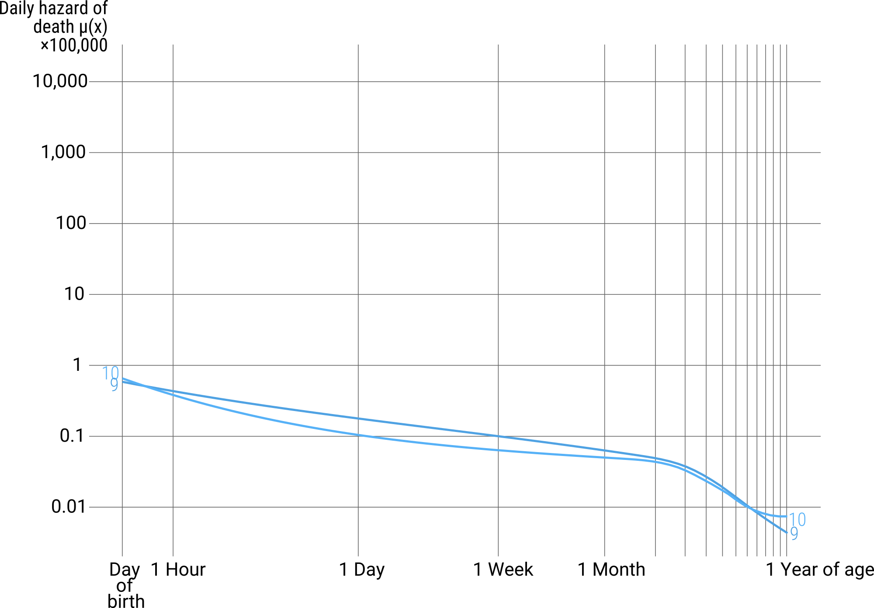
Visual storytelling via cumulative plot building
US infants born 2004. Raw data: CDC/NCHS.

Slide 64
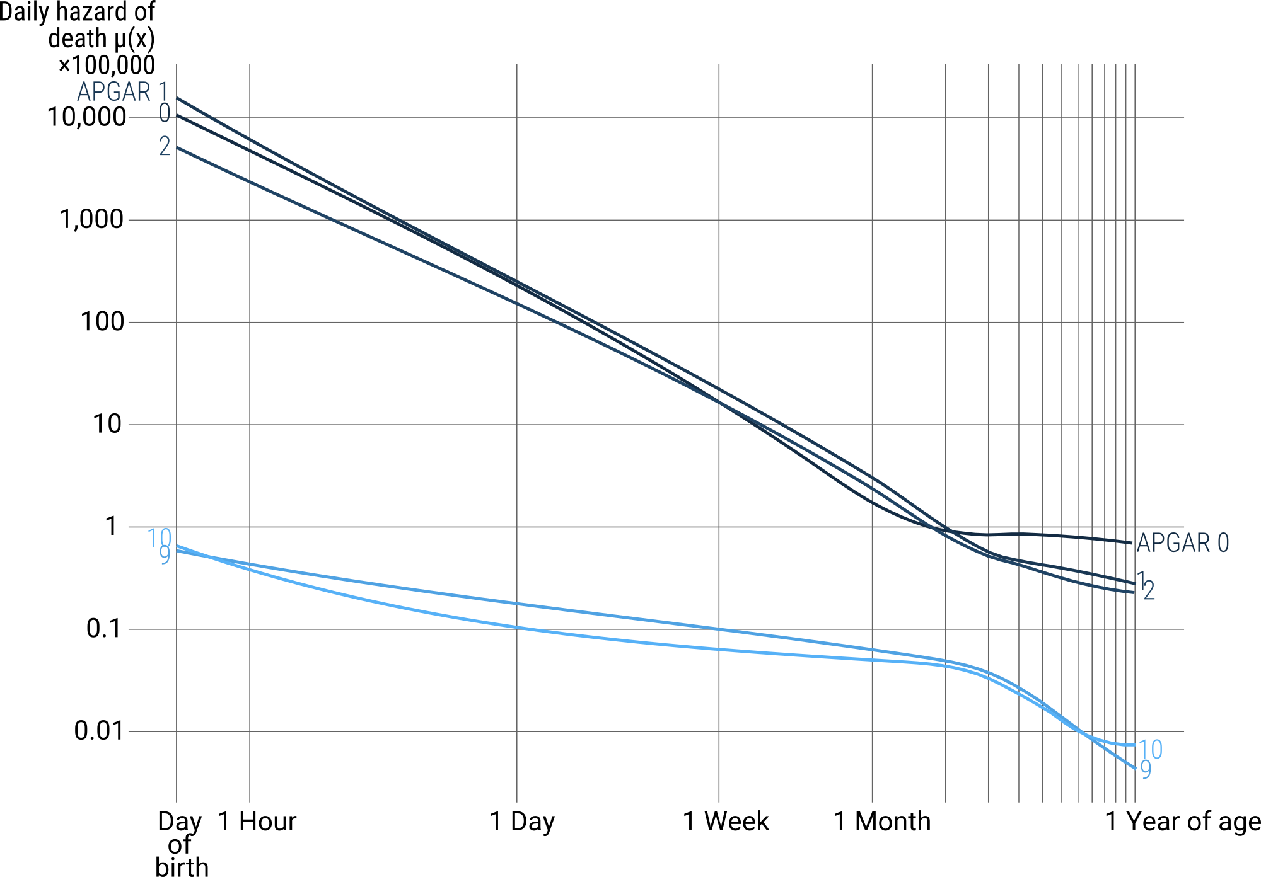
Visual storytelling via cumulative plot building
US infants born 2004. Raw data: CDC/NCHS.

Slide 65
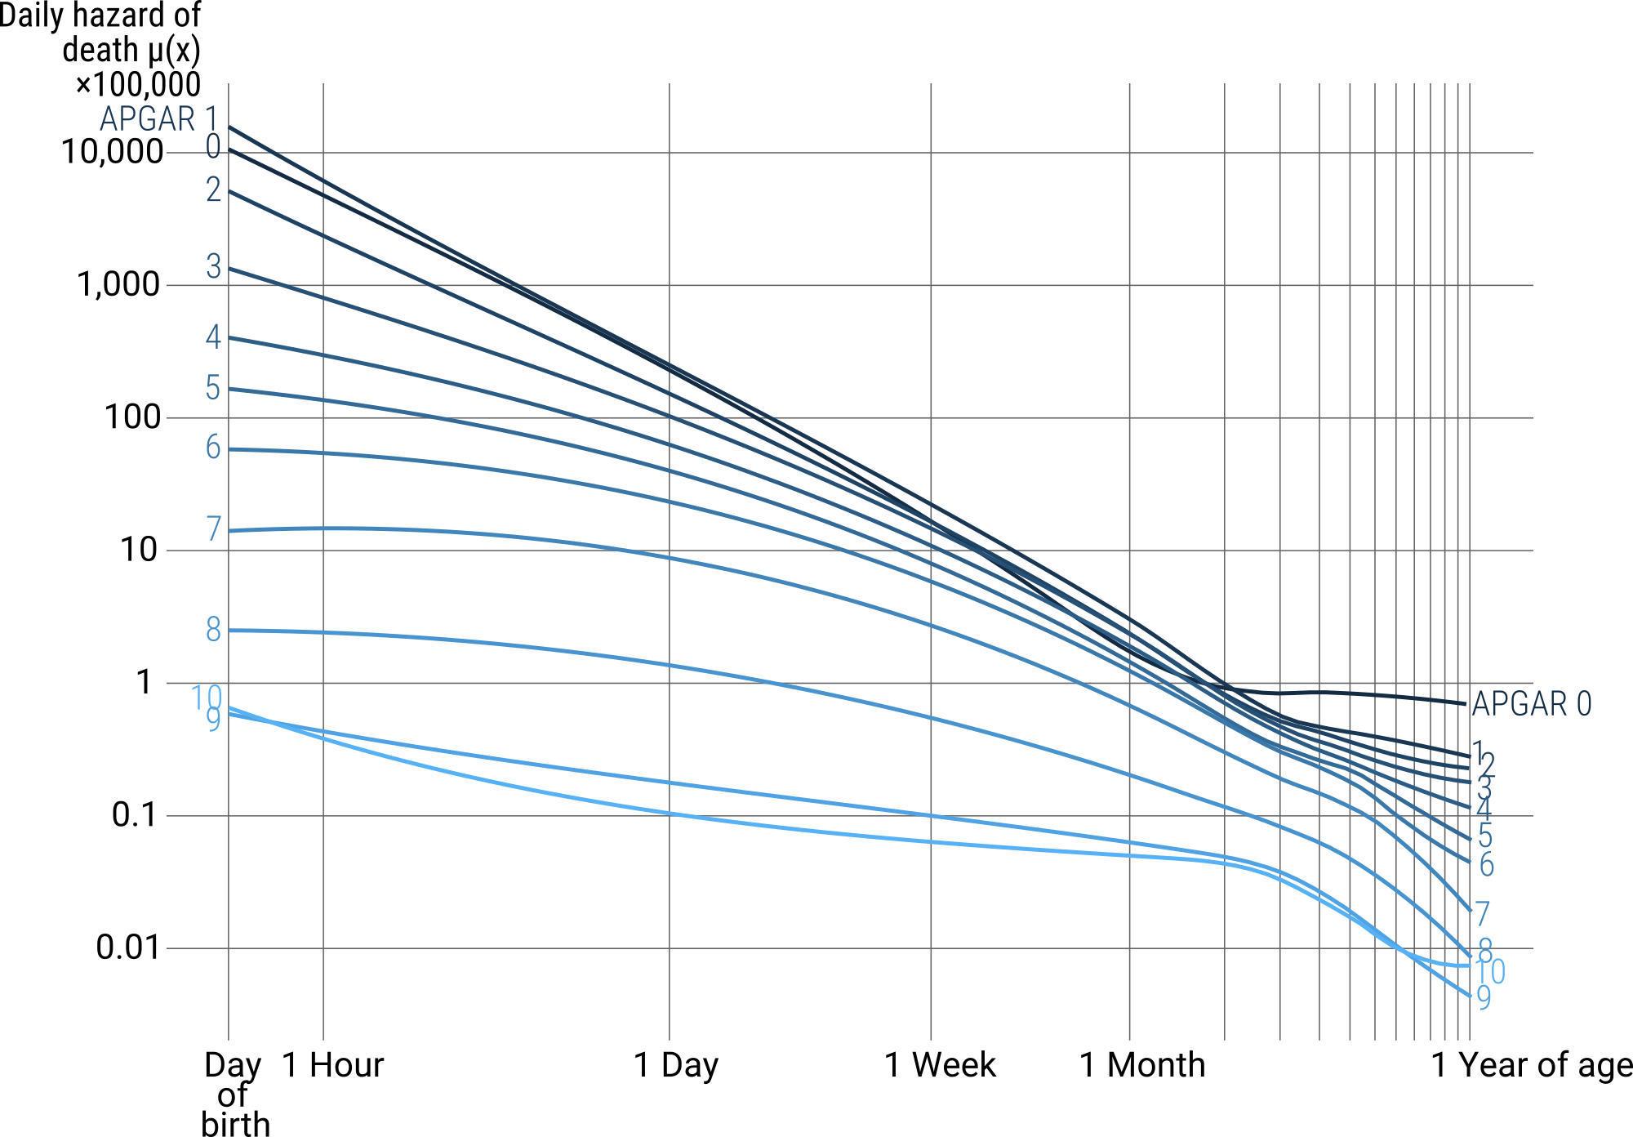
Visual storytelling via cumulative plot building
US infants born 2004. Raw data: CDC/NCHS.

Slide 66
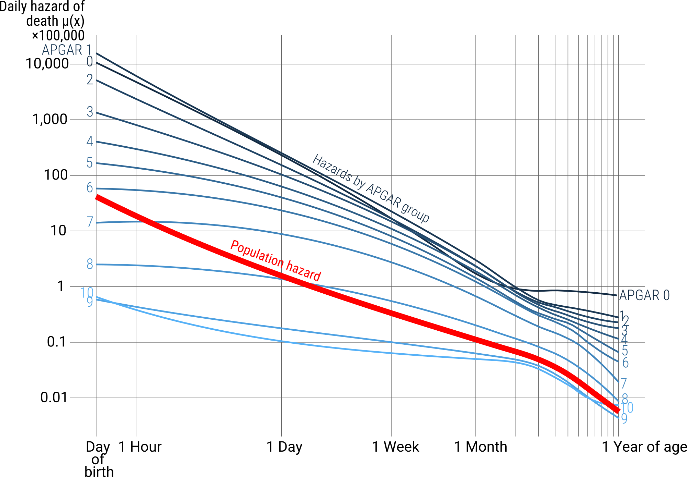
Visual storytelling via cumulative plot building
US infants born 2004. Raw data: CDC/NCHS.

Slide 67
Today’s lesson
Good Visualizations are designed
with a clear purpose, for a specific audience and for a specific medium

Slide 68
Today's exercise
For a plot you presented at a conference:
Sequence it using the cumulative plot building technique.
For a plot you included in a paper:
Add direct annotation.
Prepare to present your re-design.
Use whatever tools you’re most comfortable with.
Send your original and your re-designed plots to me as separate .png files.
Due-date: Wednesday evening.

Slide 69
Slides available at
github.com/jschoeley/edsd1718-dataviz
Jonas Schöley
jschoeley@health.sdu.dk
Twitter: @jschoeley

