Slide 1

Visual perception
Jonas Schöley
jschoeley@health.sdu.dk
Department of Public Health
University of Southern Denmark

Slide 2
Why does visualization work?
“Typically, tasks that can be performed on large multi-element displays in less than 200 to 250 milliseconds (msec) are considered preattentive.”
Healey, C. G., & Enns, J. T. (2012). Attention and visual memory in visualization and computer graphics. IEEE Transactions on Visualization and Computer Graphics, 18(7), 1170–88.

Slide 3
Why does visualization work?
“Preattentive features pop-out.”
Jon Schwabish (2016) at PRB data viz workshop.

Slide 4
Grabbing attention
Preattentive features

Slide 5

Line orientation
Source: Christopher G. Healey

Slide 6

Line length
Source: Christopher G. Healey

Slide 7

Closure
Source: Christopher G. Healey

Slide 8

Size
Source: Christopher G. Healey

Slide 9

Curvature
Source: Christopher G. Healey

Slide 10

Density
Source: Christopher G. Healey

Slide 11

Number
Source: Christopher G. Healey

Slide 12
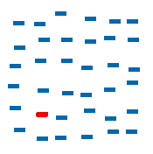
Colour (hue)
Source: Christopher G. Healey

Slide 13

Intensity
Source: Christopher G. Healey

Slide 14
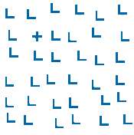
Intersection
Source: Christopher G. Healey

Slide 15
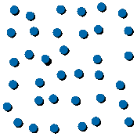
3D depth cues
Source: Christopher G. Healey

Slide 16
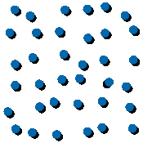
Lighting direction
Source: Christopher G. Healey

Slide 17
Preattentive features
Source: Christopher G. Healey

Slide 18
Forming the whole from its parts
Gestalt psychology

Slide 19
Gestalt psychology
Gestalt (German): form, pattern
How do people organize visual information?
How do people unify visual sensations into a whole?

Slide 20
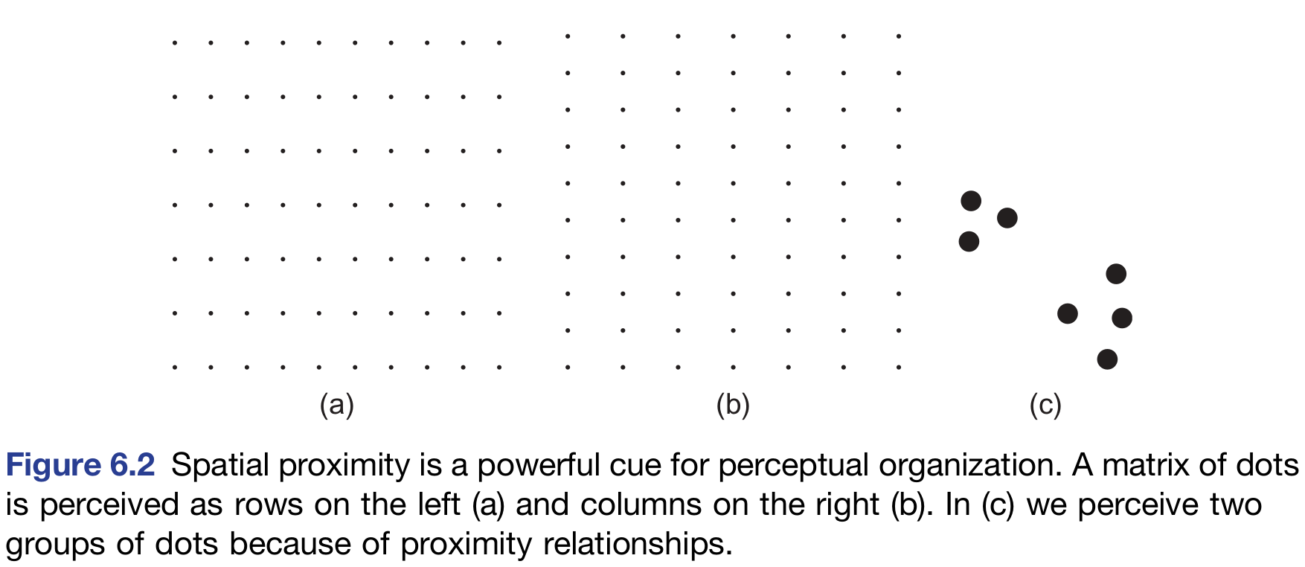
Proximity
Ware, C. (2013). Information Visualization. Perception for Design (3rd ed.). p. 182.

Slide 21
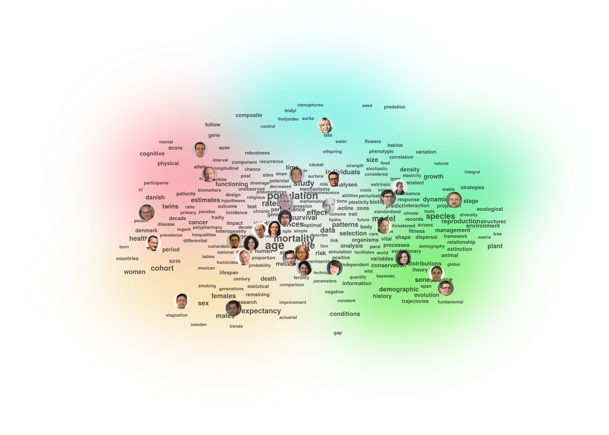
Proximity
(c) Jonas Schöley 2016.

Slide 22
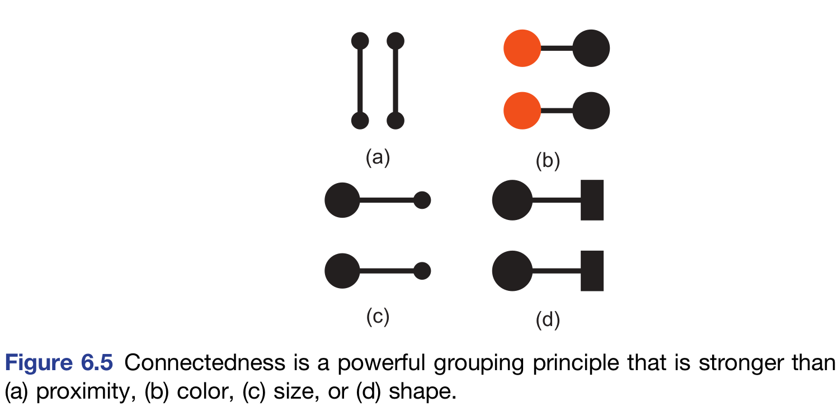
Connectedness
Ware, C. (2013). Information Visualization. Perception for Design (3rd ed.). p. 184.

Slide 23
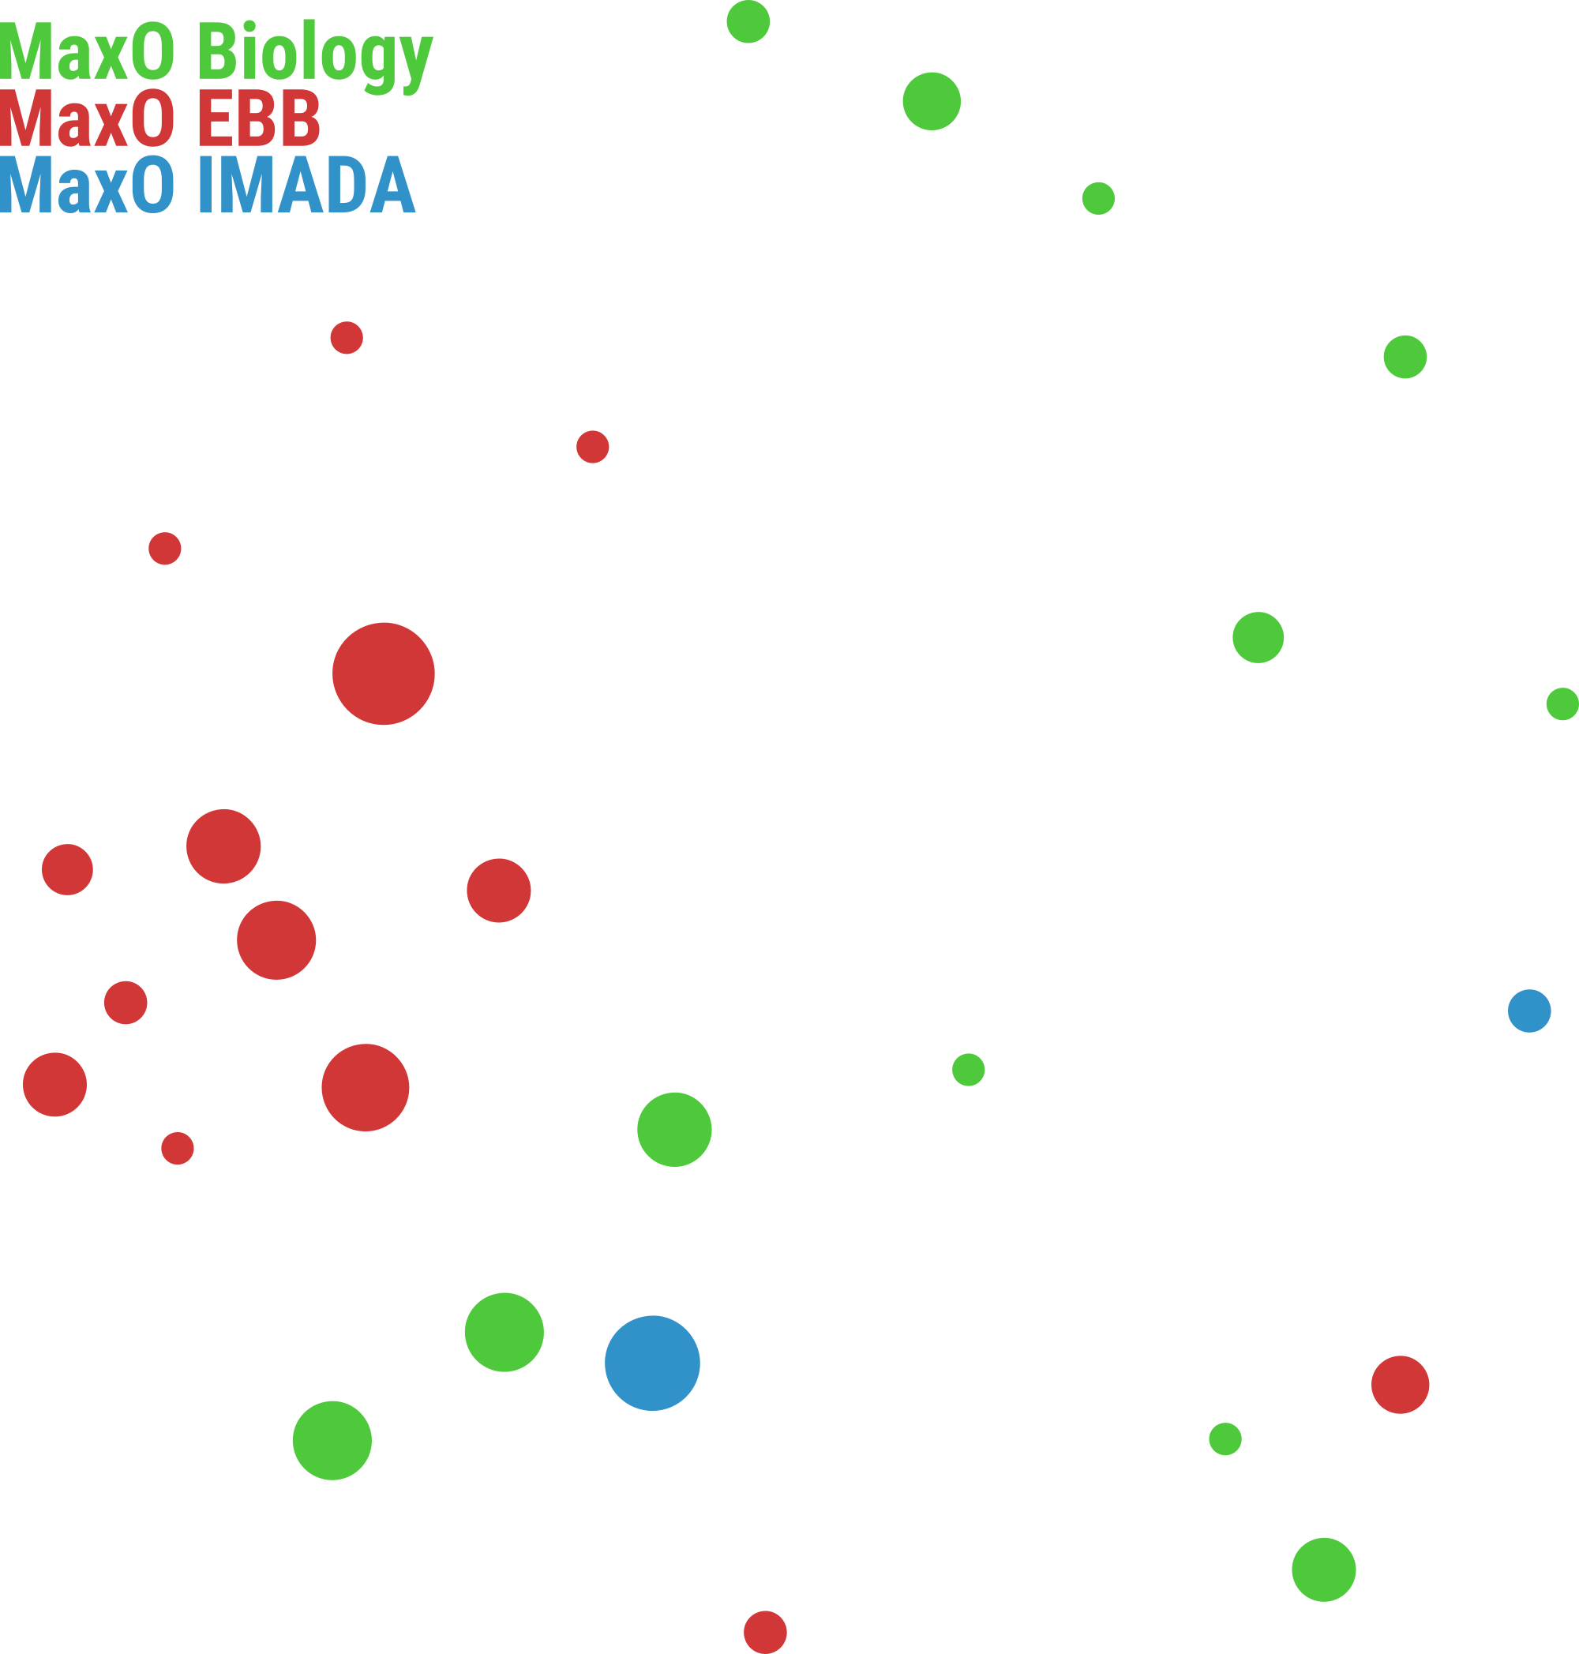
Connectedness
(c) Jonas Schöley 2016

Slide 24

Connectedness
(c) Jonas Schöley 2016

Slide 25
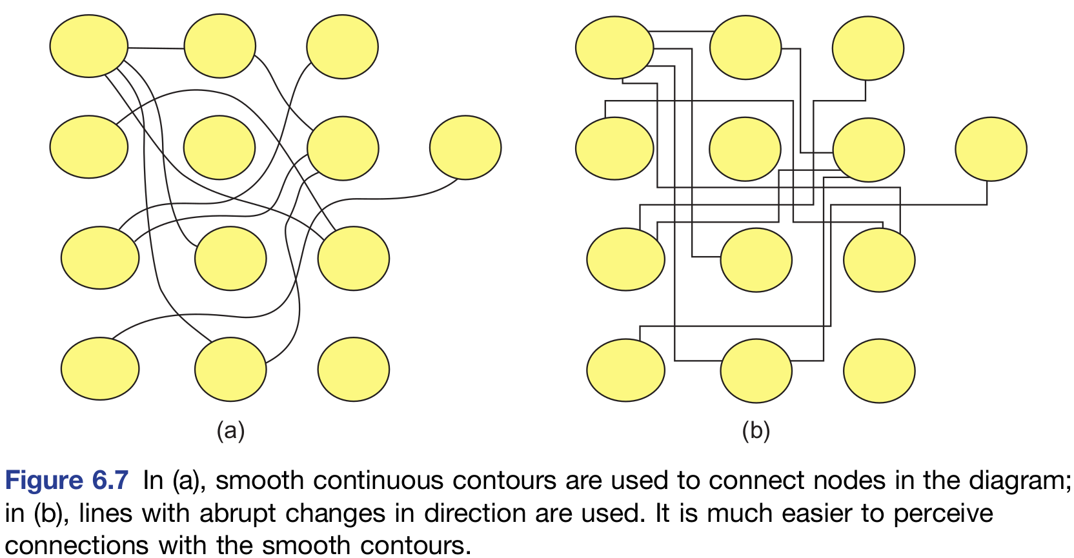
Continuity
Ware, C. (2013). Information Visualization. Perception for Design (3rd ed.). p. 184.

Slide 26
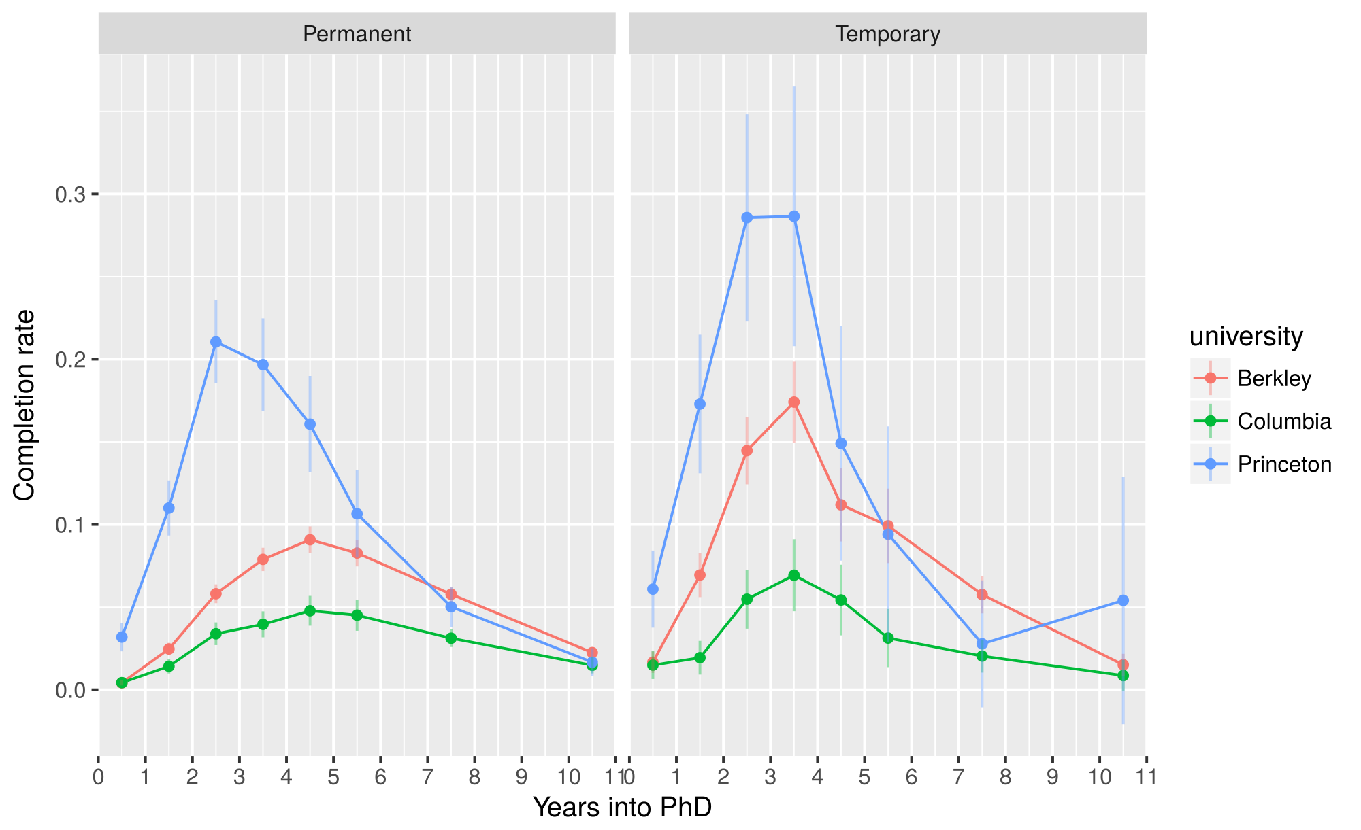
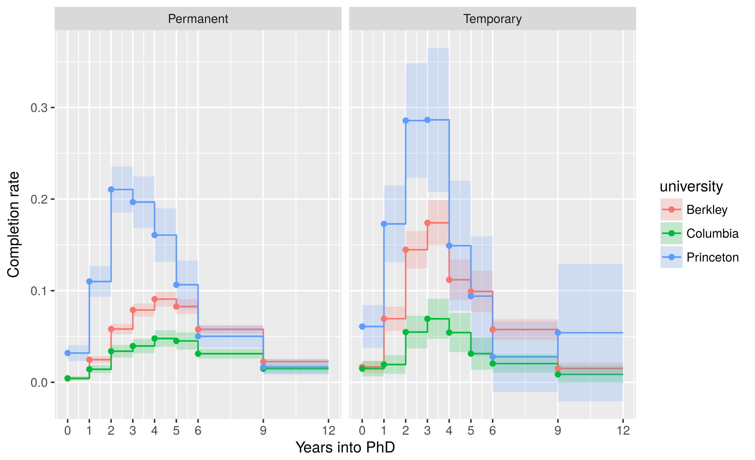
Continuity

Slide 27
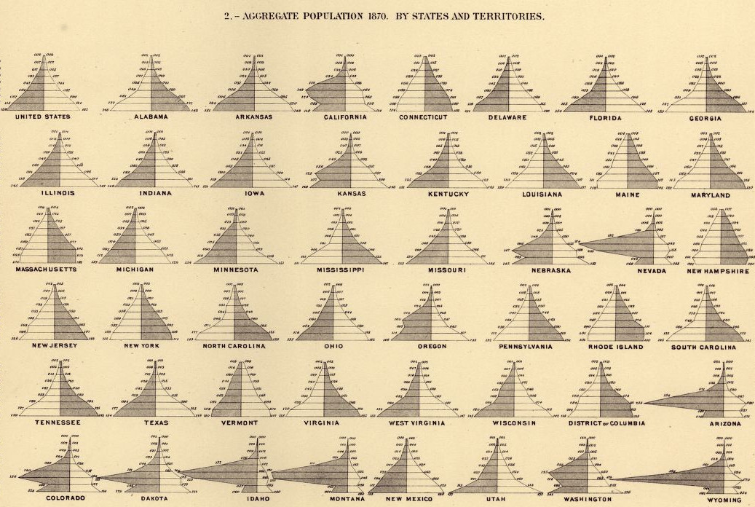
Symmetry
Walker, F. A. (1874). Statistical Atlas of the United States Based on the Results of the Ninth Census.

Slide 28
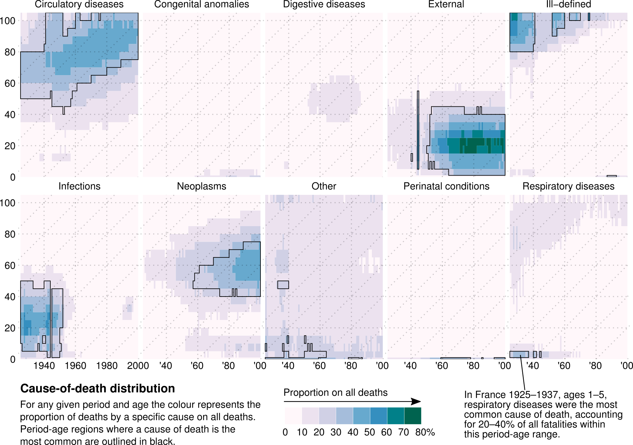
Closure and common region
Schöley, J., & Willekens, F. (2017). Visualizing compositional data on the Lexis surface.

Slide 29
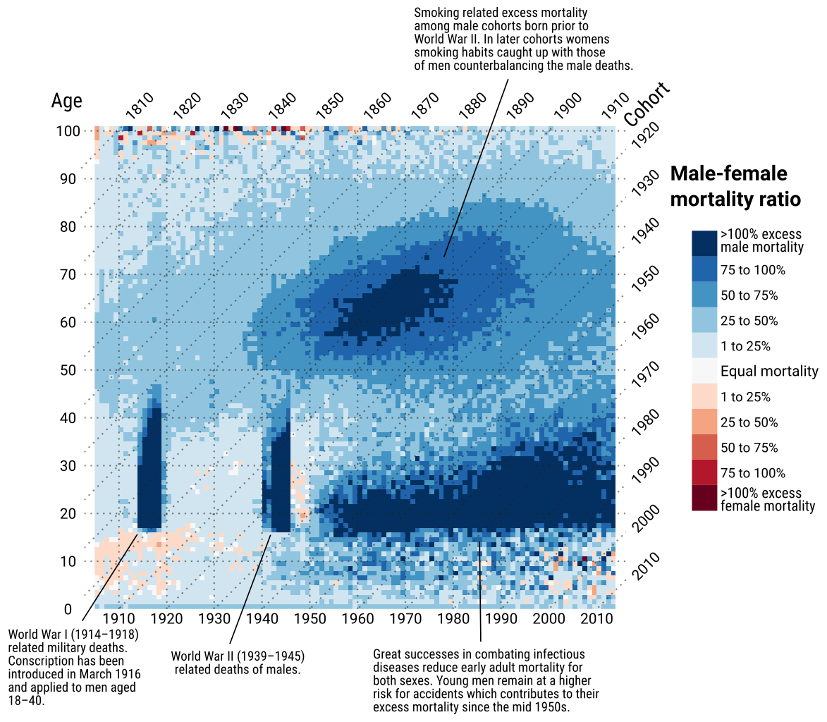
Closure and common region
Schöley, J., & Willekens, F. (2017). Visualizing compositional data on the Lexis surface. Demographic Research, 36(1), 627–658.

Slide 30
The atoms of any visualization
Marks

Slide 31
Points

Slide 32
Lines

Slide 33
Areas

Slide 34
(Volumes)

Slide 35
Assigning marks to visual channels

Slide 36
Assigning marks to visual channels
Position
horizontal
vertical

Slide 37
Assigning marks to visual channels

Slide 38
Assigning marks to visual channels
Position
horizontal
vertical
Angle
Length

Slide 39
Assigning marks to visual channels
Position
horizontal
vertical
Angle
Length

Slide 40
Encoding data via
Visual channels

Slide 41
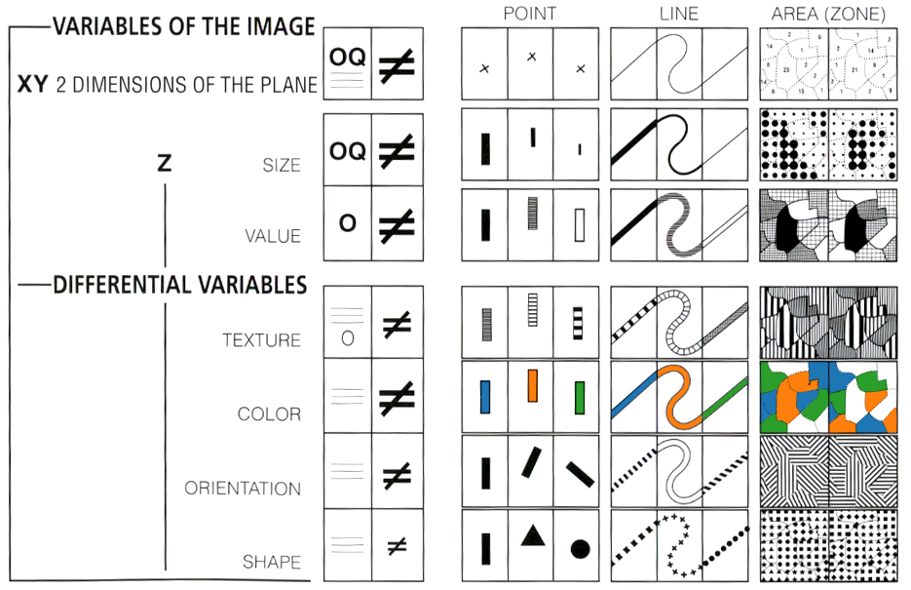
Visual primitives in data viz
Jaques Bertin. (1967). Sémiologie Graphique. Les diagrammes, les réseaux, les cartes.

Slide 42
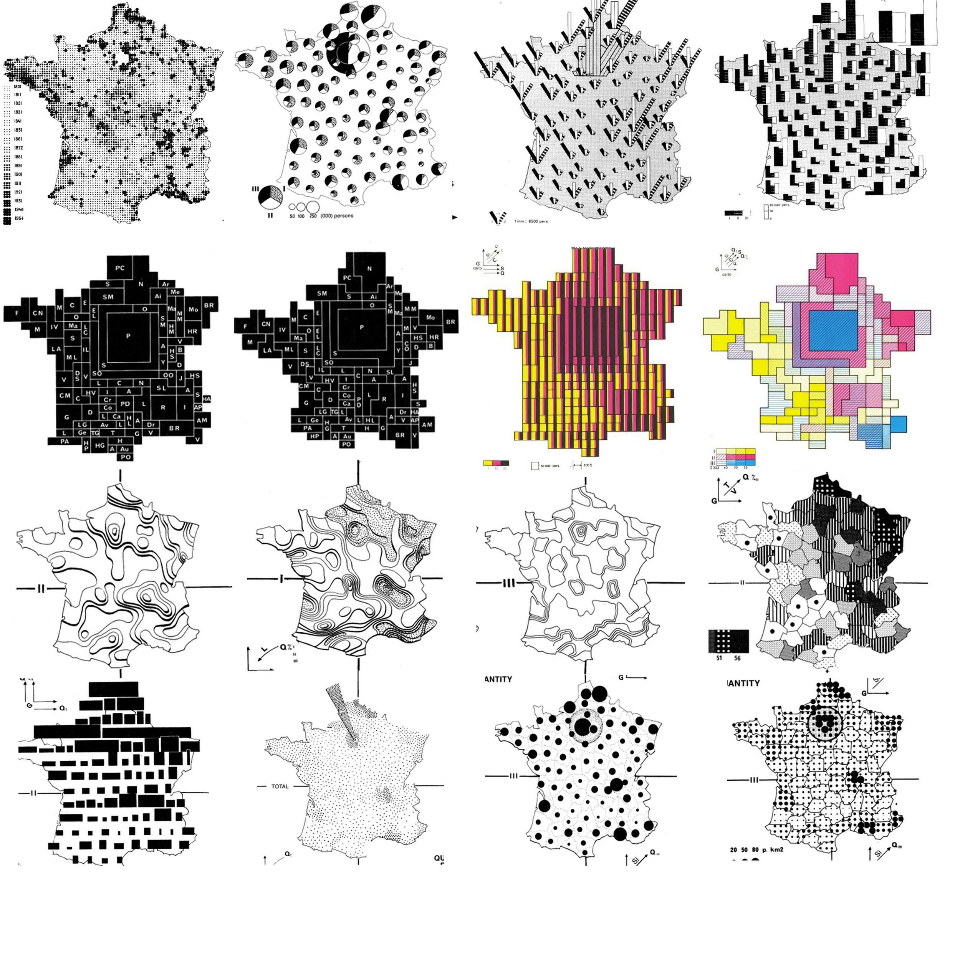
Visual primitives in data viz
Jaques Bertin. (1967).
Sémiologie Graphique. Les diagrammes, les réseaux, les cartes.

Slide 43
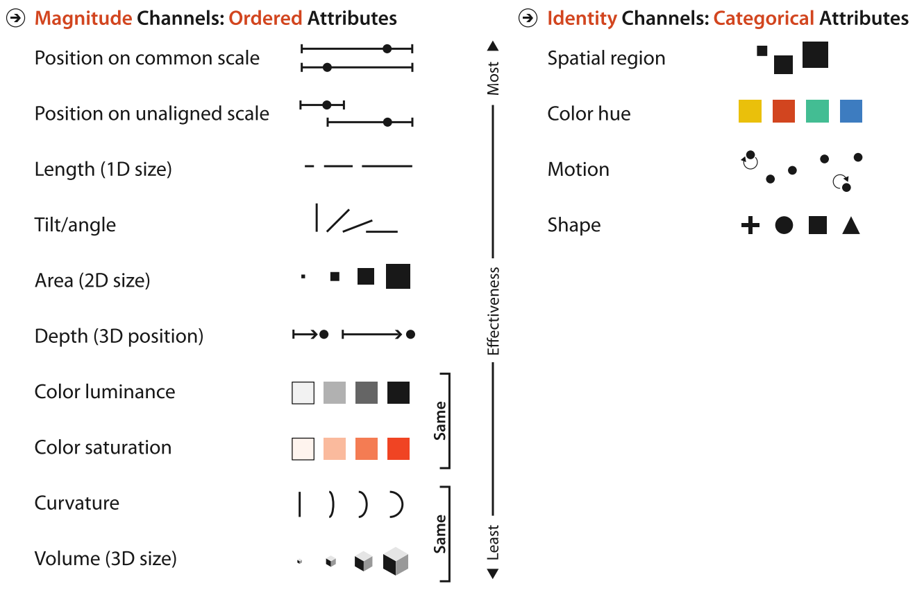
A hierarchy of visual channels
Munzner, T. (2015). Visualization Analysis & Design (1st ed.). Boca Raton, U.S.A: CRC Press.

Slide 44
Position, length and tilt

Slide 45
Area and volume

Slide 46
Spatial region and shape

Slide 47
Color

Slide 48
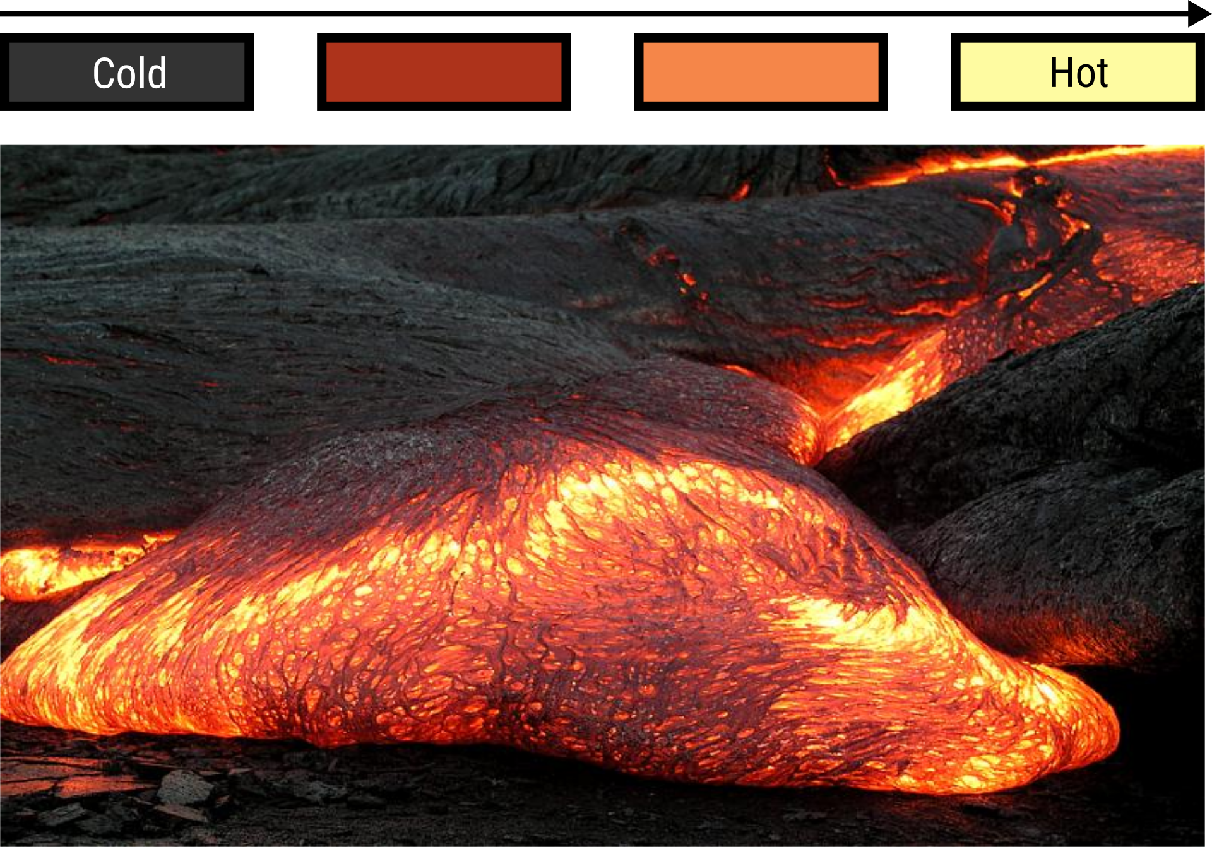
Color-coding magnitudes
Hawaii Volcano Observatory (2003).

Slide 49
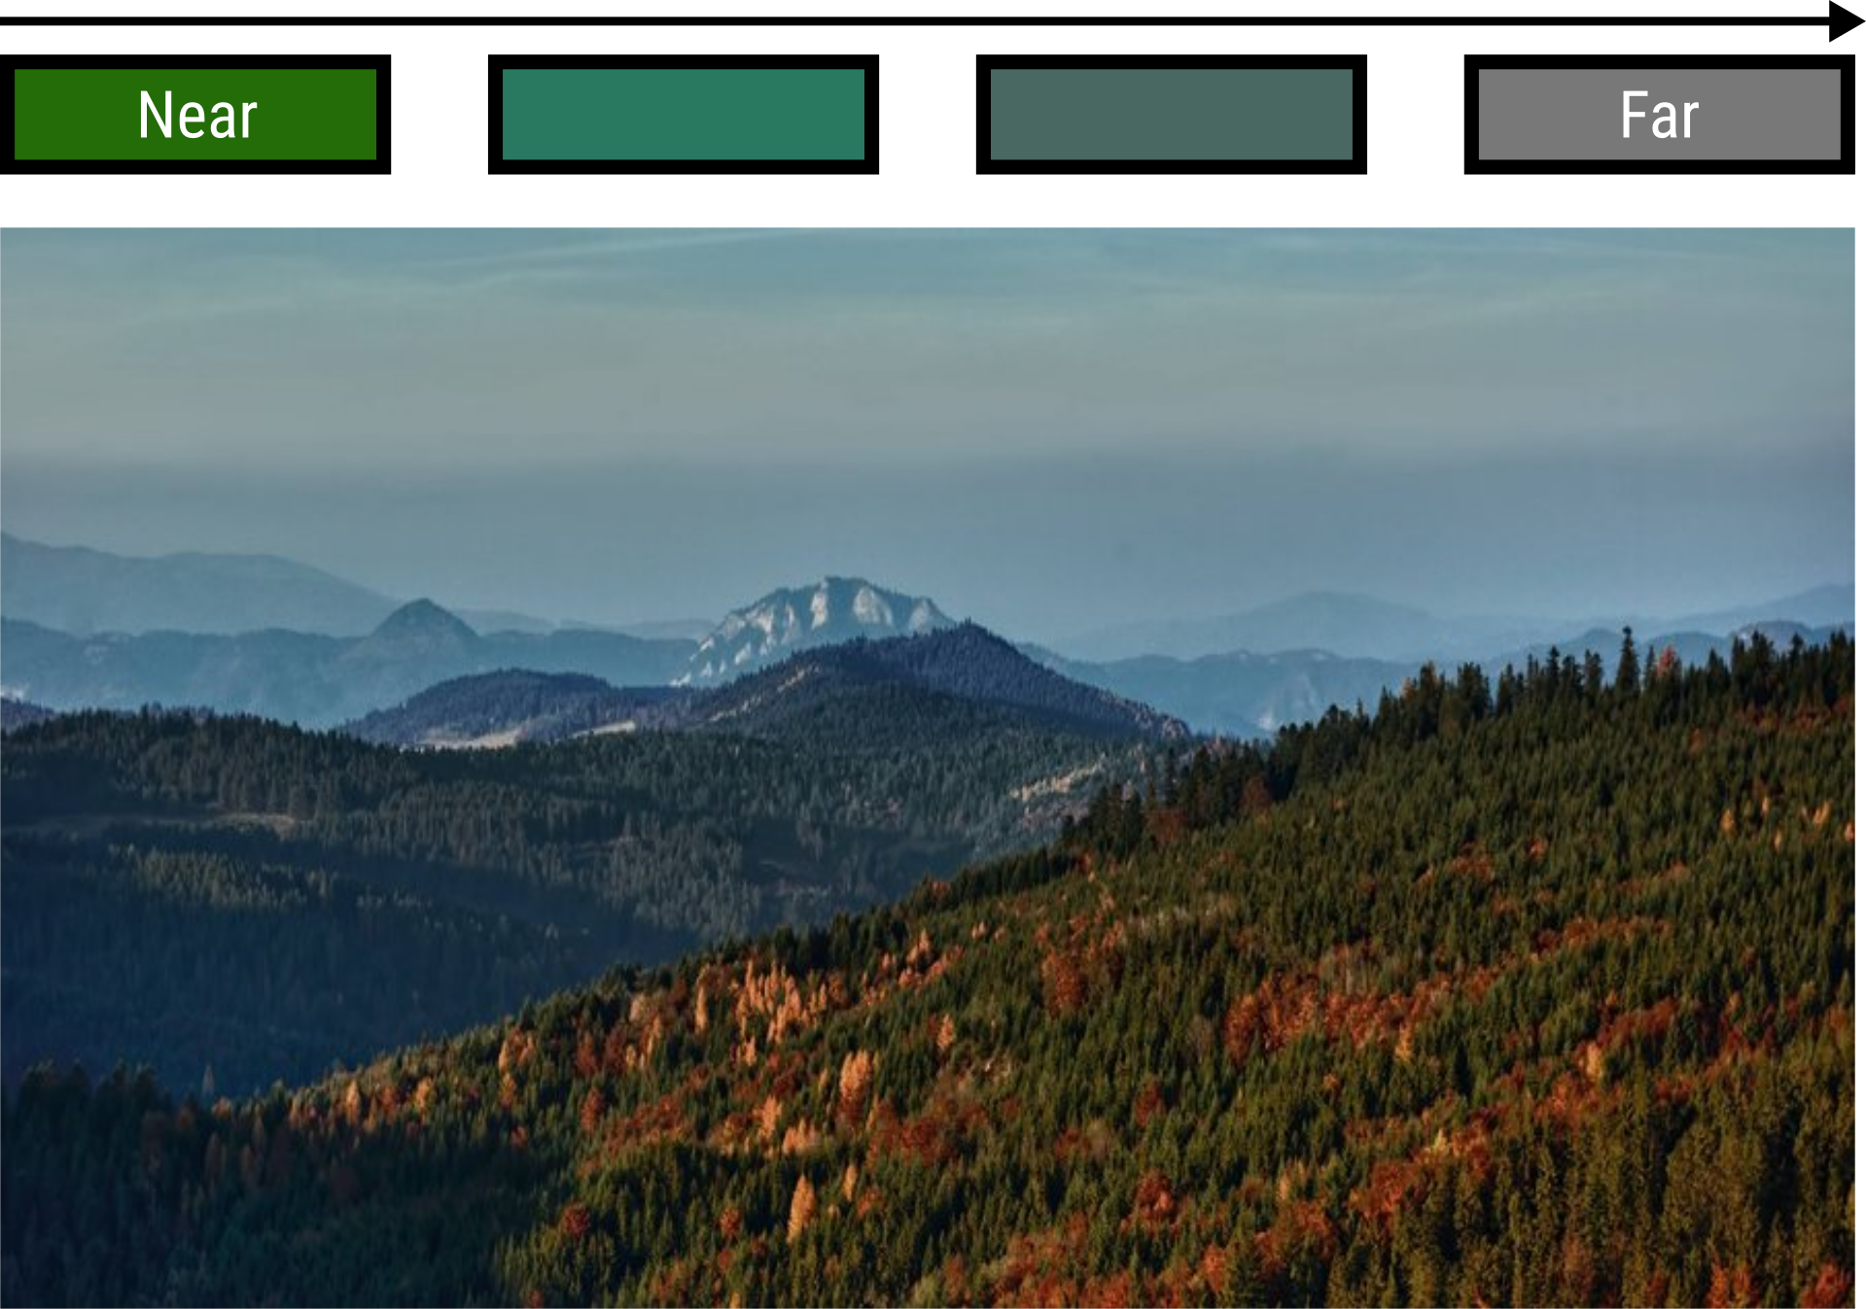
Color-coding magnitudes
Milan Cernak (2011). “Pieniny from Magura”.

Slide 50
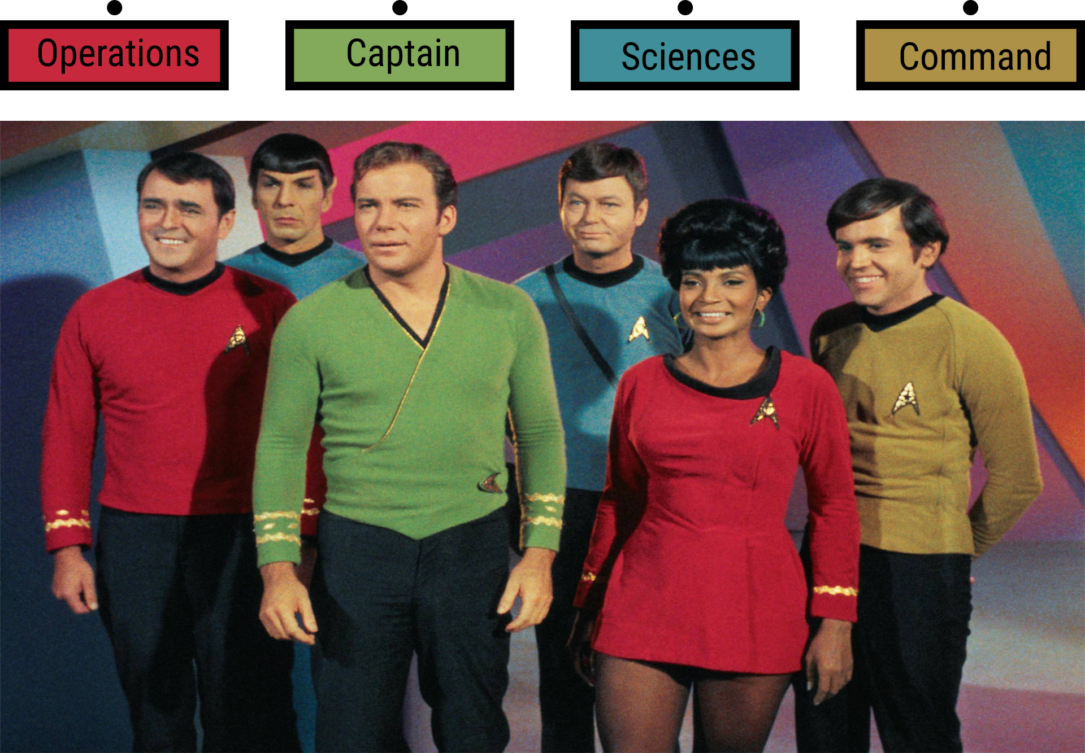
Color-coding categories
CBS Television.

Slide 51
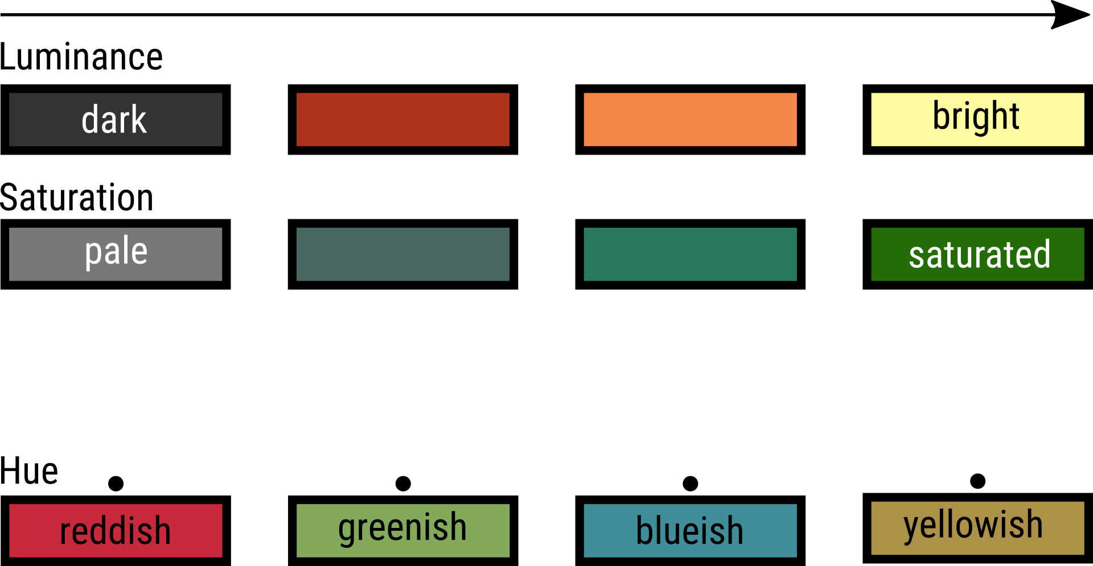
Perceptual color dimensions

Slide 52
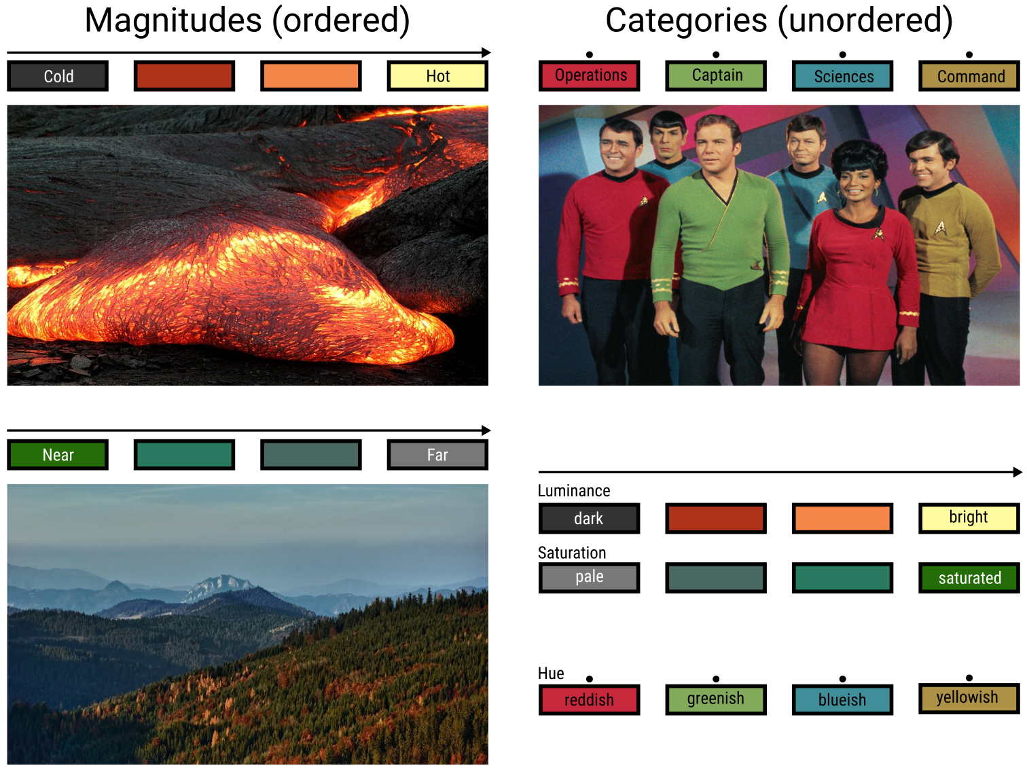
Matching color and data dimensions

Slide 53
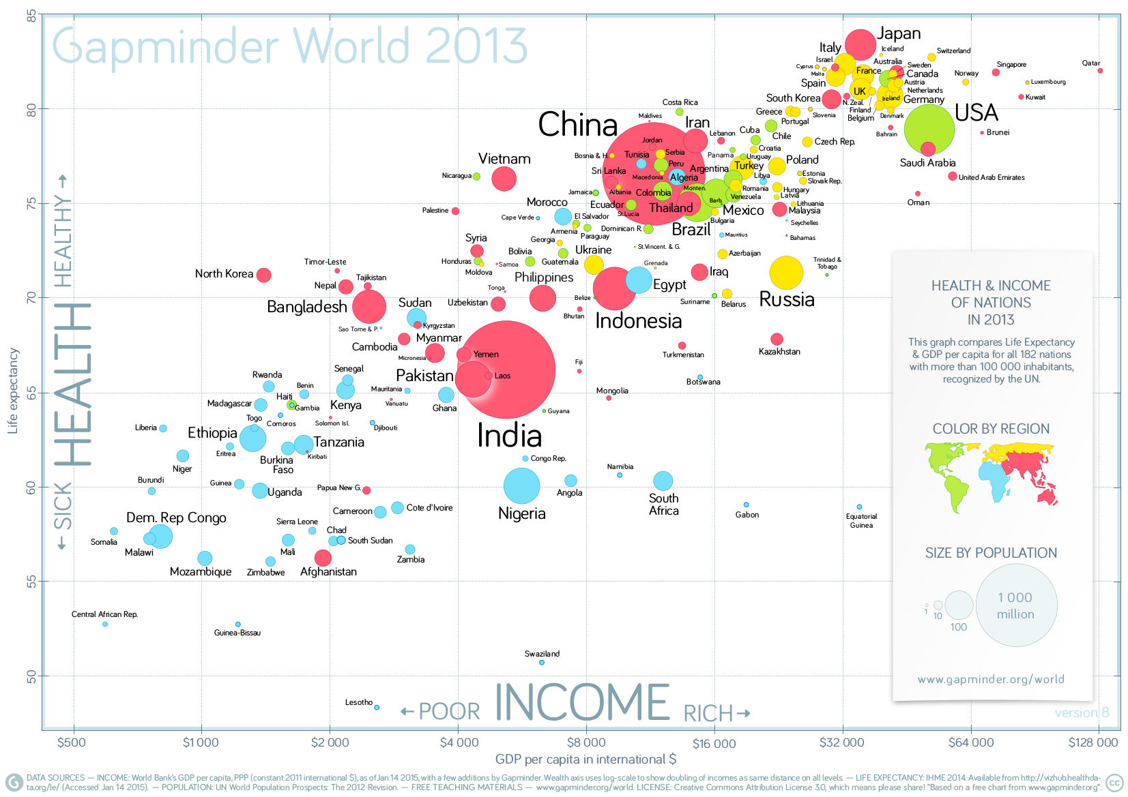
Color-coding categories
Gapminder World (2014).

Slide 54
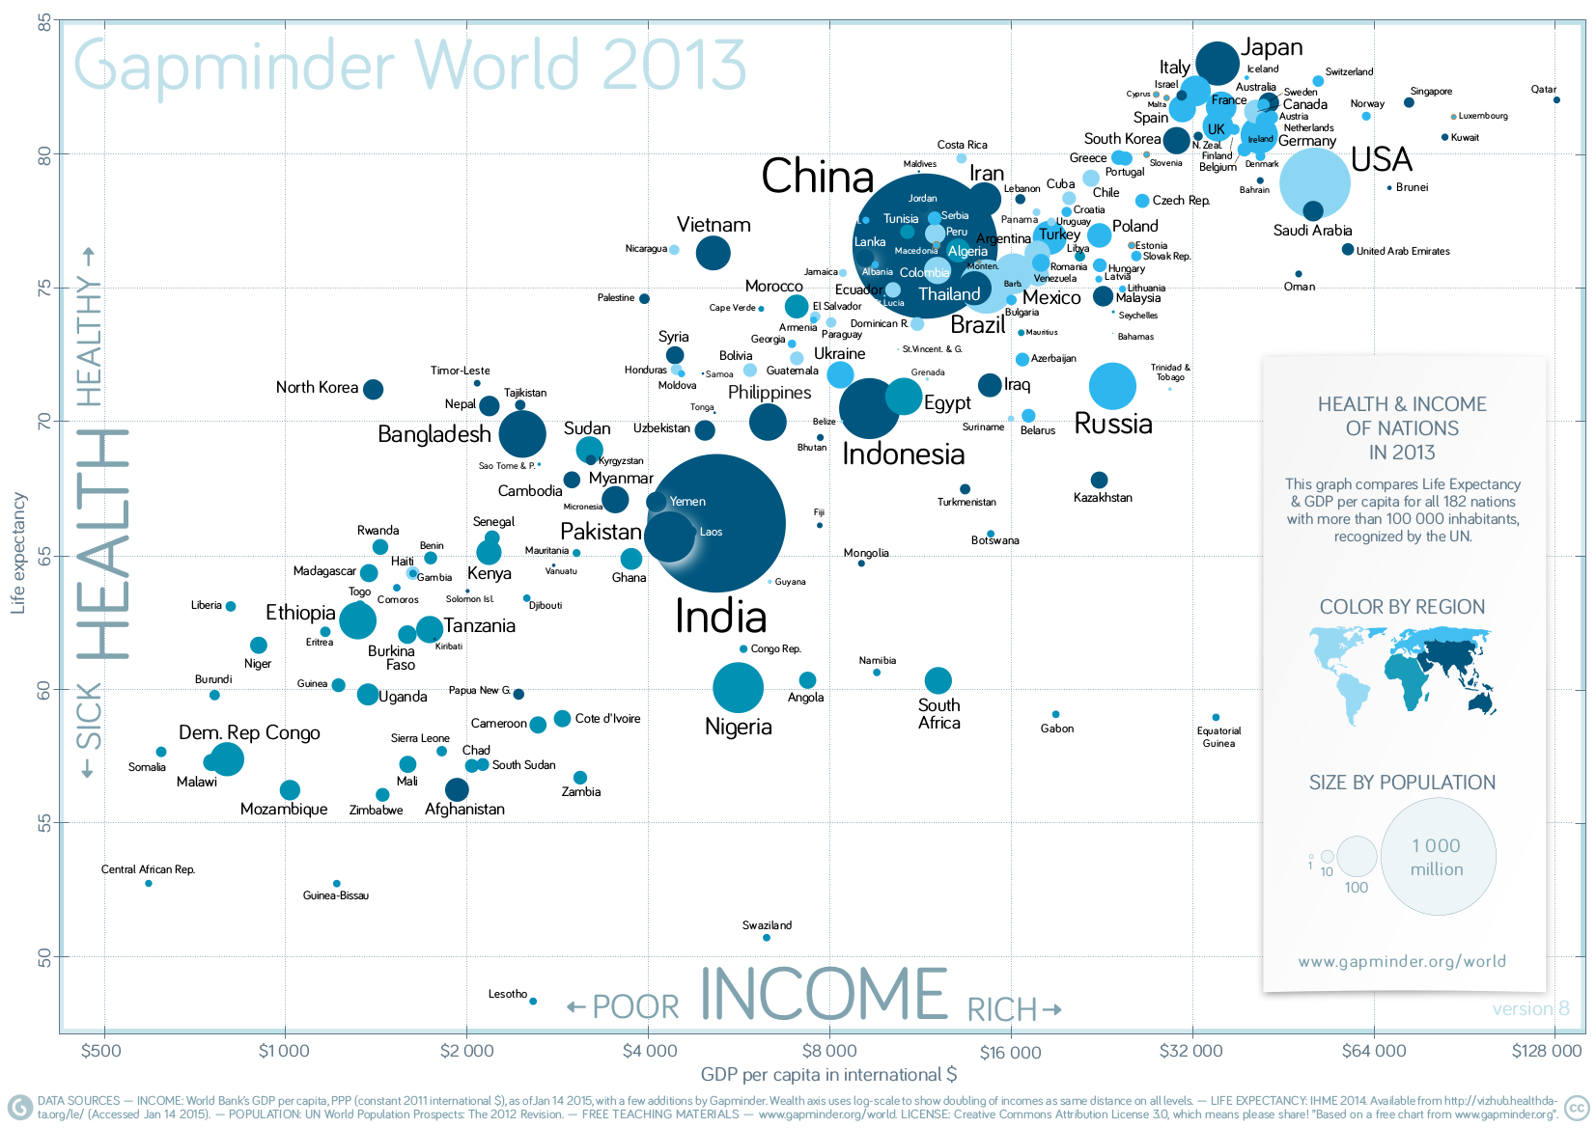
Ineffective color-coding
Redrawn from Gapminder World (2014).

Slide 55
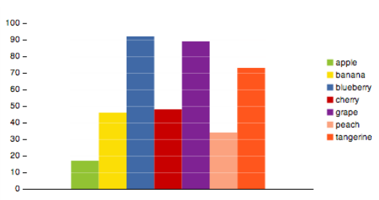
Semantically resonant colors
Sharon Lin et al. (2013). “Selecting Semantically-Resonant Colors for Data Visualization”. In: Computer Graphics Forum 32.3, pp. 401–410.

Slide 56
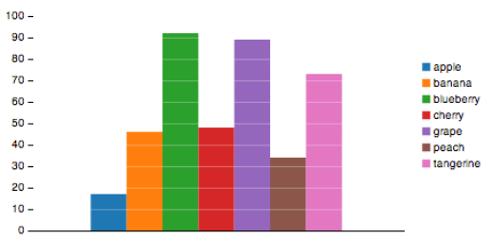
Semantically resonant colors
Sharon Lin et al. (2013). “Selecting Semantically-Resonant Colors for Data Visualization”. In: Computer Graphics Forum 32.3, pp. 401–410.

Slide 57
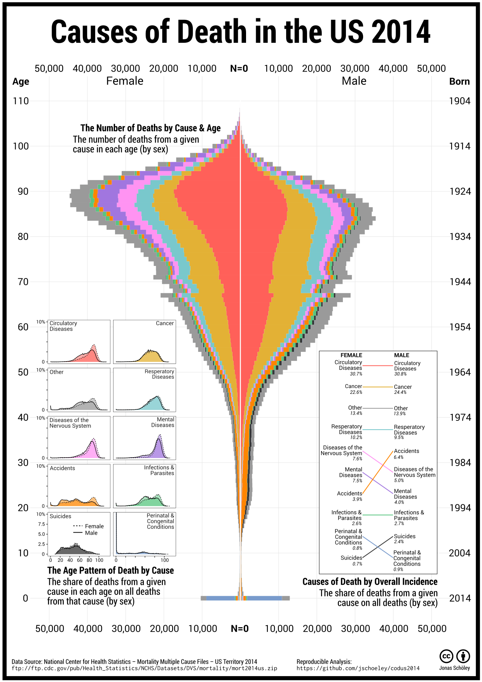
How would you color death?
Jonas Schöley (2016). github.com/jschoeley/codus2014

Slide 58
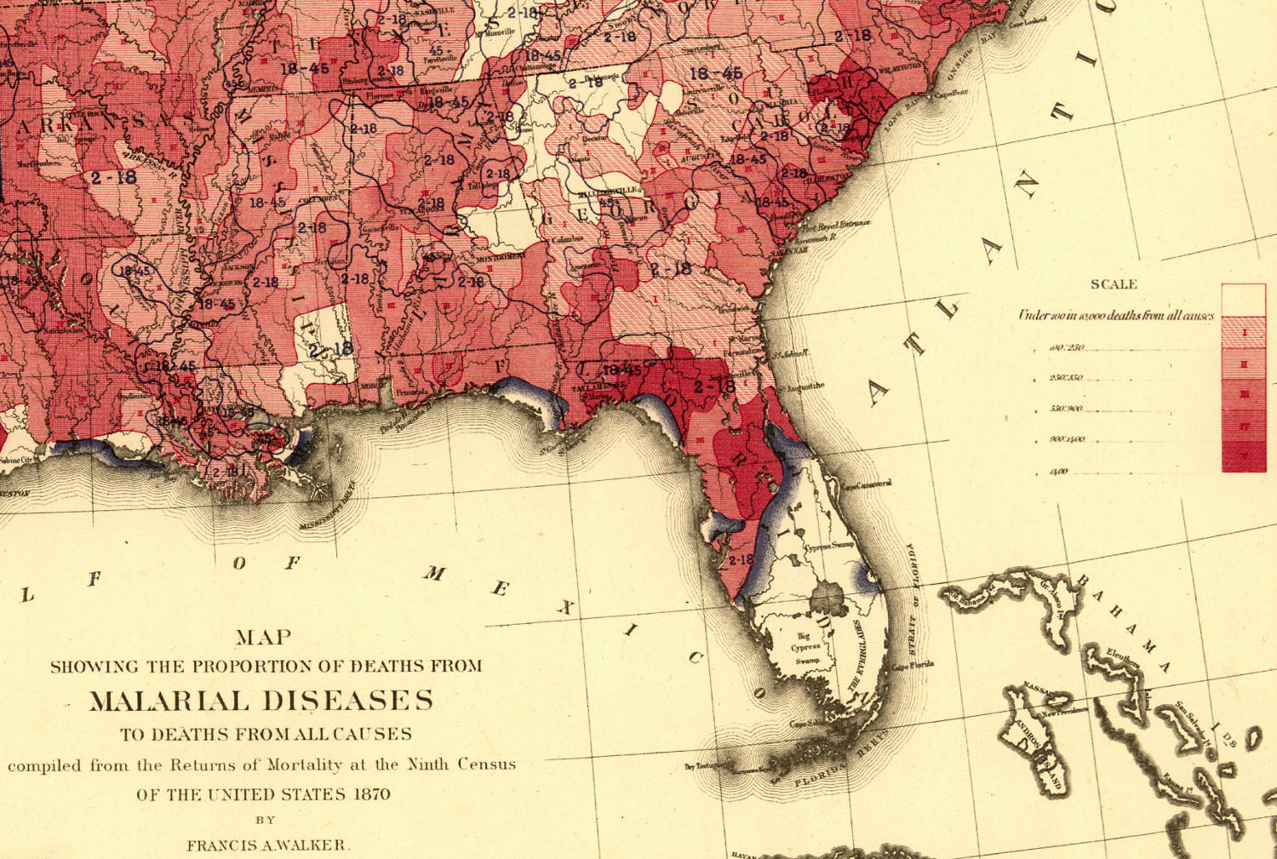
Color-coding magnitudes
Francis Walker (1874). “Statistical Atlas of the United States” [cutout].

Slide 59
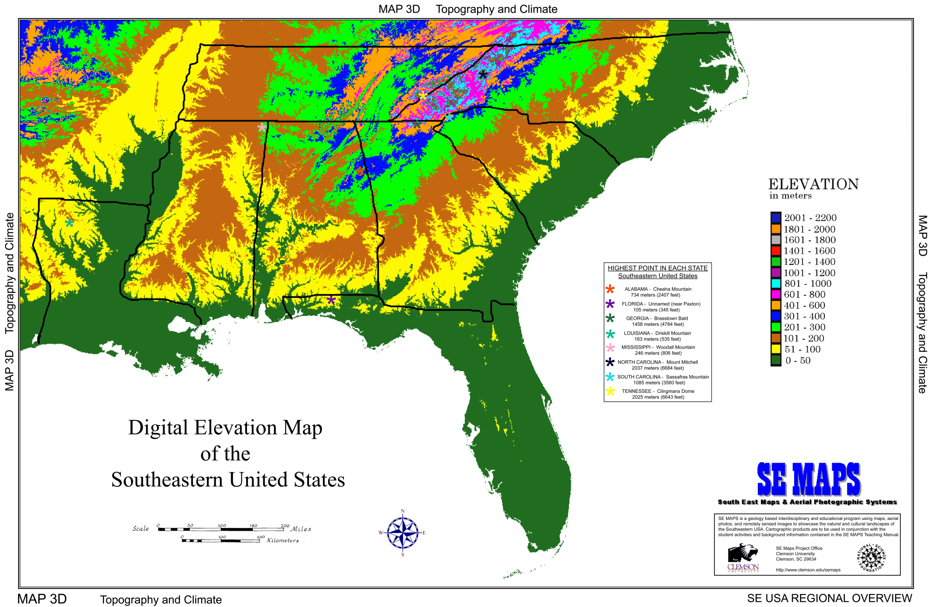
Ineffective color-coding
South East Maps & Aerial Photographic Systems.

Slide 60
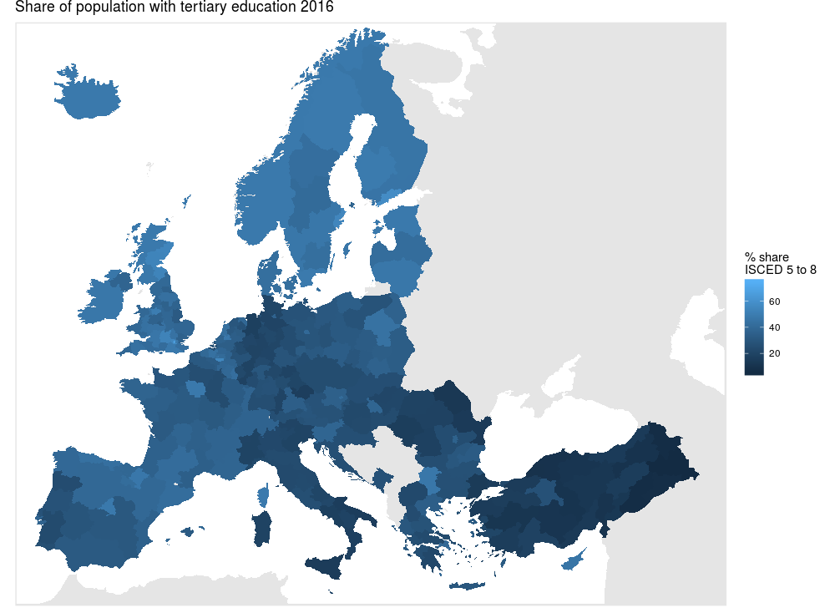
Low discriminability

Slide 61
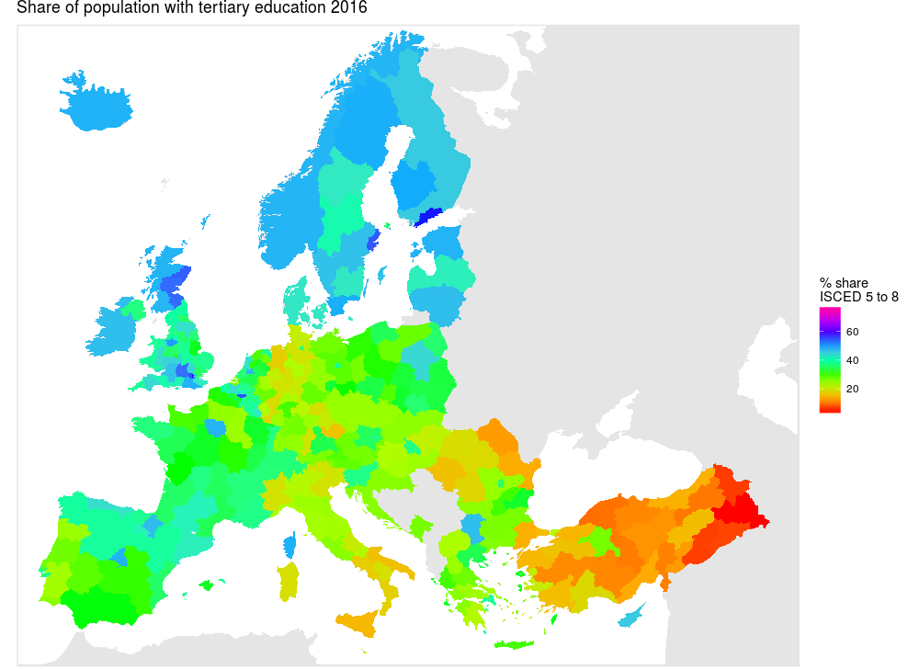
High discriminability, but unbalanced

Slide 62
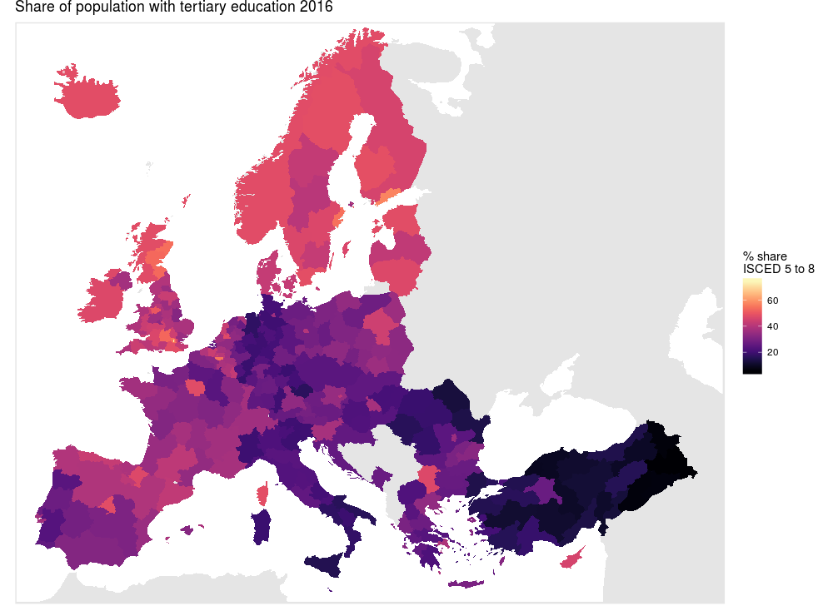
High discriminability and balanced

Slide 63
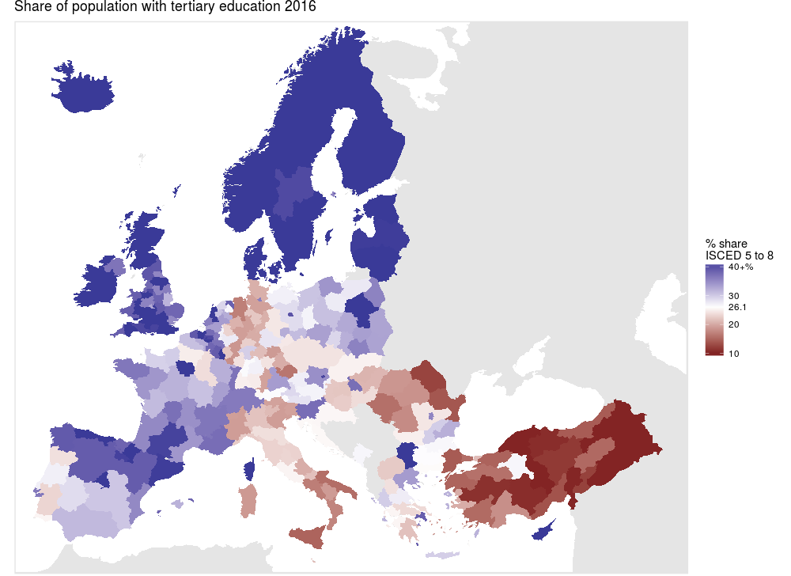
High discriminability, balanced, centered

Slide 64
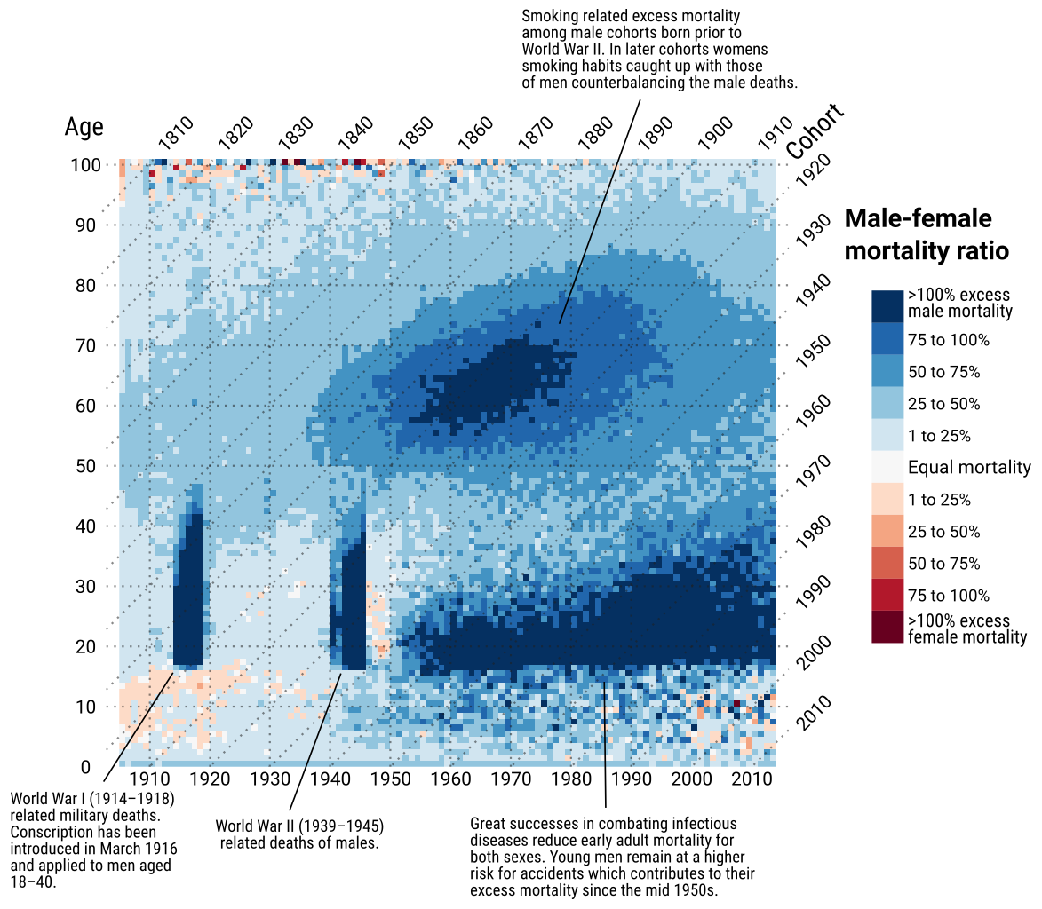
Color-coding divergent magnitudes
Schöley (2016). “Visualizing compositional data on the Lexis surface.” Data: HMD.

Slide 65
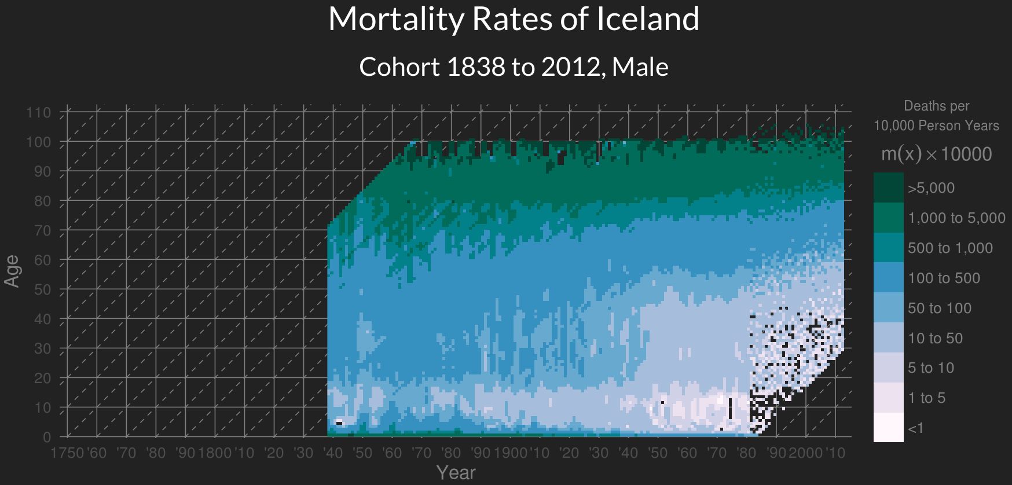
Discrete color scales
Jonas Schöley (2016). “The Human Mortality Explorer”.

Slide 66
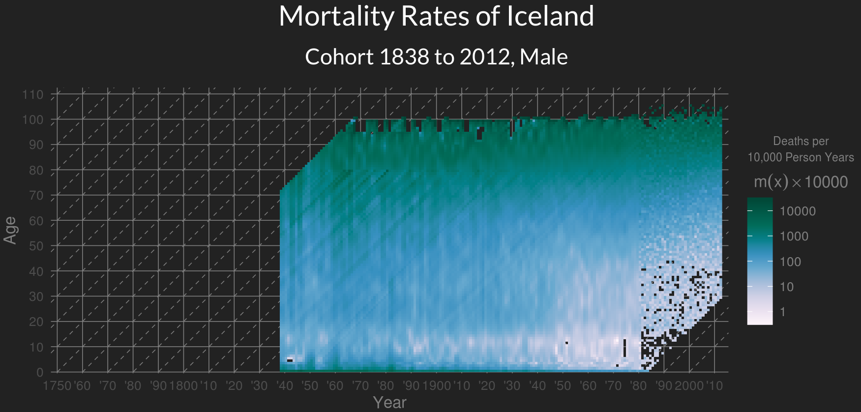
Continous color scales
Jonas Schöley (2016). “The Human Mortality Explorer”.

Slide 67
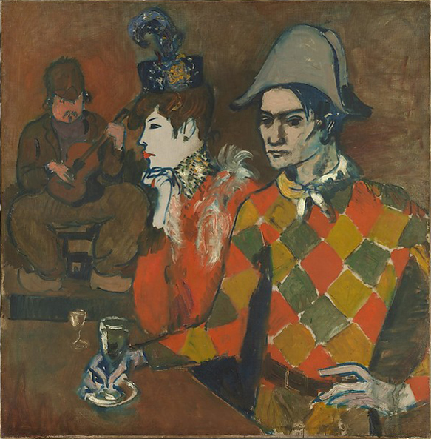
Separating foreground & background
Pablo Picasso (1905). “Au Lapin Agile”.

Slide 68
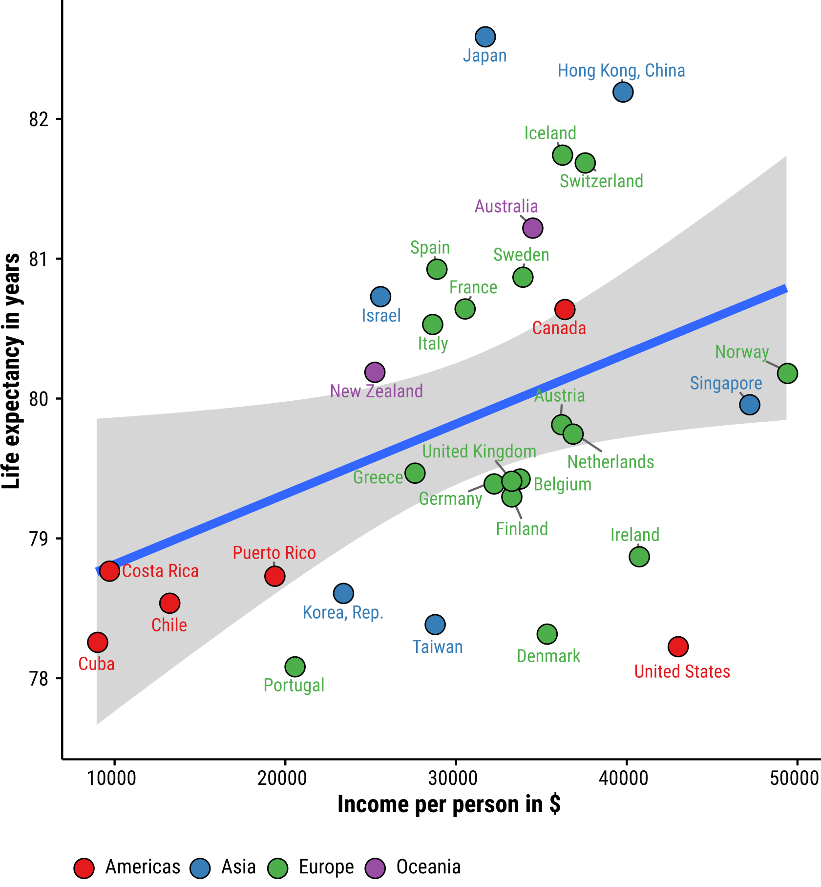
Separating foreground & background
Data: gapminder.org – displayed are data for the year 2007.

Slide 69
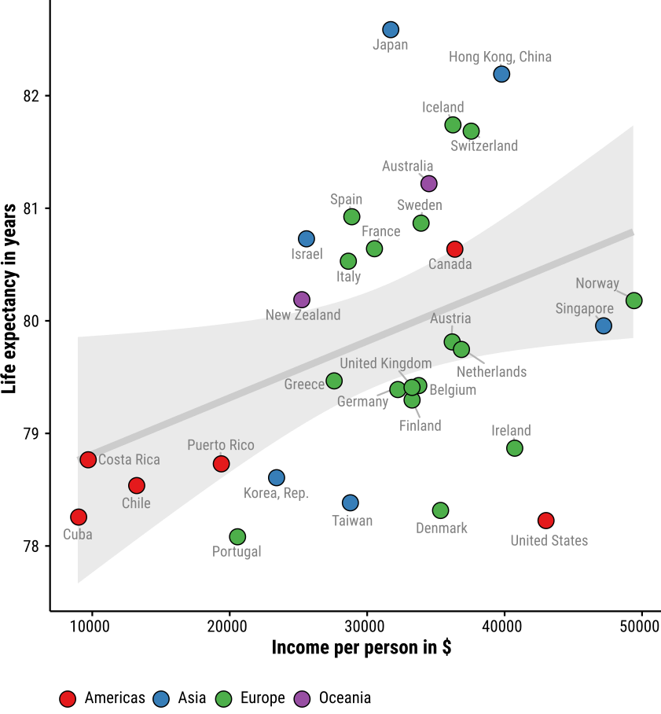
Separating foreground & background
Data: gapminder.org – displayed are data for the year 2007.

Slide 70
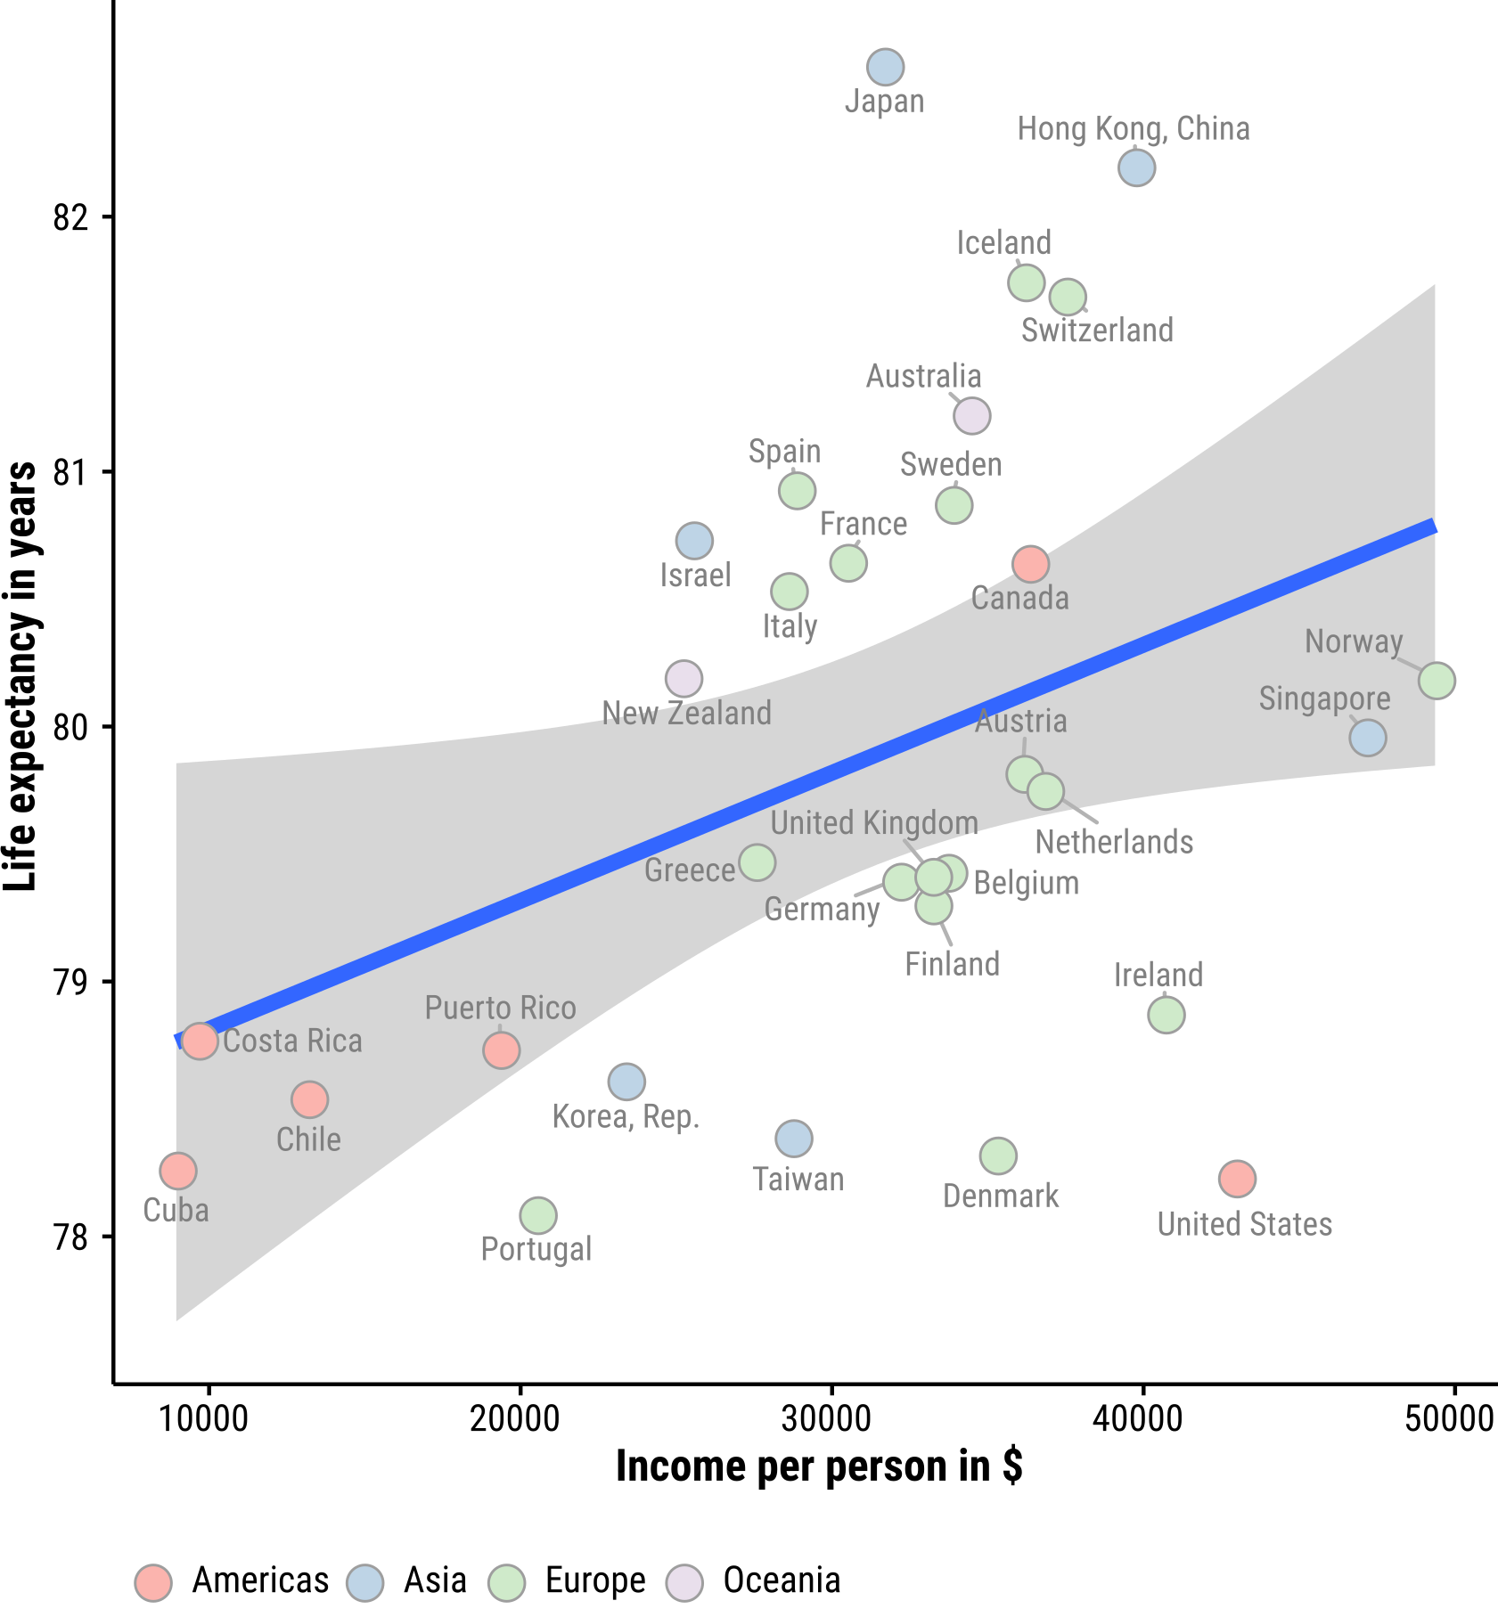
Separating foreground & background
Data: gapminder.org – displayed are data for the year 2007.

Slide 71
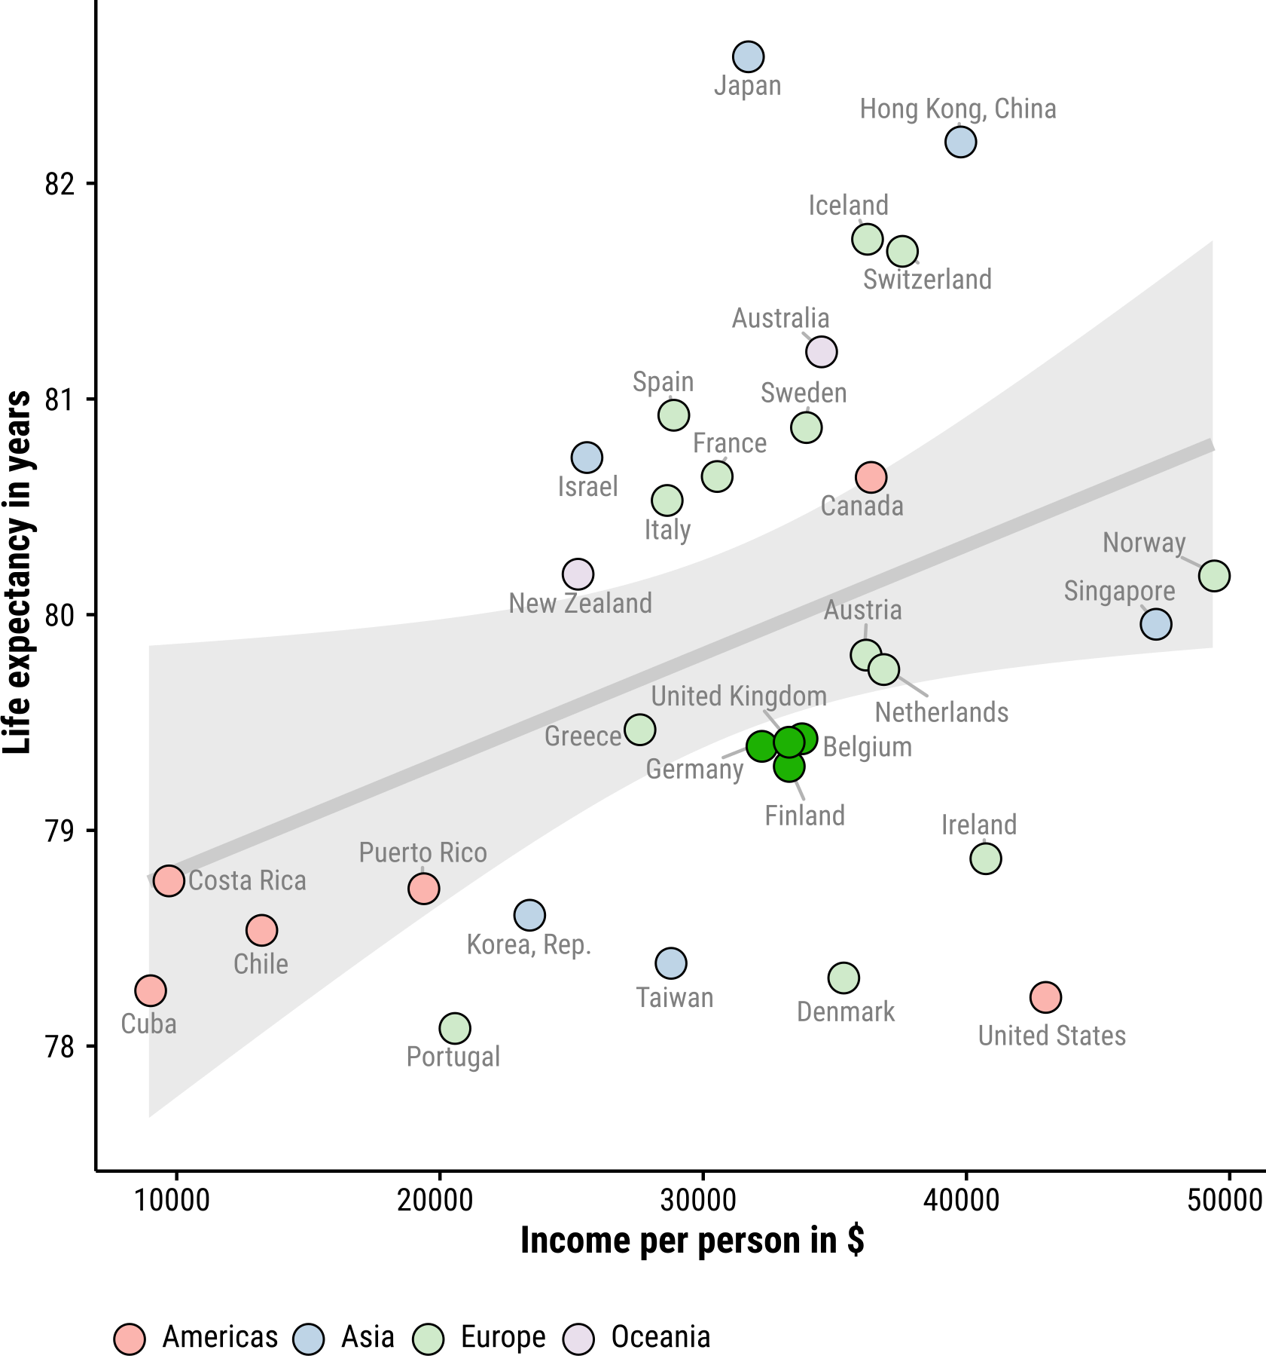
Separating foreground & background
Data: gapminder.org – displayed are data for the year 2007.

Slide 72
Further reading
Brilliant color advice from NASA earthobservatory.nasa.gov/blogs/elegantfigures/2013/08/05/subtleties-of-color-part-1-of-6
Seminal paper on construction of qualitative, sequential, divergent color scales Brewer, Cynthia A. 1994. “Guidelines for Use of the Perceptual Dimensions of Color for Mapping and Visualization.” In SPIE, edited by Jan Bares, 2171:54–63. doi:10.1117/12.175328.
Color scales for data-viz colorbrewer2.org

Slide 73
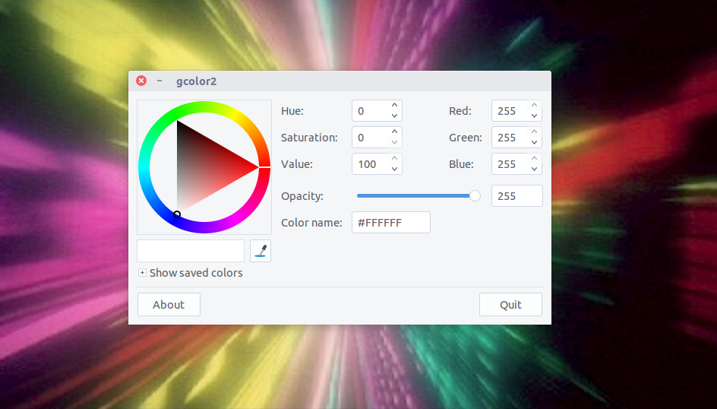
You take control!

Slide 74
Slides available at
github.com/jschoeley/idem_viz
Jonas Schöley
jschoeley@health.sdu.dk
Twitter: @jschoeley

