Slide 1

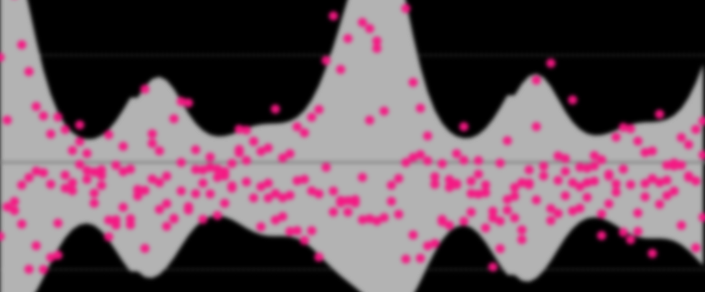
Empirical Prediction Intervals Applied to Short-term Mortality and Excess Deaths
Ricarda Duerst^{1,2}, Jonas Schöley¹
¹ Max Planck Institute for Demographic Research ² University of Helsinki

Slide 2
How many more deaths occur because of Covid-19?
Excess Deaths

Slide 3
How many more deaths occur because of Covid-19?
Excess Deaths
Observed Deaths
Expected Deaths

Slide 4


How many more deaths occur because of Covid-19?
Expected Deaths
Short-term mortality forecasts of weekly deaths

Slide 5
How to get prediction intervals? Parametric prediction intervals:
Notes:
Plot: single data series of deaths for Germany with model fit, forecast and negative binomial PI; highlight uniform width of PI

Slide 6
How to get prediction intervals? Empirical prediction intervals:
A forecast is only as precise as similar forecasts in the past turned out to be.

Slide 7
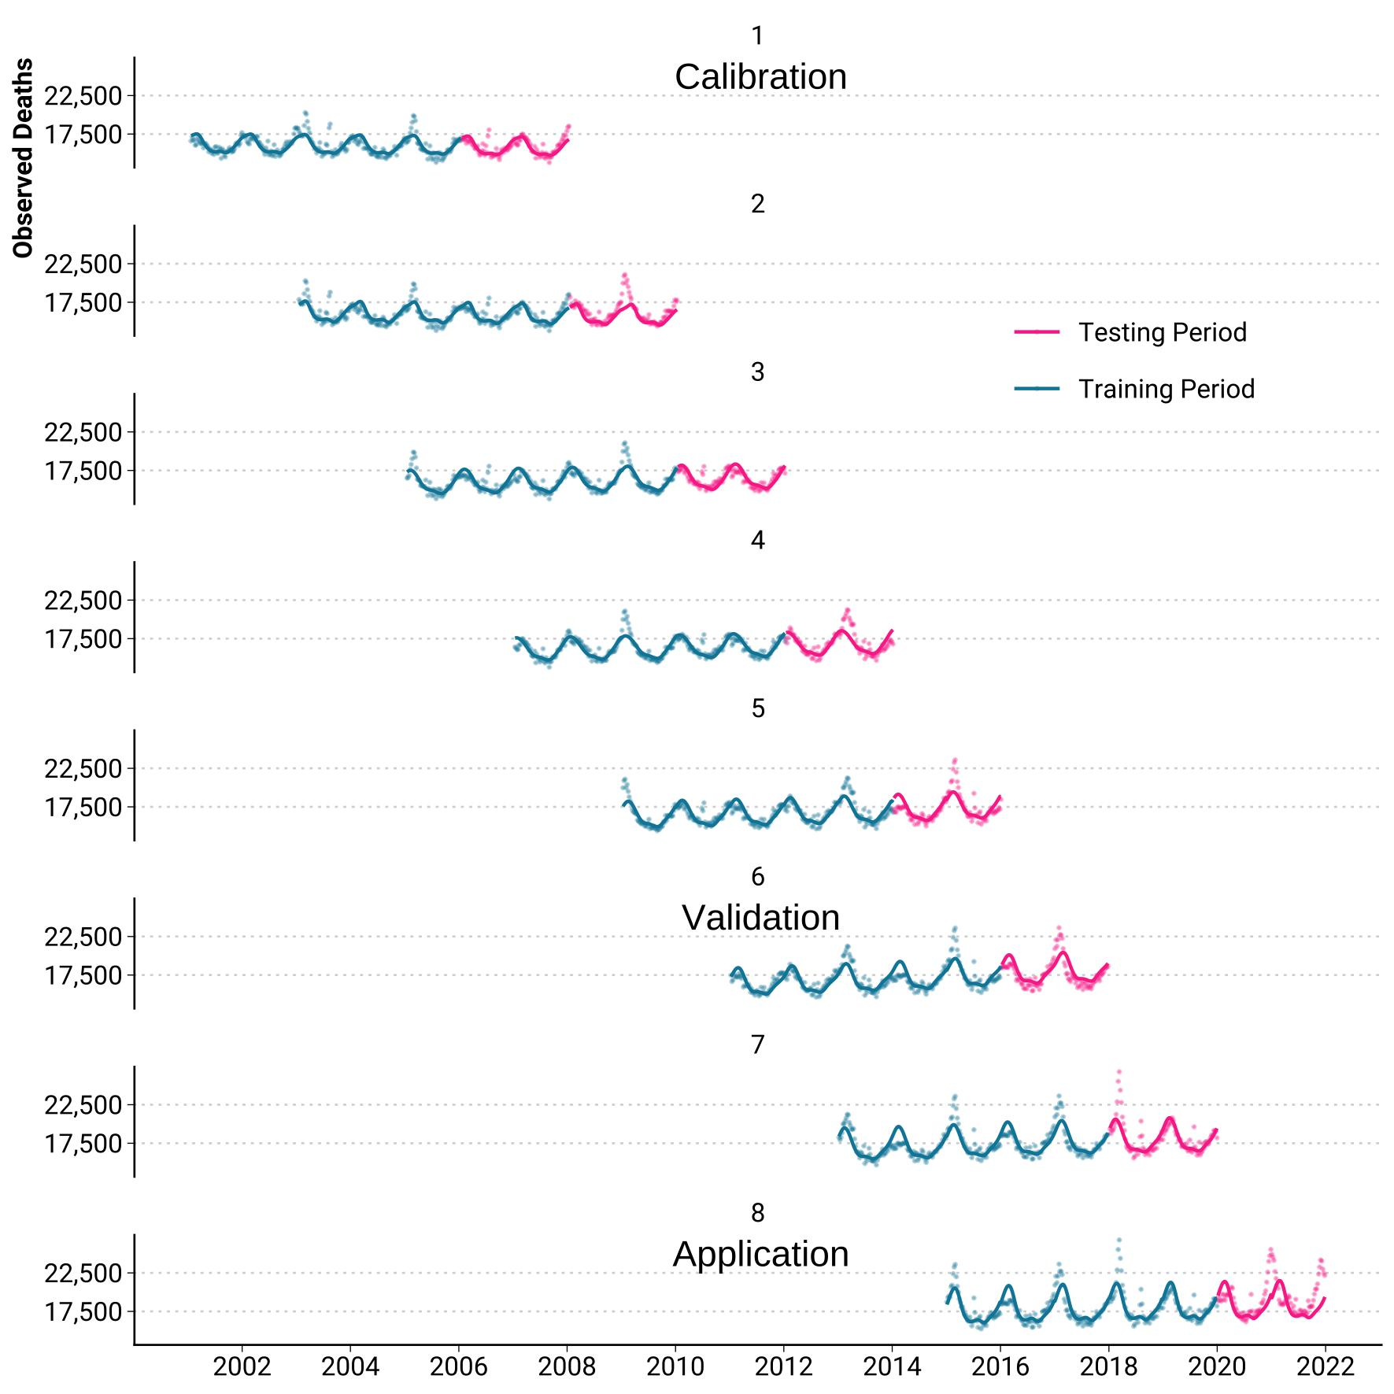
How to get empirical prediction intervals?

Slide 8
How to get empirical prediction intervals?
Forecast Error

Slide 9
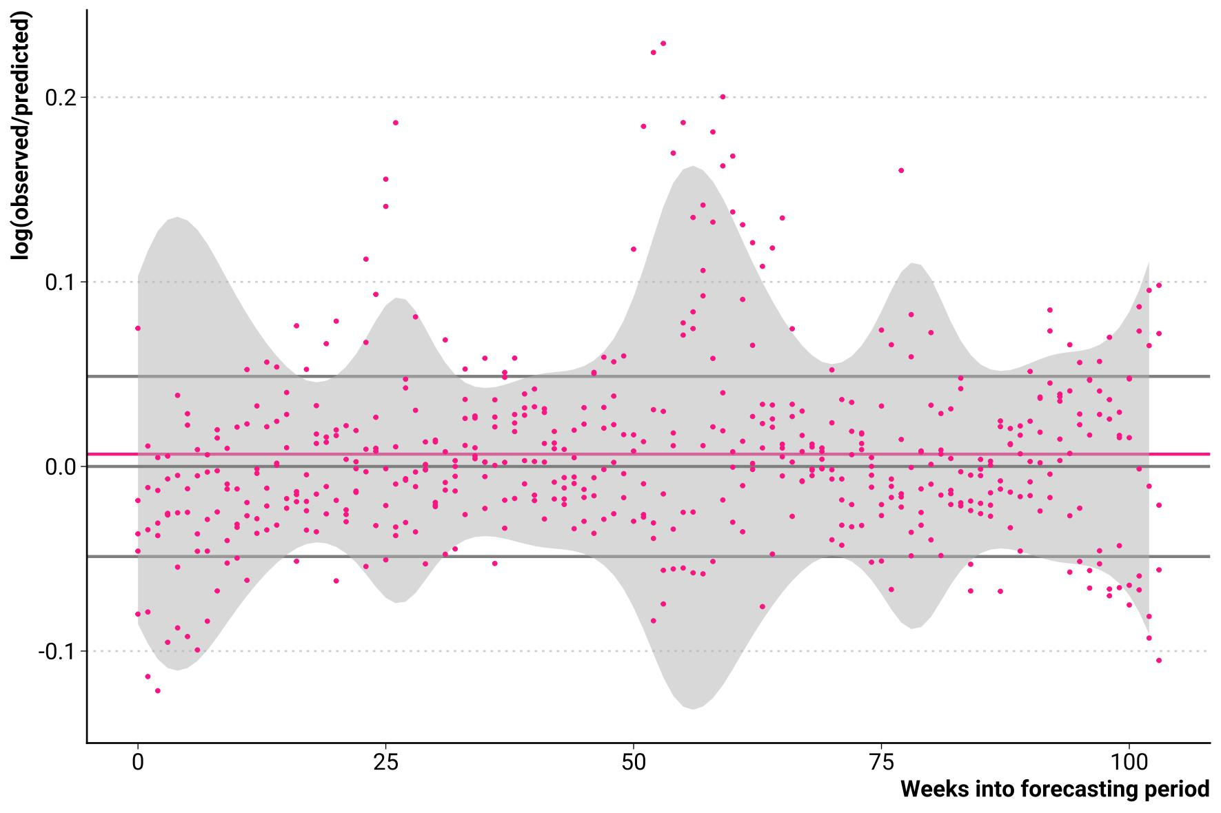

How to get empirical prediction intervals?
Distribution of the forecast error

Slide 10

How to get empirical prediction intervals?
Time-varying skew-normal model of the distribution
Distribution of the forecast error

Slide 11
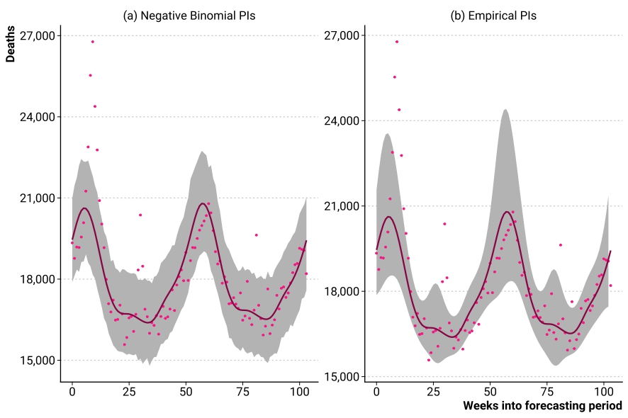
How to get empirical prediction intervals?

Slide 12
Let’s validate empirical prediction intervals!
Winter
Summer

Slide 13
Let’s validate empirical prediction intervals!
Winter
Nominal coverage: 90%
 | Coverage | Interval score
Negative binomial PIs | 0.87 | 5769
Empirical PIs | 0.81 | 5300
Summer

Slide 14
At the current stage of the COVID-19 pandemic, can we detect a 10% increase in excess deaths or would it disappear into the uncertainty of the expected deaths forecasts?

Slide 15
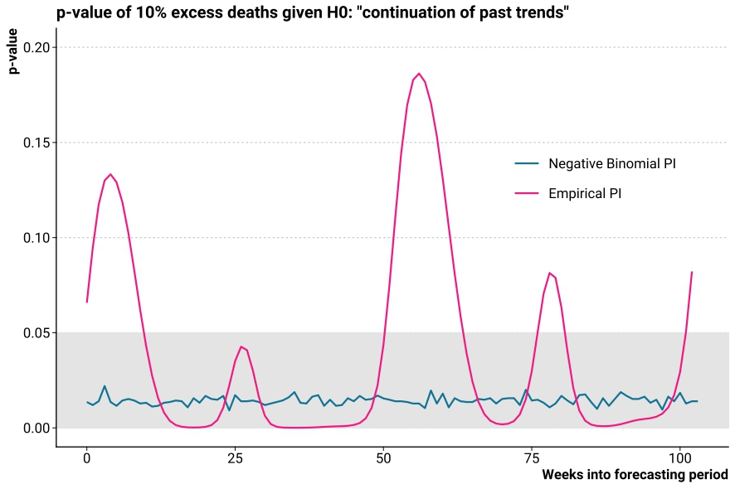
Can we detect a 10% increase in excess deaths
at the current stage of the COVID-19 pandemic?
Winter
No!
Yes!
Summer

Slide 16

Empirical Prediction intervals are great!
Ricarda Duerst
MPIDR University of Helsinki
duerst@demogr.mpg.de
Jonas Schöley
MPIDR
schoeley@demogr.mpg.de
Notes:
Insert QR Code to working paper

