Slide 1


The Gestational Age Pattern of Human Mortality
Jonas Schöley, James W. Vaupel,
Rune Lindahl-Jacobsen and James Oeppen
jschoeley@health.sdu.dk
Max-Planck Odense Center on the Biodemography of Aging
Department of Public Health
University of Southern Denmark

Slide 2
onto|gen¦ecence, noun
“Ontogenescence is a population-level phenomenon in which the death rate of each cohort tends to decrease with increasing age between conception and maturity.”
(Levitis 2011)

Slide 3
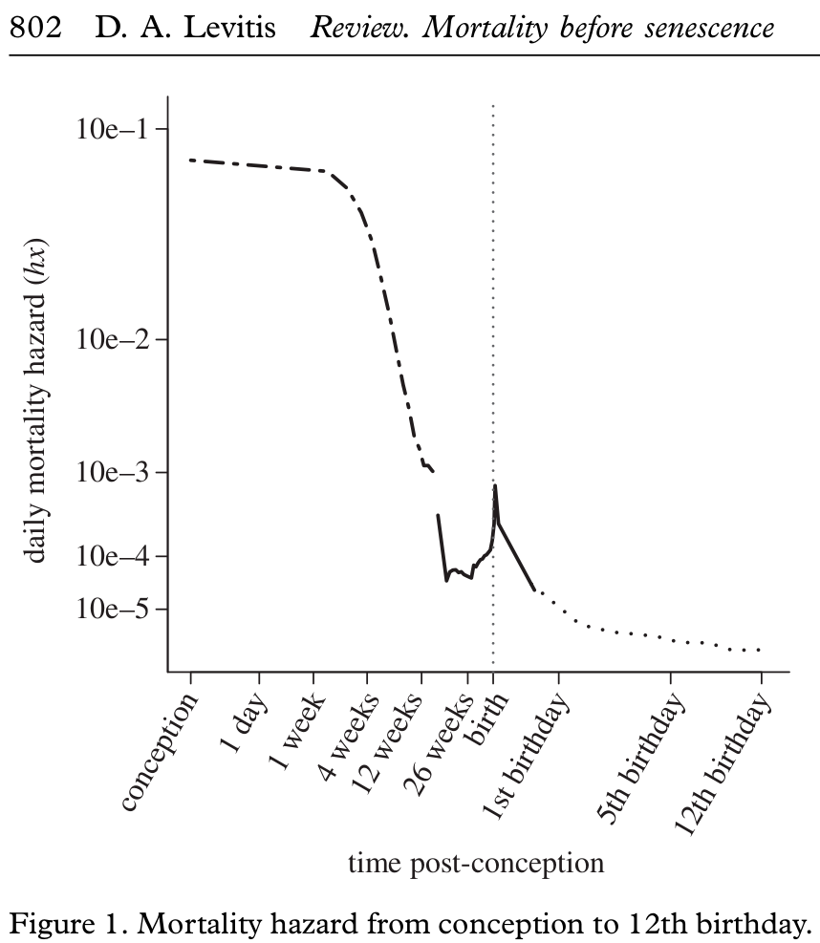
The Age Pattern of Ontogenescence
Levitis, Daniel A. (2011). “Before senescence: the evolutionary demography of ontogenesis”. In: Proceedings of the Royal Society B 278, pp. 801–809.

Slide 4
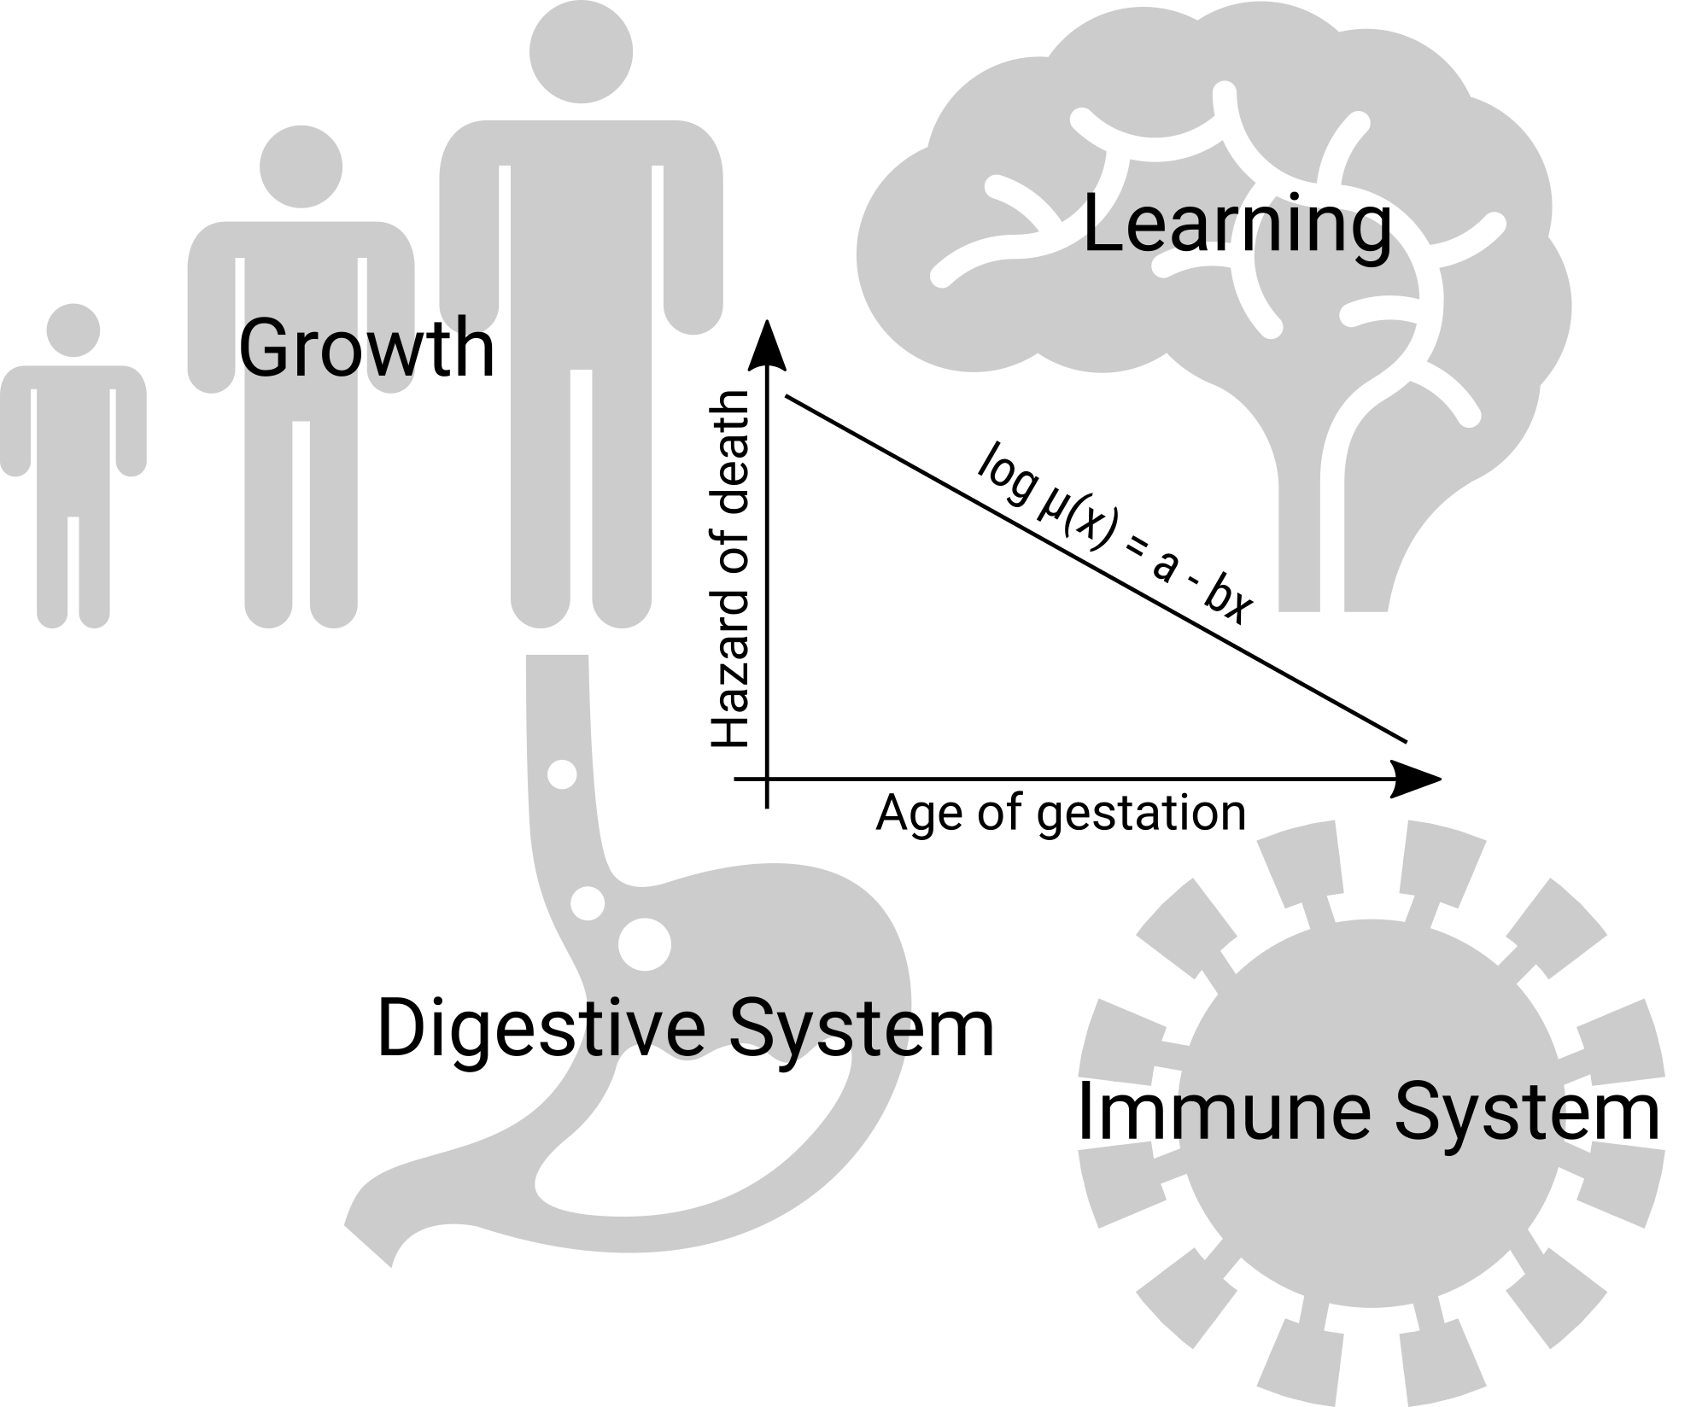
Acquired Robustness

Slide 5
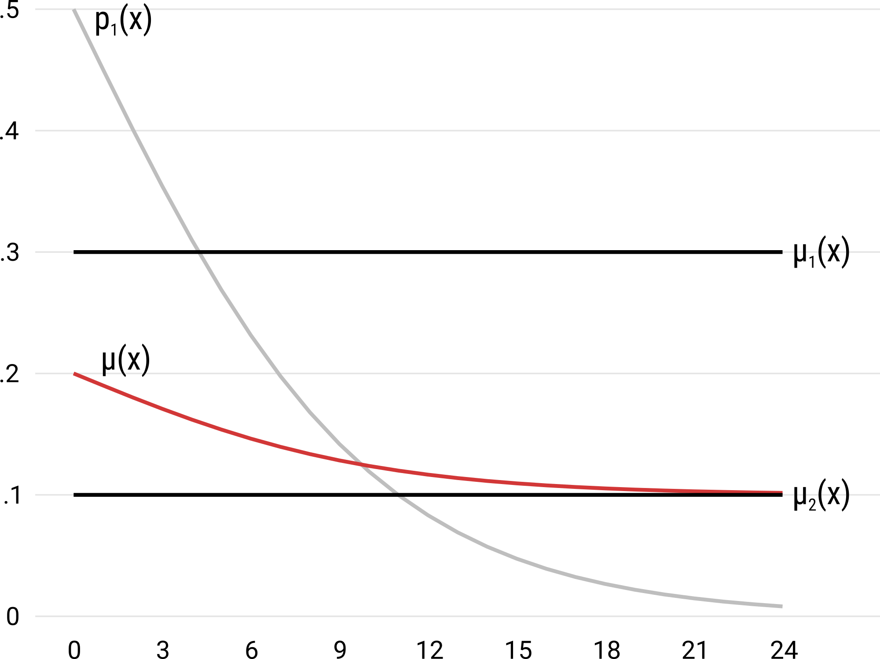
Mortality Selection
See Vaupel, James W. and Yashin, A. I. (1985). “Heterogeneities Ruses. Some Surprising Effects of Selection on Population Dynamics. In: The American Statistician. 39, 3, 176–185.

Slide 6
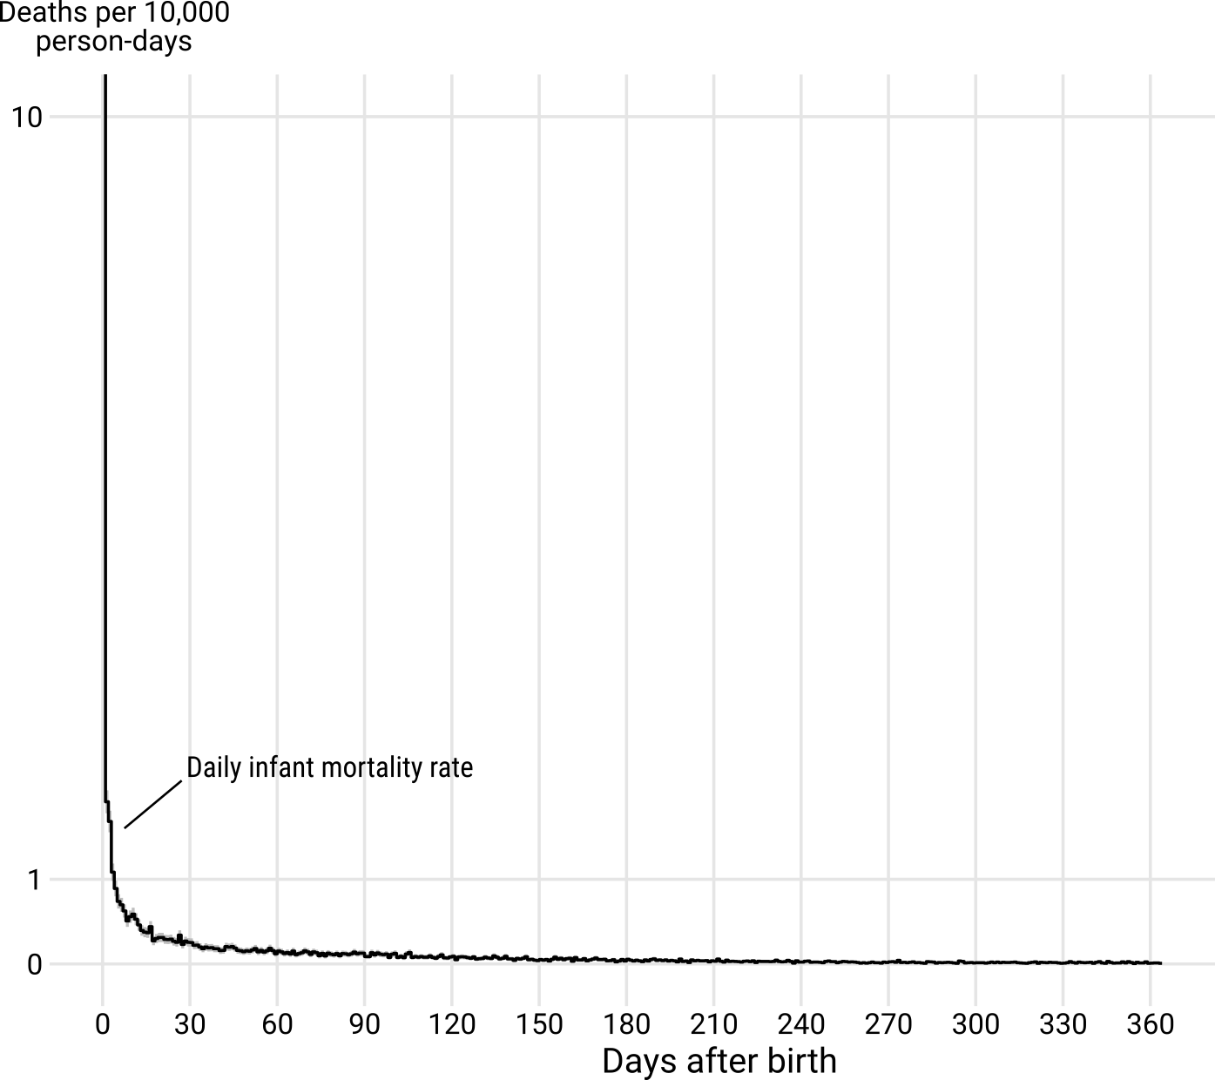
Transition of Birth
US conception cohort 2009, males & females. Data on births and infant deaths: Division of Vital Statistics.

Slide 7
Postnatal- & Gestational Age
Time post conception
Time post
birth
Levitis, Daniel A. (2011). “Before senescence: the evolutionary demography of ontogenesis”. In: Proceedings of the Royal Society B 278, pp. 801–809.

Slide 8
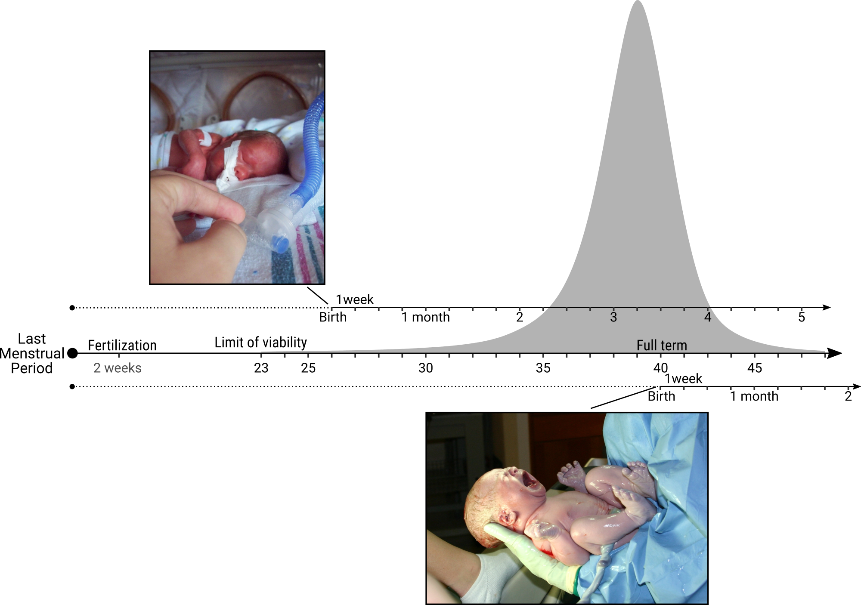
Postnatal- & Gestational Age

Slide 9
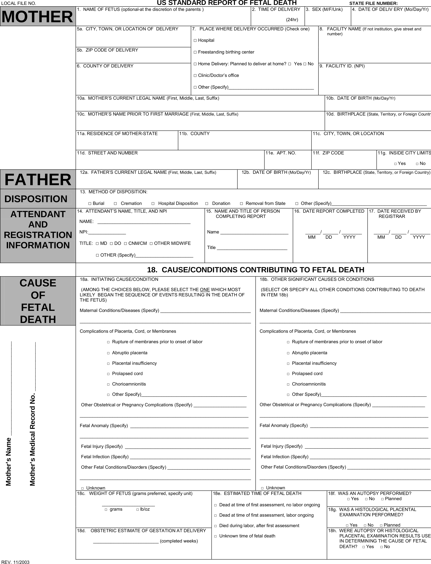
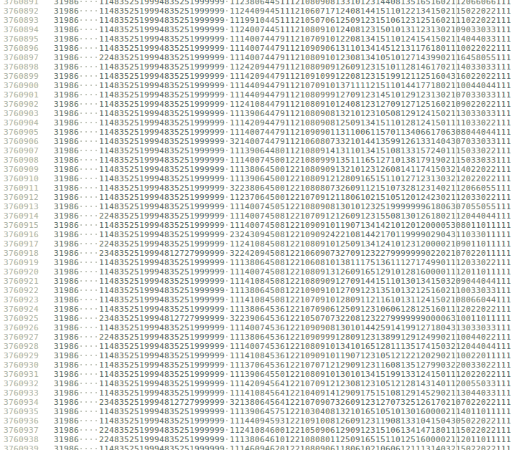
US Certificates for Birth, Fetal- & Infant Death
cdc.gov/nchs/data_access/Vitalstatsonline.htm

Slide 10
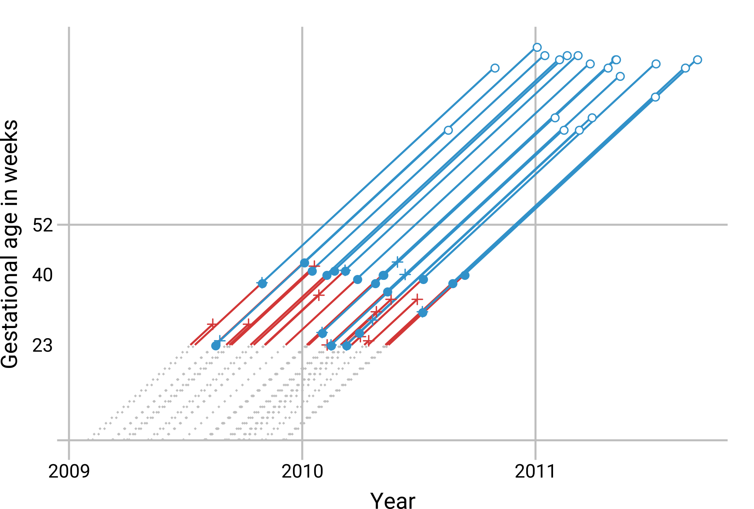
The Conception Cohort

Slide 11
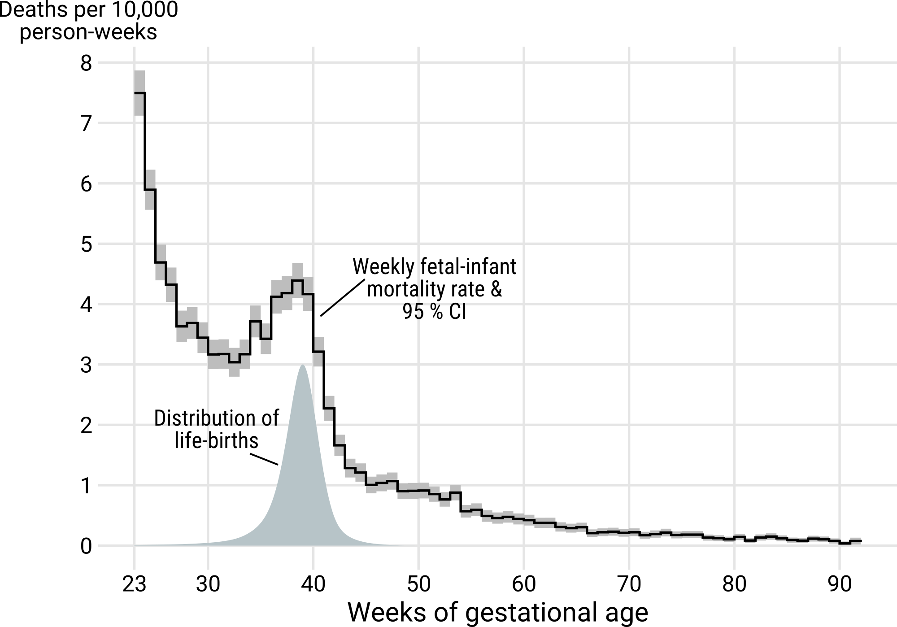
Fetal-Infant Gestational Age Mortality, US 2009, Male
US conception cohort 2009, males. Data on births, fetal- and infant deaths: Division of Vital Statistics.

Slide 12
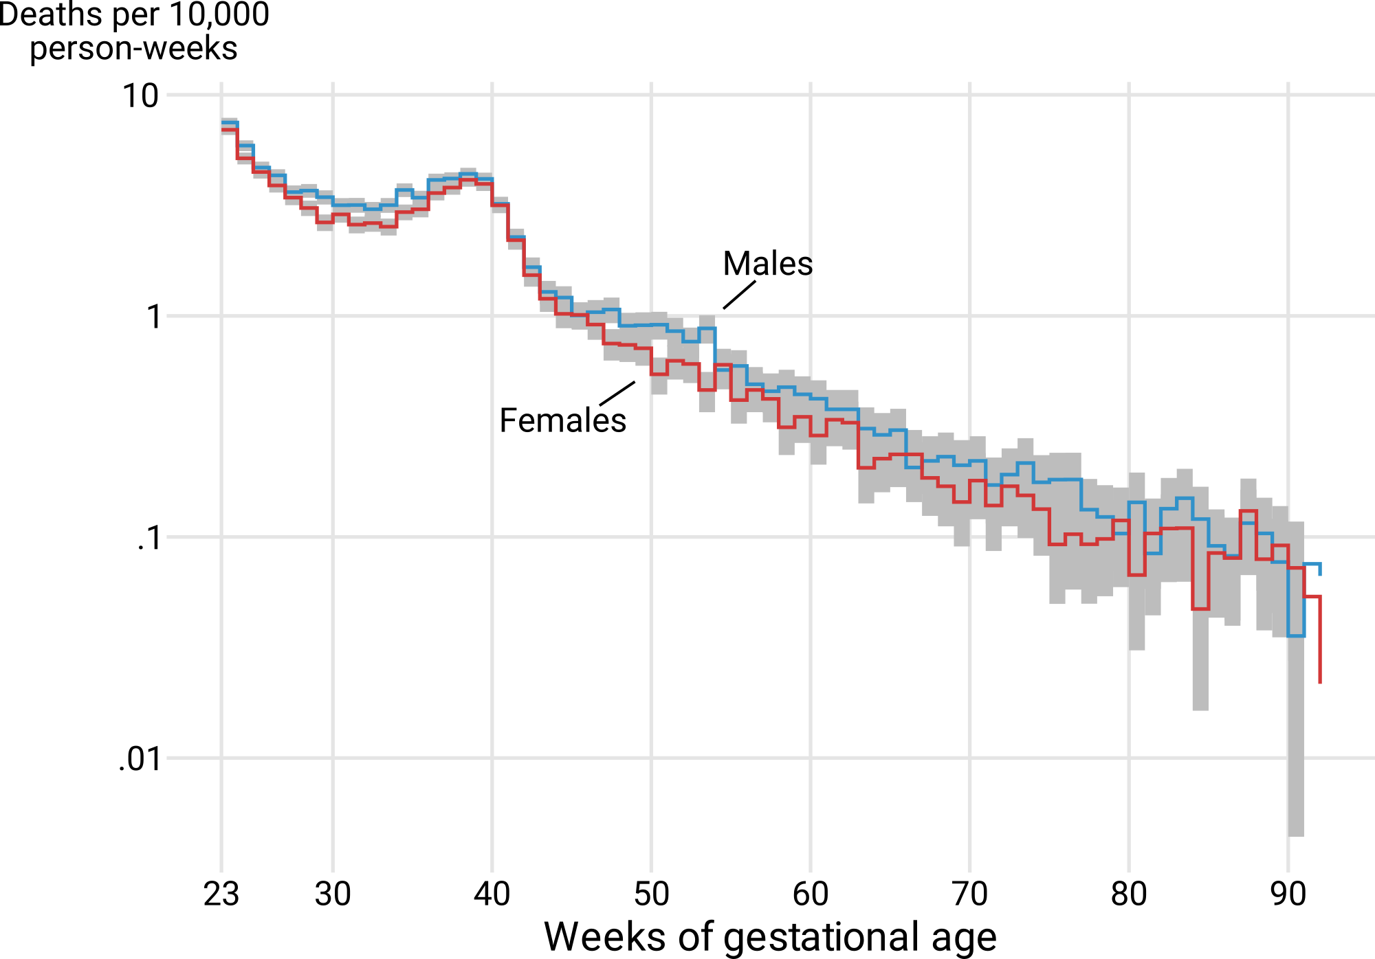
Fetal-Infant Gestational Age Mortality, US 2009
US conception cohort 2009. Data on births, fetal- and infant deaths: Division of Vital Statistics.

Slide 13
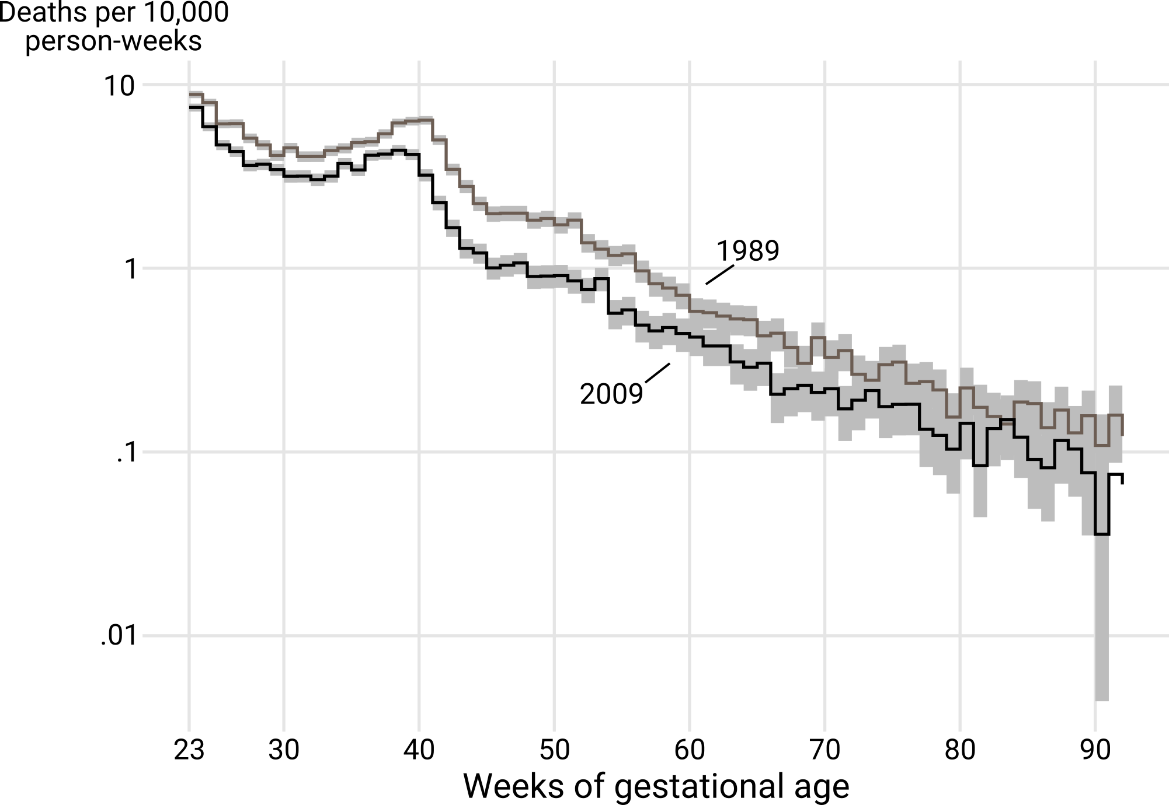
Fetal-Infant Gestational Age Mortality, US 2009
US conception cohort 2009, males. Data on births, fetal- and infant deaths: Division of Vital Statistics.

Slide 14
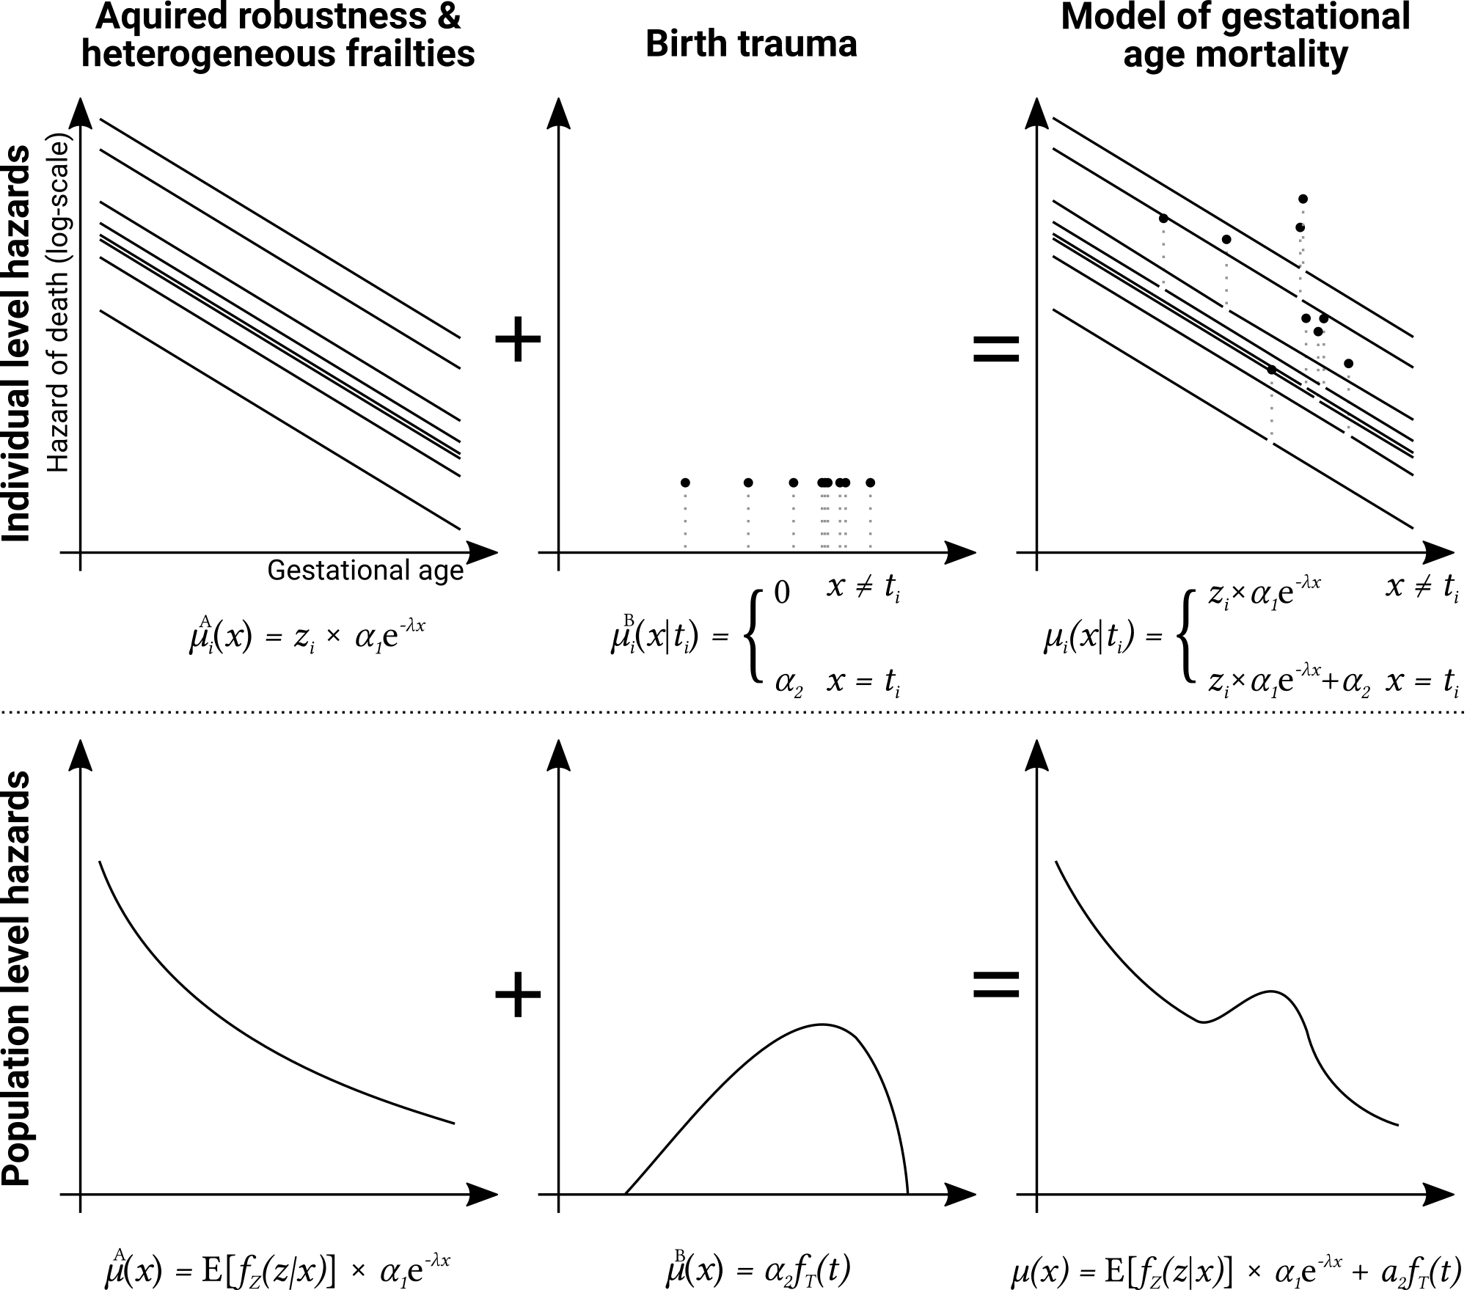
A Model of Ontogenescent Mortality

Slide 15
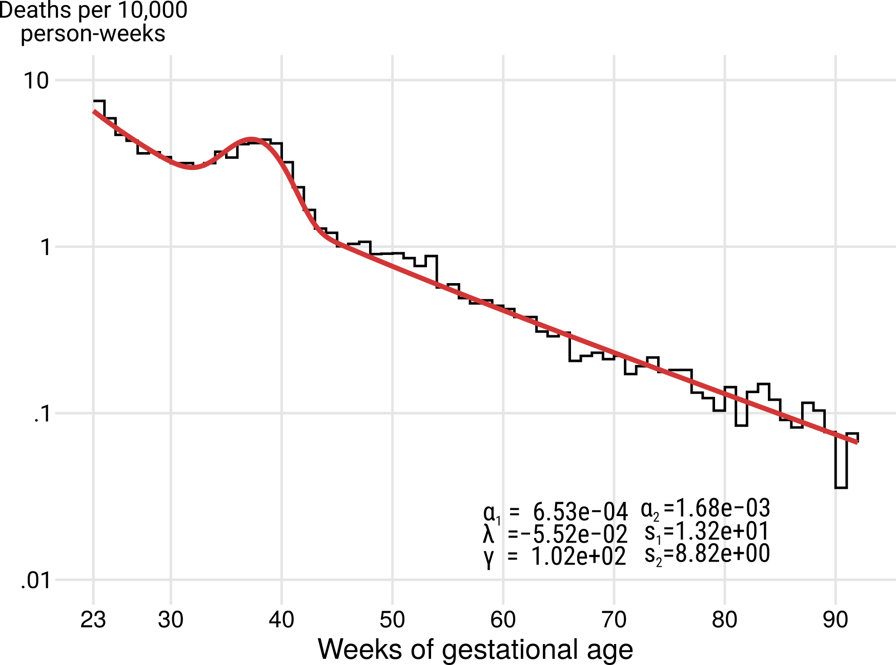
A Model of Ontogenescent Mortality

Slide 16
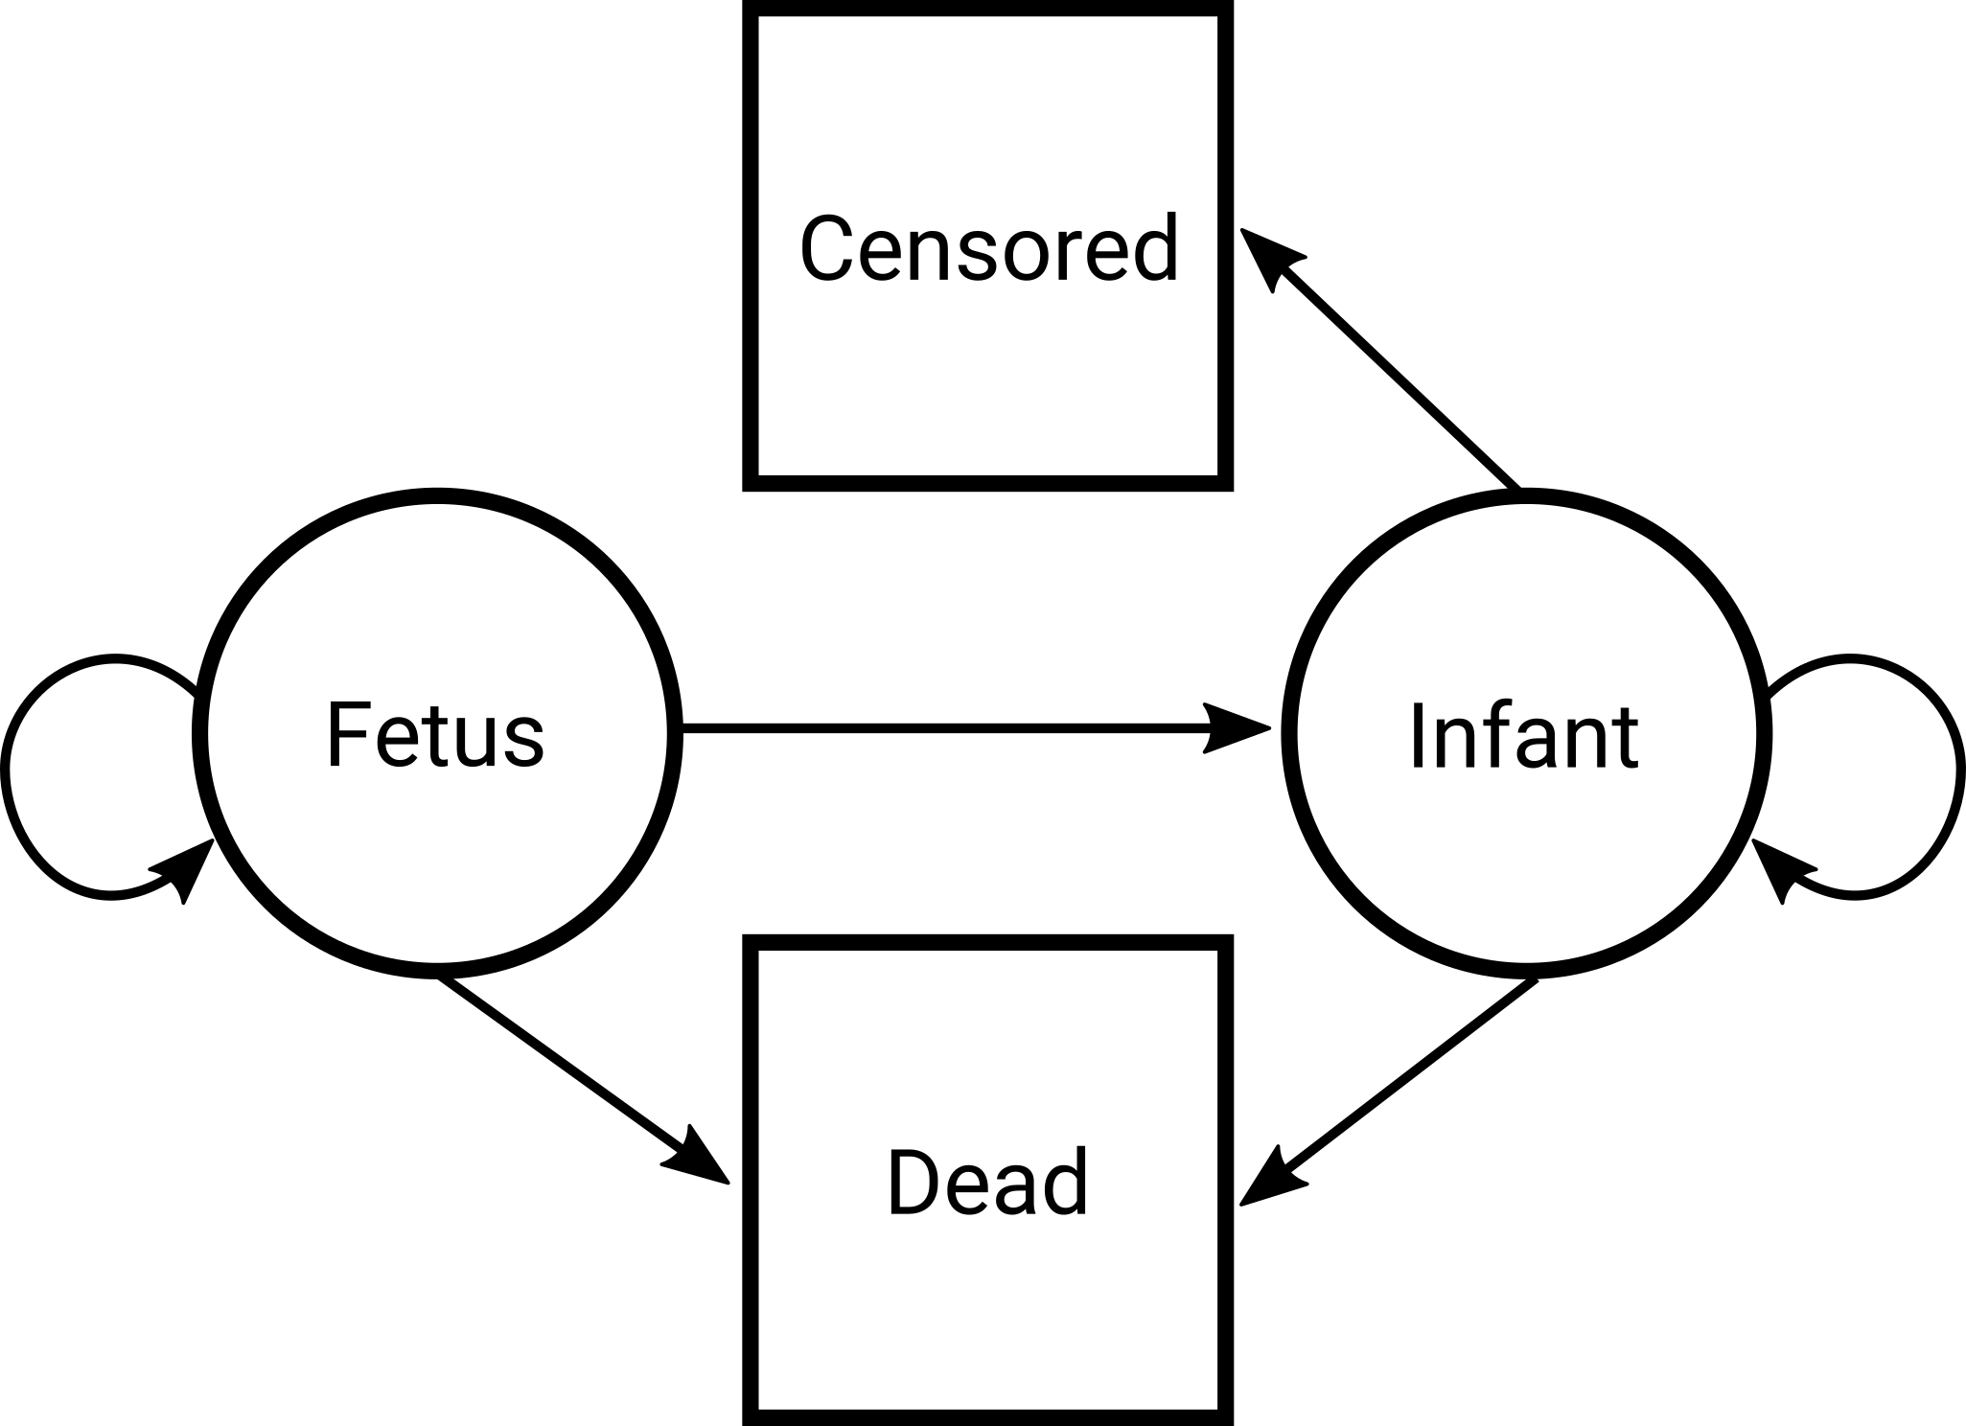
A Multistate Fetal-Infant Lifetable

Slide 17
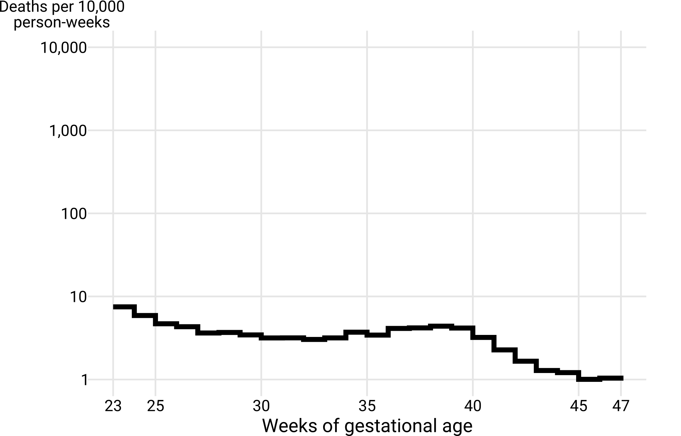
A Multistate Fetal-Infant Lifetable
US conception cohort 2009, males. Data on births, fetal- and infant deaths: Division of Vital Statistics.

Slide 18
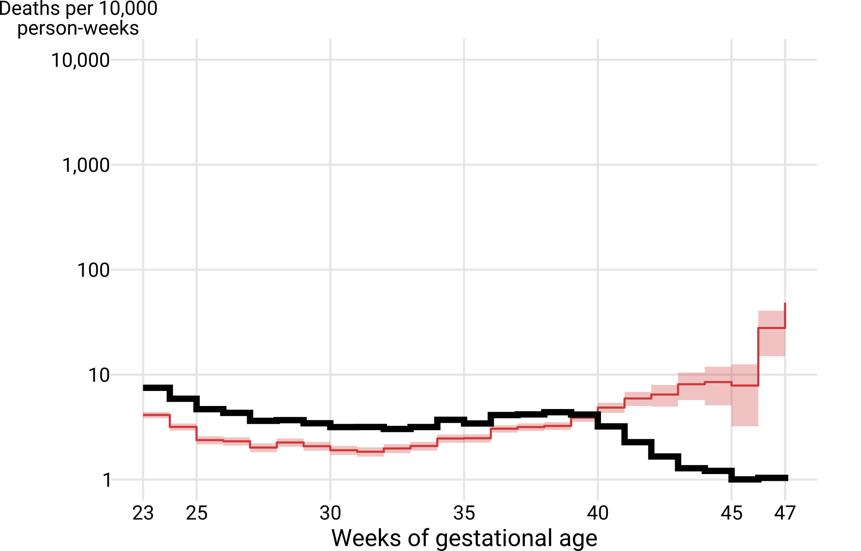
A Multistate Fetal-Infant Lifetable
US conception cohort 2009, males. Data on births, fetal- and infant deaths: Division of Vital Statistics.

Slide 19
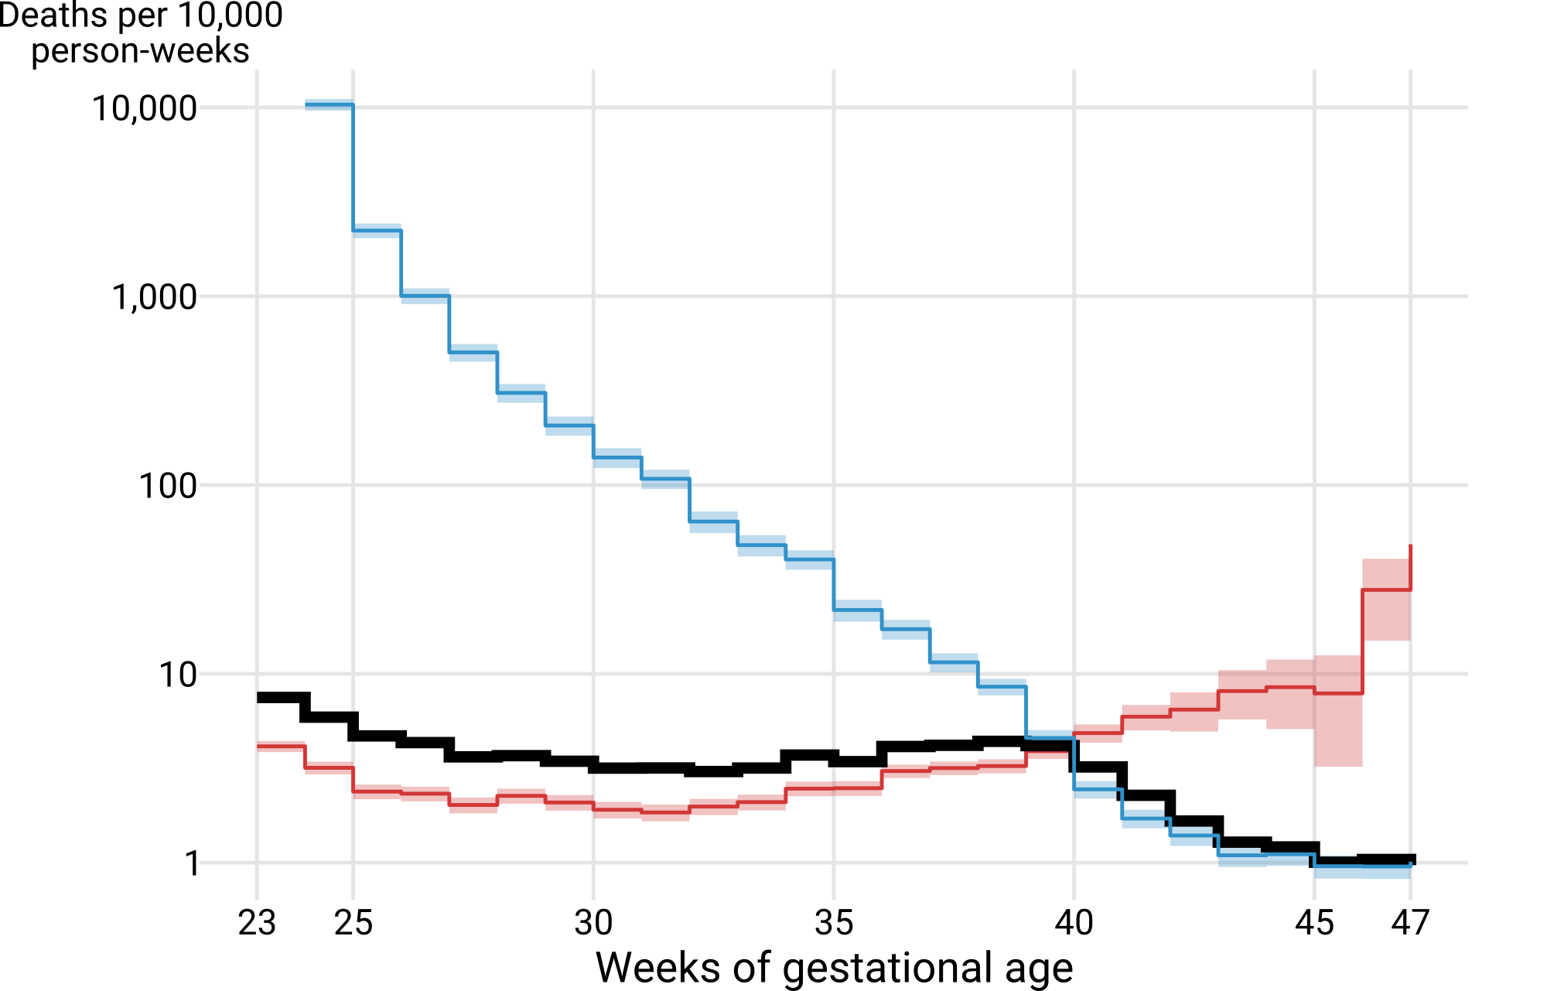
A Multistate Fetal-Infant Lifetable
US conception cohort 2009, males. Data on births, fetal- and infant deaths: Division of Vital Statistics.

Slide 20
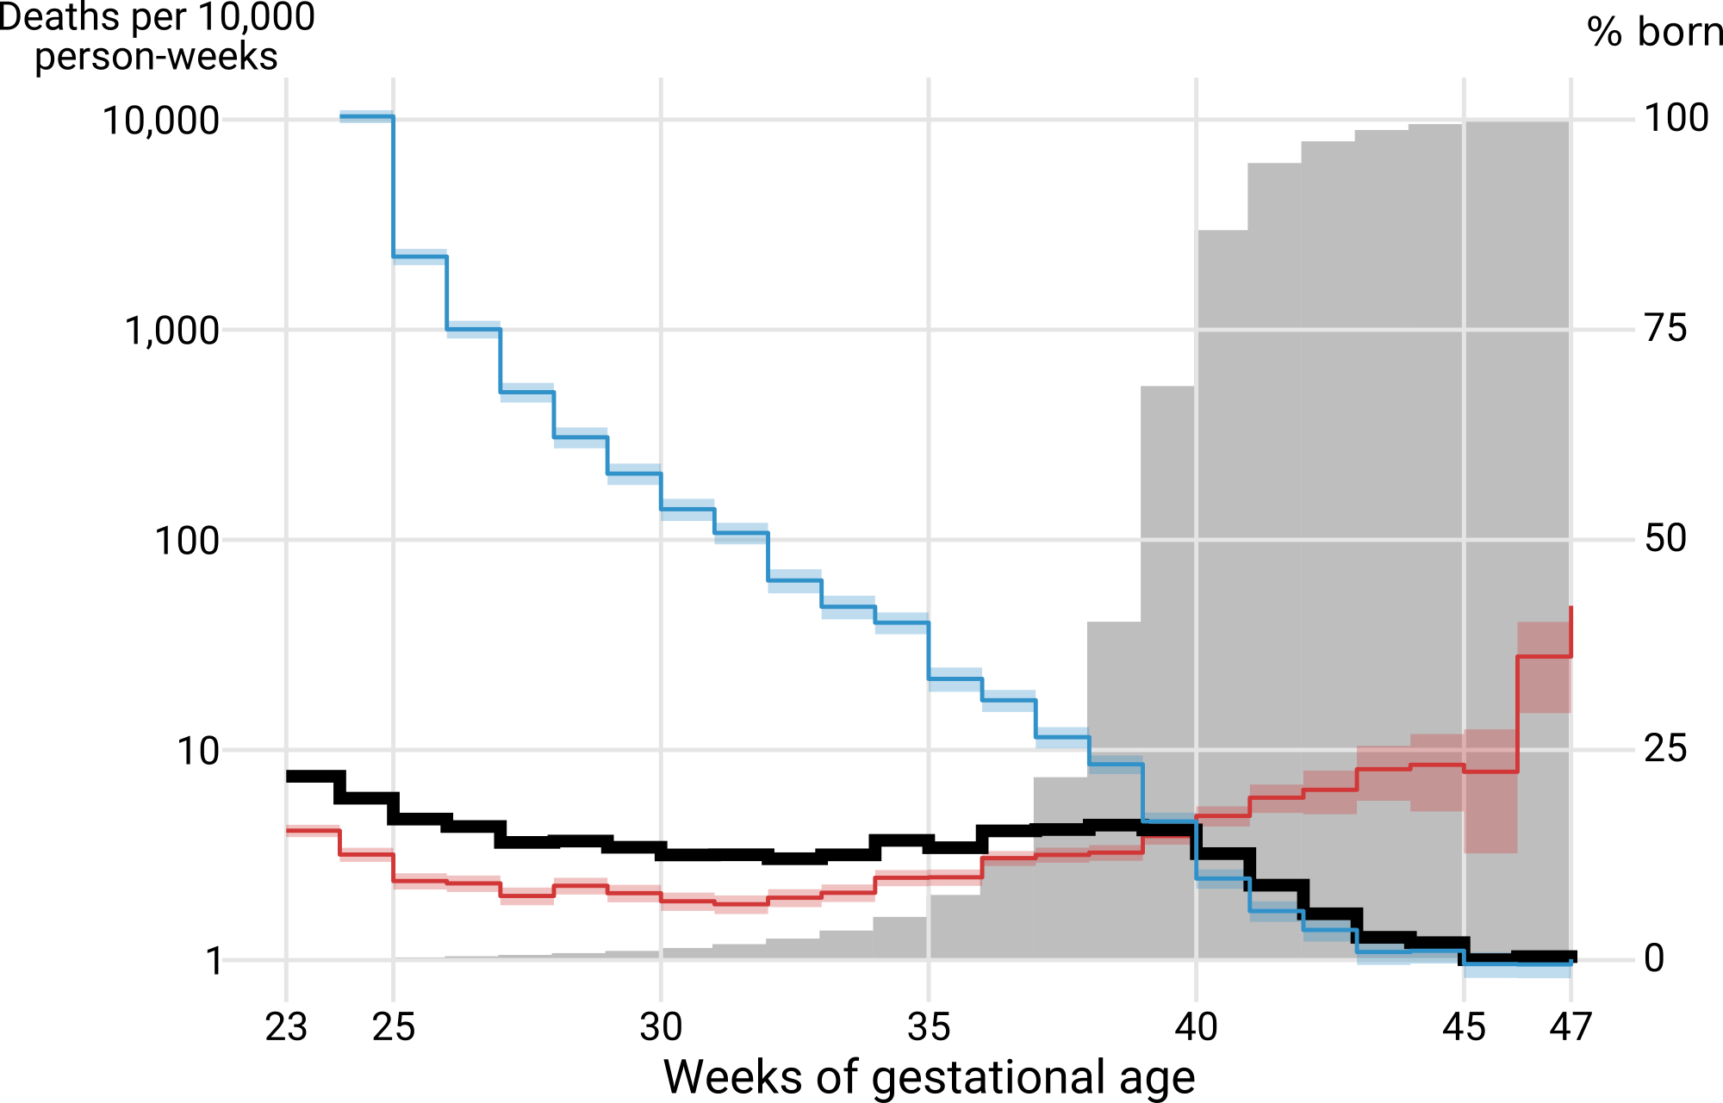
A Multistate Fetal-Infant Lifetable
US conception cohort 2009, males. Data on births, fetal- and infant deaths: Division of Vital Statistics.

Slide 21
The Age Pattern of Ontogenescence
Levitis, Daniel A. (2011). “Before senescence: the evolutionary demography of ontogenesis”. In: Proceedings of the Royal Society B 278, pp. 801–809.

Slide 22
Raw data on US births, fetal- & infant deaths
cdc.gov/nchs/data_access/Vitalstatsonline.htm
Reproducible analysis
github.com/jschoeley/fimort-agepat
Jonas Schöley
jschoeley@health.sdu.dk
Twitter: @rettungstweet

