Slide 1


The Human Mortality Explorer
jschoeley.shinyapps.io/hmdexp
Jonas Schöley
jschoeley@health.sdu.dk
Twitter: @rettungstweet
Max-Planck Odense Center on the Biodemography of Aging
Department of Public Health
University of Southern Denmark

Slide 2
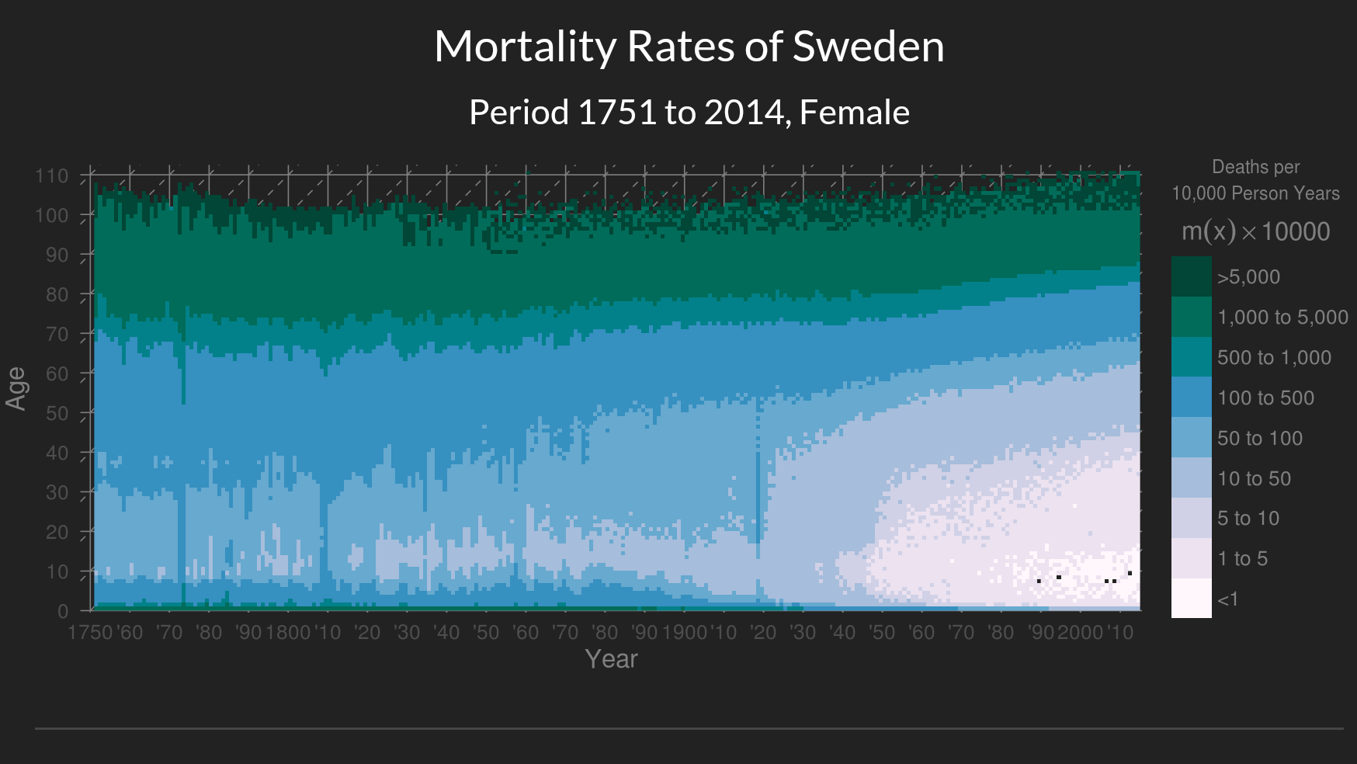
Exploring the Lexis Surface

Slide 3
Task: Navigation

Slide 4
Task: Comparison

Slide 5
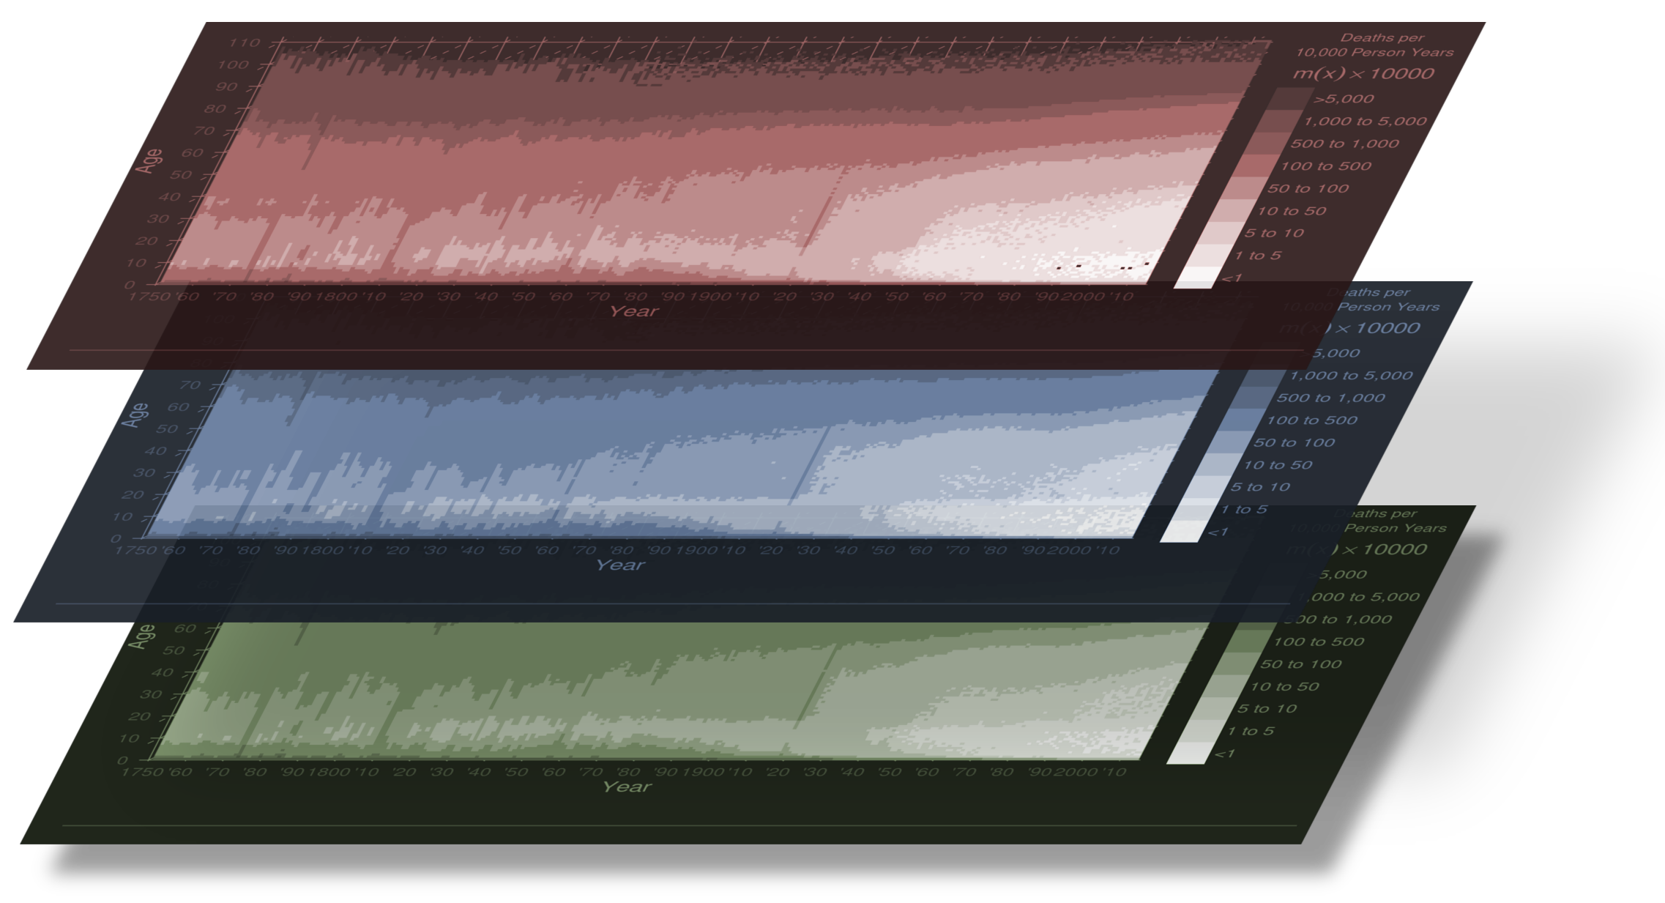
Adding Dimensions
Female
Male
Total

Slide 6
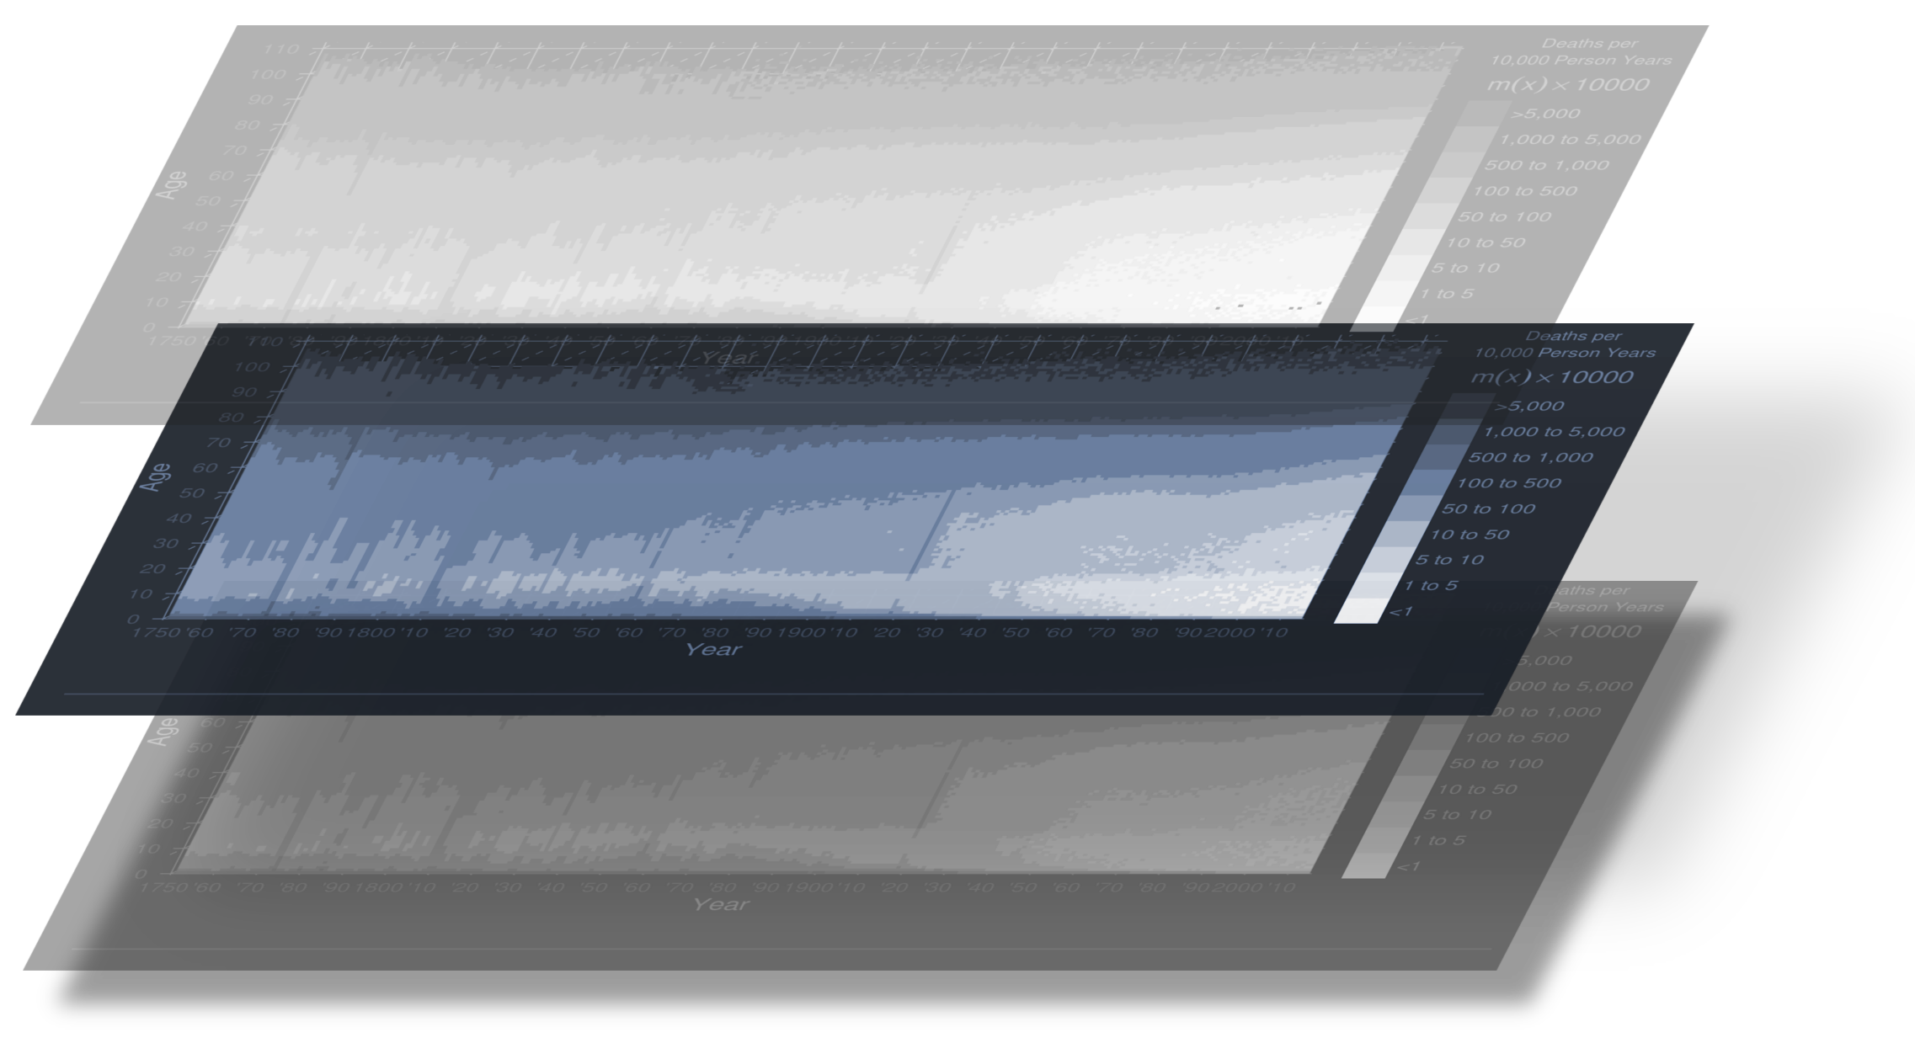
Task: Navigation

Slide 7
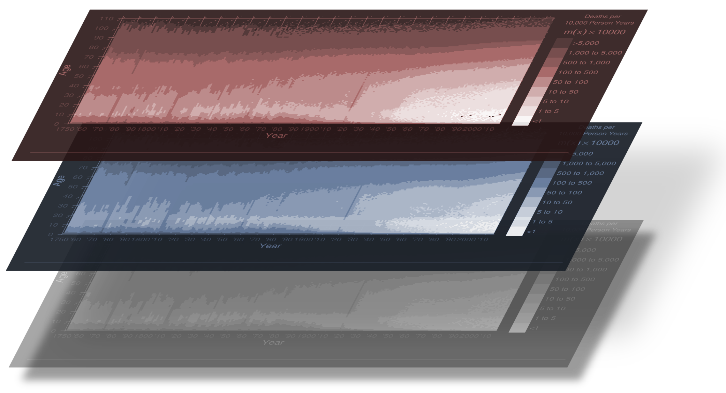
Task: Comparison

Slide 8
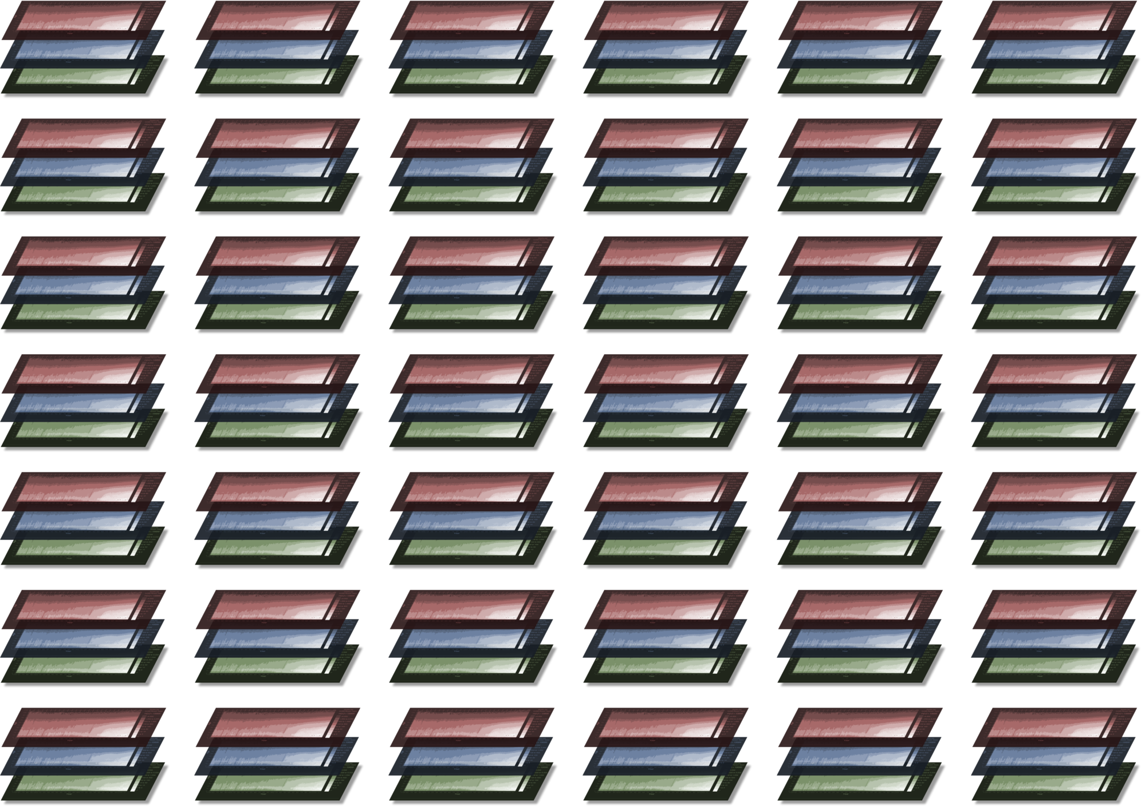
Adding Dimensions

Slide 9
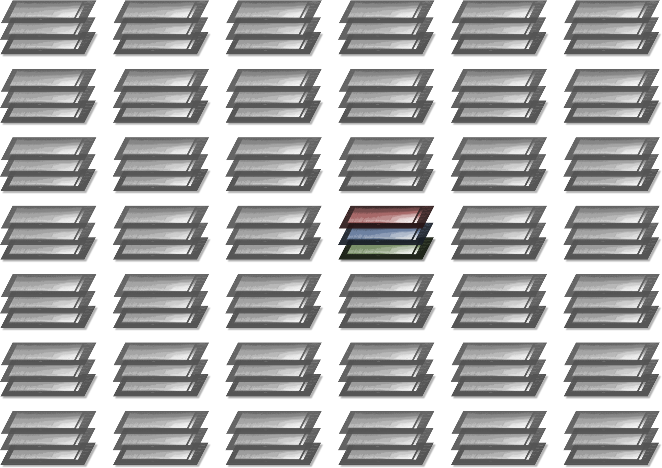
Task: Navigation

Slide 10
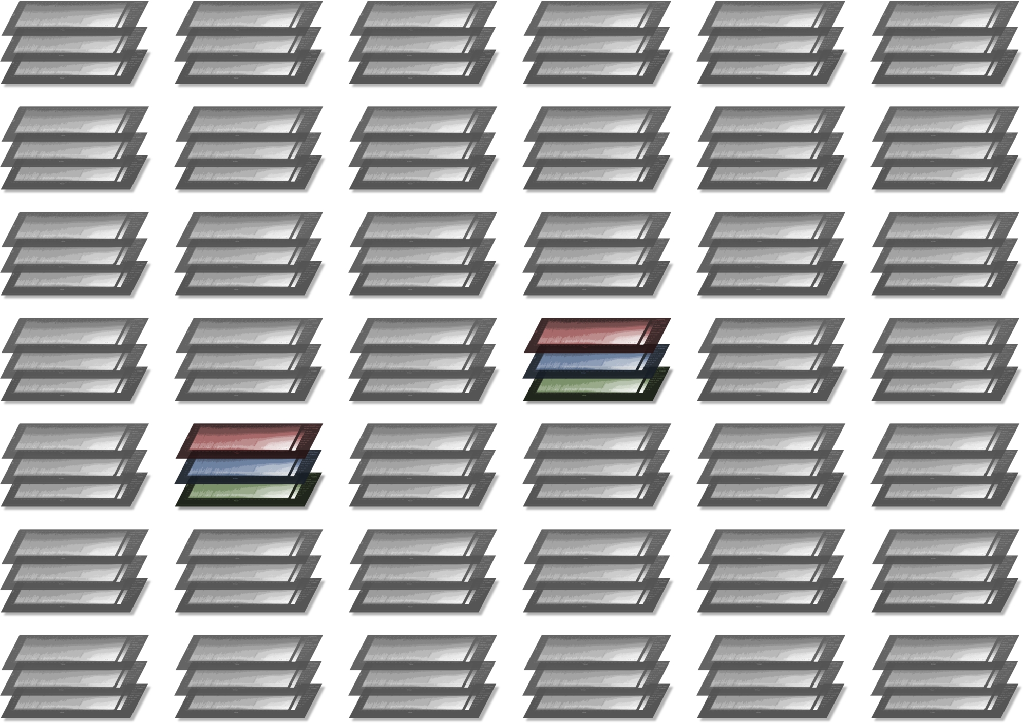
Task: Comparison

Slide 11
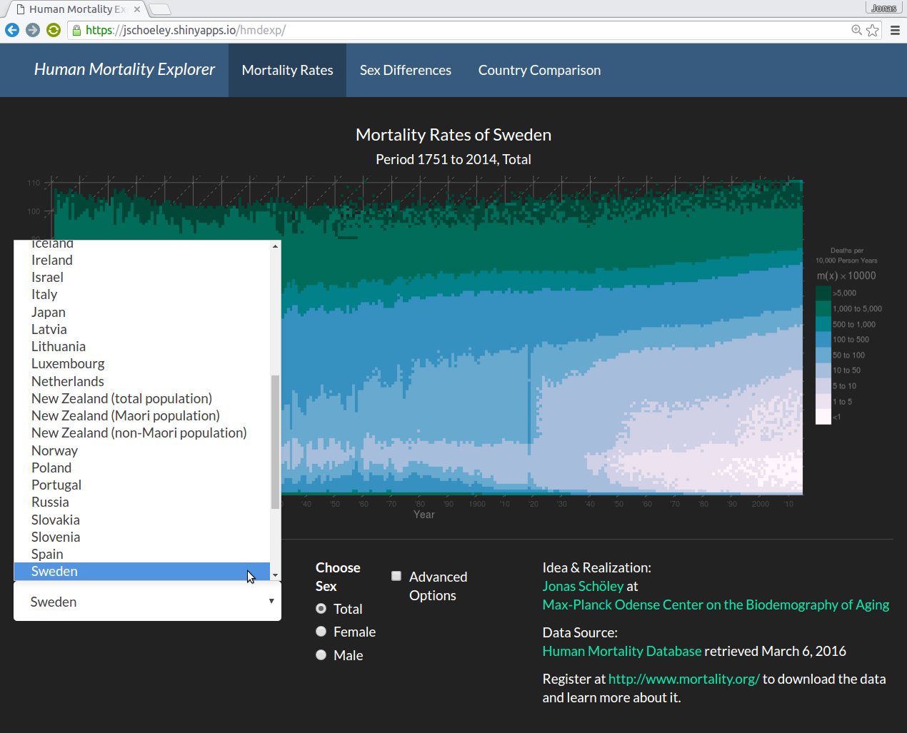
The Human Mortality Explorer

Slide 12
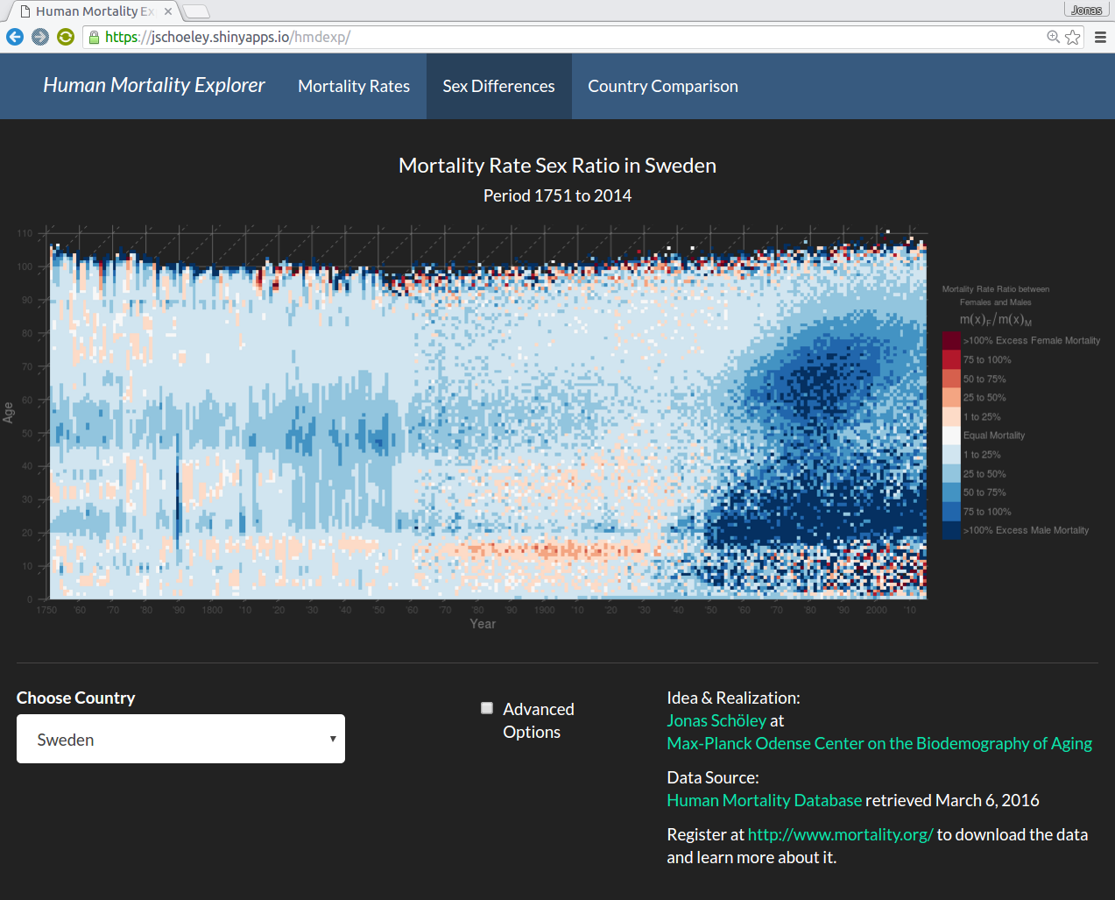
Compare Females & Males

Slide 13
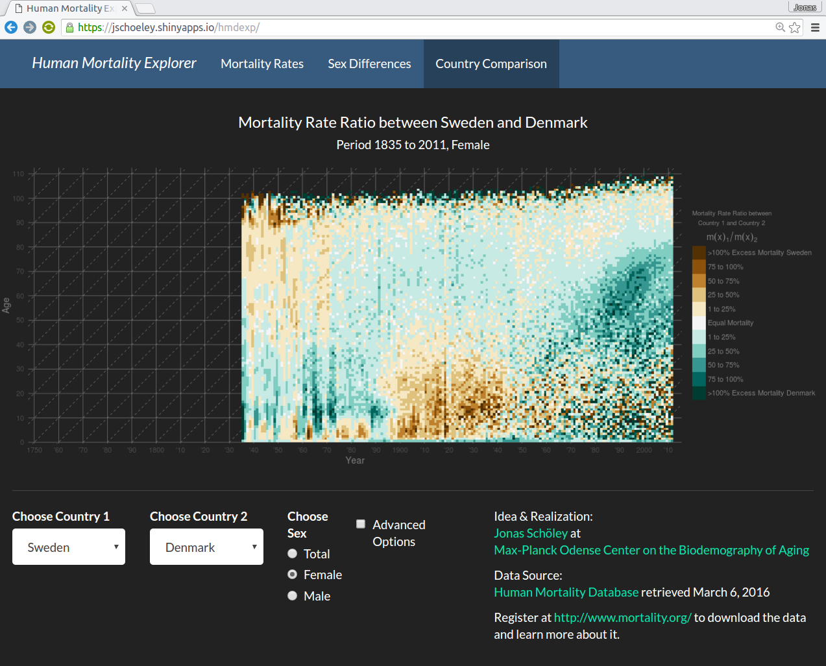
Compare Countries

Slide 14
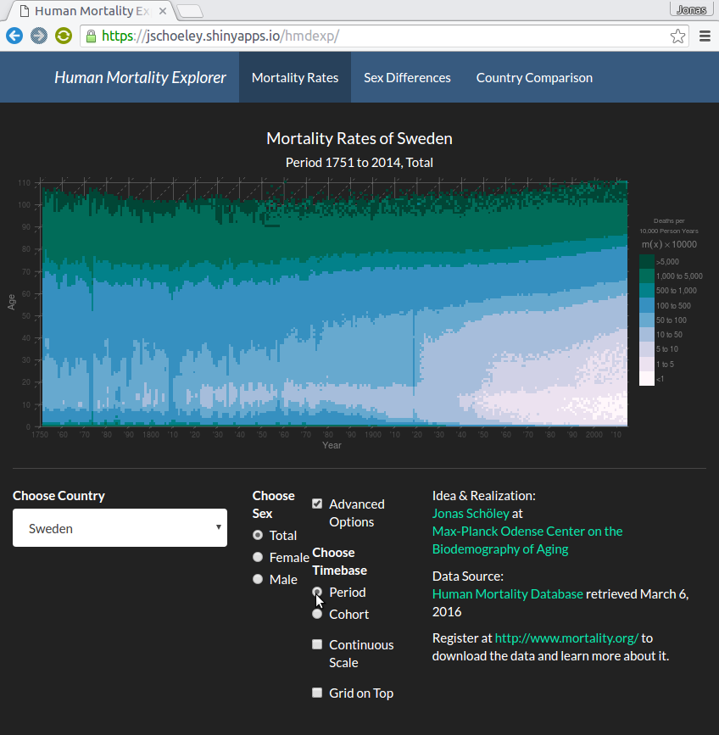
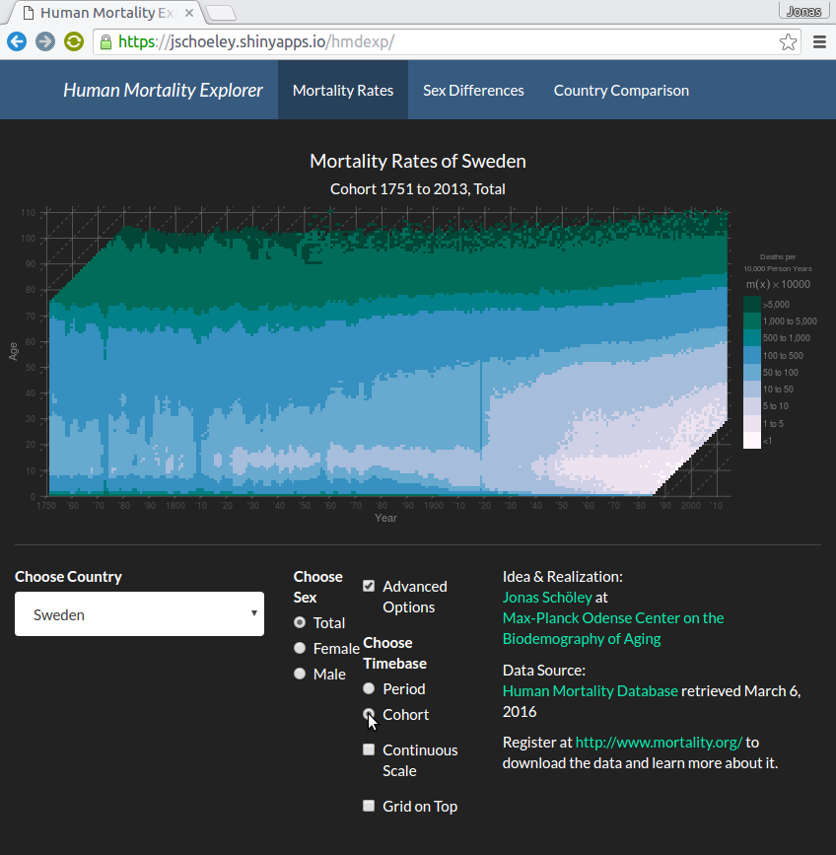
Choose Period or Cohort Rates

Slide 15

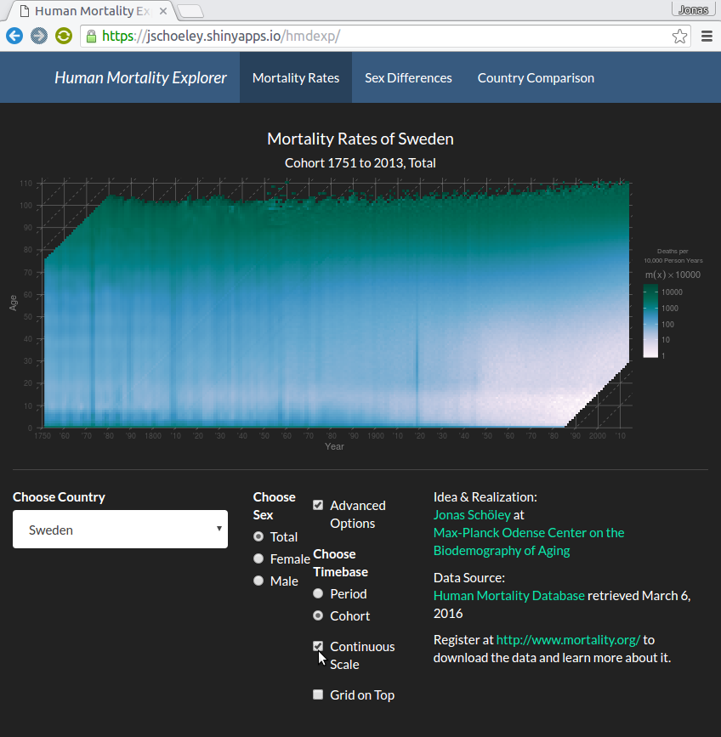
Choose Discrete or Continuous Scales

Slide 16
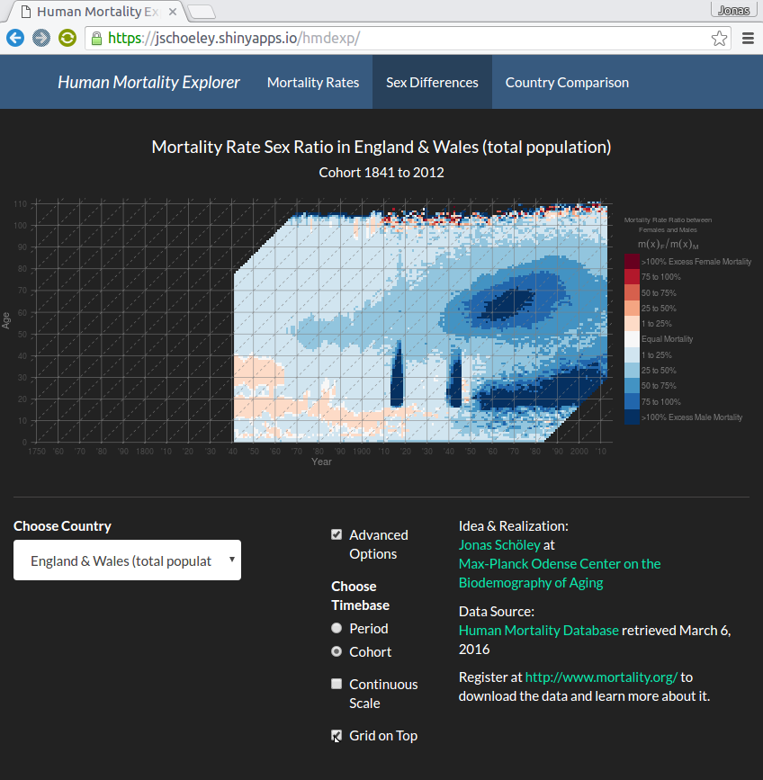
Add a Grid

Slide 17
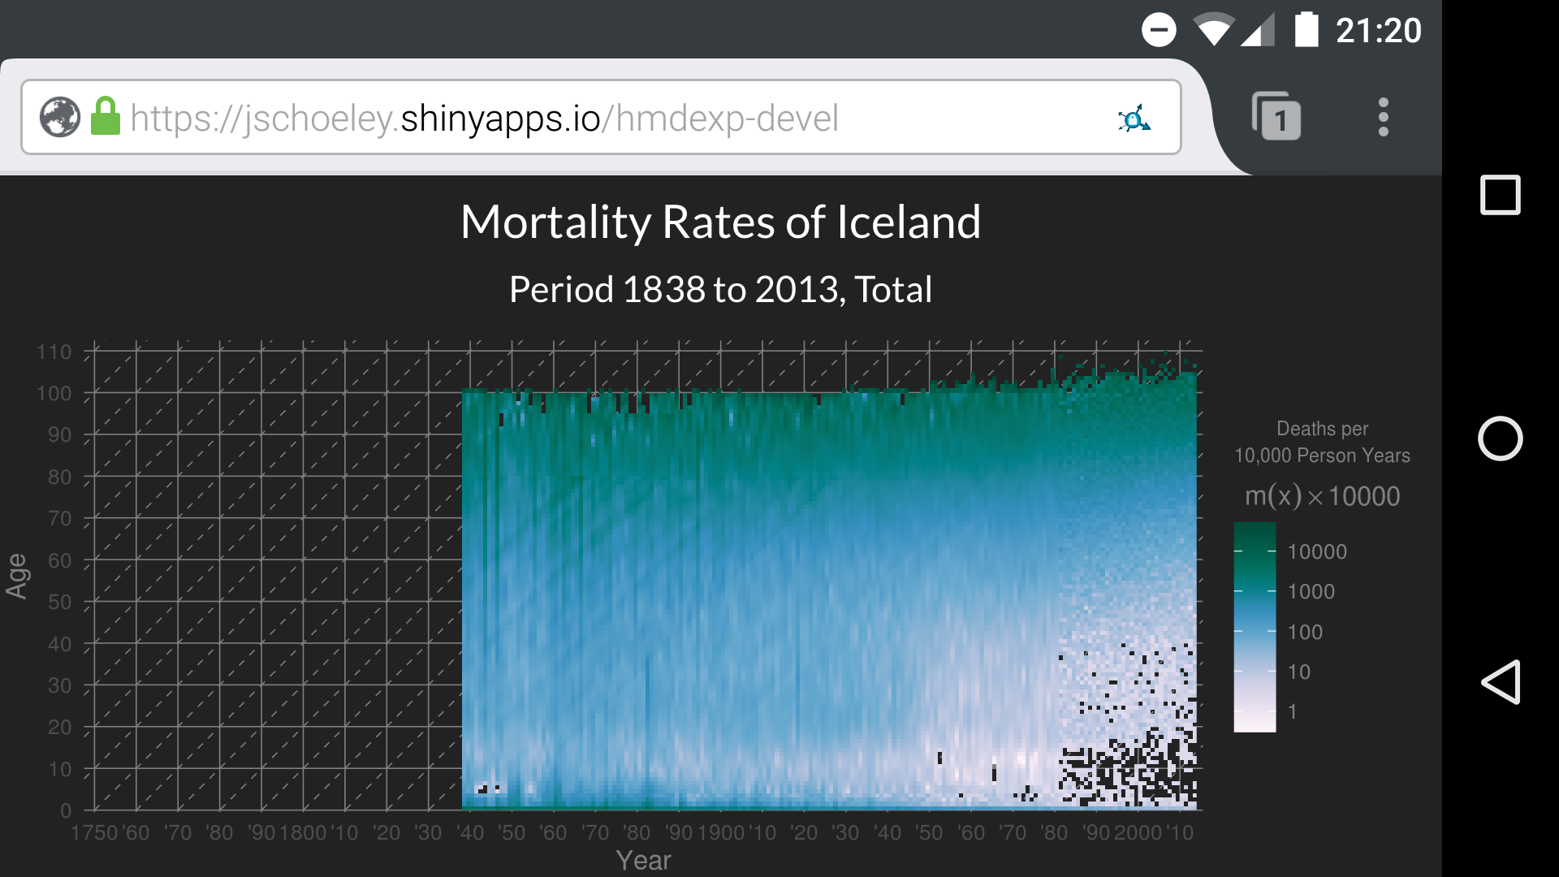
Available Across Devices

Slide 18

Powered by...

Slide 19
Use the Human Mortality Explorer
jschoeley.shinyapps.io/hmdexp
Get the Source Code
https://github.com/jschoeley/hmdexp
Jonas Schöley
jschoeley@health.sdu.dk
Twitter: @rettungstweet

