Slide 1


Selection in infant mortality
Jonas Schöley
jschoeley@health.sdu.dk
Max-Planck Odense Center on the Biodemography of Aging
Department of Public Health
University of Southern Denmark

Slide 2
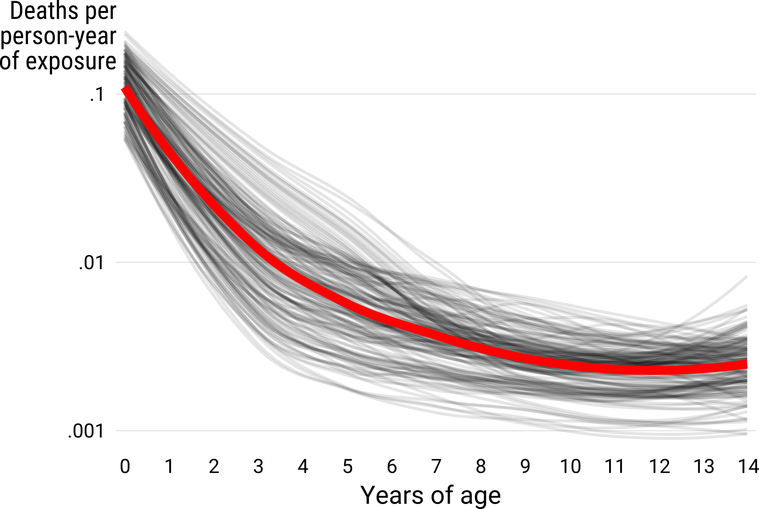
The age pattern of early life mortality
LOESS-smoothed mortality rates for various populations
available in the HMD (mortality.org) database.

Slide 3
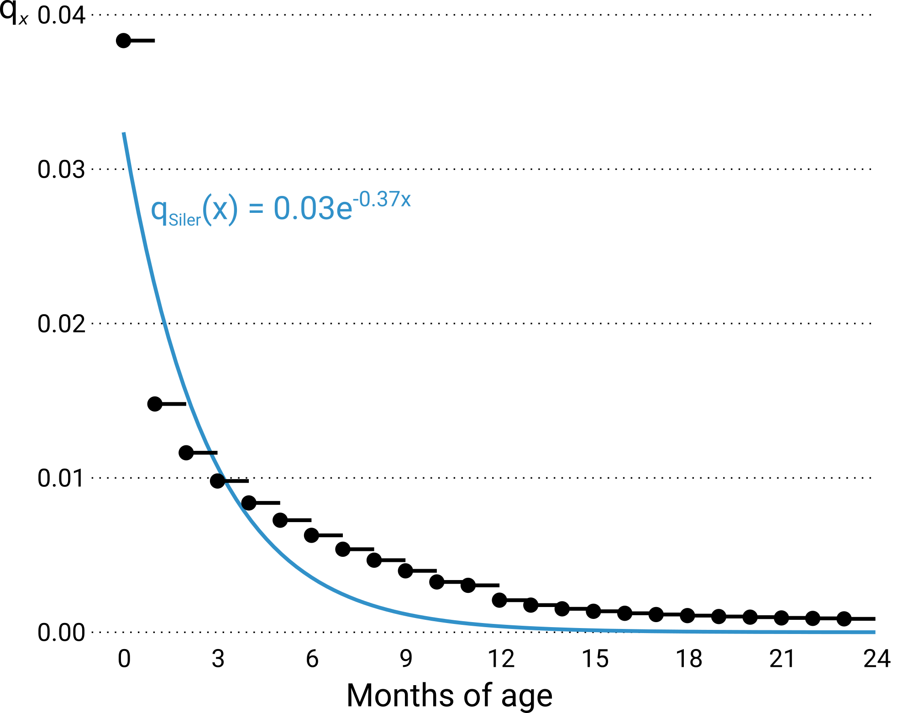
Mortality decline as growth and adaptation
“While the most common use of this decreasing hazard would be to account for the hazard due to immaturity, it can also be used [...] for other hazards to which an animal adjusts successfully.”
Siler, W. (1979). A Competing-Risk Model for Animal Mortality. Ecology, 60(4), 750–757.

Slide 4
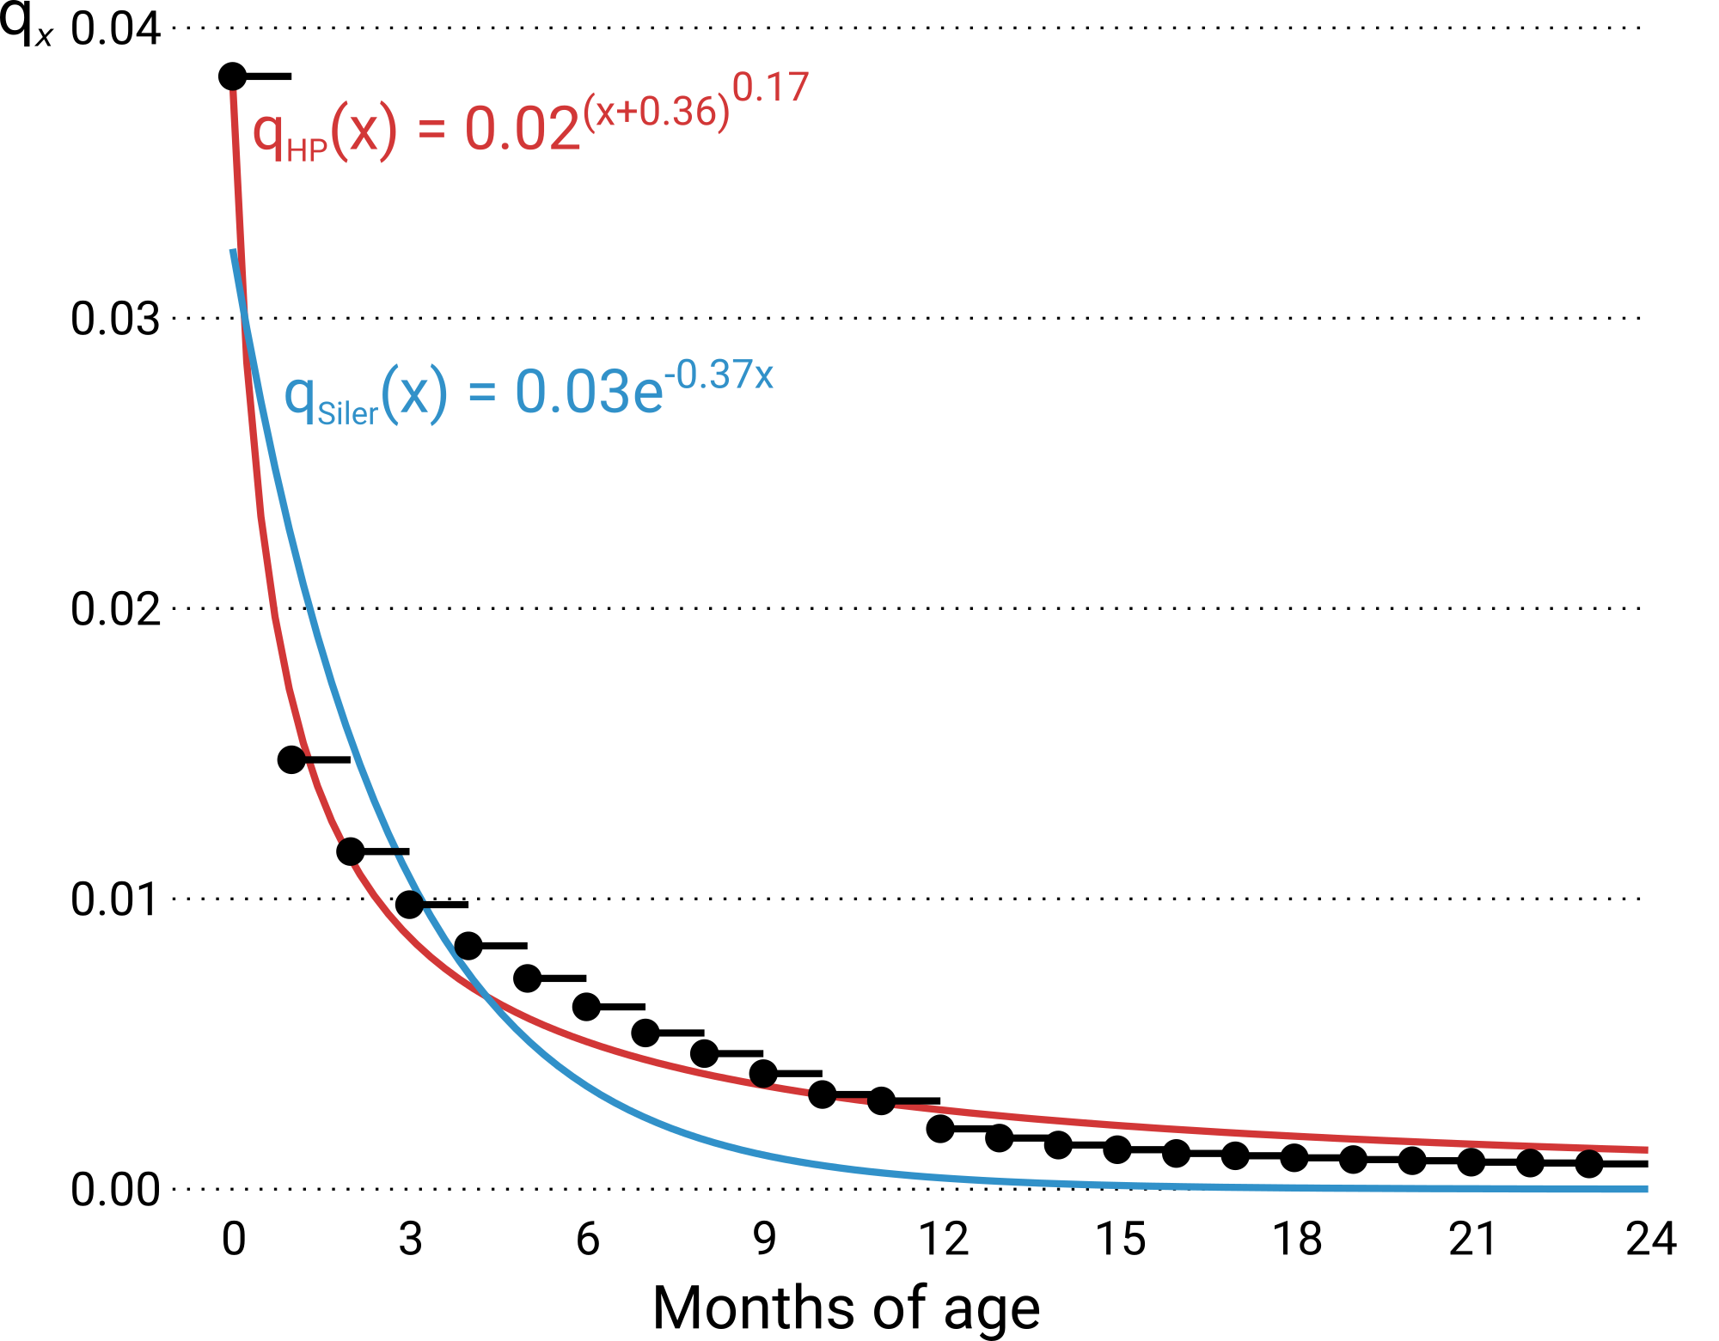
Mortality decline as growth and adaptation
C measures the rate of mortality decline in childhood (the rate at which a child adapts to its environment).
Heligman, L., & Pollard, J. H. (1980). The Age Pattern of Mortality.
Journal of the Institute of Actuaries, 107(1), 49–80.

Slide 5
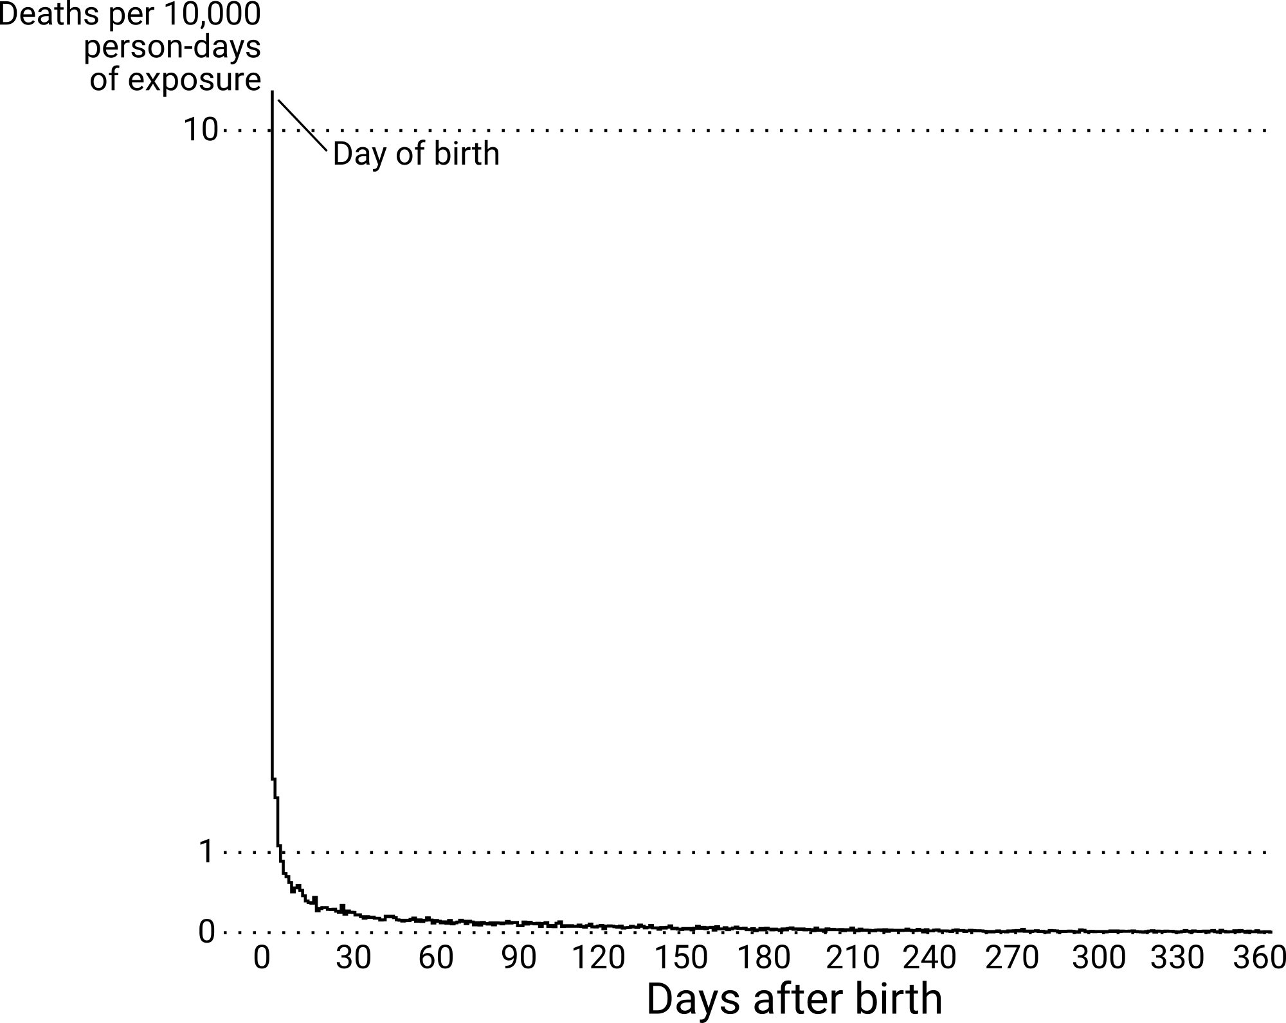
Mortality decline as mortality selection
US infant mortality by day of age for children conceived in 2009.
Raw data: CDC/NCHS

Slide 6
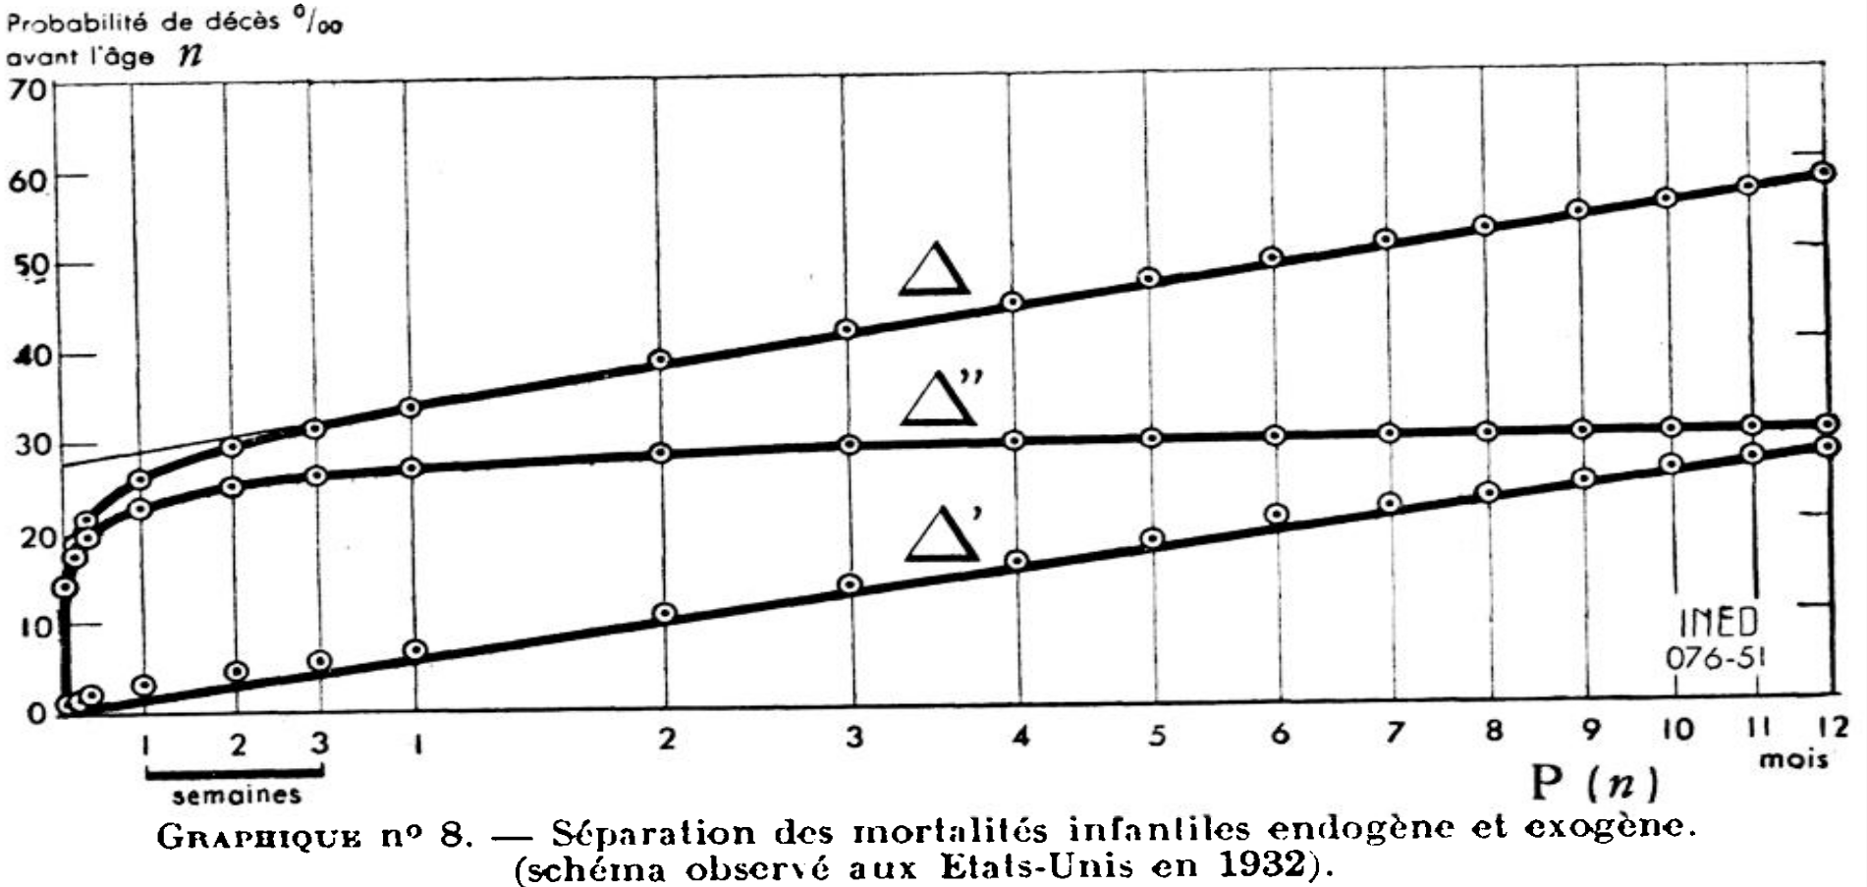
Mortality decline as mortality selection
Bourgeois-Pichat, J. (1951). La mesure de la mortalité infantile. II.
Les causes de décès. Population, 6(3), 459–480.

Slide 7
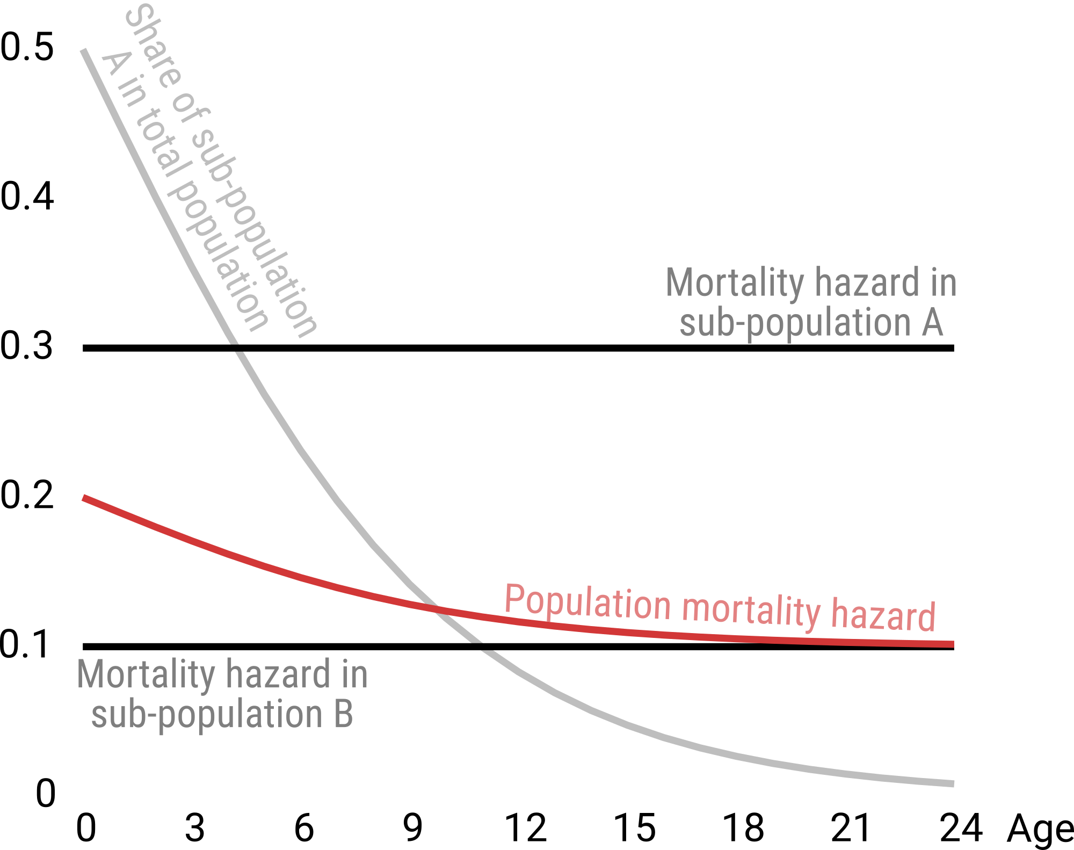
Mortality decline as mortality selection
See also: Vaupel & Yashin (1985). Heterogeneity’s Ruses: Some Surprising Effects of Selection on Population Dynamics.
The American Statistician, 39(3), 176–185.

Slide 8
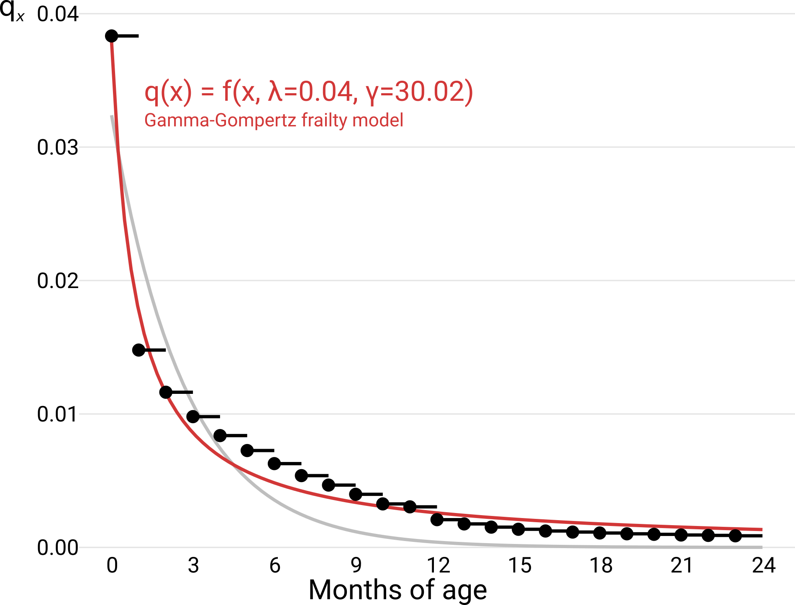
Mortality decline as mortality selection
See also: Vaupel & Yashin (1985). Heterogeneity’s Ruses: Some Surprising Effects of Selection on Population Dynamics.
The American Statistician, 39(3), 176–185.

Slide 9
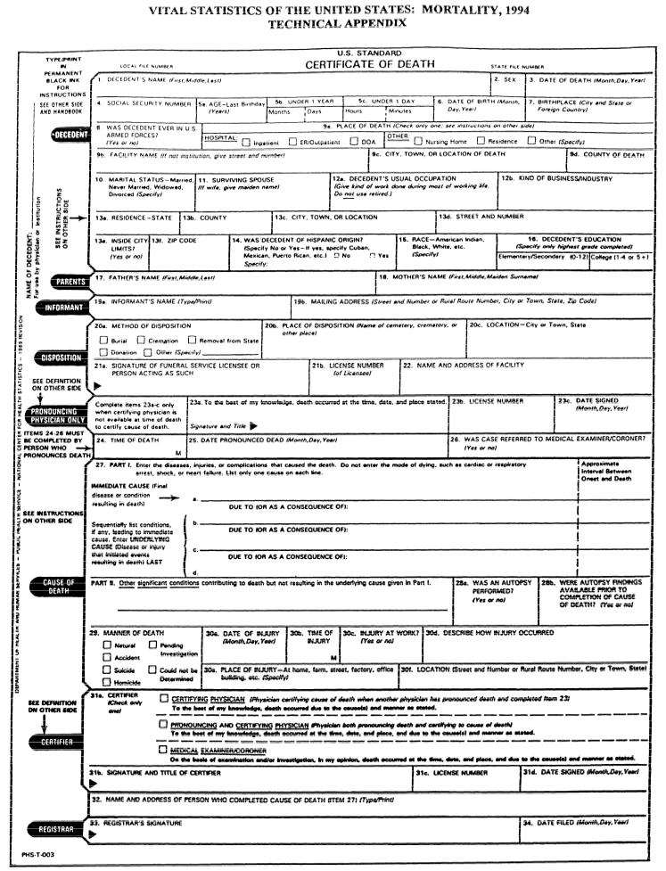
Overcoming guesswork by using individual level data
The NCHS provides:
birth certificates on ~70 million US births over period 1995–2010
death certificates on the 439,215 infant deaths during that time

Slide 10
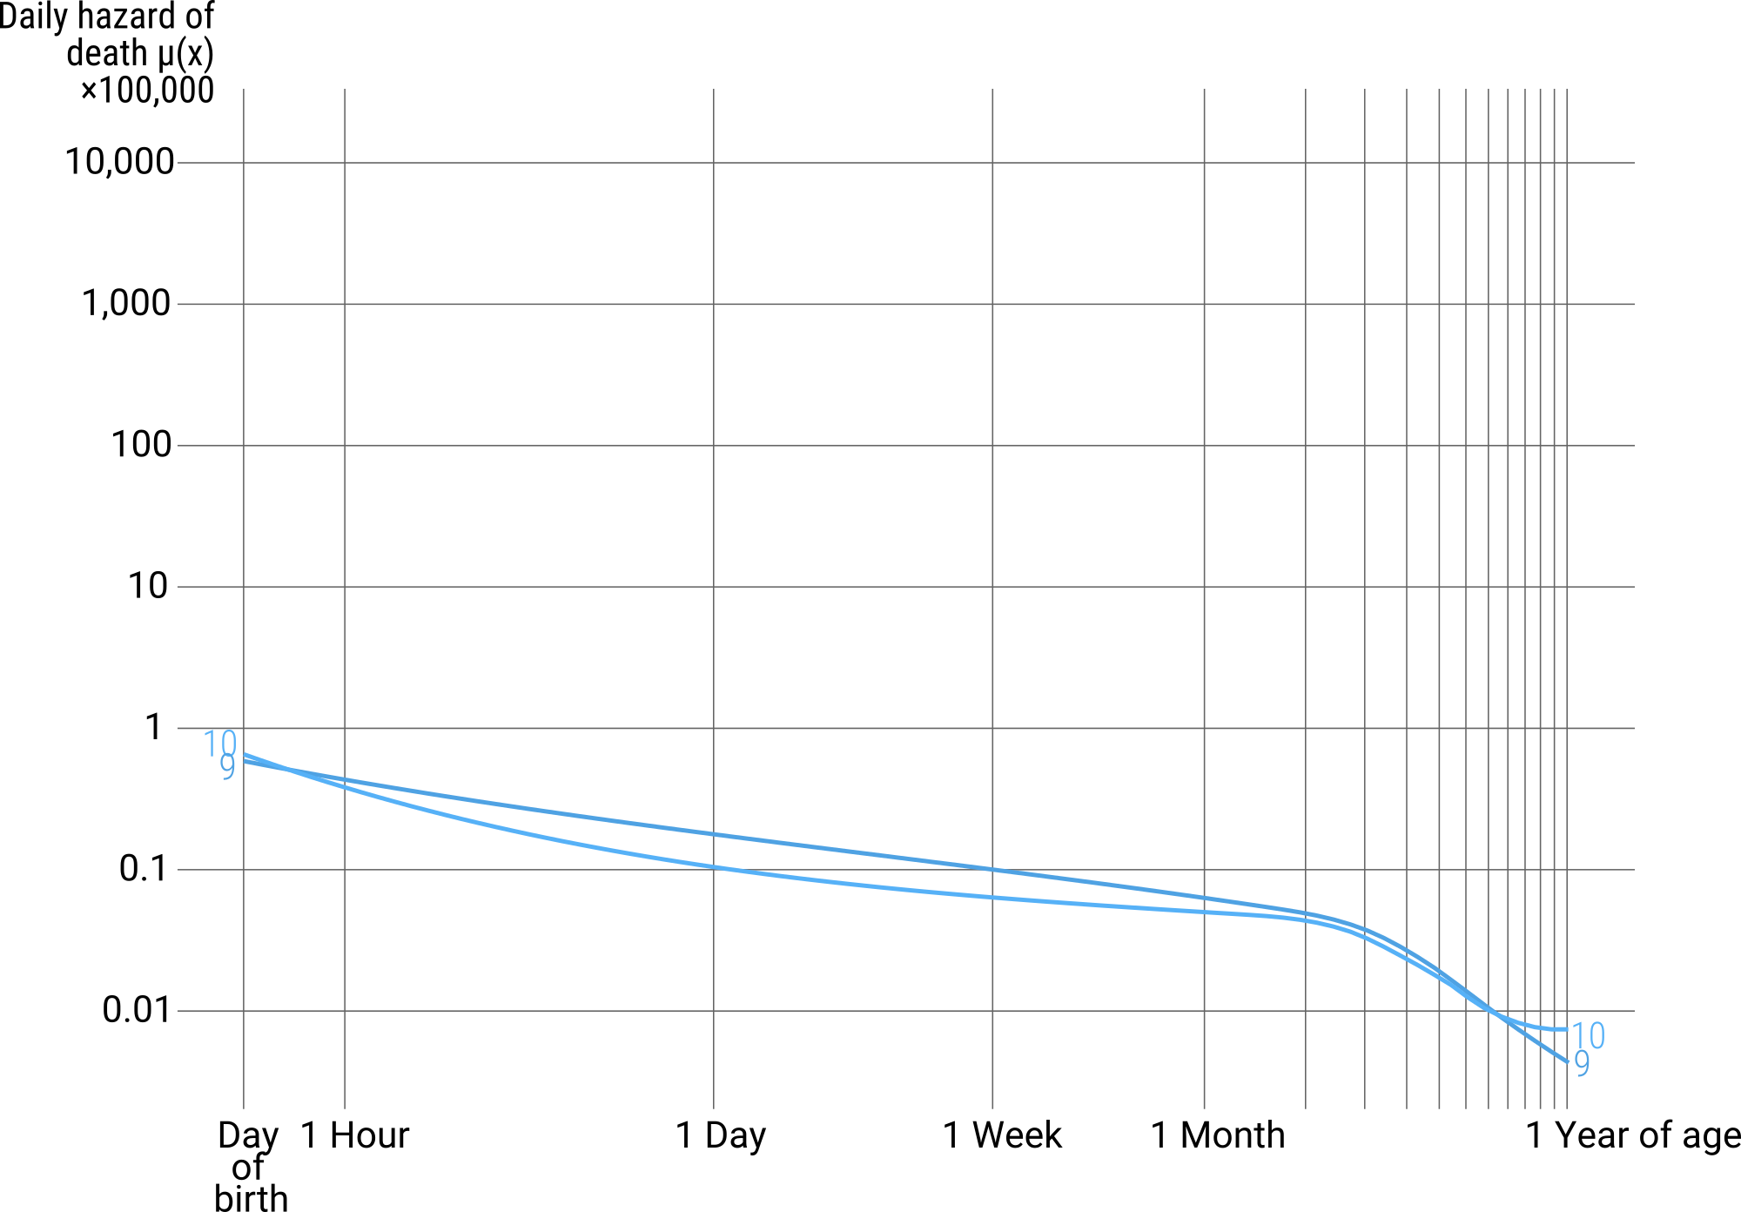
A demonstration of mortality selection
US infants born 2004. Raw data: CDC/NCHS.

Slide 11
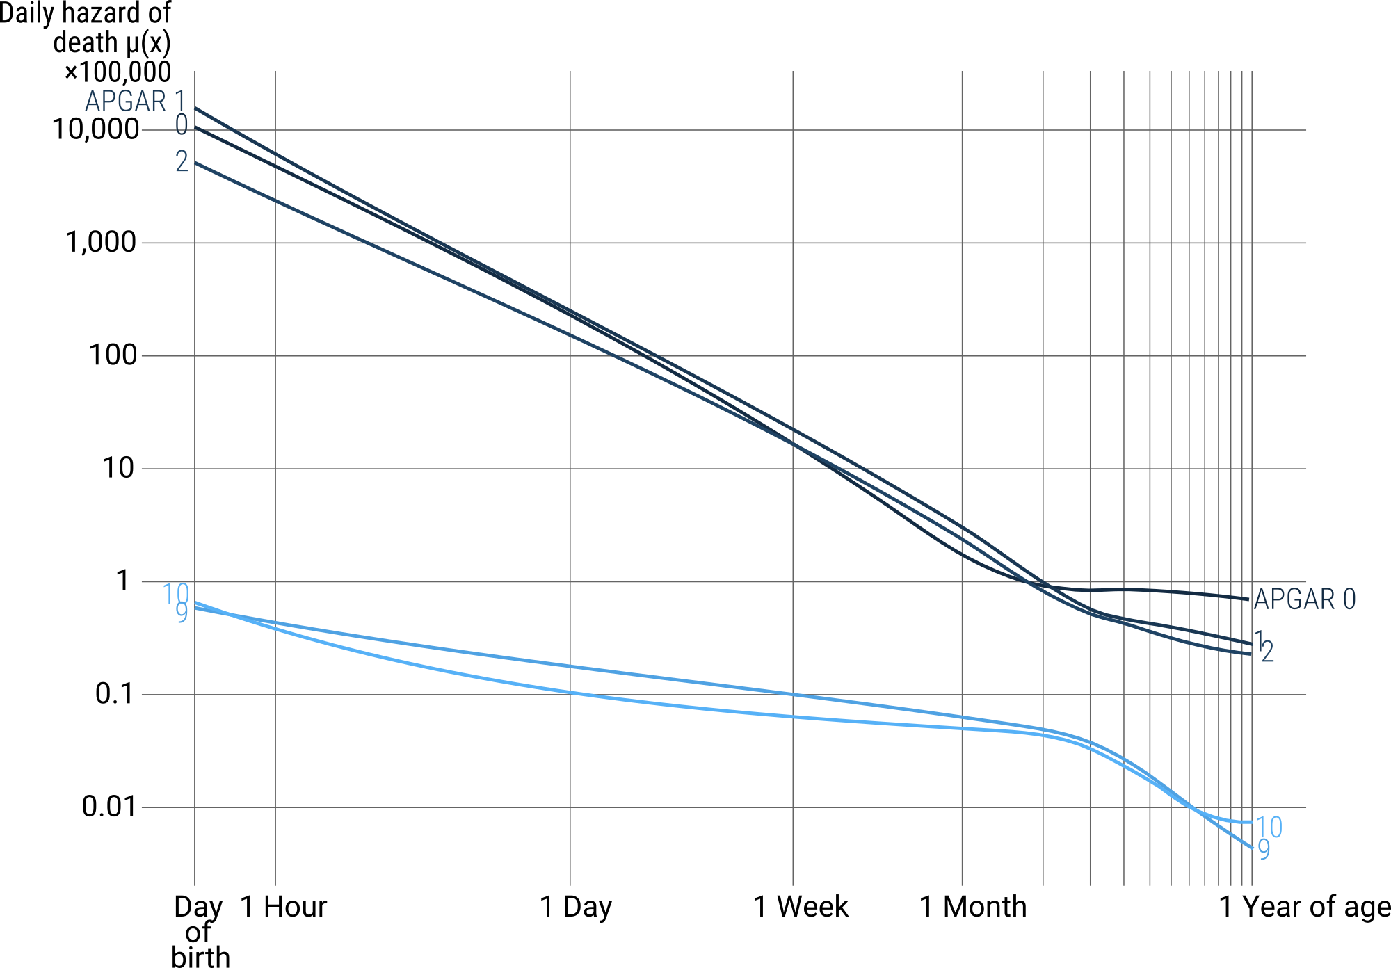
A demonstration of mortality selection
US infants born 2004. Raw data: CDC/NCHS.

Slide 12
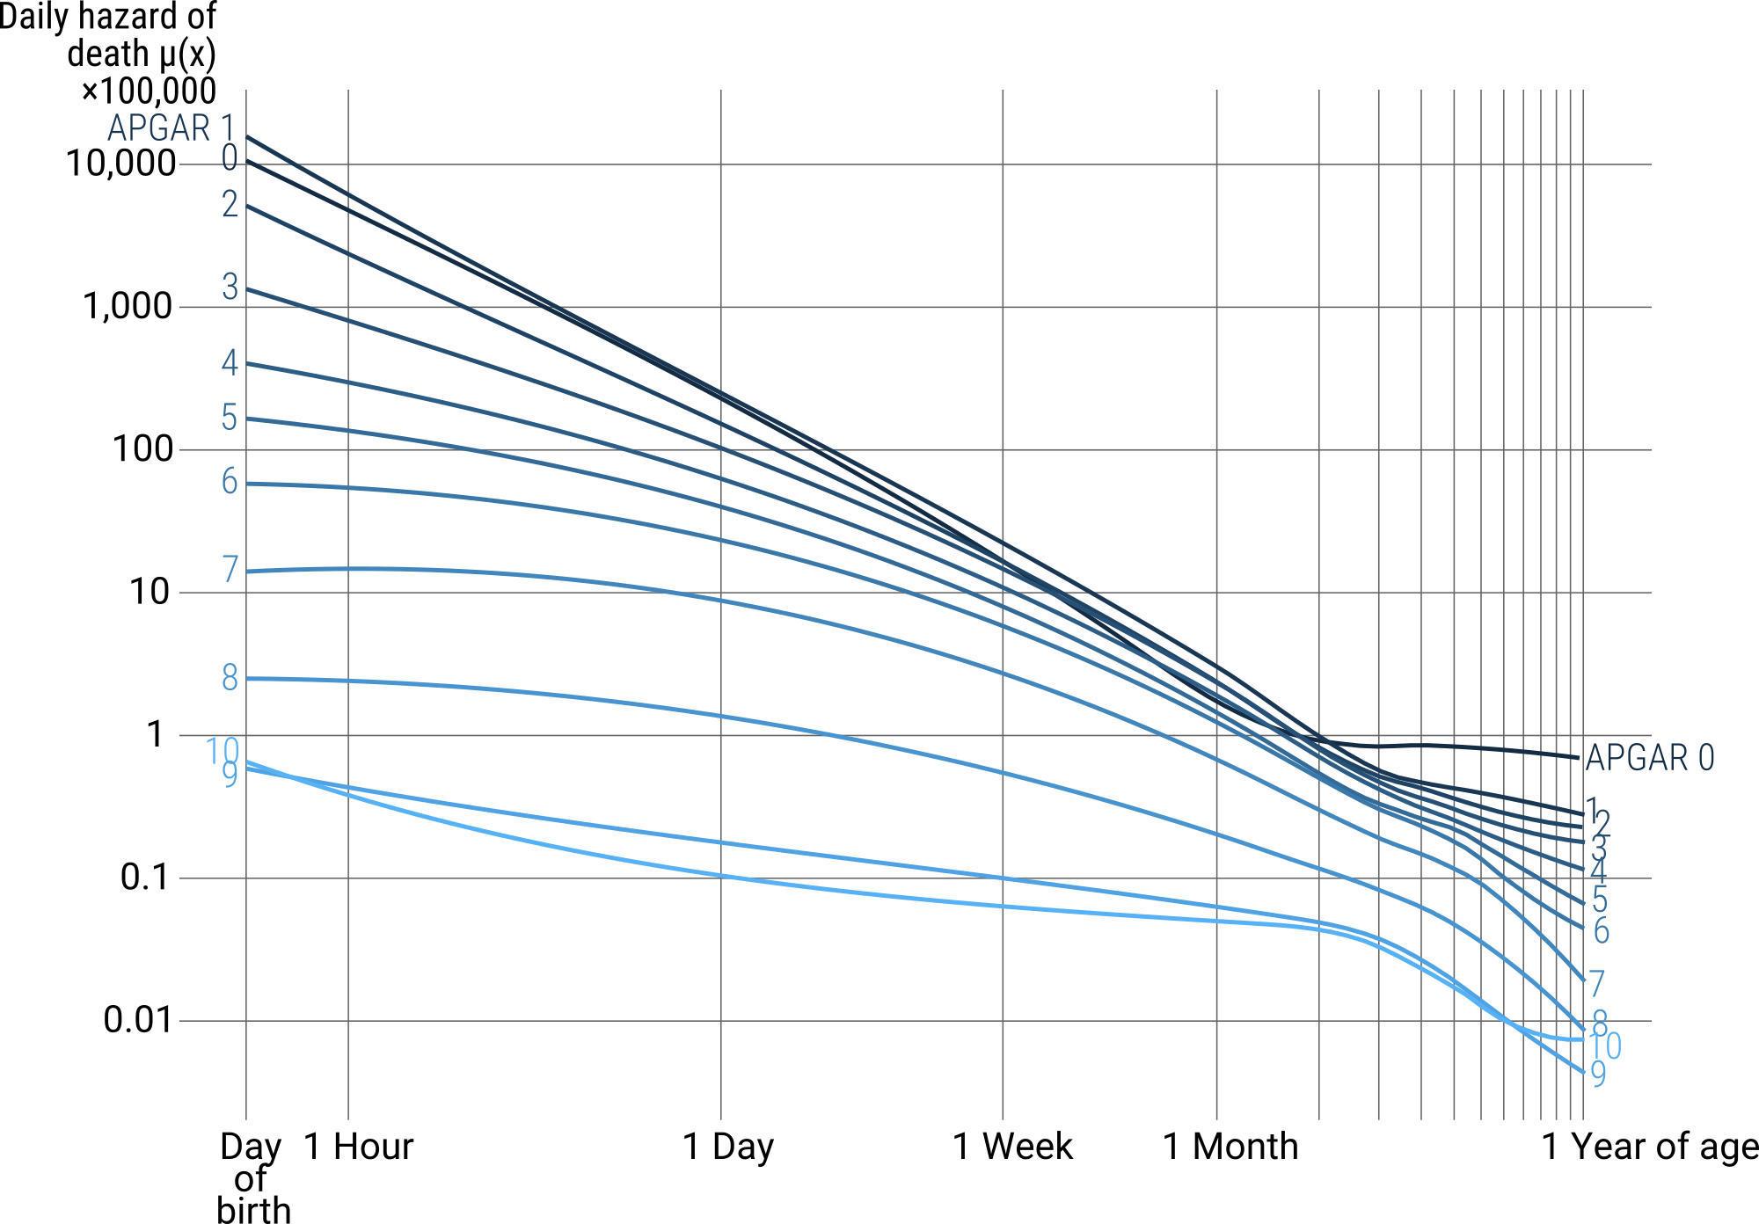
A demonstration of mortality selection
US infants born 2004. Raw data: CDC/NCHS.

Slide 13
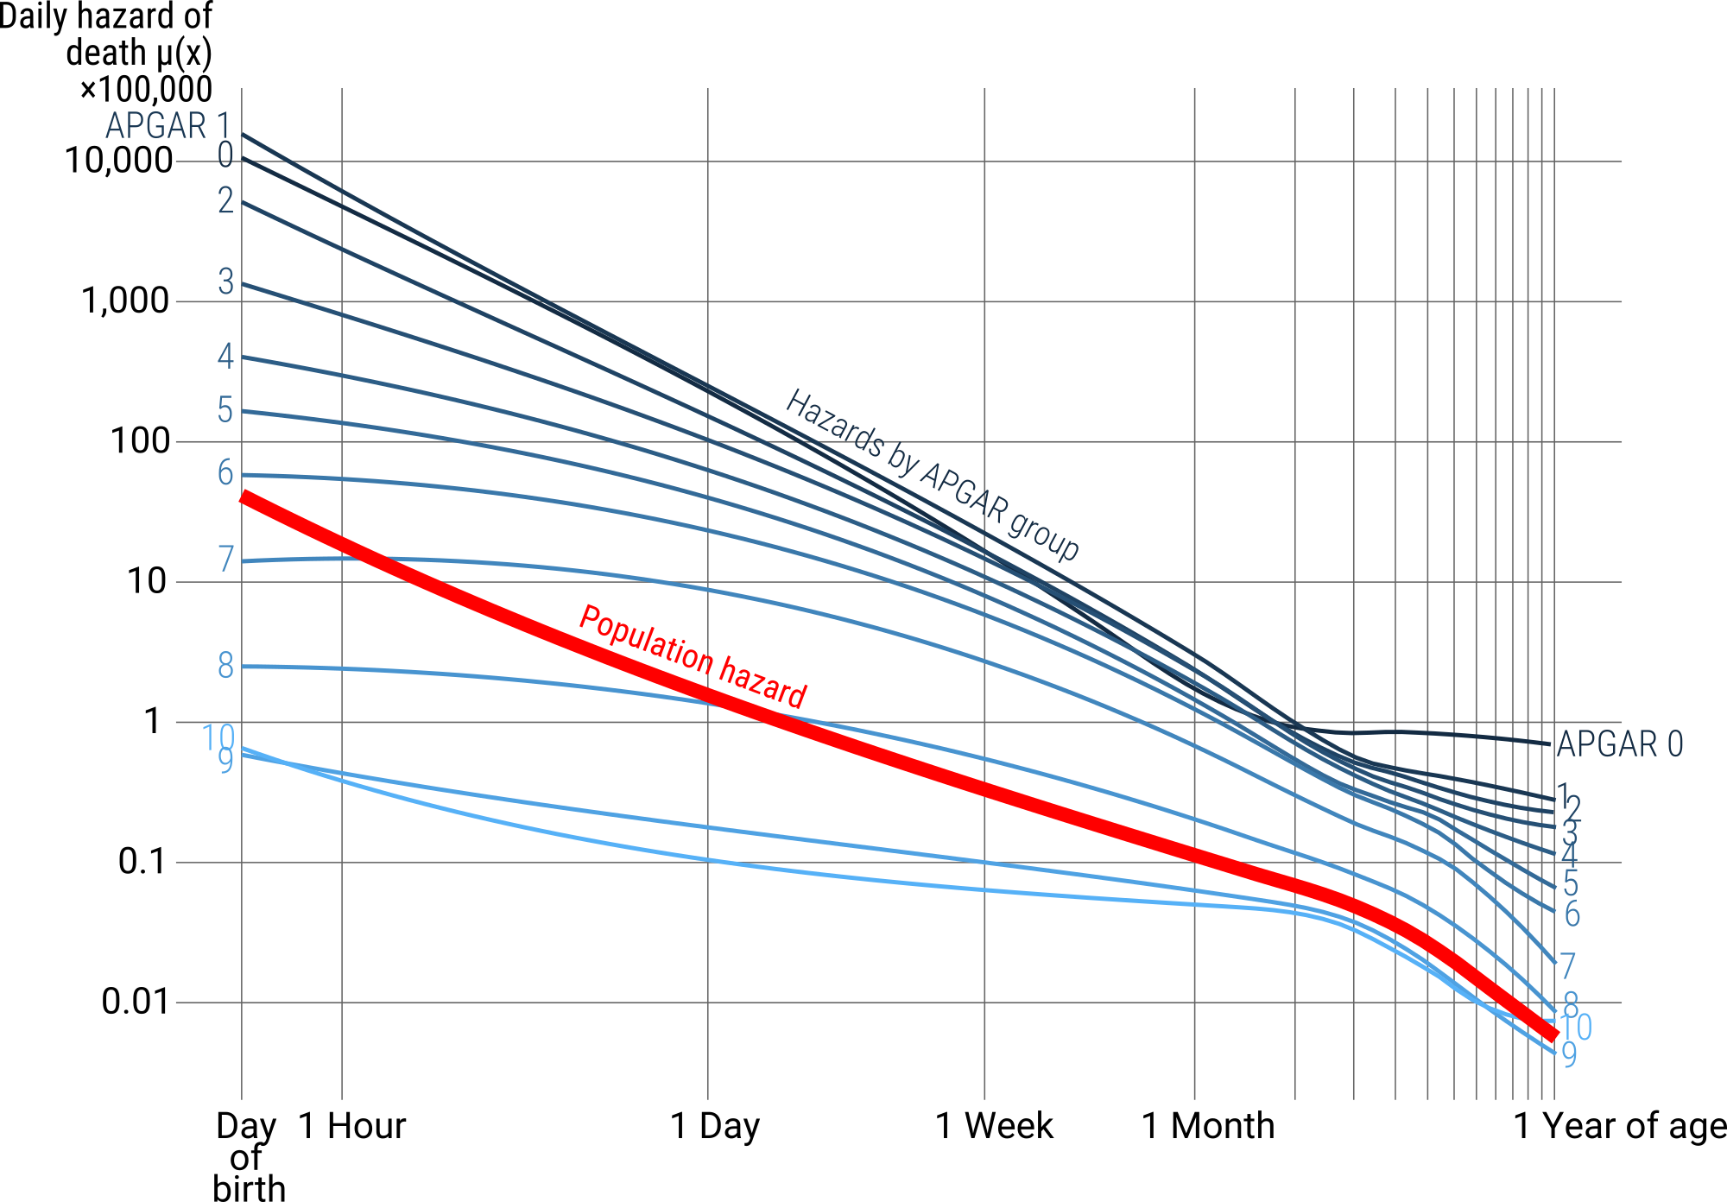
A demonstration of mortality selection
US infants born 2004. Raw data: CDC/NCHS.

Slide 14
Decomposition methods
Y(A)|X_{A} - Y(B)|X_{B} = (A-B) + (X_{A}-X_{B})
Total difference in outcome
between groups A and B
Difference due
to group effect
Difference due to
group composition

Slide 15
Decomposition methods
Vaupel, J. W., & Zhang, Z. (2010). Attrition in heterogeneous cohorts. Demographic Research, 23(26), 737–748.
Oaxaca, R. (1973). "Male-Female Wage Differentials in Urban Labor Markets". International Economic Review. 14 (3): 693–709.
Price, G. R. (1970). Selection and covariance. Nature, 227(5257), 520–1.
Y(A)|X_{A} - Y(B)|X_{B} = (A-B) + (X_{A}-X_{B})
Total difference in outcome
between groups A and B
Difference due
to group effect
Difference due to
group composition
Powers, D. A., Yoshioka, H., & Yun, M.-S. (2011). mvdcmp: Multivariate decomposition for nonlinear response models. The Stata Journal, 11(4), 556–576.
Preston, S.H., Himes, C.L., and Eggers, M. (1989). Demographic conditions responsible for population aging. Demography 26(4): 691–704.
Vaupel, J.W. and Canudas-Romo, V. (2002). Decomposing demographic change into direct vs. compositional components. Demographic Research 7(1): 1–14.

Slide 16
Decomposing the infant mortality age decline
Δµ(x) due to
comp. change
Δµ(x) due to
direct change
Δµ(x) over
absolute
percent
1st hour of life | -6.32E-02 | -1.76E-02 | 21.8
Hours 2–24 | -4.24E-03 | -7.50E-05 | 1.7
Day 1 | -2.28E-04 | -4.53E-07 | 0.2
Day 2 | -1.08E-04 | -1.04E-07 | 0
Day 3 | -5.88E-05 | -5.10E-08 | 0
Day 4 | -3.33E-05 | -2.59E-08 | 0
Day 5 | -1.75E-05 | -1.29E-08 | 0
Method: Vaupel, J.W. and Canudas-Romo, V. (2002). Decomposing demographic change into direct vs. compositional components. Demographic Research 7(1): 1–14.
Data: US infants born 2005-10. CDC/NCHS,

Slide 17
Decomposing the infant mortality age decline
% Δµ(x) due to
Δµ(x) over
total Δµ(x)
direct
change
compos.
change
hour 0 to 24 | 2.86E-03 | 39.4 | 60.6
Method: Poisson regression on infant death counts decomposed using Powers, D. A., Yoshioka, H., & Yun, M.-S. (2011). mvdcmp: Multivariate decomposition for nonlinear response models. The Stata Journal, 11(4), 556–576.
Data: US infants born 2004. CDC/NCHS,

Slide 18
Decomposing the infant mortality age decline
% Δµ(x) due to
share on compositional change
Δµ(x) over
total Δµ(x)
direct
change
compos.
change
sex
birth-
weight
birth
defect
5 min
APGAR
Mother
hour 0 to 24 | 2.86E-03 | 39.4 | 60.6 | 0.00 | 0.16 | 0.04 | 0.80 | 0.00
Method: Poisson regression on infant death counts decomposed using Powers, D. A., Yoshioka, H., & Yun, M.-S. (2011). mvdcmp: Multivariate decomposition for nonlinear response models. The Stata Journal, 11(4), 556–576.
Data: US infants born 2004. CDC/NCHS,

Slide 19
Decomposing the infant mortality age decline
% Δµ(x) due to
share on compositional change
Δµ(x) over
total Δµ(x)
direct
change
compos.
change
sex
birth-
weight
birth
defect
5 min
APGAR
Mother
hour 0 to 24 | 2.86E-03 | 39.4 | 60.6 | 0.00 | 0.16 | 0.04 | 0.80 | 0.00
Day 2 to 7 | 7.84E-06 | 85.5 | 14.5 | 0.00 | 0.27 | 0.13 | 0.59 | 0.01
Week 2 to 4 | 1.72E-06 | 91.7 | 8.3 | 0.00 | 0.25 | 0.24 | 0.49 | 0.02
Month 2 to 12 | 1.69E-06 | 93.7 | 6.3 | 0.00 | 0.52 | 0.20 | 0.28 | 0.00
Method: Poisson regression on infant death counts decomposed using Powers, D. A., Yoshioka, H., & Yun, M.-S. (2011). mvdcmp: Multivariate decomposition for nonlinear response models. The Stata Journal, 11(4), 556–576.
Data: US infants born 2004. CDC/NCHS,

Slide 20
Conclusion
Mortality selection drives the
mortality decline immediately
after birth
Still, most of the infant
mortality decline over age is
due to individual level effects.

Slide 21
Reproducible analysis
github.com/jschoeley
Jonas Schöley
jschoeley@health.sdu.dk
Twitter: @rettungstweet

