Slide 1


Selection and adaptation components of infant mortality
Jonas Schöley
jschoeley@health.sdu.dk
Max-Planck Odense Center on the Biodemography of Aging
Department of Public Health
University of Southern Denmark

Slide 2
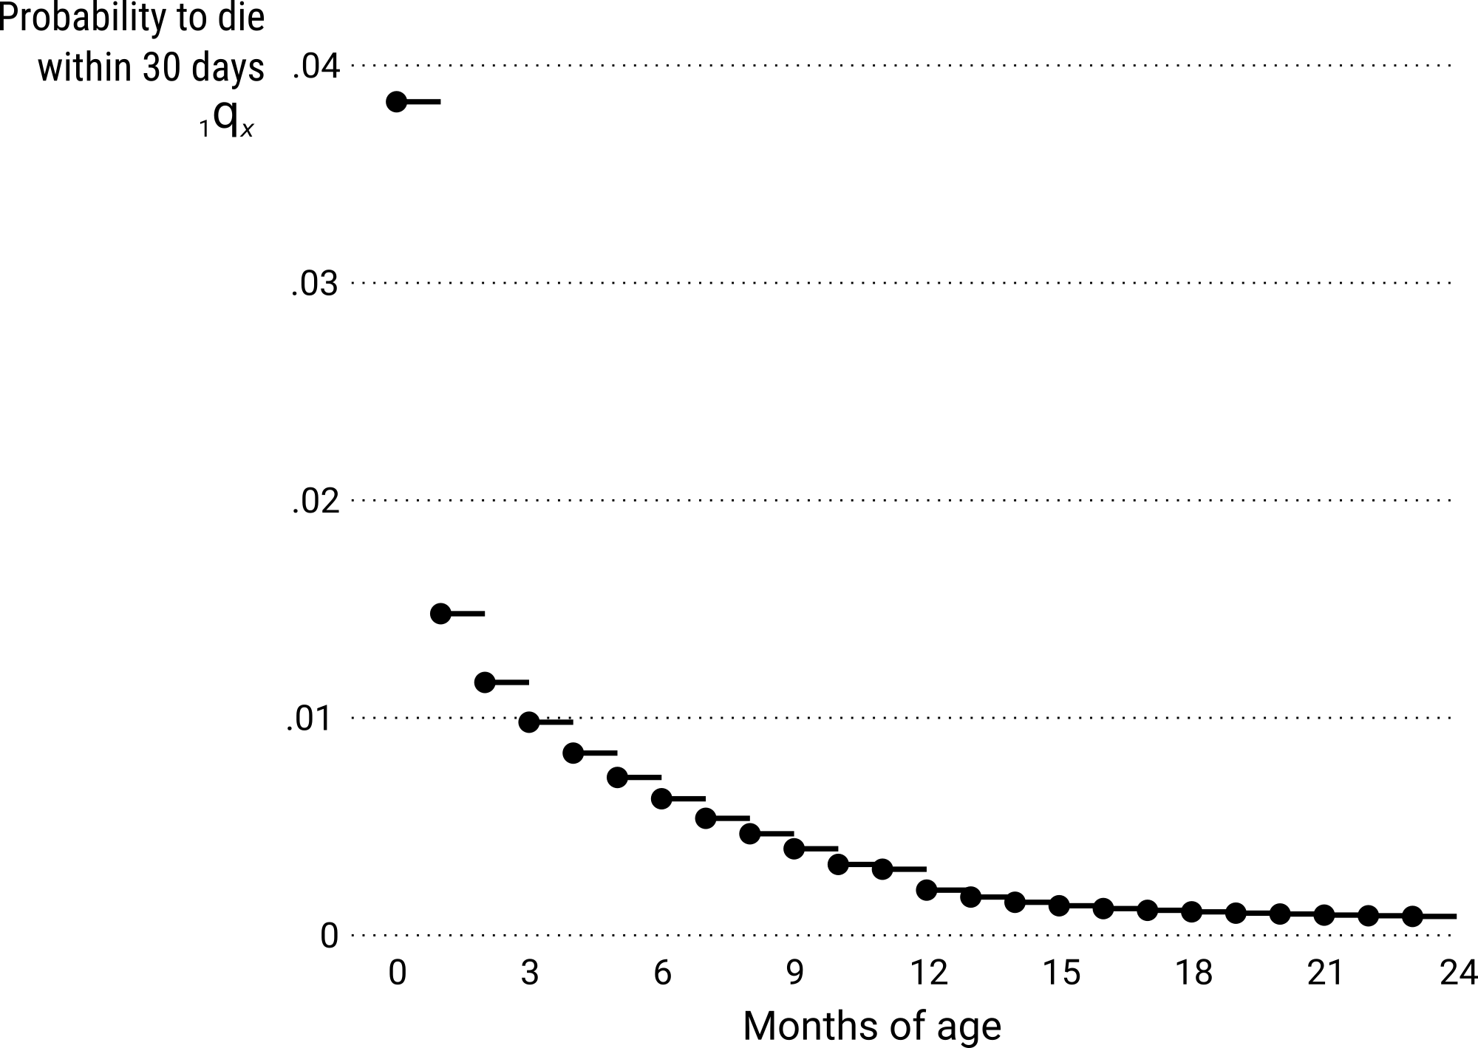
The age pattern of early life mortality
Danish males born 1911–15.
Raw data: Statistiske Departement Danmark 1920.

Slide 3
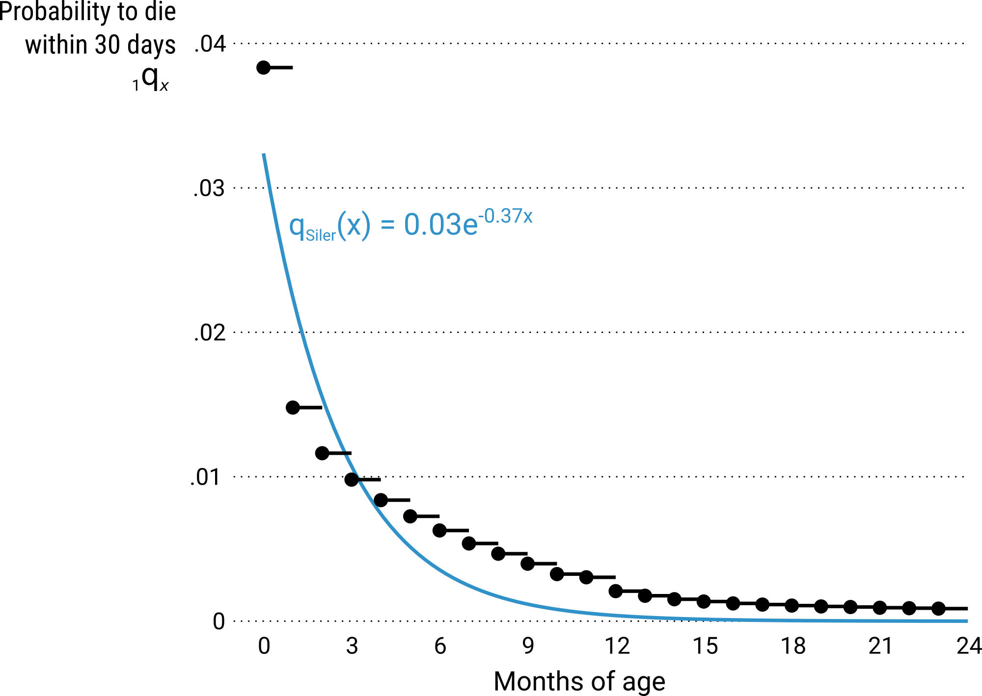
Mortality decline as growth and adaptation
“While the most common use of this decreasing hazard would be to account for the hazard due to immaturity, it can also be used [...] for other hazards to which an animal adjusts successfully.”
Siler, W. (1979). A Competing-Risk Model for Animal Mortality. Ecology, 60(4), 750–757.
Danish males born 1911–15.
Raw data: Statistiske Departement Danmark 1920.

Slide 4
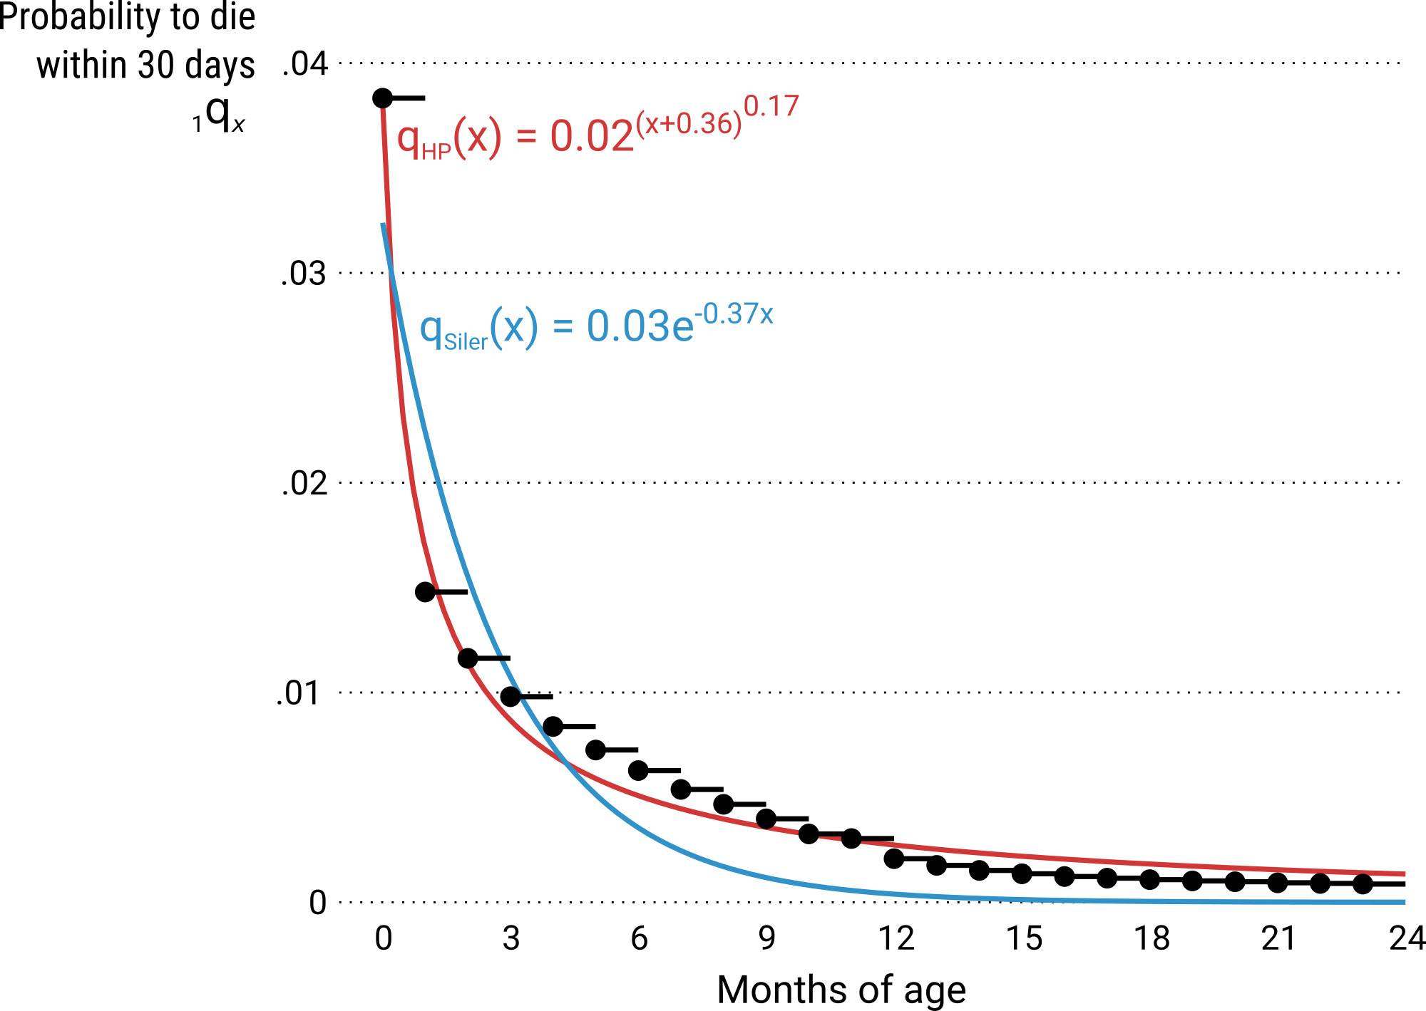
Mortality decline as growth and adaptation
“C measures the rate of mortality decline in childhood (the rate at which a child adapts to its environment).”
Heligman, L., & Pollard, J. H. (1980).
The Age Pattern of Mortality.
Journal of the Institute of Actuaries, 107(1), 49–80.
Danish males born 1911–15.
Raw data: Statistiske Departement Danmark 1920.

Slide 5
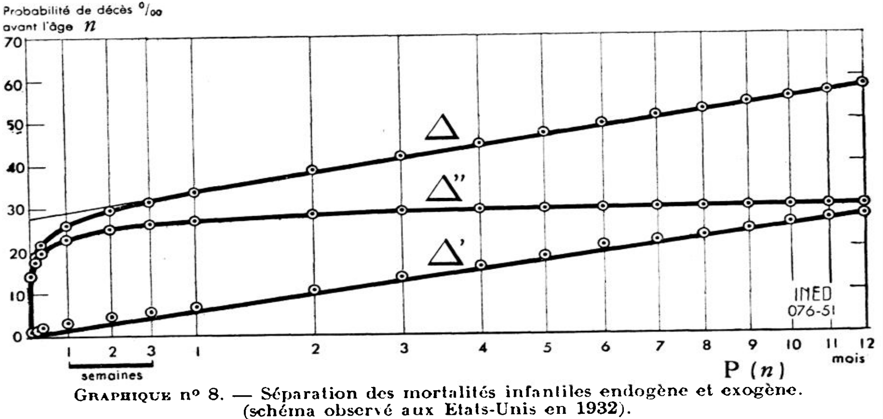
Mortality decline as mortality selection
Bourgeois-Pichat, J. (1951). La mesure de la mortalité infantile.
II. Les causes de décès. Population, 6(3), 459–480.

Slide 6
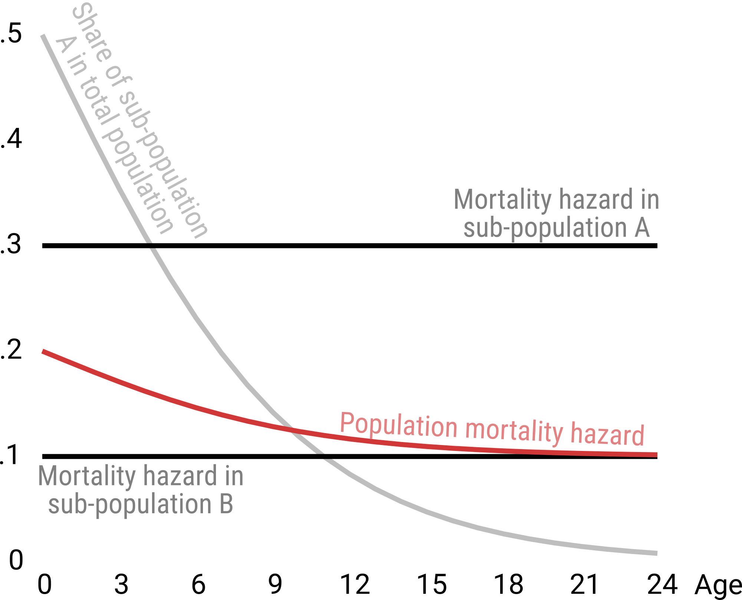
Mortality decline as mortality selection
See also: Vaupel & Yashin (1985). Heterogeneity’s Ruses: Some Surprising Effects of Selection on Population Dynamics.
The American Statistician, 39(3), 176–185.

Slide 7
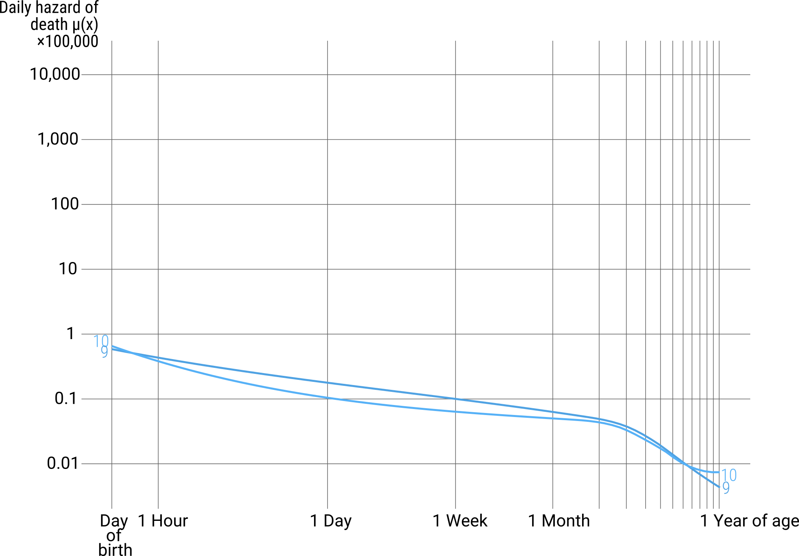
A demonstration of mortality selection
US infants born 2004. Raw data: CDC/NCHS.

Slide 8
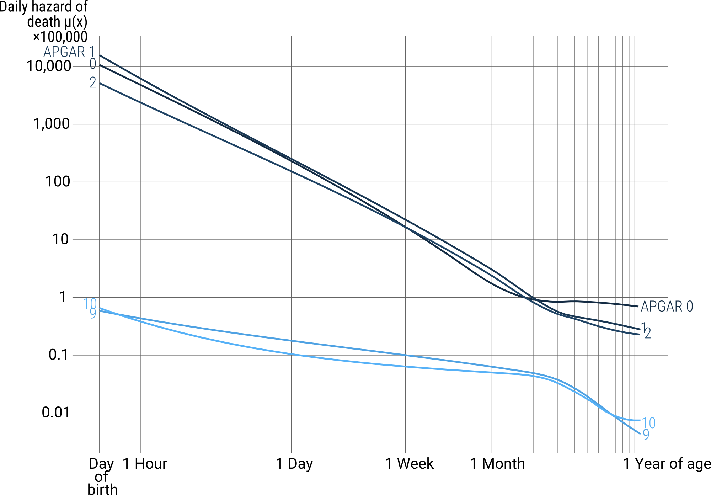
A demonstration of mortality selection
US infants born 2004. Raw data: CDC/NCHS.

Slide 9
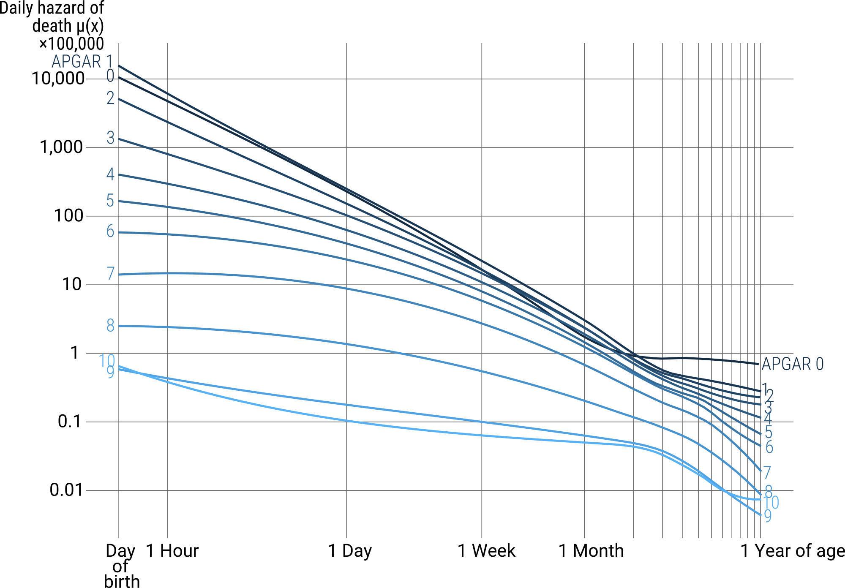
A demonstration of mortality selection
US infants born 2004. Raw data: CDC/NCHS.

Slide 10
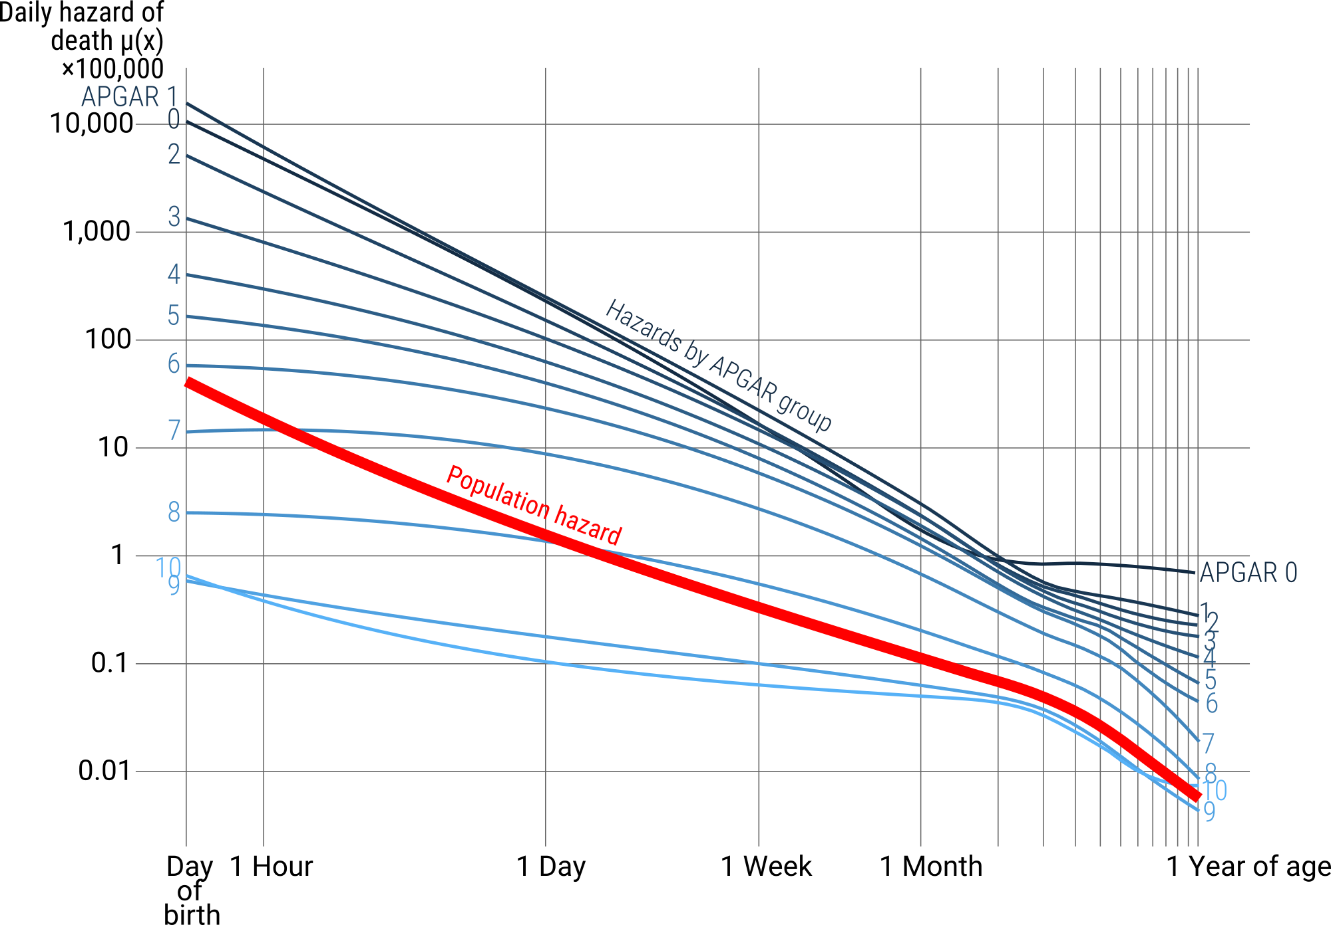
A demonstration of mortality selection
US infants born 2004. Raw data: CDC/NCHS.

Slide 11
Decomposition methods
Total difference in outcome
between groups A and B
=
Difference due
to group effect
+
Difference due to
group composition

Slide 12
Decomposition methods
Vaupel, J. W., & Zhang, Z. (2010). Attrition in heterogeneous cohorts. Demographic Research, 23(26), 737–748.
Oaxaca, R. (1973). "Male-Female Wage Differentials in Urban Labor Markets". International Economic Review. 14 (3): 693–709.
Price, G. R. (1970). Selection and covariance. Nature, 227(5257), 520–1.
Blinder, A. S., Ashenfelter, O., Ben-Porath, Y., Barr, N., & Oaxaca, R. (1973). Wage Discrimination: Reduced Form and Structural Estimates. The Journal of Human Resources, 8(4), 436–455.
Total difference in outcome
between groups A and B
=
Difference due
to group effect
+
Difference due to
group composition
Powers, D. A., Yoshioka, H., & Yun, M.-S. (2011). mvdcmp: Multivariate decomposition for nonlinear response models. The Stata Journal, 11(4), 556–576.
Preston, S.H., Himes, C.L., and Eggers, M. (1989). Demographic conditions responsible for population aging. Demography 26(4): 691–704.
Vaupel, J.W. and Canudas-Romo, V. (2002). Decomposing demographic change into direct vs. compositional components. Demographic Research 7(1): 1–14.

Slide 13
Co-variance based decomposition
Vaupel, J. W., & Zhang, Z. (2010). Attrition in heterogeneous cohorts. Demographic Research, 23(26), 737–748.
.
.
µ = µ_{z} - σ²_{μz}
=
Average change of
hazards across strata z
Variance of hazards
across strata z
Change in
Population hazard
-

Slide 14
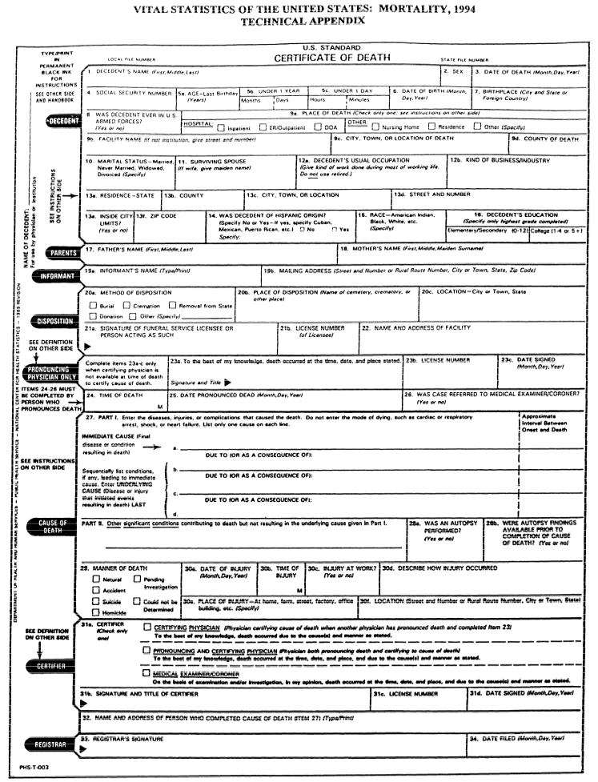
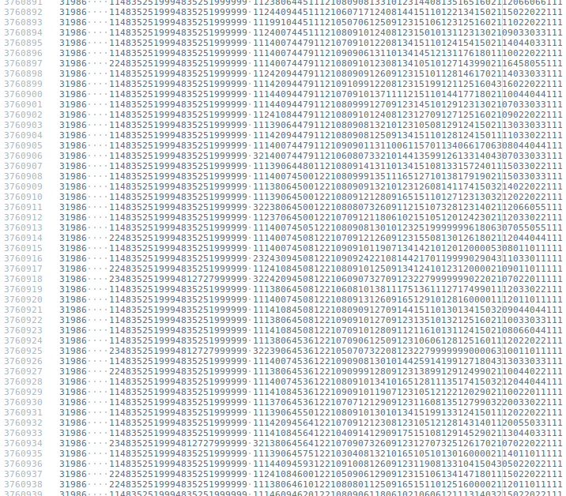
Individual level data on births and infant deaths
The NCHS provides:
birth certificates on ~70 million US births over period 1995–2010
death certificates on the 439,215 infant deaths during that time

Slide 15
Analysis pipeline
1. Raw data
US births 2005-10
N = 25,143,288
1 row = 1 birth

Slide 16
Analysis pipeline
# A tibble: 25,143,288 x 4
plurality death survtime_h survtime_h_width
<fctr> <lgl> <dbl> <dbl>
1 Single TRUE 0 1
2 Single TRUE 1 23
3 Single TRUE 1 23
4 Single TRUE 1 23
5 Single TRUE 0 1
6 Single TRUE 0 1
7 Single TRUE 1 23
8 Single TRUE 1 23
9 Single TRUE 0 1
10 Twin TRUE 0 1
# ... with 25,143,278 more rows
2. Survival data
interval censored, stratified
1. Raw data
US births 2005-10
N = 25,143,288
1 row = 1 birth
# A tibble: 48 x 8
plurality x nx Nx nEx nDx nCx lx
<fctr> <dbl> <dbl> <dbl> <dbl> <dbl> <dbl> <dbl>
1 Single 0 1 24286661 24277179 18964 0 1.0000000
2 Single 1 23 24267697 557776841 33060 0 0.9992192
3 Single 24 24 24234637 581570016 5106 0 0.9978579
4 Single 48 24 24229531 581462280 3872 0 0.9976477
5 Single 72 24 24225659 581384904 2576 0 0.9974883
6 Single 96 24 24223083 581330496 1958 0 0.9973822
7 Single 120 24 24221125 581287452 1629 0 0.9973016
8 Single 144 24 24219496 581249520 1532 0 0.9972345
9 Single 168 168 24217964 4067862420 8439 0 0.9971714
10 Single 336 168 24209525 4066702104 5646 0 0.9968239
# ... with 38 more rows
3. Neonatal life-tables
first 28 days of life cut in 12 intervals, stratified

Slide 17
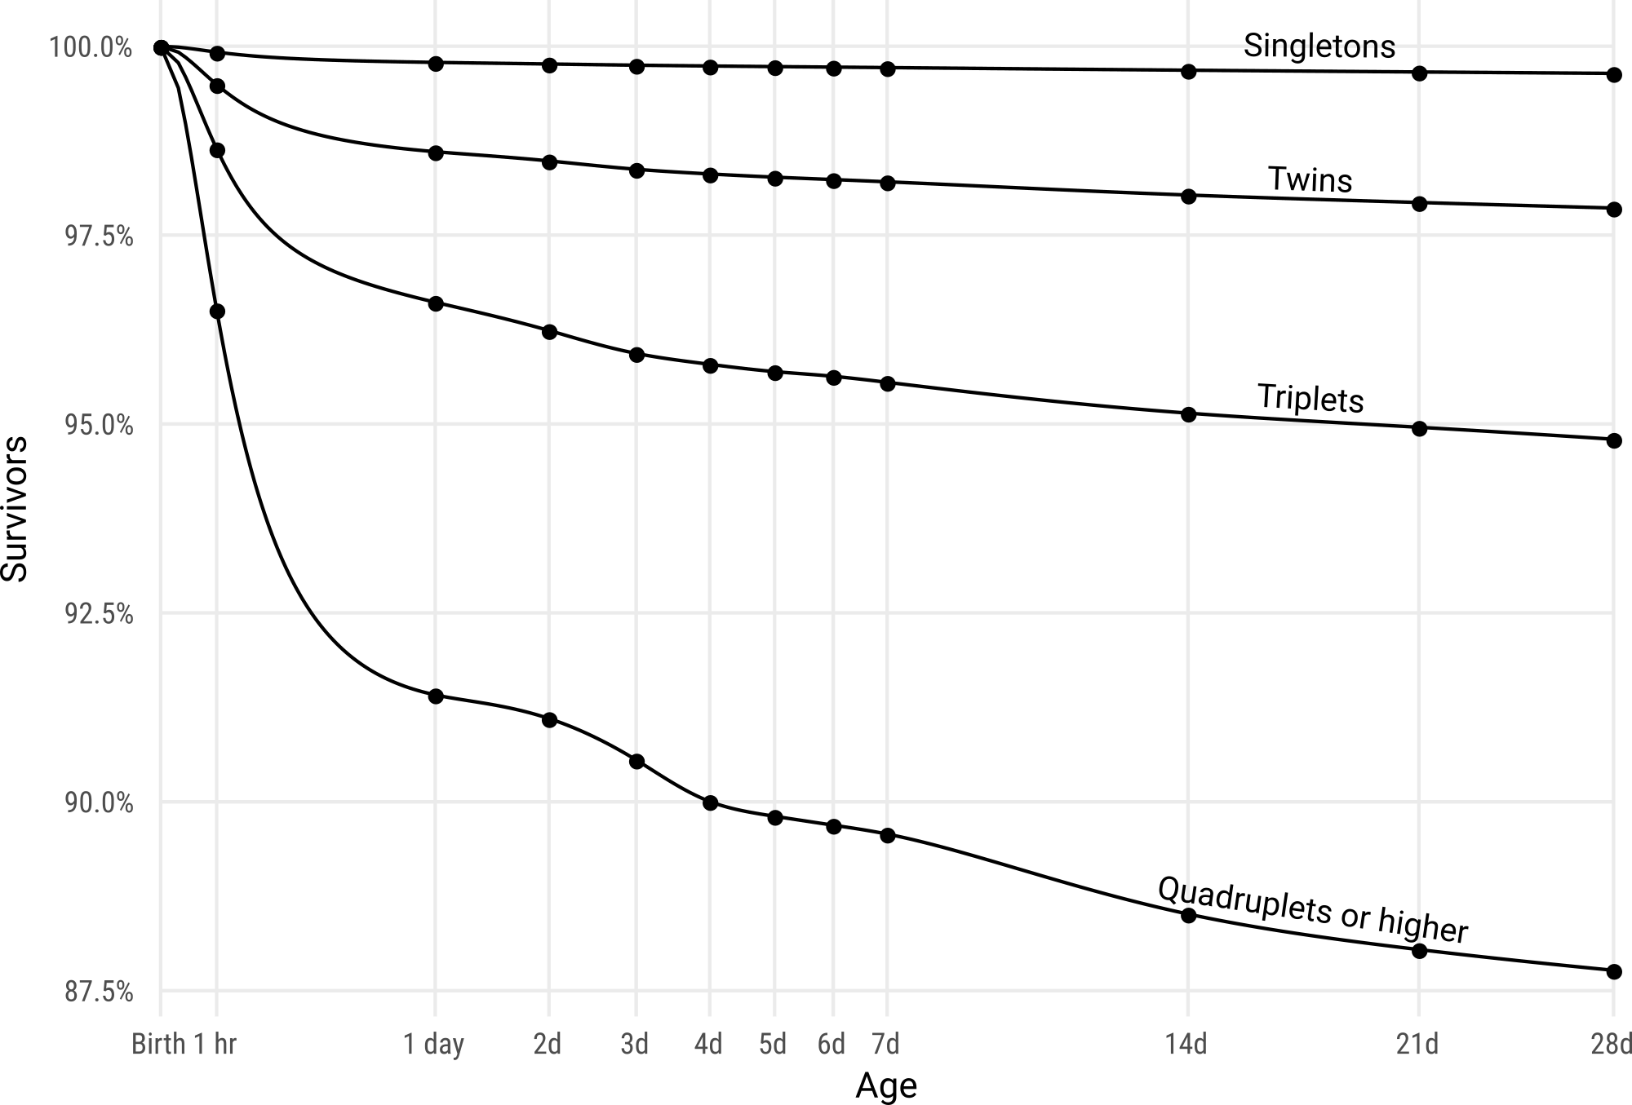
Analysis pipeline
4. Spline interpolation of life-tables
Hyman filtered cubic splines, stratified

Slide 18
Analysis pipeline
4. Spline interpolation of life-tables
Hyman filtered cubic splines, stratified
5. Vaupel-Zhang decomposition
results integrated for ease of interpretation
# A tibble: 11 x 7
x nx diff_mux diff_direct p_direct diff_compos p_compos
<dbl> <dbl> <dbl> <dbl> <dbl> <dbl> <dbl>
1 0 1 -3.372577e-04 -3.371456e-04 0.9996677 -1.120566e-07 3.322581e-04
2 1 23 -1.872115e-04 -1.871751e-04 0.9998055 -3.641661e-08 1.945213e-04
3 24 24 -1.458869e-06 -1.458637e-06 0.9998411 -2.318351e-10 1.589143e-04
4 48 24 -9.328814e-07 -9.326824e-07 0.9997866 -1.990316e-10 2.133514e-04
5 72 24 -6.967401e-07 -6.966751e-07 0.9999067 -6.499963e-11 9.329108e-05
6 96 24 -3.153042e-07 -3.152803e-07 0.9999240 -2.396879e-11 7.601798e-05
7 120 24 -1.301809e-07 -1.301690e-07 0.9999089 -1.185915e-11 9.109745e-05
8 144 24 -3.481738e-08 -3.480556e-08 0.9996607 -1.181328e-11 3.392928e-04
9 168 168 -3.634319e-07 -3.633698e-07 0.9998292 -6.208683e-11 1.708348e-04
10 336 168 -1.646642e-07 -1.646483e-07 0.9999033 -1.591812e-11 9.667023e-05
11 504 168 -6.572048e-08 -6.571205e-08 0.9998718 -8.427150e-12 1.282272e-04

Slide 19
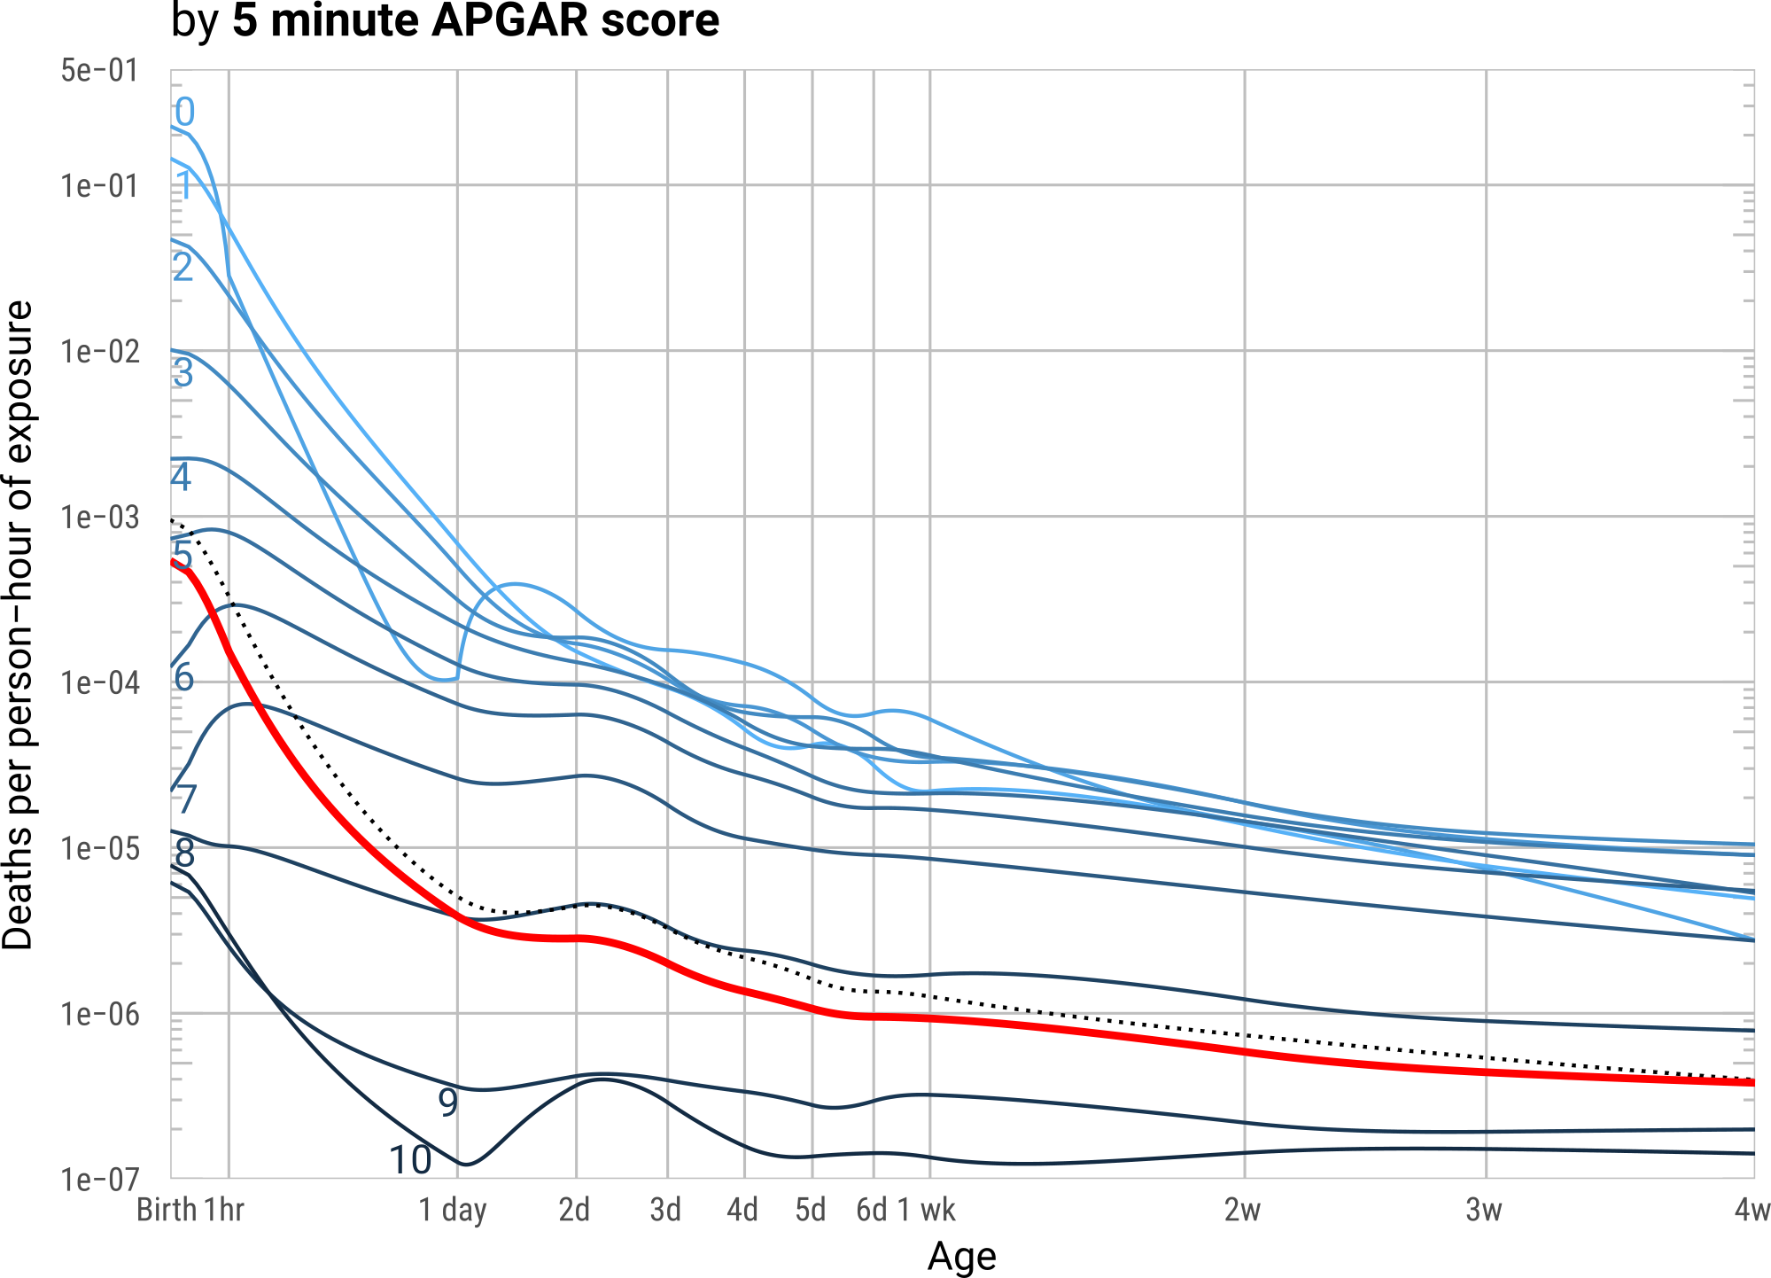
Decomposing the neonatal mortality age decline
Data: US infants born 2005-10. CDC/NCHS.

Slide 20
Decomposing the neonatal mortality age decline
APGAR | % share at birth | % share at day 28 | Percent point difference
0-7 | 3.2 | 2.9 | -0.3
8-10 | 91.8 | 92.1 | +0.3
NA | 5.0 | 5.0 | 0
Data: US infants born 2005-10. CDC/NCHS.

Slide 21
Decomposing the neonatal mortality age decline
Δµ(x) due to
comp. change
Δµ(x) due to
direct change
Δµ(x) over
absolute
percent
1st hour of life | -3.34E-04 | -2.38E-05 | 7.1
Hours 2–24 | -1.35E-04 | -4.73E-06 | 3.5
Day 1 | -9.95E-07 | -8.15E-09 | 0.1
Day 2 | -8.24E-07 | -3.18E-09 | 0
Data: US infants born 2005-10. CDC/NCHS.

Slide 22
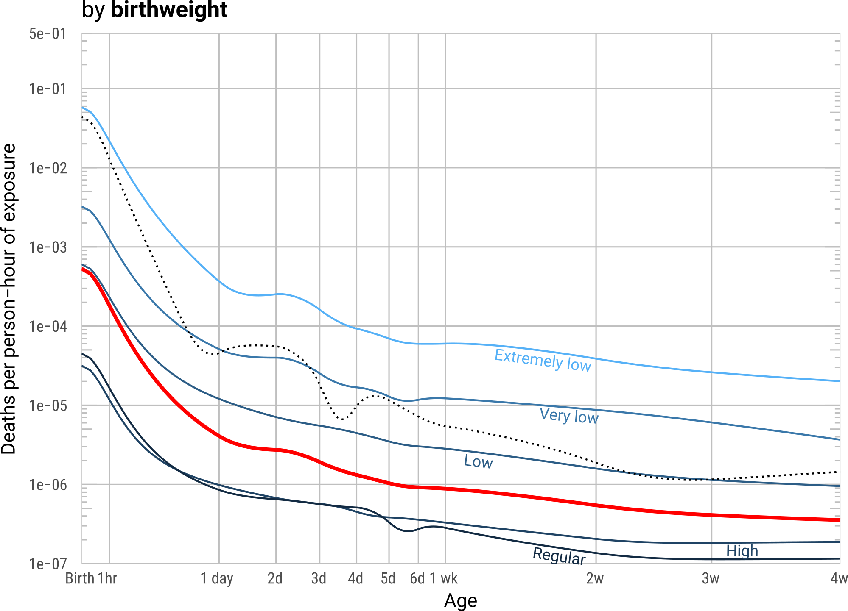
Decomposing the neonatal mortality age decline
Δµ(x) due to
comp. change
Δµ(x) due to
direct change
Δµ(x) over
absolute
percent
1st hour of life | -3.24E-04 | -9.41E-06 | 2.8
Hours 2–24 | -1.66E-04 | -2.86E-06 | 1.6
Day 1 | -1.32E-06 | -9.44E-09 | 0.7
Day 2 | -7.93E-07 | -6.36E-09 | 0.7
Data: US infants born 2005-10. CDC/NCHS.

Slide 23
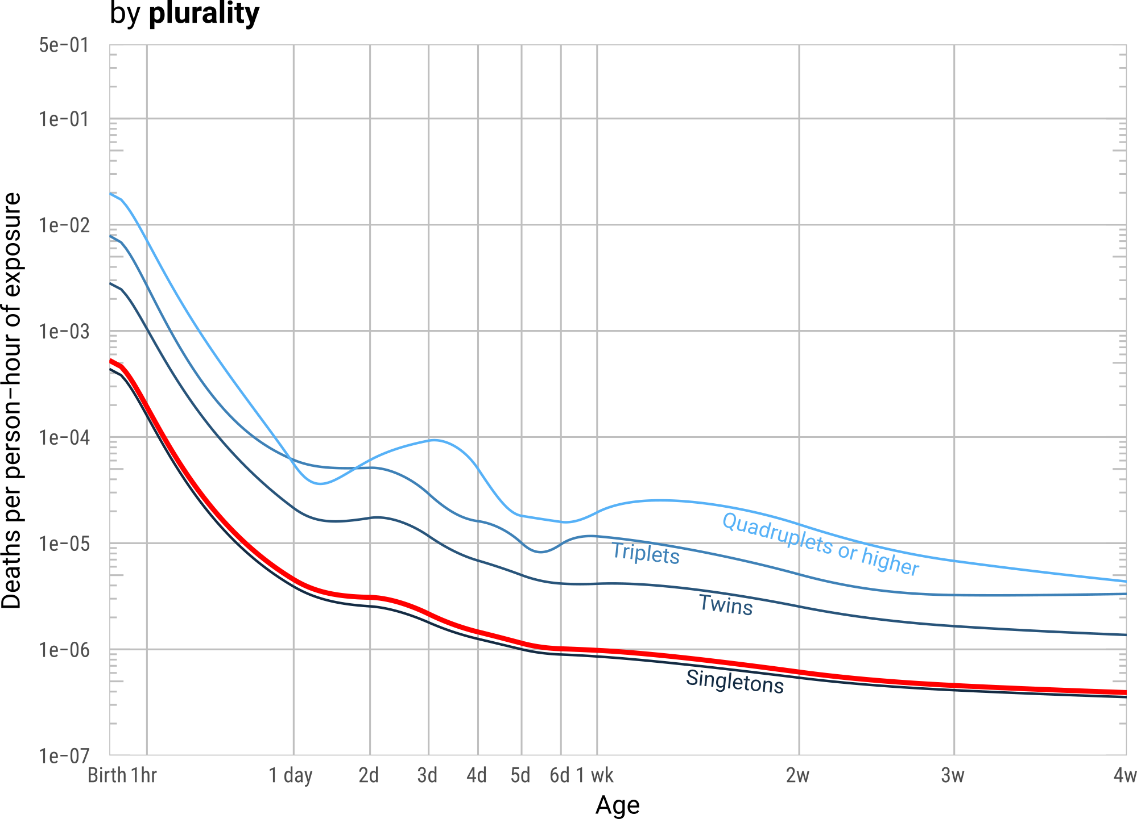
Decomposing the neonatal mortality age decline
Δµ(x) due to
comp. change
Δµ(x) due to
direct change
Δµ(x) over
absolute
percent
1st hour of life | -3.37E-04 | -1.12E-07 | 0
Hours 2–24 | -1.87E-04 | -3.64E-08 | 0
Day 1 | -1.45E-06 | -2.32E-10 | 0
Day 2 | -9.32E-07 | -1.99E-10 | 0
Data: US infants born 2005-10. CDC/NCHS.

Slide 24
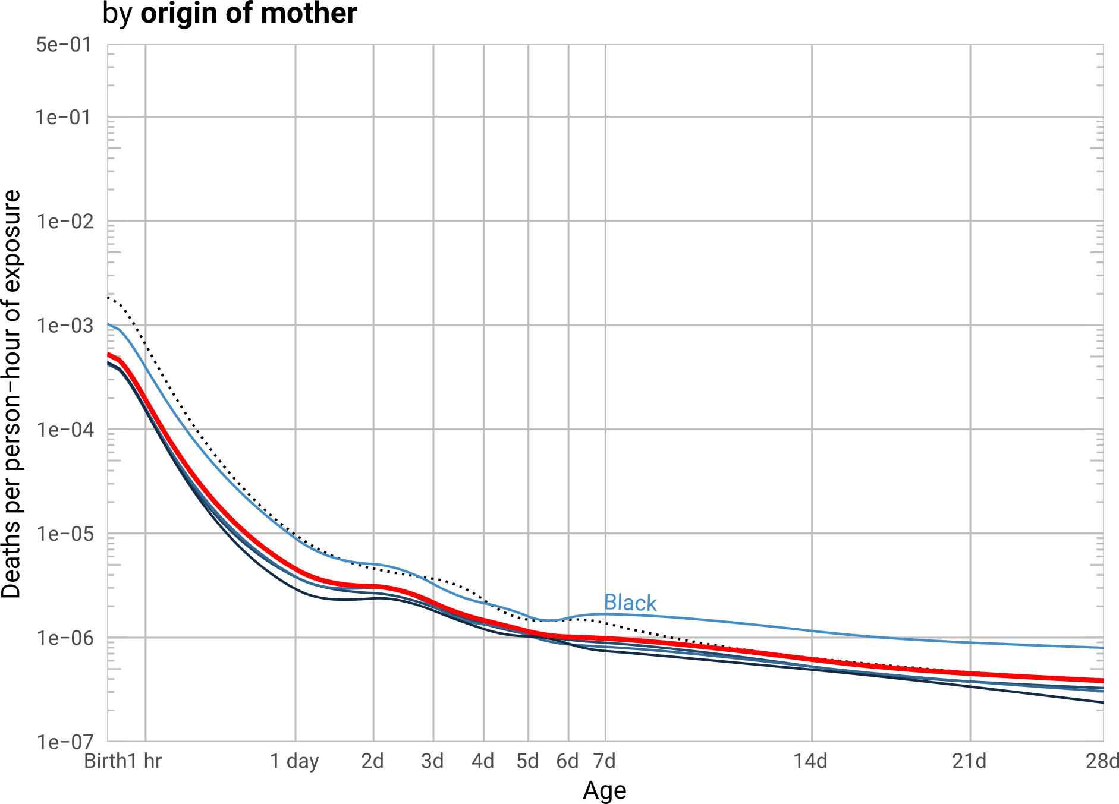
Decomposing the neonatal mortality age decline
Δµ(x) due to
comp. change
Δµ(x) due to
direct change
Δµ(x) over
absolute
percent
1st hour of life | -3.37E-04 | -2.32E-08 | 0
Hours 2–24 | -1.87E-04 | -9.35E-09 | 0
Day 1 | -1.45E-06 | -3.28E-11 | 0
Day 2 | -9.34E-07 | -1.13E-11 | 0
Data: US infants born 2005-10. CDC/NCHS.

Slide 25
Decomposing the neonatal mortality age decline
Decomposed by
APGAR score ×
Birthweight ×
Gestation at delivery ×
Birth defect ×
Birth injury ×
Plurality ×
Sex ×
Mother’s resident status ×
Mother’s education ×
Mother’s race and origin ×
Mother’s marital status ×
Mother’s age ×
Alcohol or tobacco use during pregnancy
290,327 population strata / life-tables
Data: US infants born 2005-10. CDC/NCHS.

Slide 26
Decomposing the neonatal mortality age decline
Decomposed by
APGAR score ×
Birthweight ×
Gestation at delivery ×
Birth defect ×
Birth injury ×
Plurality ×
Sex ×
Mother’s resident status ×
Mother’s education ×
Mother’s race and origin ×
Mother’s marital status ×
Mother’s age ×
Alcohol or tobacco use during pregnancy
Changing composition along these
strata explains 25 % of the mortality
Decline over the first hour of life.
290,327 population strata / life-tables
Data: US infants born 2005-10. CDC/NCHS.

Slide 27
Conclusion
Mortality selection explains part of
the mortality decline immediately
after birth...
...still, most of the neonatal
mortality decline over age is
due to individual level effects.

Slide 28
More on this project
github.com/jschoeley/imort_select
Jonas Schöley
jschoeley@health.sdu.dk
Twitter: @jschoeley

