Slide 1




Quantifying impacts of the COVID-19 pandemic through life expectancy losses
Jonas Schöley
@jschoeley
0000-0002-3340-8518
schoeley@demogr.mpg.de

Slide 2
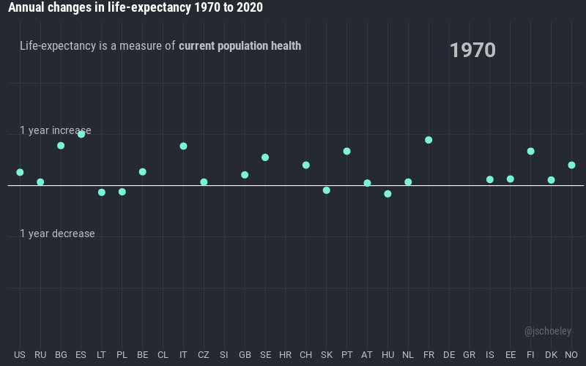
Why life expectancy?

Slide 3
Why e₀
to quantify period shocks?
Why not 1/e₀?

Slide 4
Why? Attention!
1/e₀

Slide 5
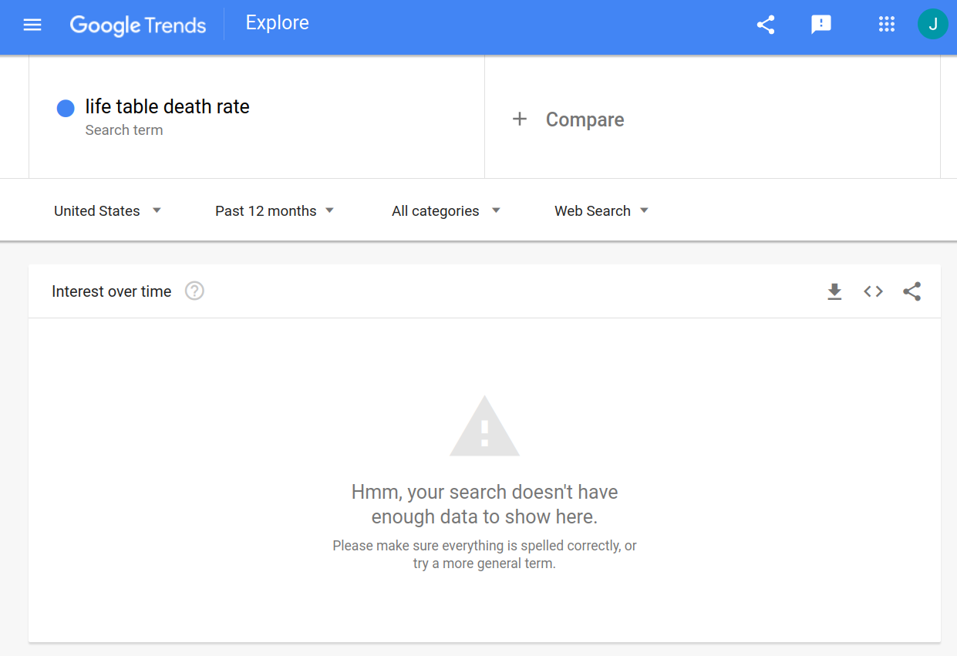
Why? Attention!

Slide 6
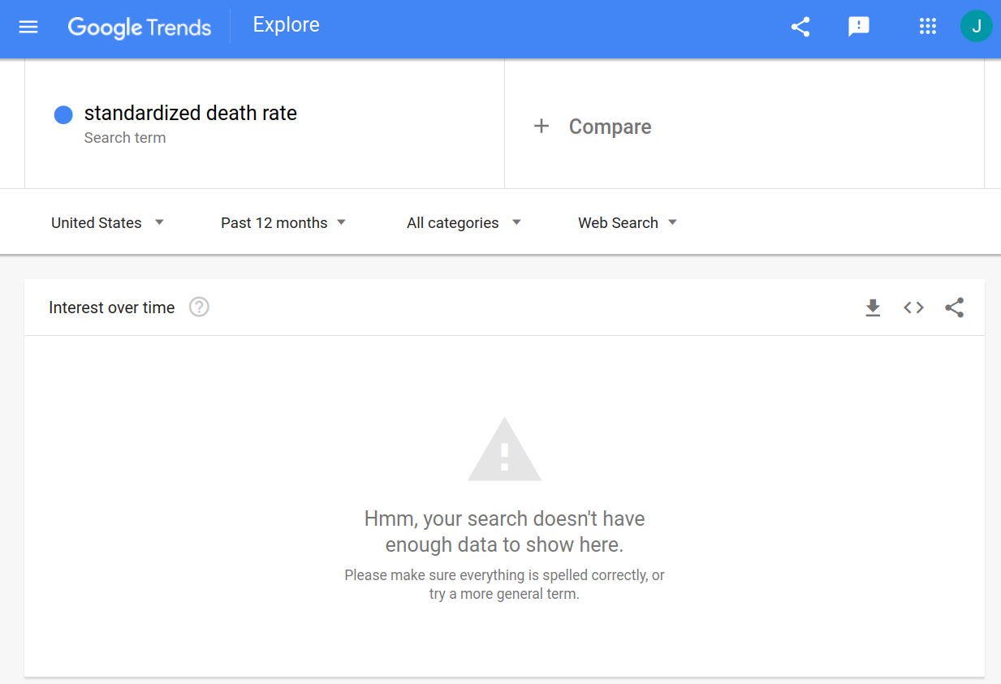
Why? Attention!

Slide 7
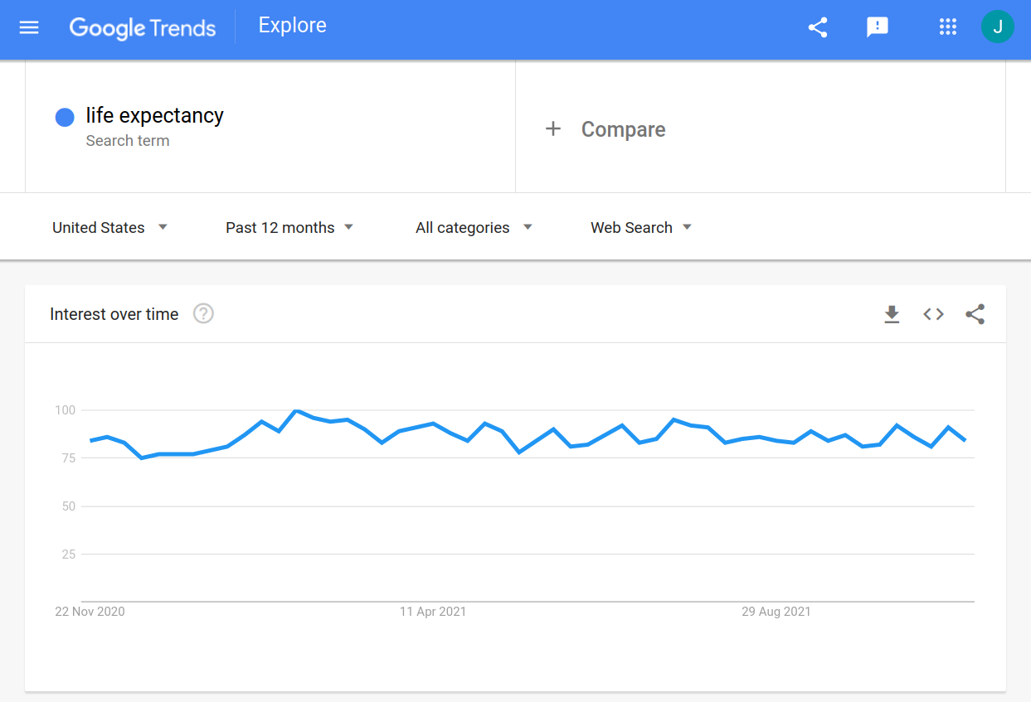
Why? Attention!

Slide 8
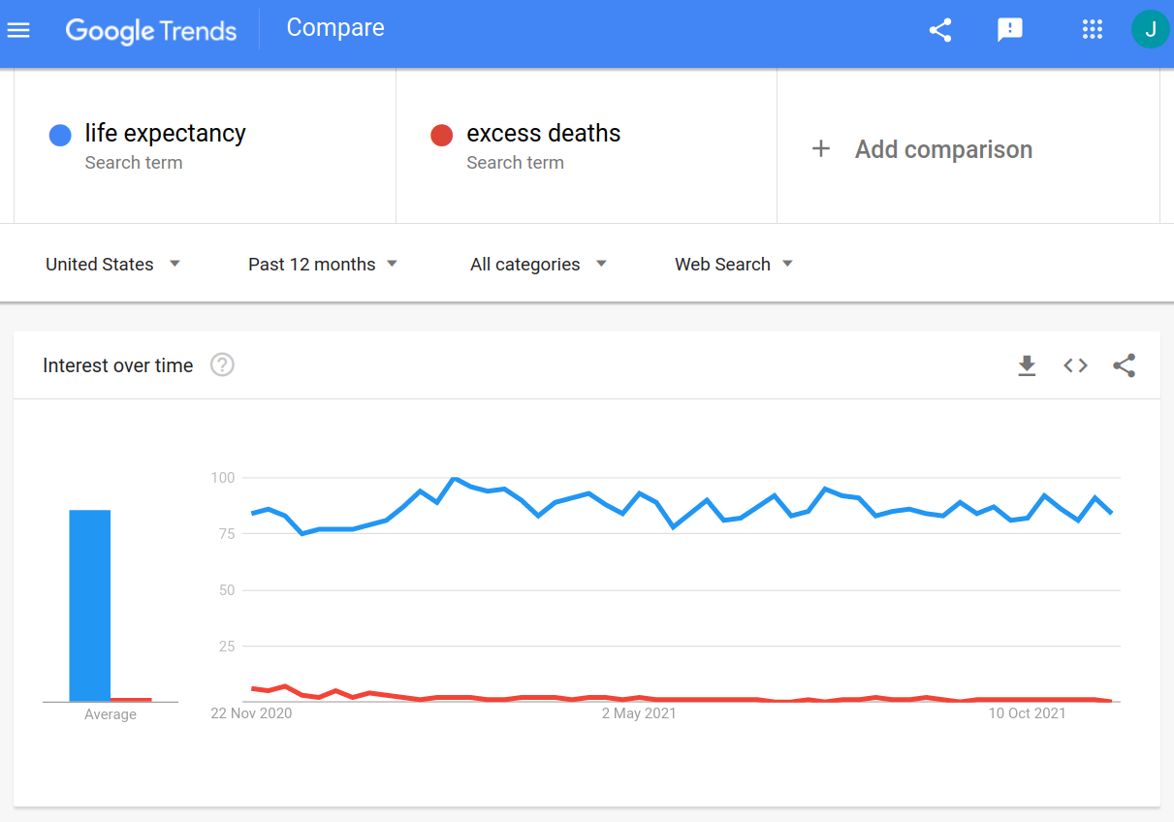
Why? Attention!

Slide 9
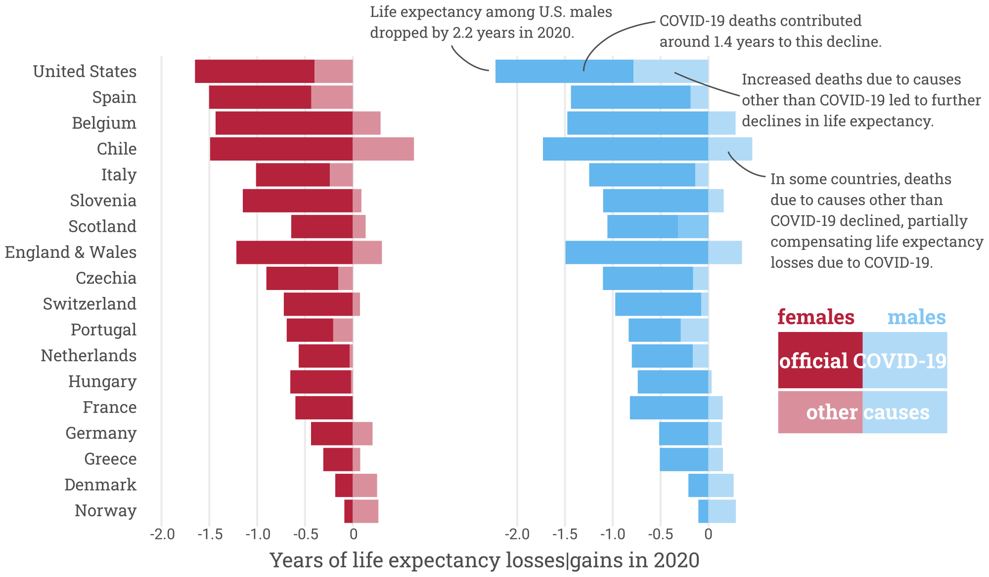
Why? Decomposition!

Slide 10
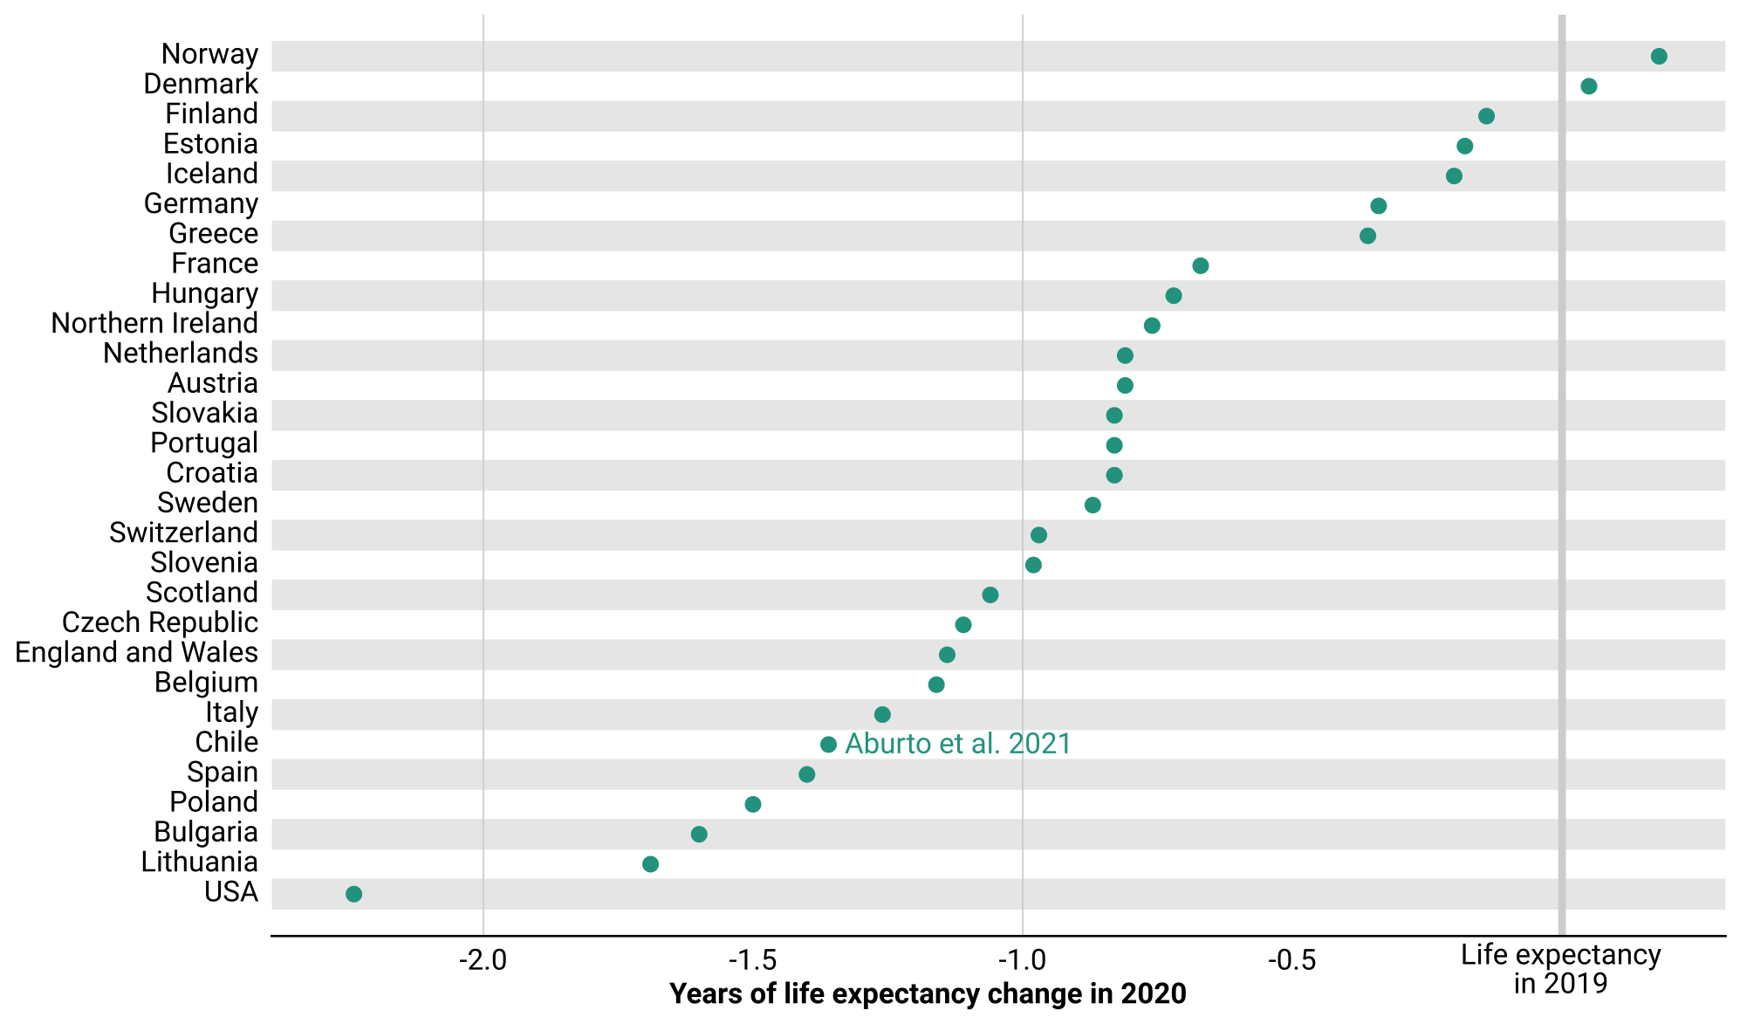
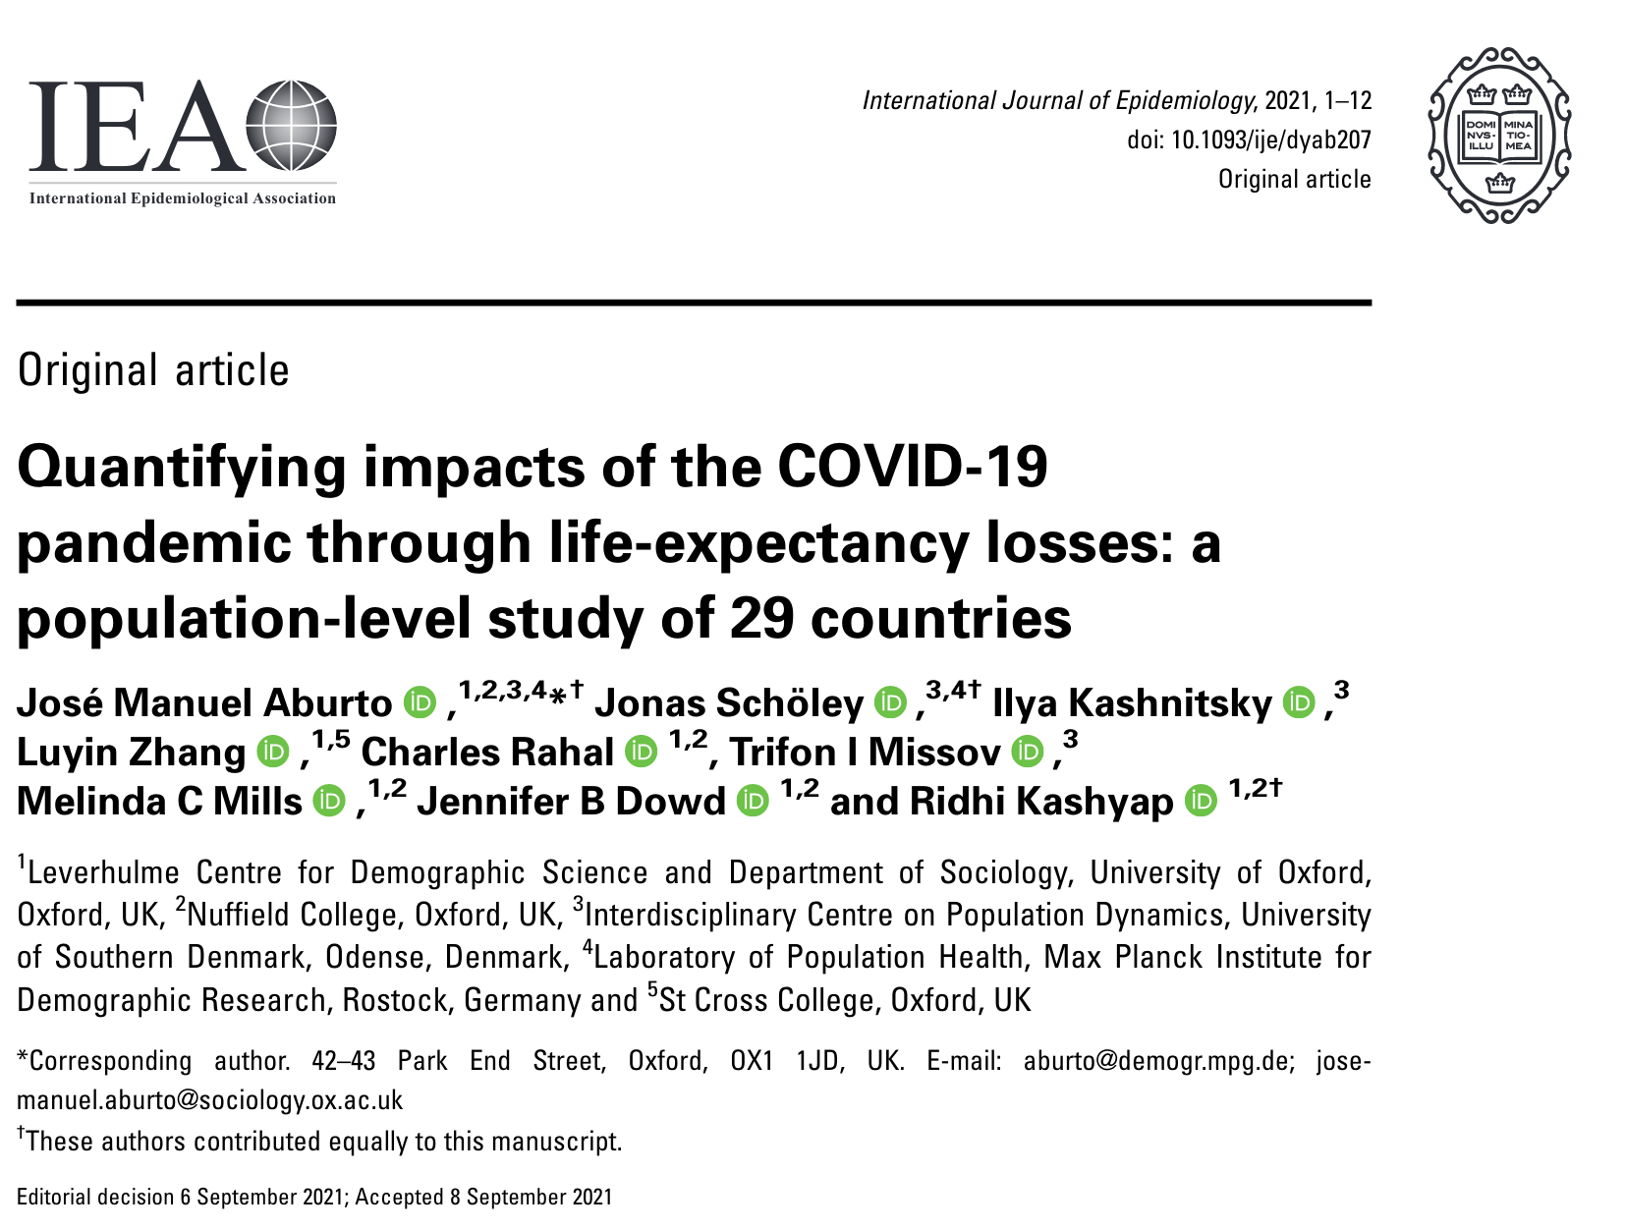
Why? Robustness!
Aburto & Schöley et al. 2021. Quantifying impacts of the COVID-19 pandemic through life-expectancy losses: a population-level study of 29 countries. 10.1093/ije/dyab207

Slide 11
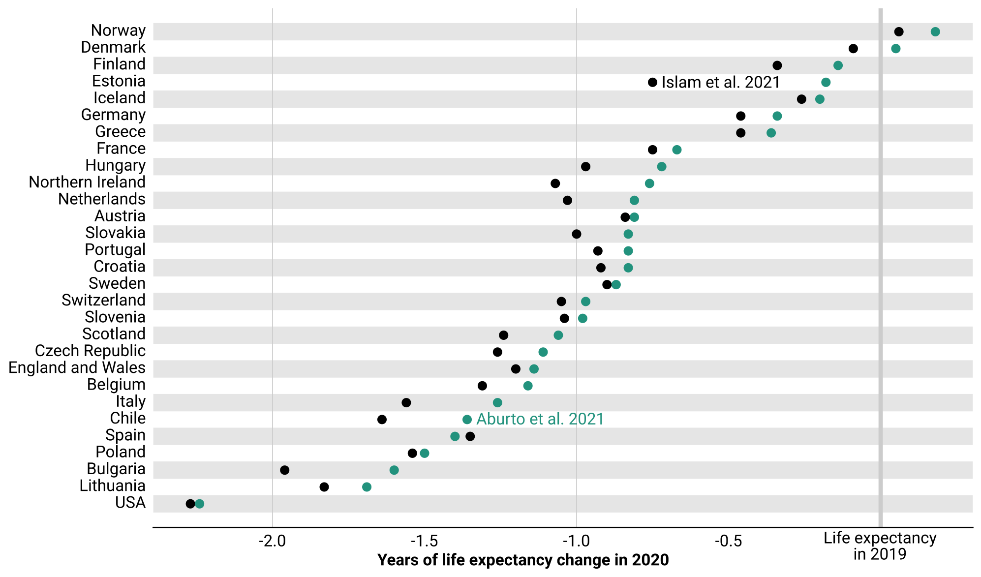
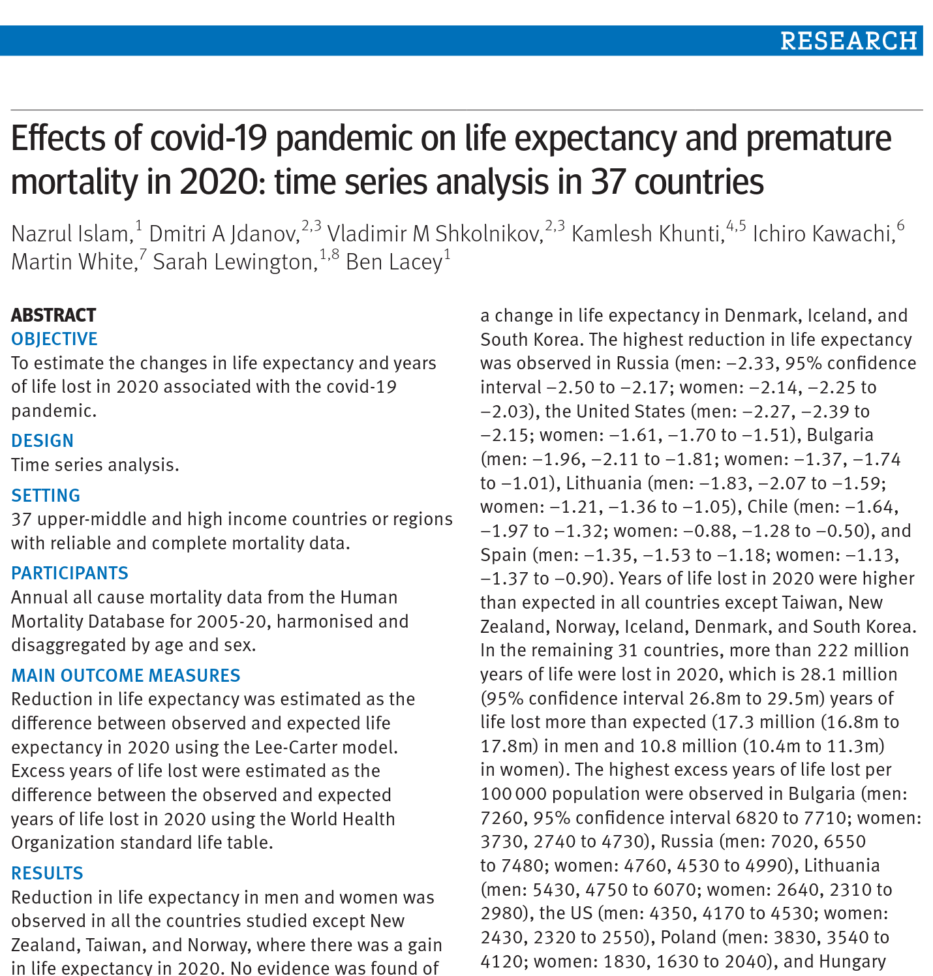
Why? Robustness!
Aburto & Schöley et al. 2021. Quantifying impacts of the COVID-19 pandemic through life-expectancy losses: a population-level study of 29 countries. 10.1093/ije/dyab207
Islam & Jdanov et al. 2021. Effects of covid-19 pandemic on life expectancy and premature mortality in 2020: time series analysis in 37 countries. 10.1136/bmj-2021-066768

Slide 12
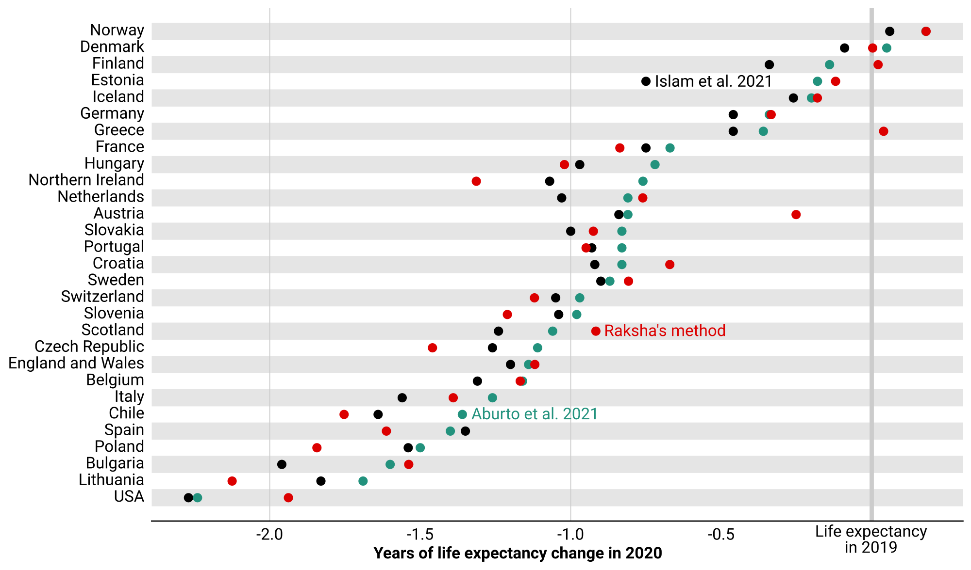
Why? Robustness!
Aburto & Schöley et al. 2021. Quantifying impacts of the COVID-19 pandemic through life-expectancy losses: a population-level study of 29 countries. 10.1093/ije/dyab207
Islam & Jdanov et al. 2021. Effects of covid-19 pandemic on life expectancy and premature mortality in 2020: time series analysis in 37 countries. 10.1136/bmj-2021-066768
For Raksha’s method see:
Session 166 Methods and Data for Demographic Analysis. A radically simple way to monitor life expectancy.

Slide 13
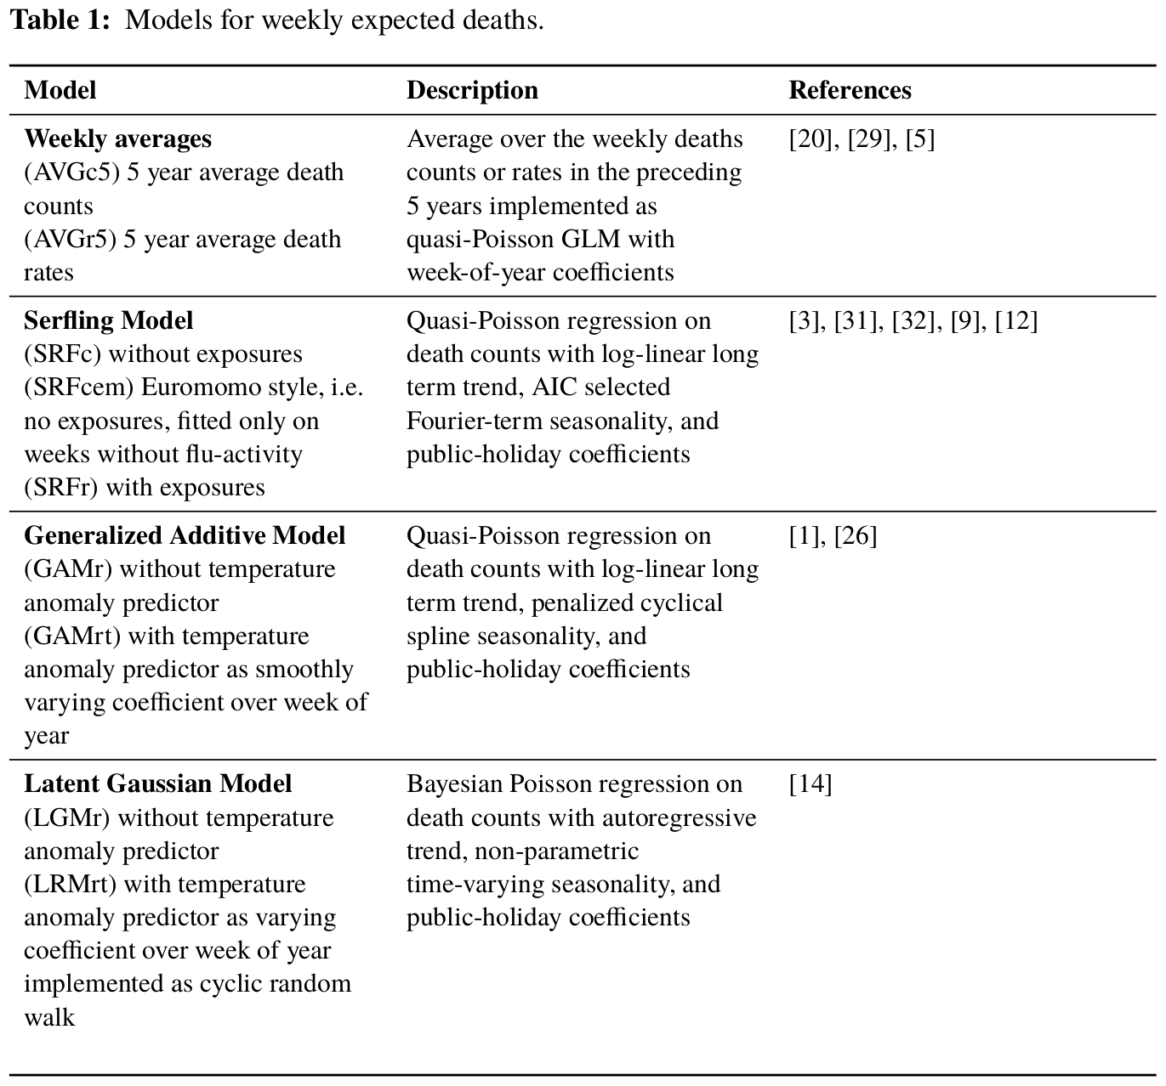
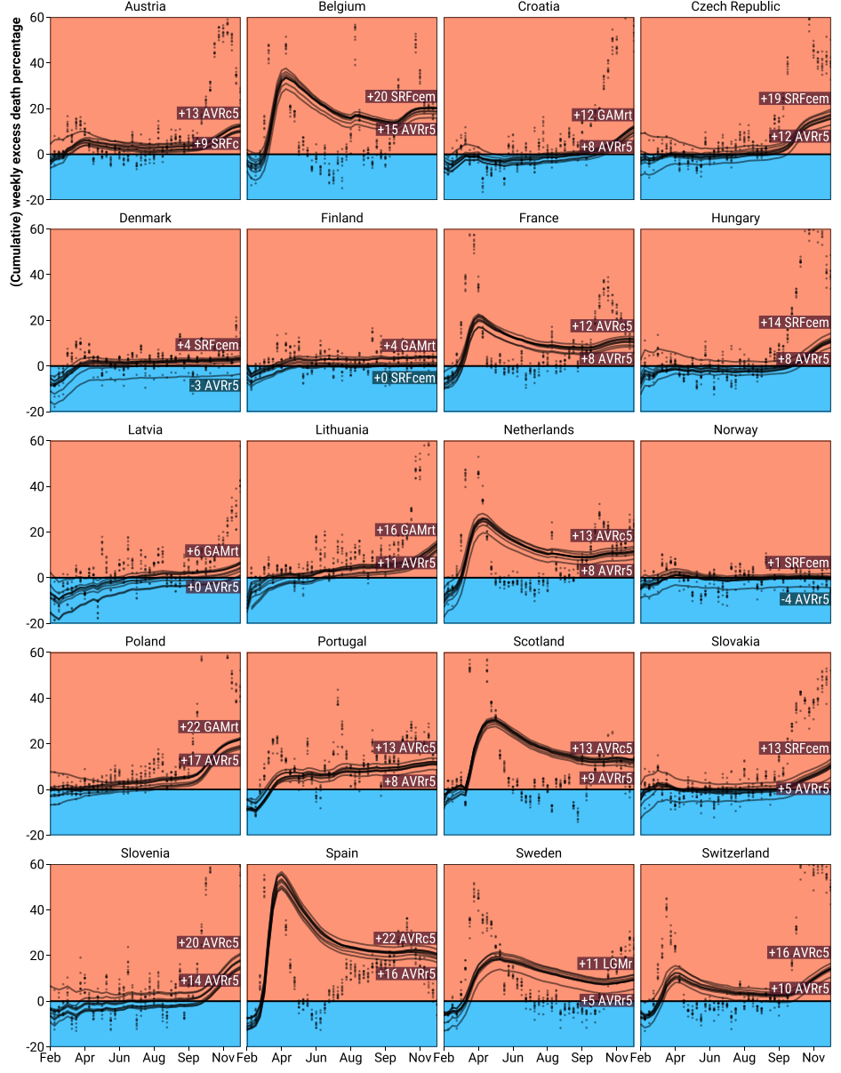
Why? Robustness!
Schöley. 2021. Robustness and bias of European excess death estimates in 2020 under varying model
Specifications. 10.1101/2021.06.04.21258353
Presented at session 118. Estimating and Modelling Mortality

Slide 14
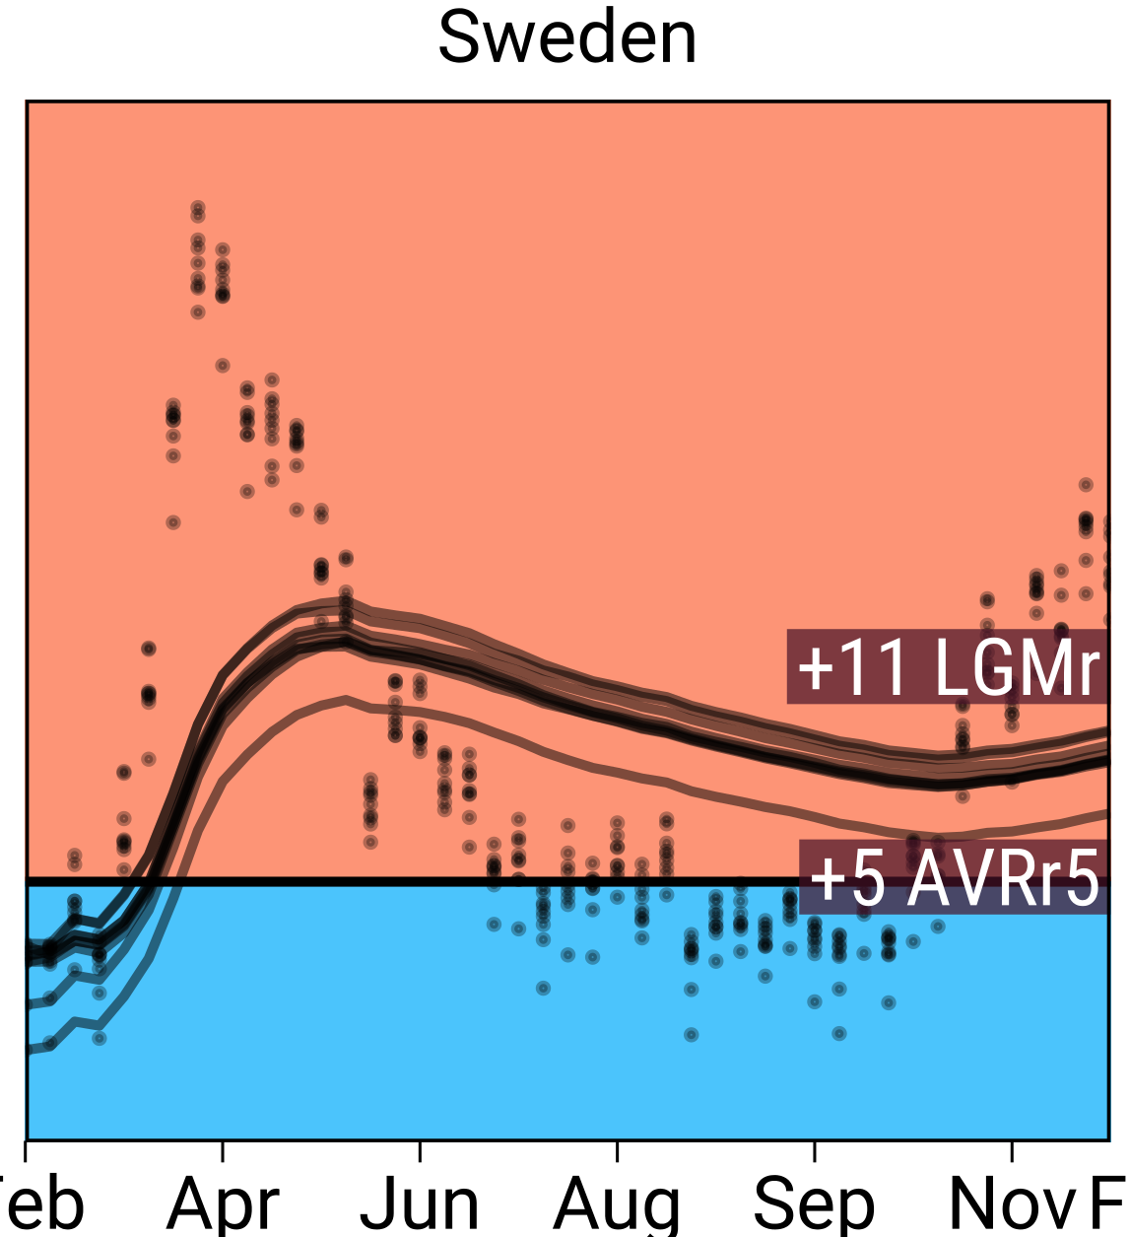
Why? Robustness!
Aburto & Schöley et al. 2021. Quantifying impacts of the COVID-19 pandemic through life-expectancy losses: a population-level study of 29 countries. 10.1093/ije/dyab207
Islam & Jdanov et al. 2021. Effects of covid-19 pandemic on life expectancy and premature mortality in 2020: time series analysis in 37 countries. 10.1136/bmj-2021-066768
For Raksha’s method see:
Session 166 Methods and Data for Demographic Analysis. A radically simple way to monitor life expectancy.

Slide 15
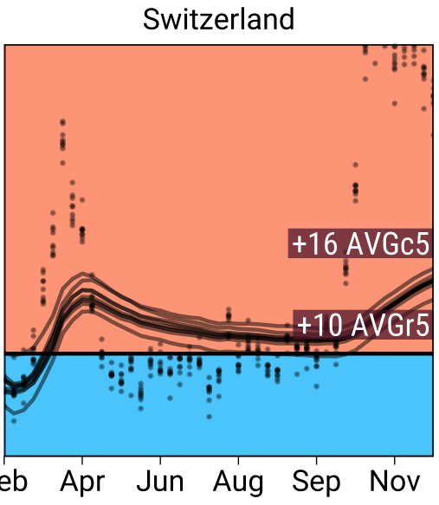
Why? Robustness!
Aburto & Schöley et al. 2021. Quantifying impacts of the COVID-19 pandemic through life-expectancy losses: a population-level study of 29 countries. 10.1093/ije/dyab207
Islam & Jdanov et al. 2021. Effects of covid-19 pandemic on life expectancy and premature mortality in 2020: time series analysis in 37 countries. 10.1136/bmj-2021-066768
For Raksha’s method see:
Session 166 Methods and Data for Demographic Analysis. A radically simple way to monitor life expectancy.

Slide 16
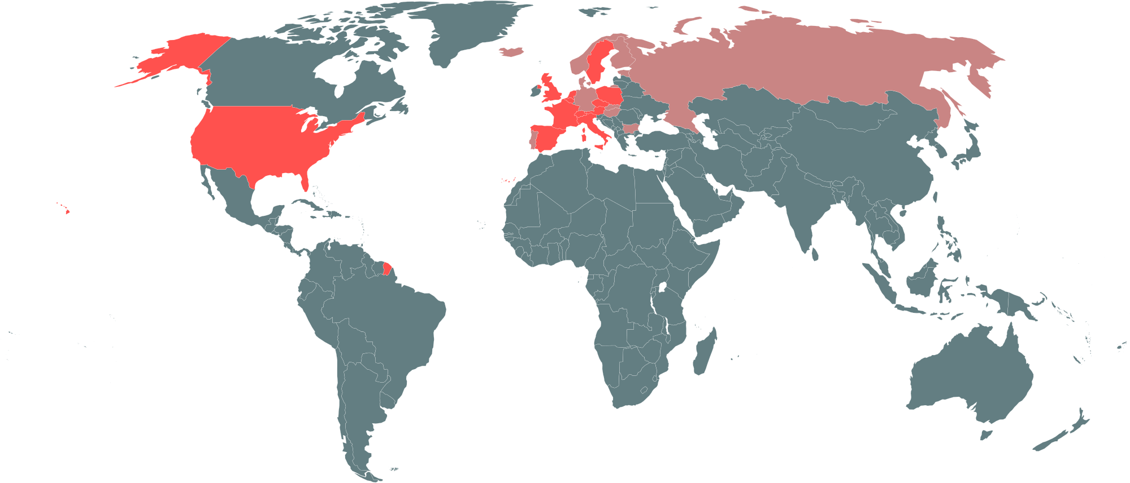
Why? Historical perspective!
Countries with largest drop in life expectancy since at least 1950 in 2020
Countries for which we checked

Slide 17
What’s next?

Slide 18
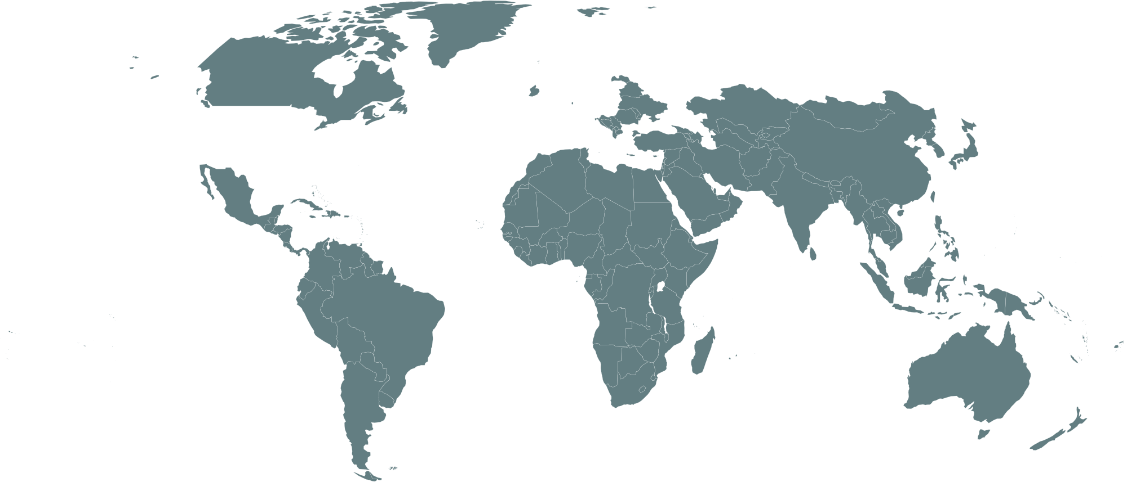
Coverage or quality?

Slide 19
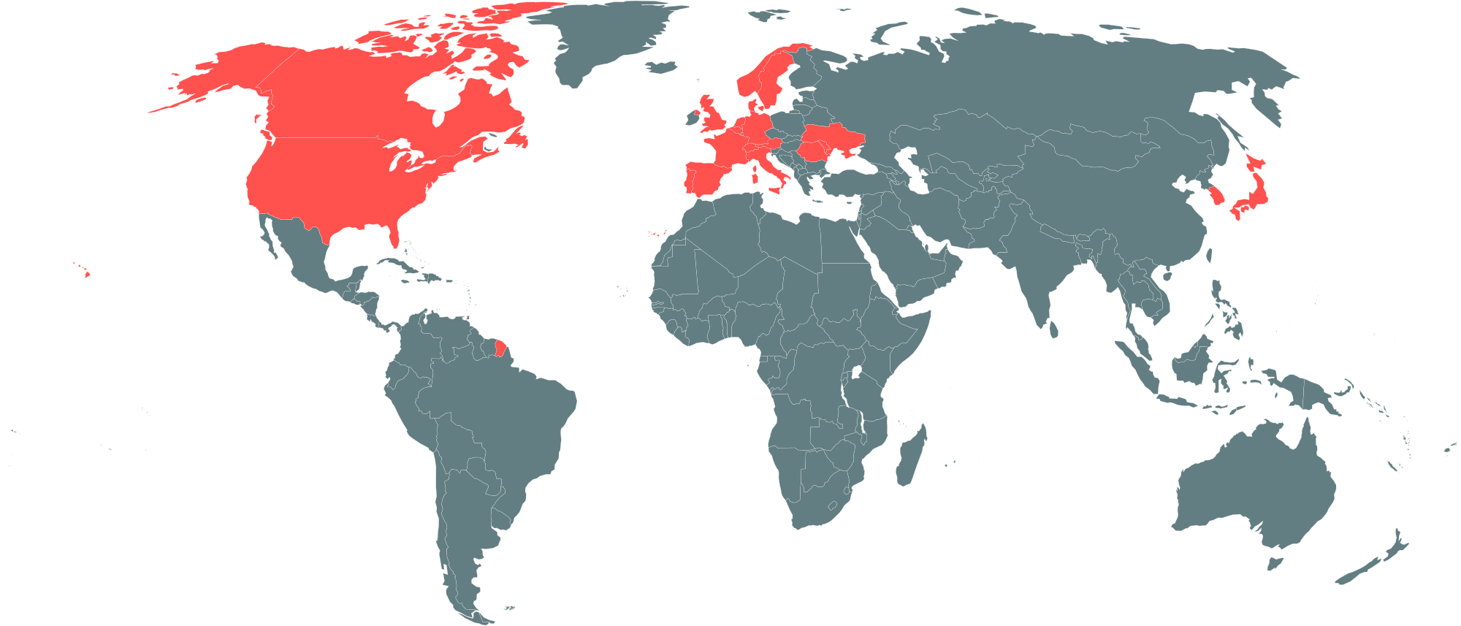
Coverage or quality?
The demography of COVID-19 deaths. INED. dc-covid.site.ined.fr

Slide 20
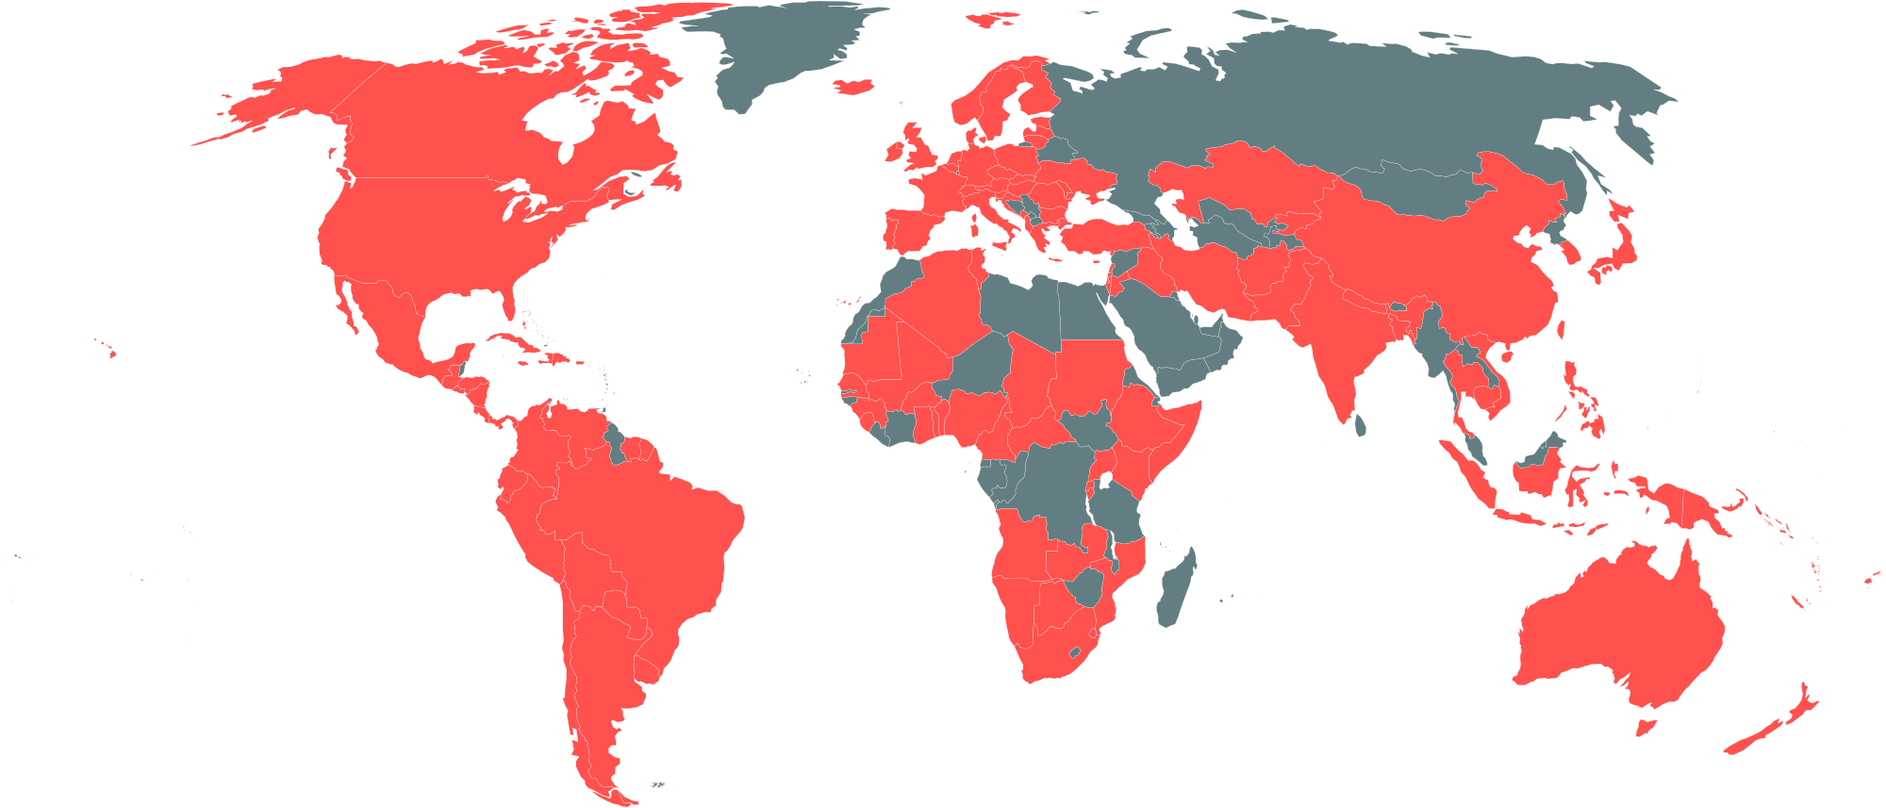
Coverage or quality?
COVerAGE-DB: A database of COVID-19 cases and deaths by age. MPIDR.

Slide 21
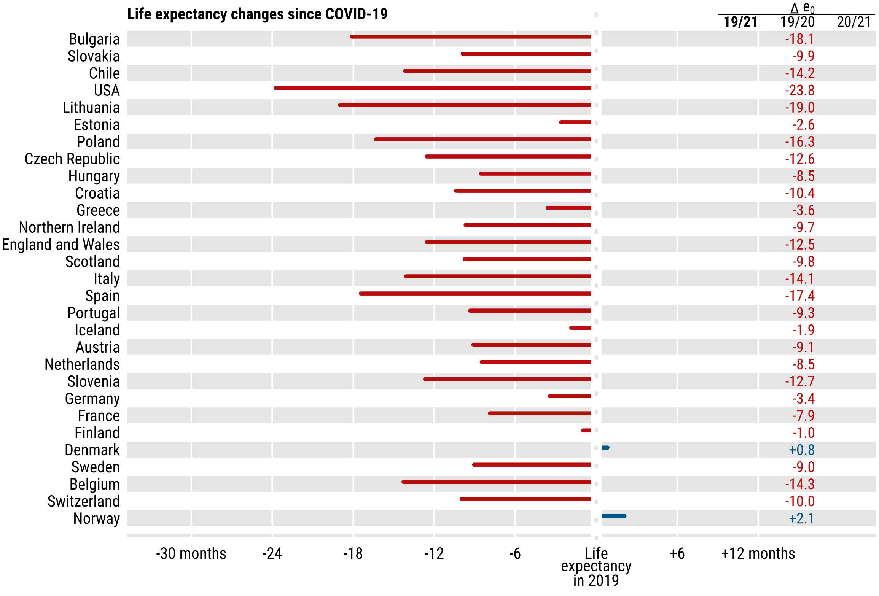
Bounce backs or continued losses?

Slide 22
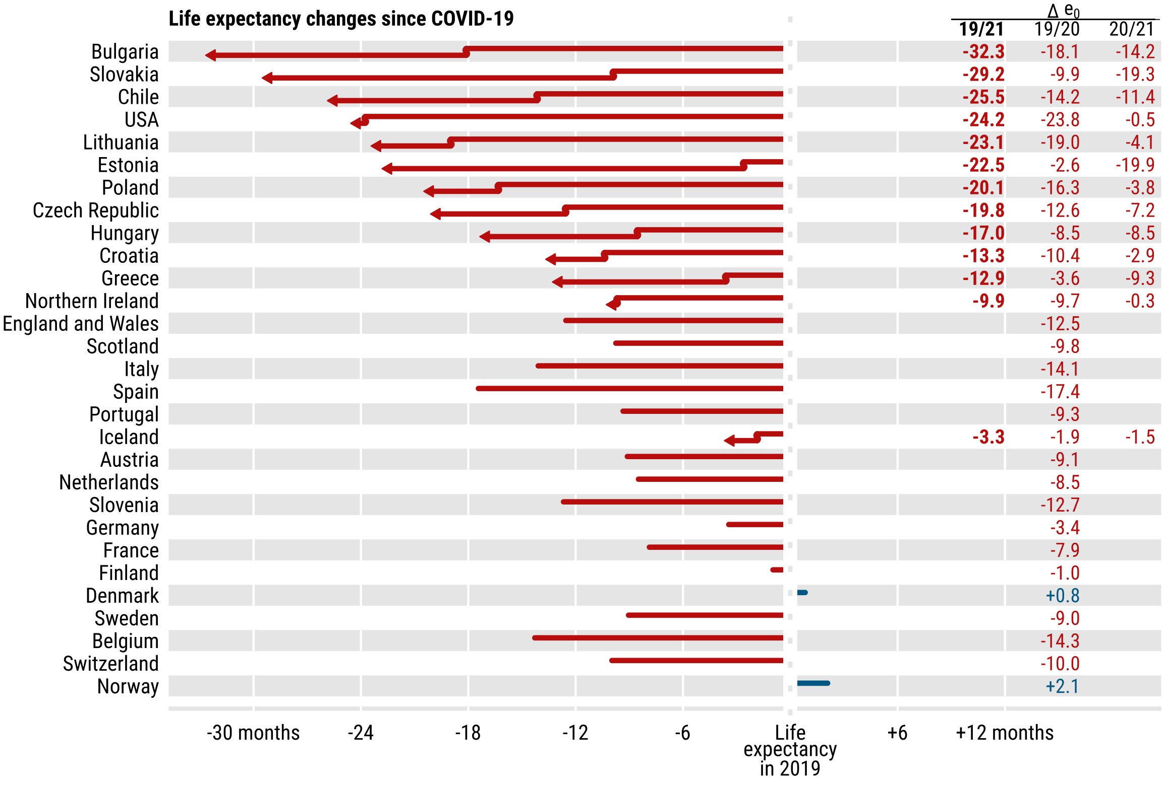
Bounce backs or continued losses?

Slide 23
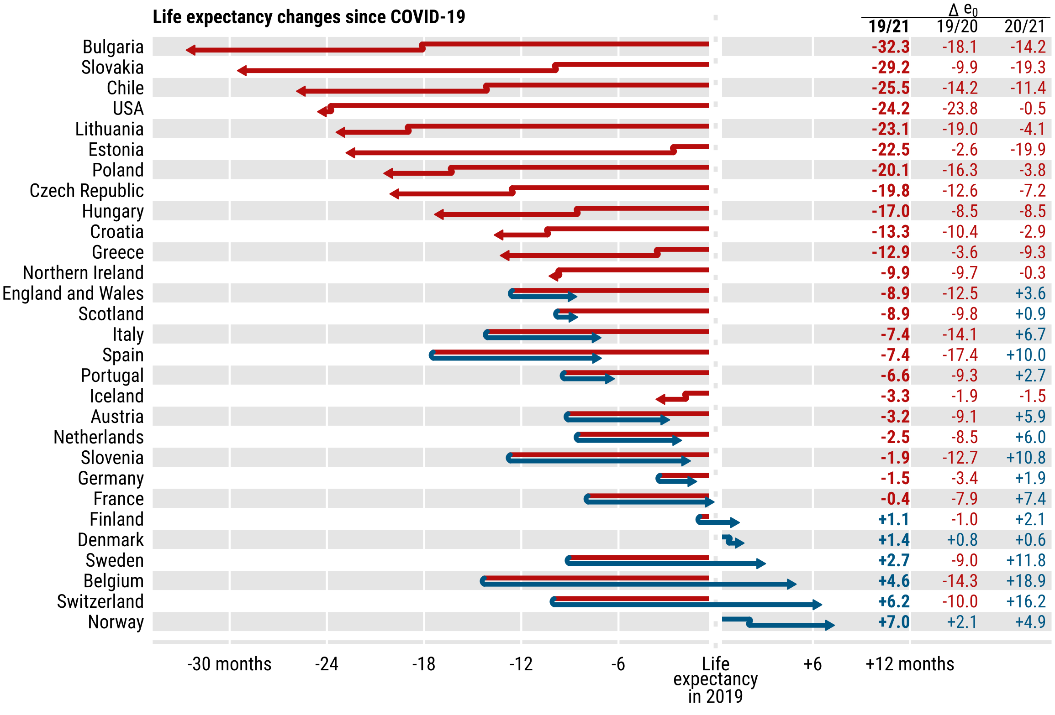
Bounce backs or continued losses?

Slide 24
Reproducible analysis
github.com/jschoeley
Jonas Schöley
@jschoeley
0000-0002-3340-8518
schoeley@demogr.mpg.de

