Slide 1
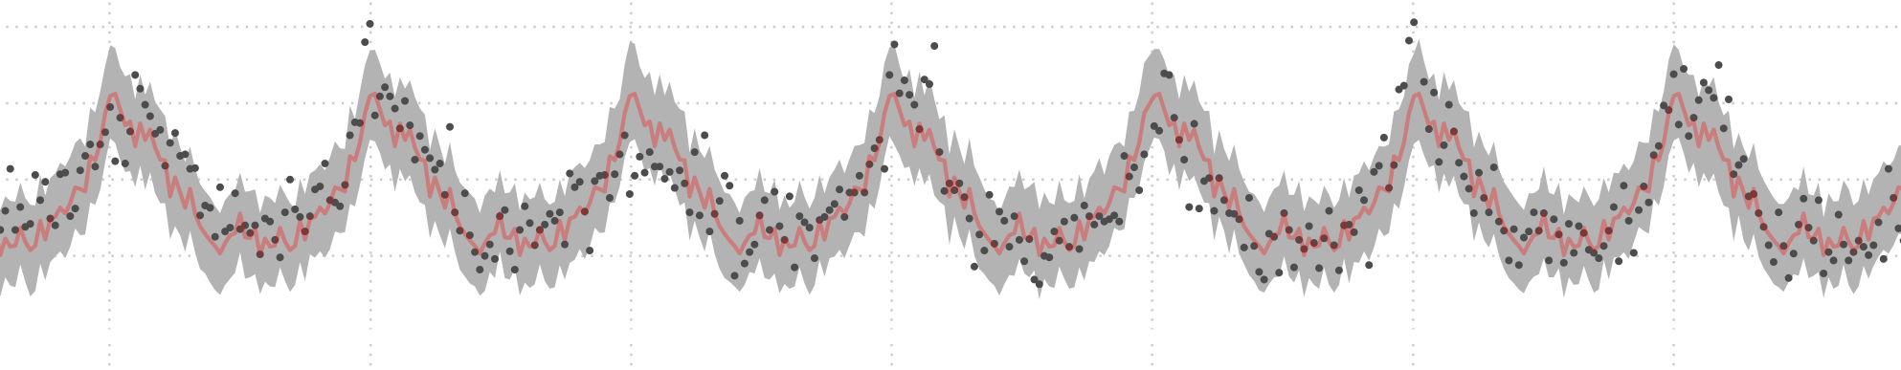




Robustness and bias of excess death estimates under varying model specifications
Jonas Schöley
Jonas Schöley
@jschoeley
0000-0002-3340-8518
schoeley@demogr.mpg.de

Slide 2
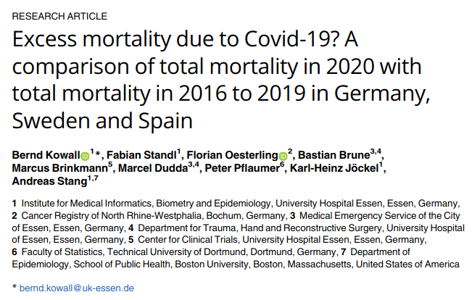
What should we expect?
10.1371/journal.pone.0255540

Slide 3
What should we expect?
Excess deaths = Observed deaths -
Expected deaths
10.1371/journal.pone.0255540

Slide 4
What should we expect?
How many deaths should we expect in the absence of COVID-19?
Excess deaths = Observed deaths -
Expected deaths

Slide 5
What should we expect?
How many deaths should we expect in the absence of COVID-19?
Excess deaths = Observed deaths -
Expected deaths
Robustness does model specification change our conclusions on excess deaths?

Slide 6
What should we expect?
How many deaths should we expect in the absence of COVID-19?
Excess deaths = Observed deaths -
Expected deaths
Robustness does model specification change our conclusions on excess deaths?
Bias Are some models prone to predict too many, too few excess deaths?

Slide 7
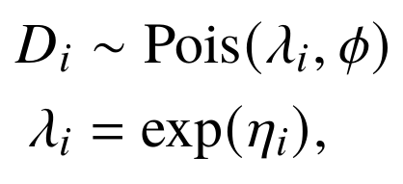
A zoo of models
Expected deaths

Slide 8
A zoo of models
Expected deaths
- (time-varying) seasonality
- population structure
- time trend
- temperature
- temporal auto-correlation
- public holidays

Slide 9
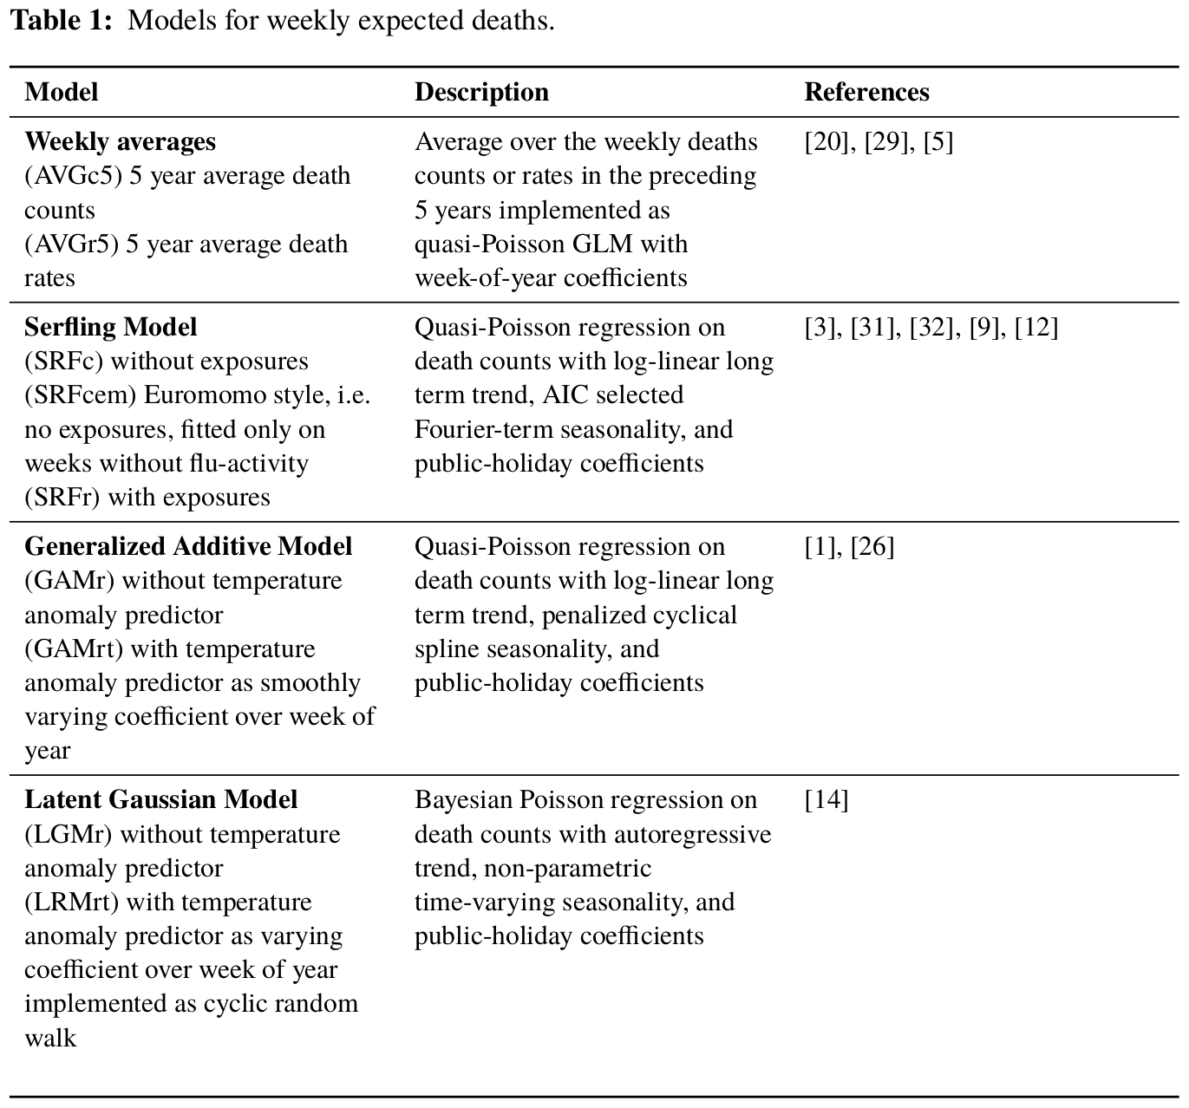
A zoo of models
Expected deaths
- (time-varying) seasonality
- population structure
- time trend
- temperature
- temporal auto-correlation
- public holidays

Slide 10
A zoo of models
Expected deaths
- (time-varying) seasonality
- population structure
- time trend
- temperature
- temporal auto-correlation
- public holidays

Slide 11
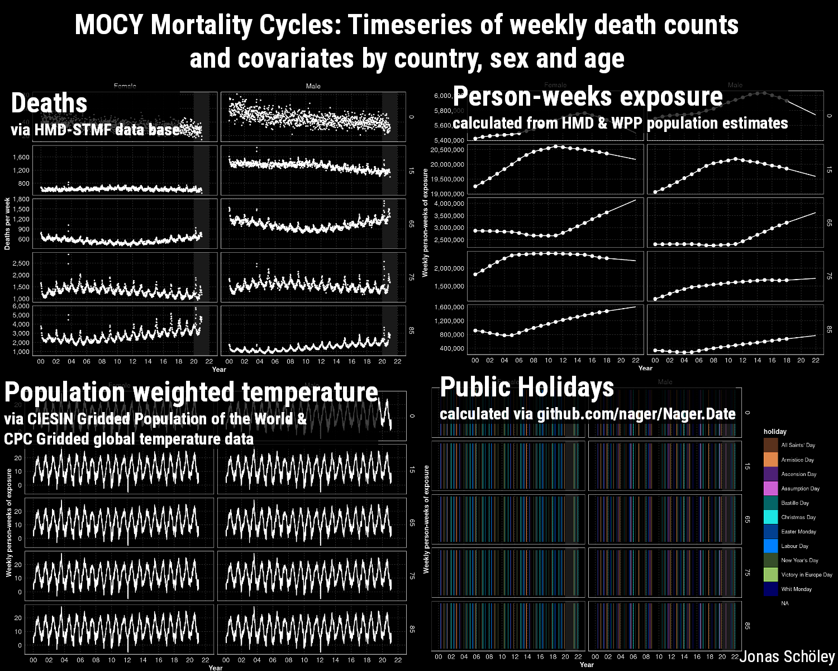
The data
Given timeseries on weekly death counts and
covariates predict:
- weekly expected death counts
March 2020 to Nov 2021
- across 20 European countries
- by sex and age group
(0-65, 65-75, 75-85, 85+)
Download from osf.io/k84rz/

Slide 12
Robustness

Slide 13
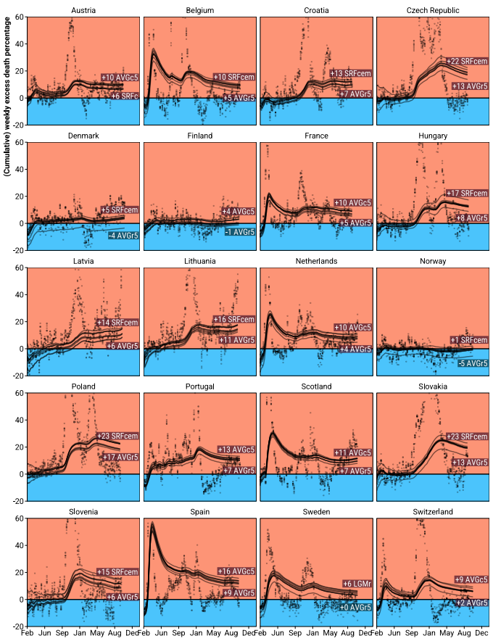
Robustness
Weekly and cumulative excess death percentage since March 2020 as predicted from 9 different models

Slide 14
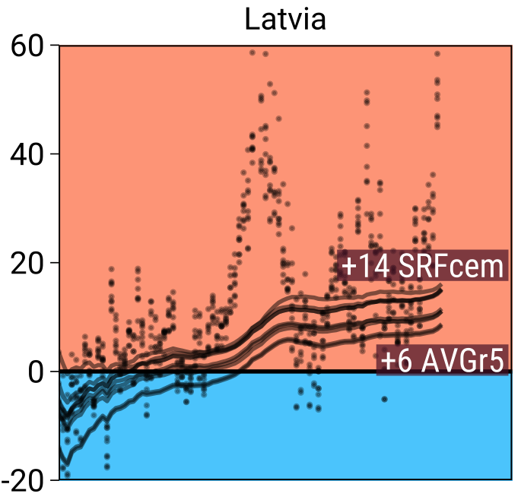
Robustness
Weekly and cumulative excess death percentage as predicted from 9 different models
during the year 2020.
+60% excess deaths
-20% excess deaths

Slide 15
Robustness
Weekly and cumulative excess death percentage as predicted from 9 different models
during the year 2020.
+60% excess deaths
- models agree on weekly pattern of excess but disagree on level
-20% excess deaths

Slide 16
Robustness
Weekly and cumulative excess death percentage as predicted from 9 different models
during the year 2020.
+60% excess deaths
- models agree on weekly pattern of excess but disagree on level
- model disagreement increases over time
-20% excess deaths

Slide 17
Robustness
Weekly and cumulative excess death percentage as predicted from 9 different models
during the year 2020.
+60% excess deaths
- models agree on weekly pattern of excess but disagree on level
- model disagreement increases over time
- 5-year average death rates tend towards low excess
-20% excess deaths

Slide 18
Robustness
Weekly and cumulative excess death percentage as predicted from 9 different models
during the year 2020.
+60% excess deaths
- models agree on weekly pattern of excess but disagree on level
- model disagreement increases over time
- 5-year average death rates tend towards low excess
- Serfling models tend towards high excess
-20% excess deaths

Slide 19
Robustness
Weekly and cumulative excess death percentage as predicted from 9 different models
during the year 2020.
+60% excess deaths
- models agree on weekly pattern of excess but disagree on level
- model disagreement increases over time
- 5-year average death rates tend towards low excess
- Serfling models tend towards high excess
- broad agreement about existence of significantly elevated annual excess deaths. Exceptions: Denmark, Finland, Latvia and Norway
-20% excess deaths

Slide 20
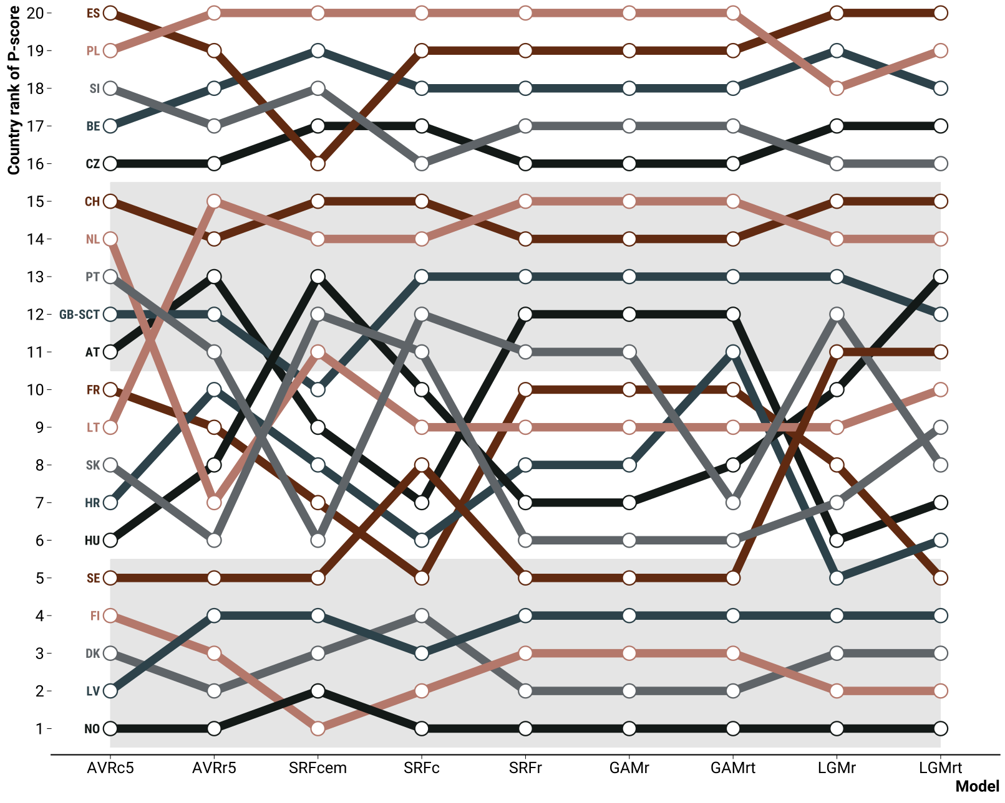
Robustness
Country rank of percent excess deaths in 2020 under different models

Slide 21
Error & Bias

Slide 22
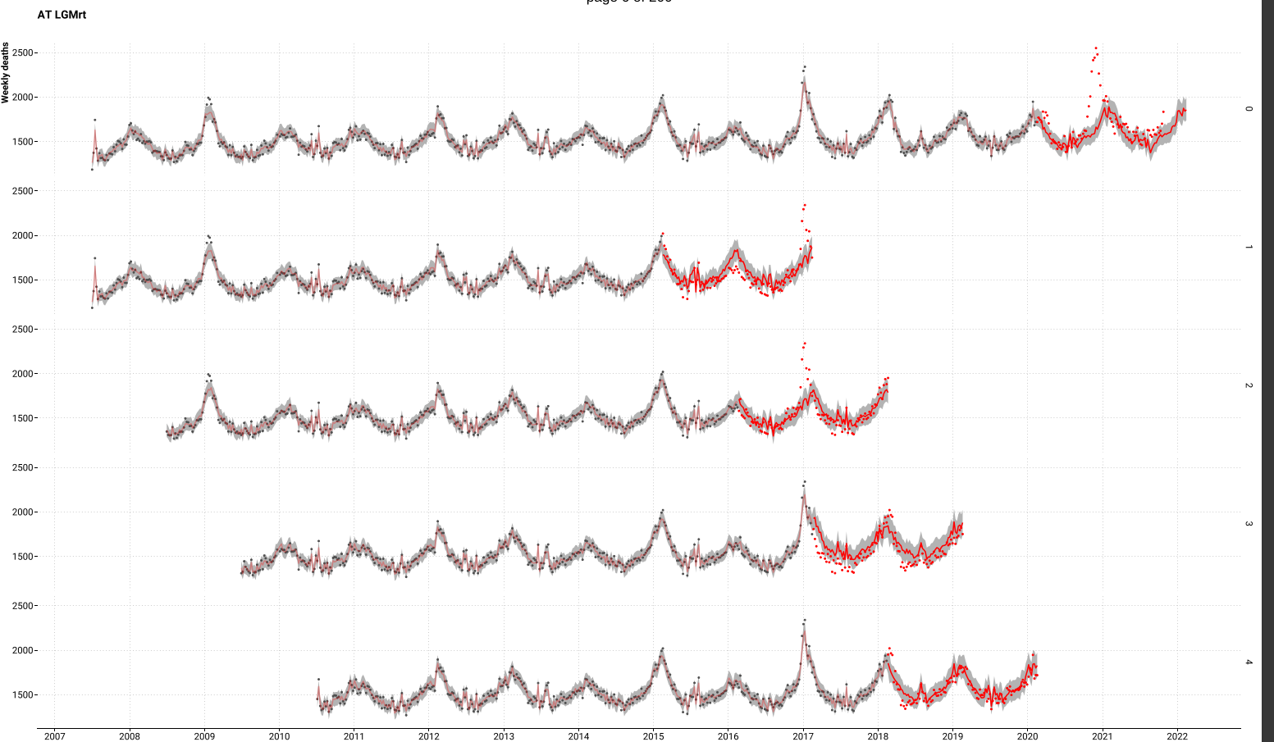
Error & Bias
Rolling origin four-fold cross-validation setup mirroring the task of predicting weekly
deaths past the beginning of the COVID-19 pandemic given pre-pandemic data.

Slide 23
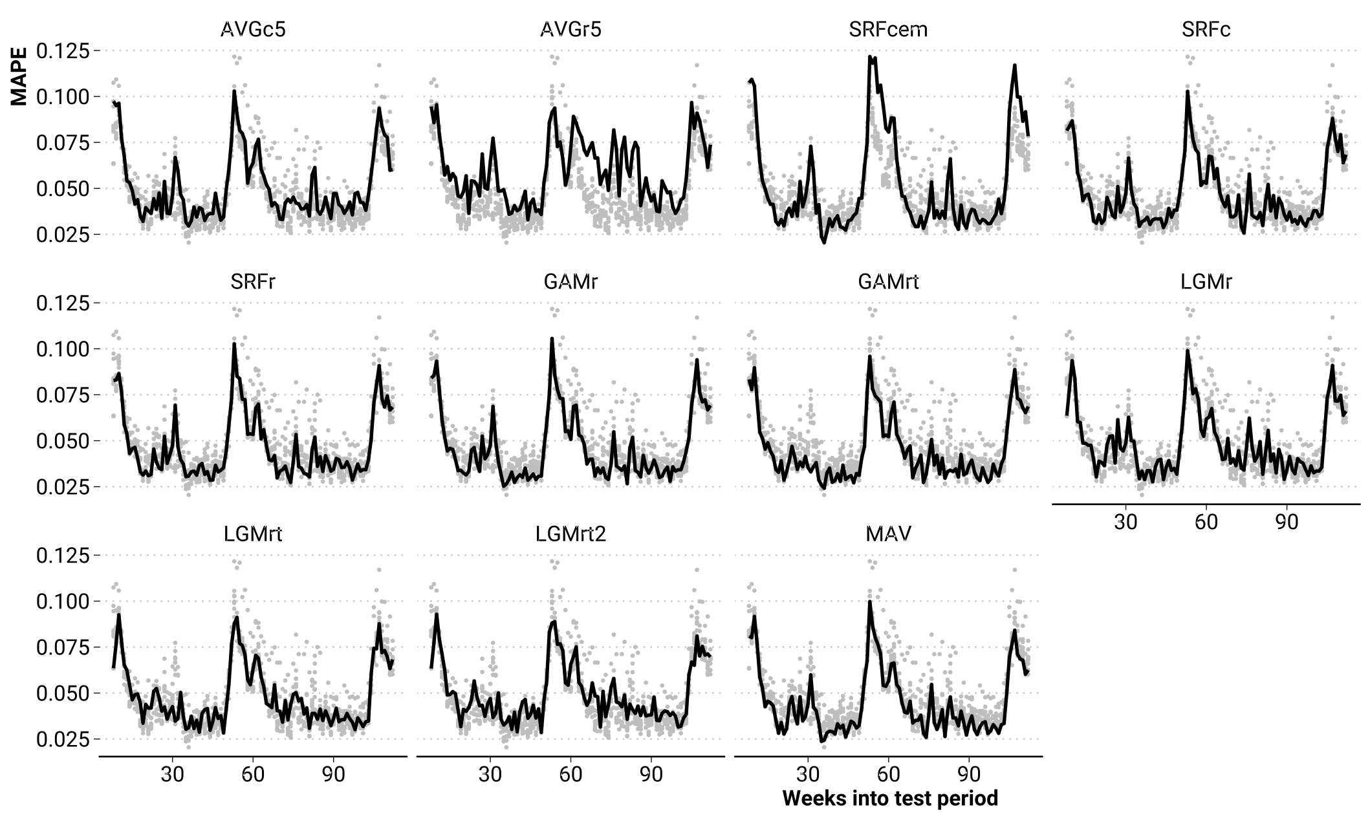
Error & Bias
Mean absolute percentage error of weekly death counts for different models.
Grey points show MAPE of all other models

Slide 24
Error & Bias
Mean absolute percentage error of weekly death counts for different models.
Grey points show MAPE of all other models

Slide 25
Error & Bias
Mean absolute percentage error of weekly death counts for different models.
Grey points show MAPE of all other models

Slide 26
Error & Bias
Mean absolute percentage error of weekly death counts for different models.
Grey points show MAPE of all other models

Slide 27
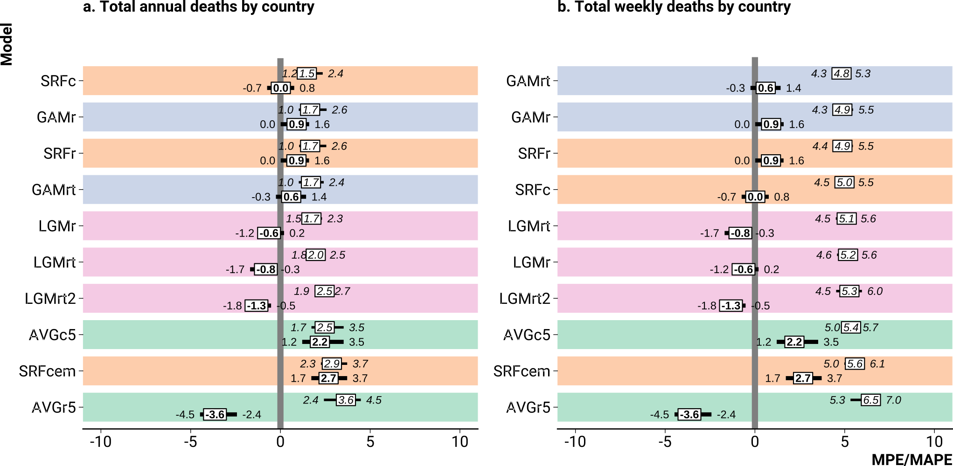
Error & Bias
Bias (MPE, bold) and error (MAPE, italic) by model when predicting death counts on test data.

Slide 28
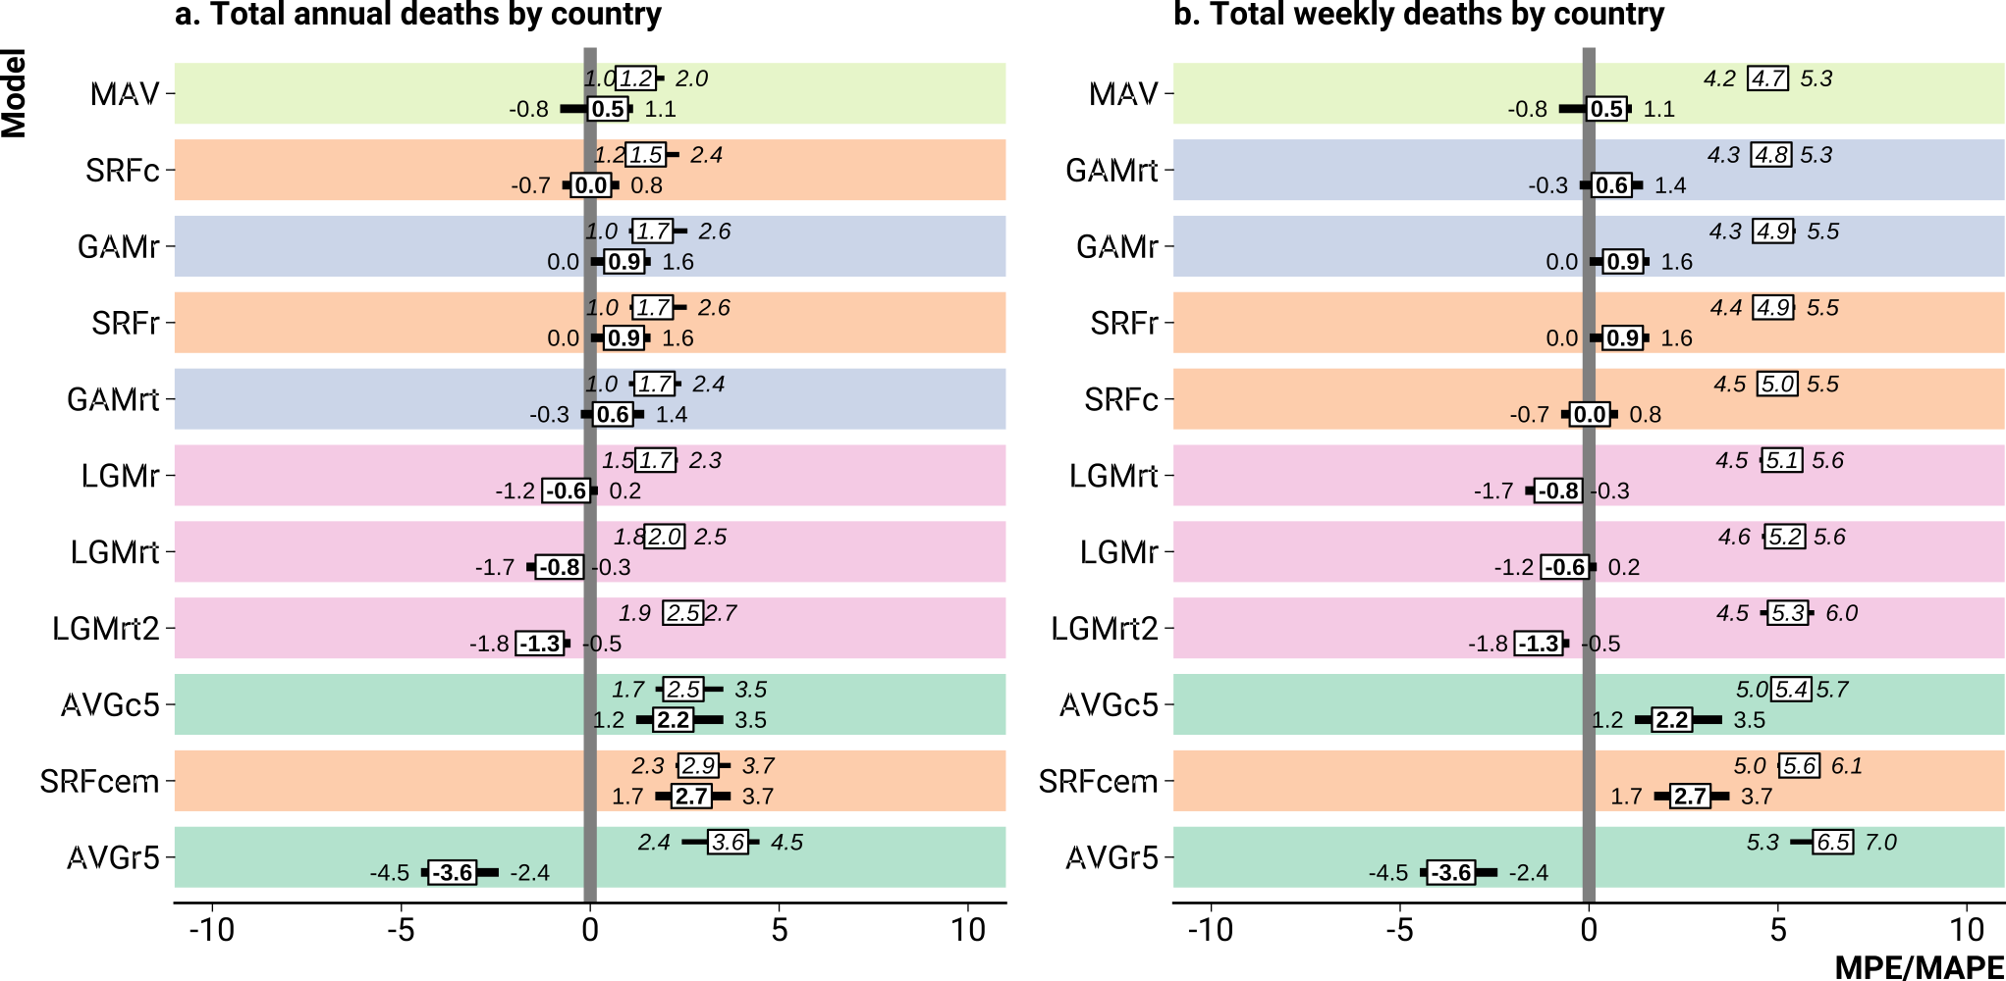
Error & Bias
Bias (MPE, bold) and error (MAPE, italic) by model when predicting death counts on test data.

Slide 29
Suggestions

Slide 30
Suggestions
Provide robustness checks for country rankings of excess deaths

Slide 31
Suggestions
Avoid the average death rate model

Slide 32
Suggestions
For a simple and sensitive robustness check present excess estimates under the 5-year average death rate model and a Euromomo style Serfling model
Put in appendix only!

Slide 33
Suggestions
Don’t sweat over temperature

Slide 34
Suggestions
Consider an ensemble model approach

Slide 35
Reproducible analysis
github.com/jschoeley/rbx2020
Jonas Schöley
@jschoeley
0000-0002-3340-8518
schoeley@demogr.mpg.de

