Slide 1
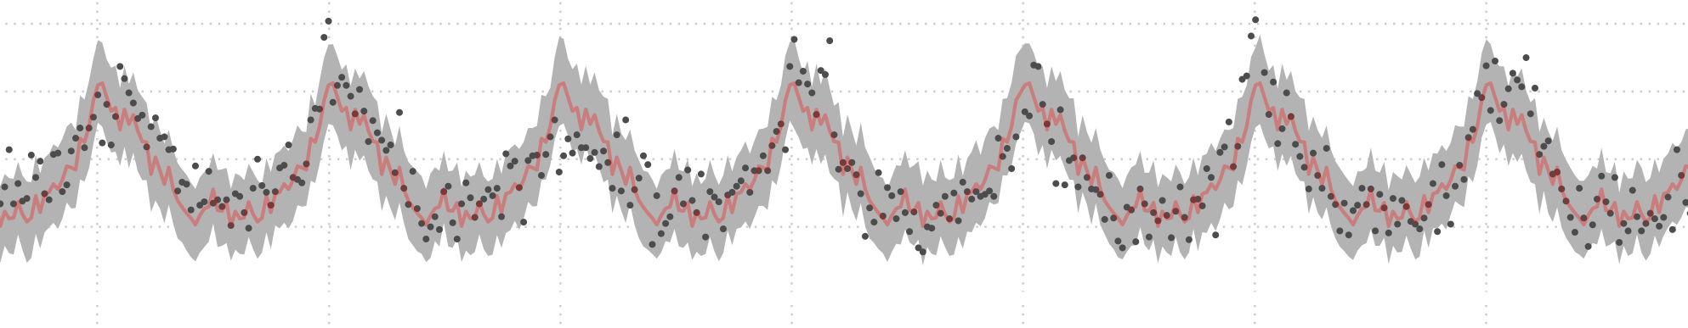




Robustness and bias of excess death estimates under varying model specifications
Jonas Schöley
Jonas Schöley
@jschoeley
0000-0002-3340-8518
schoeley@demogr.mpg.de

Slide 2
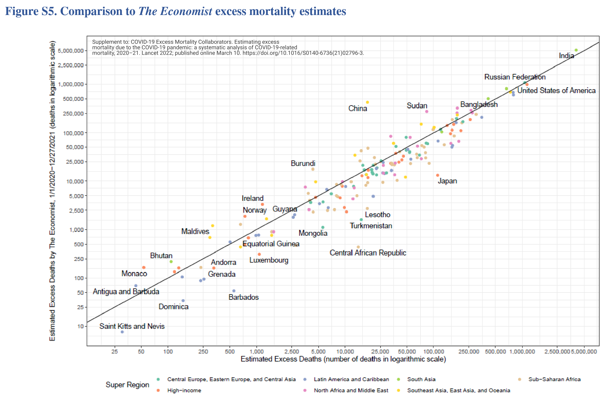
Excess disagreement
10.1016/S0140-6736(21)02796-3

Slide 3
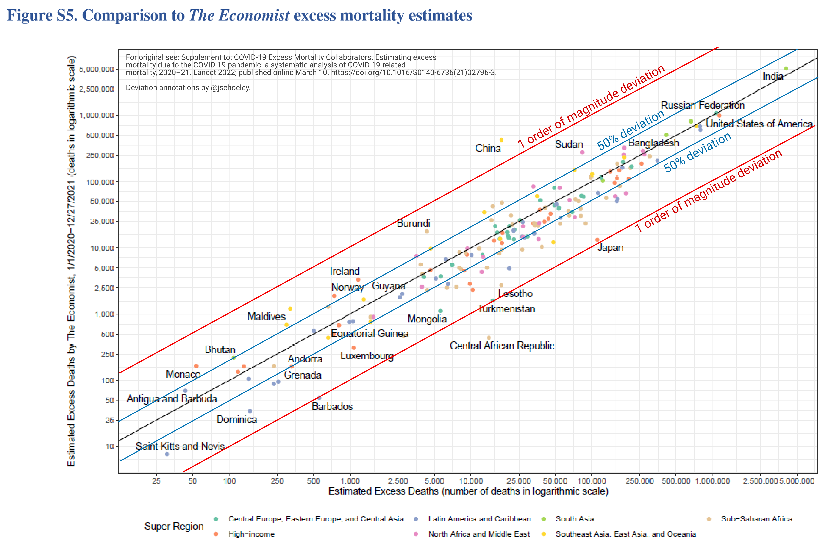
Excess disagreement
10.1016/S0140-6736(21)02796-3

Slide 4
Excess disagreement
Robustness does model specification change our conclusions on excess deaths?
10.1016/S0140-6736(21)02796-3

Slide 5
Excess disagreement
Robustness does model specification change our conclusions on excess deaths?
Bias Are some models prone to predict too many, too few excess deaths?
10.1016/S0140-6736(21)02796-3

Slide 6
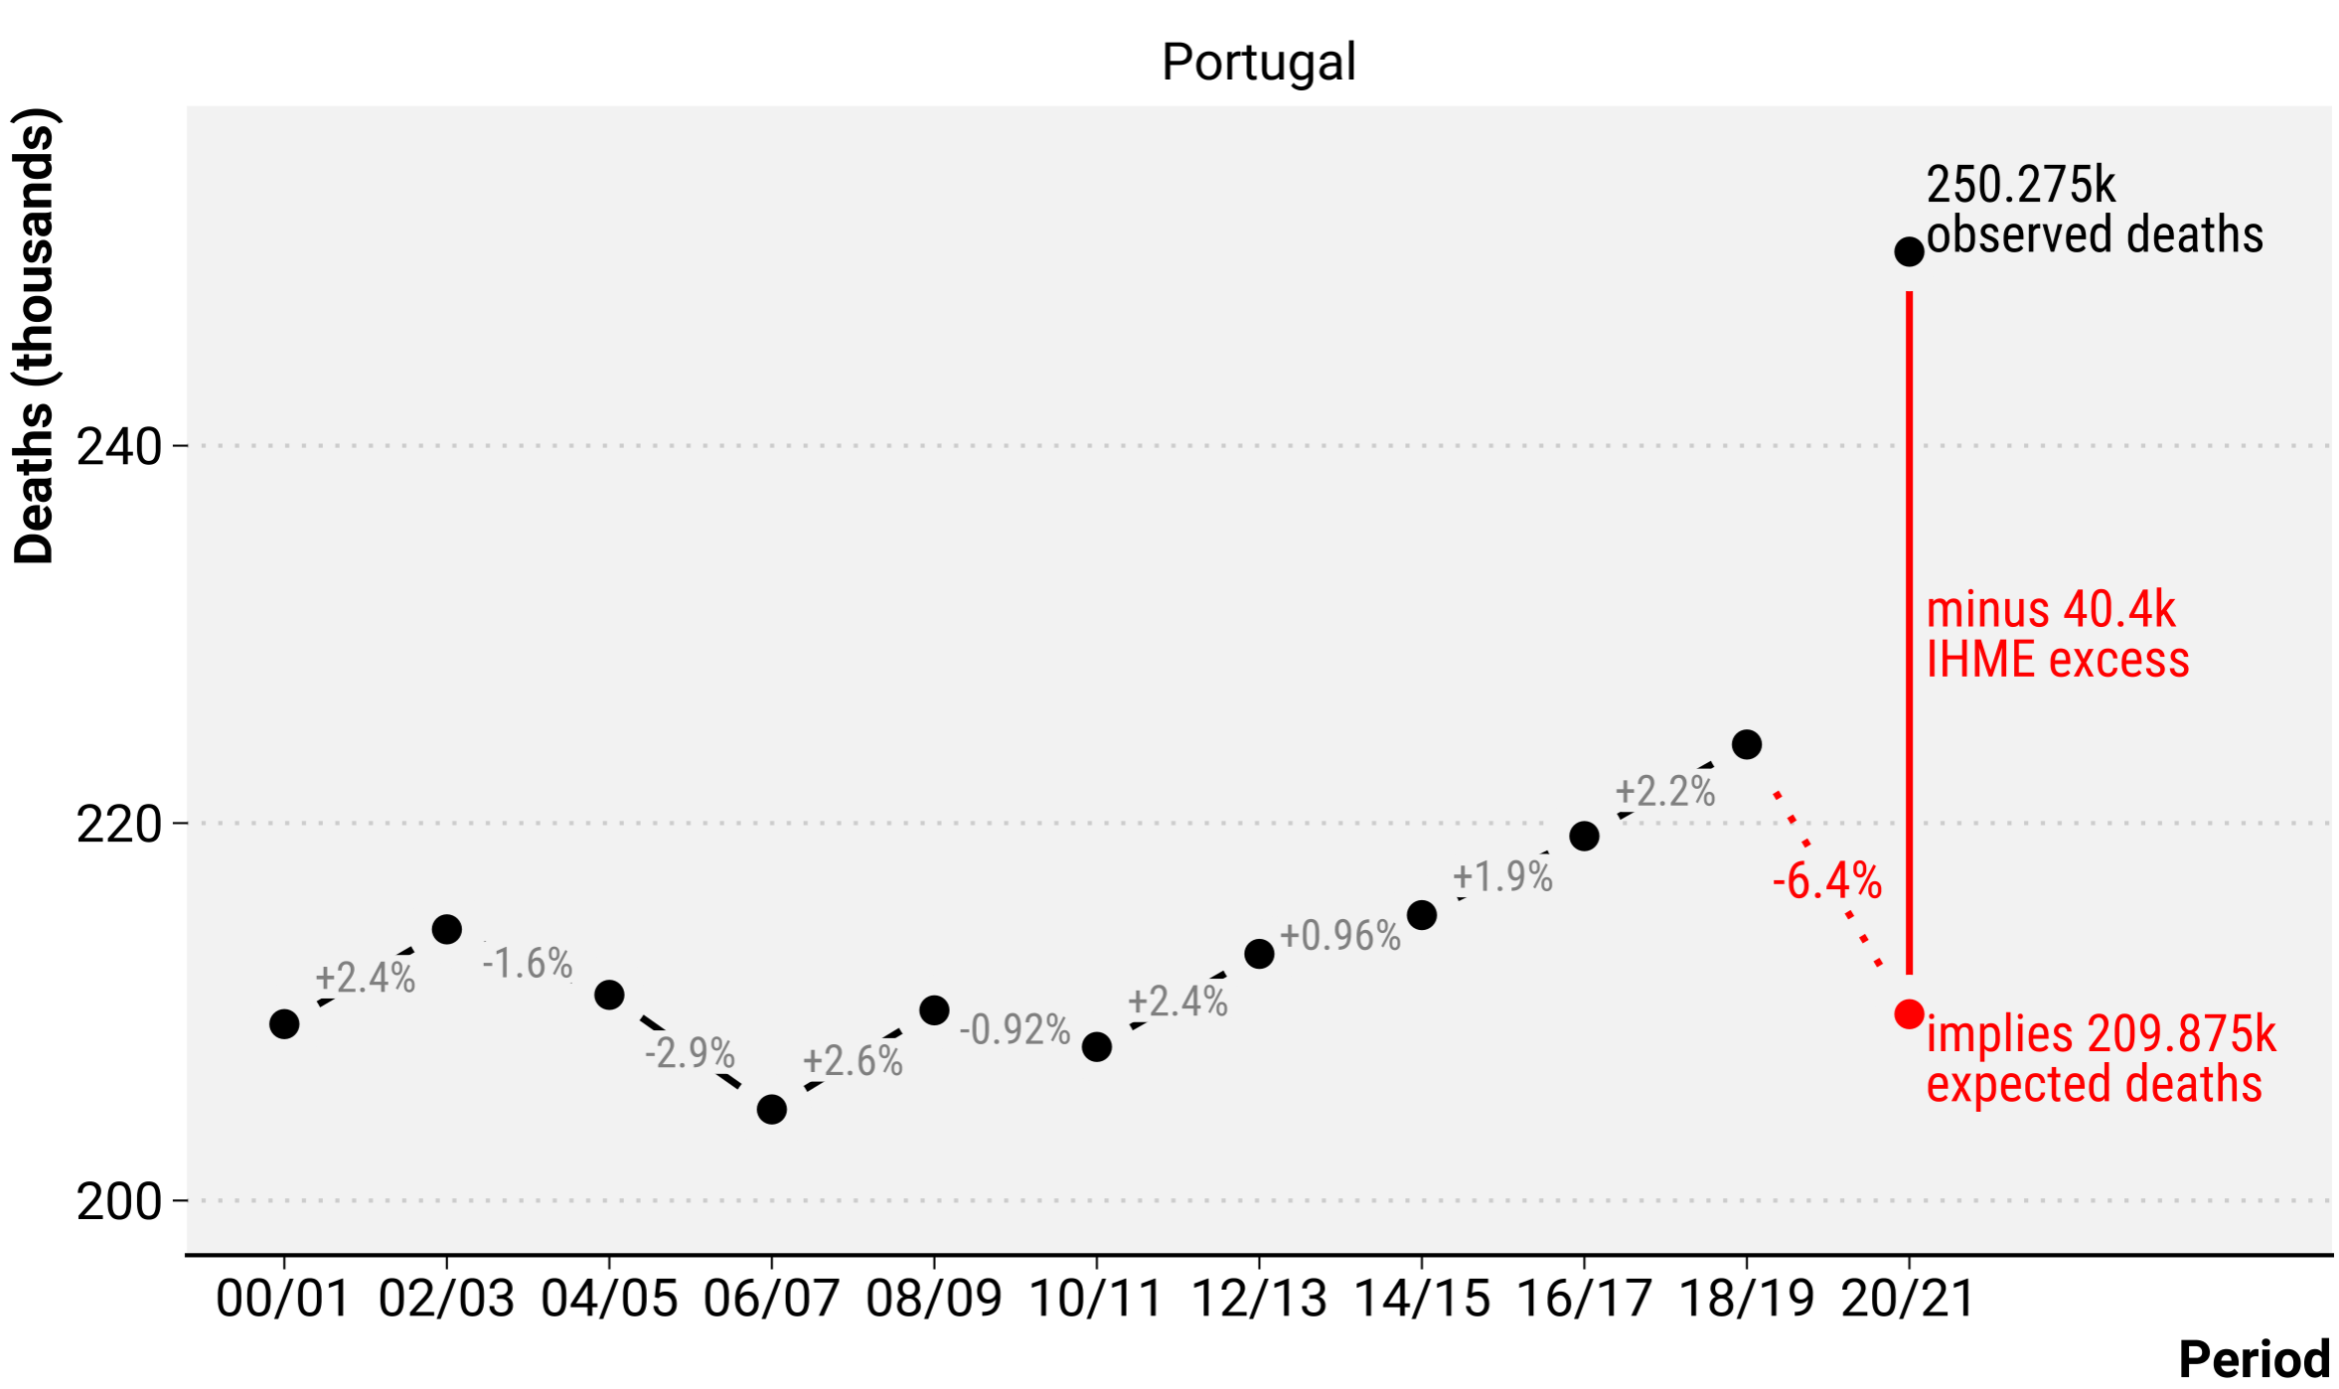
Excess disagreement
Robustness does model specification change our conclusions on excess deaths?
Bias Are some models prone to predict too many, too few excess deaths?

Slide 7
What should we expect?
How many deaths should we expect in the absence of COVID-19?
Excess deaths = Observed deaths -
Expected deaths

Slide 8
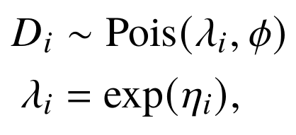
A zoo of models
Expected deaths

Slide 9
A zoo of models
Expected deaths
- (time-varying) seasonality
- population structure
- time trend
- temperature
- temporal auto-correlation
- public holidays

Slide 10
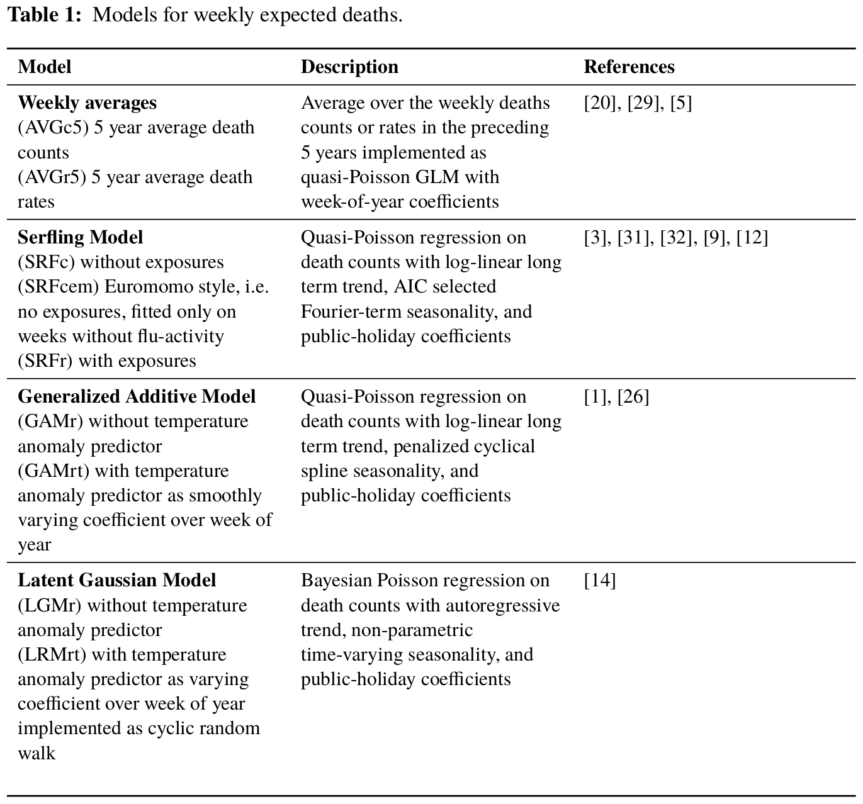
A zoo of models
Expected deaths
- (time-varying) seasonality
- population structure
- time trend
- temperature
- temporal auto-correlation
- public holidays
10.1101/2021.06.04.21258353

Slide 11
A zoo of models
Expected deaths
- (time-varying) seasonality
- population structure
- time trend
- temperature
- temporal auto-correlation
- public holidays
10.1101/2021.06.04.21258353

Slide 12
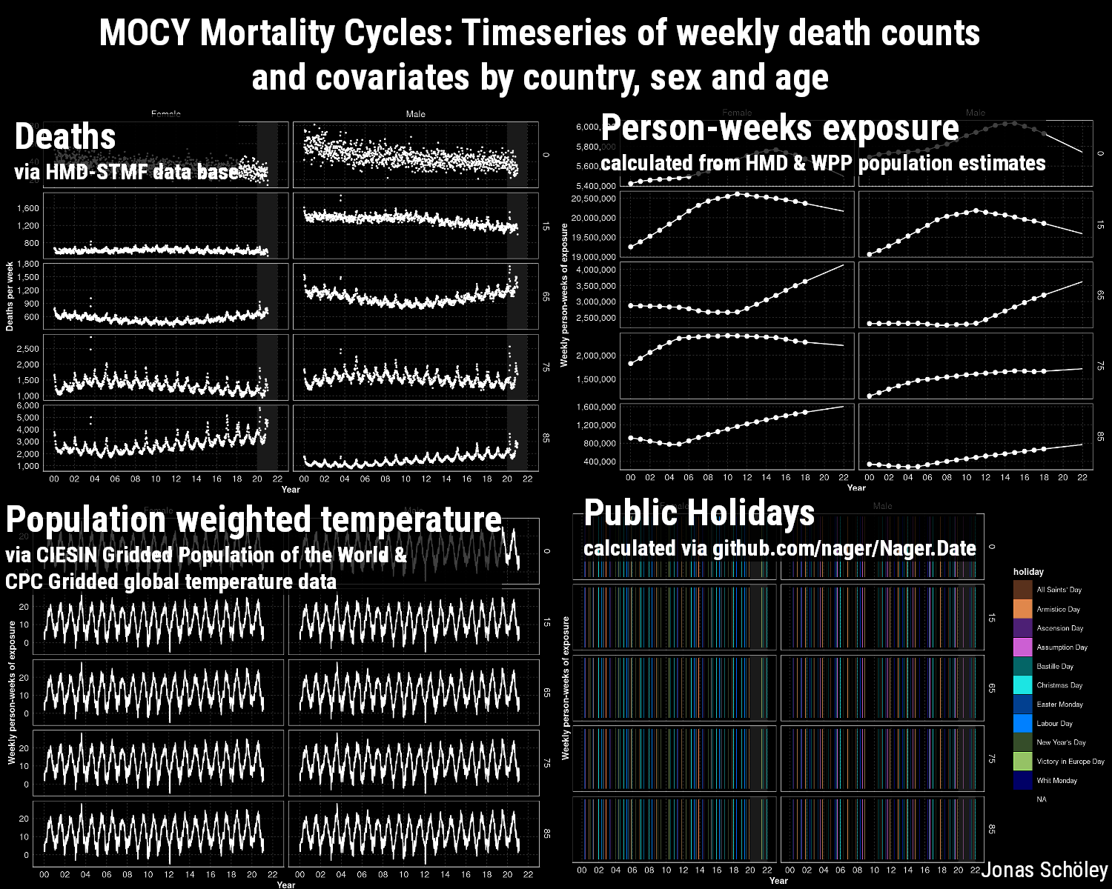
The data
Given timeseries on weekly death counts and
covariates predict:
- weekly expected death counts
March 2020 to Nov 2021
- across 20 European countries
- by sex and age group
(0-65, 65-75, 75-85, 85+)
Download from osf.io/k84rz/

Slide 13
Robustness

Slide 14
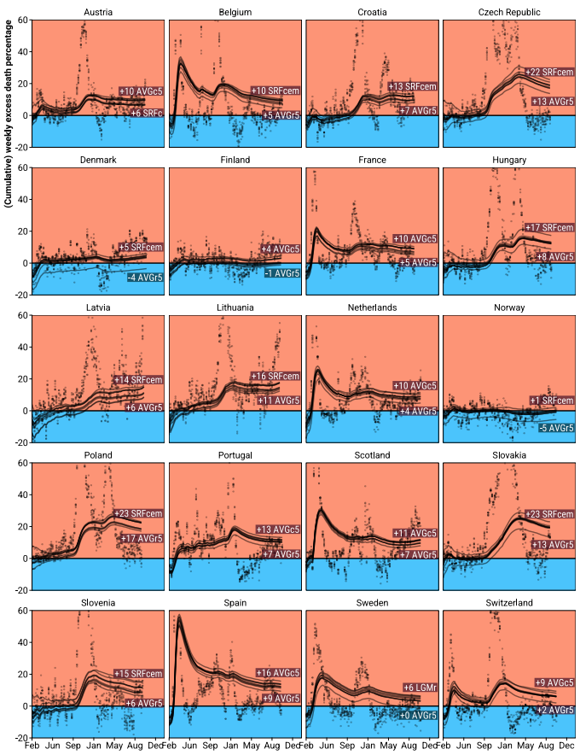
Robustness
Weekly and cumulative excess death percentage since March 2020 as predicted from 9 different models
10.1101/2021.06.04.21258353

Slide 15
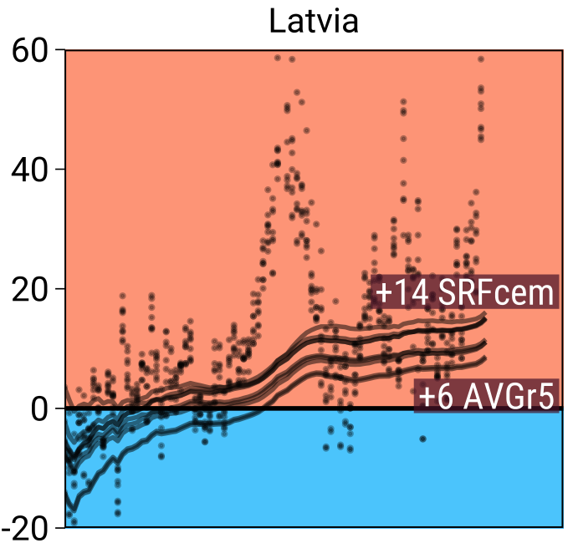
Robustness
Weekly and cumulative excess death percentage as predicted from 9 different models
during the year 2020.
+60% excess deaths
-20% excess deaths
10.1101/2021.06.04.21258353

Slide 16
Robustness
Weekly and cumulative excess death percentage as predicted from 9 different models
during the year 2020.
+60% excess deaths
- models agree on weekly pattern of excess but disagree on level
-20% excess deaths
10.1101/2021.06.04.21258353

Slide 17
Robustness
Weekly and cumulative excess death percentage as predicted from 9 different models
during the year 2020.
+60% excess deaths
- models agree on weekly pattern of excess but disagree on level
- model disagreement increases over time
-20% excess deaths
10.1101/2021.06.04.21258353

Slide 18
Robustness
Weekly and cumulative excess death percentage as predicted from 9 different models
during the year 2020.
+60% excess deaths
- models agree on weekly pattern of excess but disagree on level
- model disagreement increases over time
- 5-year average death rates tend towards low excess
-20% excess deaths
10.1101/2021.06.04.21258353

Slide 19
Robustness
Weekly and cumulative excess death percentage as predicted from 9 different models
during the year 2020.
+60% excess deaths
- models agree on weekly pattern of excess but disagree on level
- model disagreement increases over time
- 5-year average death rates tend towards low excess
- Serfling models tend towards high excess
-20% excess deaths
10.1101/2021.06.04.21258353

Slide 20
Robustness
Weekly and cumulative excess death percentage as predicted from 9 different models
during the year 2020.
+60% excess deaths
- models agree on weekly pattern of excess but disagree on level
- model disagreement increases over time
- 5-year average death rates tend towards low excess
- Serfling models tend towards high excess
- broad agreement about existence of significantly elevated annual excess deaths. Exceptions: Denmark, Finland, Latvia and Norway
-20% excess deaths
10.1101/2021.06.04.21258353

Slide 21
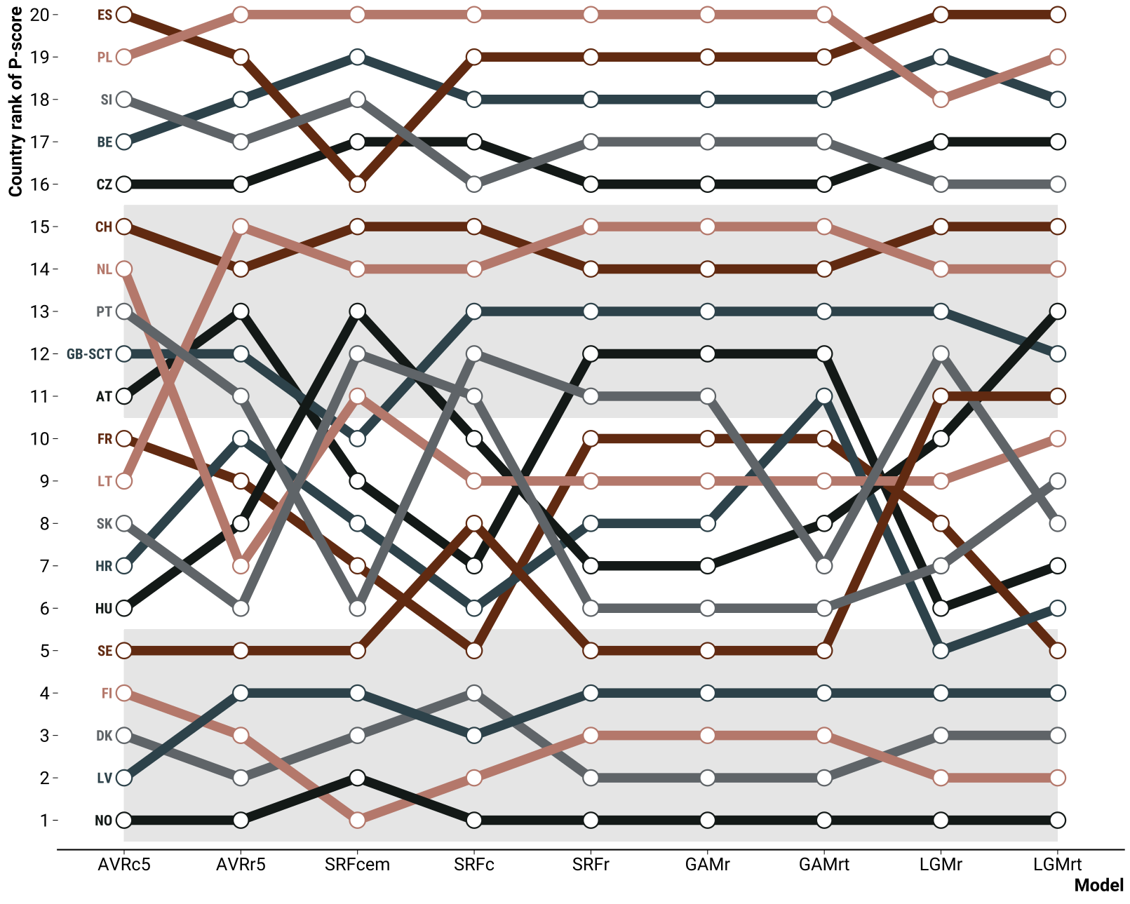
Robustness
Country rank of percent excess deaths in 2020 under different models
10.1101/2021.06.04.21258353

Slide 22
Error & Bias

Slide 23
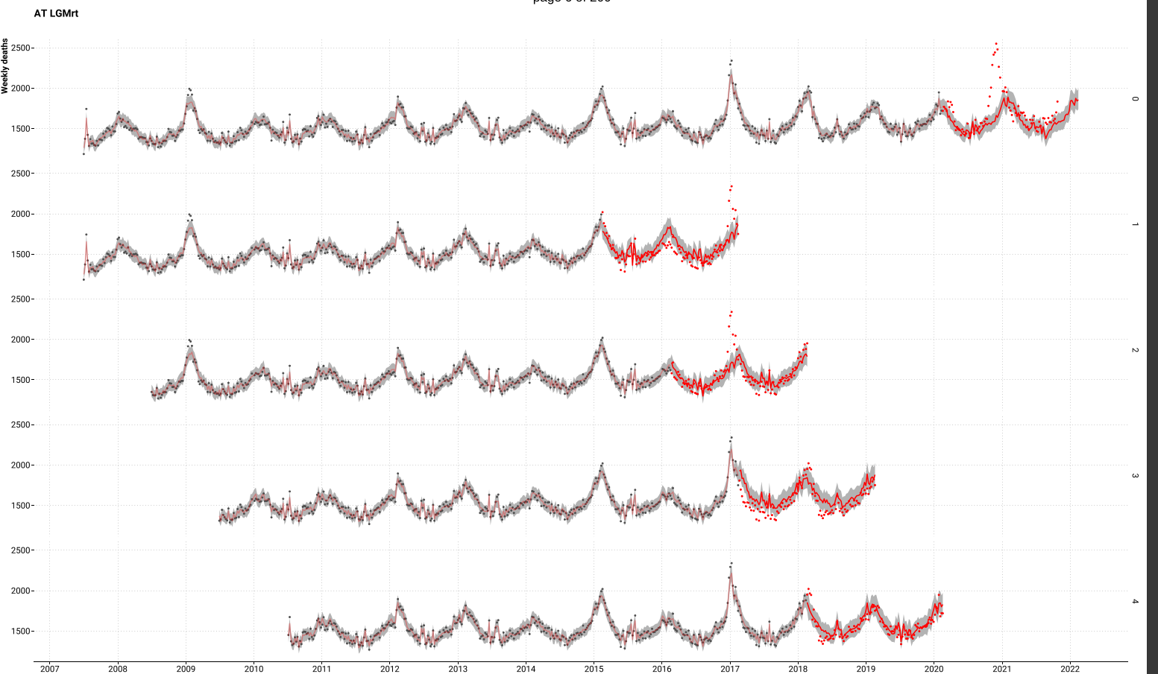
Error & Bias
Rolling origin four-fold cross-validation setup mirroring the task of predicting weekly
deaths past the beginning of the COVID-19 pandemic given pre-pandemic data.
10.1101/2021.06.04.21258353

Slide 24
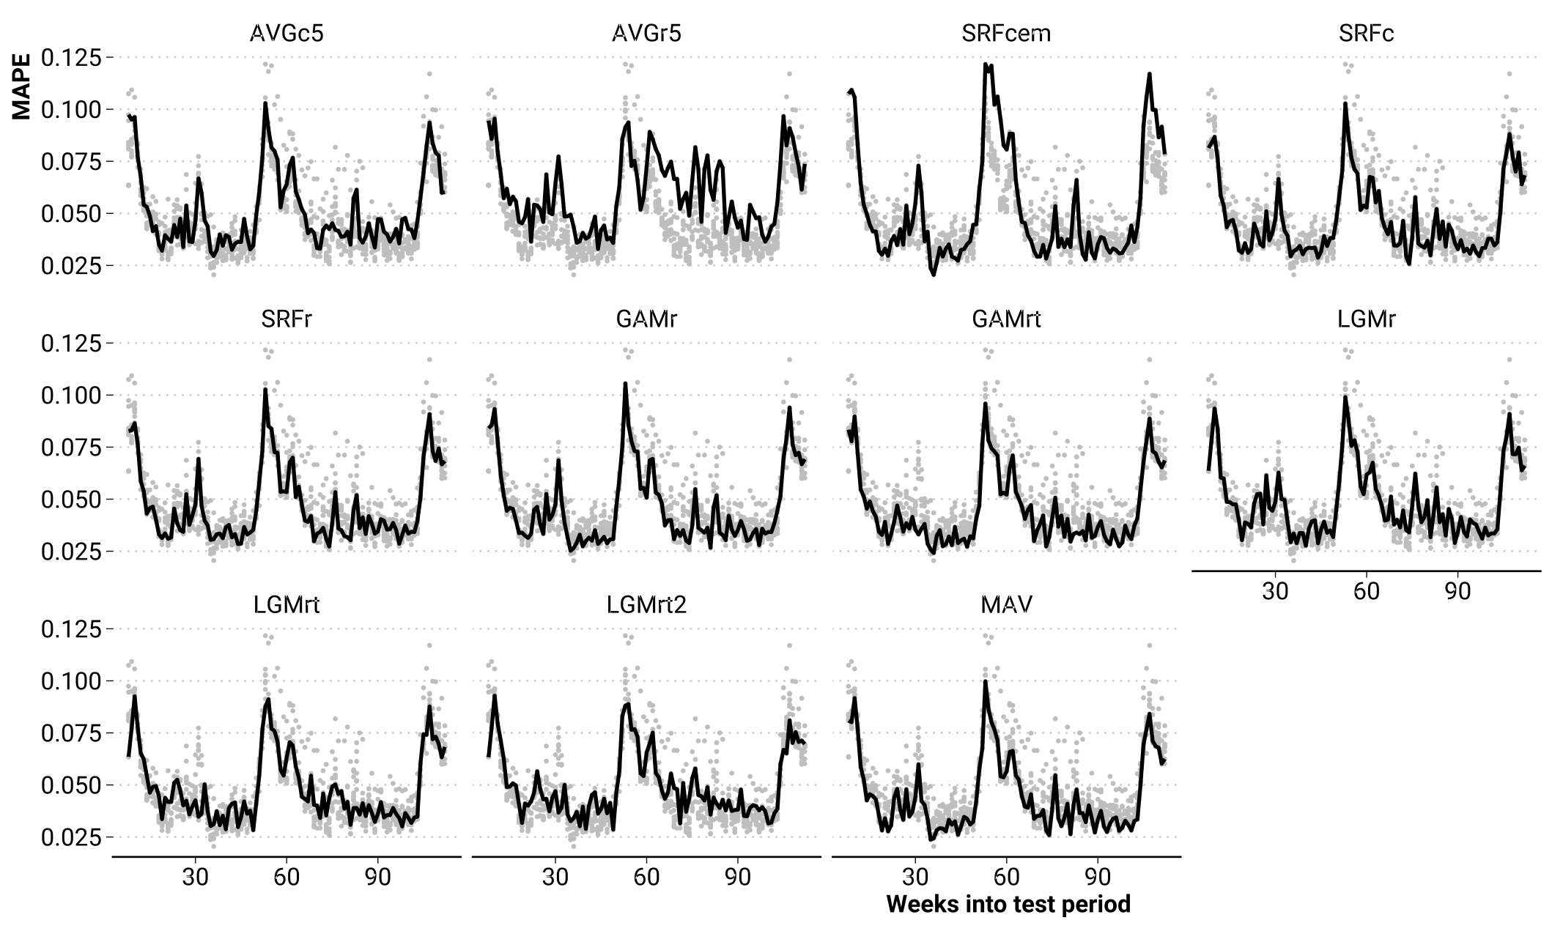
Error & Bias
Mean absolute percentage error of weekly death counts for different models.
Grey points show MAPE of all other models
10.1101/2021.06.04.21258353

Slide 25
Error & Bias
Mean absolute percentage error of weekly death counts for different models.
Grey points show MAPE of all other models
10.1101/2021.06.04.21258353

Slide 26
Error & Bias
Mean absolute percentage error of weekly death counts for different models.
Grey points show MAPE of all other models
10.1101/2021.06.04.21258353

Slide 27
Error & Bias
Mean absolute percentage error of weekly death counts for different models.
Grey points show MAPE of all other models
10.1101/2021.06.04.21258353

Slide 28
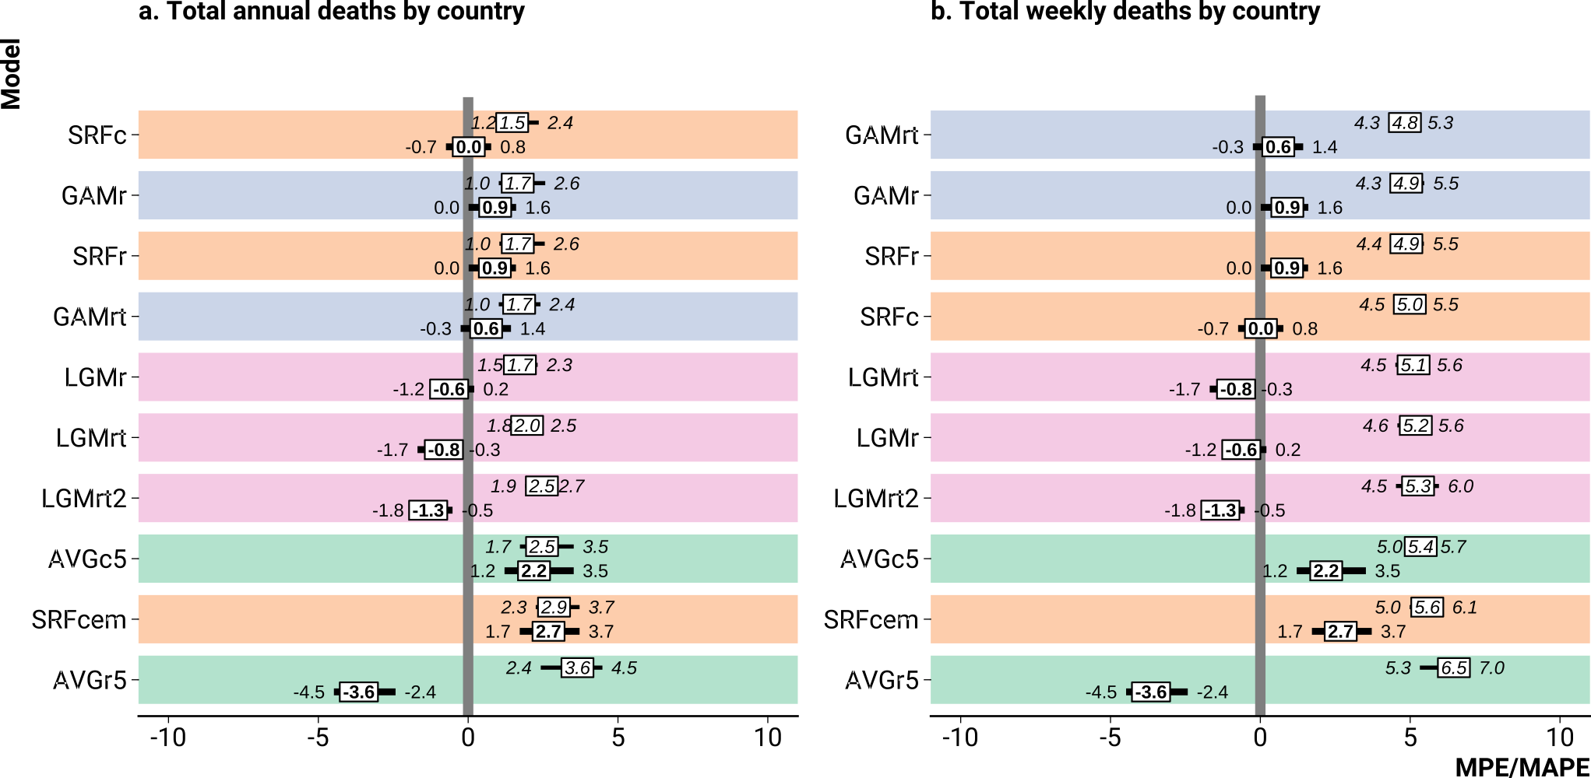
Error & Bias
Bias (MPE, bold) and error (MAPE, italic) by model when predicting death counts on test data.
10.1101/2021.06.04.21258353

Slide 29
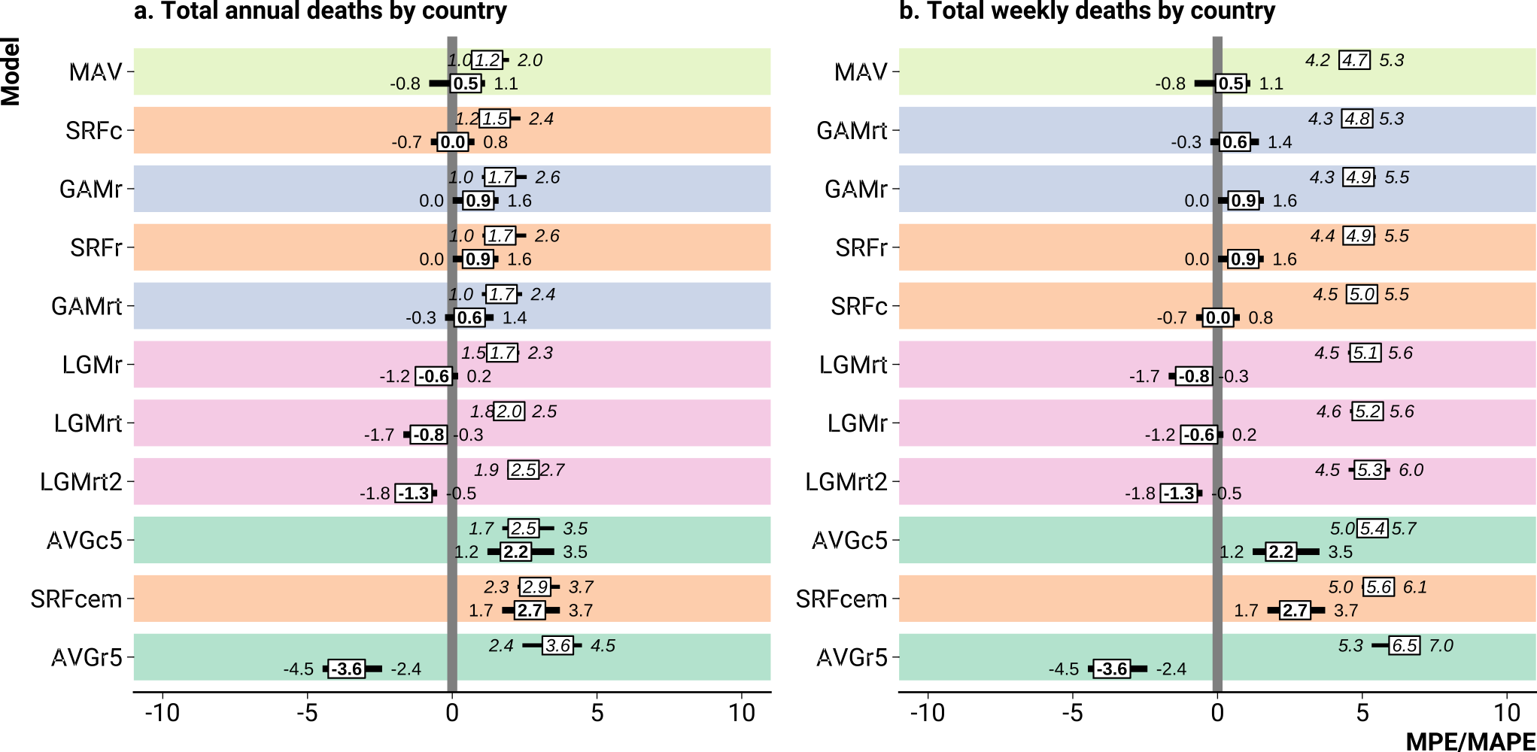
Error & Bias
Bias (MPE, bold) and error (MAPE, italic) by model when predicting death counts on test data.
10.1101/2021.06.04.21258353

Slide 30
Suggestions

Slide 31
Suggestions
Provide robustness checks for country rankings of excess deaths

Slide 32
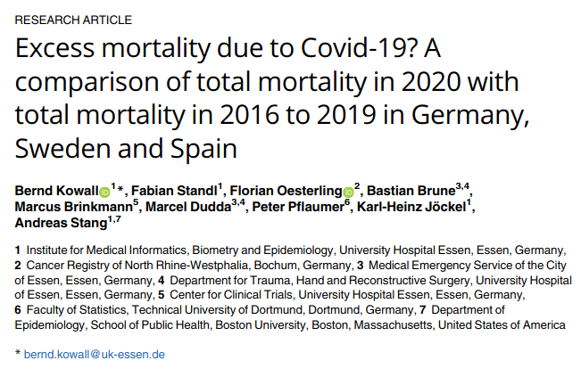
Suggestions
Avoid the average death rate model

Slide 33
Suggestions
For a simple and sensitive robustness check present excess estimates under the 5-year average death rate model and a Euromomo style Serfling model
Put in appendix only!

Slide 34
Suggestions
Don’t sweat over temperature

Slide 35
Suggestions
Consider an ensemble model approach

Slide 36
Reproducible analysis
github.com/jschoeley/rbx2020
Jonas Schöley
@jschoeley
0000-0002-3340-8518
schoeley@demogr.mpg.de

