Slide 1


PASH
Pace & Shape Analysis in R
Jonas Schöley etal.
jschoeley@health.sdu.dk
Max-Planck Odense Center on the Biodemography of Aging
Department of Public Health
University of Southern Denmark

Slide 2
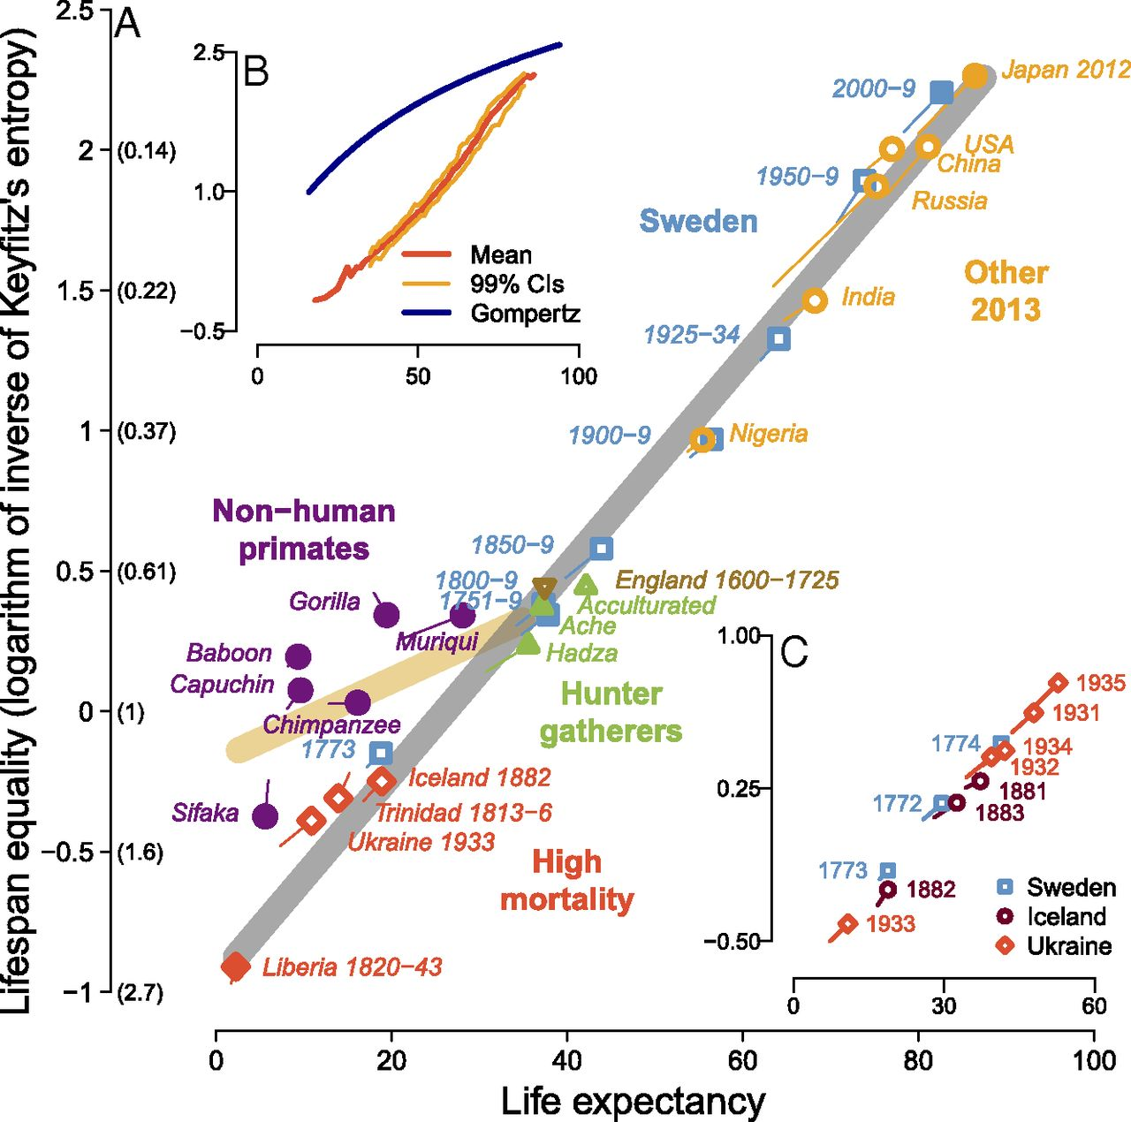
The logistics of comparative mortality research

Slide 3

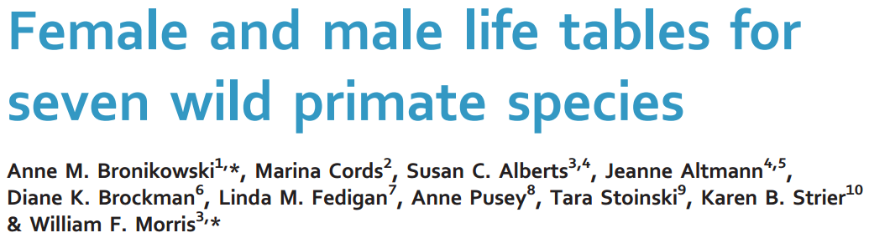

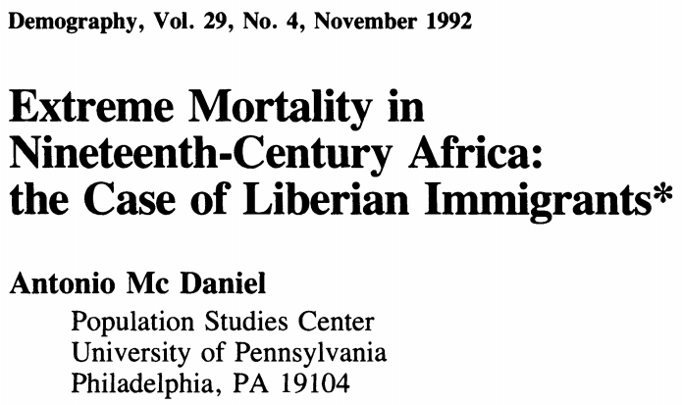

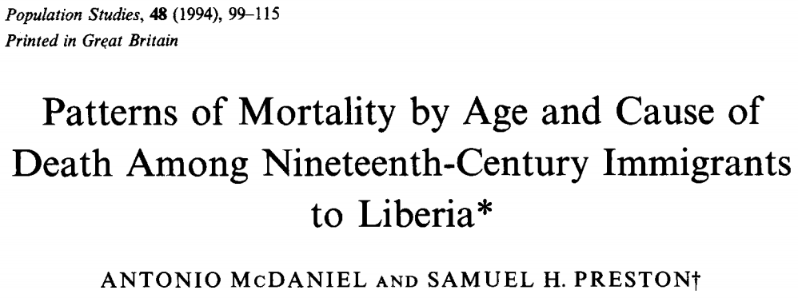

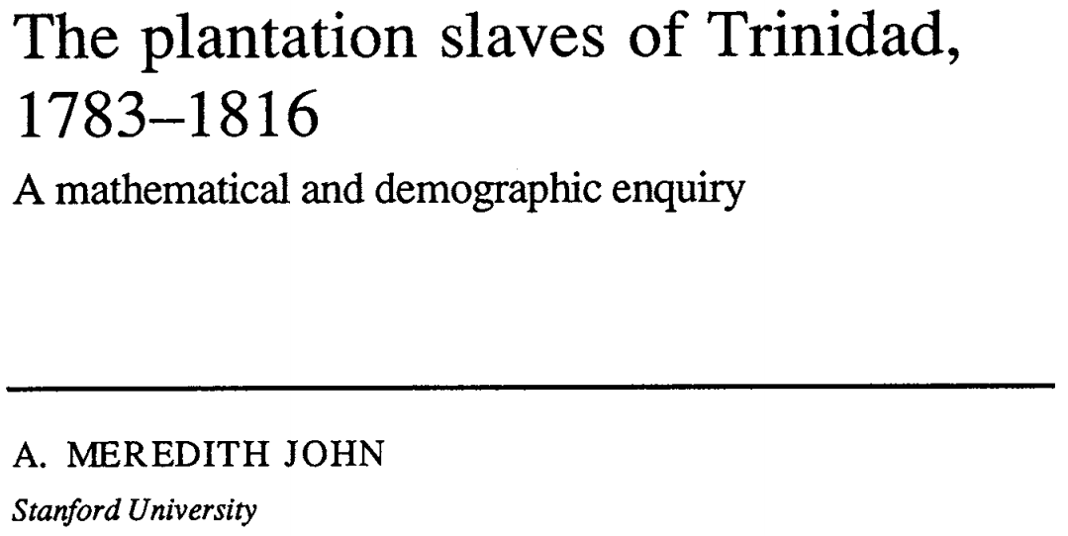
The logistics of comparative mortality research

Slide 4
A software solution
Magic
Gini, Entropy, CV, IQR, Mortality ratio, Life-expectancy ratio
Life-expectancy, Survival quantiles, LT death rate
Pace standardized life-tables
Harmonized life-tables
...

Slide 5
A software solution
Magic
PASH
Gini, Entropy, CV, IQR, Mortality ratio, Life-expectancy ratio
Life-expectancy, Survival quantiles, LT death rate
Pace standardized life-tables
Harmonized life-tables
...

Slide 6
PASH: Pace & shape analysis in R
Friendly to casual & expert users
Complete implementation of Annette Baudischs Pace & Shape methodology
PASH
Support for many different data formats
Works with data across the tree of life

Slide 7

A pace & shape implementation
Pace measures
Life-expectancy, life-table death rate, survival quantiles
Shape measures
Keyfitz’s entropy, Gini coefficient, CV, IQR, Mortality ratio, Life-expectancy ratio,
Probability to survive to mean age at death, Average change of mortality over age
Life-table standardization

Slide 8
Support for many different data situations
Life-tables
_{n}m_{x} _{n}q_{x} l_{x} _{n}d_{x} _{n}L_{x}
open/closed
single-year, abridged,
irregular abridged
constant hazard, uniform distribution of deaths
user specified _{n}a_{x}
“continuous” cohort
life-tables
Survival times
censoring, truncation,
late-entry
choice among Kaplan-M.
or Nelson-Aalen estimator for LT construction
leverage existing functionality of “survival” package
Population matrices
continuous and discrete time Markov chain models
PASH
Gini, Entropy, CV, IQR, Mortality ratio, Life-expectancy ratio
Life-expectancy, Survival quantiles, LT death rate
Pace standardized life-tables
Harmonized life-tables
...

Slide 9
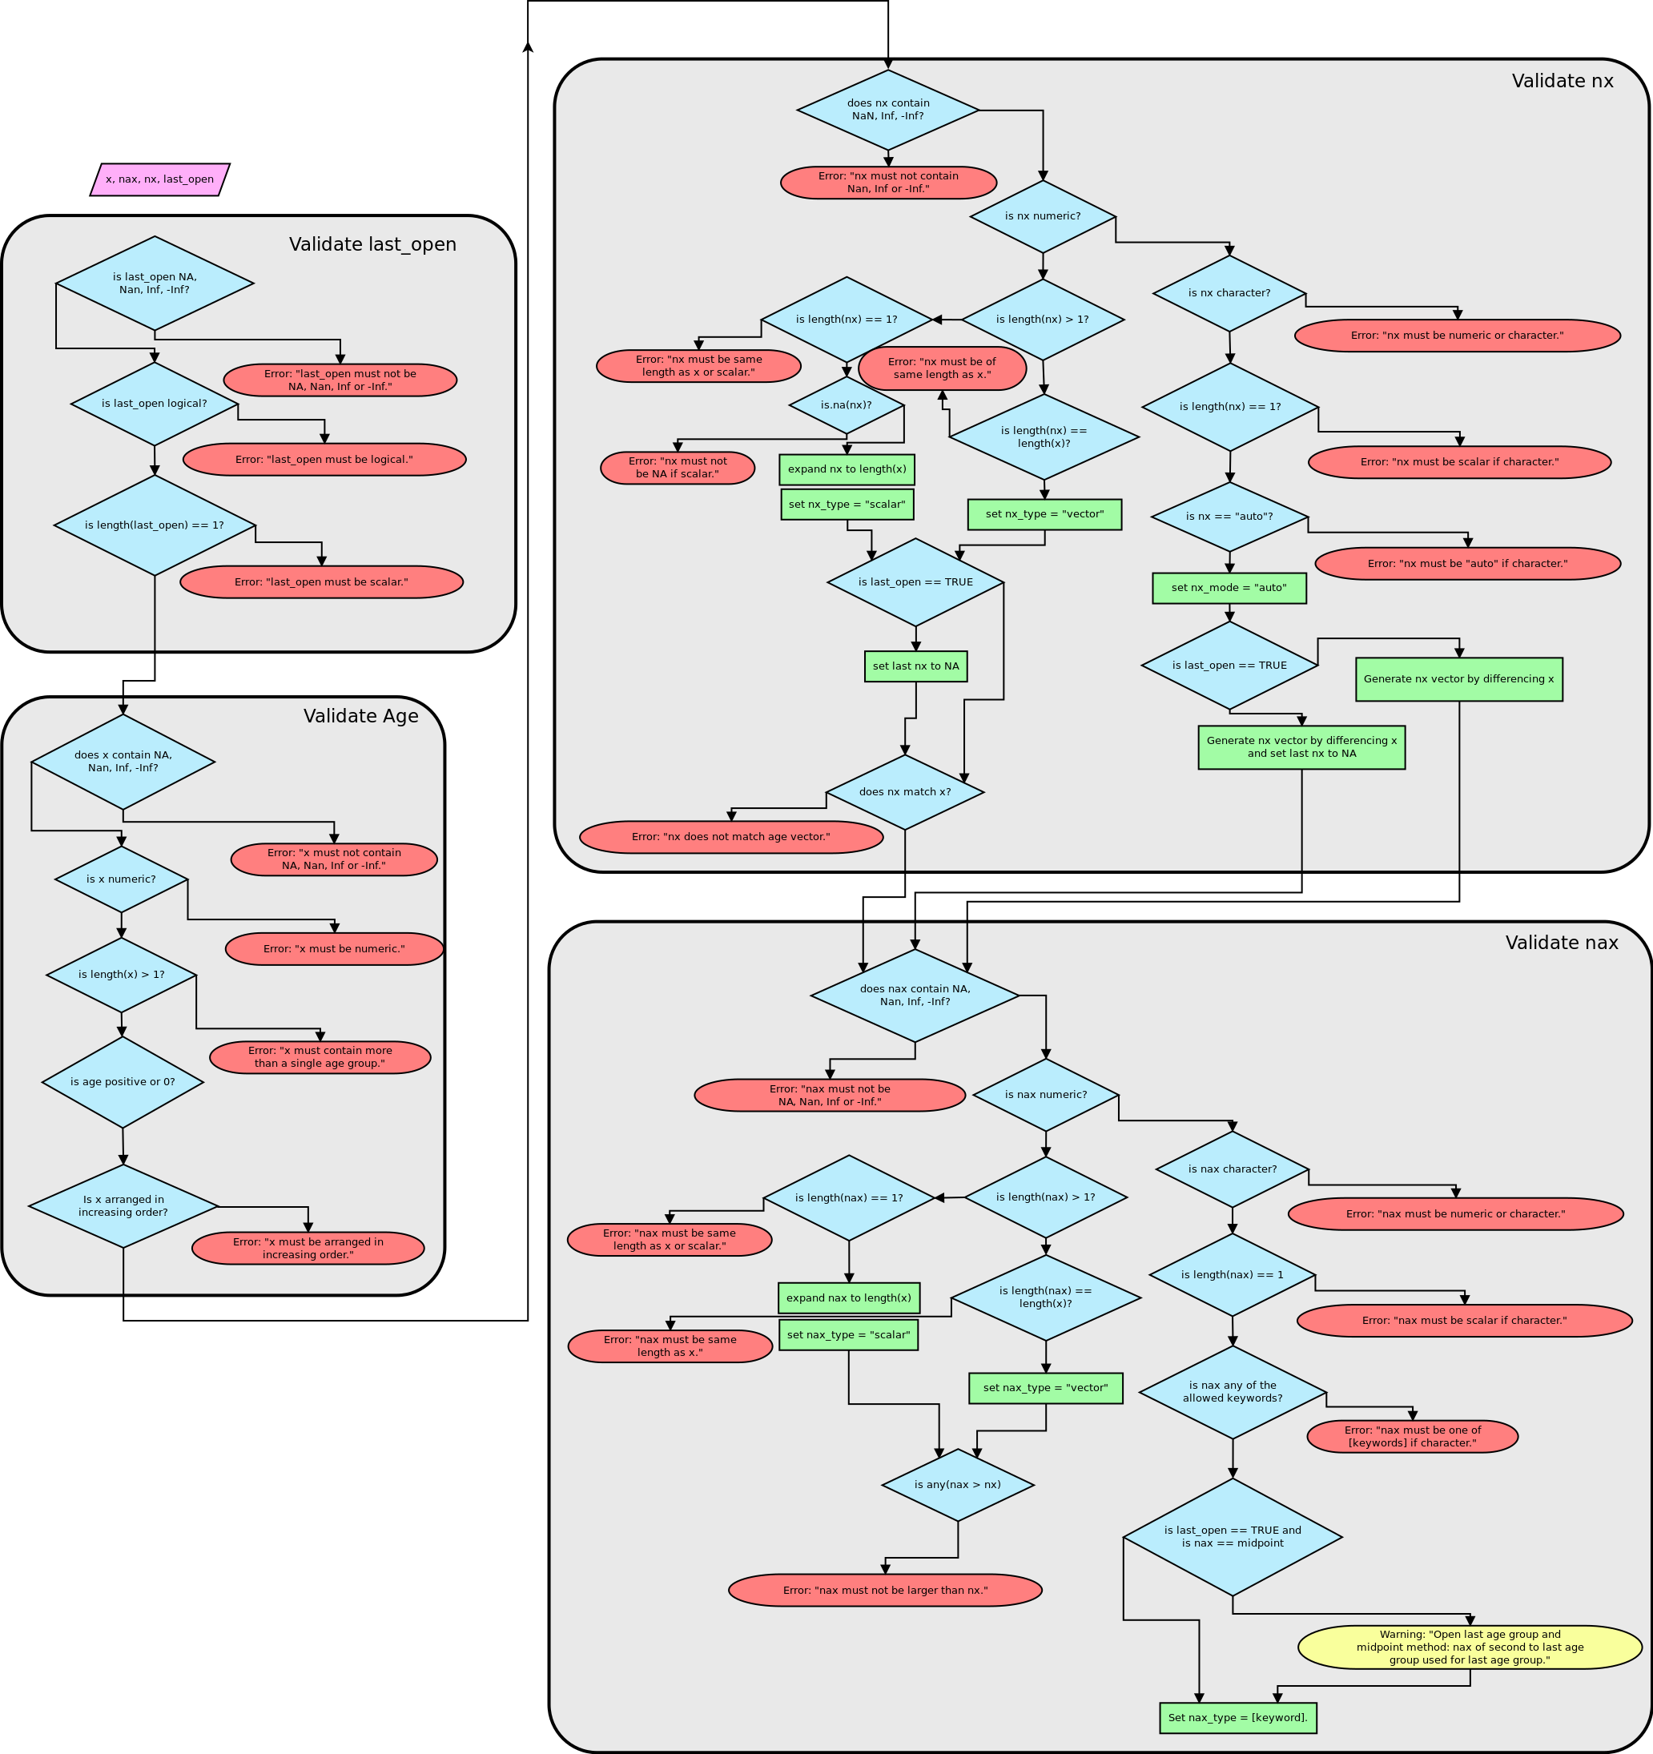
Extensive error detection
x lx
1 0 100000
2 1 99133
3 5 99986
4 10 98910
5 15 98815
6 20 98334
7 25 97704
8 30 97151
9 35 96492
10 40 95588
11 45 94195
12 50 91937
13 55 88711
14 60 83845
15 65 76377
16 70 66225
17 75 53803
18 80 37441
19 85 21134
Error: lx function not
monotonically decreasing

Slide 10
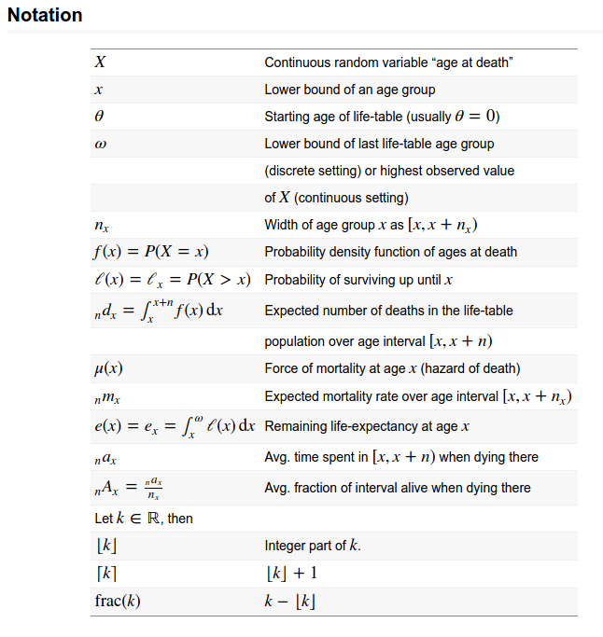
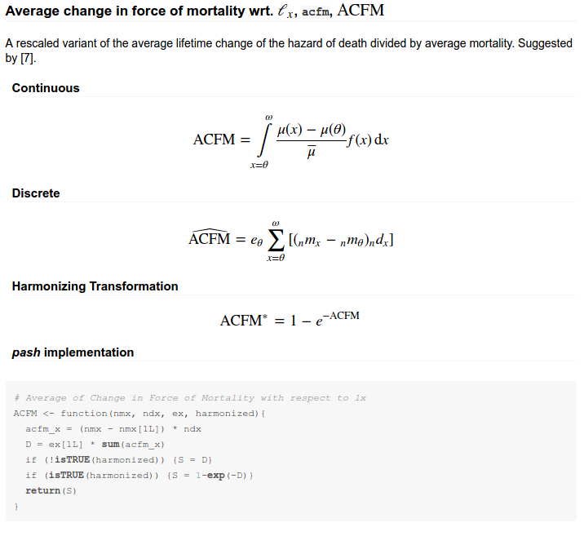
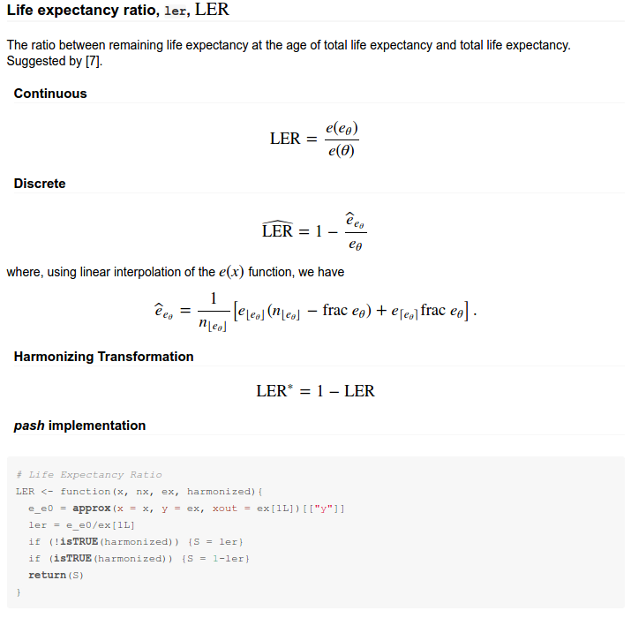
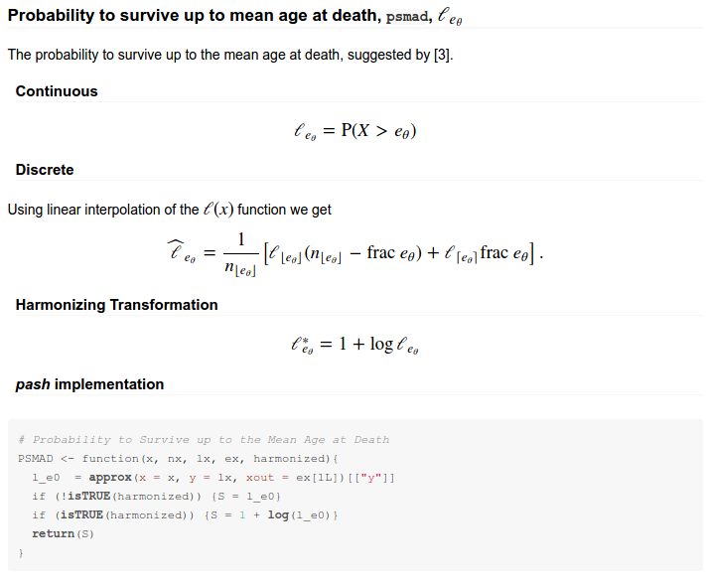
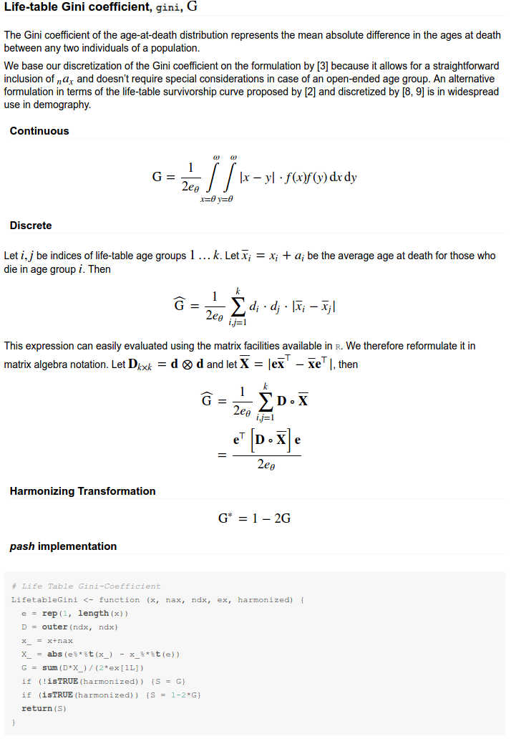
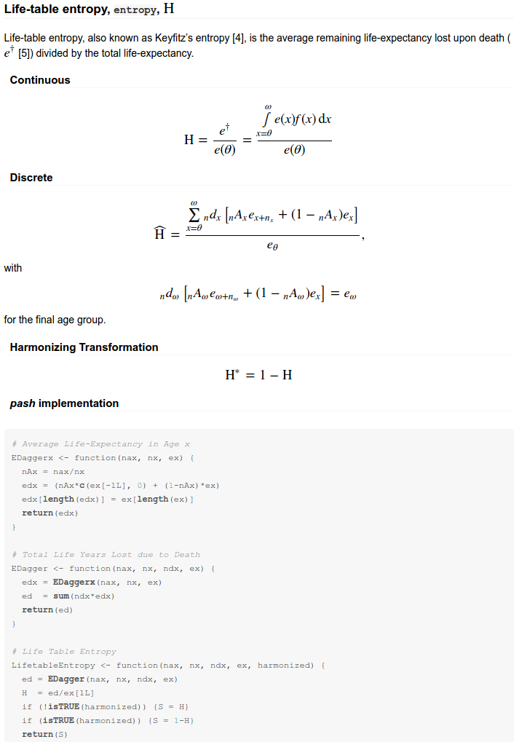
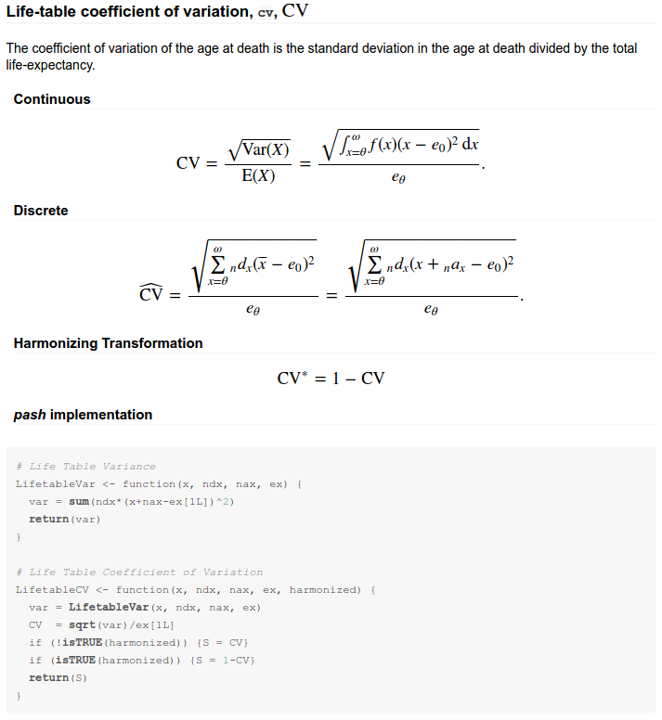
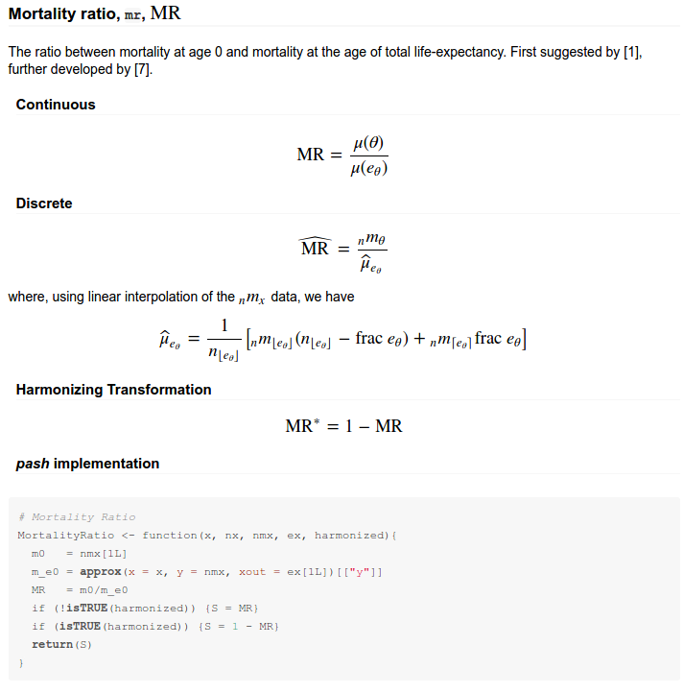
Extensive documentation and method reports

Slide 11
Demography across the tree of life
Never
assume a human origin!

Slide 12
PASH: Data input
> prestons_lx
x lx
1 0 100000
2 1 99133
3 5 98986
4 10 98910
5 15 98815
6 20 98334
7 25 97704
8 30 97151
9 35 96492
10 40 95588
11 45 94195
12 50 91937
13 55 88711
14 60 83845
15 65 76377
16 70 66225
17 75 53803
18 80 37441
19 85 21134
Preston, Samuel H., Patric Heuveline, and Michel Guillot. 2001. Demography. Oxford, UK: Blackwell, p. 51 and United Nations 1994.

Slide 13
PASH: Data input
> lt = Inputlx(x = prestons_lx$x, lx = preston_lt$lx, last_open = TRUE)
Inputlx() and last_open = TRUE: nmx of open age group log-linearly extrapolated based on preceding two nmx.
> summary(lt)
A life table with 19 age groups.
Source: lx
Average life expectancy : 72.96 years
Avg. e0 lost upon death : 12.79 years
Life table entropy : 0.175
Gini Coefficient : 0.117

Slide 14
PASH: Pace & shape measures
> GetPace(lt)
e0 qlx ldr
72.95989256 76.16214399 0.01370616
> GetShape(lt, harmonized = FALSE)
entropy gini cv mr ler
0.1752712 0.1168986 0.2265215 0.1467121 0.1422102
acfm psmad
4.9759710 0.5887144
> GetShape(lt, harmonized = TRUE)
entropy gini cv mr ler
0.8247288 0.7662027 0.7734785 0.8532879 0.8577898...

Slide 15
PASH: Pace standardization
> StandardizeLT(lt)
x nx x_s nx_s nmx_s lx_s ex_s
1 0 1 0.00000000 0.01370616 0.63531636 1.00000 1.00000000
2 1 4 0.01370616 0.05482464 0.02706733 0.99133 0.99497973
3 5 5 0.06853080 0.06853080 0.01120781 0.98986 0.94159198
4 10 5 0.13706161 0.06853080 0.01402188 0.98910 0.87375835
5 15 5 0.20559241 0.06853080 0.07120241 0.98815 0.80603463
6 20 5 0.27412321 0.06853080 0.09378739 0.98334 0.74127893
7 25 5 0.34265401 0.06853080 0.08282430 0.97704 0.67730698
8 30 5 0.41118482 0.06853080 0.09931796 0.97151 0.61243648
9 35 5 0.47971562 0.06853080 0.13735057 0.96492 0.54785434
10 40 5 0.54824642 0.06853080 0.21420913 0.95588 0.48418068
11 45 5 0.61677722 0.06853080 0.35403571 0.94195 0.42230344
12 50 5 0.68530803 0.06853080 0.52116517 0.91937 0.36330297
13 55 5 0.75383883 0.06853080 0.82297419 0.88711 0.30673770
14 60 5 0.82236963 0.06853080 1.36027381 0.83845 0.25402001
15 65 5 0.89090043 0.06853080 2.07763939 0.76377 0.20697640
16 70 5 0.95943124 0.06853080 3.02032121 0.66225 0.16492143
17 75 5 1.02796204 0.06853080 5.23330745 0.53803 0.12655641
18 80 5 1.09649284 0.06853080 8.12467413 0.37441 0.09835747
19 85 NA 1.16502365 NA 12.61350119 0.21134 0.07928013

Slide 16
Case study: Pace & shape analysis of HMD data
> sweden5x5
# A tibble: 2,496 × 5
sex period x nmx nax
<fctr> <fctr> <int> <dbl> <dbl>
1 female 1755-1759 0 0.23517 0.35
2 female 1755-1759 1 0.04076 1.52
3 female 1755-1759 5 0.01256 1.88
4 female 1755-1759 10 0.00658 2.53
5 female 1755-1759 15 0.00622 2.44
6 female 1755-1759 20 0.00720 2.62
7 female 1755-1759 25 0.00929 2.57
8 female 1755-1759 30 0.01230 2.53
9 female 1755-1759 35 0.01108 2.49
10 female 1755-1759 40 0.01622 2.59
# ... with 2,486 more rows

Slide 17
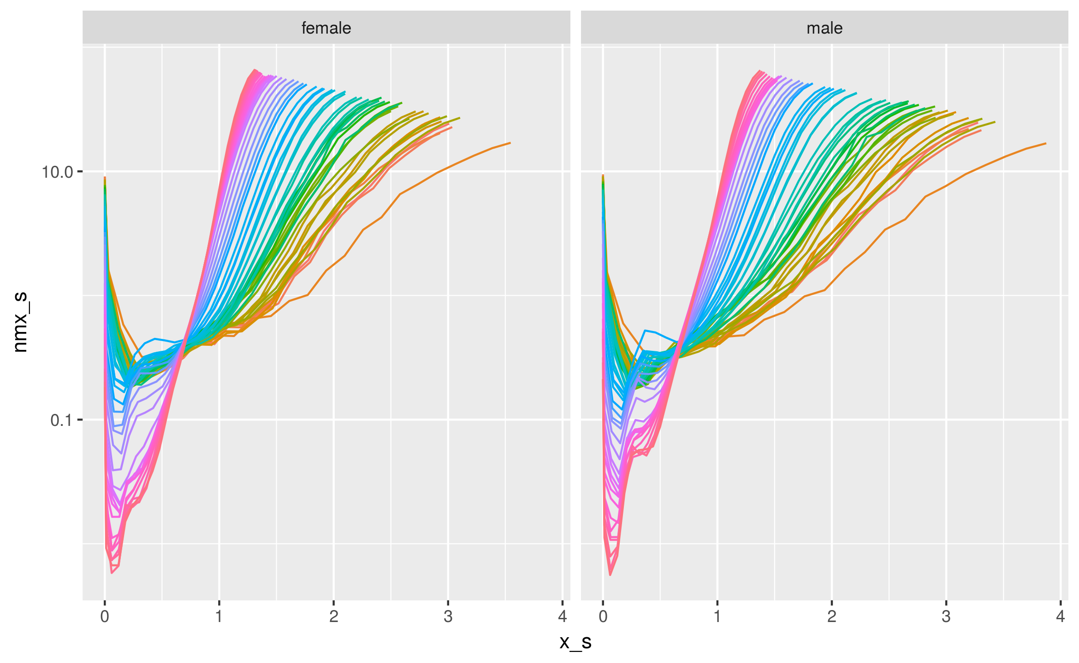
Pace-standardized age-specific mortality
sweden5x5 %>% group_by(period, sex) %>%
do(Inputnmx(x=.$x, nmx=.$nmx) %>% StandardizeLT()) %>%
qplot(x=x_s, y=nmx_s, color=period, geom="line", facets=~sex, data=., log="y") +
guides(color = FALSE)

Slide 18
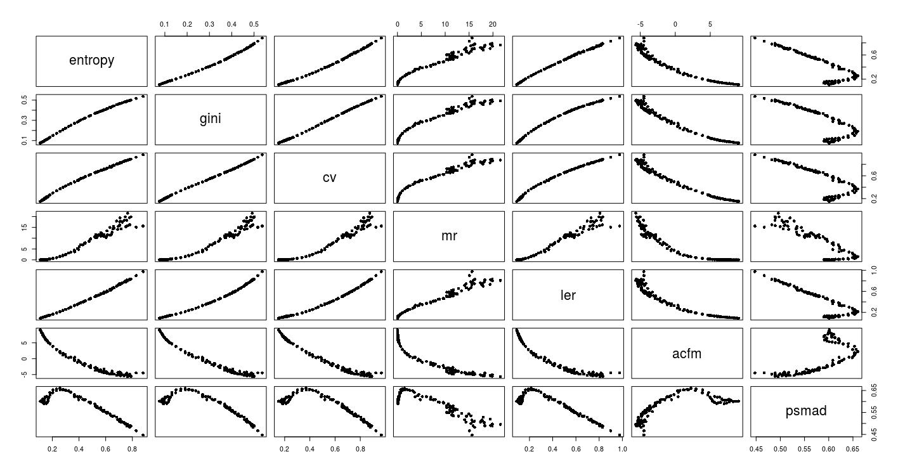
Correlation among shape measures
sweden5x5 %>% group_by(period, sex) %>%
do(Inputnmx(x = .$x, nmx = .$nmx, last_open = TRUE) %>%
GetShape(harmonized = FALSE) %>% t() %>% as.data.frame()) %>%
pairs(x = .[3:9], data = ., pch = 16)

Slide 19
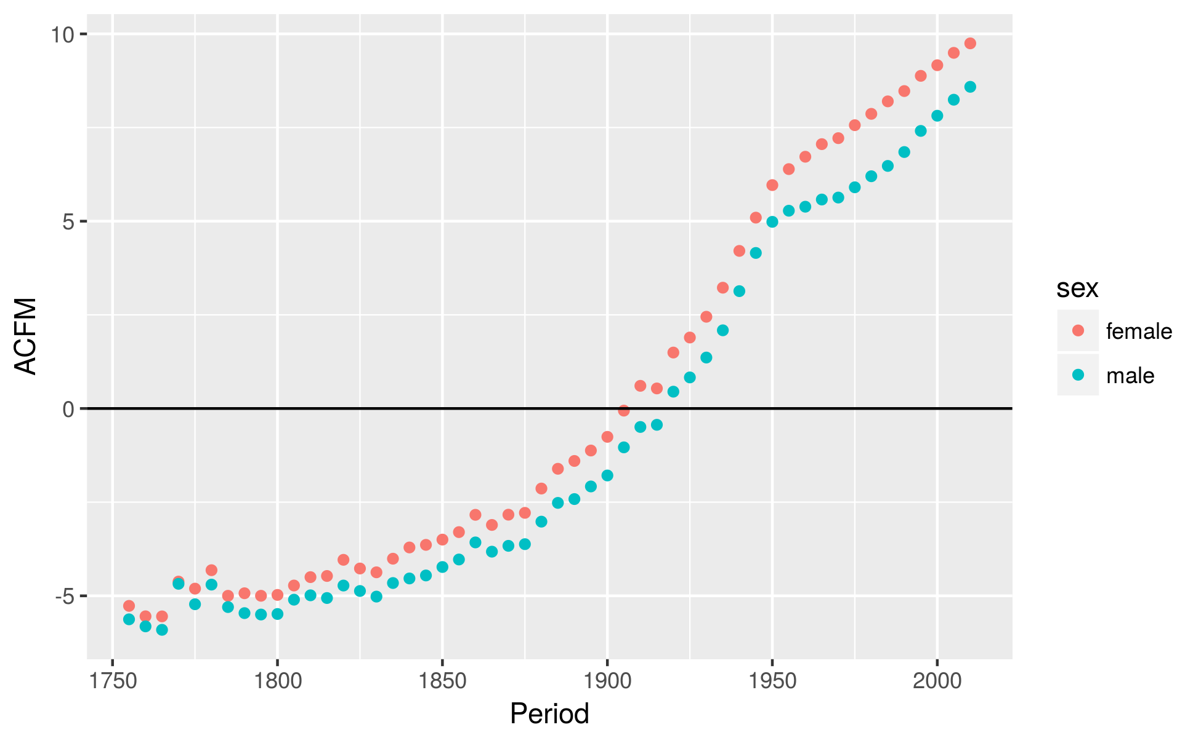
The emergence of senescence
sweden5x5 %>% group_by(period, sex) %>%
do(Inputnmx(x=.$x, nmx=.$nmx, nax = .$nax, last_open=TRUE) %>%
GetShape(type="acfm", harmonized=FALSE) %>% as.data.frame()) %>%
qplot(x=as.numeric(substr(period, 1,4)), y=., color=sex, data=.,
ylab="ACFM", xlab="Period") + geom_hline(yintercept=0)

Slide 20
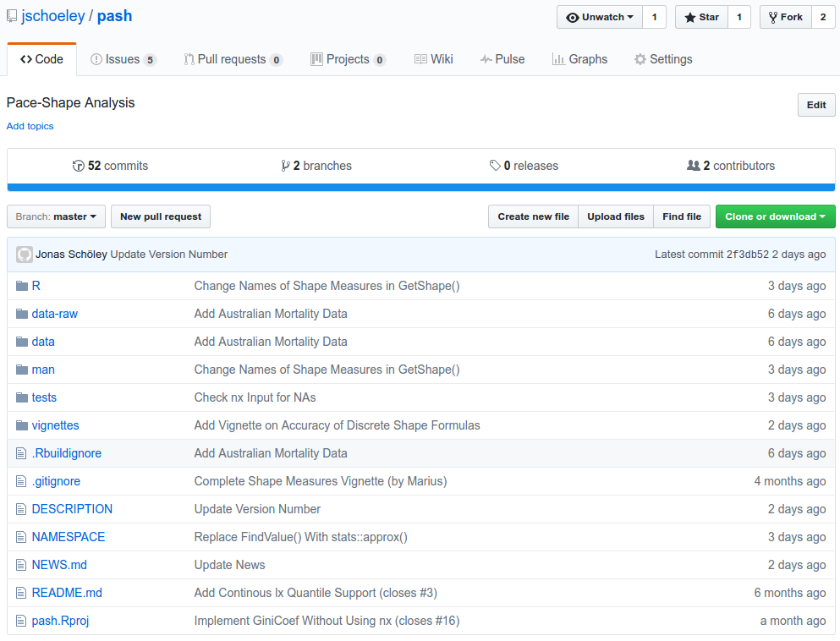
Join us on github.com/jschoeley/pash
Jonas Schöley
Marius Pascariu
Francisco Villavicencio
Maciej Danko
Iain Stott
Annette Baudisch

Slide 21
Reproducible analysis
github.com/jschoeley/pash
Jonas Schöley
jschoeley@health.sdu.dk
Twitter: @rettungstweet

