Slide 1




Predictive Modeling
Jonas Schöley
@jschoeley
0000-0002-3340-8518
schoeley@demogr.mpg.de

Slide 2
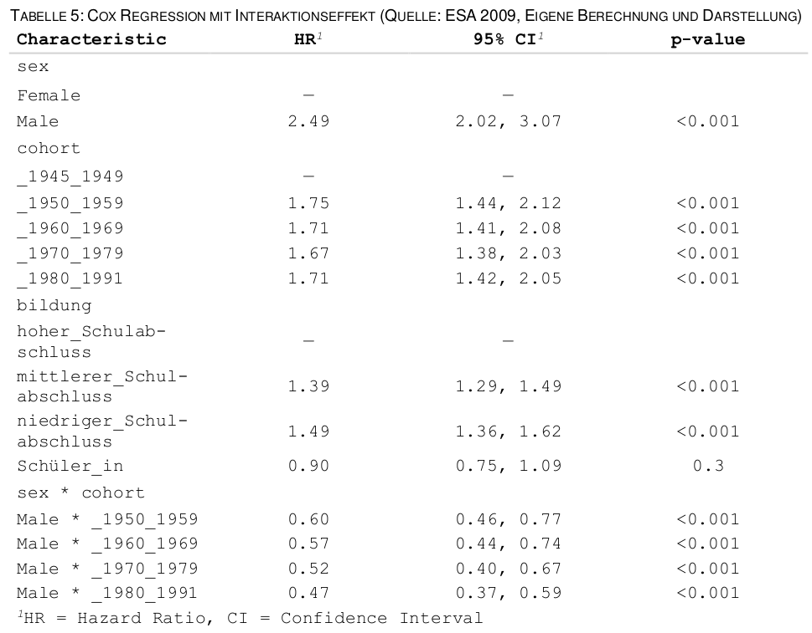
Parameter-centric modeling
Balling (2022). Das Rauchverhalten von Männern
und Frauen in verschiedenen Kohorten.

Slide 3
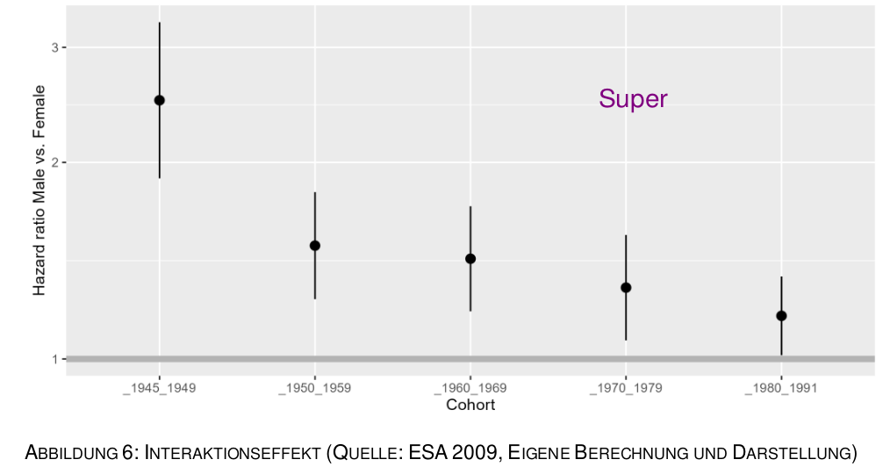
Parameter-centric modeling vs. predictive modeling
Balling (2022). Das Rauchverhalten von Männern
und Frauen in verschiedenen Kohorten.

Slide 4
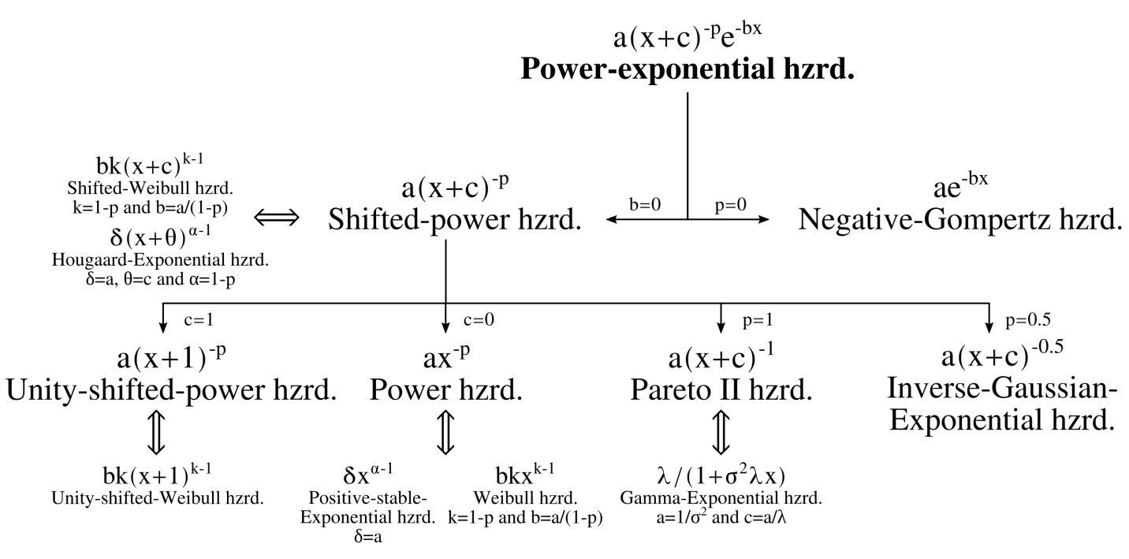
Parameter-centric modeling vs. predictive modeling
Schöley (2020). The dynamics of ontogenescence. Github link.

Slide 5
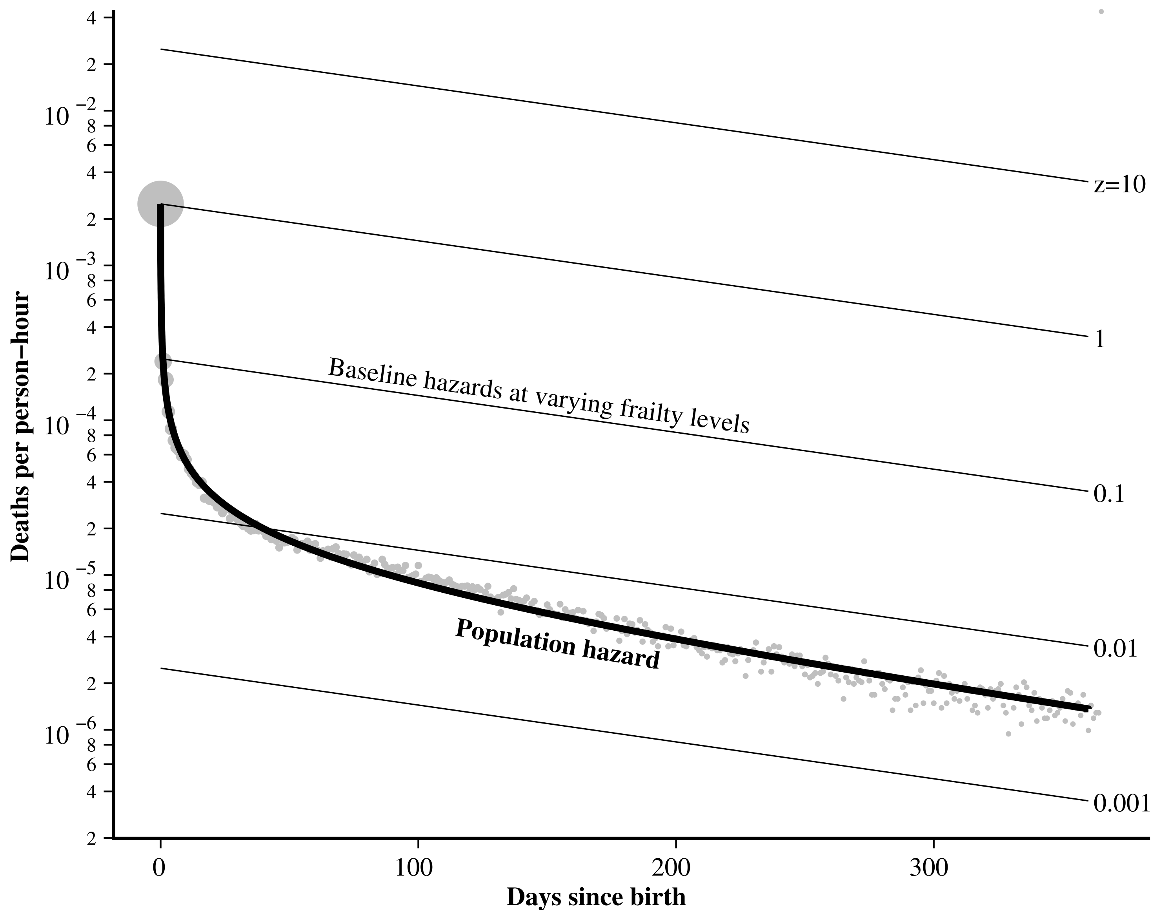
Parameter-centric modeling vs. predictive modeling
Schöley (2020). The dynamics of ontogenescence. Github link.

Slide 6
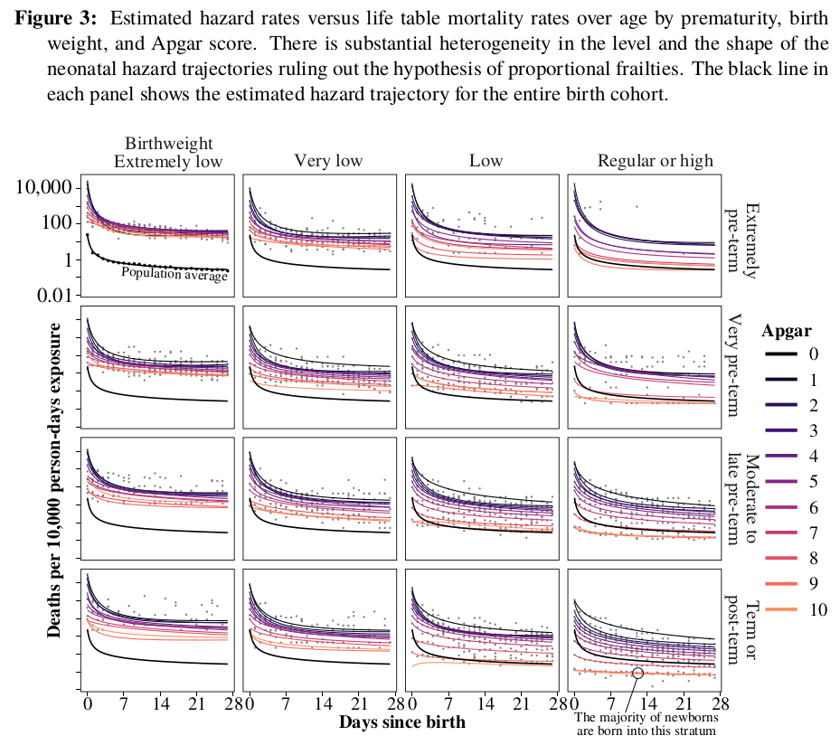
Parameter-centric modeling vs. predictive modeling
Schöley (2020). The dynamics of ontogenescence. Github link.

Slide 7
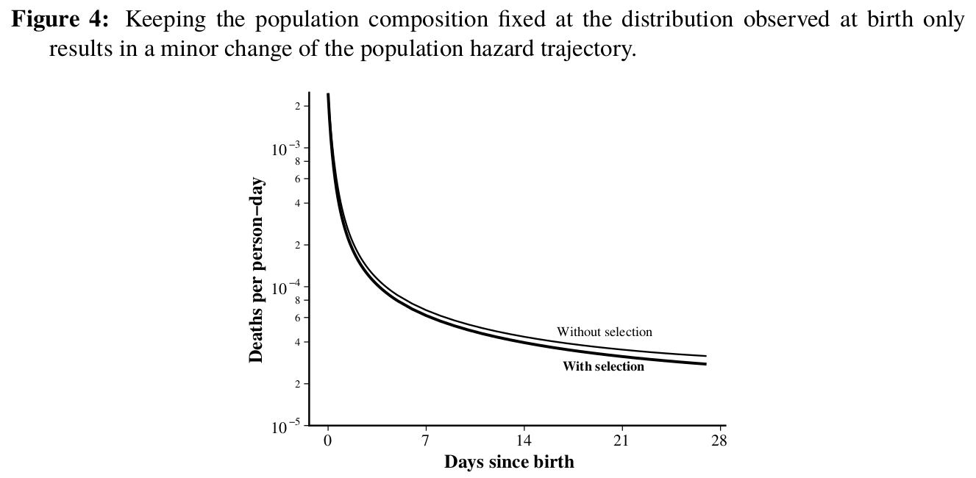
Parameter-centric modeling vs. predictive modeling
Schöley (2020). The dynamics of ontogenescence. Github link.

Slide 8
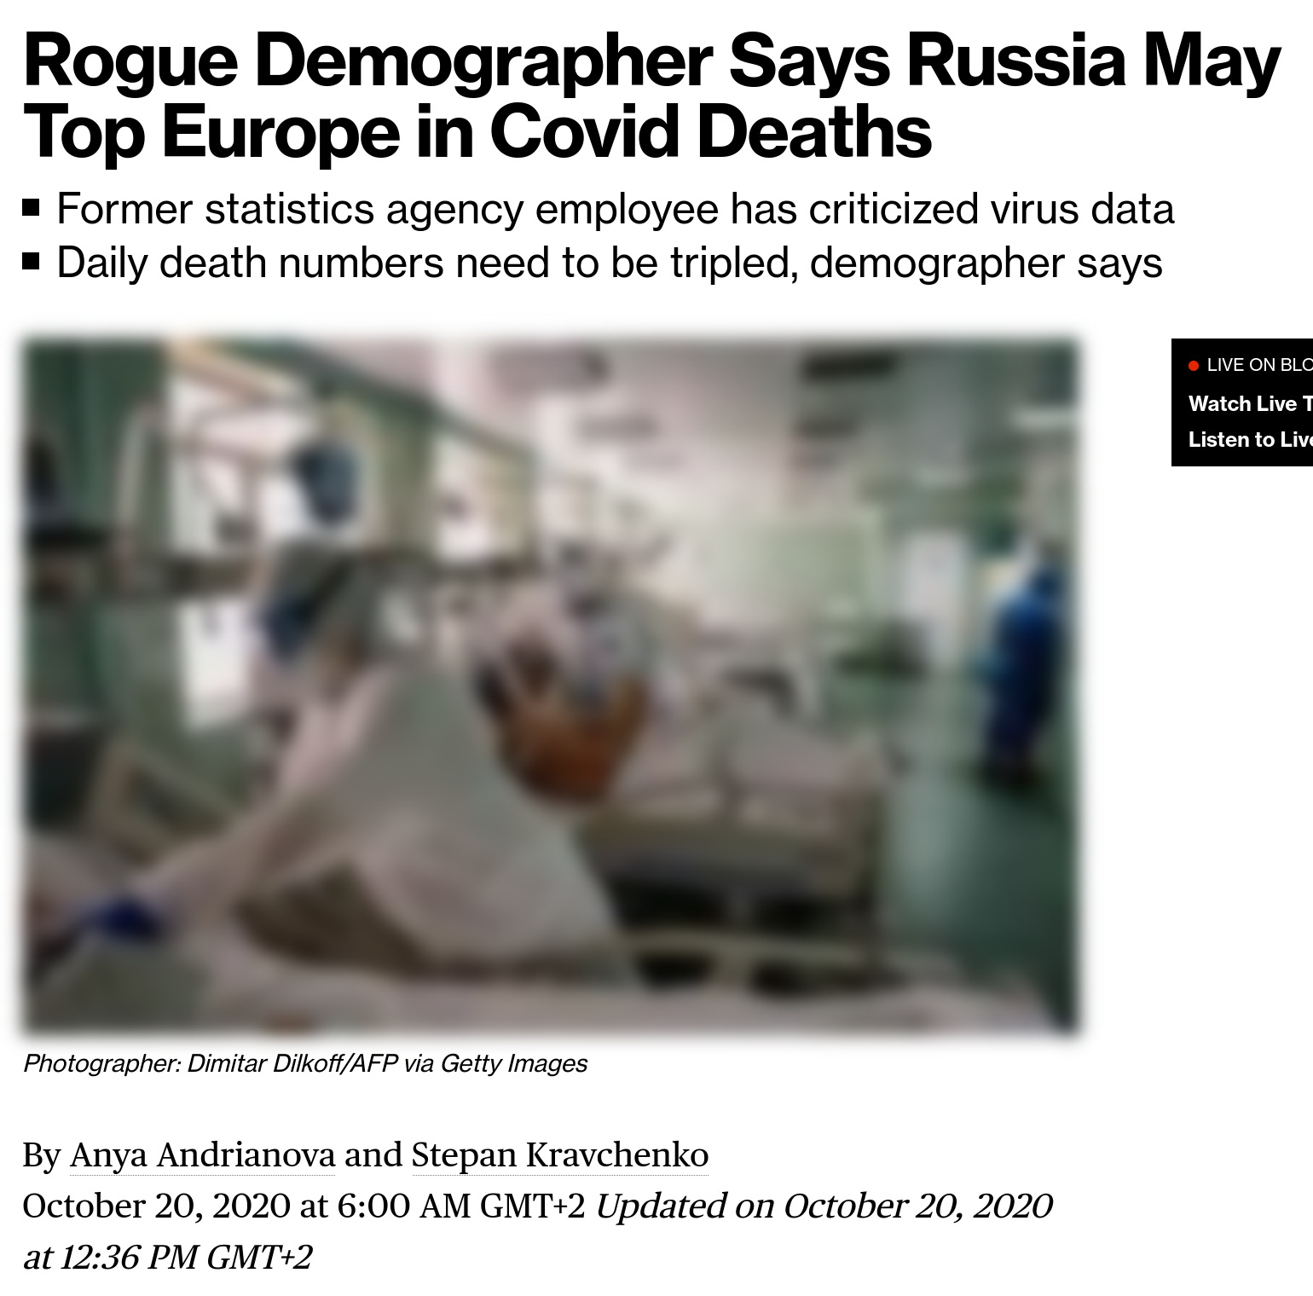

Predictive modeling in demography: Indirect estimation
Bloomberg. October 20, 2020. Link.
Aleksei Raksha

Slide 9
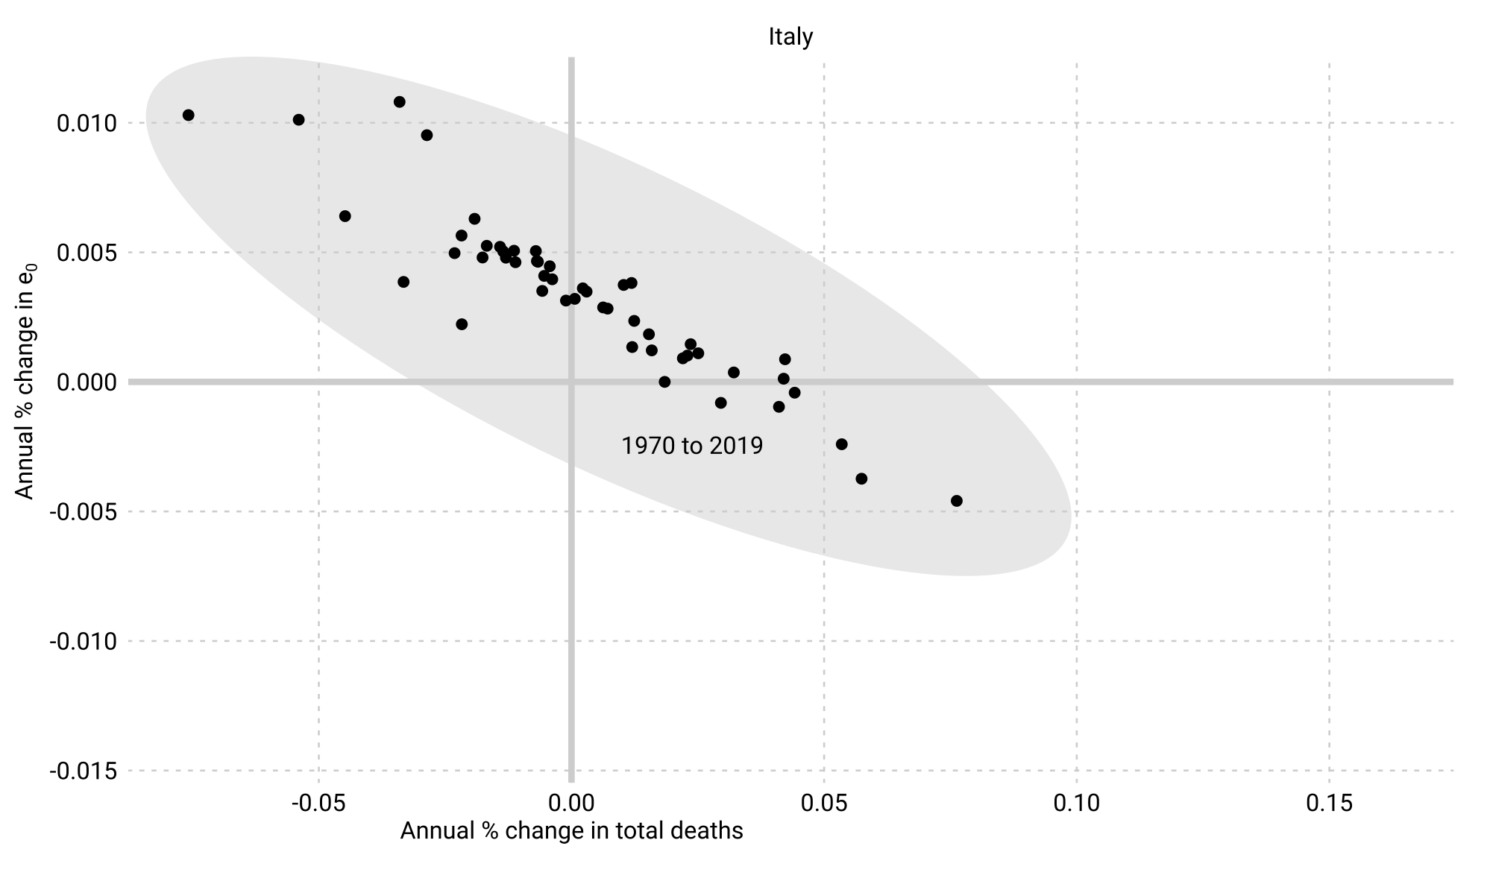
Predictive modeling in demography: Indirect estimation

Slide 10
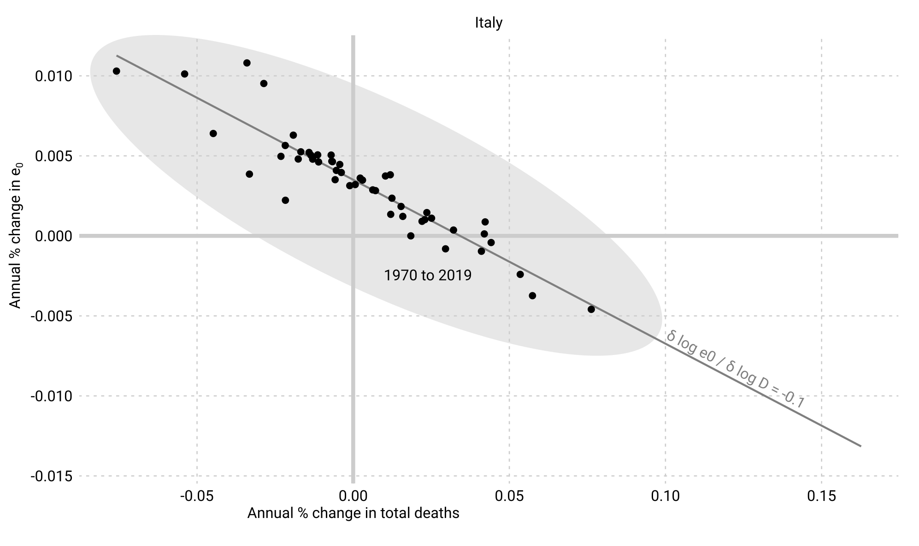
Predictive modeling in demography: Indirect estimation

Slide 11
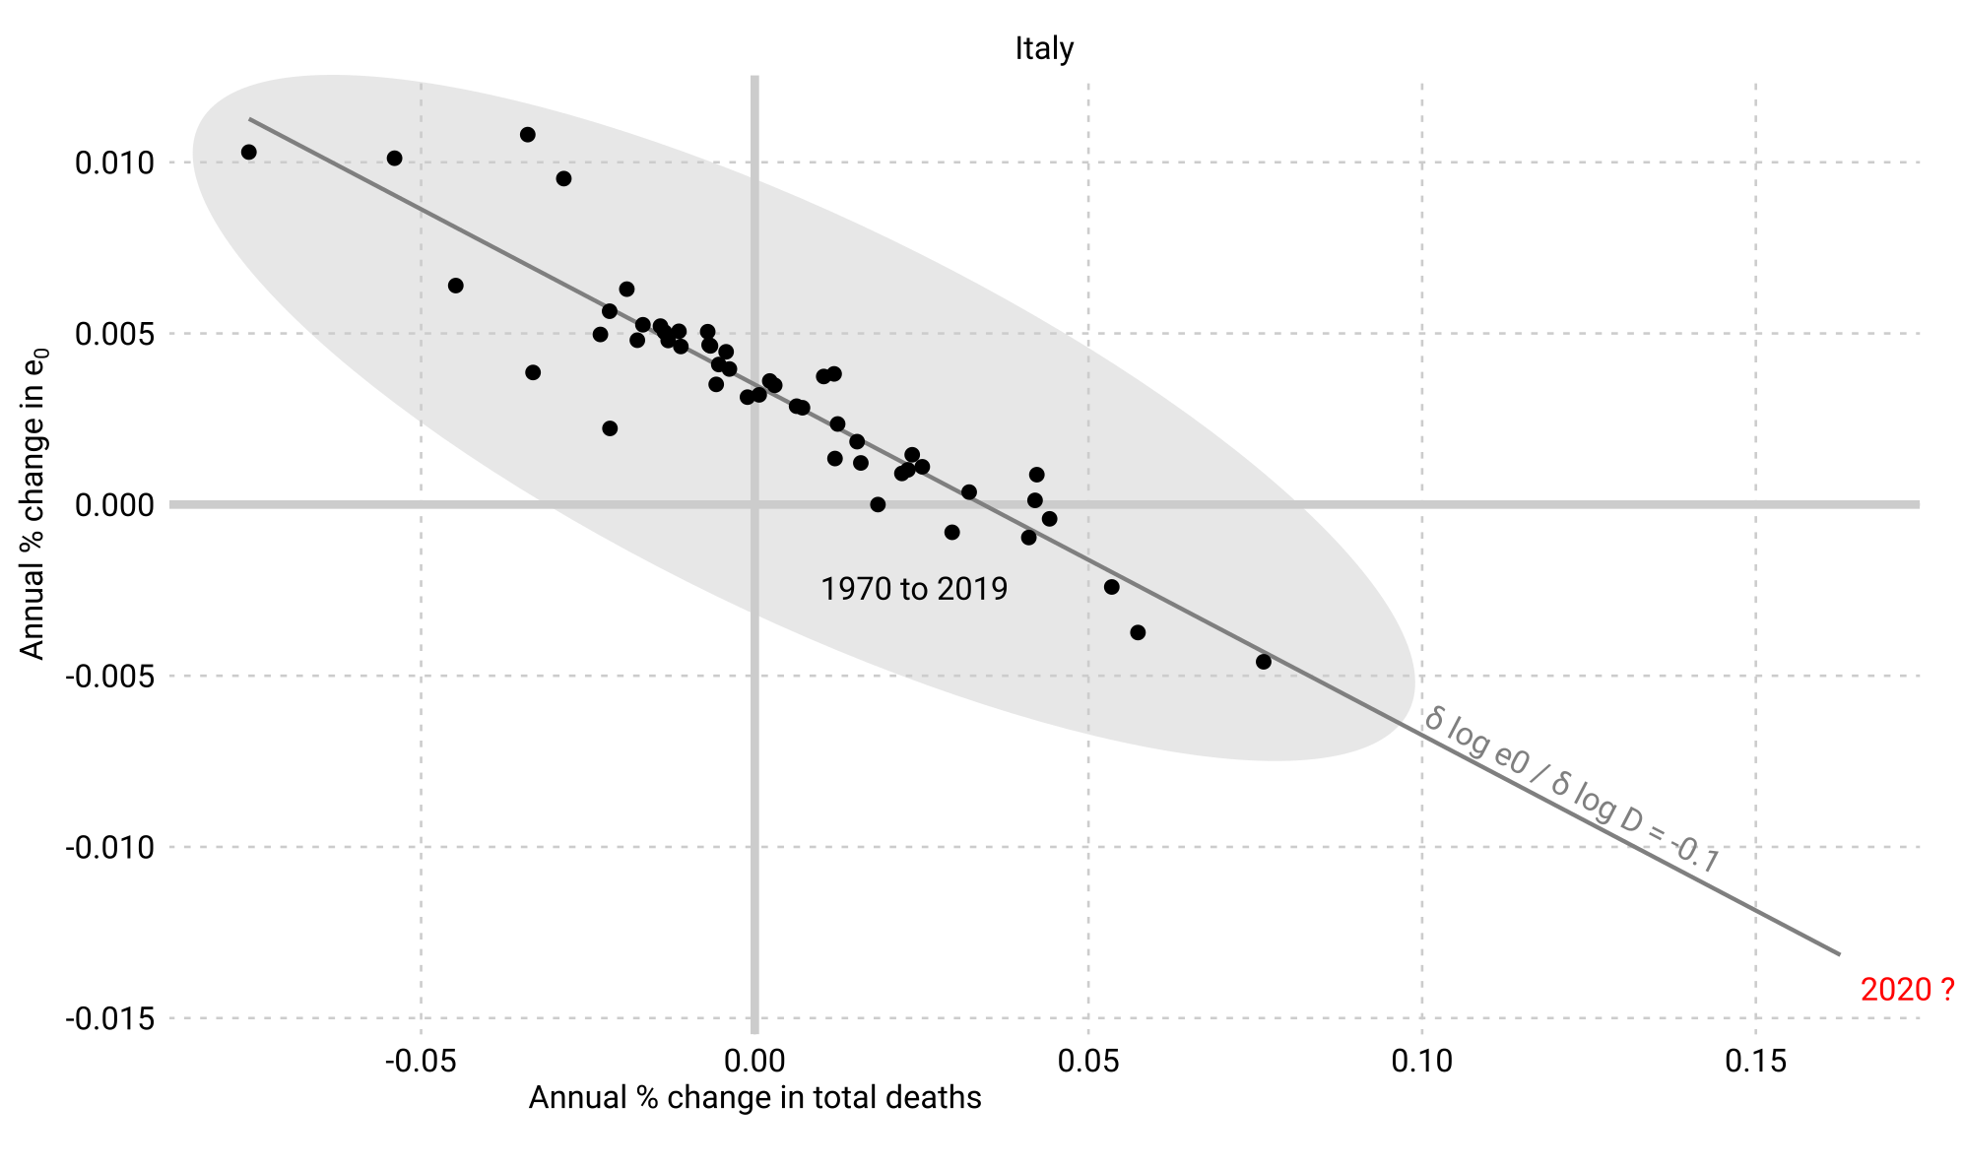
Predictive modeling in demography: Indirect estimation

Slide 12

Predictive modeling in demography: Indirect estimation

Slide 13
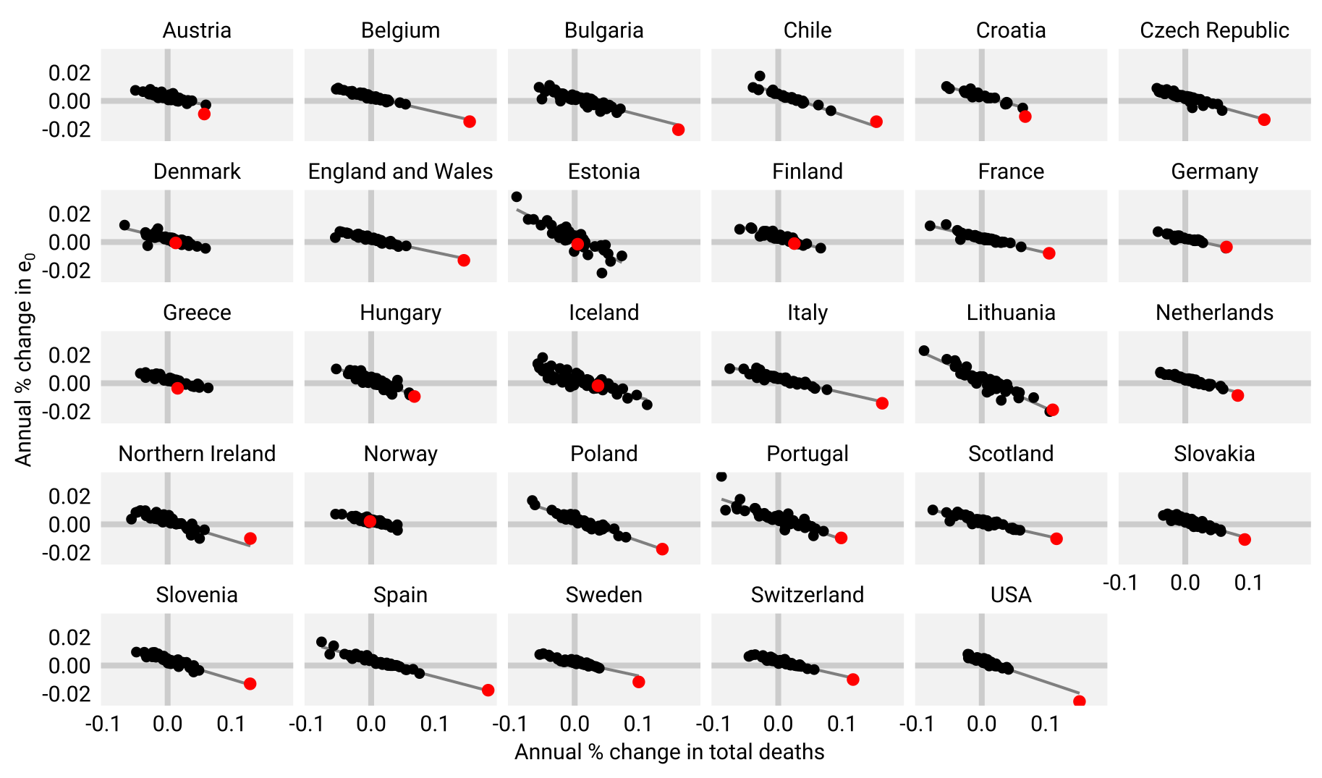
Predictive modeling in demography: Indirect estimation

Slide 14
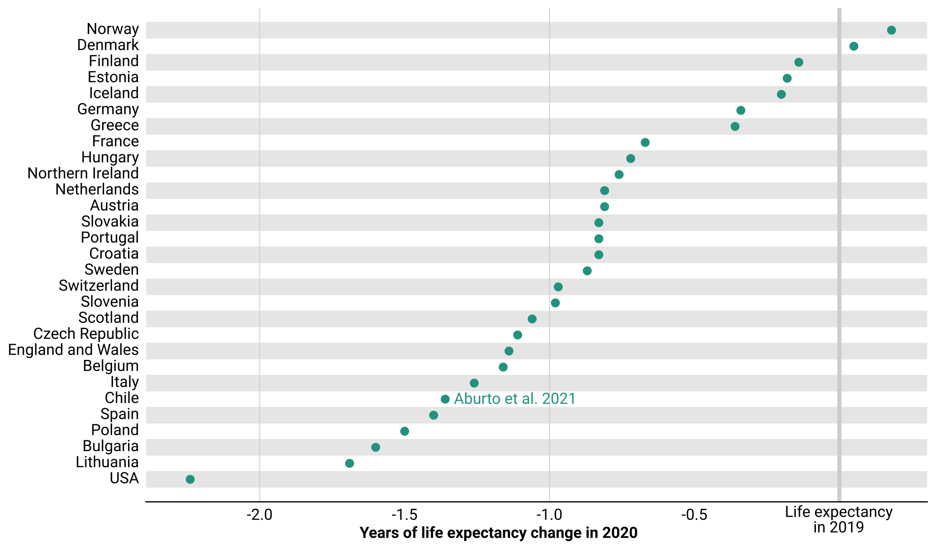
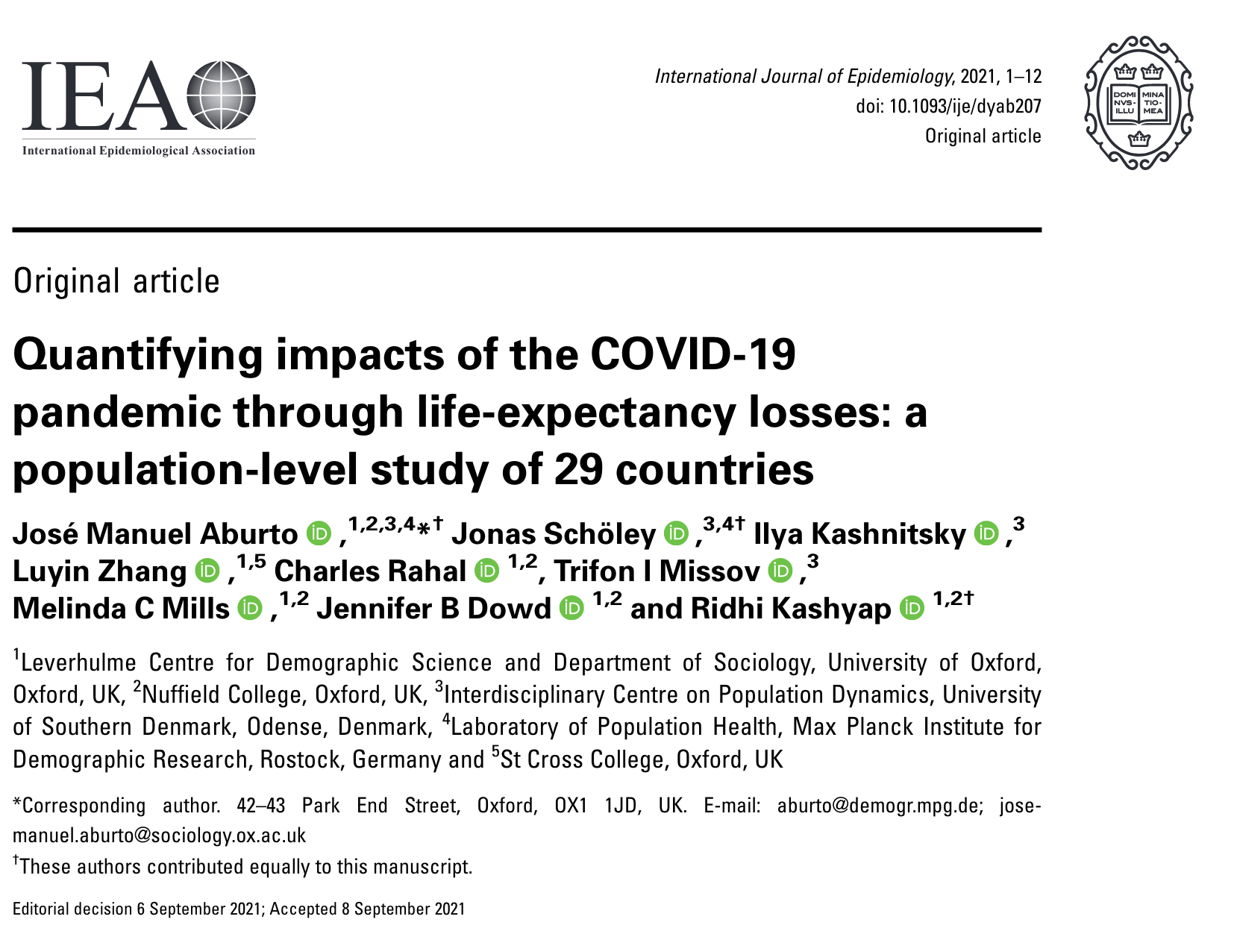
Predictive modeling in demography: Indirect estimation
Aburto & Schöley et al. 2021. Quantifying impacts of the COVID-19 pandemic through life-expectancy losses: a population-level study of 29 countries. 10.1093/ije/dyab207

Slide 15
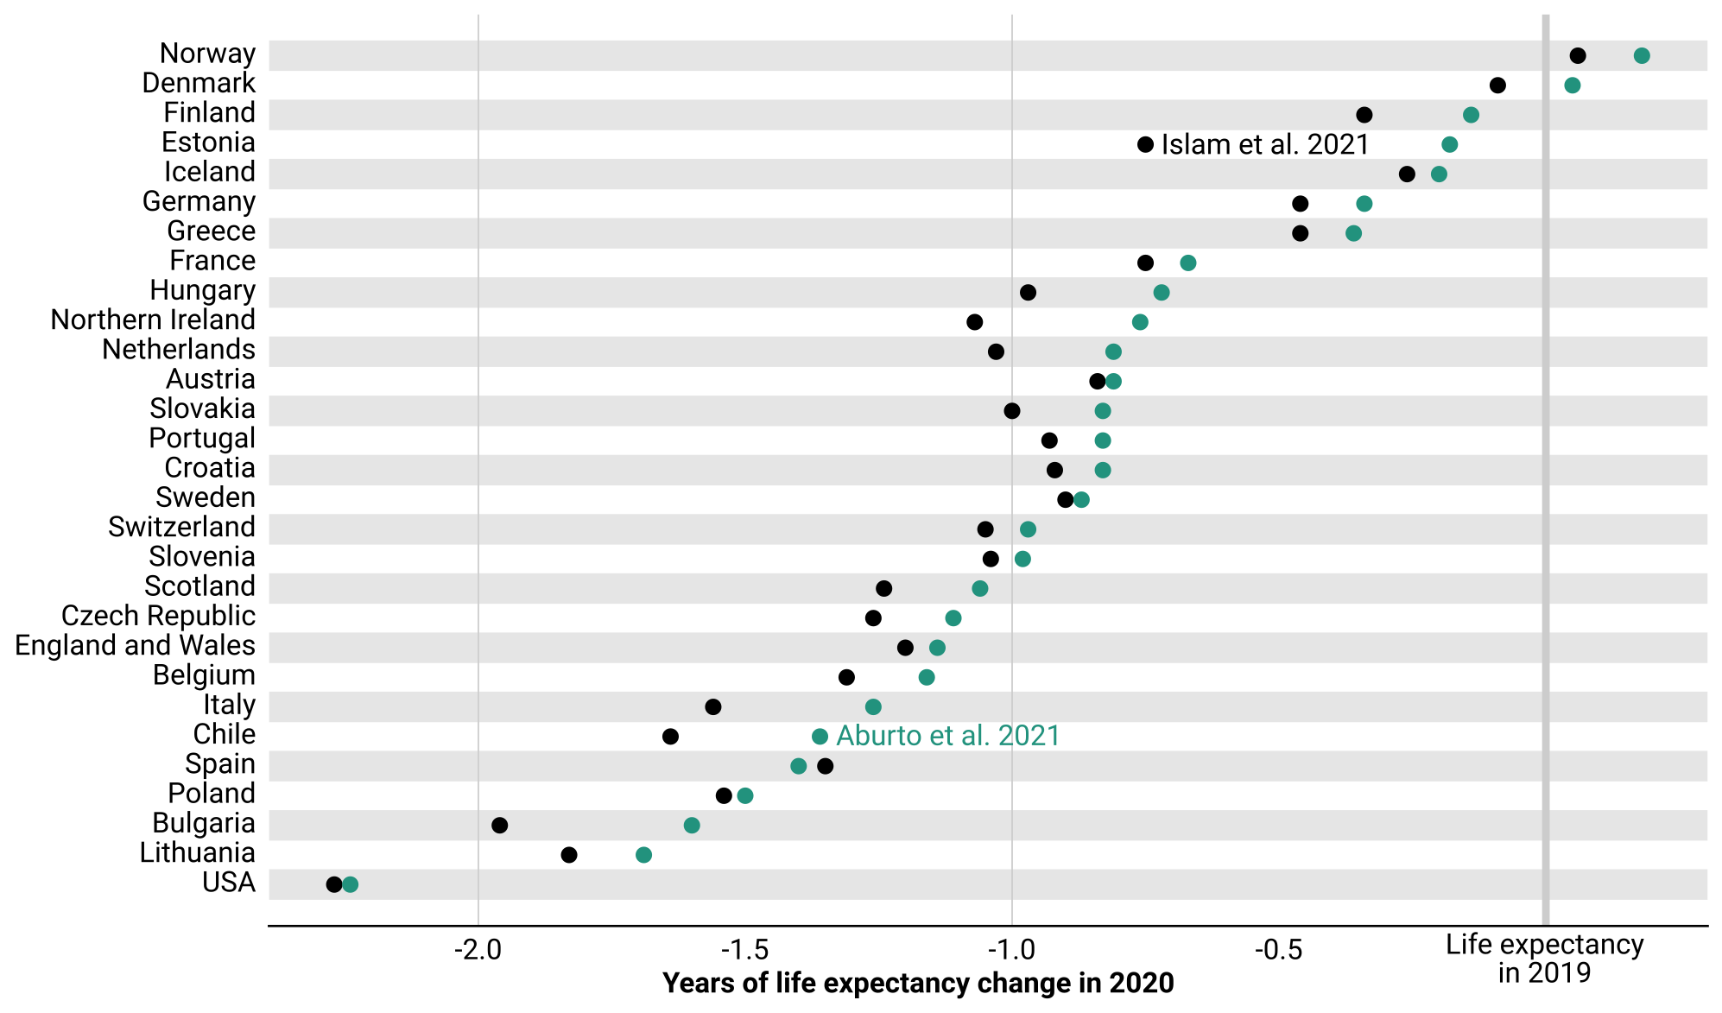
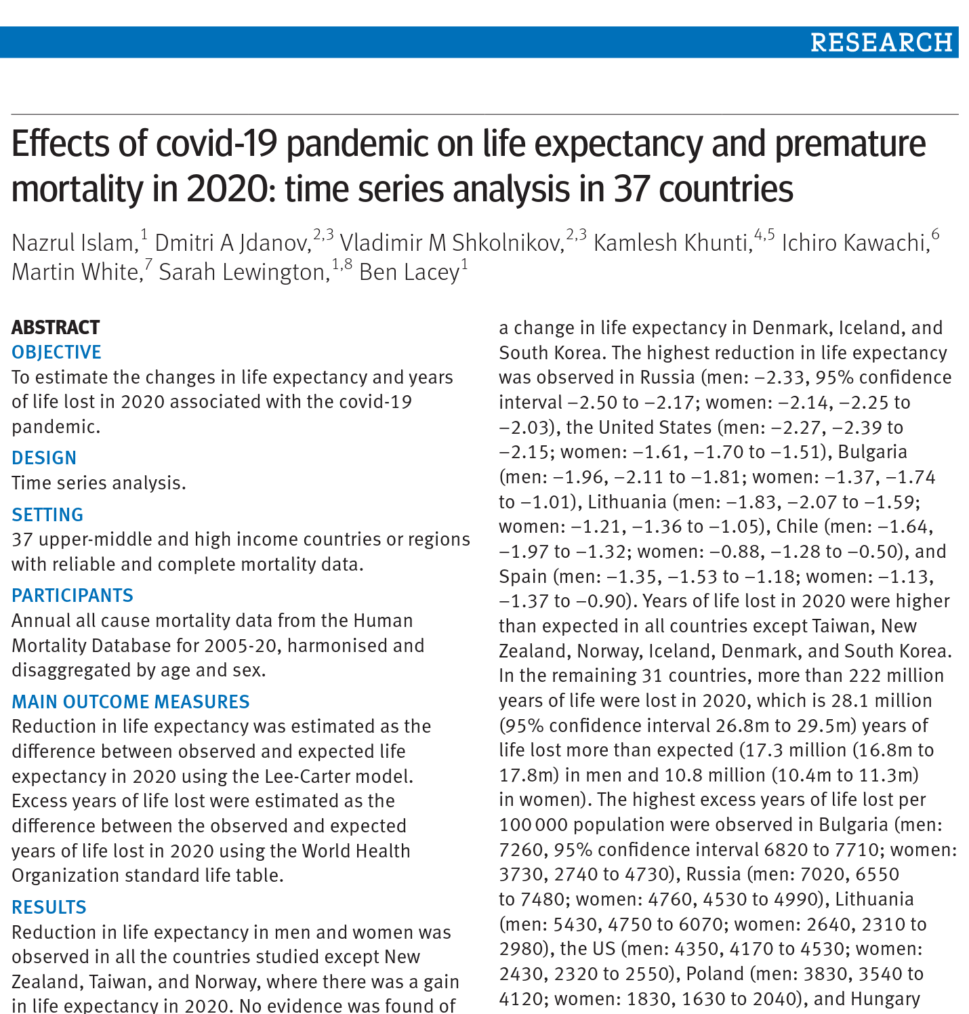
Predictive modeling in demography: Indirect estimation
Aburto & Schöley et al. 2021. Quantifying impacts of the COVID-19 pandemic through life-expectancy losses: a population-level study of 29 countries. 10.1093/ije/dyab207
Islam & Jdanov et al. 2021. Effects of covid-19 pandemic on life expectancy and premature mortality in 2020: time series analysis in 37 countries. 10.1136/bmj-2021-066768

Slide 16
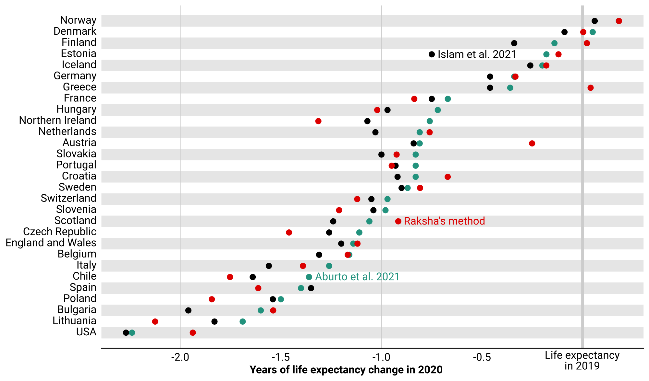
Predictive modeling in demography: Indirect estimation
Aburto & Schöley et al. 2021. Quantifying impacts of the COVID-19 pandemic through life-expectancy losses: a population-level study of 29 countries. 10.1093/ije/dyab207
Islam & Jdanov et al. 2021. Effects of covid-19 pandemic on life expectancy and premature mortality in 2020: time series analysis in 37 countries. 10.1136/bmj-2021-066768

Slide 17
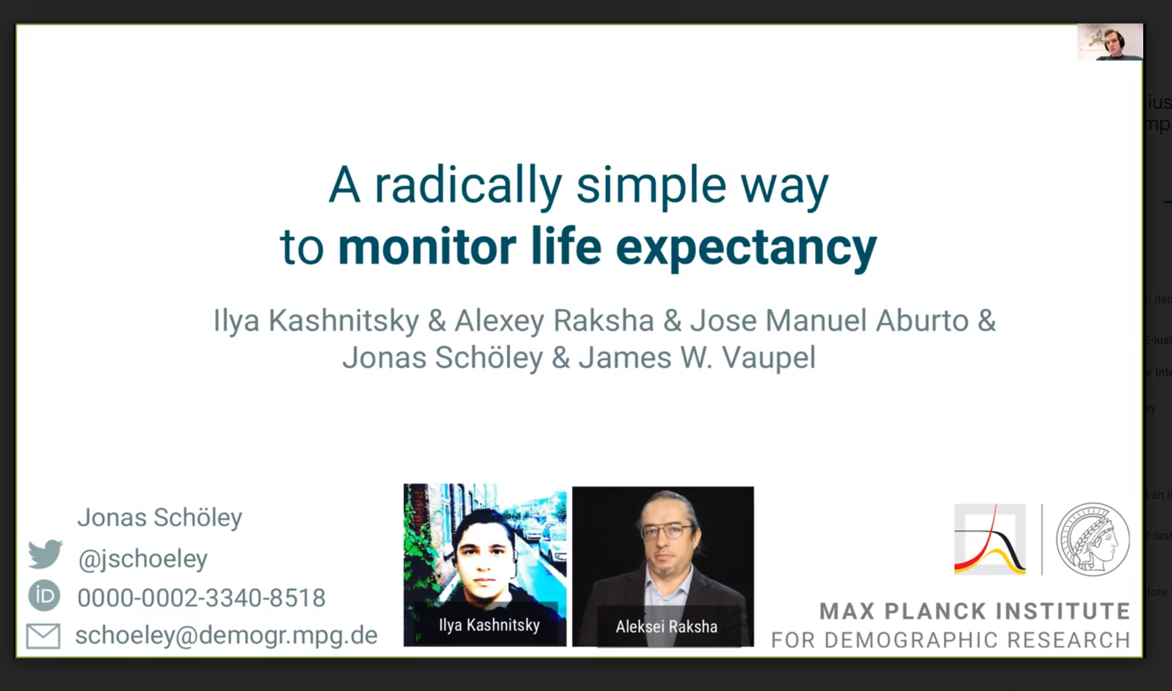
Predictive modeling in demography: Indirect estimation
Kashnitsky, Raksha, Schöley etal. (2021). Monitoring life expectancy. Link to video

Slide 18
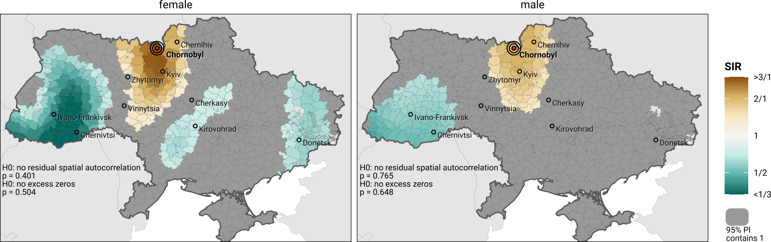
Predictive modeling in demography: Spatial analyses
Levchuk, Schöley, Cilek, Jasilionis (2023). Long-term health effects of the Chernobyl accident.

Slide 19
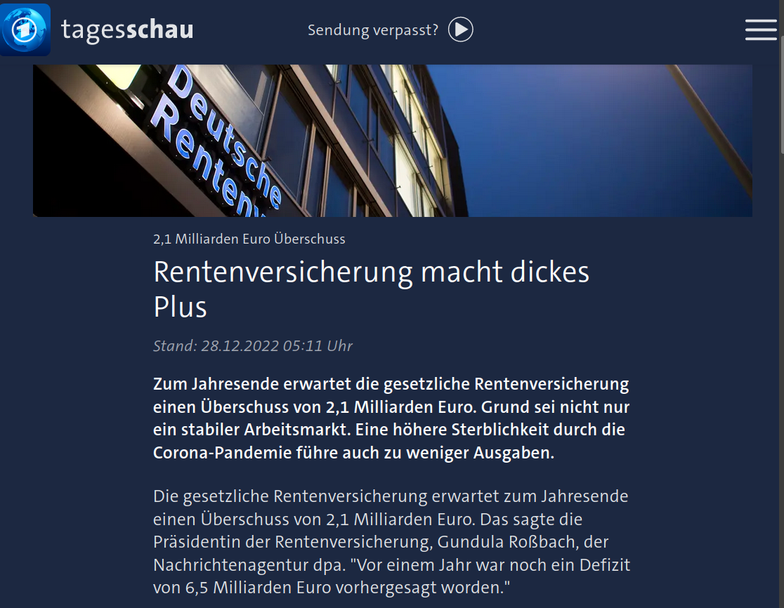
Predictive modeling in demography: Projections and forecasts

Slide 20
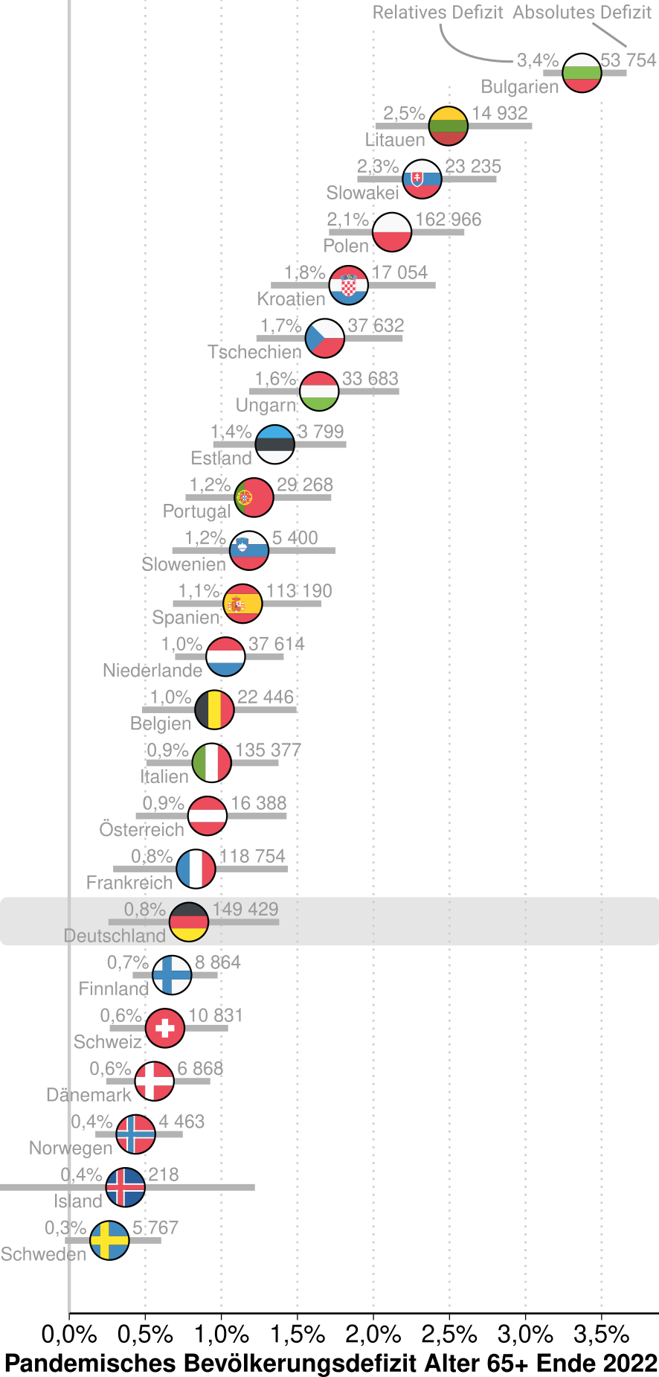
Predictive modeling in demography: Projections and forecasts
Schöley (2023). Bevölkerungsalterung unter Pandemiebedingungen.

Slide 21
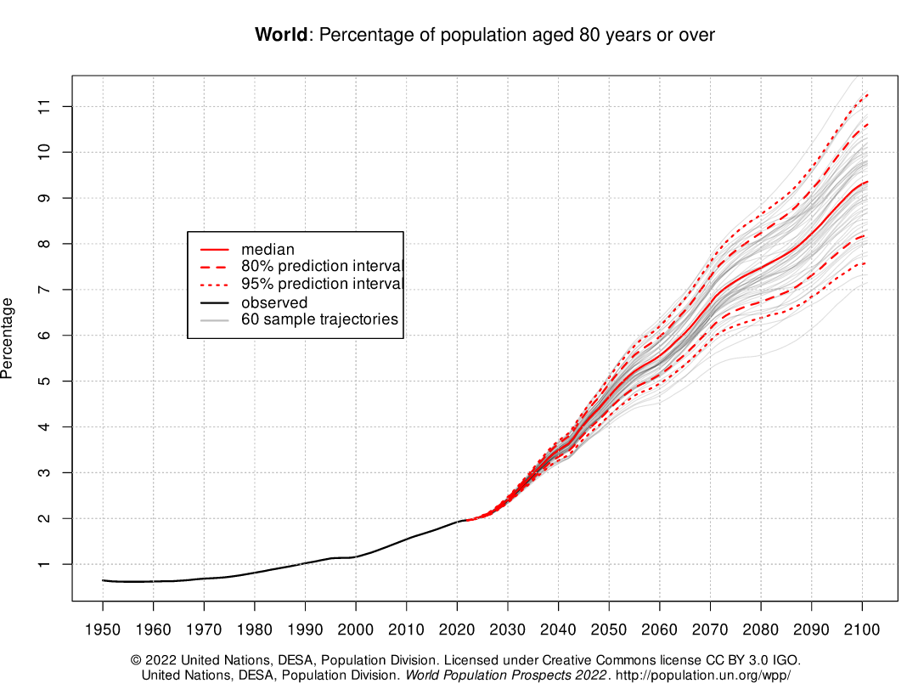
Predictive modeling in demography: Projections and forecasts
UN (2022). World Population Prospects. Web link.

Slide 22
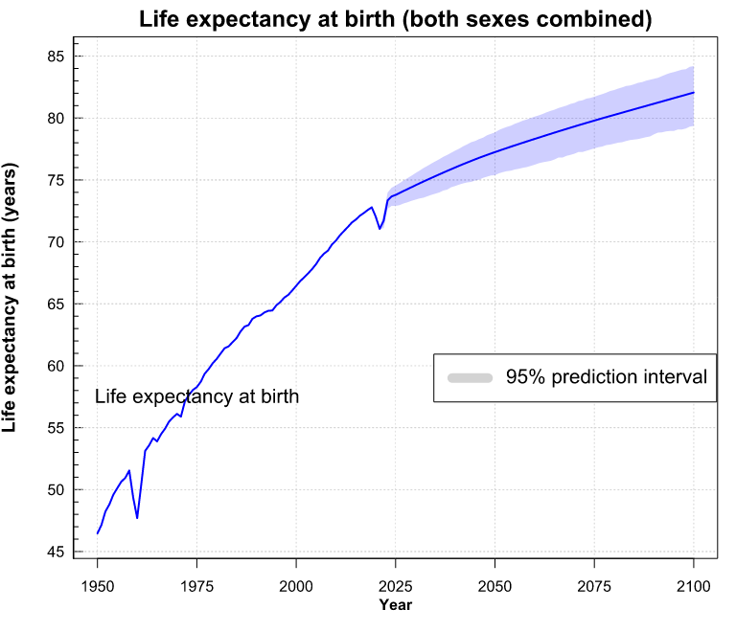
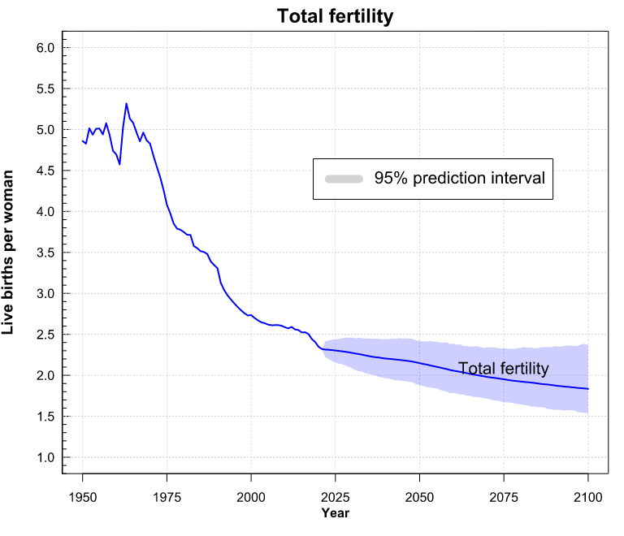
Predictive modeling in demography: Projections and forecasts
UN (2022). World Population Prospects. Web link.

Slide 23
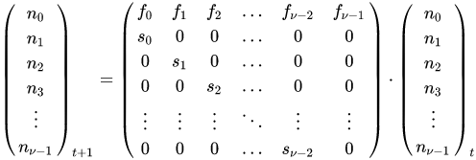
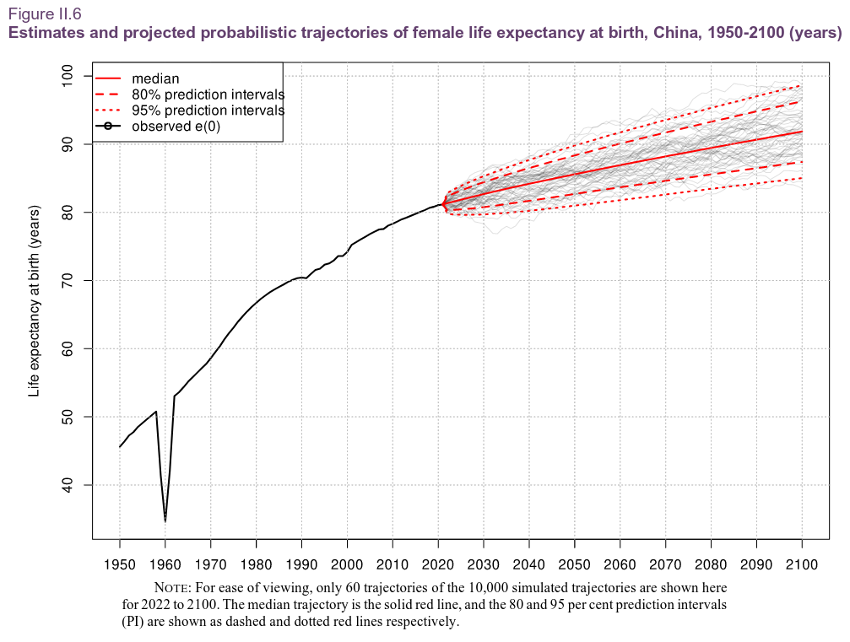
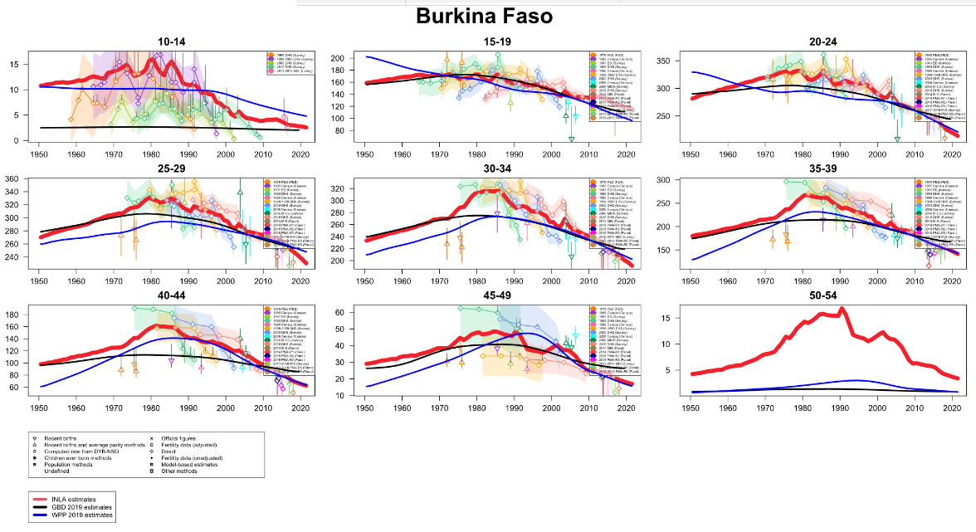
Predictive modeling in demography: Projections and forecasts
Population projection Cohort component / Leslie
+ Net-migration by age
Baseline population estimates
Life-expectancy forecasts with
derived mortality by age
Fertility forecasts
UN (2022). World Population Prospects. Web link.

Slide 24
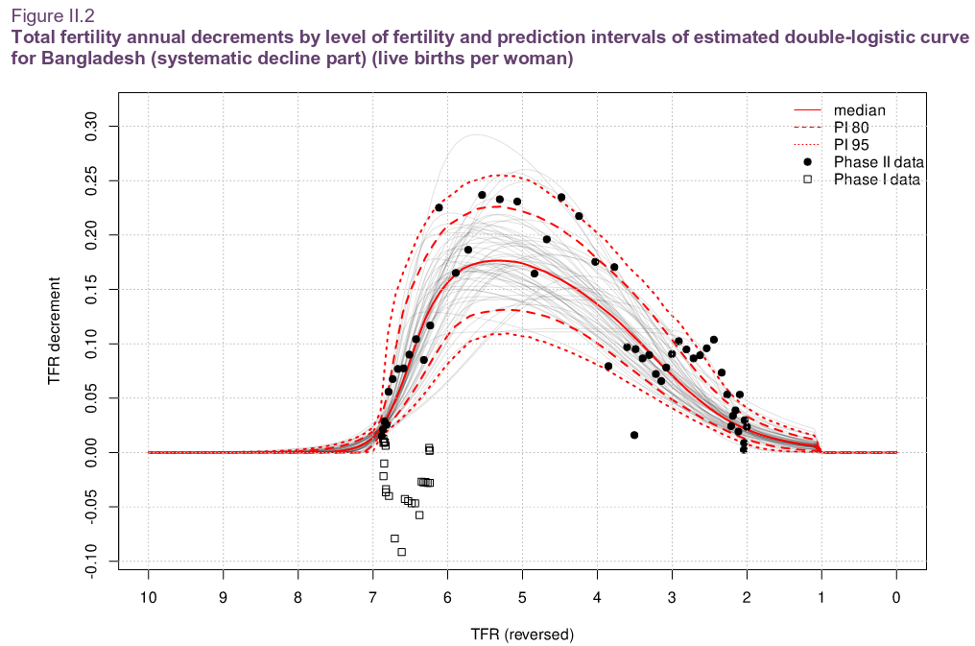
Predictive modeling in demography: Projections and forecasts
Life-expectancy forecasts with
derived mortality by age
Fertility forecasts
UN (2022). World Population Prospects. Web link.

Slide 25
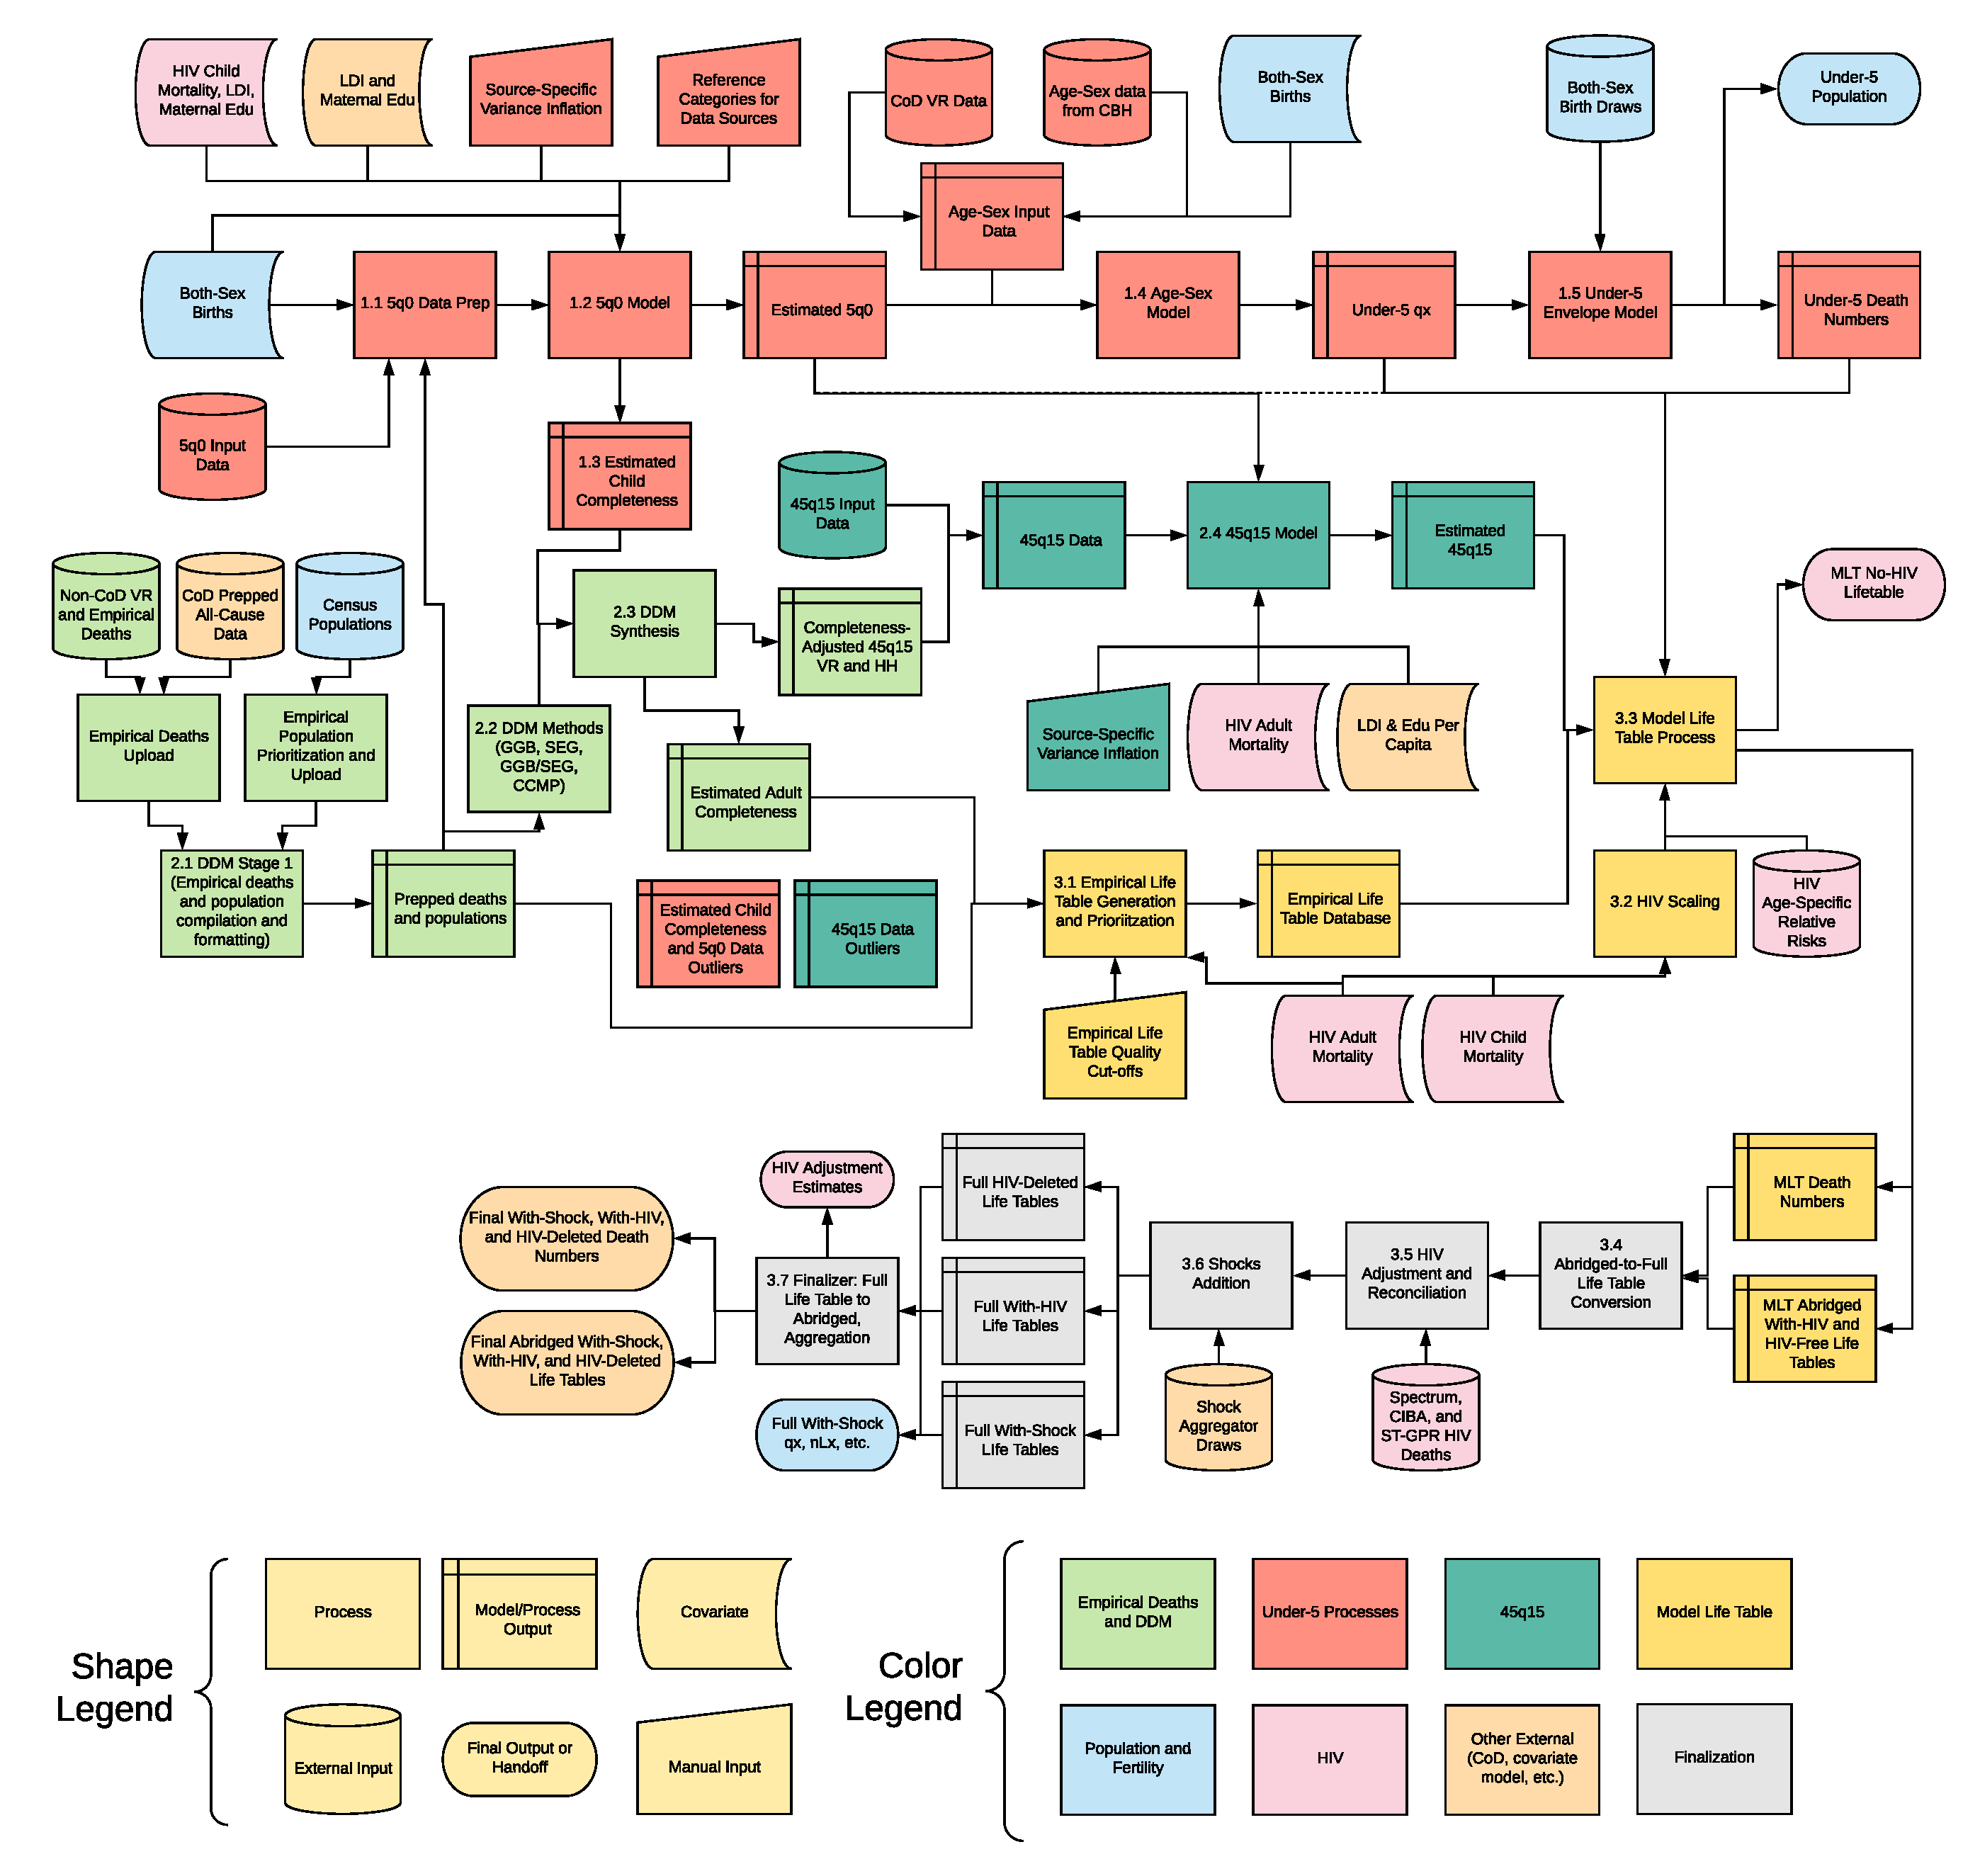
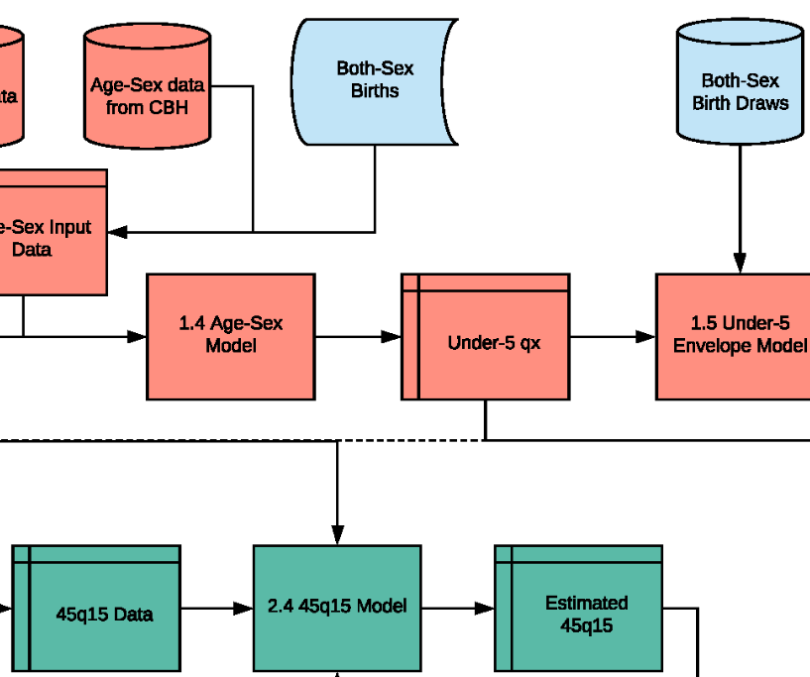
Predictive modeling in demography: Projections and forecasts
Global Burden of Disease (2019).
Mortality 1 Estimation Flowchart. Web link.

Slide 26
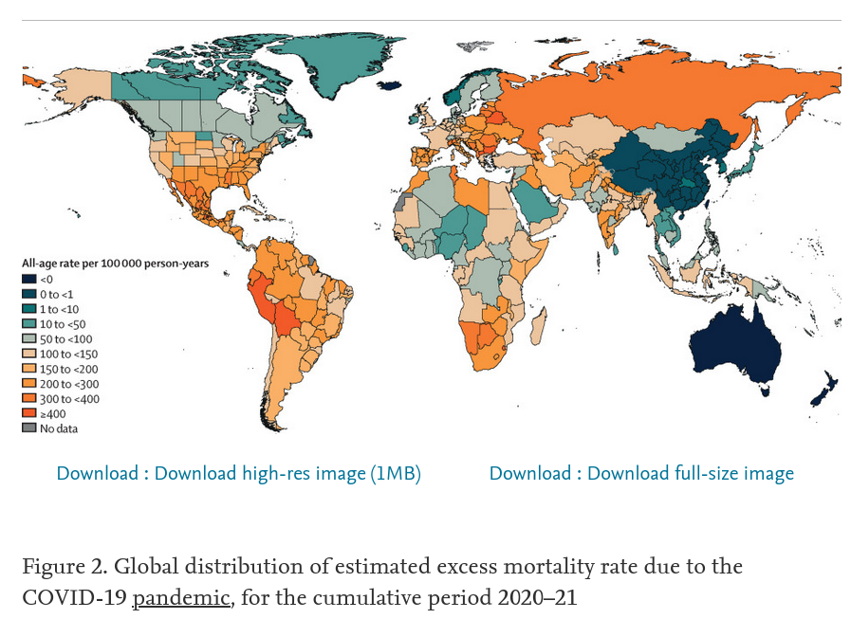
Predictive modeling in demography: Indirect estimation
COVID-19 Excess Mortality Collaborators (2022). Estimating excess mortality... 10.1016/S0140-6736(21)02796-3

Slide 27
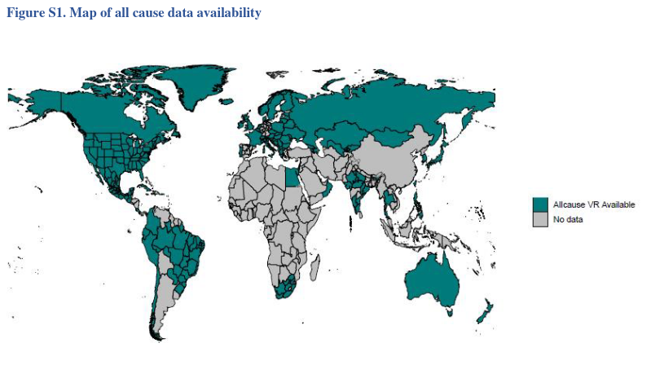
Predictive modeling in demography: Indirect estimation
COVID-19 Excess Mortality Collaborators (2022). Estimating excess mortality... Link to Supplementary

Slide 28
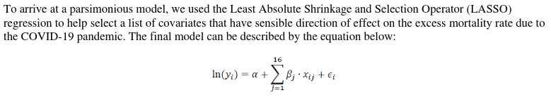
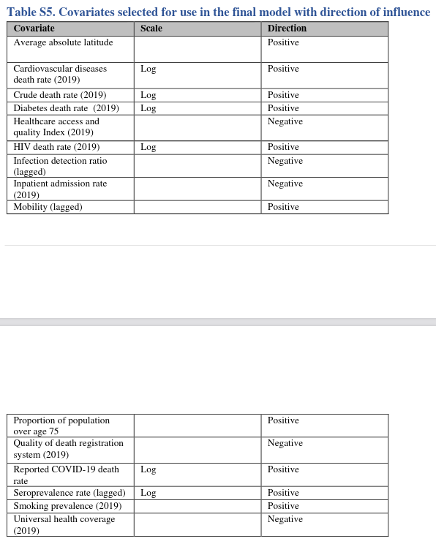
Predictive modeling in demography: Indirect estimation
COVID-19 Excess Mortality Collaborators (2022). Estimating excess mortality... Link to Supplementary
github.com/ihmeuw-demographics/publication_covid_em/tree/main/03_ensemble_excess_model

Slide 29
Parameter-centric modeling vs. predictive modeling
f(y|x,θ)
vs.
f(y|x,θ)

Slide 30
Predictive modeling workflow
f(y|x,θ)
Predict from model
Transform model predictions
Propagate prediction uncertainty through analysis
Cross-validate predictive accuracy & model calibration

Slide 31
Predict from model

Slide 32
Predict from model – The model equation
D_{t} ~ NegBin(μ_{t}, θ)
μ_{t} = exp( β₀ + β_{y}year_{t} + Σ_{i=1:52} β_{w[i]}week_{t} + log(populationt) )
θ = exp (β_{θ})
Observations
Sampling Distribution
Parameters
Predictors

Slide 33
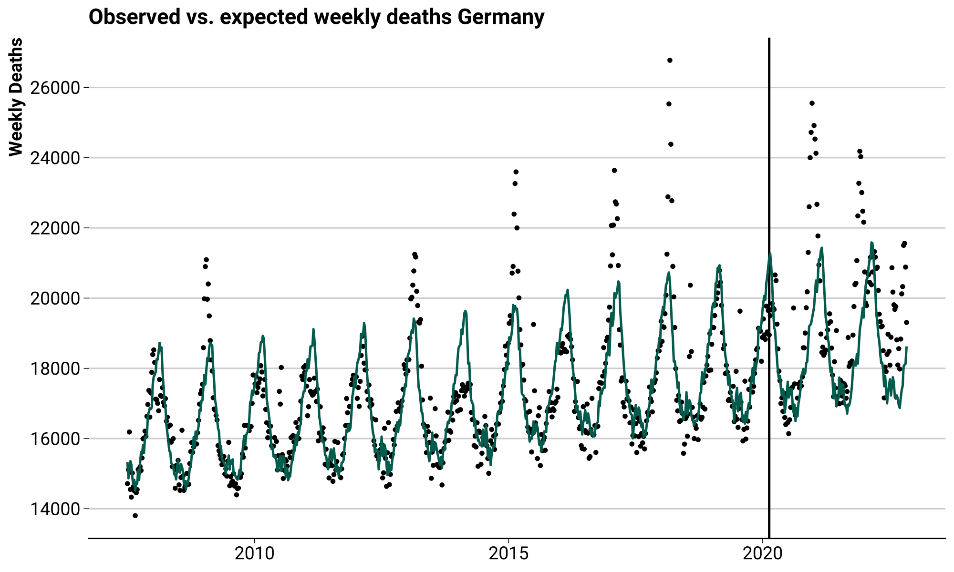
Predict from model – Point estimates

Slide 34
Transform model predictions

Slide 35
Transform model predictions
D_{t} ~ NegBin(μ_{t}, θ)
μ_{t} = exp( β₀ + β_{y}year_{t} + Σ_{i=1:52} β_{w[i]}week_{t} + log(populationt) )
θ = exp (β_{θ})
Cumulative excess deaths:
∑_{t} D_{t} - μ_{t}

Slide 36
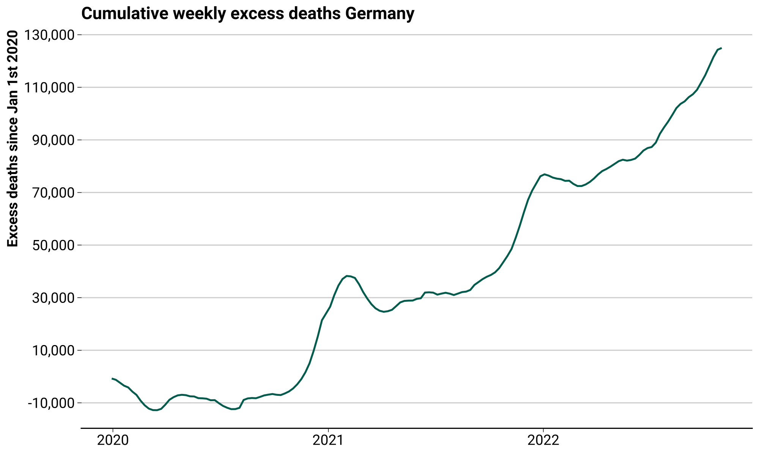
Transform model predictions

Slide 37
Propagate prediction uncertainty through analysis

Slide 38
Propagate uncertainty
How many deaths in a week had C19 not occurred?
Excess = Observed - Expected

Slide 39

Propagate uncertainty
How many deaths in a week had C19 not occurred?
Excess = Observed -

Slide 40

Propagate uncertainty
How many deaths in a week had C19 not occurred?
= Observed -

Slide 41
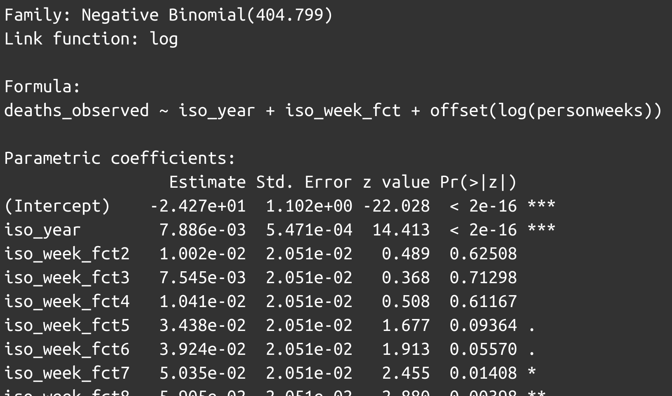
Propagate uncertainty – Epistemic uncertainty
D_{t} ~ NegBin(μ_{t}, θ)
μ_{t} = exp( β₀ + β_{y}year_{t} + Σ_{i=1:52} β_{w[i]}week_{t} + log(populationt) )
θ = exp (β_{θ})
Uncertainty regarding the
state of the world, here:
Uncertain parameter estimates
Hüllermeier (2021). Aleatoric and epistemic uncertainty in machine learning... 10.1007/s10994-021-05946-3

Slide 42
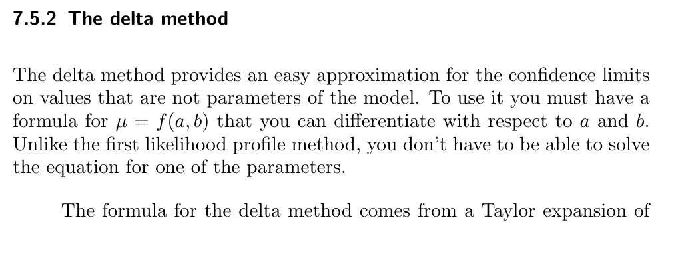
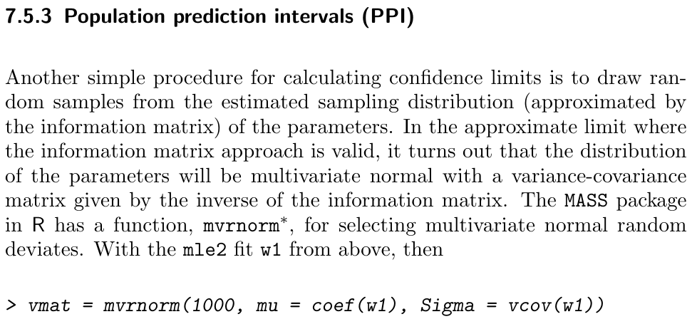
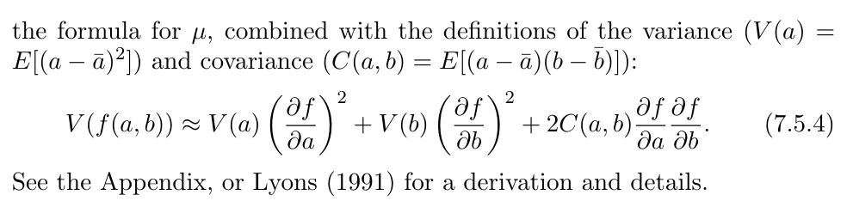
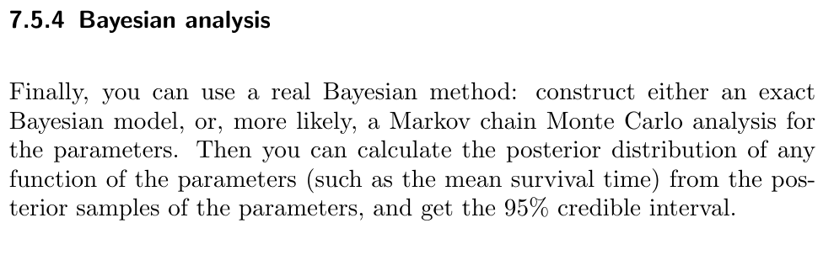
Propagate uncertainty – Epistemic uncertainty
Bolker (2007). Ecological Models and Data in R. ms.mcmaster.ca/~bolker/emdbook/book.pdf

Slide 43
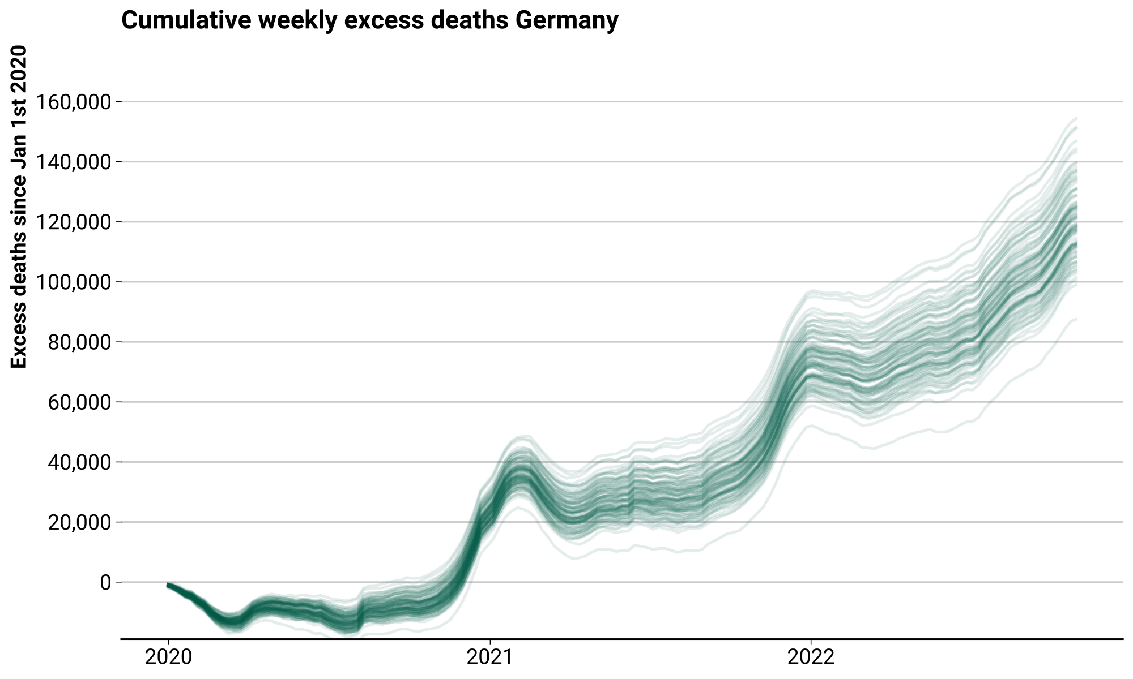
Propagate uncertainty – Epistemic uncertainty
Uncertainty in model
parameters propagated
through transformed
model predictions via
sampling from Multi-
variate Normal approx.
to sampling distribution
of beta’s

Slide 44
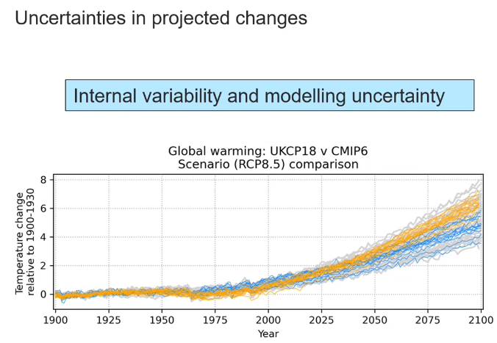
Propagate uncertainty – Epistemic uncertainty
Uncertainty regarding the
state of the world, here:
Uncertain model structure
“The reason why different climate
models give different projections
is because they use different,
but plausible, representations
of climate processes.”
Murphy (2022). Informing risks and decisions using the UK climate projections. youtu.be/uiSTmy1vqIs

Slide 45
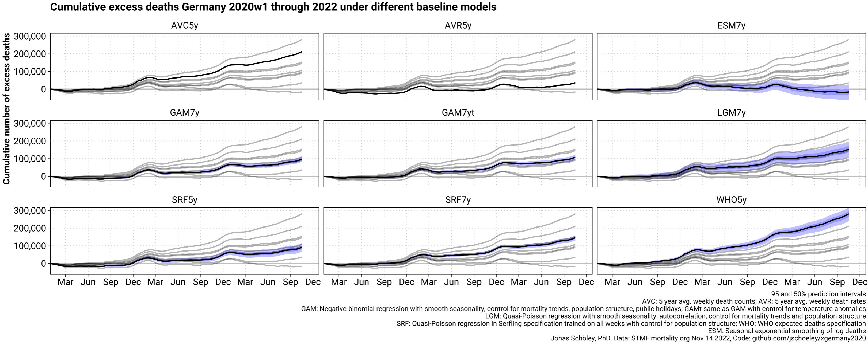
Propagate uncertainty – Epistemic uncertainty

Slide 46
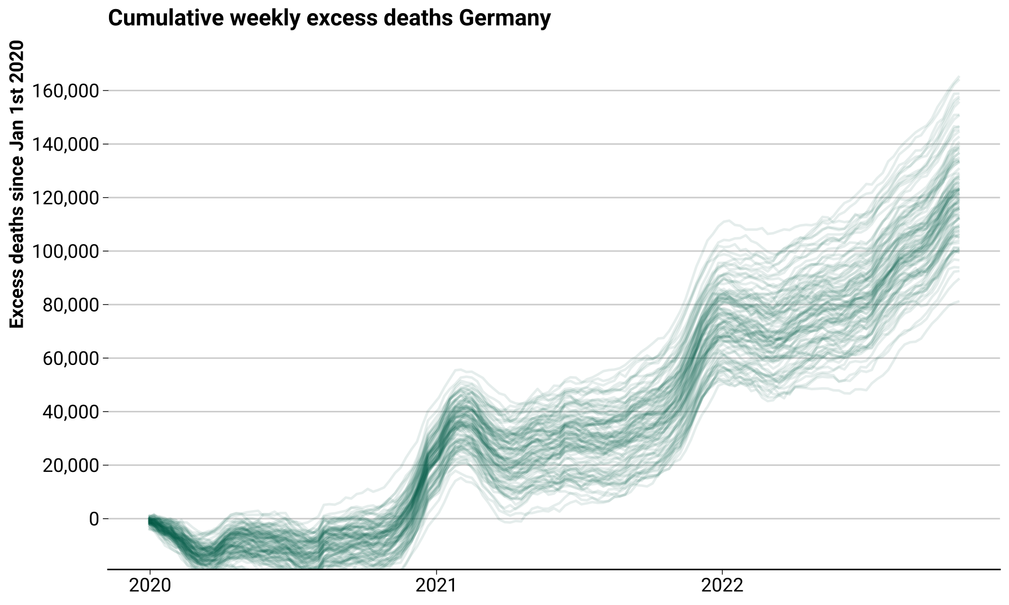
Propagate uncertainty – Aleatoric uncertainty
Given the sampled
model parameters,
draw samples from the
outcome distribution
(Negative-Binomial in
this case).

Slide 47
Propagate uncertainty – Aleatoric uncertainty

Slide 48
Cross-validate predictive accuracy & model calibration

Slide 49
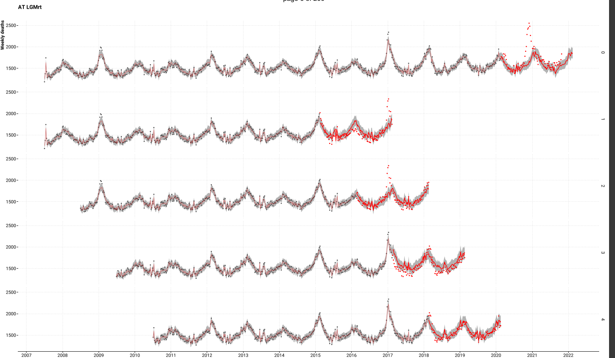
Cross validate – Error & Bias
Rolling origin four-fold cross-validation setup mirroring the task of predicting weekly
deaths past the beginning of the COVID-19 pandemic given pre-pandemic data.

Slide 50
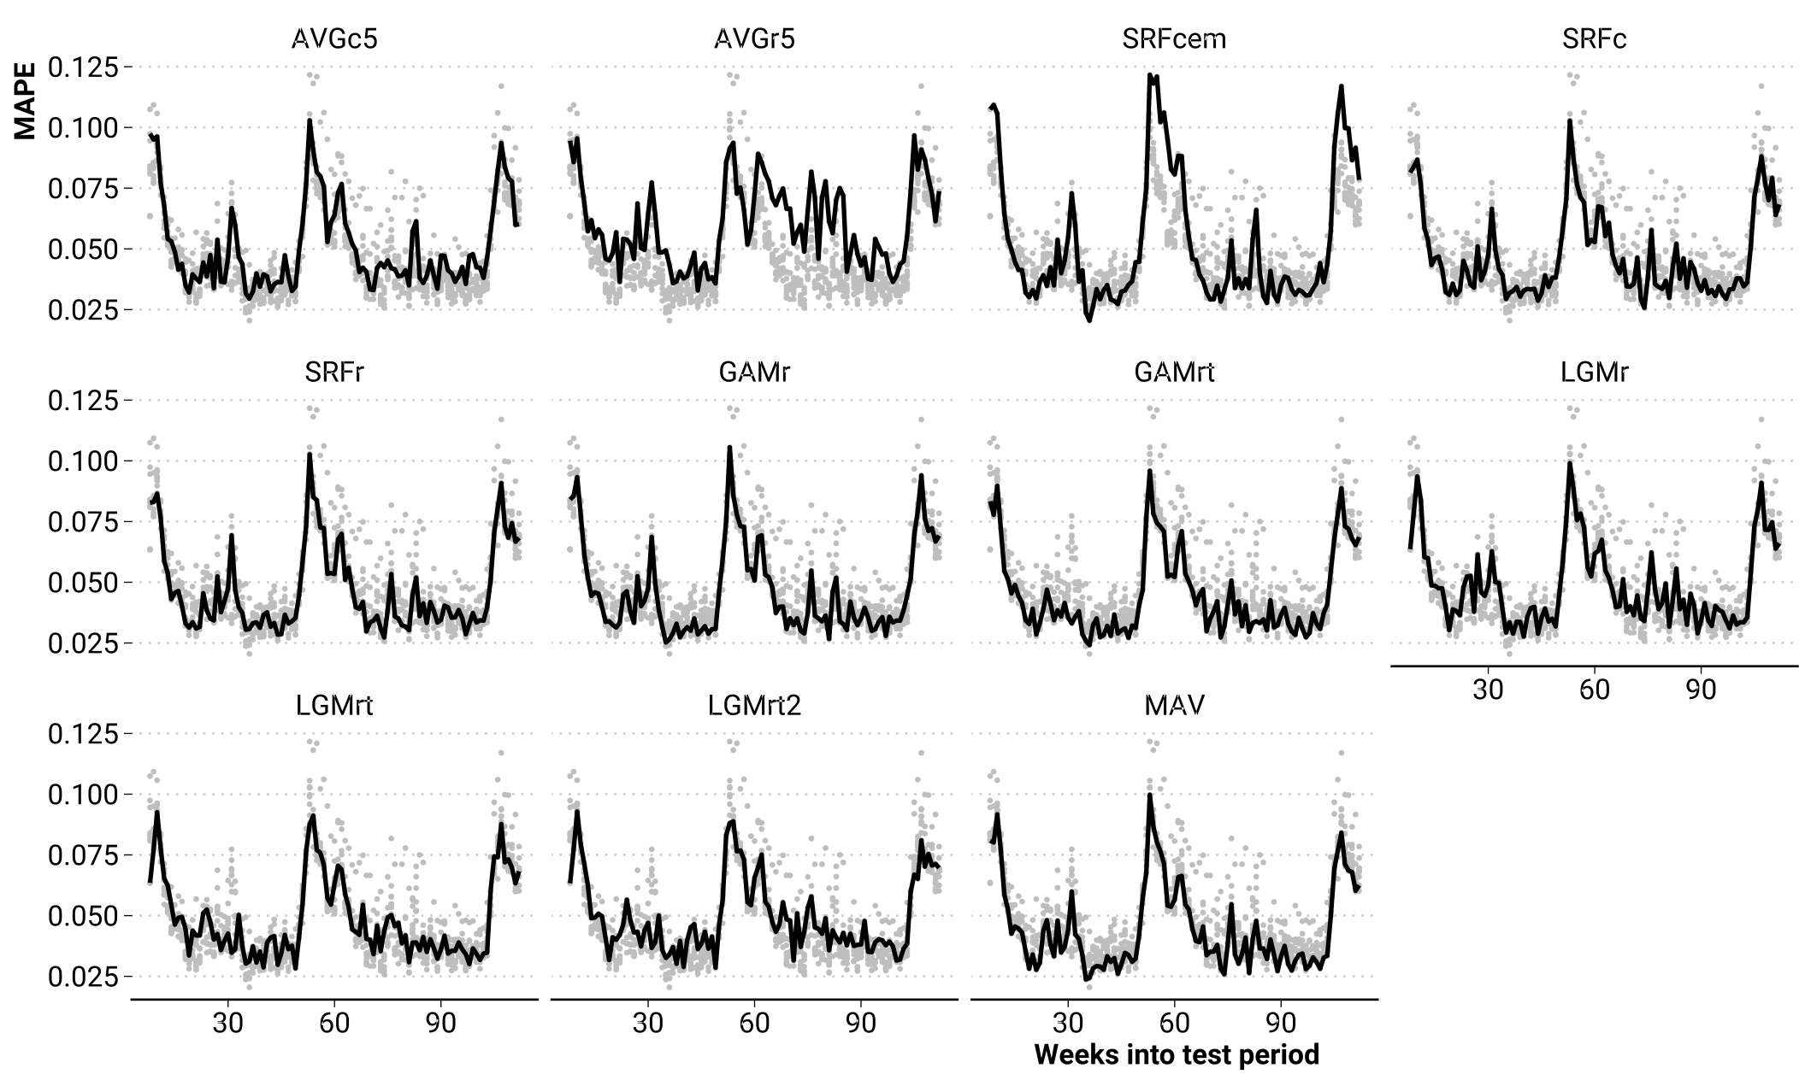
Cross validate – Error & Bias
Mean absolute percentage error of weekly death counts for different models.
Grey points show MAPE of all other models

Slide 51
Cross validate – Error & Bias
Mean absolute percentage error of weekly death counts for different models.
Grey points show MAPE of all other models

Slide 52
Cross validate – Error & Bias
Mean absolute percentage error of weekly death counts for different models.
Grey points show MAPE of all other models

Slide 53
Cross validate – Error & Bias
Mean absolute percentage error of weekly death counts for different models.
Grey points show MAPE of all other models

Slide 54
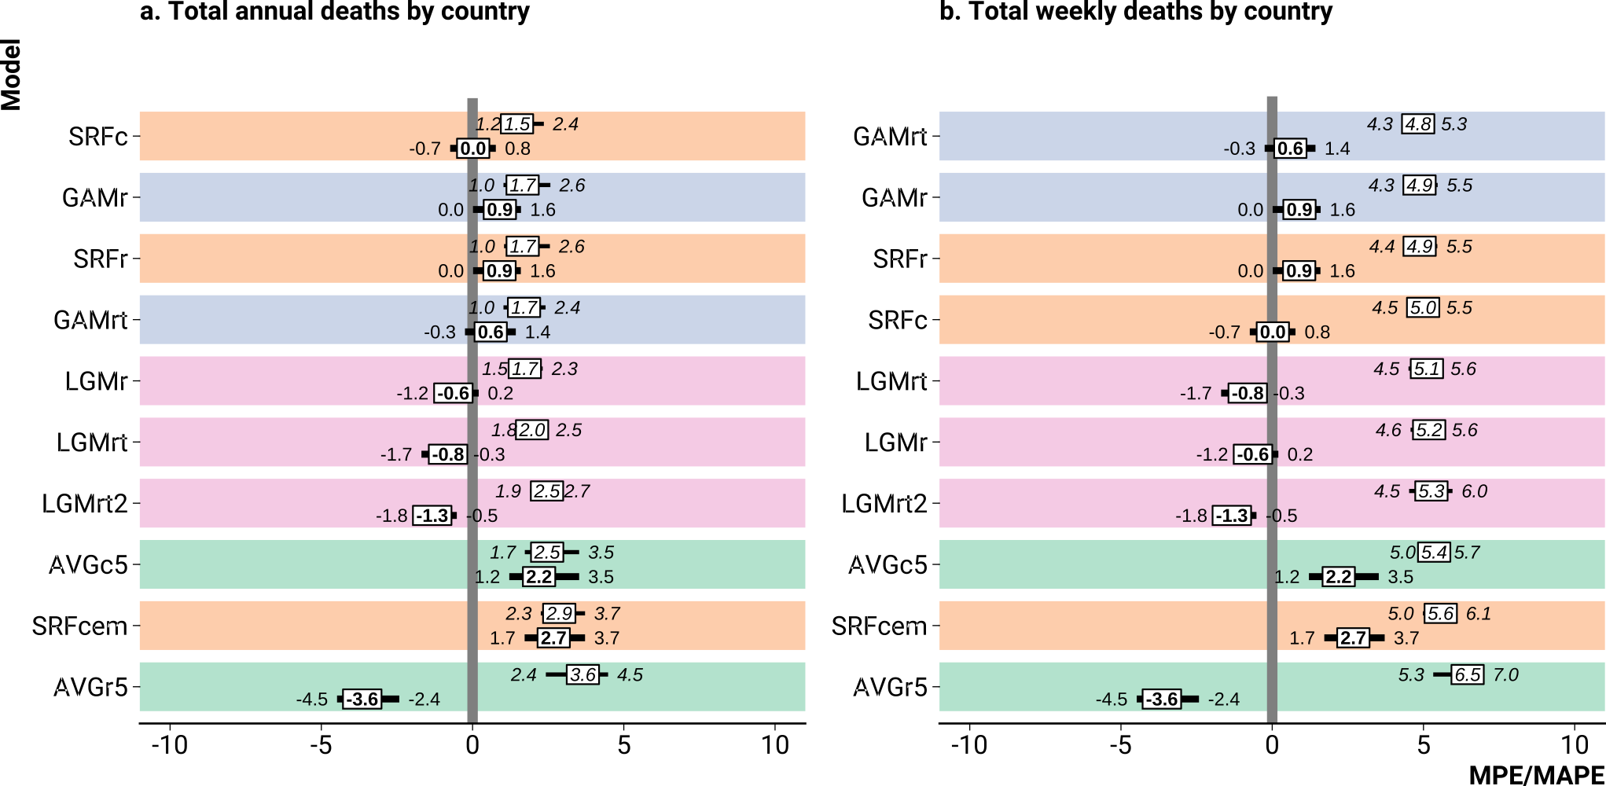
Cross validate – Error & Bias
Bias (MPE, bold) and error (MAPE, italic) by model when predicting death counts on test data.

Slide 55
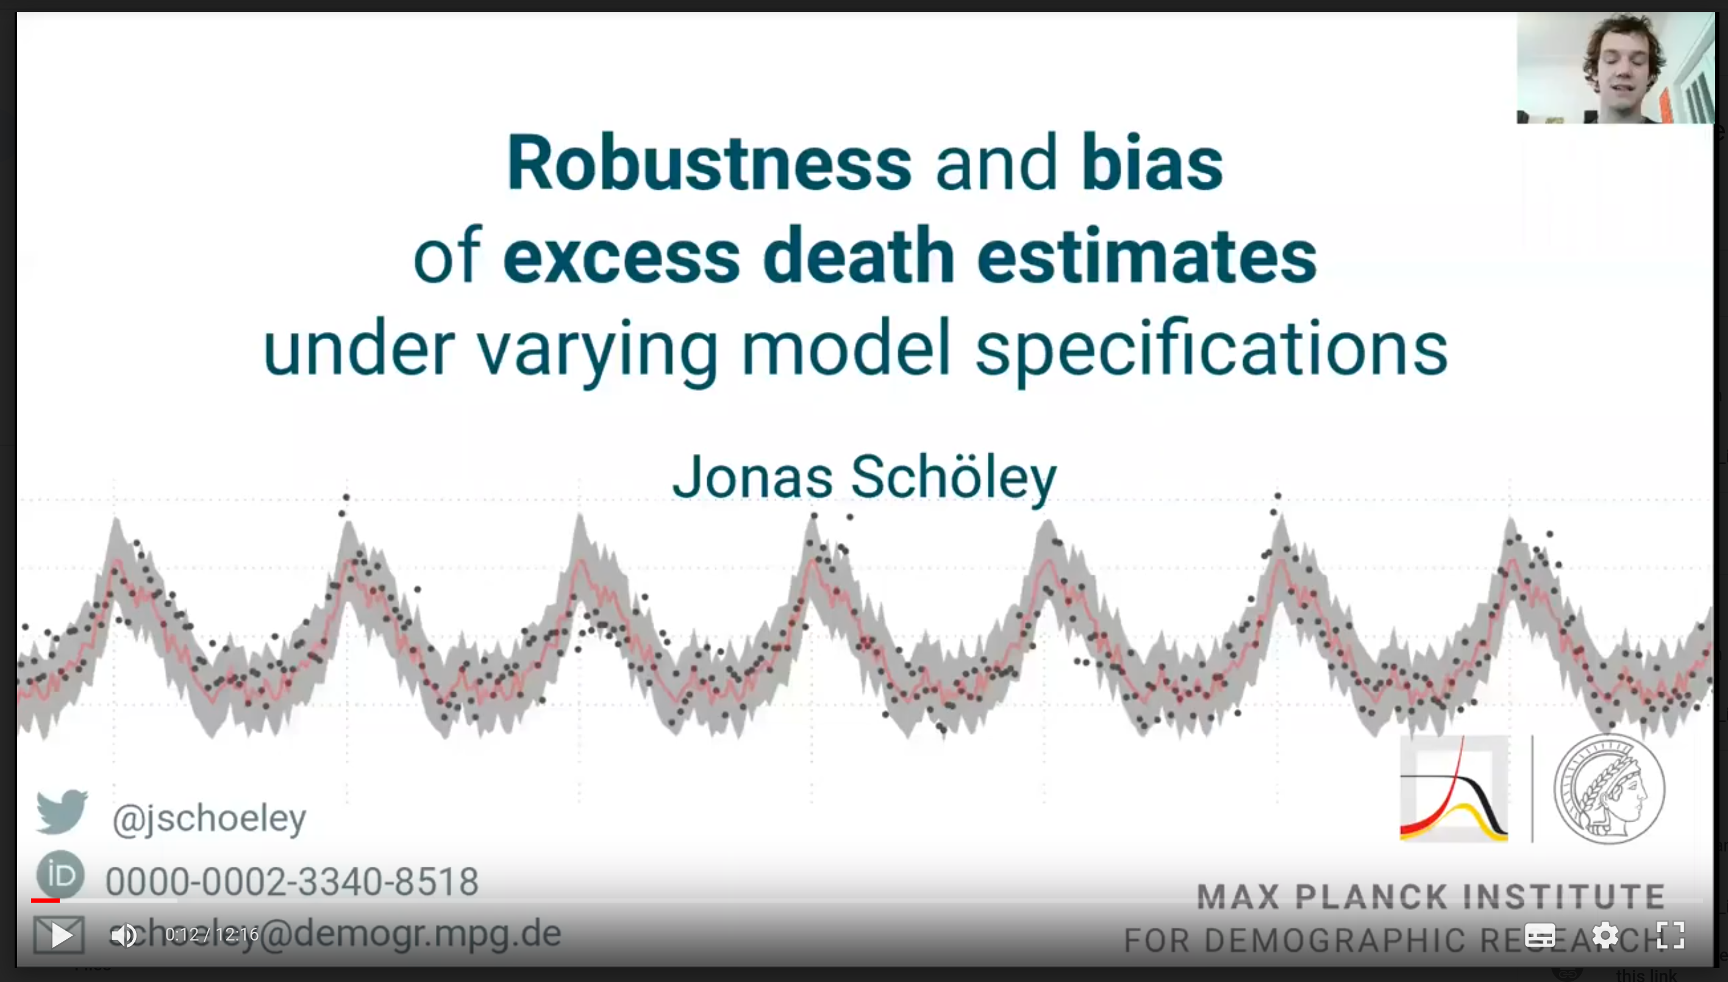
Cross validation – Error & Bias
Schöley (2021). Robustness and bias in excess death estimates. Link to video

Slide 56
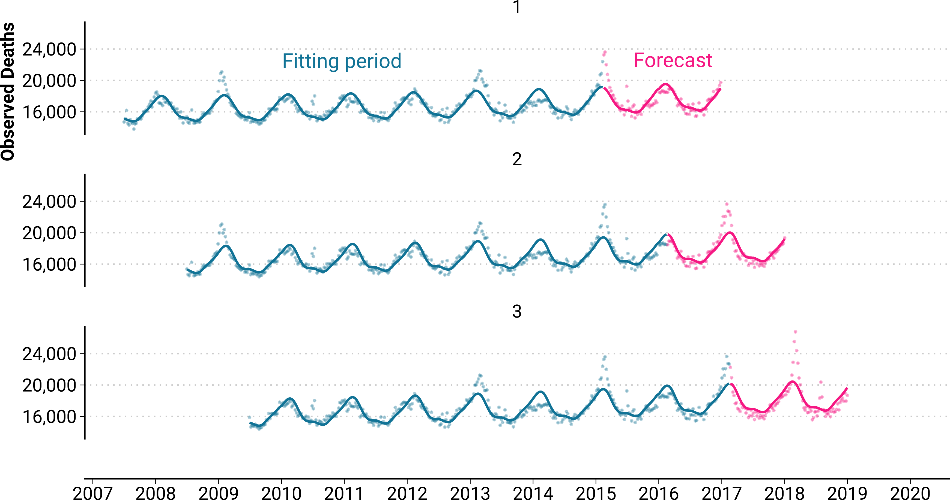
Cross validation – Calibration

Slide 57
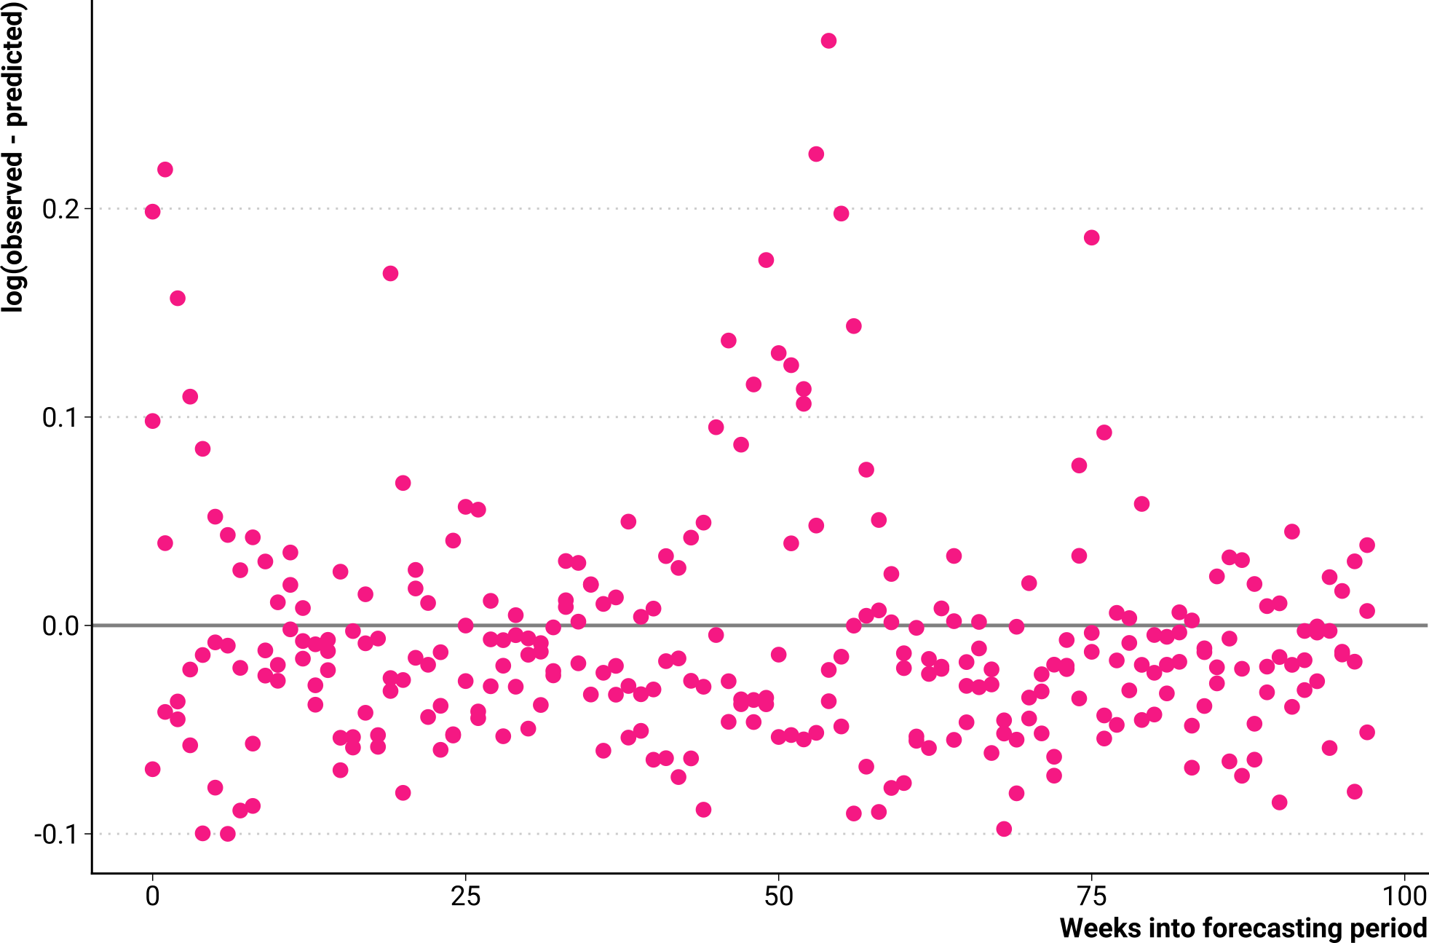
Cross validation – Calibration

Slide 58

Cross validation – Calibration
Prediction interval with
90% nominal coverage
via Negative-Bin.
GAM model

Slide 59
Cross validation – Calibration
Prediction interval with
90% nominal coverage
via Negative-Bin.
GAM model
Actual coverage ~87%

Slide 60

Cross validation – Calibration
Prediction interval with
90% nominal coverage
via Poisson GAM model
Actual coverage ~22%

Slide 61

Cross validation – Calibration
Schöley (2022). Empirical prediction intervals. Link to video

Slide 62
Reproducible analysis
github.com/jschoeley/phds22-predictive_modeling
Jonas Schöley
@jschoeley
0000-0002-3340-8518
schoeley@demogr.mpg.de

