Slide 1




Dynamic visualization
Jonas Schöley
@jschoeley.com
0000-0002-3340-8518
schoeley@demogr.mpg.de

Slide 2

Interactivity introducing shiny
shiny is:
1 A graphical user-interface for your R program
2 Your R program as a web-page
3 A web-application framework for R
Posit (2025). Shiny: easy web apps for data science. shiny.posit.co/.

Slide 3
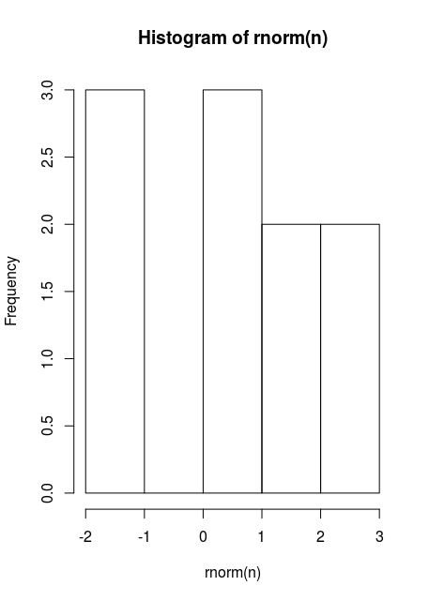
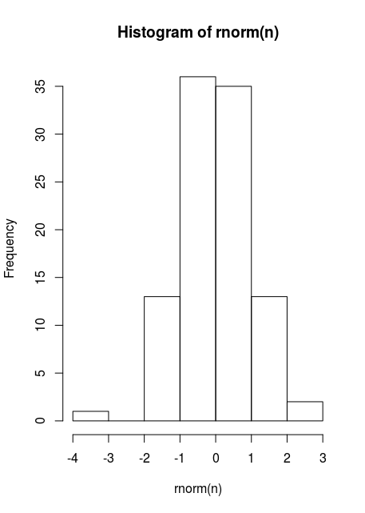
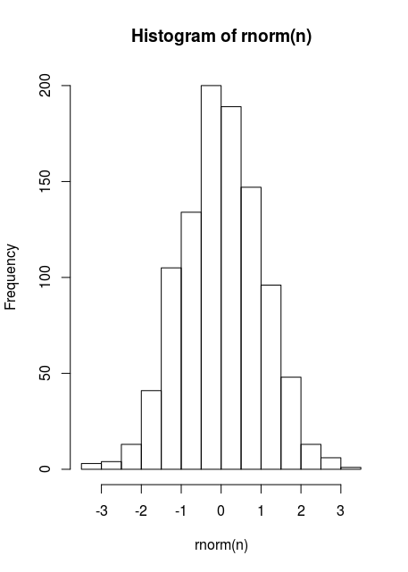
Interactivity introducing shiny
shiny is:
1 A graphical user-interface for your R program
n = 10
hist(rnorm(n))
n = 100
hist(rnorm(n))
n = 1000
hist(rnorm(n))

Slide 4
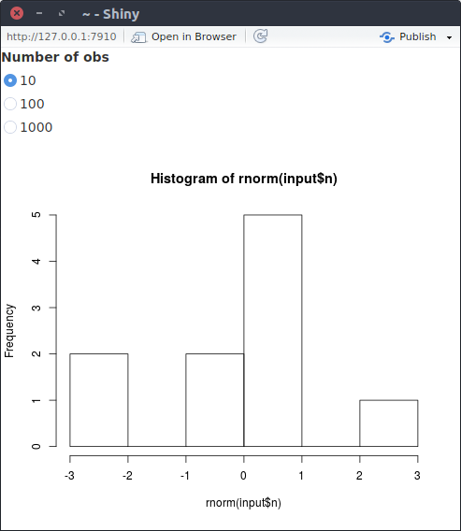
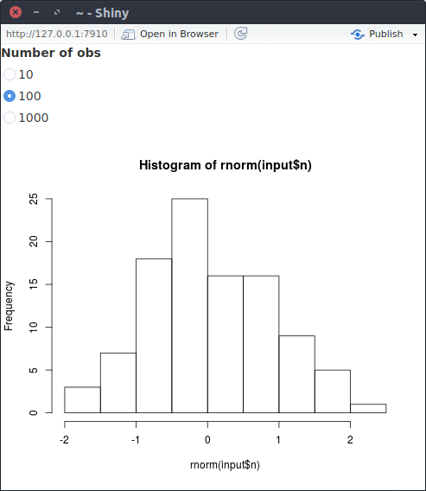
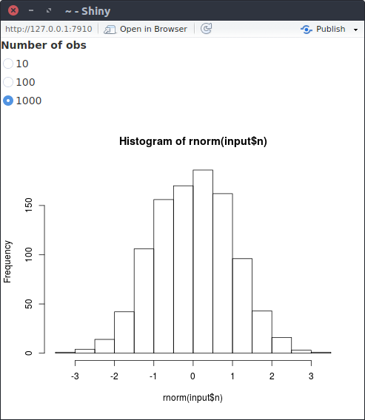
Interactivity introducing shiny
shiny is:
1 A graphical user-interface for your R program
library(shiny)
ui <- bootstrapPage(
radioButtons(inputId = "n", label = "Number of obs",
choices = list(10, 100, 1000)),
plotOutput(outputId = "plot")
)
server <- function(input, output) {output$plot <- renderPlot(hist(rnorm(input$n)))}
shinyApp(ui = ui, server = server)

Slide 5
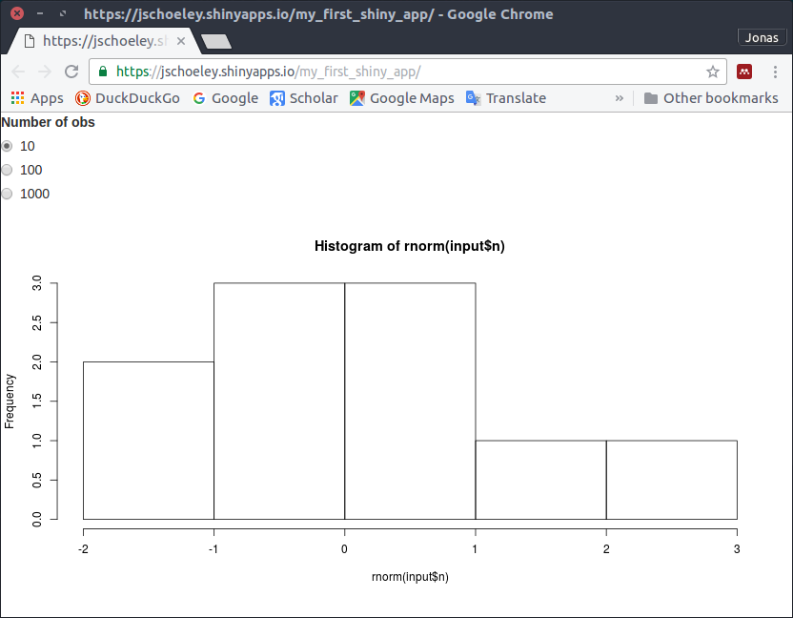
Interactivity introducing shiny
shiny is:
2 Your R program as a web-page

Slide 6
Interactivity introducing shiny
shiny is:
3 A web-application framework for R
sends user input
to server
Web browser
displaying
web-page
Web server
running
R+Shiny
sends UI updates
to user
listens for user input
performs R calculations
builds web-page
listens for updates from server
renders web-page

Slide 7
Interactivity introducing shiny
Building a shiny app means:
1 Building a user interface (UI)
2 Connecting R code with the UI

Slide 8
Interactivity introducing shiny
library(shiny)
ui <- bootstrapPage(
radioButtons(inputId = "n",
label = "Number of obs",
choices = list(10, 100, 1000)),
plotOutput(outputId = "plot")
)
server <- function(input, output) {
output$plot <- renderPlot(
hist(rnorm(input$n))
)
}
shinyApp(ui = ui, server = server)

Slide 9
Interactivity introducing shiny
1 Building a user interface (UI)
library(shiny)
ui <- bootstrapPage(
radioButtons(inputId = "n",
label = "Number of obs",
choices = list(10, 100, 1000)),
plotOutput(outputId = "plot")
)
server <- function(input, output) {
output$plot <- renderPlot(
hist(rnorm(input$n))
)
}
shinyApp(ui = ui, server = server)

Slide 10
Interactivity introducing shiny
library(shiny)
ui <- bootstrapPage(
radioButtons(inputId = "n",
label = "Number of obs",
choices = list(10, 100, 1000)),
plotOutput(outputId = "plot")
)
server <- function(input, output) {
output$plot <- renderPlot(
hist(rnorm(input$n))
)
}
shinyApp(ui = ui, server = server)
Create an empty web-page
learn about more sophisticated layouts at
shiny.posit.co/r/articles/build/layout-guide/

Slide 11
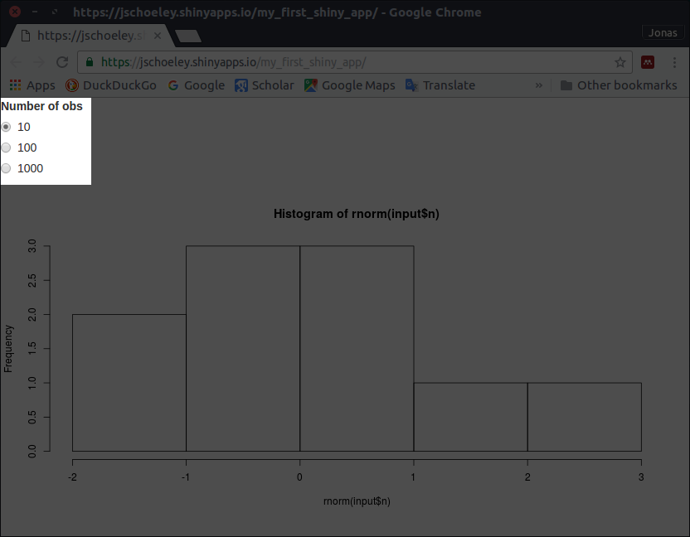
Interactivity introducing shiny
library(shiny)
ui <- bootstrapPage(
radioButtons(inputId = "n",
label = "Number of obs",
choices = list(10, 100, 1000)),
plotOutput(outputId = "plot")
)
server <- function(input, output) {
output$plot <- renderPlot(
hist(rnorm(input$n))
)
}
shinyApp(ui = ui, server = server)
Define input UI elements
Learn more about different input elements
shiny.posit.co/r/components/

Slide 12
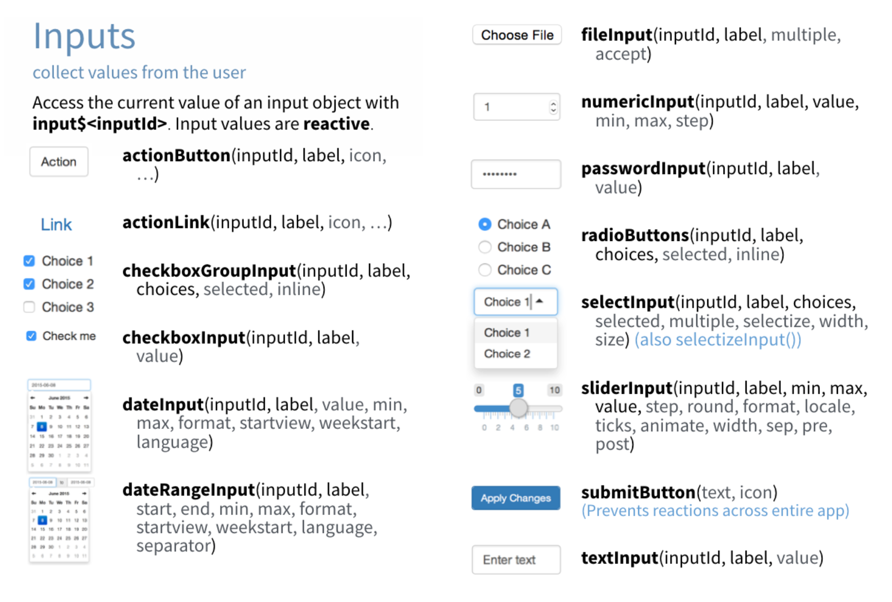
Interactivity introducing shiny
library(shiny)
ui <- bootstrapPage(
radioButtons(inputId = "n",
label = "Number of obs",
choices = list(10, 100, 1000)),
plotOutput(outputId = "plot")
)
server <- function(input, output) {
output$plot <- renderPlot(
hist(rnorm(input$n))
)
}
shinyApp(ui = ui, server = server)
Define input UI elements
Learn more about different input elements
shiny.posit.co/r/components/

Slide 13
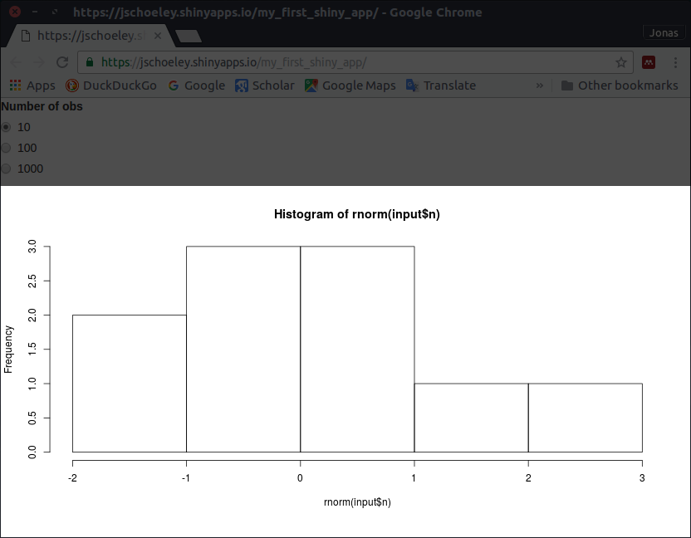
Interactivity introducing shiny
library(shiny)
ui <- bootstrapPage(
radioButtons(inputId = "n",
label = "Number of obs",
choices = list(10, 100, 1000)),
plotOutput(outputId = "plot")
)
server <- function(input, output) {
output$plot <- renderPlot(
hist(rnorm(input$n))
)
}
shinyApp(ui = ui, server = server)
Define output UI elements
Learn more about different output elements
shiny.posit.co/r/components/

Slide 14
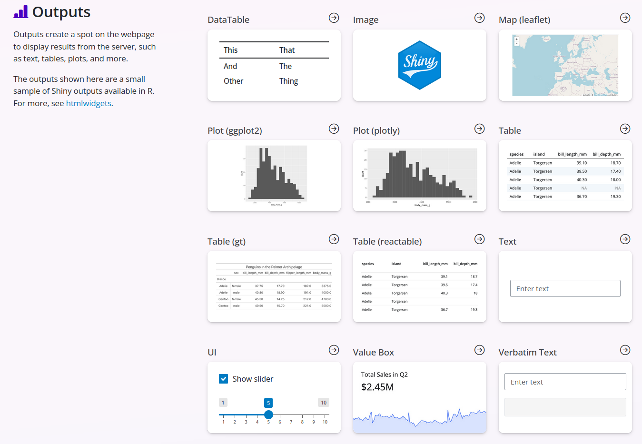
Interactivity introducing shiny
library(shiny)
ui <- bootstrapPage(
radioButtons(inputId = "n",
label = "Number of obs",
choices = list(10, 100, 1000)),
plotOutput(outputId = "plot")
)
server <- function(input, output) {
output$plot <- renderPlot(
hist(rnorm(input$n))
)
}
shinyApp(ui = ui, server = server)
Define output UI elements
Learn more about different output elements
shiny.posit.co/r/components/

Slide 15
Interactivity introducing shiny
library(shiny)
ui <- bootstrapPage(
radioButtons(inputId = "n",
label = "Number of obs",
choices = list(10, 100, 1000)),
plotOutput(outputId = "plot")
)
server <- function(input, output) {
output$plot <- renderPlot(
hist(rnorm(input$n))
)
}
shinyApp(ui = ui, server = server)
Don’t forget the comma
the UI specification is one large nested function
call with different UI elements as parameters

Slide 16
Interactivity introducing shiny
library(shiny)
ui <- bootstrapPage(
radioButtons(inputId = "n",
label = "Number of obs",
choices = list(10, 100, 1000)),
plotOutput(outputId = "plot")
)
server <- function(input, output) {
output$plot <- renderPlot(
hist(rnorm(input$n))
)
}
shinyApp(ui = ui, server = server)
2 Connecting R code with the UI

Slide 17
Interactivity introducing shiny
R communicates with the UI using 2 lists
the input list contains the values of all input
elements of the UI, the output list contains
the objects which R sends to the UI
library(shiny)
ui <- bootstrapPage(
radioButtons(inputId = "n",
label = "Number of obs",
choices = list(10, 100, 1000)),
plotOutput(outputId = "plot")
)
server <- function(input, output) {
output$plot <- renderPlot(
hist(rnorm(input$n))
)
}
shinyApp(ui = ui, server = server)
2 Connecting R code with the UI

Slide 18
Interactivity introducing shiny
R communicates with the UI using 2 lists
the input list contains the values of all input
elements of the UI, the output list contains
the objects which R sends to the UI
library(shiny)
ui <- bootstrapPage(
radioButtons(inputId = "n",
label = "Number of obs",
choices = list(10, 100, 1000)),
plotOutput(outputId = "plot")
)
server <- function(input, output) {
output$plot <- renderPlot(
hist(rnorm(input$n))
)
}
shinyApp(ui = ui, server = server)

Slide 19
Interactivity introducing shiny
R communicates with the UI using 2 lists
the input list contains the values of all input
elements of the UI, the output list contains
the objects which R sends to the UI
library(shiny)
ui <- bootstrapPage(
radioButtons(inputId = "n",
label = "Number of obs",
choices = list(10, 100, 1000)),
plotOutput(outputId = "plot")
)
server <- function(input, output) {
output$plot <- renderPlot(
hist(rnorm(input$n))
)
}
shinyApp(ui = ui, server = server)

Slide 20
Interactivity introducing shiny
library(shiny)
ui <- bootstrapPage(
radioButtons(inputId = "n",
label = "Number of obs",
choices = list(10, 100, 1000)),
plotOutput(outputId = "plot")
)
server <- function(input, output) {
output$plot <- renderPlot(
hist(rnorm(input$n))
)
}
shinyApp(ui = ui, server = server)
The “actual” R code
R calculates new output once new input arrives

Slide 21
Interactivity introducing shiny
library(shiny)
ui <- bootstrapPage(
radioButtons(inputId = "n",
label = "Number of obs",
choices = list(10, 100, 1000)),
plotOutput(outputId = "plot")
)
server <- function(input, output) {
output$plot <- renderPlot(
hist(rnorm(input$n))
)
}
shinyApp(ui = ui, server = server)
Static R code
R code which is only run once per shiny session
goes outside the ui or server functions.

Slide 22
Interactivity introducing shiny
library(shiny)
ui <- bootstrapPage(
radioButtons(inputId = "n",
label = "Number of obs",
choices = list(10, 100, 1000)),
plotOutput(outputId = "plot")
)
server <- function(input, output) {
output$plot <- renderPlot(
hist(rnorm(input$n))
)
}
shinyApp(ui = ui, server = server)

Slide 23
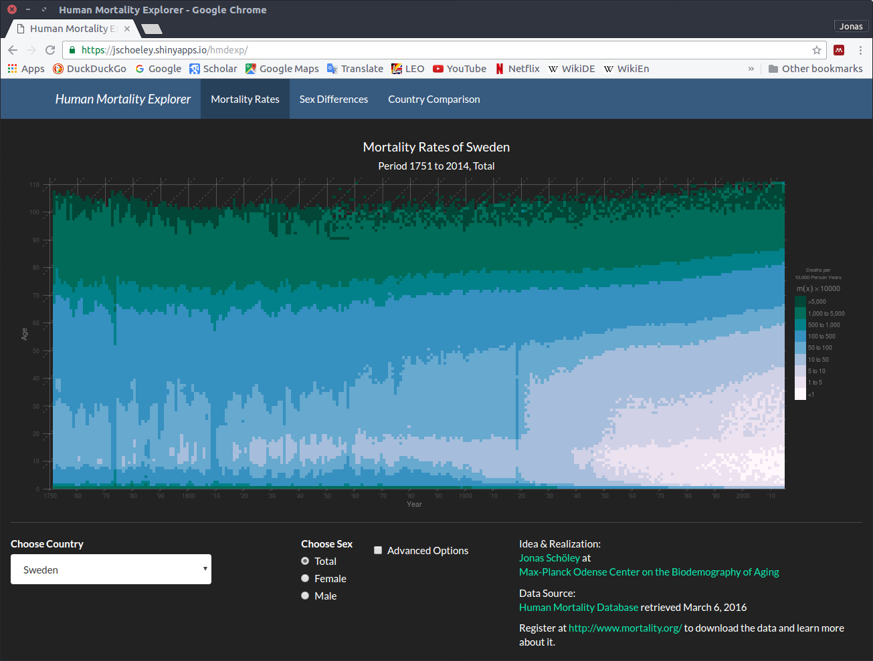
Interactivity introducing shiny
Example hmdexplorer.
Schöley (2016). The human mortality database explorer. jschoeley.shinyapps.io/hmdexp/.

Slide 24
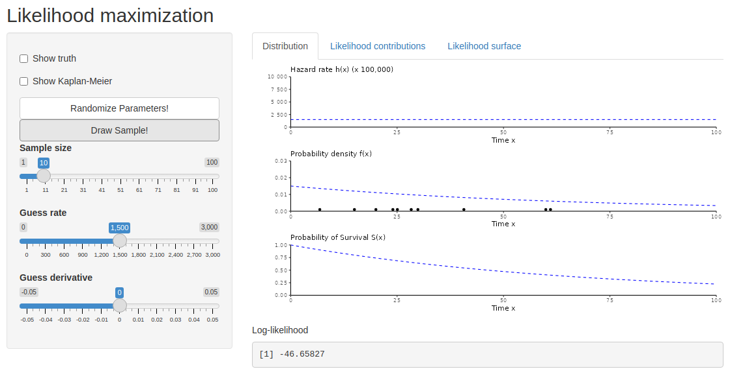
Interactivity introducing shiny
Example likelihoodguessr.

Slide 25
Interactivity introducing shiny
Example likelihoodguessr.

Slide 26
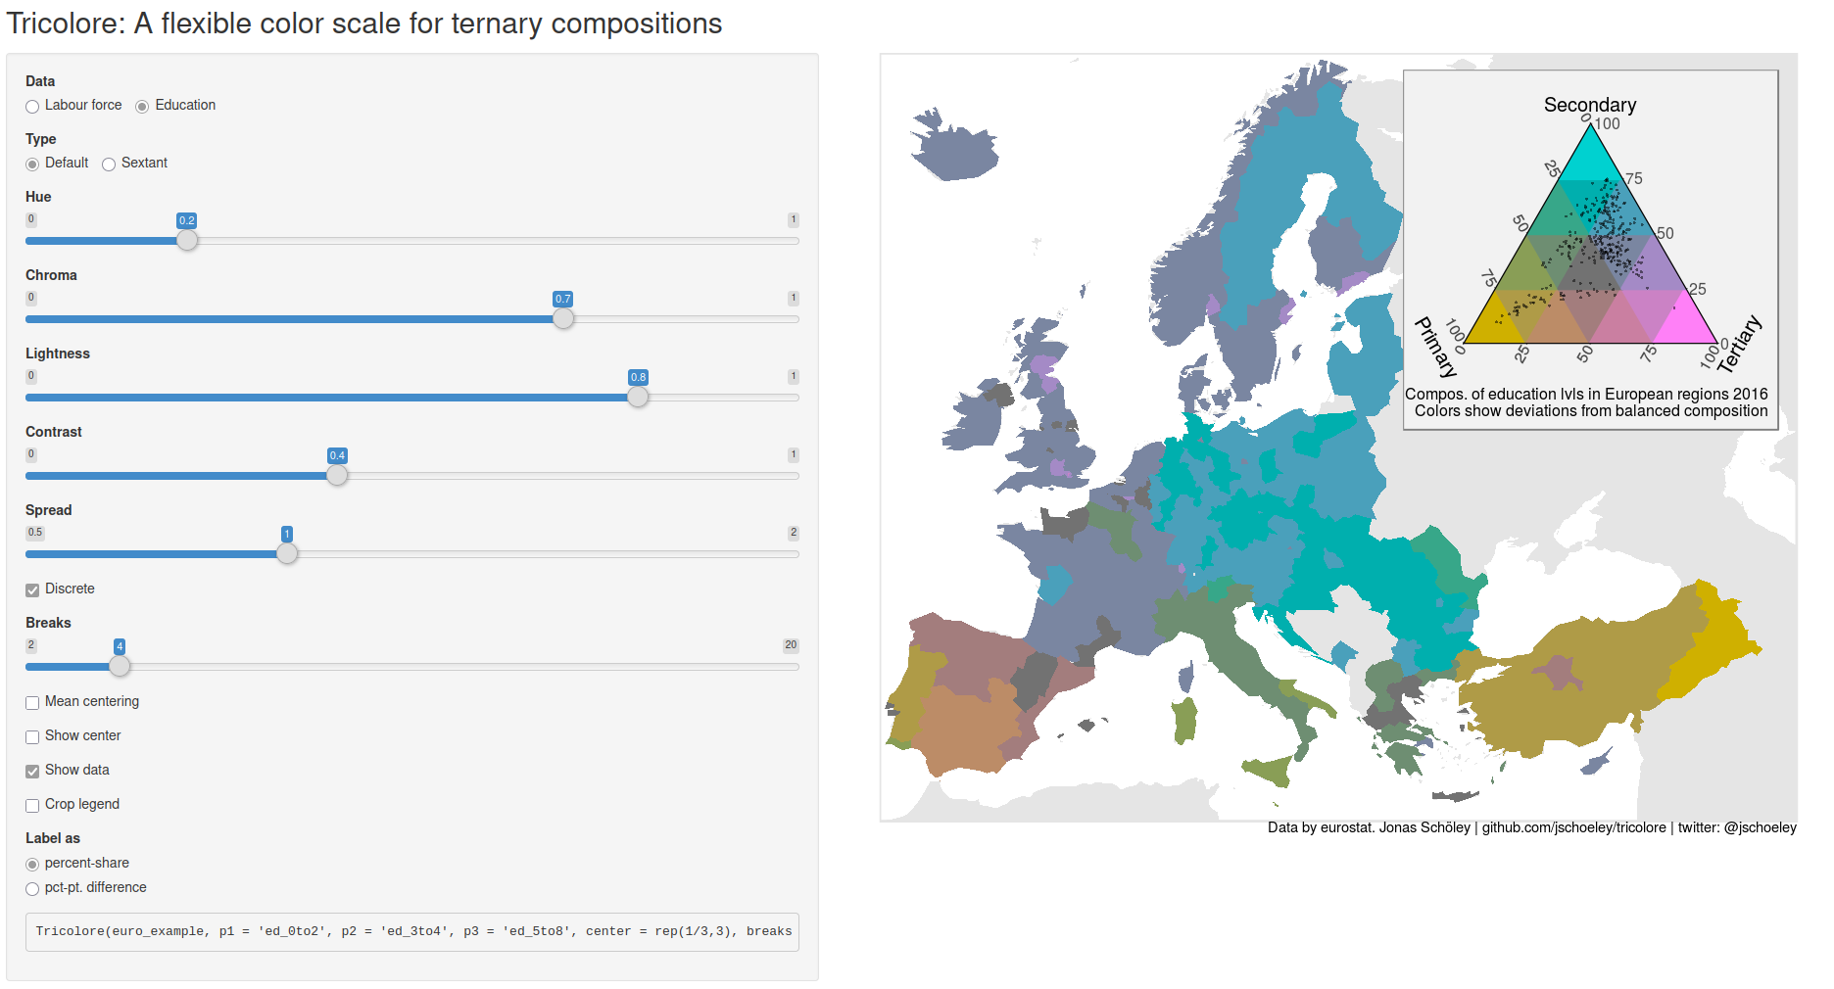
Interactivity introducing shiny
Schöley (2018). tricolore. jschoeley.shinyapps.io/tricolore/.

Slide 27
Reproducible analysis
github.com/jschoeley
Jonas Schöley
jschoeley.com
@jschoeley.com
0000-0002-3340-8518
schoeley@demogr.mpg.de

