Slide 1


Mapping Uncertainty via Multidimensional Color Scales
Jonas Schöley
schoeley@demogr.mpg.de
The Interdisciplinary Centre on Population Dynamics
University of Southern Denmark

Slide 2
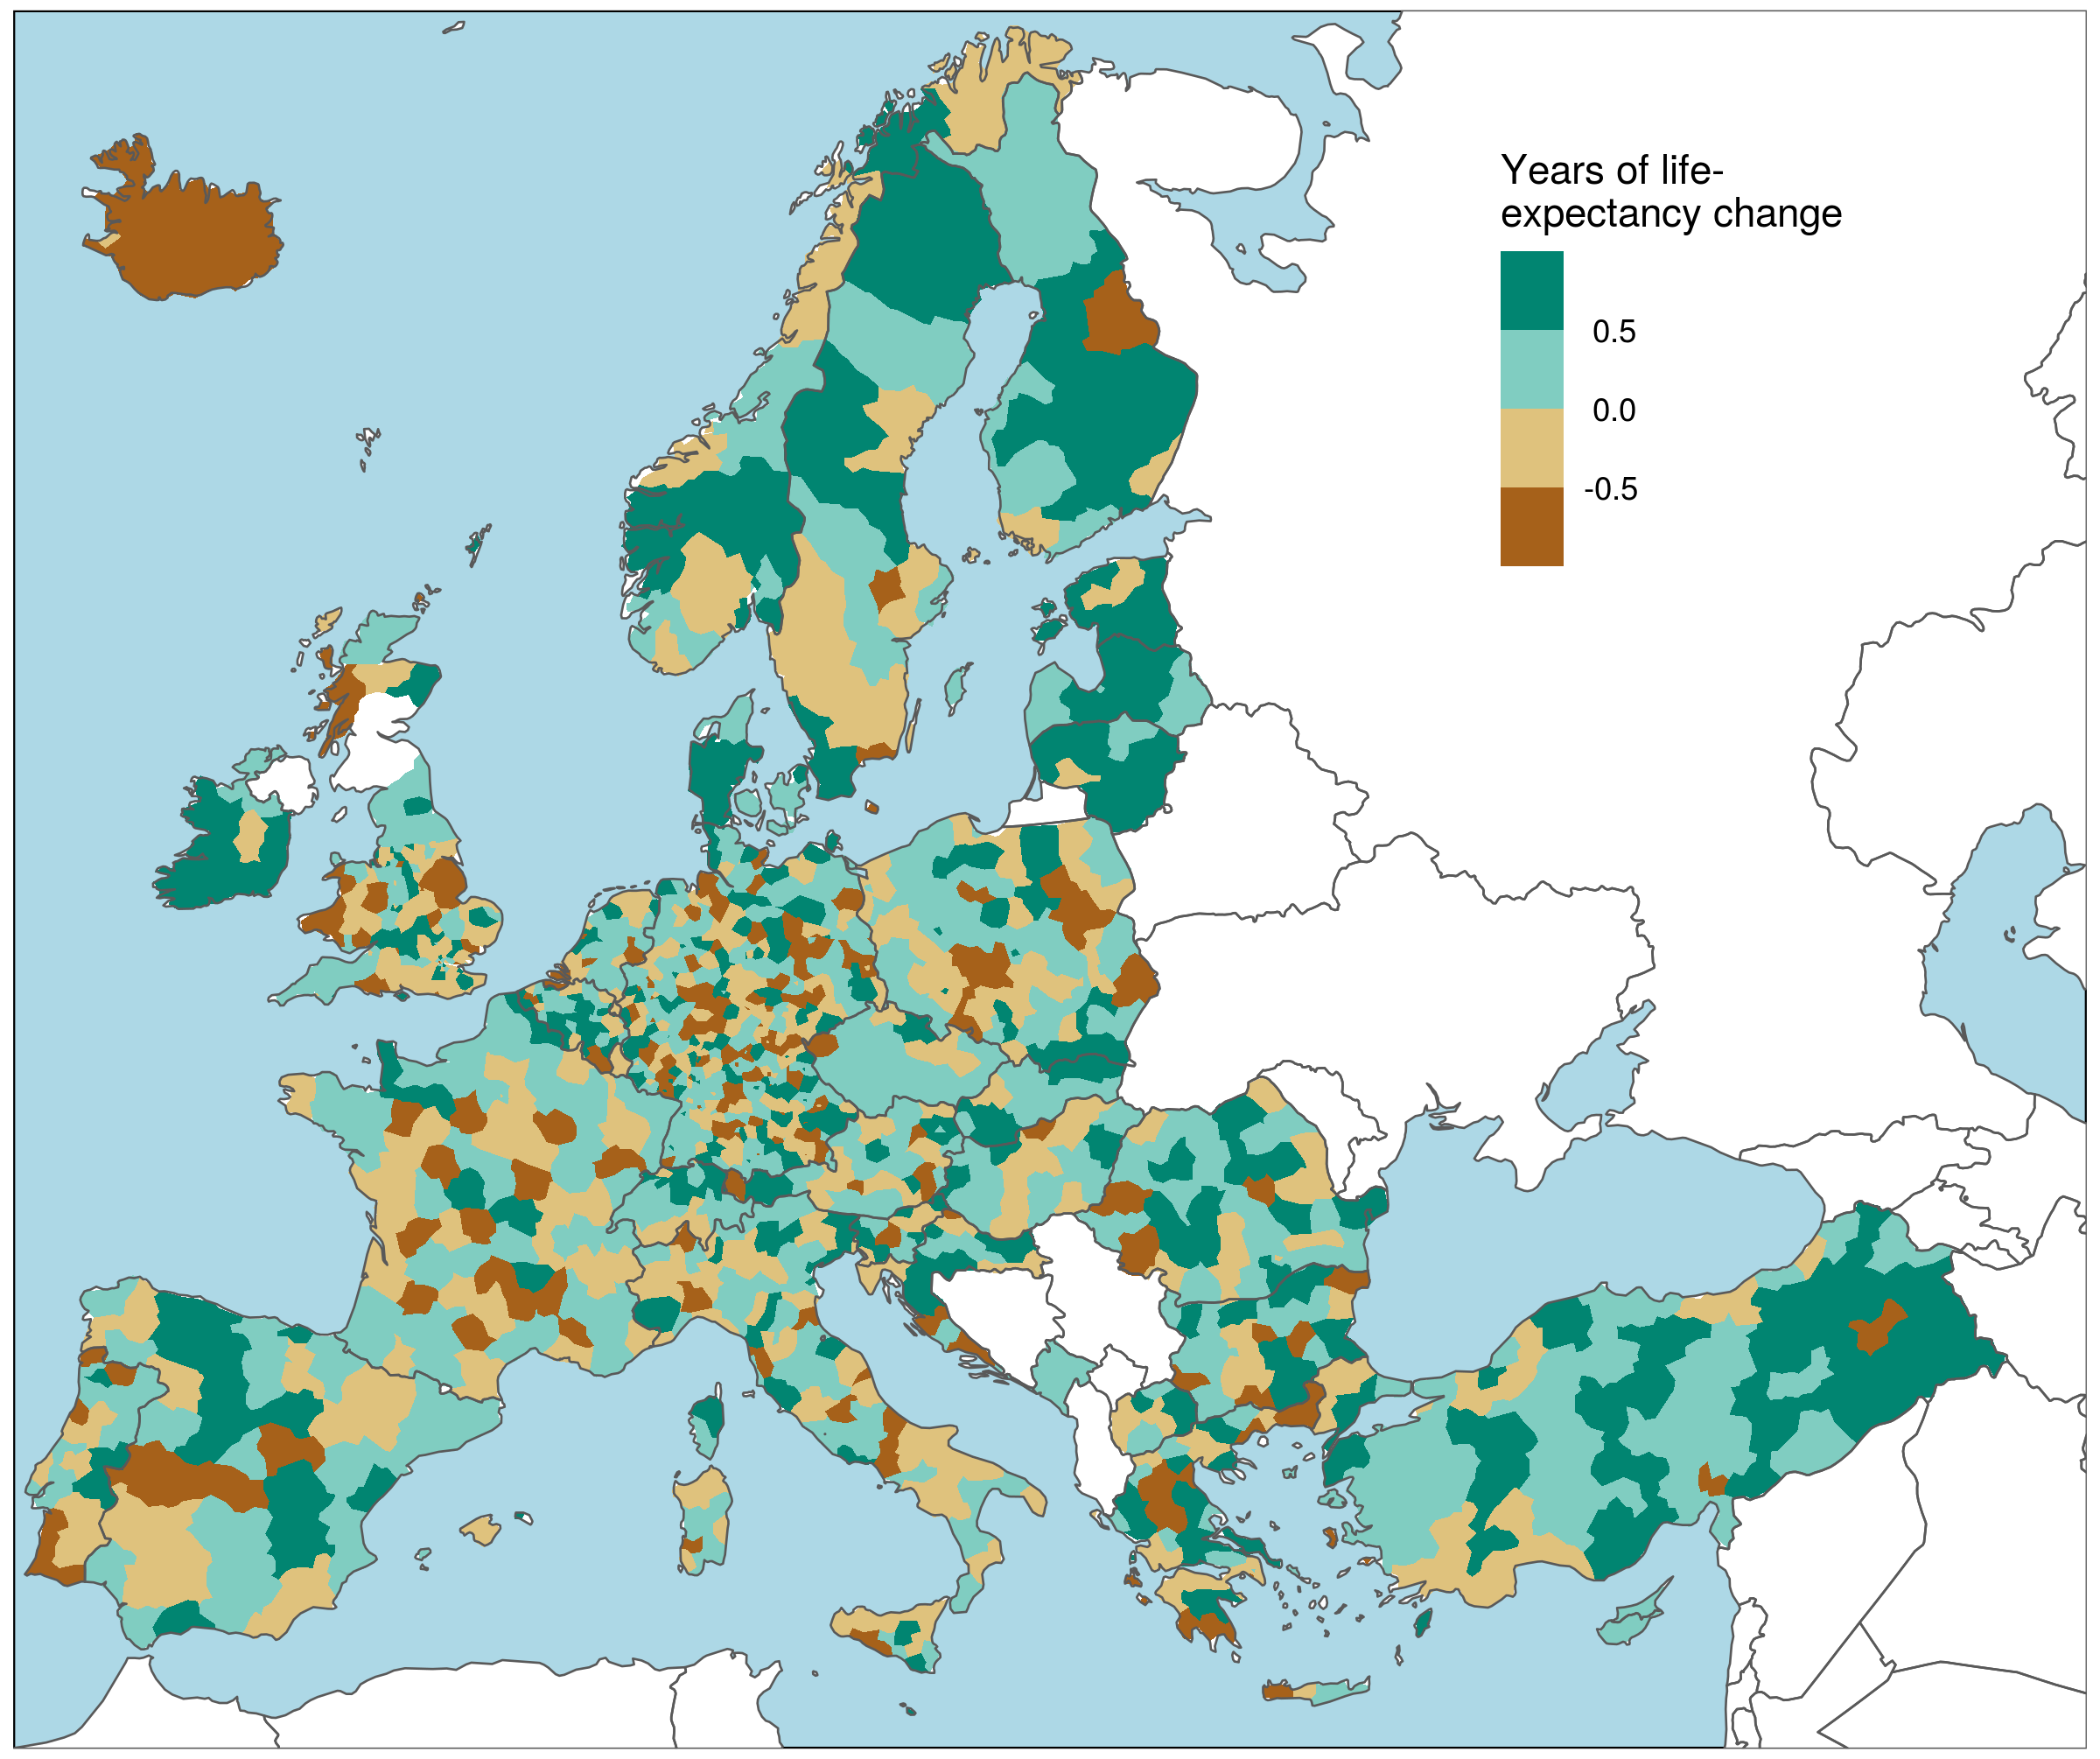
Change in life-expectancy from 2014 to 2017 across European NUTS-3 regions
Schöley (2021). github.com/jschoeley/rore2021-mapping_uncertainty

Slide 3
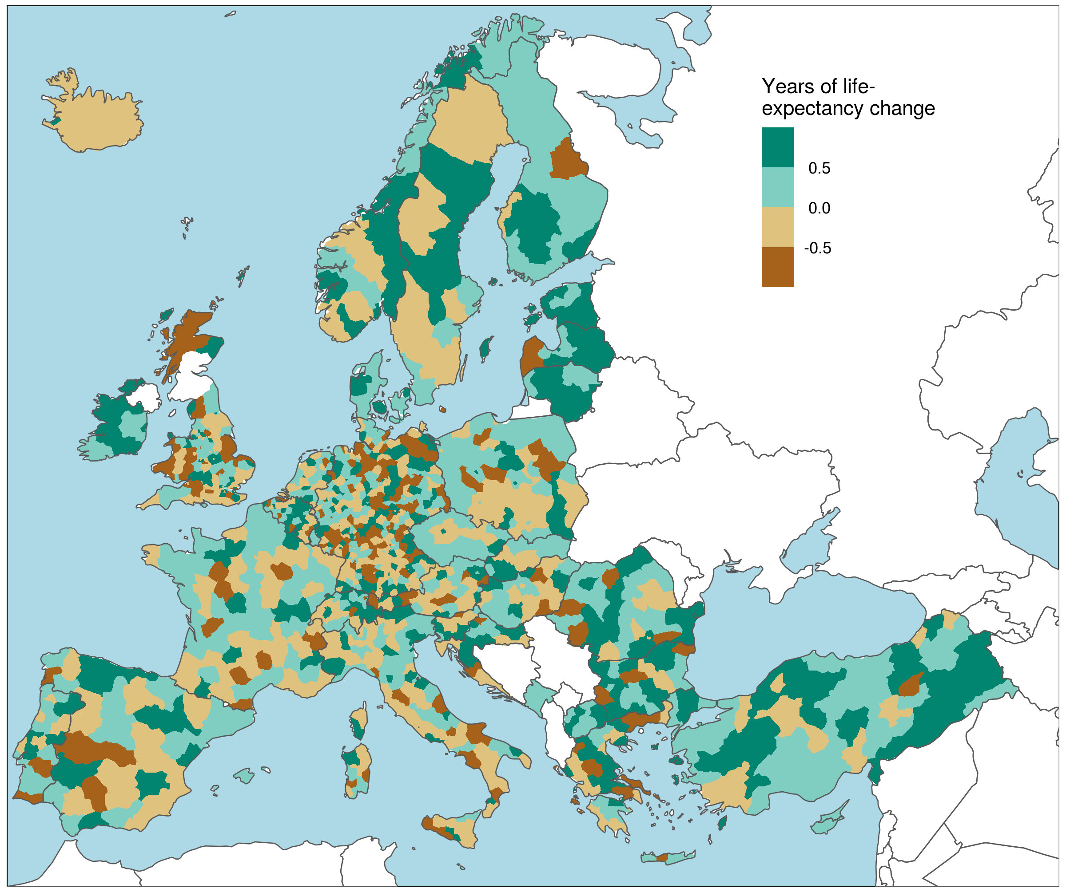
Change in life-expectancy from 2014 to 2017 across European NUTS-3 regions alternative outcome
Schöley (2021). github.com/jschoeley/rore2021-mapping_uncertainty

Slide 4
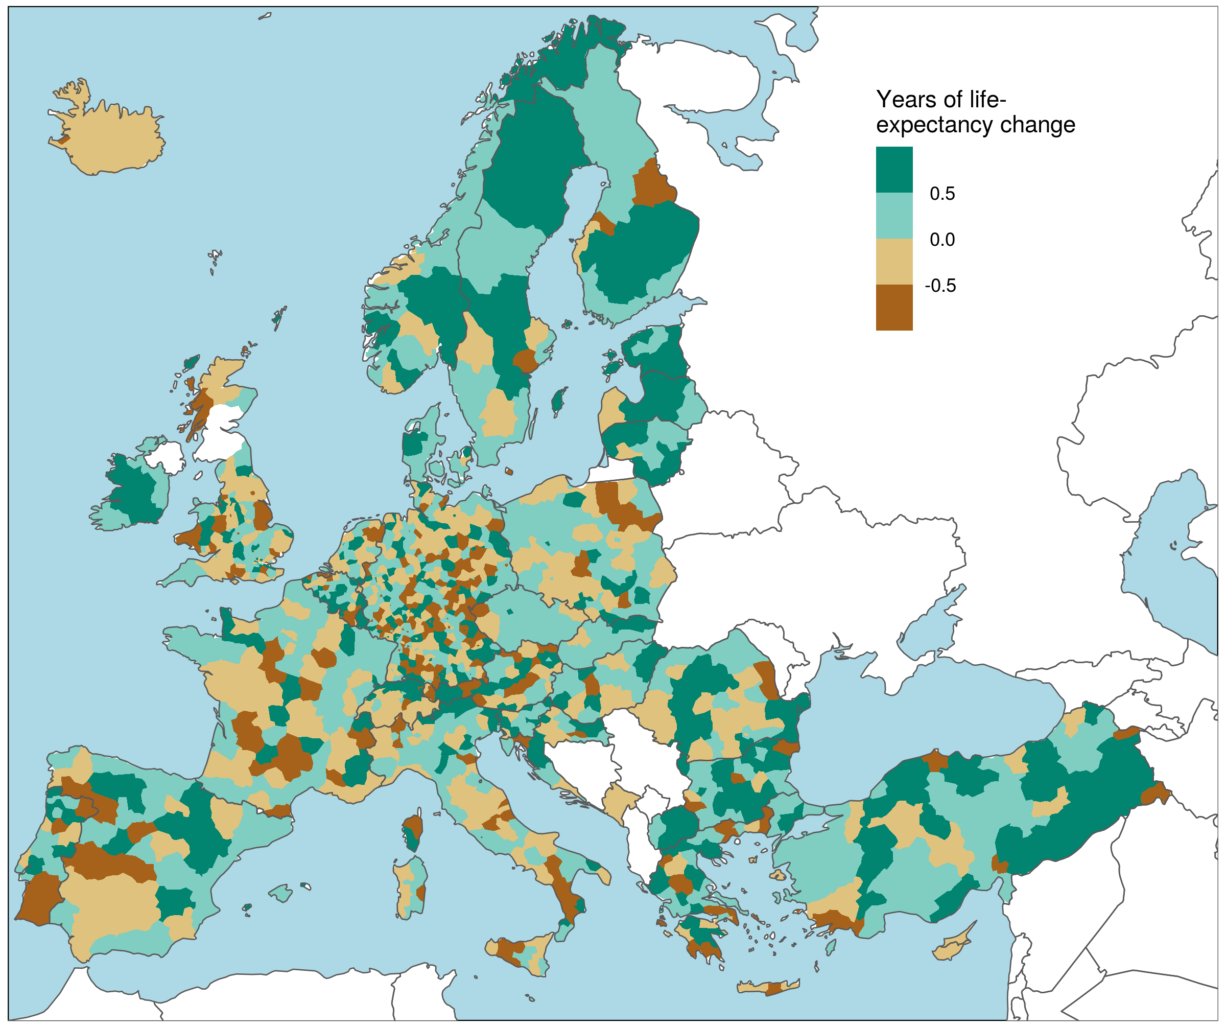
Change in life-expectancy from 2014 to 2017 across European NUTS-3 regions alternative outcome
Schöley (2021). github.com/jschoeley/rore2021-mapping_uncertainty

Slide 5
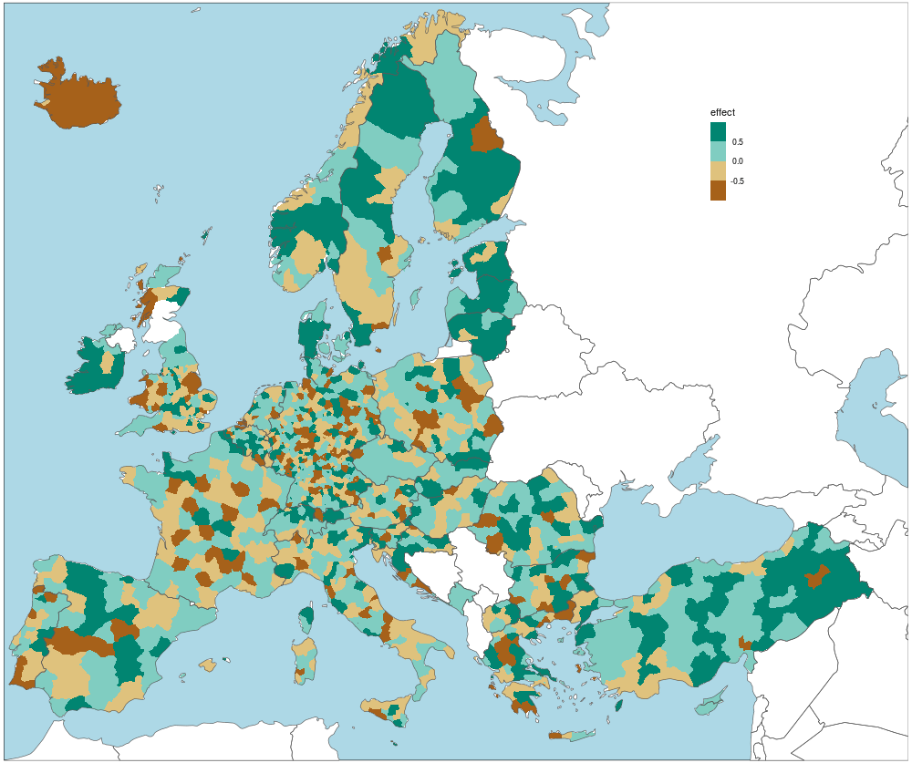
Change in life-expectancy from 2014 to 2017 across European NUTS-3 regions
alternative outcomes
under Poisson
sampling
Schöley (2021). github.com/jschoeley/rore2021-mapping_uncertainty

Slide 6
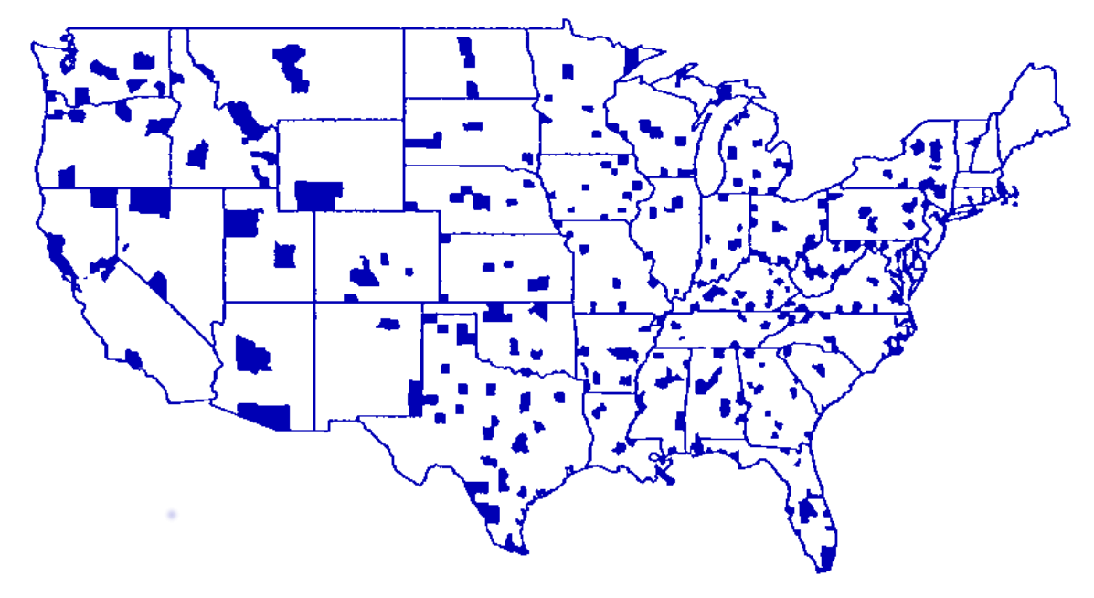
TRUE
Counties with disease incidence above 90% quantile
Gelman and Prince (1999). All maps of parameter estimates are misleading.

Slide 7
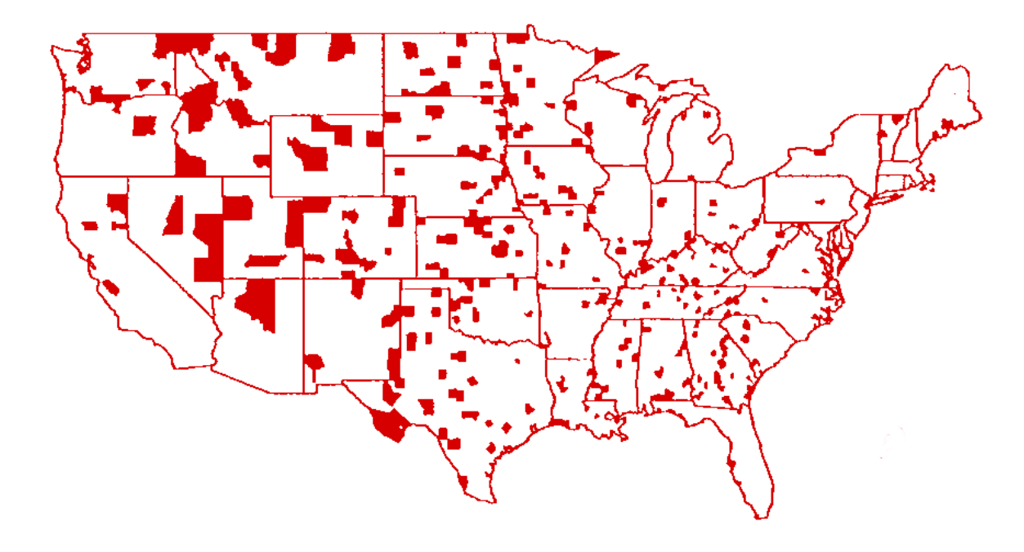
OBSERVED
TRUE
Counties with disease incidence above 90% quantile
Gelman and Prince (1999). All maps of parameter estimates are misleading.

Slide 8
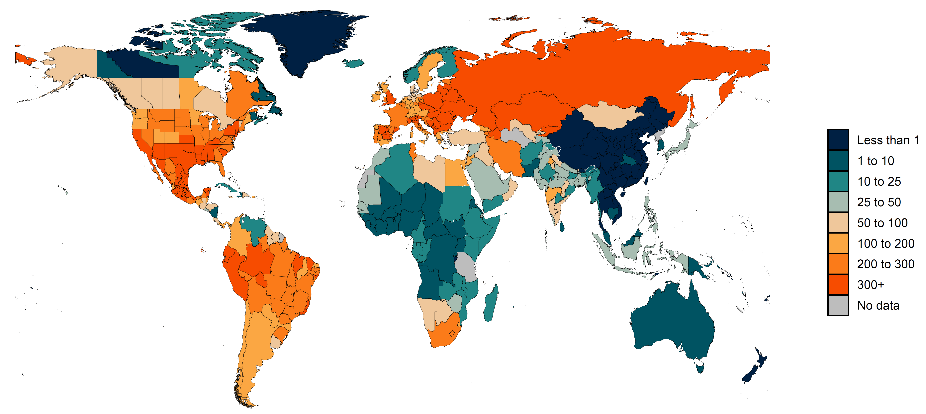
Cumulative total COVID-19 death rate by May 13, 2021
IHME (2021). Estimation of total mortality due to COVID-19.

Slide 9
What To Do?

Slide 10
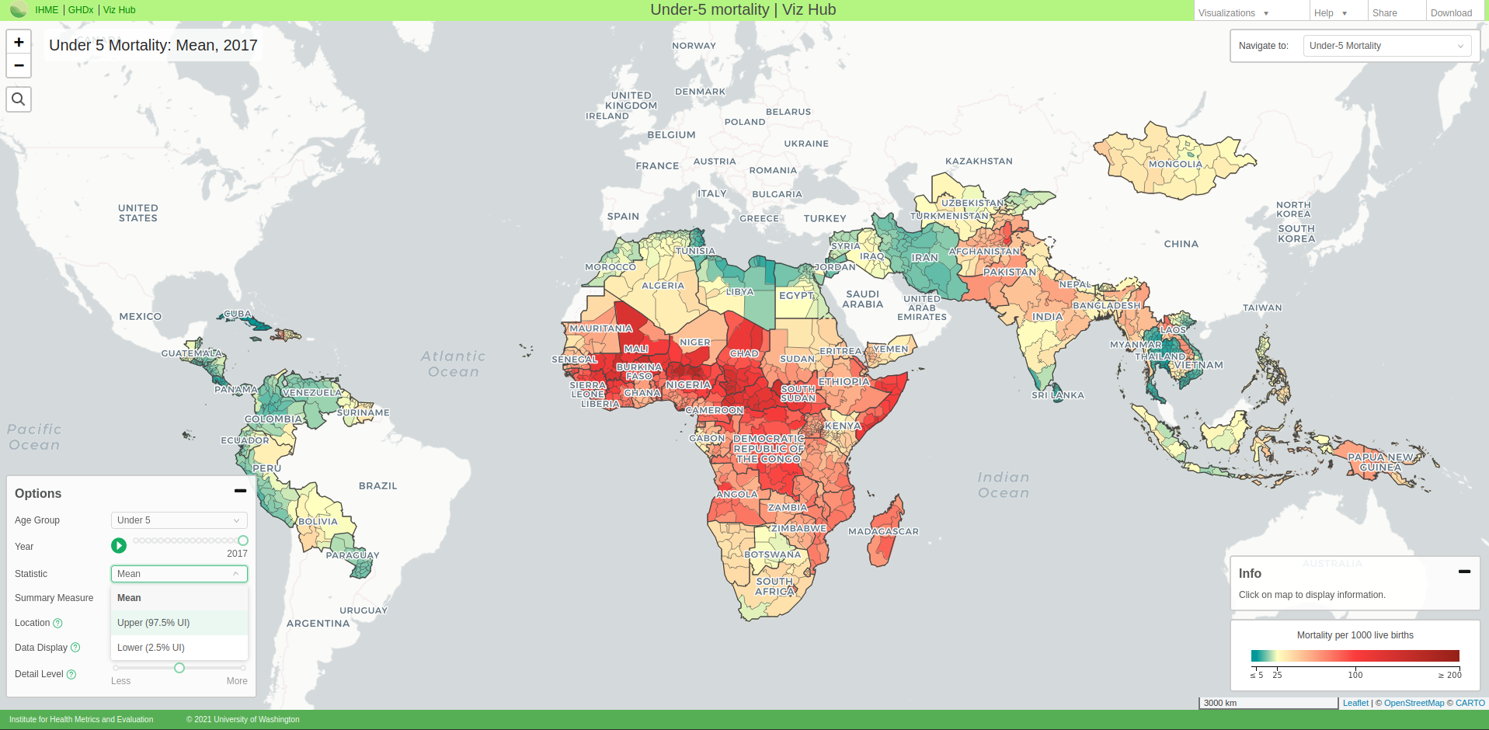
Interactivity Reveal uncertainty on demand
IHME (2021). Viz Hub. vizhub.healthdata.org/lbd/under5#

Slide 11
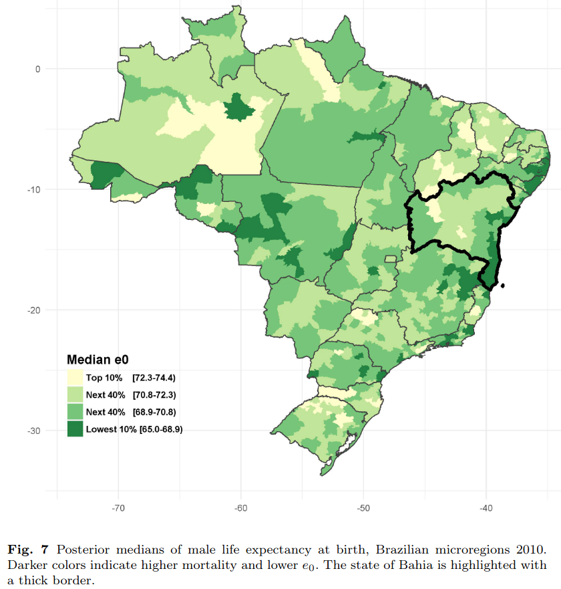
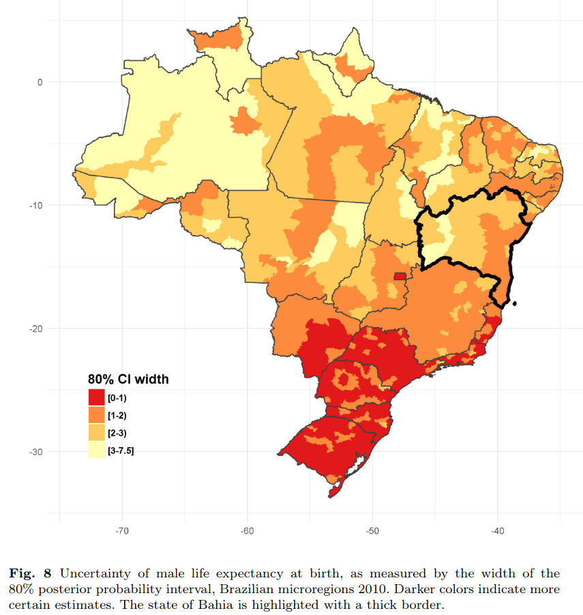
Juxtaposition Show uncertainty next to estimates
Schmertmann and Gonzaga (2018). Bayesian estimation of age-specific mortality and life expectancy...

Slide 12
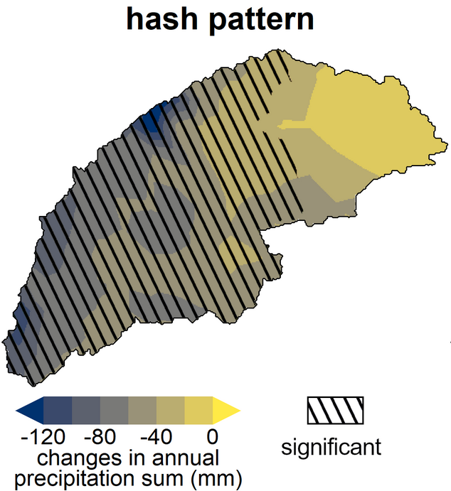
Layering Add a graphical uncertainty layer
Joris Eekhout (2019). Visualizing Uncertainty in Maps.
joriseekhout.com/blog/visualizing-uncertainty-in-maps

Slide 13
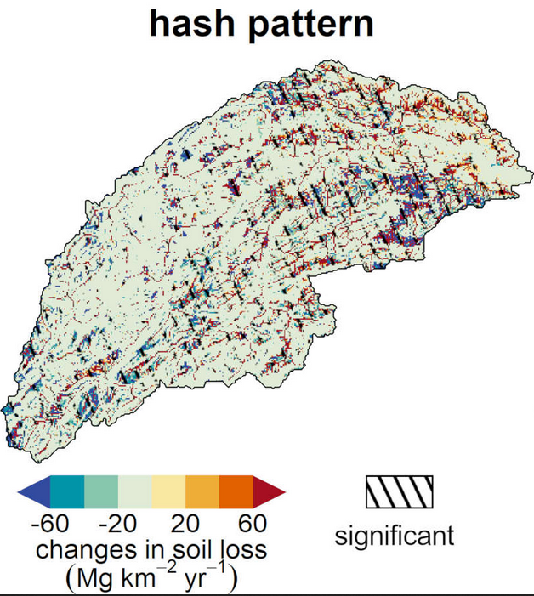
Layering Add a graphical uncertainty layer
Joris Eekhout (2019). Visualizing Uncertainty in Maps.
joriseekhout.com/blog/visualizing-uncertainty-in-maps

Slide 14
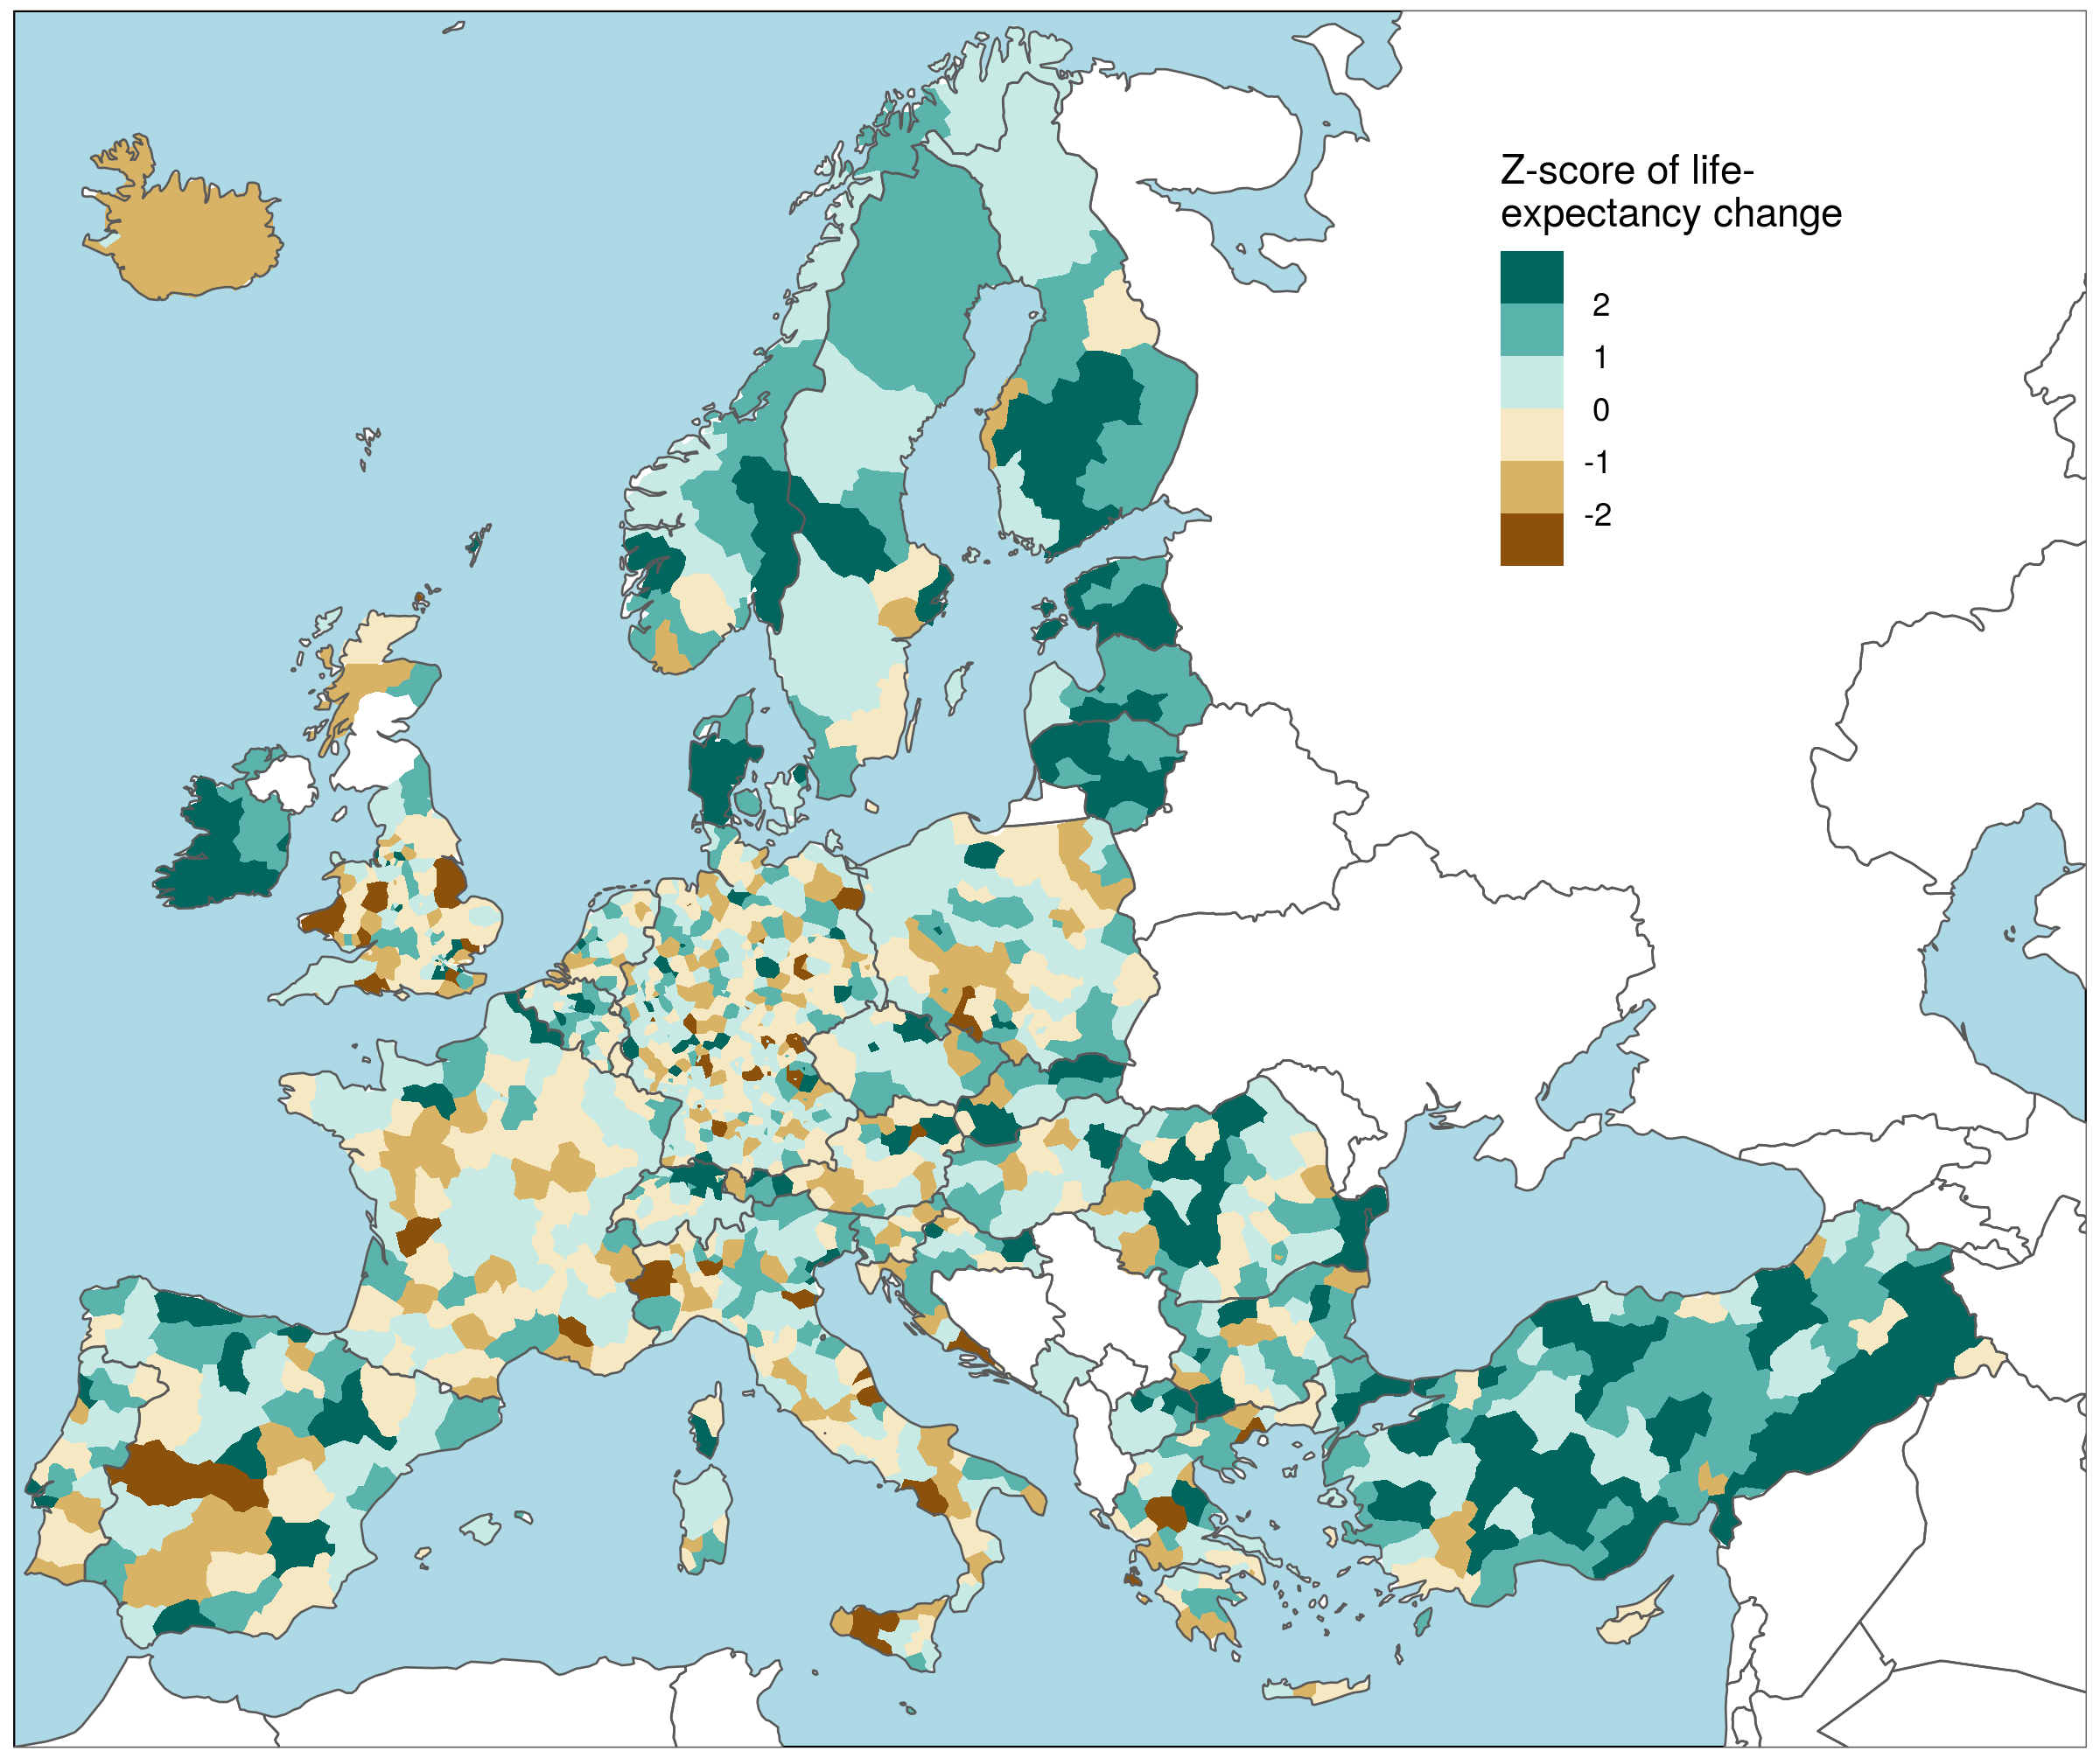
Summarizing Plot a joint indicator of uncertainty and effect size
Change in life-expectancy Z-scores from 2014 to 2017 across European NUTS-3 regions
Schöley (2021). github.com/jschoeley/rore2021-mapping_uncertainty

Slide 15
Animate alternative outcomes
Change in life-expectancy from 2014 to 2017 across European NUTS-3 regions under repeated Poisson sampling of age-specific death counts.
Schöley (2021). github.com/jschoeley/rore2021-mapping_uncertainty

Slide 16
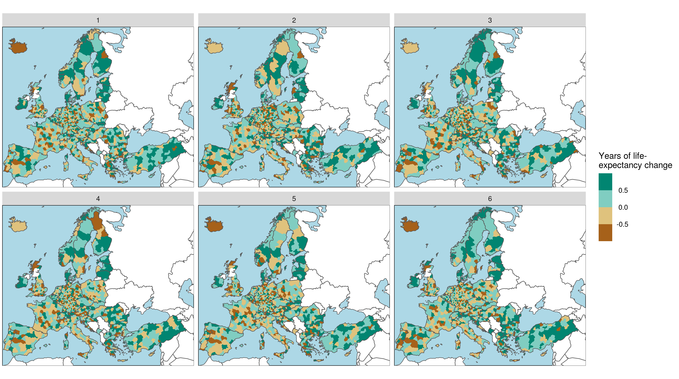
Facet alternative outcomes
Change in life-expectancy from 2014 to 2017 across European NUTS-3 regions under repeated Poisson sampling of age-specific death counts.
Schöley (2021). github.com/jschoeley/rore2021-mapping_uncertainty

Slide 17
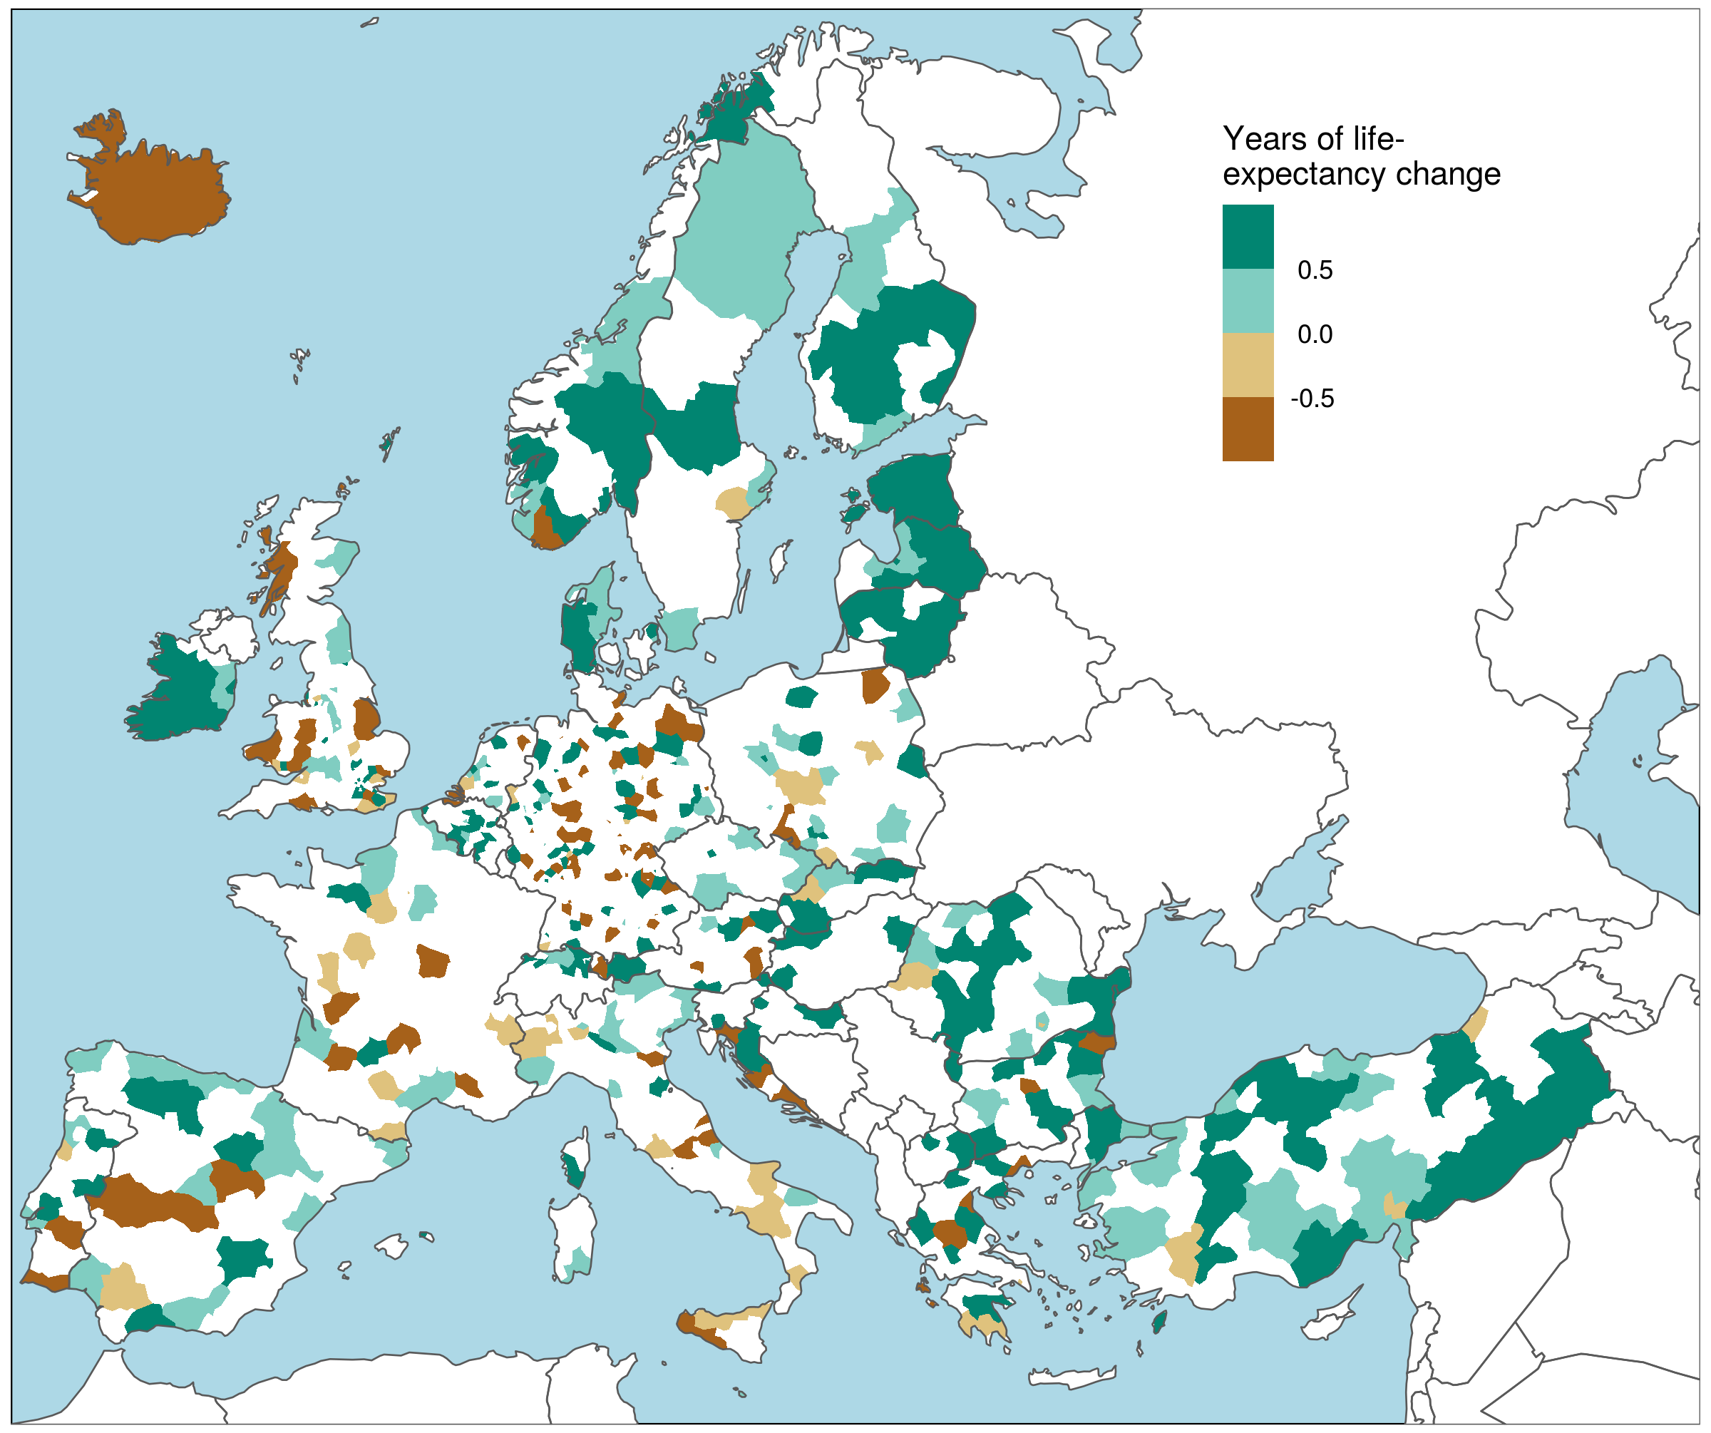
Cut-off uncertain estimates
Change in life-expectancy from 2014 to 2017 across European NUTS-3 regions where direction of change is >90% certain.
Schöley (2021). github.com/jschoeley/rore2021-mapping_uncertainty

Slide 18
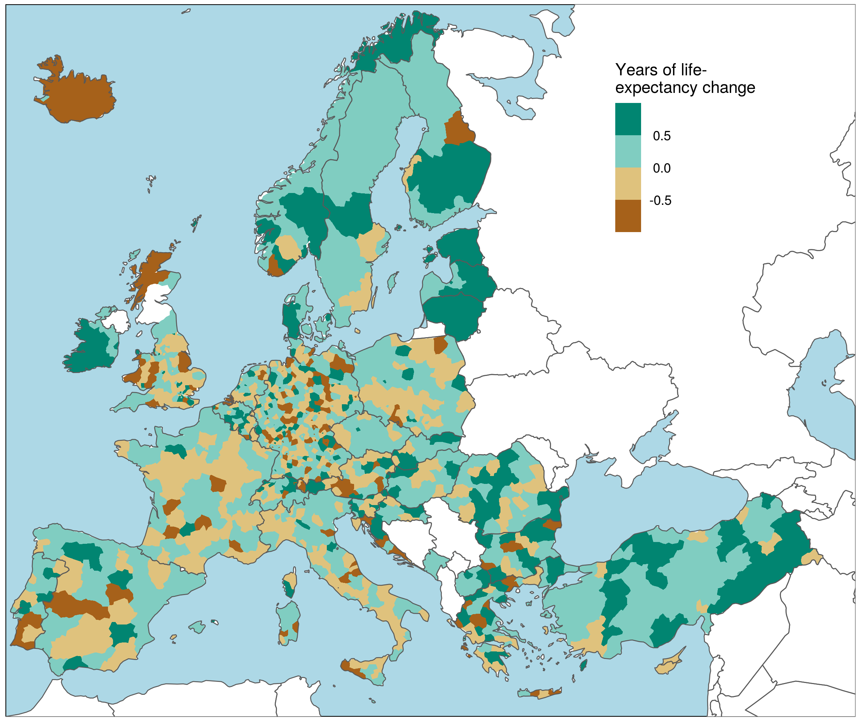
Change in life-expectancy from 2014 to 2017 across European NUTS-3 regions
Schöley (2021). github.com/jschoeley/rore2021-mapping_uncertainty

Slide 19
Multidimensional Color Scales

Slide 20
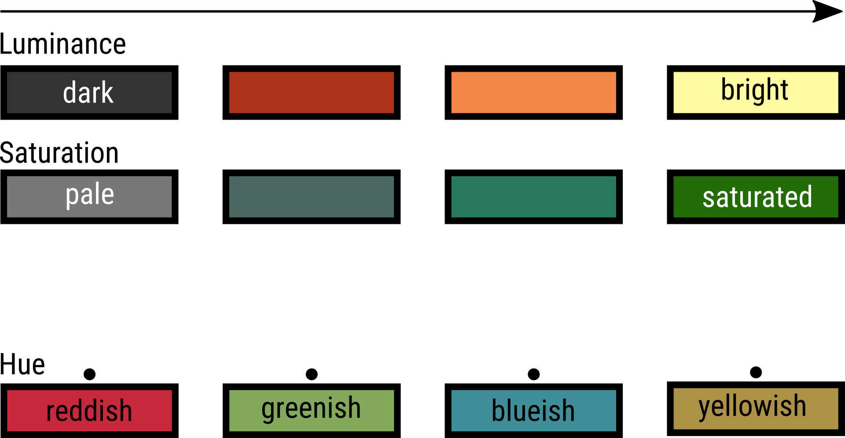
Three dimensions of color

Slide 21
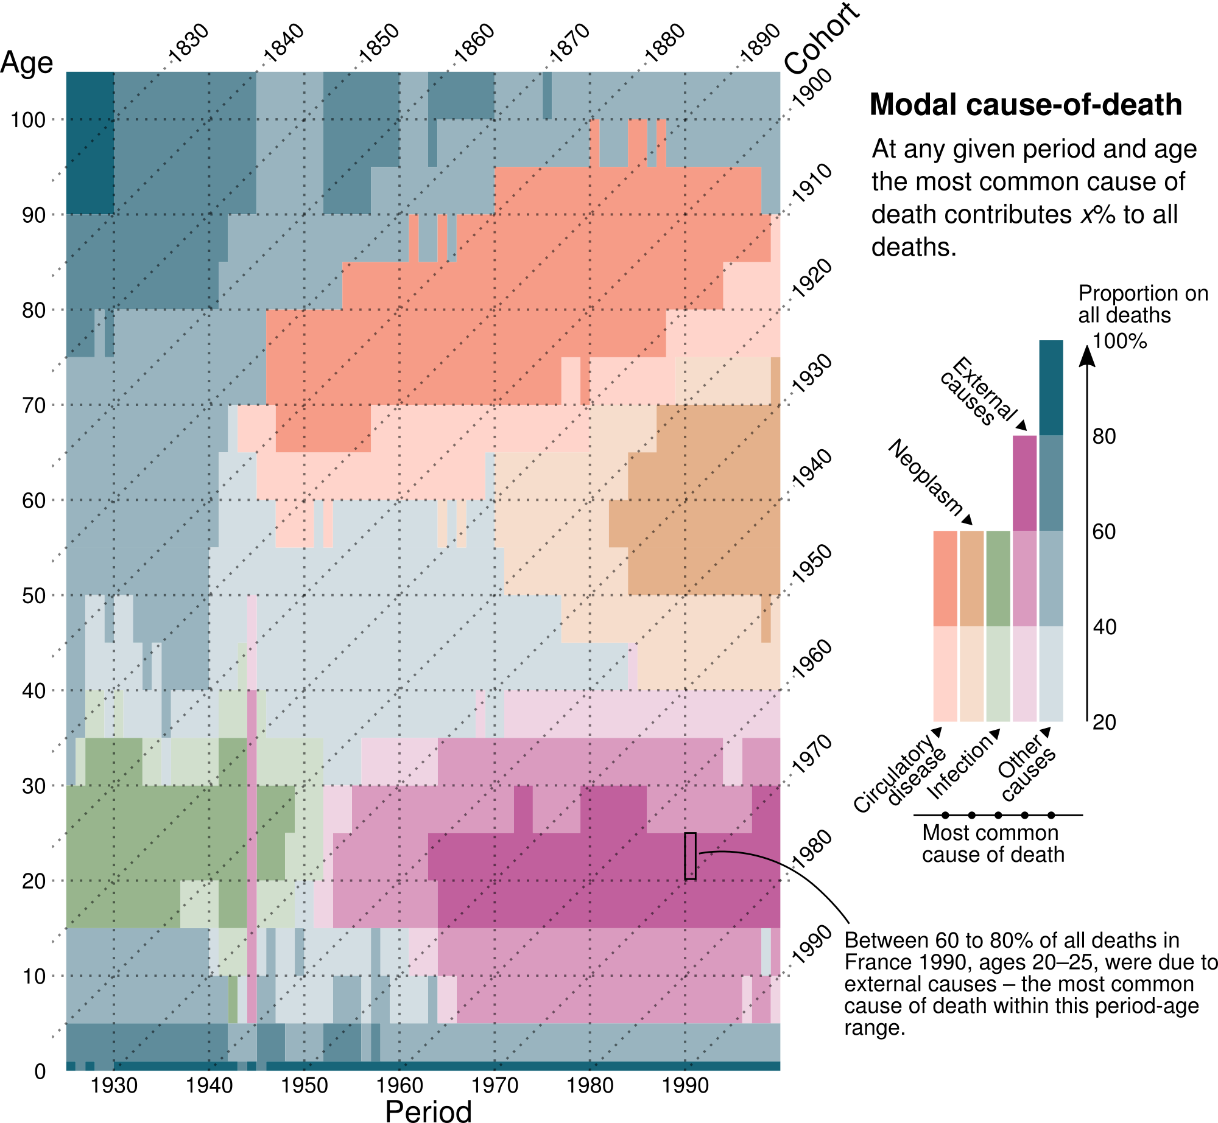
Map color dimensions to data dimensions
Schöley & Willekens (2017). Visualizing compositional data on the Lexis surface.

Slide 22
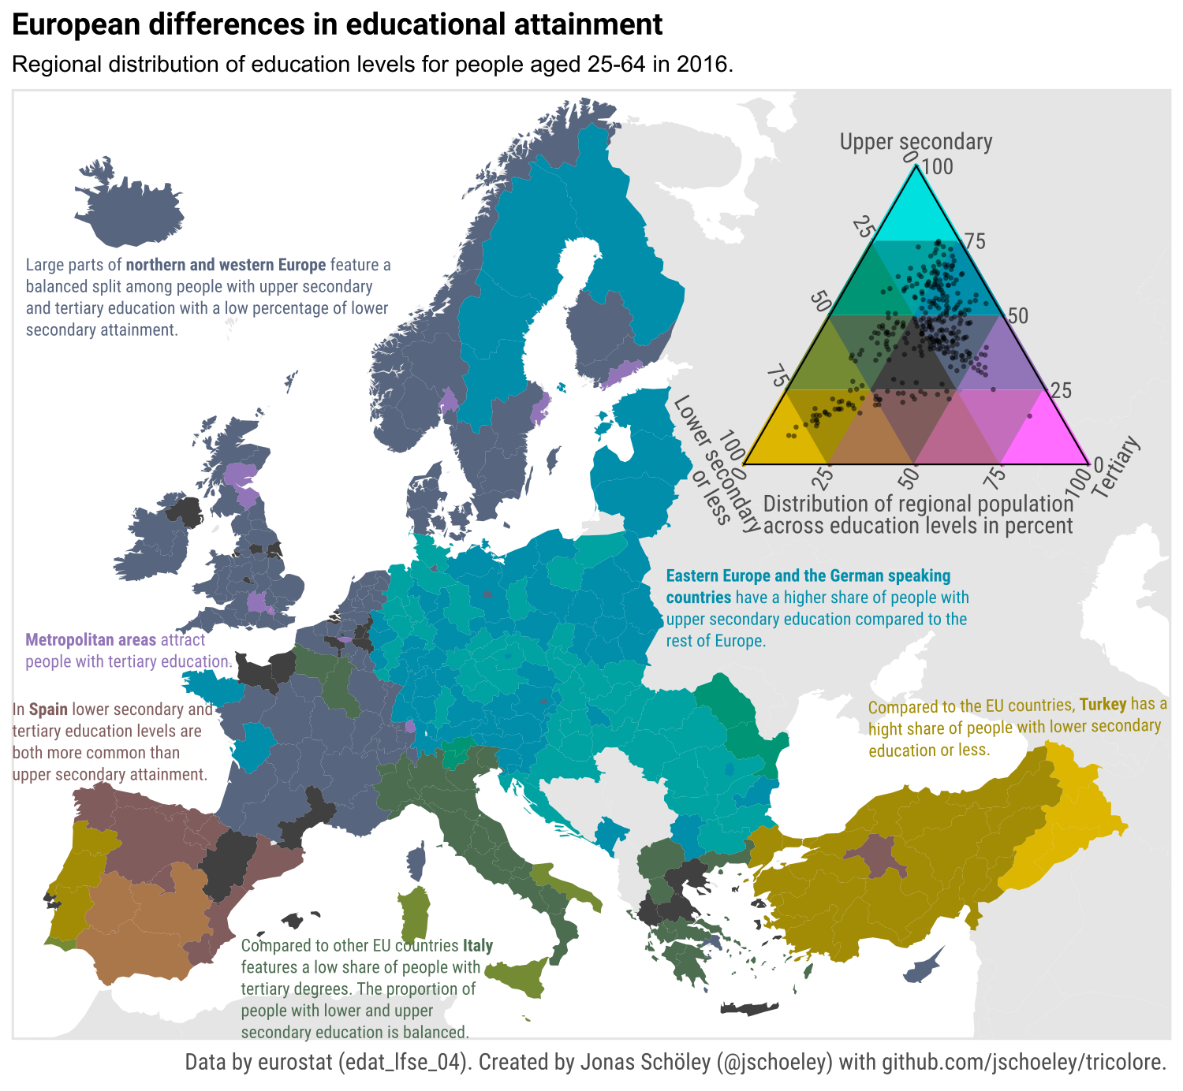

Map color dimensions to data dimensions
Tricolore – a flexible color scale for ternary compositions.
> install.packages(‘tricolore’)

Slide 23
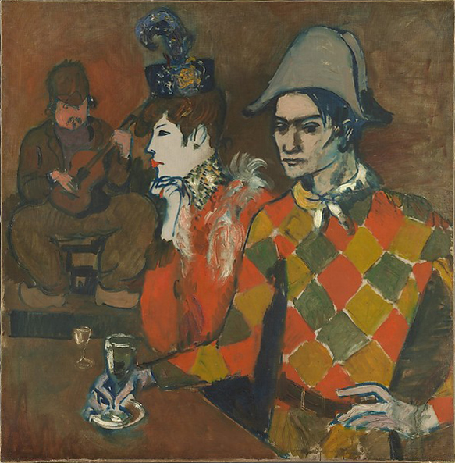
Map color dimensions to data dimensions
Pablo Picasso (1905). Au Lapin Agile.

Slide 24
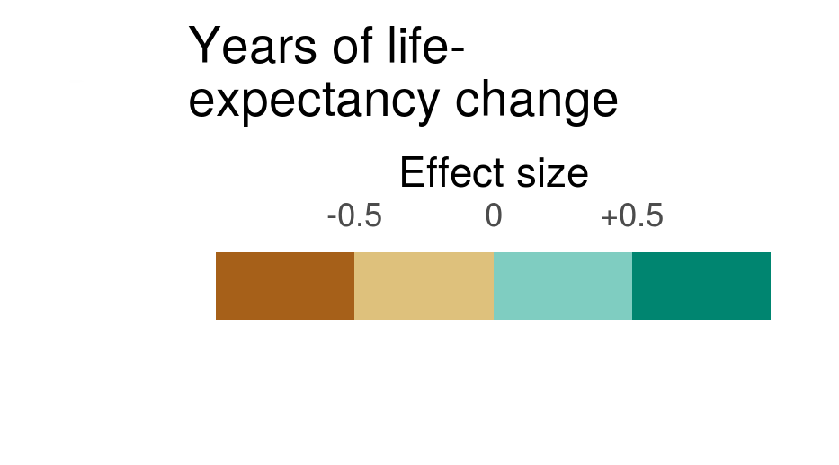
Map color dimensions to data dimensions
Schöley (2021). github.com/jschoeley/rore2021-mapping_uncertainty

Slide 25

Map color dimensions to data dimensions
Schöley (2021). github.com/jschoeley/rore2021-mapping_uncertainty

Slide 26
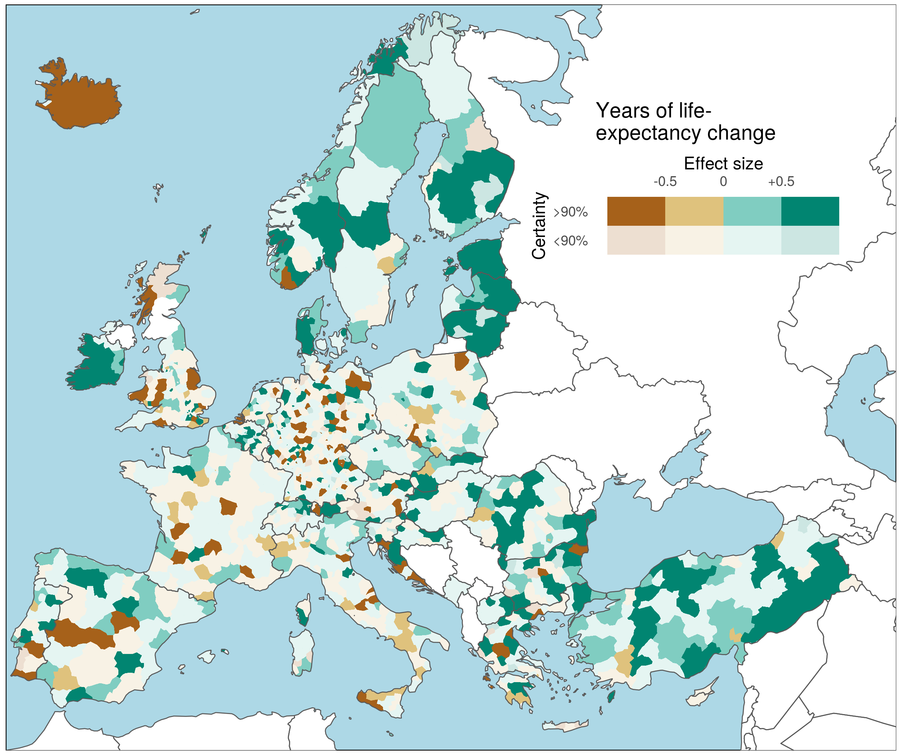
Map color dimensions to data dimensions
Schöley (2021). github.com/jschoeley/rore2021-mapping_uncertainty

Slide 27
Value-by-alpha uncertainty coding
Schöley (2021). github.com/jschoeley/rore2021-mapping_uncertainty

Slide 28
Value-by-alpha uncertainty coding
# create divergent color scale with
# 4 effect levels and 2 certainty levels
certain_colors <- RColorBrewer::brewer.pal(4, 'BrBG')
uncertain_colors <-
prismatic::clr_alpha(certain_colors, alpha = 0.2)
uncertainty_palette_4x2 <- tibble(
id = c(sapply(1:2, paste0, 1:4)),
rgb = c(uncertain_colors, certain_colors)
)
# A tibble: 8 x 2
id rgb
<chr> <chr>
1 11 #A6611A33
2 12 #DFC27D33
3 13 #80CDC133
4 14 #01857133
5 21 #A6611A
6 22 #DFC27D
7 23 #80CDC1
8 24 #018571
Schöley (2021). github.com/jschoeley/rore2021-mapping_uncertainty

Slide 29
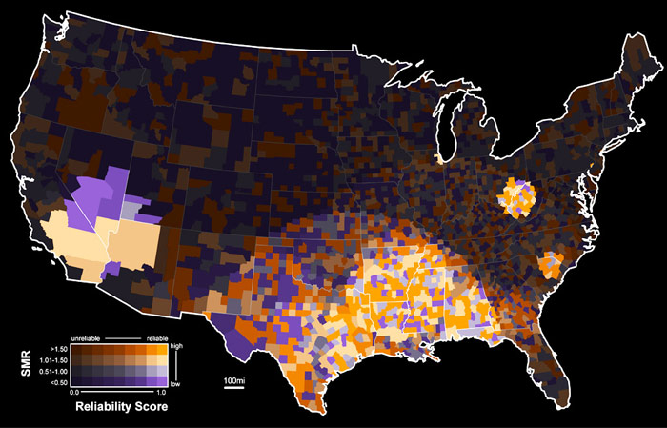
Value-by-alpha uncertainty coding
Roth etal. (2010). Value-by-alpha maps: An alternative technique to the cartogram.

Slide 30
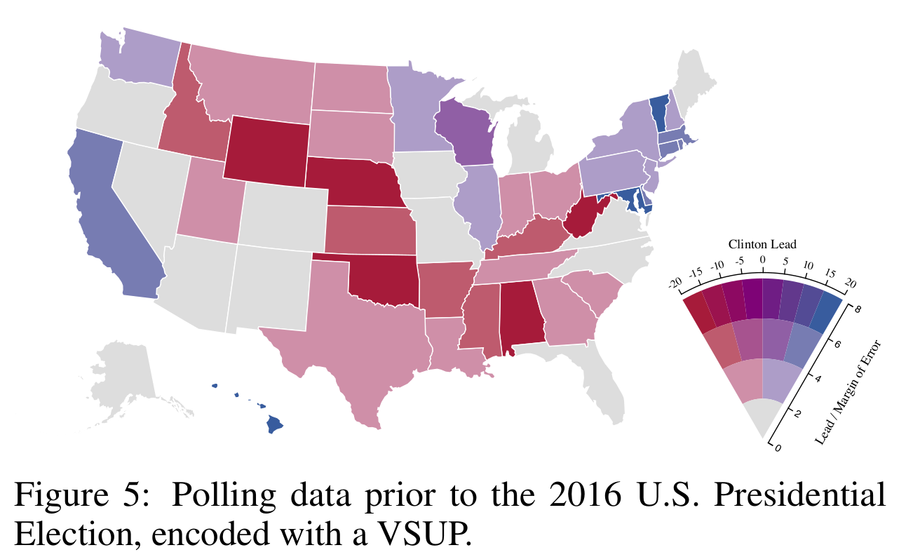
Value-Suppressing Uncertainty Palettes
Correll, Moritz, Heer (2018). Value-Suppressing Uncertainty Palettes.

Slide 31
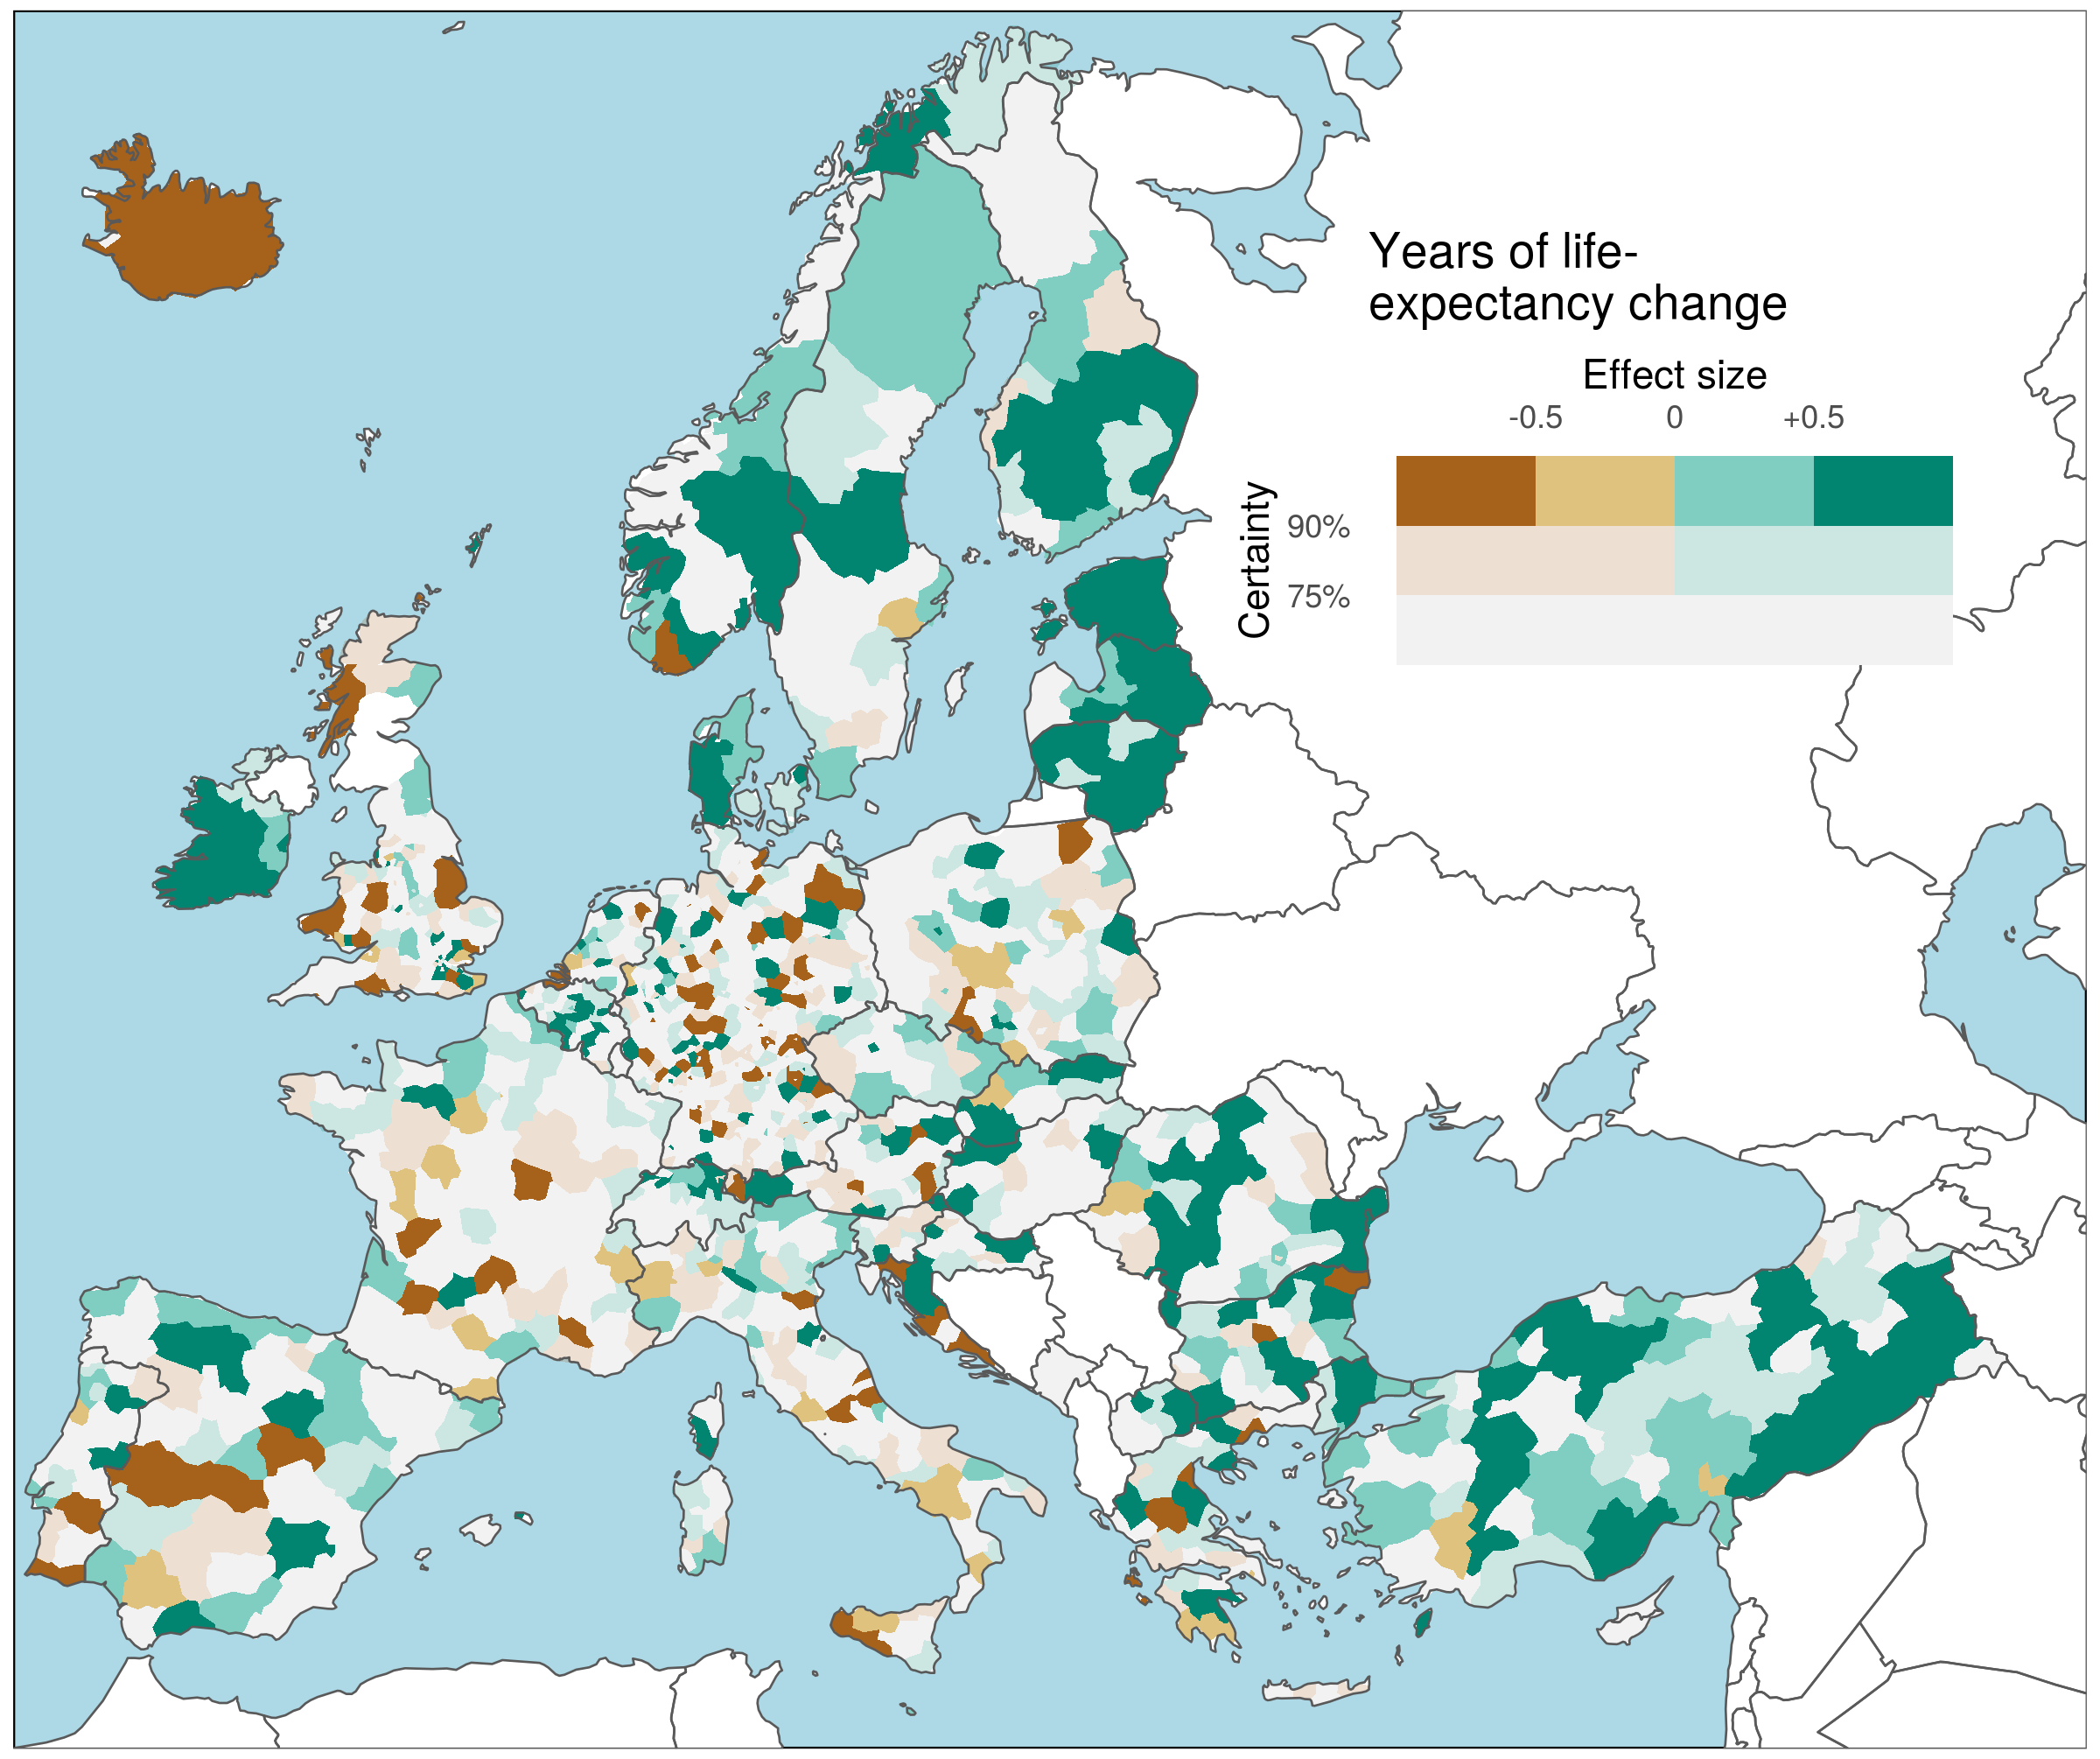
Value-Suppressing Uncertainty Palettes
Schöley (2021). github.com/jschoeley/rore2021-mapping_uncertainty

Slide 32
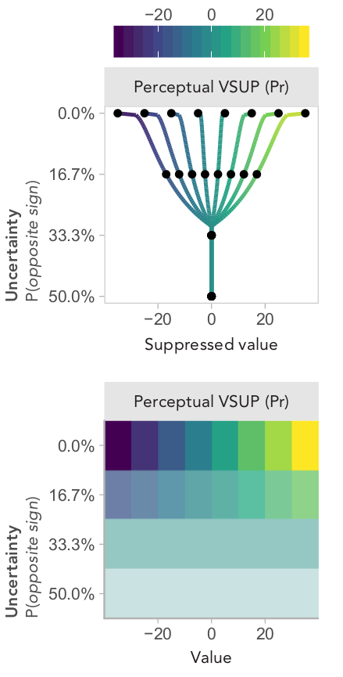
Value-Suppressing Uncertainty Palettes
Kay (2021). How Much Value Should an Uncertainty Palette Suppress...

Slide 33
Materials & Code
github.com/jschoeley/rore2021-mapping_uncertainty
Jonas Schöley
jschoeley@demogr.mpg.de
Twitter: @jschoeley

