Slide 1

Mapping Europe's demographic diversity
with multi-dimensional color scales
Jonas Schöley
@jschoeley

Slide 2
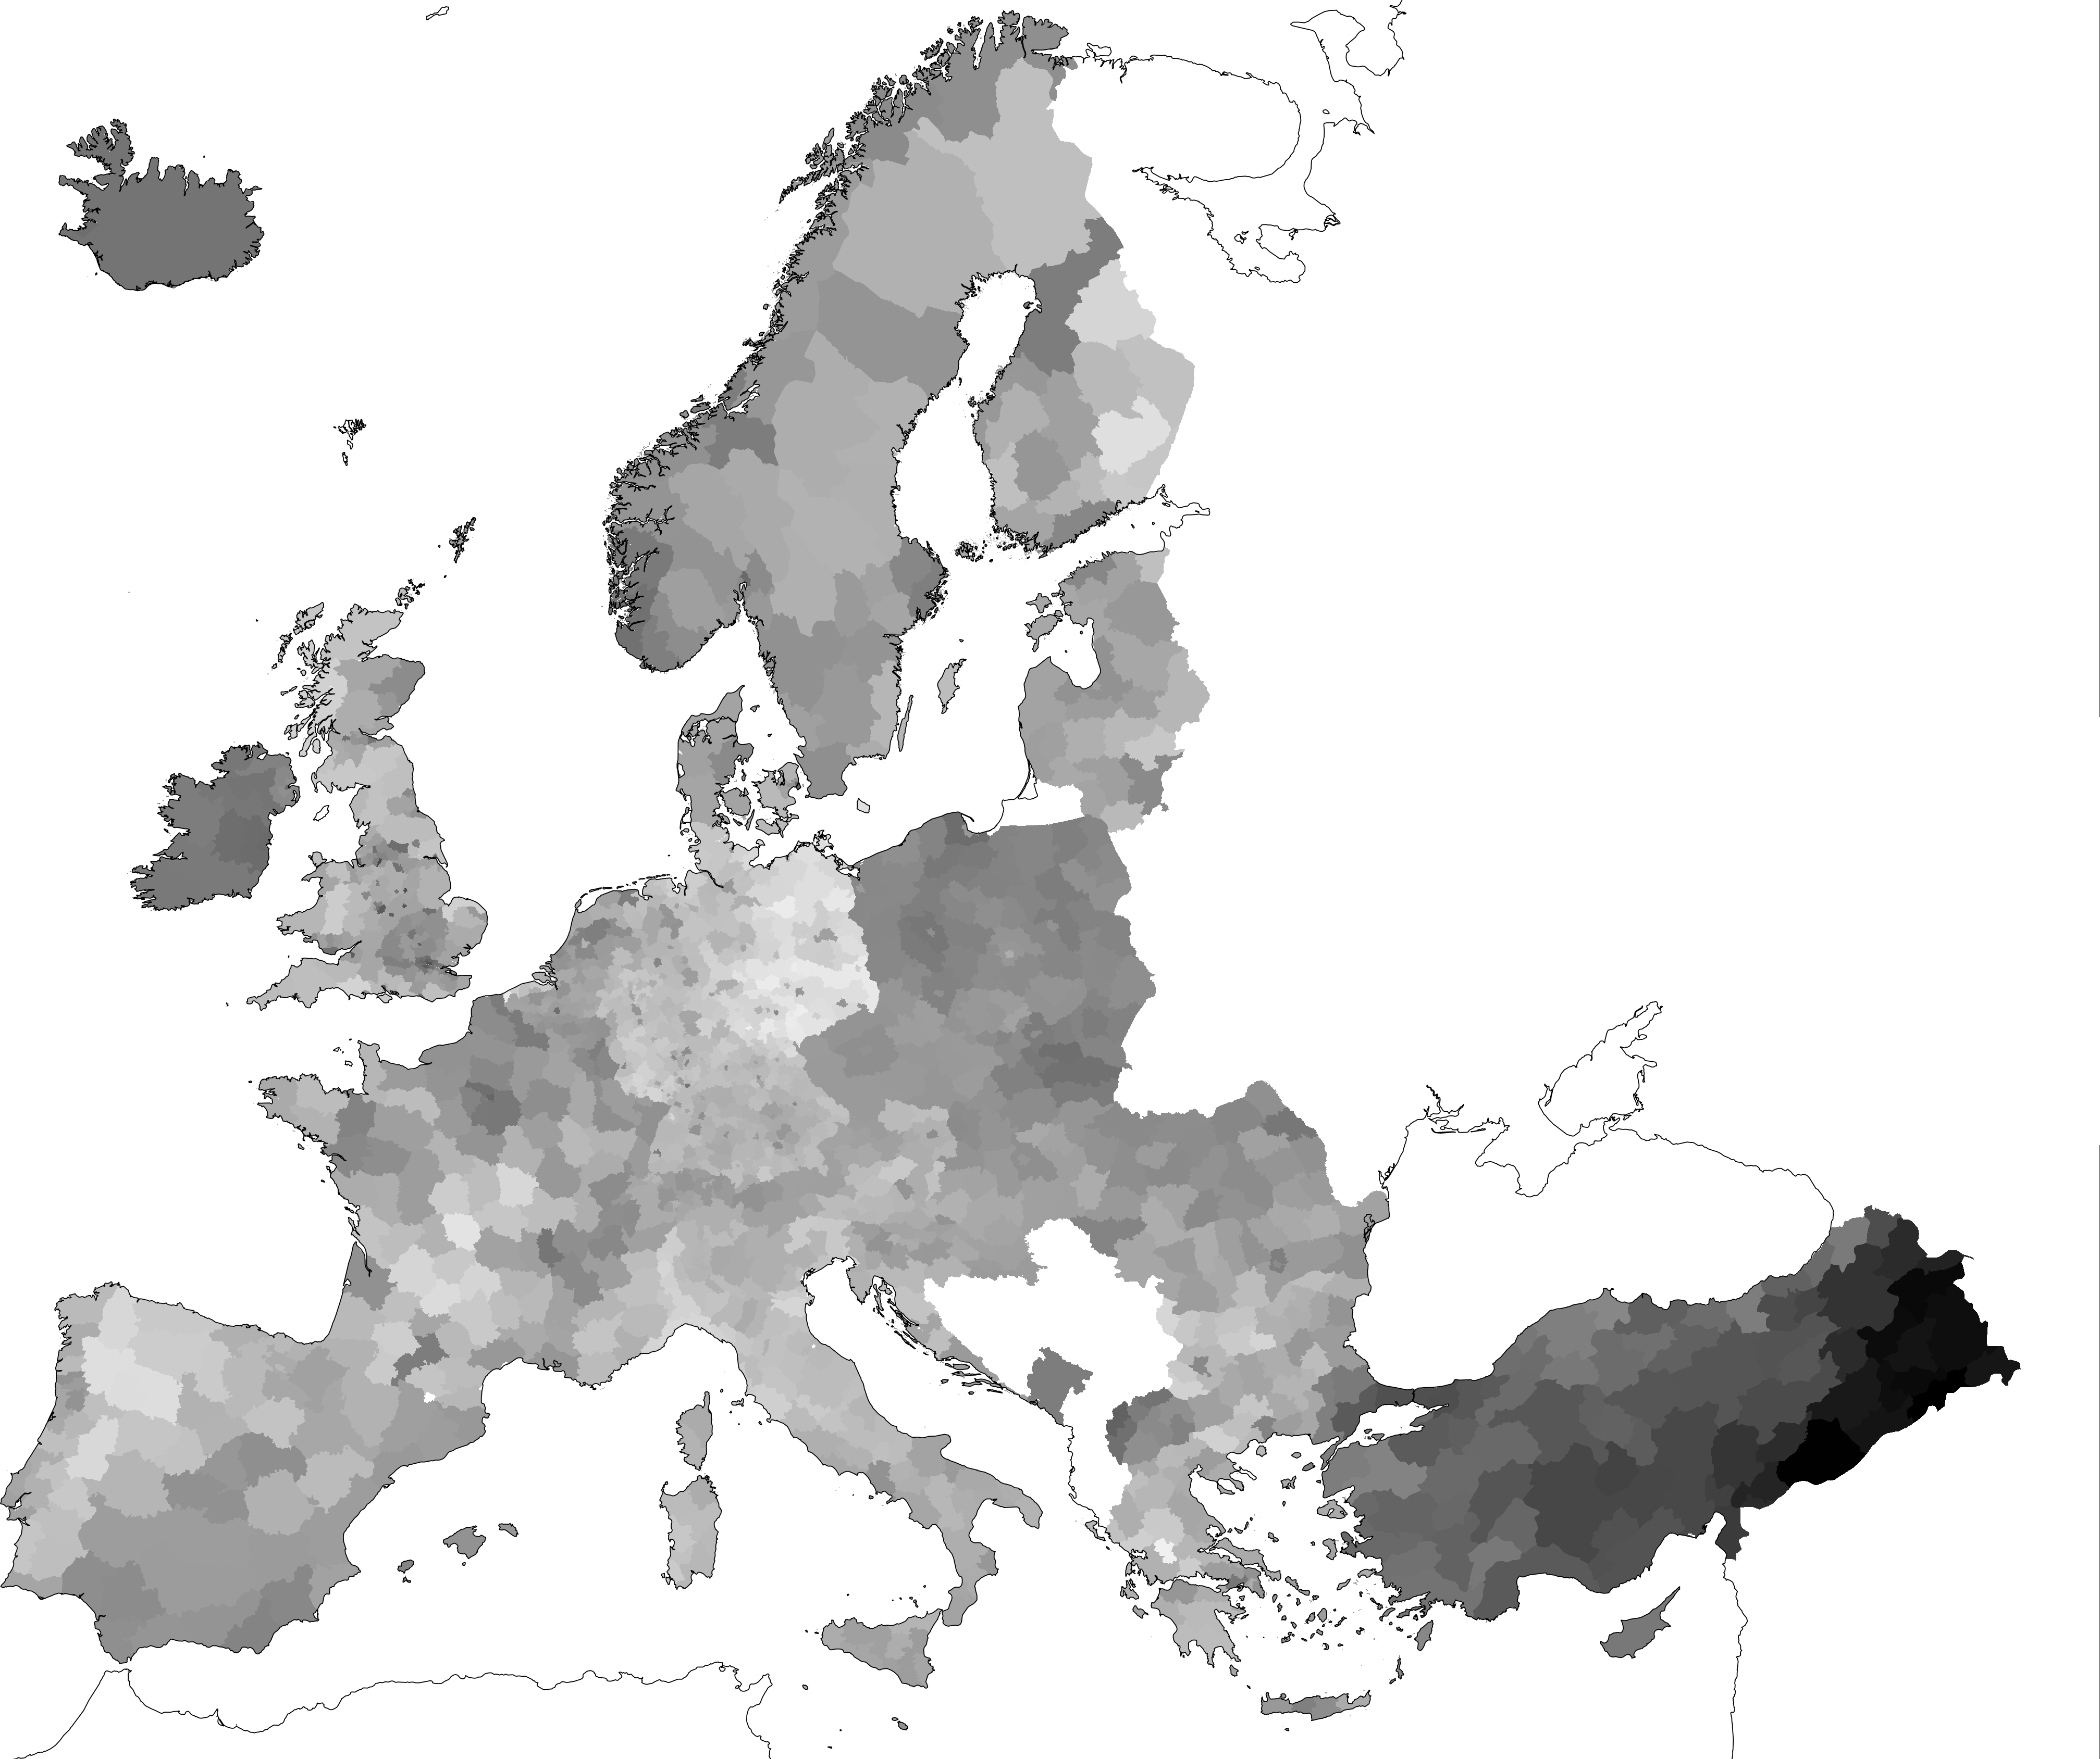

Median age by region 2015
Data by Eurostat
50 years
20 years
Jonas Schöley @jschoeley

Slide 3
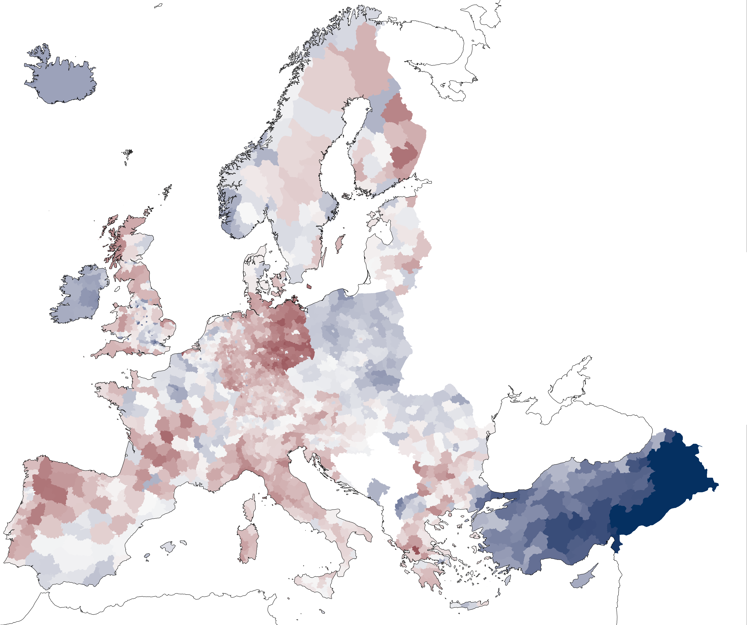
Regional deviations from European median age 2015
Data by Eurostat
Dimension 1 = Hue
Older than European median
Younger than European median
Dimension 2 = Darkness
Distance from European median
Jonas Schöley @jschoeley

Slide 4

Regional deviations from European median age 2015
Data by Eurostat
15 years above or more
42.8 = European median age
15 years below or more
Jonas Schöley @jschoeley

Slide 5
Regional deviations from European age composition 2015
Data by Eurostat
Dimension 1 = Hue
Above average young population
Above average working age population
Above average retirement age population
Dimension 2 = Lightness
Distance from average
European age structure
Jonas Schöley @jschoeley

Slide 6
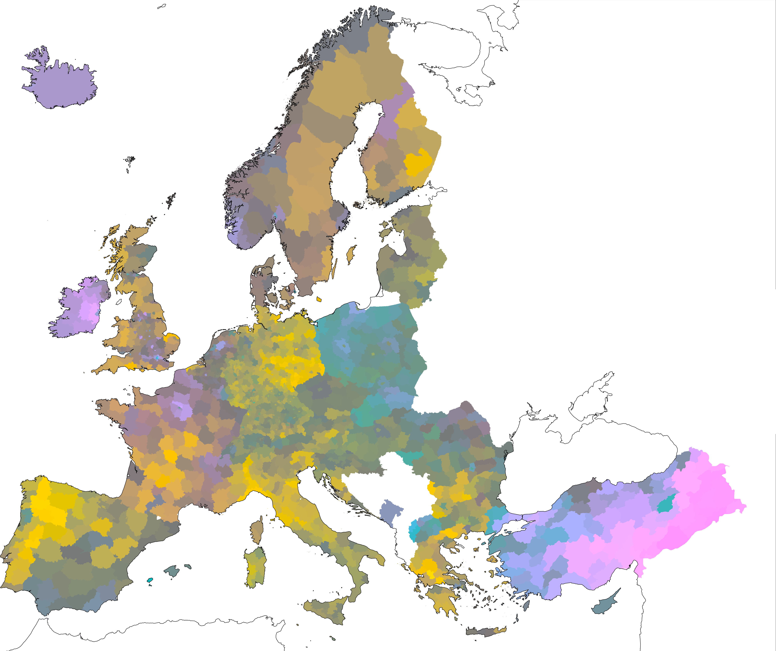
Regional deviations from European age composition 2015
Data by Eurostat
Dimension 1 = Hue
Above average young population
Above average working age population
Above average retirement age population
Dimension 2 = Lightness
Distance from average
European age structure
Jonas Schöley @jschoeley

Slide 7
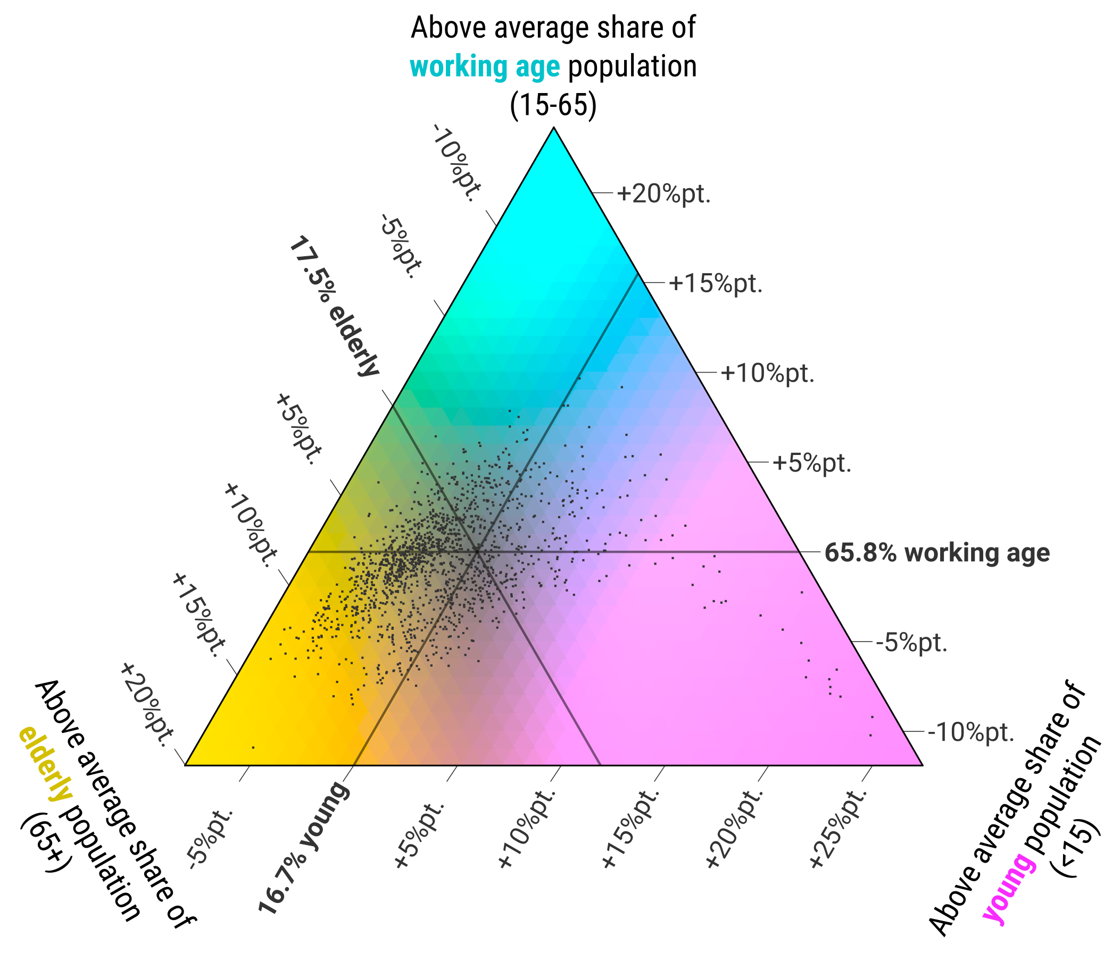
Regional deviations from European age composition 2015
Data by Eurostat
Kashnitsky & Schöley 2018.
Regional population structures at a glance. The Lancet.
Jonas Schöley @jschoeley

Slide 8
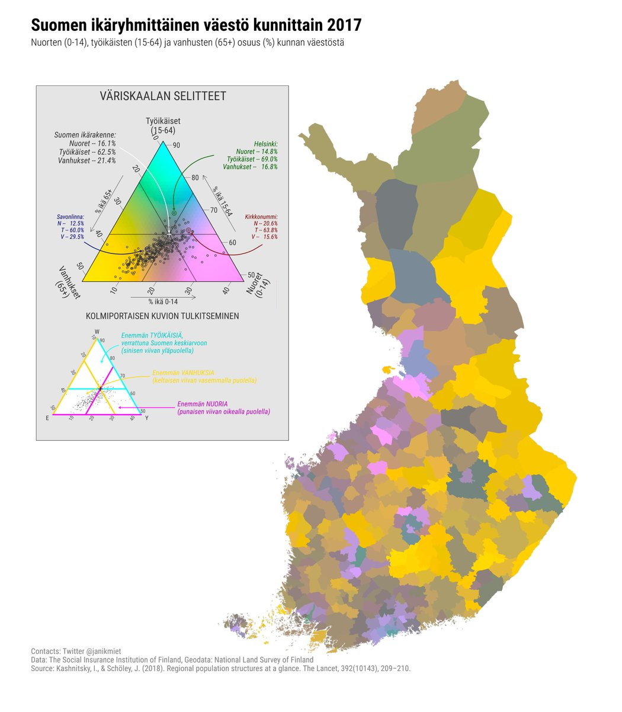
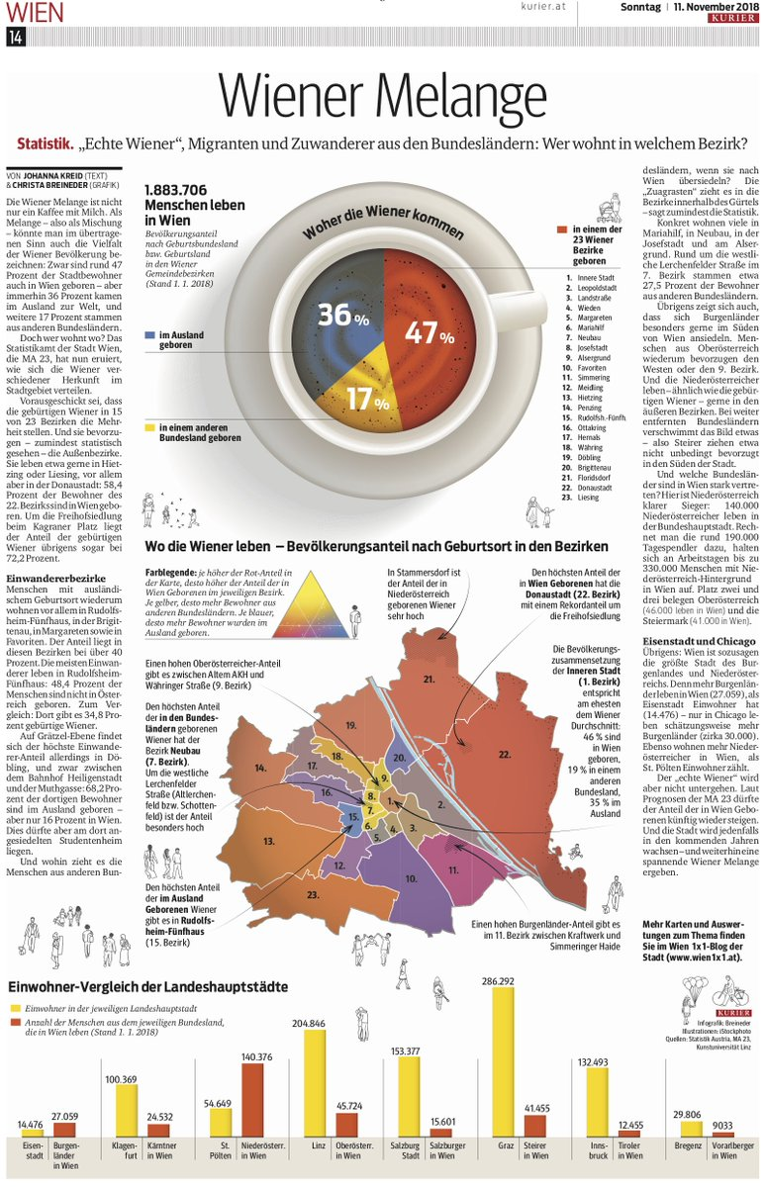
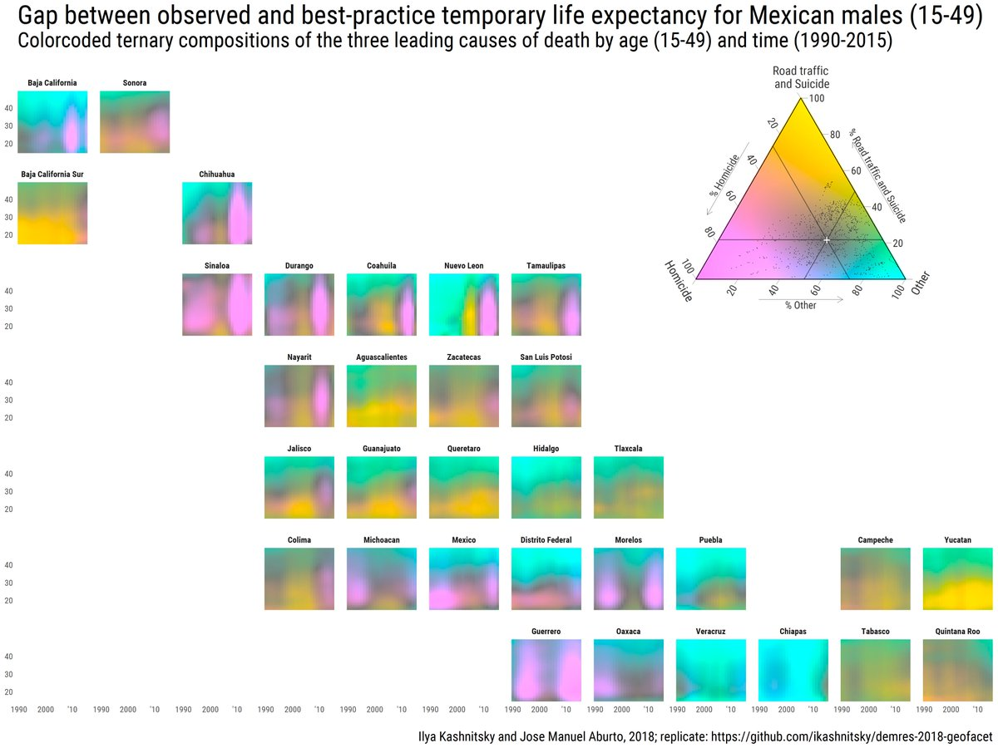
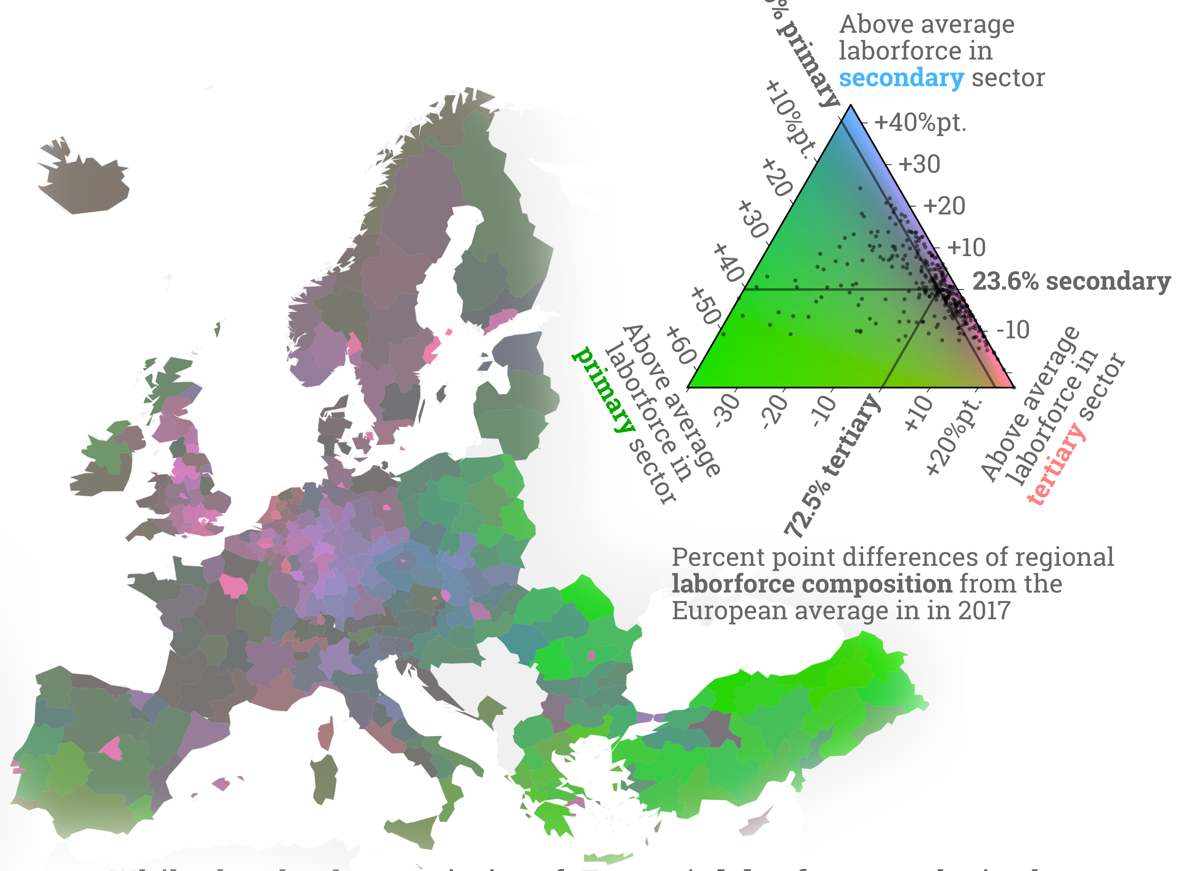
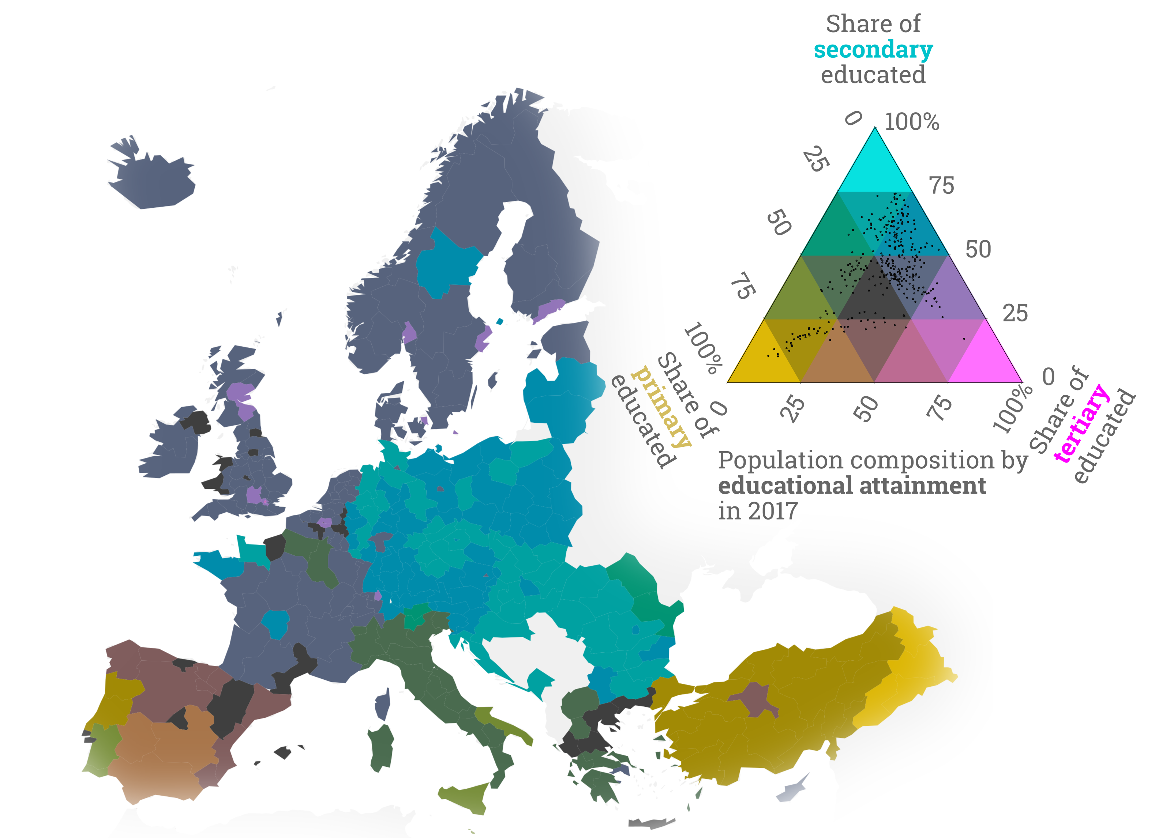
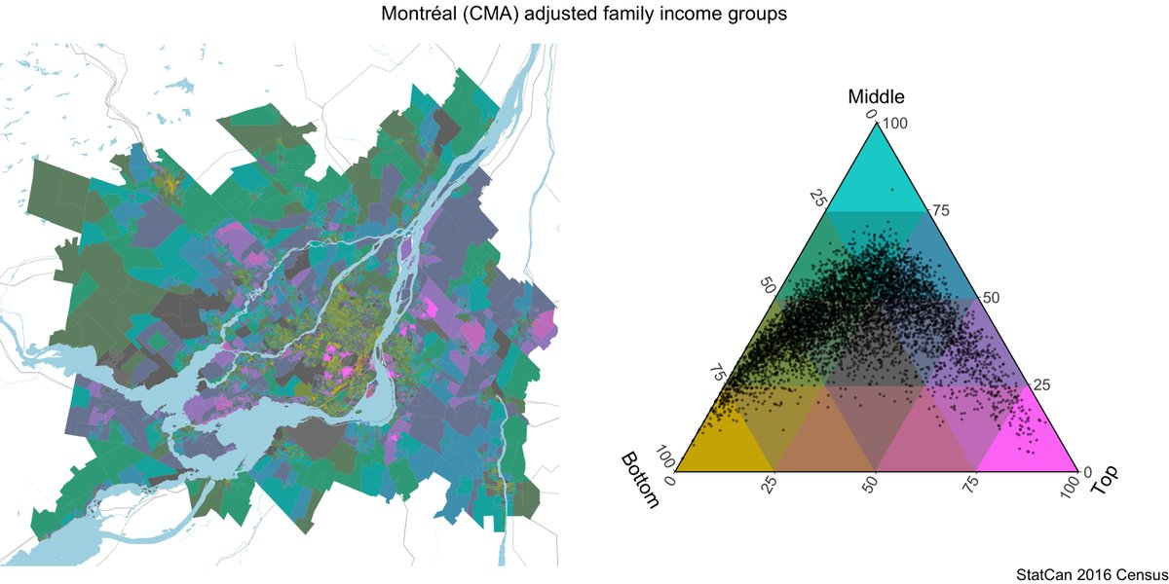
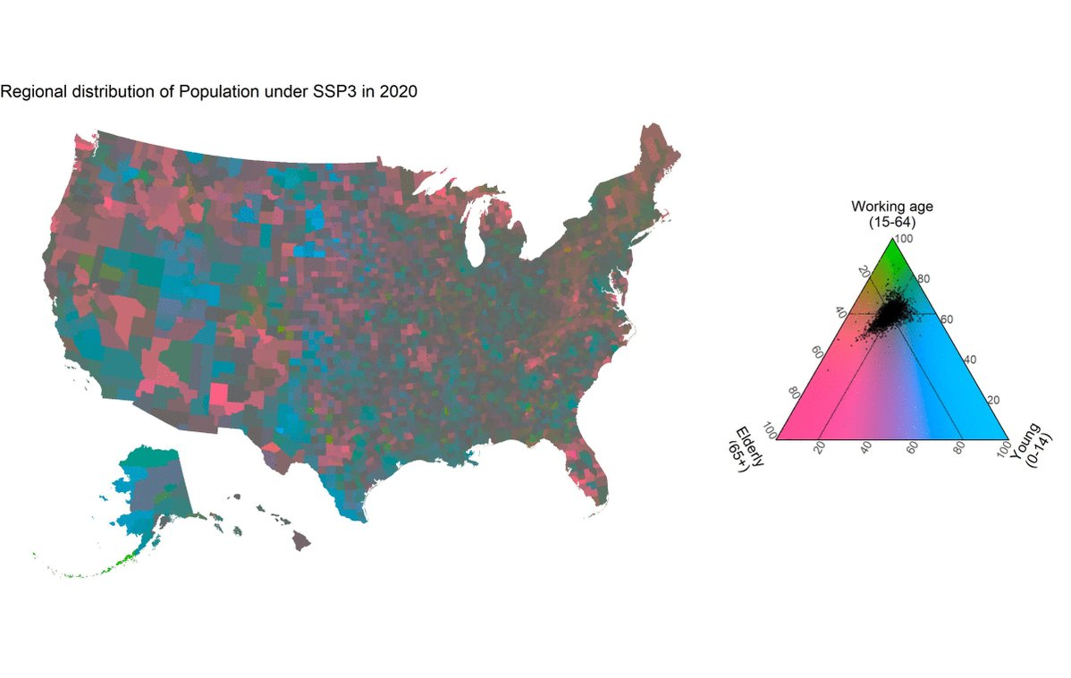
Causes of death in Mexico
Finland’s age structure
Vienna’s population by origin
Labor-force composition
Tricolore – a flexible color scale for ternary compositions.
> install.packages(‘tricolore’)
Educational attainment in Europe
Income distribution in Canadian cities
Forecasts of US age distribution
Jonas Schöley @jschoeley

Slide 9
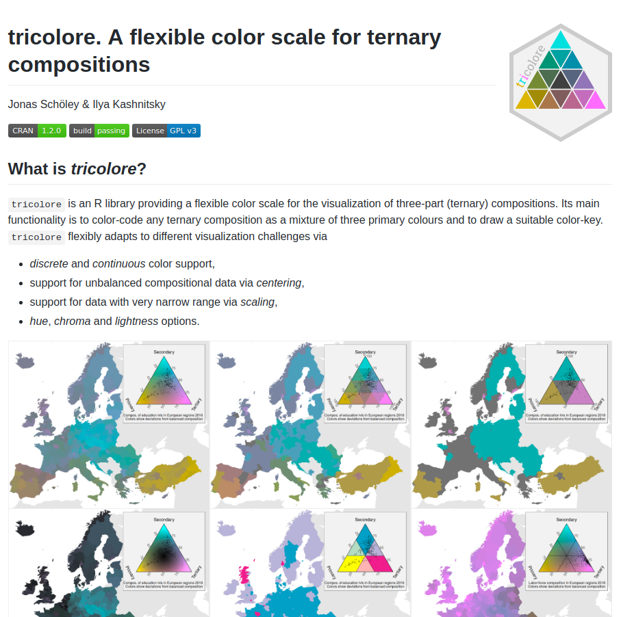
github.com/jschoeley/tricolore
Jonas Schöley @jschoeley

