Slide 1
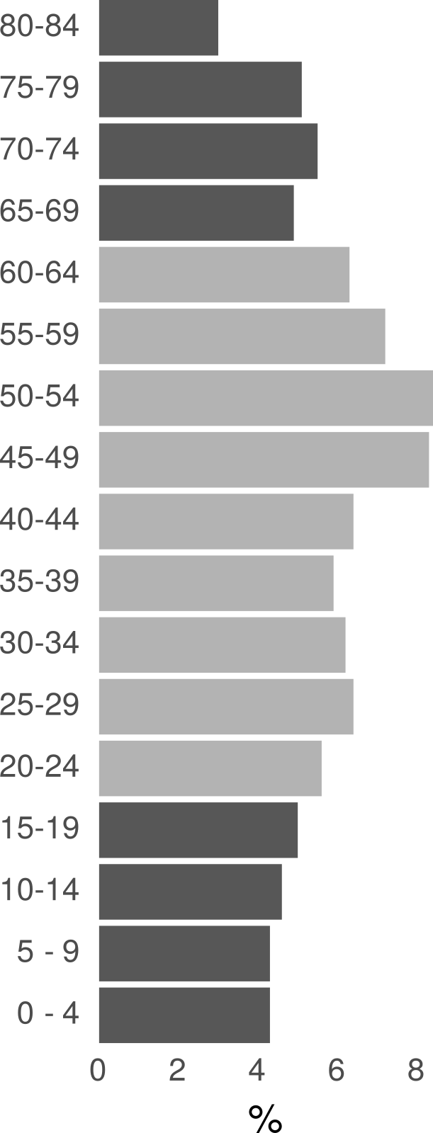
Schöley & Kashnitsky 2018

Slide 2
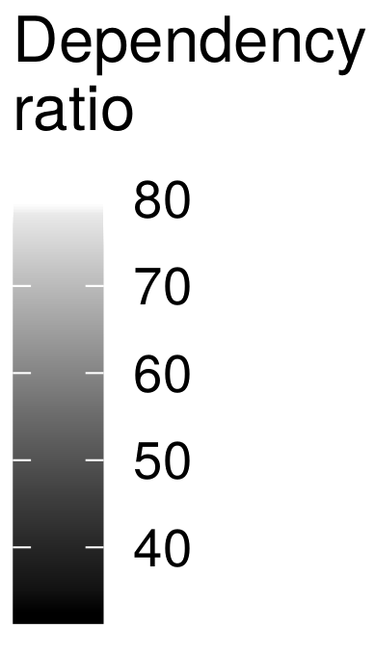
Schöley & Kashnitsky 2018

Slide 3
Dependency ratio.
European NUTS-3 regions 2015.
Data by Eurostat.
Schöley & Kashnitsky 2018

Slide 4
Schöley & Kashnitsky 2018

Slide 5
Schöley & Kashnitsky 2018

Slide 6
Schöley & Kashnitsky 2018

Slide 7
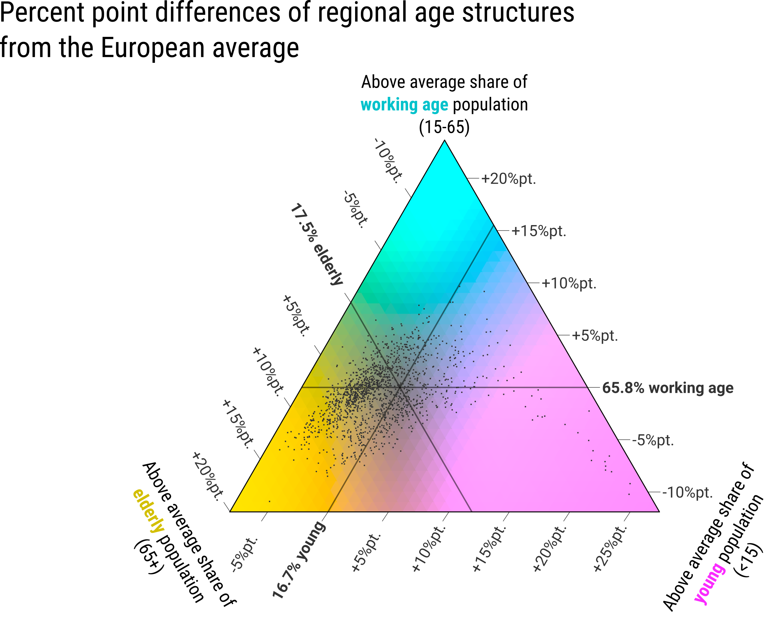
Kashnitsky & Schöley (2018).
Regional population structures at a glance.
The Lancet.
Schöley & Kashnitsky 2018

Slide 8
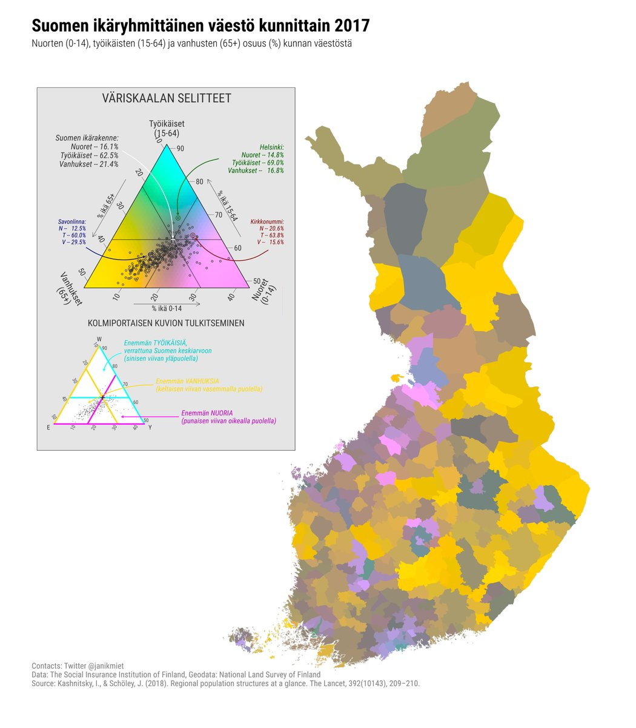

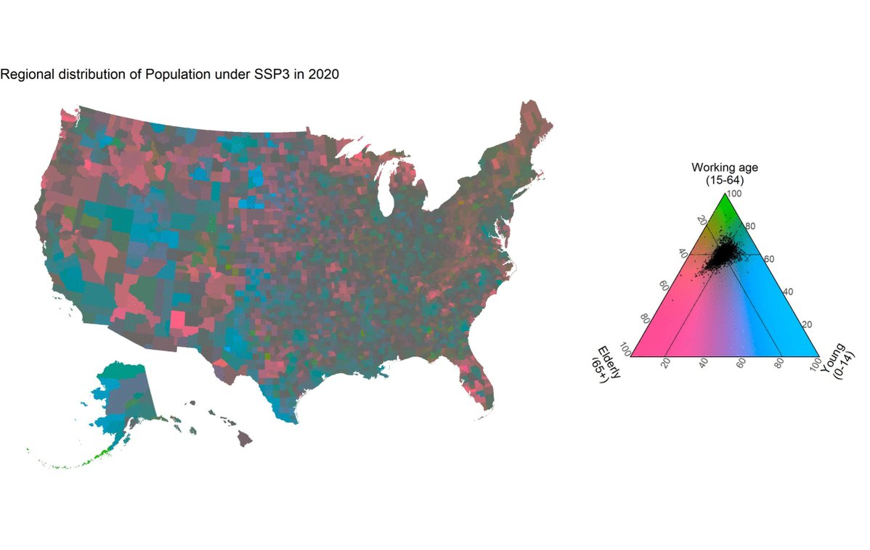
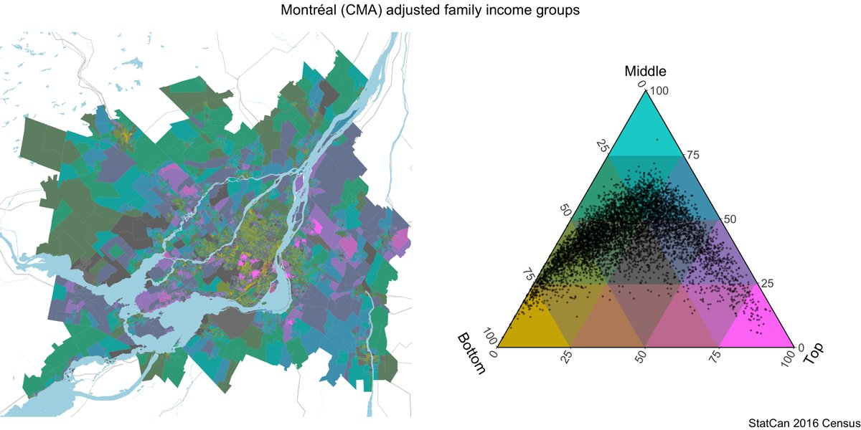
Tricolore – a flexible color scale for ternary compositions. CRAN.
> install.packages(‘tricolore’)
Schöley & Kashnitsky 2018

