Slide 1



Survival Analysis
Session 3: Incomplete Observations
Jonas Schöley
@jschoeley
0000-0002-3340-8518
j.schoeley@uni-rostock.de
CC-BY Jonas Schöley 2022

Slide 2
Recap: Survival Identities
In survival analysis we
consider the random variable
“X: Time until event”
x = 0.1 weeks, 2.3 weeks…
We express our knowledge about the distribution of X in any of these functions. Knowing any single function we can derive all other via the Survival Identities.
h(x): Hazard function
The instantaneous rate
of new events at time x
among those who did not
experience the event yet.
f(x): Density function
The relative likelihood of
experiencing the event
around time x.
h(x) = lim_{h→0} P(x≤X<x+h|X≥x)/h
F(x)=₀∫^{x} f(x) dx
S(x)=_{x}∫^{Inf} f(x) dx
h(x)=- S’(x)/S(x)
F(x): Distribution function
aka Cumulative function
The probability of
experiencing the event until
time x.
S(x): Survival function
The probability of not
experiencing the event until
time x.
H(x) = ₀∫^{x} h(x) dx
F(x): Distribution function
aka Cumulative function
The probability of
experiencing the event until
time x.
F(x): Distribution function
aka Cumulative function
The probability of
experiencing the event until
time x.
H(x) = -log S(x)
S(x)=1-F(x)
H(x): Cumulative Hazard
The integral of h(x).
F(x) = P(X≤x)
S(x) = P(X>x)
S(x) = exp(-H(x))

Slide 3
What Does Survival Data Look Like?
In survival analysis we
consider the random variable
“X: Time until event”
x = 0.1 month, 2.3 months…
Observation index
Observed event time
i
x
1
22
2
23
Who? 8 breast cancer patients
Start of observation? Cancer diagnosis
Event of interest? Death
Time unit? Months
End of observation? 10 years follow up
3
38
4
42
5
73
6
77
7
89
8
115
x_{i=1}=22
x_{i=3}=38
x_{i=5}=73
x_{i=2}=23
x_{i=4}=42
x_{i=6}=77
x_{i=7}=89
x_{i=8}=115
Time x
Time x₀
Start of observation time
Time x_{ω}
End of observation time

Slide 4
Inferring the Survival Density from Data
A
C
B
Which distribution most likely corresponds to the data?

Slide 5
Inferring the Survival Density from Data
A
C
B
Which distribution most likely corresponds to the data?
→ Maximum Likelihood Estimation

Slide 6
Inferring the Survival Density from Data
Which distribution most likely corresponds to the data?
→ Maximum Likelihood Estimation
Maximum Likelihood Estimation
We fit a model f_{θ} to the data x by choosing model parameters θ
which maximize the likelihood function L, i.e. which make the
observed data most probable.
L(θ|x) = ∏_{i} f_{θ}(x_{i})
In practice we often maximize the log-likelihood for convenience:
log L(θ|x) = log ∏_{i} f_{θ}(x_{i}) = ∑_{i} log f_{θ}(x_{i})
Product over all observations
Probability density given parameters θ
Single observed survival time

Slide 7
Inferring the Survival Density from Data
Which distribution most likely corresponds to the data?
→ Maximum Likelihood Estimation
Maximum Likelihood Estimation
We fit a model f_{θ} to the data x by choosing model parameters θ
which maximize the likelihood function L, i.e. which make the
observed data most probable.
L(θ|x) = ∏_{i} f_{θ}(x_{i})
In practice we often maximize the log-likelihood for convenience:
log L(θ|x) = log ∏_{i} f_{θ}(x_{i}) = ∑_{i} log f_{θ}(x_{i})
You need:
→ data x
Product over all observations
Probability density given parameters θ
Single observed survival time
x_{i=1}=22
x_{i=3}=38
x_{i=5}=73
x_{i=2}=23
x_{i=4}=42
x_{i=6}=77
x_{i=7}=89
x_{i=8}=115
Time x
Time x₀
Start of observation time
Time x_{ω}
End of observation time

Slide 8
Inferring the Survival Density from Data
Which distribution most likely corresponds to the data?
→ Maximum Likelihood Estimation
Maximum Likelihood Estimation
We fit a model f_{θ} to the data x by choosing model parameters θ
which maximize the likelihood function L, i.e. which make the
observed data most probable.
L(θ|x) = ∏_{i} f_{θ}(x_{i})
In practice we often maximize the log-likelihood for convenience:
log L(θ|x) = log ∏_{i} f_{θ}(x_{i}) = ∑_{i} log f_{θ}(x_{i})
You need:
→ data x
→ a probability density f_{θ} (“the model”) parameterized by…
Product over all observations
Probability density given parameters θ
Single observed survival time
x_{i=1}=22
x_{i=3}=38
x_{i=5}=73
f_{θ}(x)= λ exp(-λx)
x_{i=2}=23
x_{i=4}=42
x_{i=6}=77
x_{i=7}=89
x_{i=8}=115
Time x
Time x₀
Start of observation time
Time x_{ω}
End of observation time

Slide 9
Inferring the Survival Density from Data
Which distribution most likely corresponds to the data?
→ Maximum Likelihood Estimation
Maximum Likelihood Estimation
We fit a model f_{θ} to the data x by choosing model parameters θ
which maximize the likelihood function L, i.e. which make the
observed data most probable.
L(θ|x) = ∏_{i} f_{θ}(x_{i})
In practice we often maximize the log-likelihood for convenience:
log L(θ|x) = log ∏_{i} f_{θ}(x_{i}) = ∑_{i} log f_{θ}(x_{i})
You need:
→ data x
→ a probability density f_{θ} (“the model”) parameterized by…
→ ...a set of parameters θ
Product over all observations
Probability density given parameters θ
Single observed survival time
x_{i=1}=22
x_{i=3}=38
x_{i=5}=73
f_{θ=λ}(x)= λ exp(-λx)
x_{i=2}=23
x_{i=4}=42
x_{i=6}=77
x_{i=7}=89
x_{i=8}=115
Time x
Time x₀
Start of observation time
Time x_{ω}
End of observation time

Slide 10
Inferring the Survival Density from Data
Which distribution most likely corresponds to the data?
→ Maximum Likelihood Estimation
f(x)
Observed event time
i
x
Observation index
0.020
1
22
2
23
3
38
0.015
4
42
5
73
6
77
0.010
7
89
8
115
0.005
x_{i=1}=22
x_{i=3}=38
x_{i=5}=73
x_{i=2}=23
x_{i=4}=42
x_{i=6}=77
x_{i=7}=89
x_{i=8}=115
f_{θ=λ}(x)= λ exp(-λx)
Time x
Time x₀
Start of observation time
Time x_{ω}
End of observation time

Slide 11
Inferring the Survival Density from Data
Which distribution most likely corresponds to the data?
→ Maximum Likelihood Estimation
f(x)
Observed event time
Density
i
x
f_{λ=0.01}(x)
Observation index
0.020
1
22
2
23
3
38
0.015
4
42
5
73
6
77
0.010
7
89
8
115
0.005
x_{i=1}=22
x_{i=3}=38
x_{i=5}=73
x_{i=2}=23
x_{i=4}=42
x_{i=6}=77
x_{i=7}=89
x_{i=8}=115
f_{θ=λ}(x)= λ exp(-λx)
Time x
Time x₀
Start of observation time
Time x_{ω}
End of observation time

Slide 12
Inferring the Survival Density from Data
Which distribution most likely corresponds to the data?
→ Maximum Likelihood Estimation
log density /
log Likelihood
contribution
f(x)
Observed event time
Density
i
x
f_{λ=0.01}(x)
log f_{λ=0.01}(x)
Observation index
0.020
1
22
2
23
3
38
0.015
4
42
5
73
6
77
0.010
7
89
8
115
log L(λ=0.01|x) = ∑_{i} log f_{λ=0.01}(x_{i}) = ?
0.005
x_{i=1}=22
x_{i=3}=38
x_{i=5}=73
x_{i=2}=23
x_{i=4}=42
x_{i=6}=77
x_{i=7}=89
x_{i=8}=115
f_{θ=λ}(x)= λ exp(-λx)
Time x
Time x₀
Start of observation time
Time x_{ω}
End of observation time

Slide 13
Inferring the Survival Density from Data
Which distribution most likely corresponds to the data?
→ Maximum Likelihood Estimation
log density /
log Likelihood
contribution
f(x)
Observed event time
Density
i
x
f_{λ=0.01}(x)
log f_{λ=0.01}(x)
Observation index
0.020
1
22
0.0080
-4.83
2
23
0.0079
-4.84
3
38
0.0068
-4.99
0.015
4
42
0.0066
-5.03
5
73
0.0048
-5.34
6
77
0.0046
-5.38
0.010
7
89
0.0041
-5.50
8
115
0.0032
-5.76
log L(λ=0.01|x) = ∑_{i} log f_{λ=0.01}(x_{i}) = -41.67
0.005
x_{i=1}=22
x_{i=3}=38
x_{i=5}=73
x_{i=2}=23
x_{i=4}=42
x_{i=6}=77
x_{i=7}=89
x_{i=8}=115
f_{θ=λ}(x)= λ exp(-λx)
Time x
Time x₀
Start of observation time
Time x_{ω}
End of observation time

Slide 14
Inferring the Survival Density from Data
Which distribution most likely corresponds to the data?
→ Maximum Likelihood Estimation
log density /
log Likelihood
contribution
f(x)
Observed event time
Density
i
x
f_{λ=0.02}(x)
log f_{λ=0.02}(x)
Observation index
0.020
1
22
2
23
3
38
0.015
4
42
5
73
6
77
0.010
7
89
8
115
log L(λ=0.02|x) = ∑_{i} log f_{λ=0.01}(x_{i}) = ?
0.005
x_{i=1}=22
x_{i=3}=38
x_{i=5}=73
x_{i=2}=23
x_{i=4}=42
x_{i=6}=77
x_{i=7}=89
x_{i=8}=115
f_{θ=λ}(x)= λ exp(-λx)
Time x
Time x₀
Start of observation time
Time x_{ω}
End of observation time

Slide 15
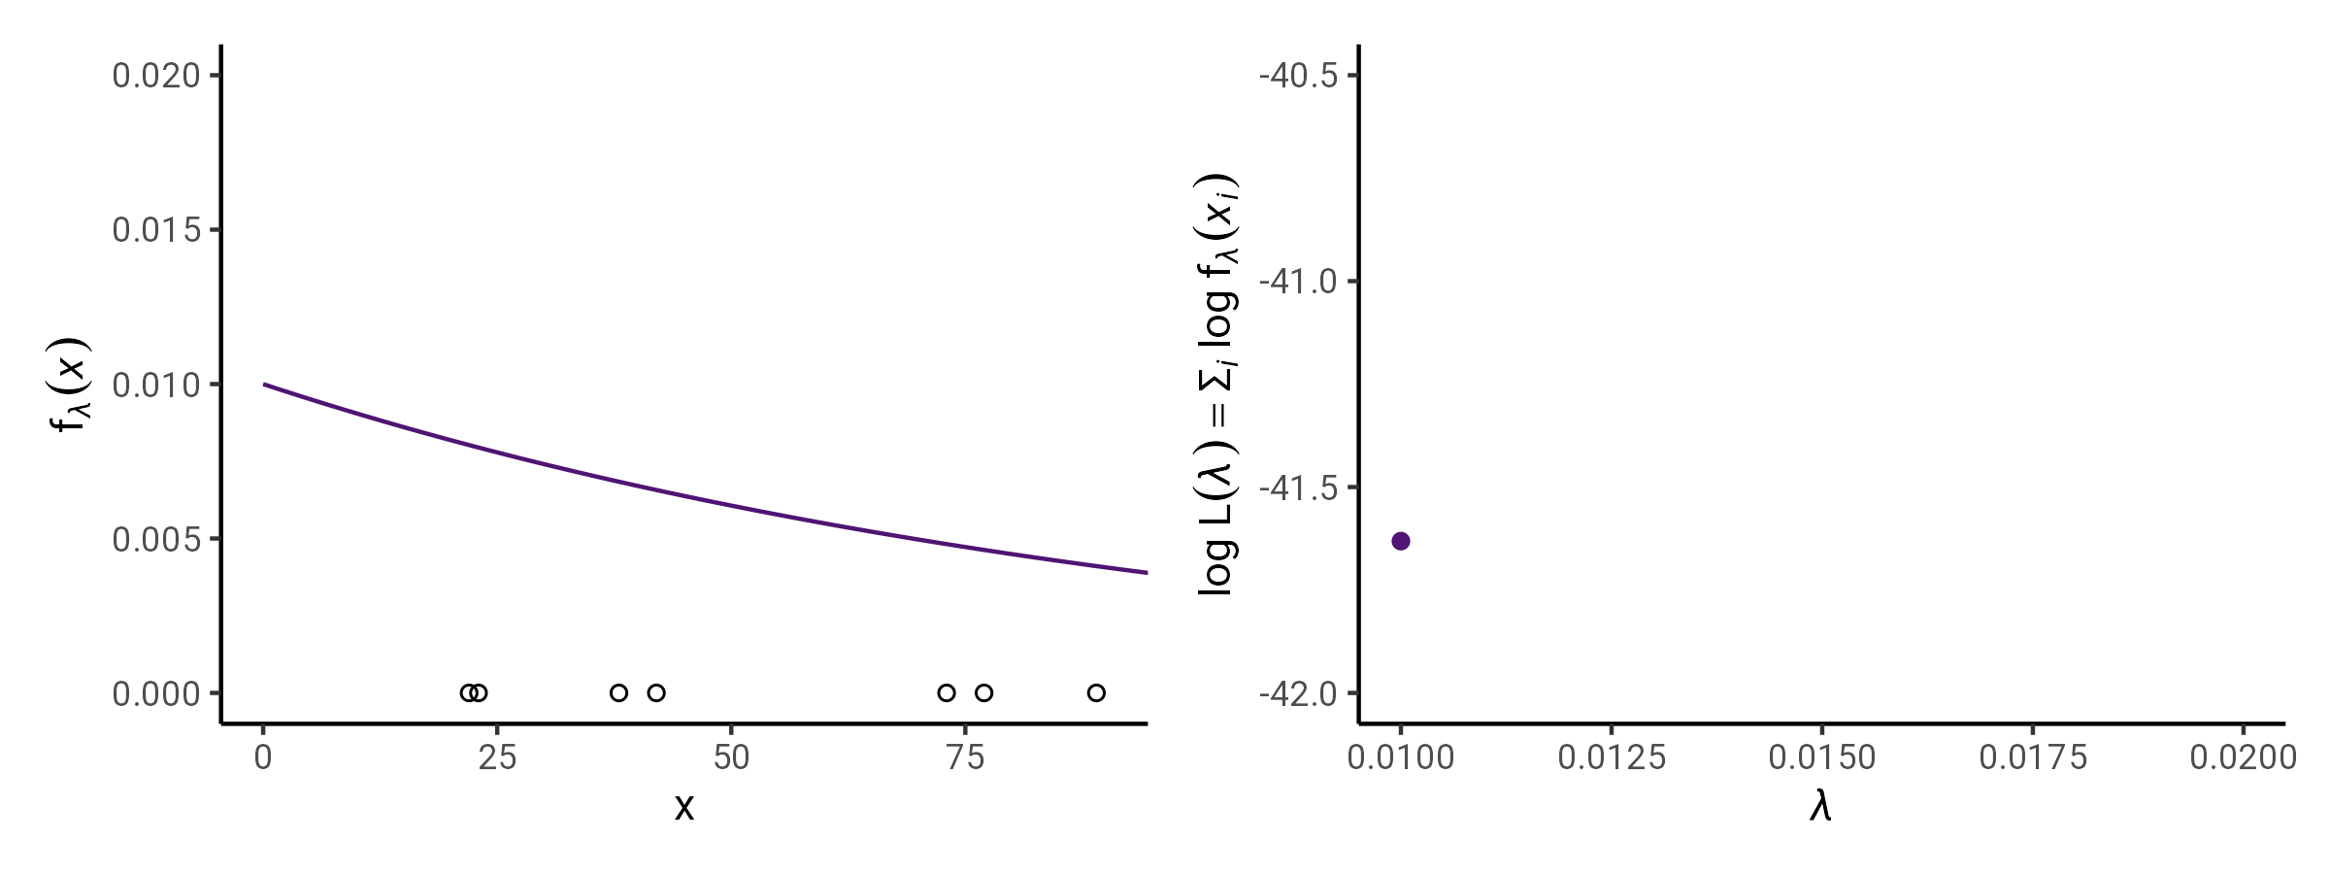
Inferring the Survival Density from Data
Which distribution most likely corresponds to the data?
→ Maximum Likelihood Estimation

Slide 16
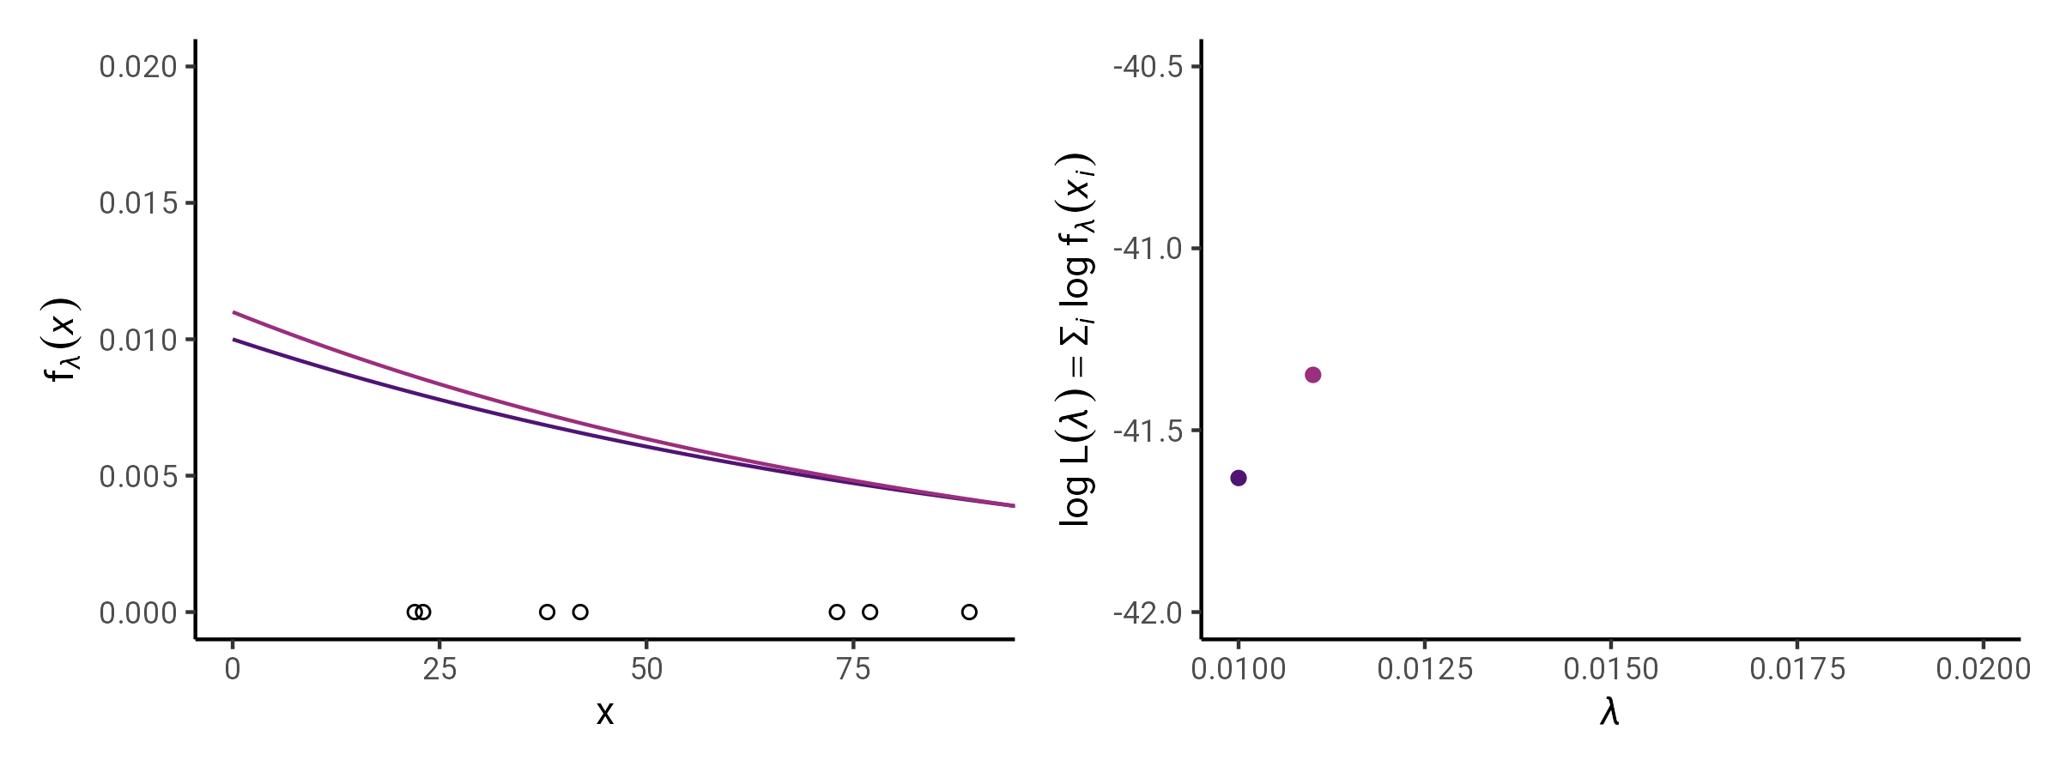
Inferring the Survival Density from Data
Which distribution most likely corresponds to the data?
→ Maximum Likelihood Estimation

Slide 17
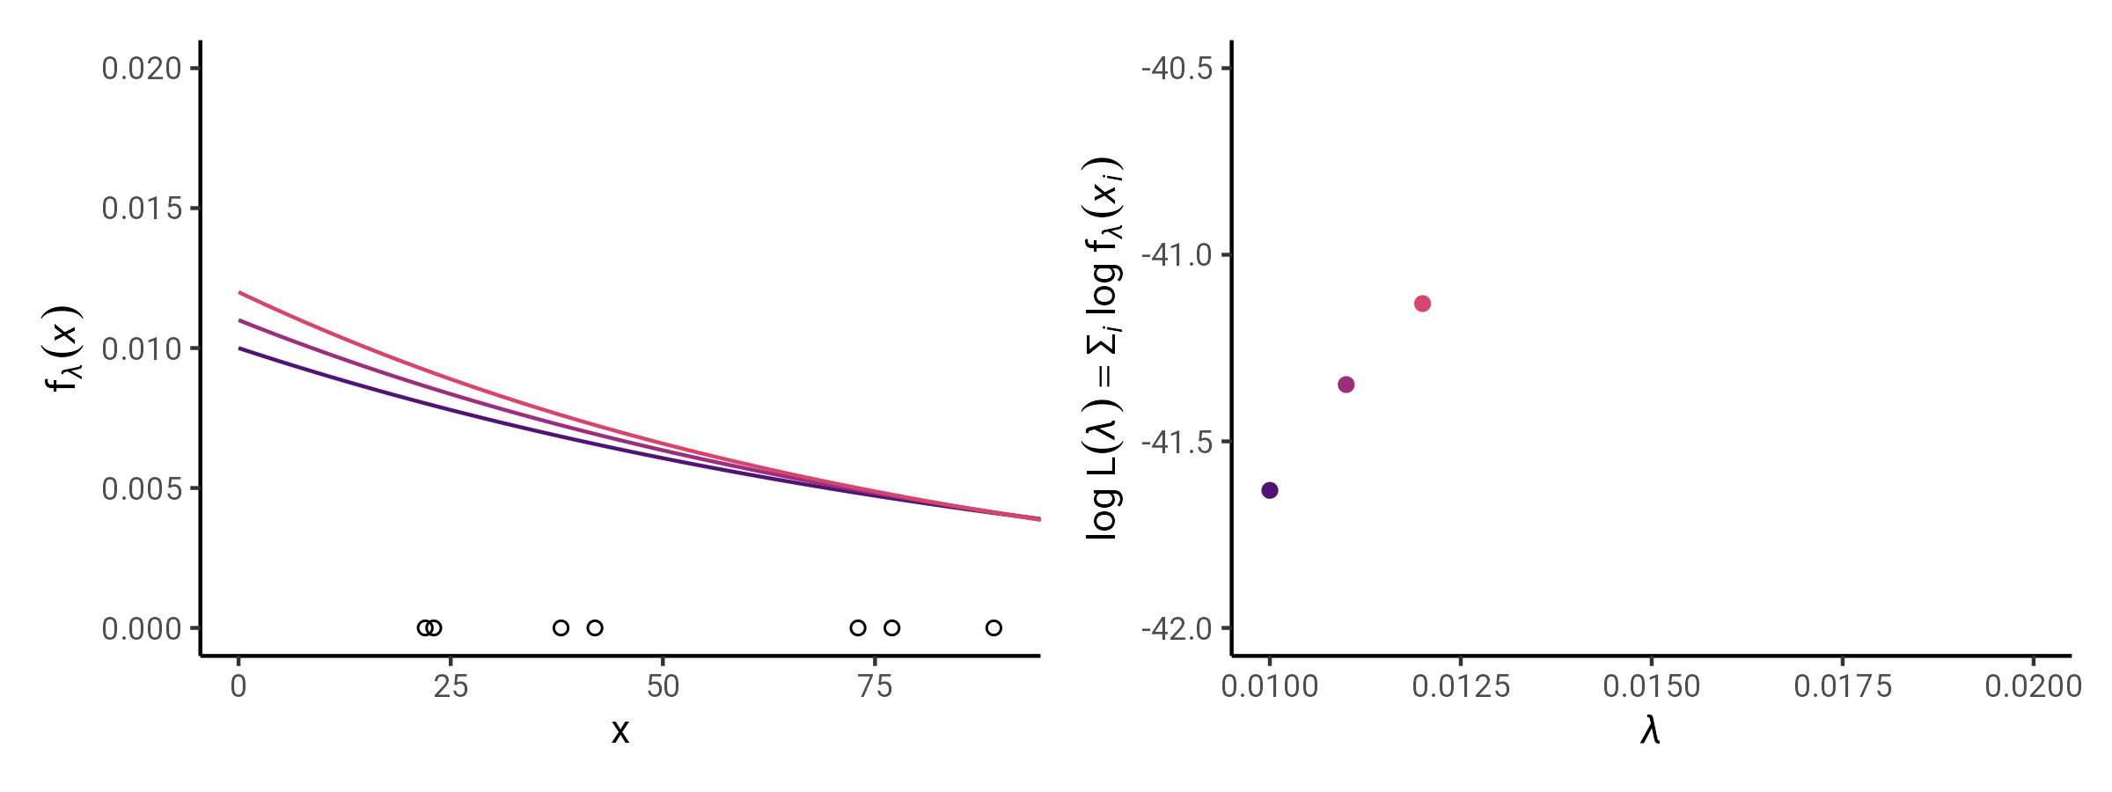
Inferring the Survival Density from Data
Which distribution most likely corresponds to the data?
→ Maximum Likelihood Estimation

Slide 18

Inferring the Survival Density from Data
Which distribution most likely corresponds to the data?
→ Maximum Likelihood Estimation

Slide 19
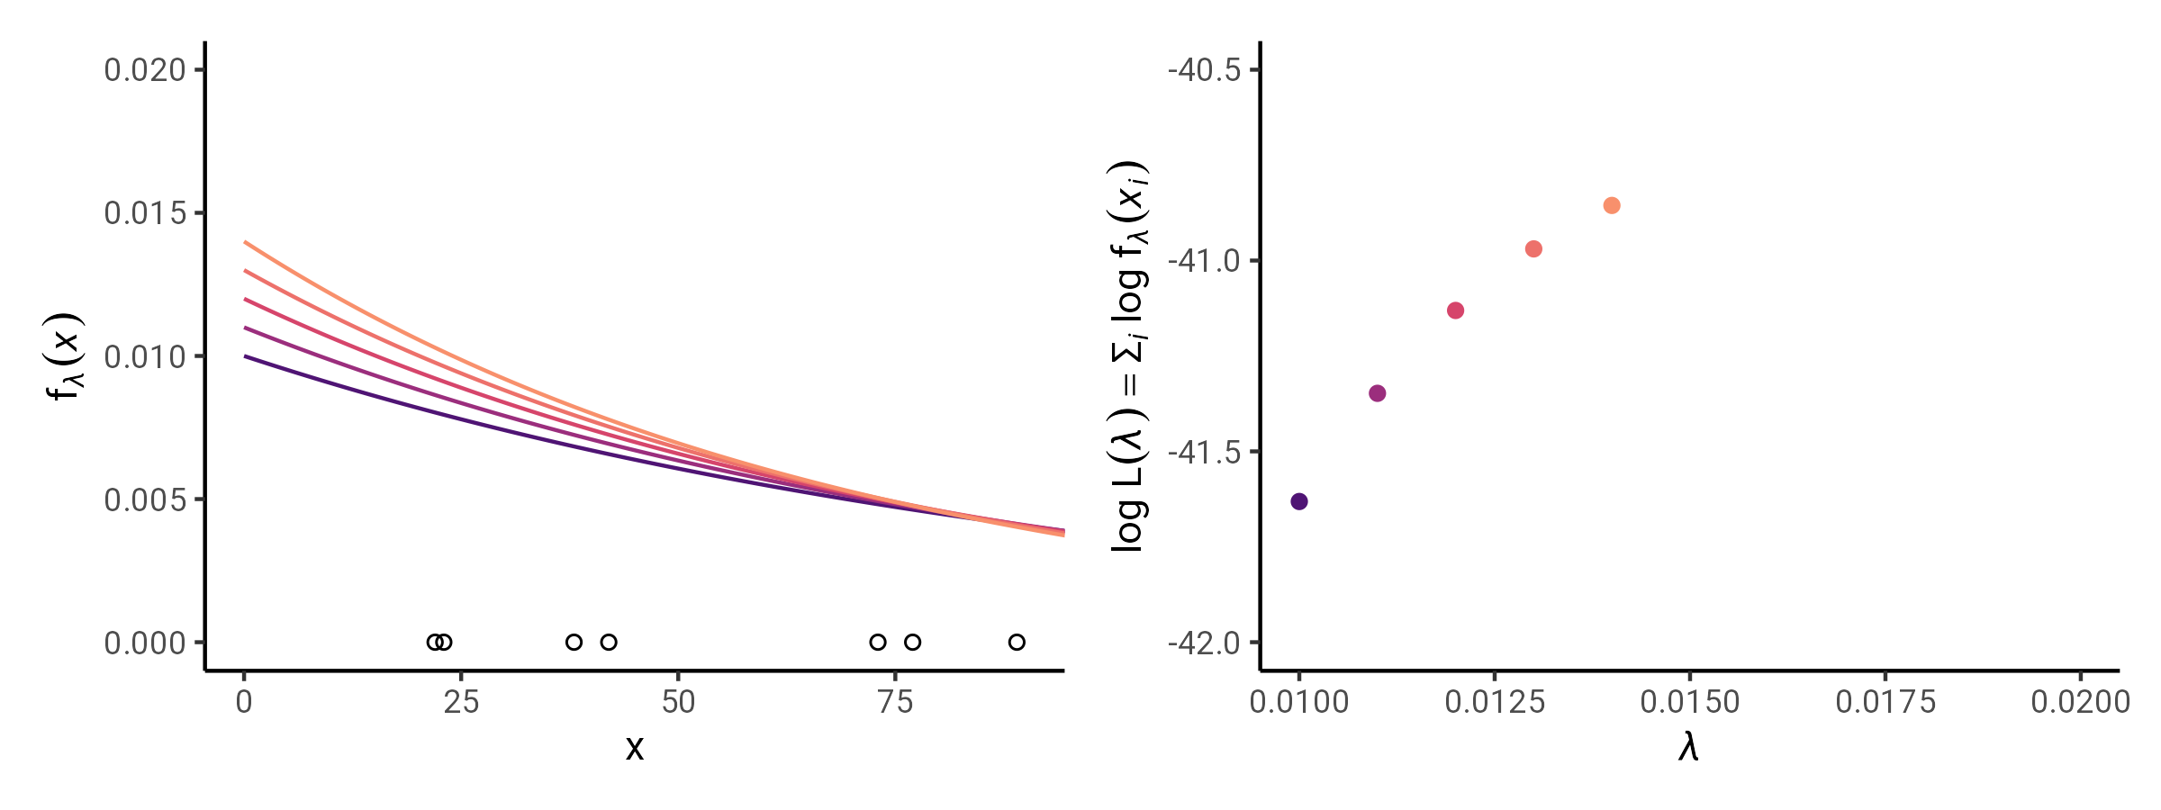
Inferring the Survival Density from Data
Which distribution most likely corresponds to the data?
→ Maximum Likelihood Estimation

Slide 20
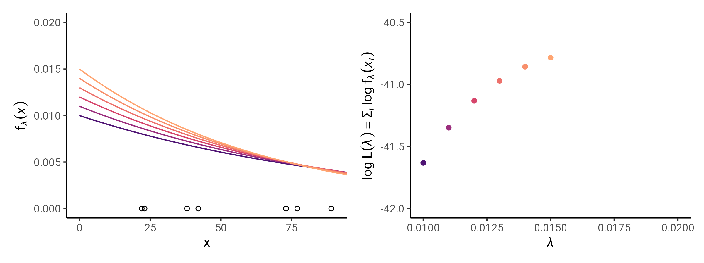
Inferring the Survival Density from Data
Which distribution most likely corresponds to the data?
→ Maximum Likelihood Estimation

Slide 21
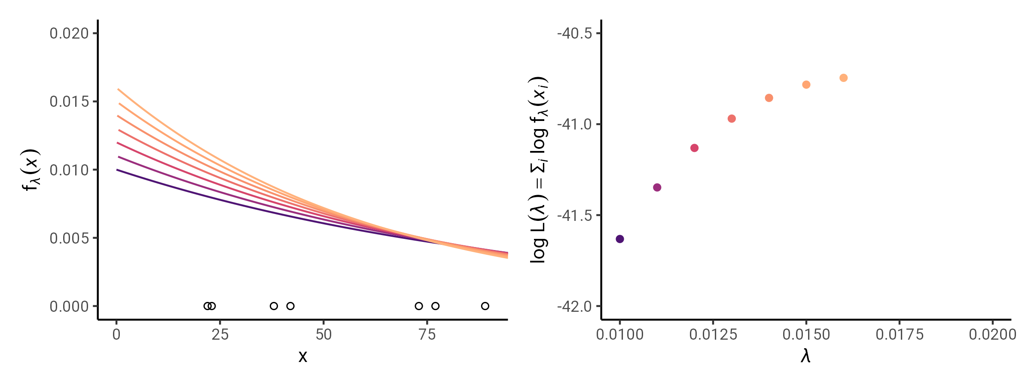
Inferring the Survival Density from Data
Which distribution most likely corresponds to the data?
→ Maximum Likelihood Estimation

Slide 22
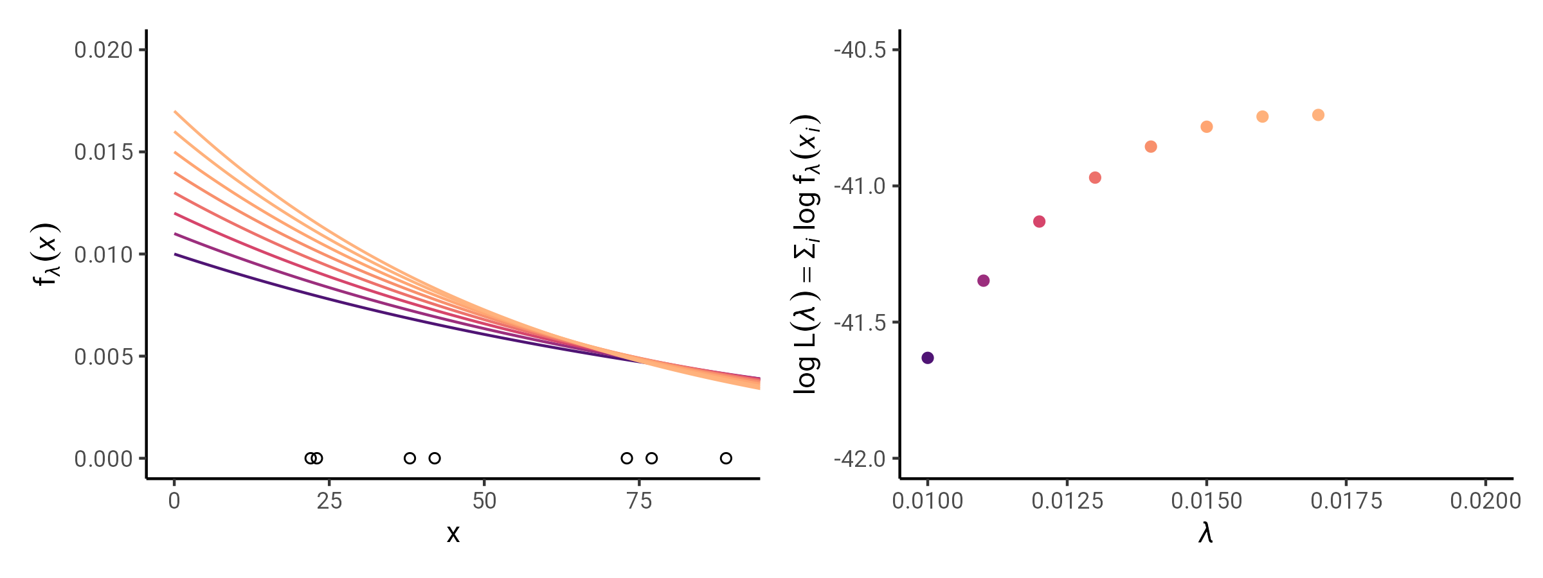
Inferring the Survival Density from Data
Which distribution most likely corresponds to the data?
→ Maximum Likelihood Estimation

Slide 23

Inferring the Survival Density from Data
Which distribution most likely corresponds to the data?
→ Maximum Likelihood Estimation

Slide 24
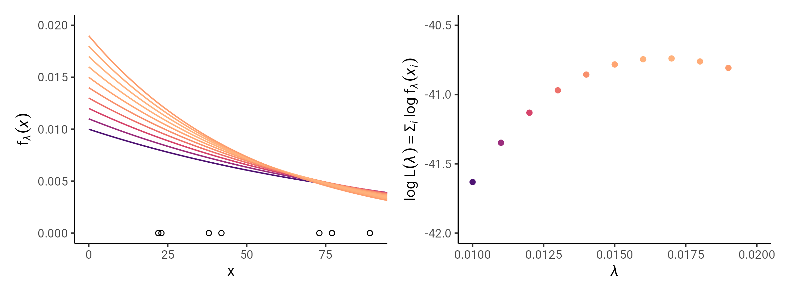
Inferring the Survival Density from Data
Which distribution most likely corresponds to the data?
→ Maximum Likelihood Estimation

Slide 25
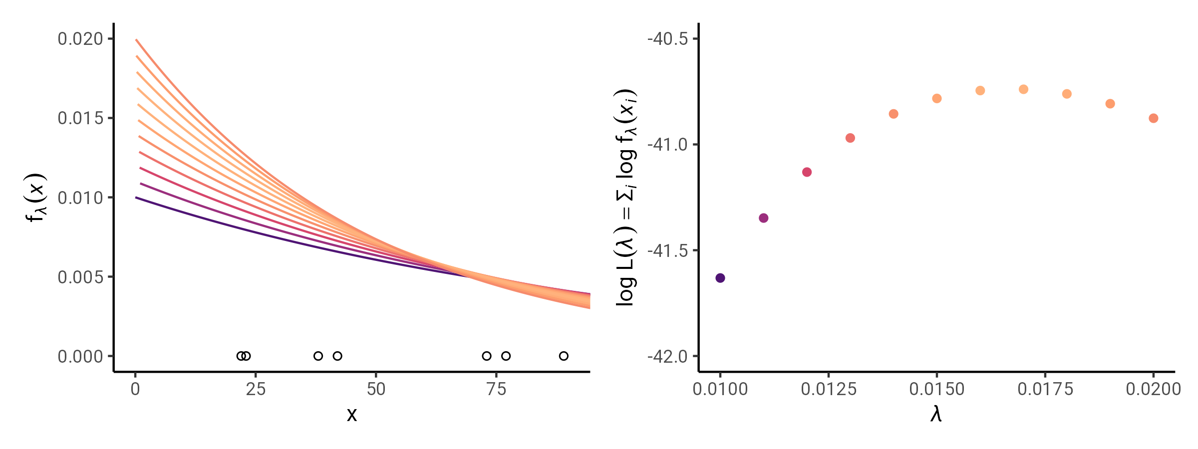
Inferring the Survival Density from Data
Which distribution most likely corresponds to the data?
→ Maximum Likelihood Estimation

Slide 26
Inferring the Survival Density from Data
Which distribution most likely corresponds to the data?
→ Maximum Likelihood Estimation
Observation index
Observed event time
Maximum Likelihood Estimation
We fit a model f_{θ} to the data x by choosing model parameters θ
which maximize the likelihood function L, i.e. which make the
observed data most probable.
L(θ|x) = ∏_{i} f_{θ}(x_{i})
In practice we often maximize the log-likelihood for convenience:
log L(θ|x) = log ∏_{i} f_{θ}(x_{i}) = ∑_{i} log f_{θ}(x_{i})
i
x
f_{λ=0.05}(x)
log f_{λ=0.05}(x)
1
22
0.0166
-4.095
2
23
0.0158
-4.145
3
38
0.0075
-4.895
Product over all observations
4
42
0.0061
-5.095
Probability density given parameters θ
5
73
0.0013
-6.645
6
77
0.0011
-6.845
Single observed survival time
7
89
0.0006
-7.744
8
115
0.0002
-8.745
log L(λ=0.05|x) = ∑_{i} log f_{λ=0.05}(x_{i}) = -47.915
x_{i=1}=22
x_{i=3}=38
x_{i=5}=73
x_{i=2}=23
x_{i=4}=42
x_{i=6}=77
x_{i=7}=89
x_{i=8}=115
f_{θ=λ}(x)= λ exp(-λx)
Time x
Time x₀
Start of observation time
Time x_{ω}
End of observation time

Slide 27
Censoring
But what if some people did not experience the event during the observation time?
→ Censored observations

Slide 28
Inferring the Survival Density from Data
Which distribution most likely corresponds to the data?
→ Maximum Likelihood Estimation
f(x)
Observed event time
Event indicator
i
x
δ
Observation index
1
22
1
For censored observations the survival time is
not exactly known.
→ a right censored event did not happen until time x
→ a left censoring event did happen before time x
0.020
2
23
1
3
38
1
4
42
1
0.015
5
73
1
6
77
1
0.010
7
89
1
8
115
1
0.005
9
>120
0
x_{i=1}=22
x_{i=3}=38
x_{i=5}=73
x_{i=2}=23
x_{i=4}=42
x_{i=6}=77
x_{i=7}=89
x_{i=8}=115
f_{θ=λ}(x)= λ exp(-λx)
Time x
Time x₀
Start of observation time
Time x_{ω}
End of observation time

Slide 29
Inferring the Survival Density from Data
Which distribution most likely corresponds to the data?
→ Maximum Likelihood Estimation
f(x)
Observed event time
Event indicator
i
x
δ
Observation index
1
22
1
For censored observations the survival time is
not exactly known.
→ a right censored event did not happen until time x
→ a left censoring event did happen before time x
Incomplete observations affect the likelihood
L(θ|x) = ∏_{i} f_{θ}^{δ}(x_{i})S_{θ}^{1-δ}(x_{i}) = ∏_{i} λ_{θ}^{δ}(x_{i})S_{θ}(x_{i})
log L(θ|x) = ∑_{i} δ log λ_{θ}(x_{i}) + log S_{θ}(x_{i})
0.020
2
23
1
3
38
1
4
42
1
0.015
5
73
1
6
77
1
0.010
7
89
1
8
115
1
0.005
9
>120
0
x_{i=1}=22
x_{i=3}=38
x_{i=5}=73
x_{i=2}=23
x_{i=4}=42
x_{i=6}=77
x_{i=7}=89
x_{i=8}=115
f_{θ=λ}(x)= λ exp(-λx)
Time x
Time x₀
Start of observation time
Time x_{ω}
End of observation time

Slide 30
Materials for this lecture
github.com/jschoeley/survival_analysis-ur-ss22
Jonas Schöley
@jschoeley
0000-0002-3340-8518
j.schoeley@uni-rostock.de
CC-BY Jonas Schöley 2022

