Slide 1



Survival Analysis
Session 2: From Data to Distribution
Jonas Schöley
@jschoeley
0000-0002-3340-8518
j.schoeley@uni-rostock.de
CC-BY Jonas Schöley 2022

Slide 2
Recap: Survival Identities
In survival analysis we
consider the random variable
“X: Time until event”
x = 0.1 weeks, 2.3 weeks…

Slide 3
Recap: Survival Identities
In survival analysis we
consider the random variable
“X: Time until event”
x = 0.1 weeks, 2.3 weeks…
We express our knowledge about the distribution of X in any of these functions. Knowing any single function we can derive all other via the Survival Identities.

Slide 4
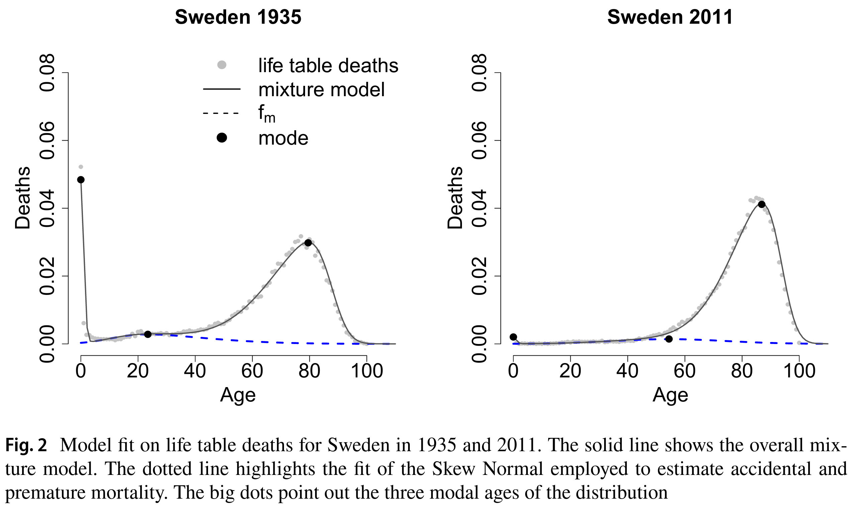
Recap: Survival Identities
In survival analysis we
consider the random variable
“X: Time until event”
x = 0.1 weeks, 2.3 weeks…
We express our knowledge about the distribution of X in any of these functions. Knowing any single function we can derive all other via the Survival Identities.
f(x): Density function
The relative likelihood of
experiencing the event
around time x.
Zanotto etal. (2021). A Mixture‑Function Mortality Model.

Slide 5
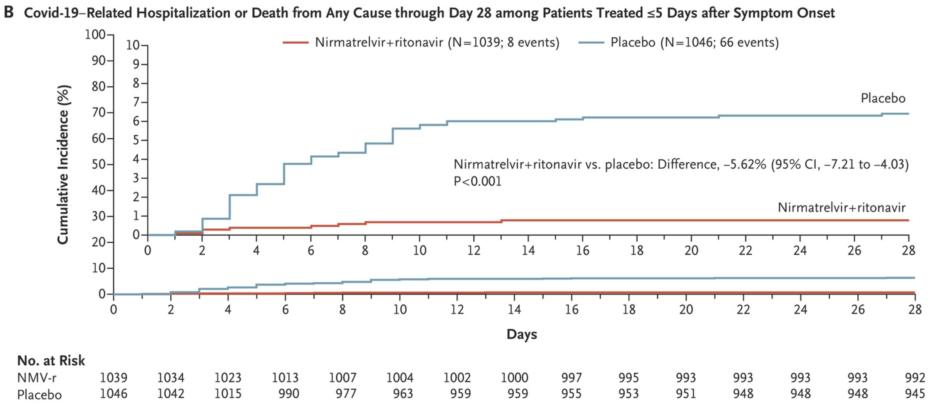
Recap: Survival Identities
In survival analysis we
consider the random variable
“X: Time until event”
x = 0.1 weeks, 2.3 weeks…
We express our knowledge about the distribution of X in any of these functions. Knowing any single function we can derive all other via the Survival Identities.
f(x): Density function
The relative likelihood of
experiencing the event
around time x.
F(x)=₀∫^{x} f(x) dx
F(x): Distribution function
aka Cumulative function
The probability of
experiencing the event until
time x.
F(x): Distribution function
aka Cumulative function
The probability of
experiencing the event until
time x.
F(x): Distribution function
aka Cumulative function
The probability of
experiencing the event until
time x.
Hammond etal. (2022). Oral Nirmatrelvir for High-Risk, Nonhospitalized Adults with Covid-19.
F(x) = P(X≤x)

Slide 6
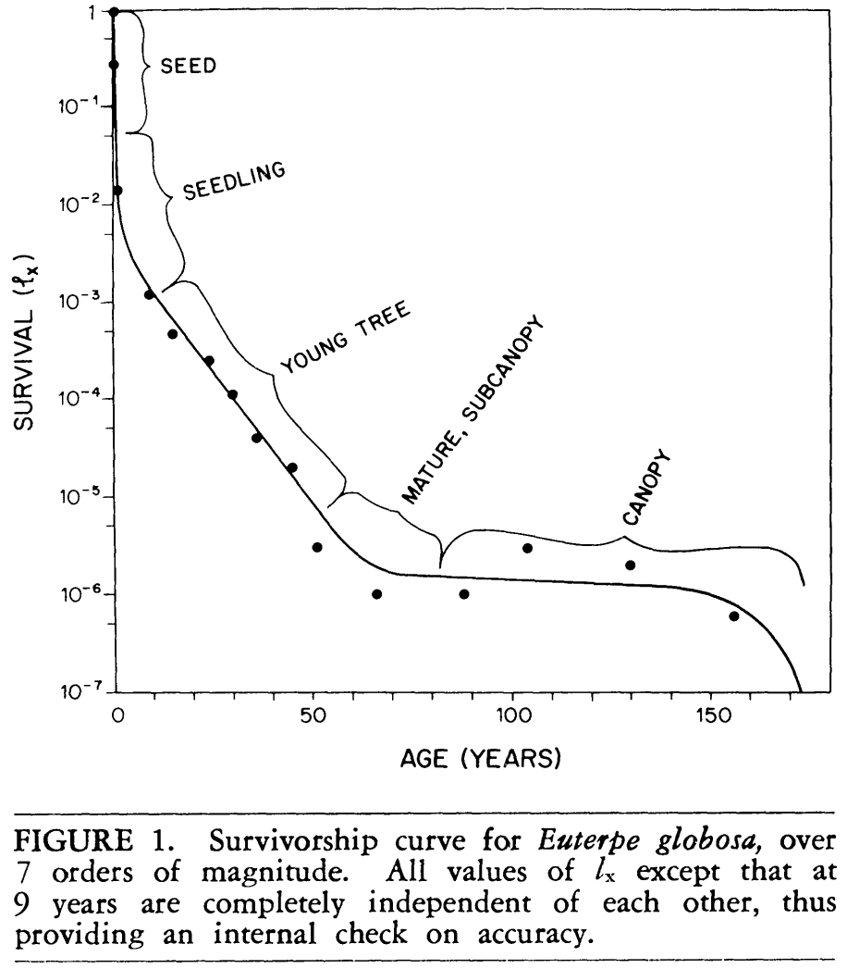
Recap: Survival Identities
In survival analysis we
consider the random variable
“X: Time until event”
x = 0.1 weeks, 2.3 weeks…
We express our knowledge about the distribution of X in any of these functions. Knowing any single function we can derive all other via the Survival Identities.
f(x): Density function
The relative likelihood of
experiencing the event
around time x.
F(x)=₀∫^{x} f(x) dx
S(x)=_{x}∫^{Inf} f(x) dx
F(x): Distribution function
aka Cumulative function
The probability of
experiencing the event until
time x.
S(x): Survival function
The probability of not
experiencing the event until
time x.
F(x): Distribution function
aka Cumulative function
The probability of
experiencing the event until
time x.
F(x): Distribution function
aka Cumulative function
The probability of
experiencing the event until
time x.
S(x)=1-F(x)
F(x) = P(X≤x)
S(x) = P(X>x)
Valen (1975). Life, Death, and Energy of a Tree.

Slide 7
Recap: Survival Identities
In survival analysis we
consider the random variable
“X: Time until event”
x = 0.1 weeks, 2.3 weeks…
We express our knowledge about the distribution of X in any of these functions. Knowing any single function we can derive all other via the Survival Identities.
h(x): Hazard function
The instantaneous rate
of new events at time x
among those who did not
experience the event yet.
f(x): Density function
The relative likelihood of
experiencing the event
around time x.
h(x) = lim_{h→0} P(x≤X<x+h|X≥x)/h
F(x)=₀∫^{x} f(x) dx
S(x)=_{x}∫^{Inf} f(x) dx
h(x)=- S’(x)/S(x)
F(x): Distribution function
aka Cumulative function
The probability of
experiencing the event until
time x.
S(x): Survival function
The probability of not
experiencing the event until
time x.
F(x): Distribution function
aka Cumulative function
The probability of
experiencing the event until
time x.
F(x): Distribution function
aka Cumulative function
The probability of
experiencing the event until
time x.
S(x)=1-F(x)
F(x) = P(X≤x)
S(x) = P(X>x)

Slide 8
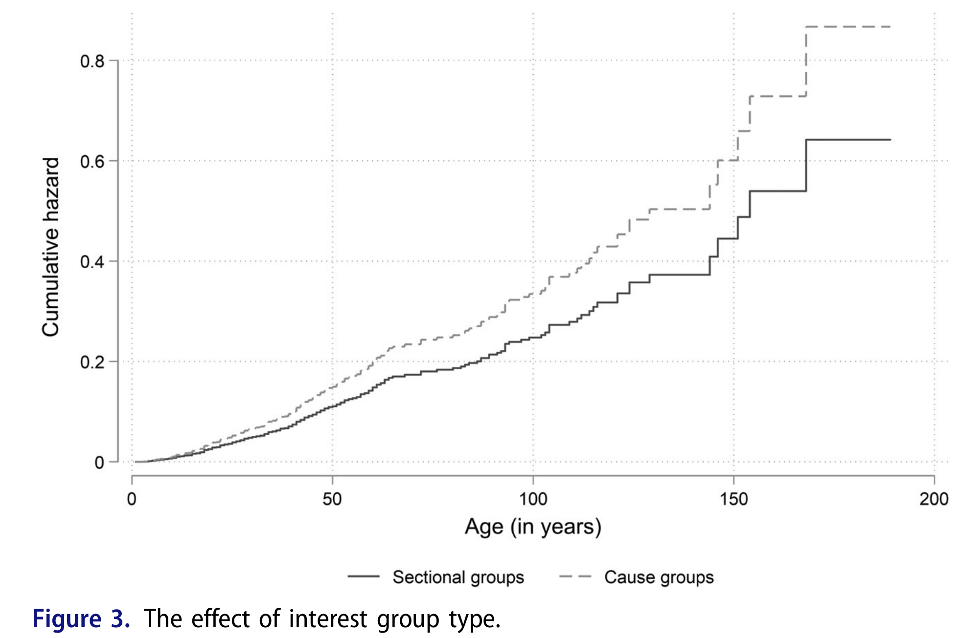
Recap: Survival Identities
In survival analysis we
consider the random variable
“X: Time until event”
x = 0.1 weeks, 2.3 weeks…
We express our knowledge about the distribution of X in any of these functions. Knowing any single function we can derive all other via the Survival Identities.
Klüver (2022). The survival of interest groups.
h(x): Hazard function
The instantaneous rate
of new events at time x
among those who did not
experience the event yet.
f(x): Density function
The relative likelihood of
experiencing the event
around time x.
h(x) = lim_{h→0} P(x≤X<x+h|X≥x)/h
F(x)=₀∫^{x} f(x) dx
S(x)=_{x}∫^{Inf} f(x) dx
h(x)=- S’(x)/S(x)
F(x): Distribution function
aka Cumulative function
The probability of
experiencing the event until
time x.
S(x): Survival function
The probability of not
experiencing the event until
time x.
H(x) = ₀∫^{x} h(x) dx
F(x): Distribution function
aka Cumulative function
The probability of
experiencing the event until
time x.
F(x): Distribution function
aka Cumulative function
The probability of
experiencing the event until
time x.
H(x) = -log S(x)
S(x)=1-F(x)
H(x): Cumulative Hazard
The integral of h(x).
F(x) = P(X≤x)
S(x) = P(X>x)
S(x) = exp(-H(x))

Slide 9
Last Week’s Homework
Choose a time-to-event setting that interests you and look up a constant rate related to that setting. What is the time scale for your setting? When does the time-to-event start? When have have half of the population experienced the event given the chosen rate?
Example: Today we looked at the time until I catch COVID. I choose the rate 2,428 infections per 100,000 persons per 7 days from the local COVID incidences and assumed this rate to be constant. The timescale was “weeks into the semester” and it starts at the first week of the semester. I used the survival function of the exponential distribution to calculate the time until the probability of catching COVID reached 50%.
S(x) = exp(-₀∫^{x} λdx) = exp(-λx)

Slide 10
What Does Survival Data Look Like?
In survival analysis we
consider the random variable
“X: Time until event”
x = 0.1 month, 2.3 months…

Slide 11
What Does Survival Data Look Like?
In survival analysis we
consider the random variable
“X: Time until event”
x = 0.1 month, 2.3 months…
Who? 8 breast cancer patients

Slide 12
What Does Survival Data Look Like?
In survival analysis we
consider the random variable
“X: Time until event”
x = 0.1 month, 2.3 months…
Who? 8 breast cancer patients
Start of observation? Cancer diagnosis

Slide 13
What Does Survival Data Look Like?
In survival analysis we
consider the random variable
“X: Time until event”
x = 0.1 month, 2.3 months…
Who? 8 breast cancer patients
Start of observation? Cancer diagnosis
Event of interest? Death

Slide 14
What Does Survival Data Look Like?
In survival analysis we
consider the random variable
“X: Time until event”
x = 0.1 month, 2.3 months…
Who? 8 breast cancer patients
Start of observation? Cancer diagnosis
Event of interest? Death
Time unit? Months

Slide 15
What Does Survival Data Look Like?
In survival analysis we
consider the random variable
“X: Time until event”
x = 0.1 month, 2.3 months…
Who? 8 breast cancer patients
Start of observation? Cancer diagnosis
Event of interest? Death
Time unit? Months
End of observation? 10 years follow up

Slide 16
What Does Survival Data Look Like?
In survival analysis we
consider the random variable
“X: Time until event”
x = 0.1 month, 2.3 months…
Who? 8 breast cancer patients
Start of observation? Cancer diagnosis
Event of interest? Death
Time unit? Months
End of observation? 10 years follow up
Time x
Time x₀
Start of observation time
Time x_{ω}
End of observation time

Slide 17
What Does Survival Data Look Like?
In survival analysis we
consider the random variable
“X: Time until event”
x = 0.1 month, 2.3 months…
Observation index
Observed event time
i
x
1
22
2
23
Who? 8 breast cancer patients
Start of observation? Cancer diagnosis
Event of interest? Death
Time unit? Months
End of observation? 10 years follow up
3
38
4
42
5
73
6
77
7
89
8
115
x_{i=1}=22
x_{i=3}=38
x_{i=5}=73
x_{i=2}=23
x_{i=4}=42
x_{i=6}=77
x_{i=7}=89
x_{i=8}=115
Time x
Time x₀
Start of observation time
Time x_{ω}
End of observation time

Slide 18
Inferring the Survival Density from Data
A
C
B
Which distribution most likely corresponds to the data?

Slide 19
Inferring the Survival Density from Data
A
C
B
Which distribution most likely corresponds to the data?
→ Maximum Likelihood Estimation

Slide 20
Censoring
But what if some people did not experience the event during the observation time?
Next week → Censored observations

Slide 21
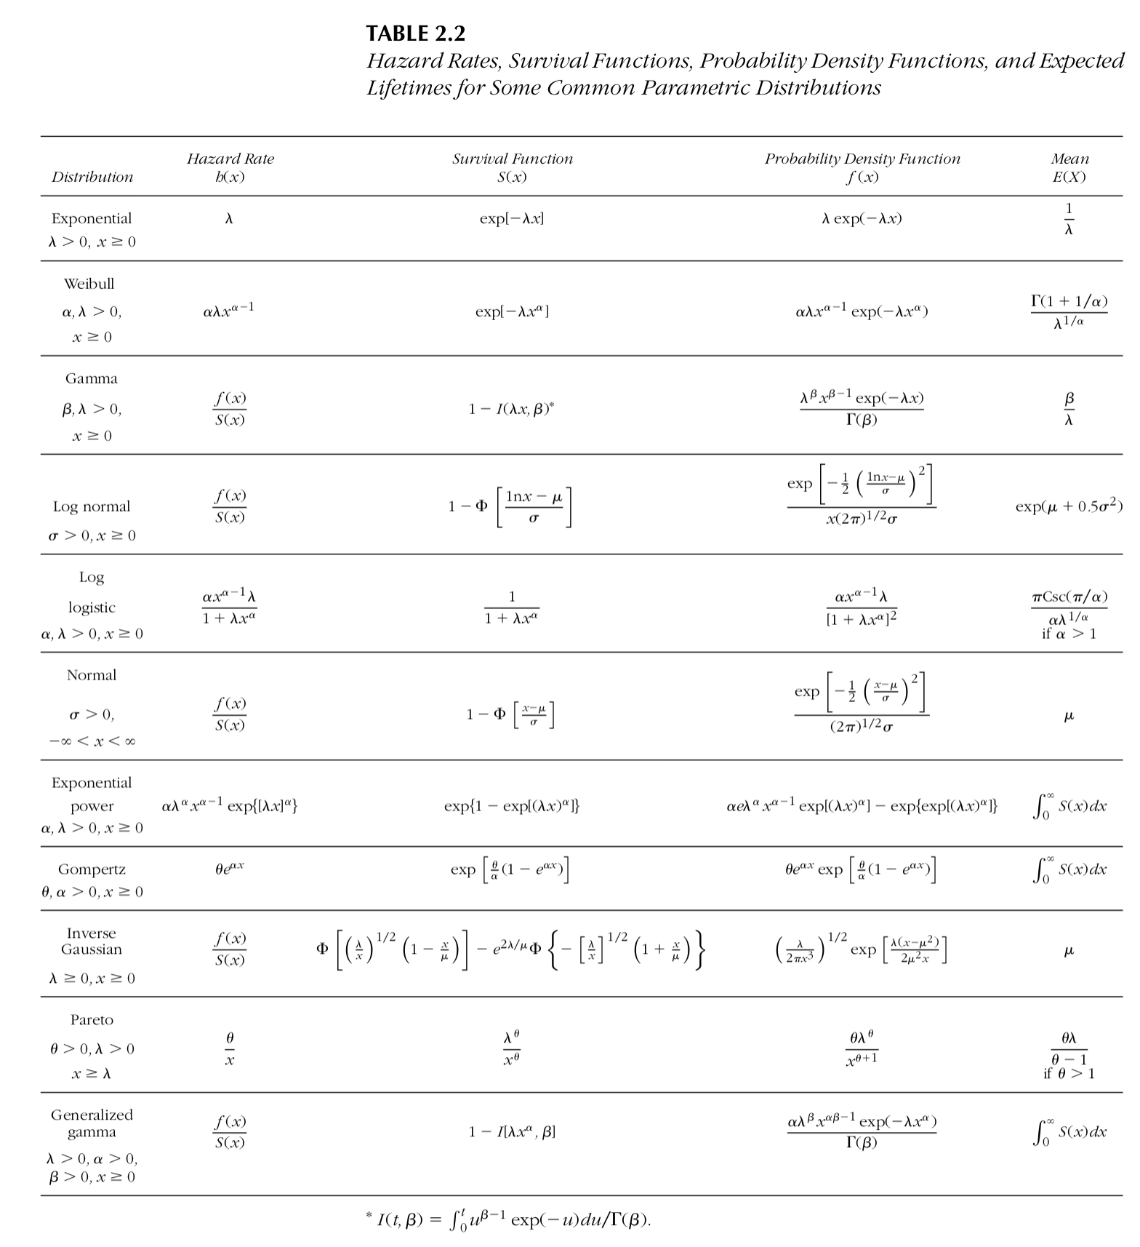
Homework
Using the breastcancer data choose a distribution from the table to the right and fit it to the data via Maximum Likelihood. Use R. You can adapt the script we wrote today.

Slide 22
Materials for this lecture
github.com/jschoeley/survival_analysis-ur-ss22
Jonas Schöley
@jschoeley
0000-0002-3340-8518
j.schoeley@uni-rostock.de
CC-BY Jonas Schöley 2022

