Slide 1



Survival Analysis
Session 1: Probabilities of Survival
Jonas Schöley
@jschoeley
0000-0002-3340-8518
j.schoeley@uni-rostock.de
CC-BY Jonas Schöley 2022

Slide 2
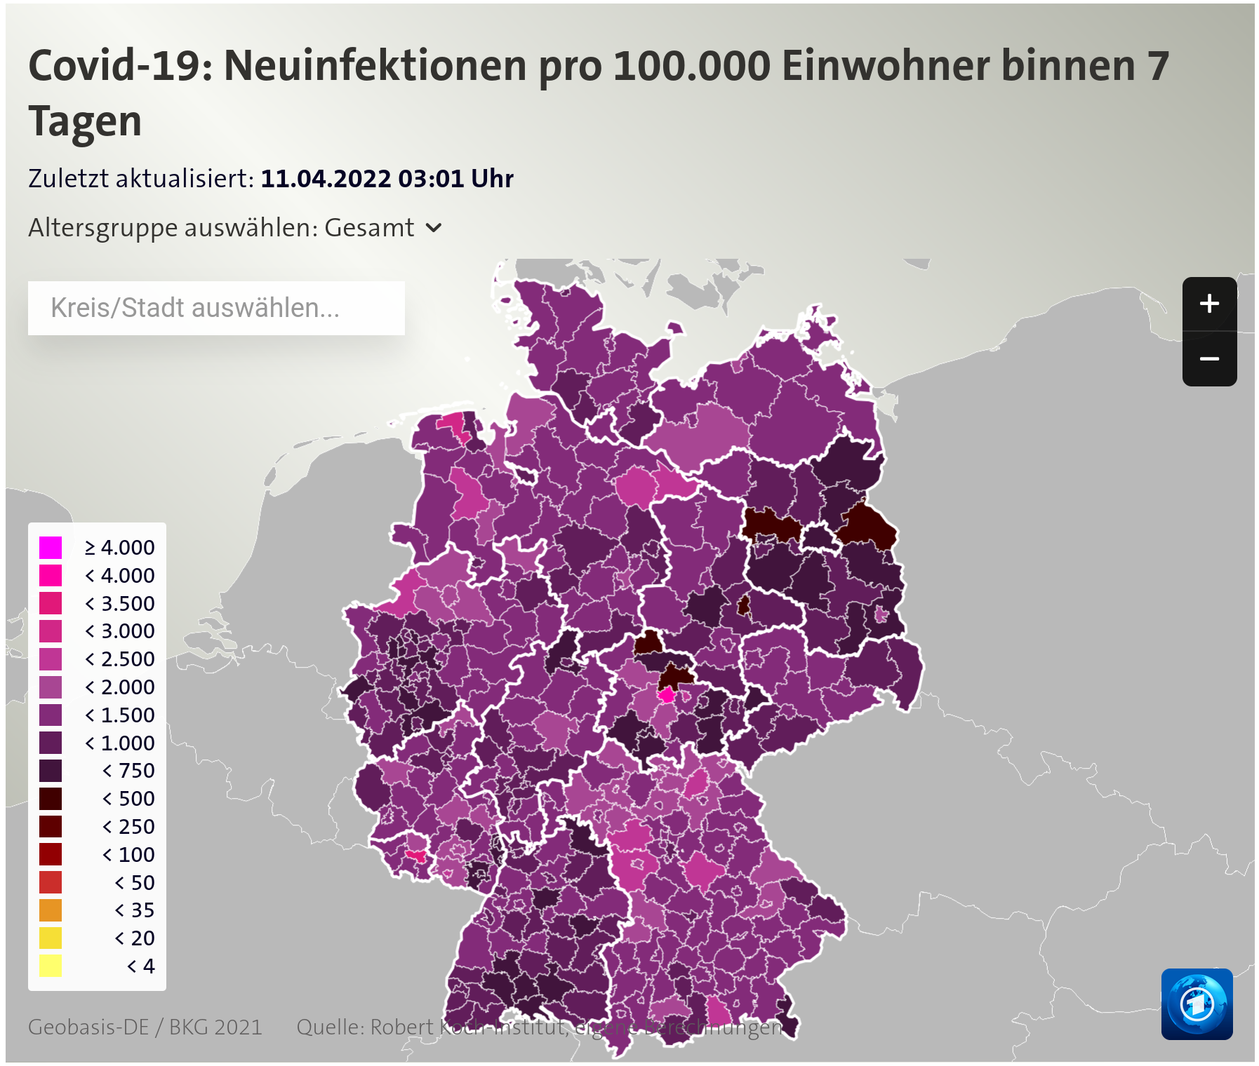
How long until infection?

Slide 3
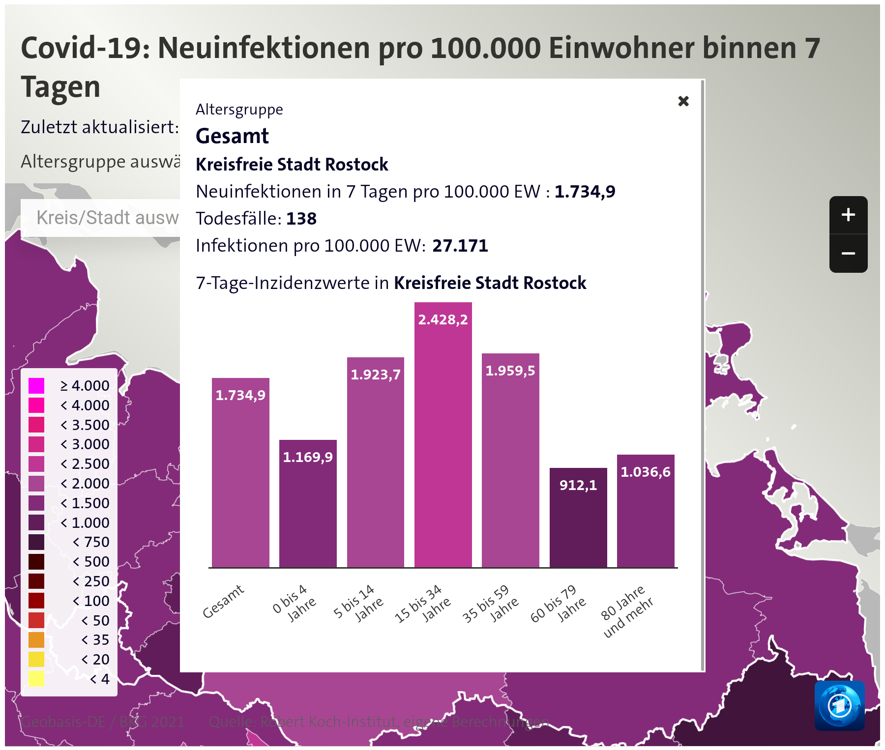
How long until infection?

Slide 4
How long until infection?
What is the expected time until infection given current rates?
What is the median time until infection given current rates?
What is the probability of me “surviving” the
whole semester without catching COVID given current rates?

Slide 5
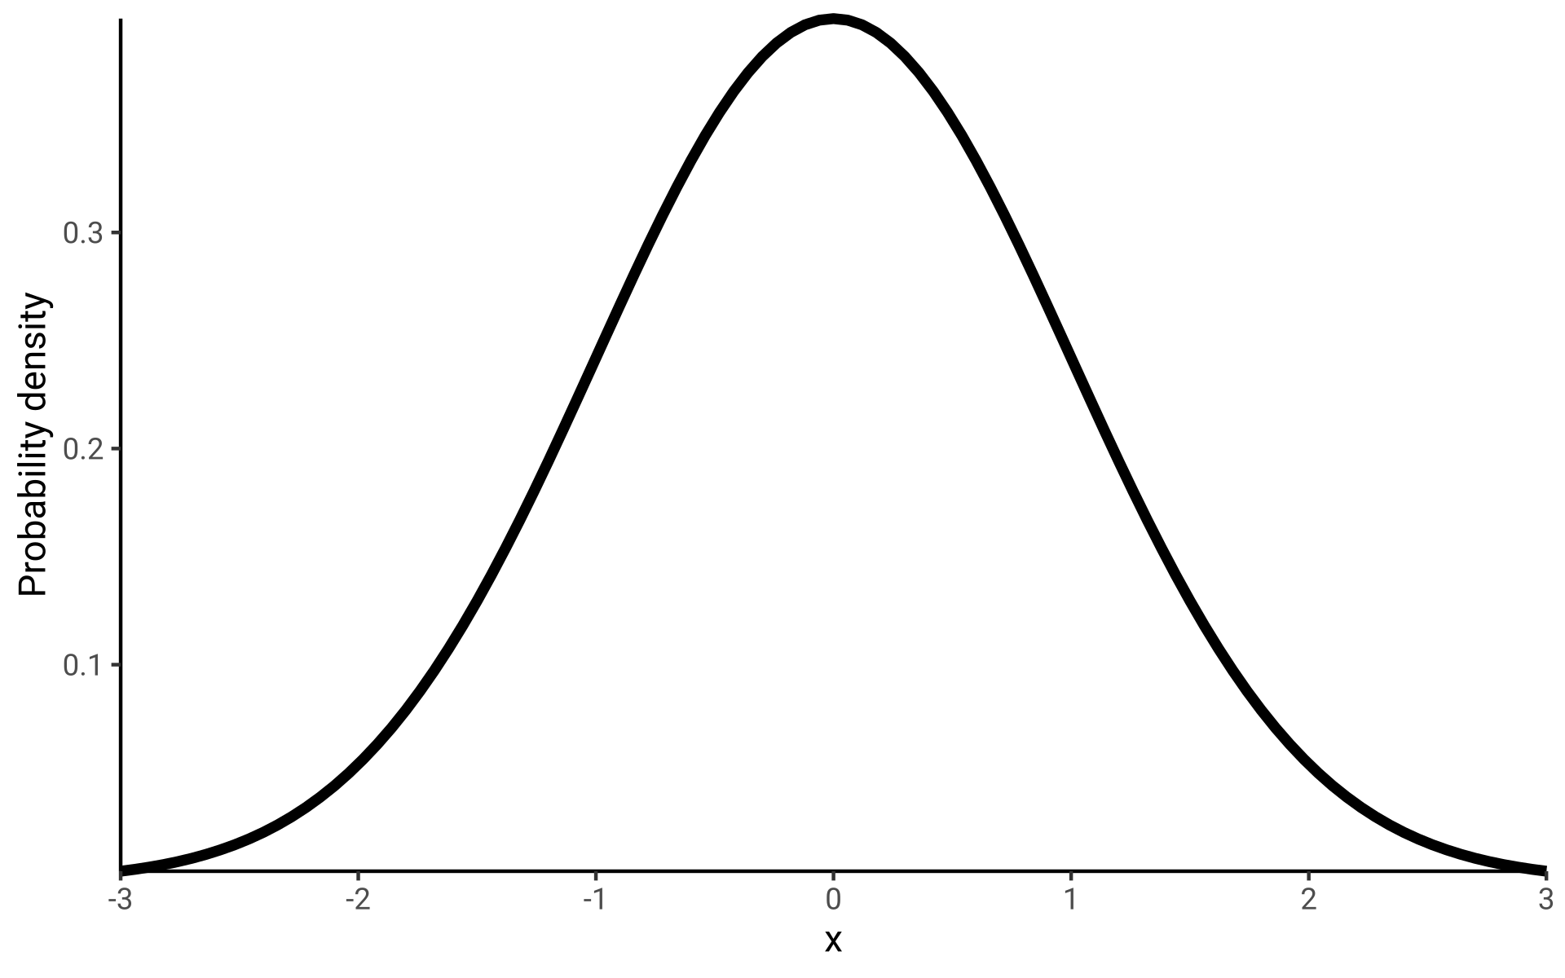
Recap: Random Variables & Probability Distributions
For refreshing your understanding of random variables and probability distributions watch
Khan Academy (2012). Random variables. YouTube.
Princeton COS 302 (2020). Probability density and mass functions. YouTube.

Slide 6
Recap: Random Variables & Probability Distributions
X: Random Variable
A variable whose possible
values x are outcomes of a
random phenomenon.
The relative likelihood of
values is given by the
probability density f_{X}(x).

Slide 7
Recap: Random Variables & Probability Distributions
Random variable X: Population growth
Realized values x = +1.1%, -0.2%, +0.2%...
X: Temperature anomaly
x = +5.1, +3.7, -1.2, -0.2...

Slide 8
Survival Distributions
Because time until event is always positive, we only use distributions over the positive real numbers.
In survival analysis we
consider the random variable
“X: Time until event”
x = 0.1 weeks, 2.3 weeks…

Slide 9
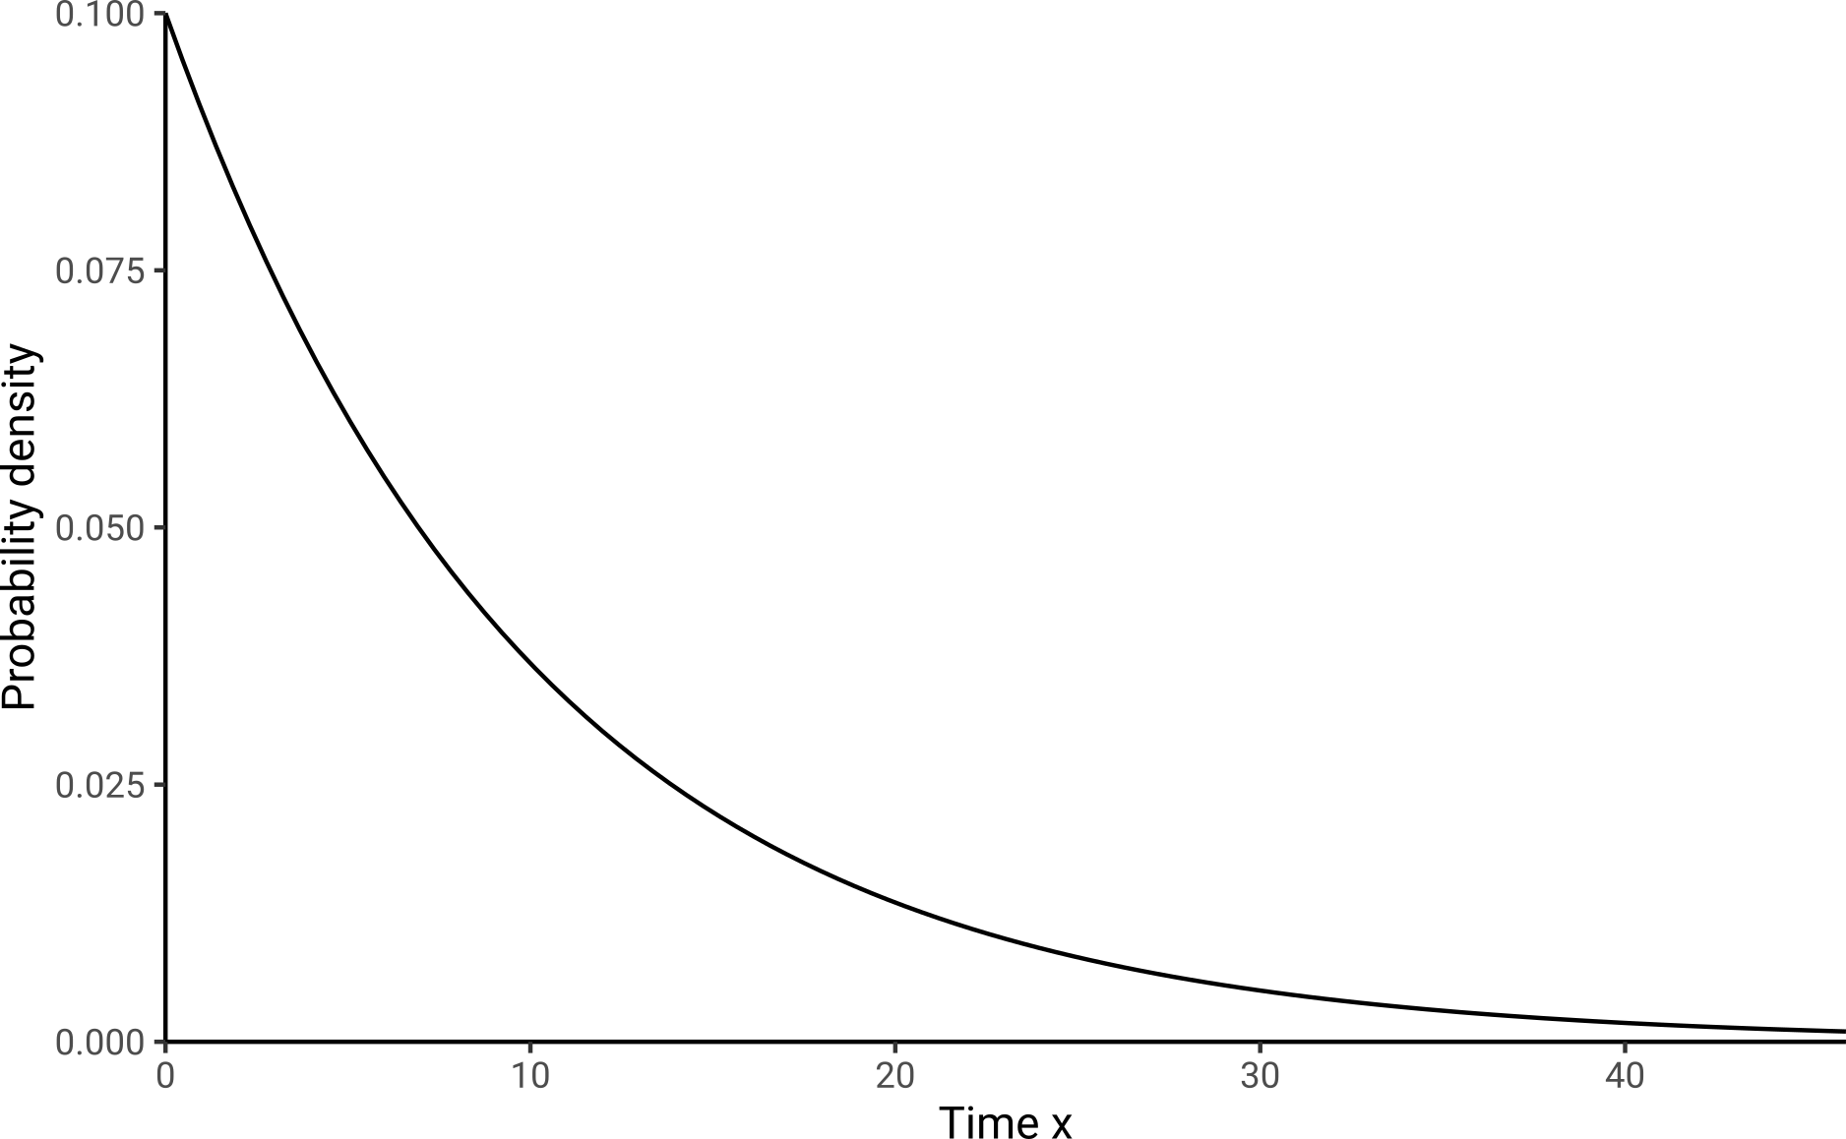
f(x) Density Function
In survival analysis we
consider the random variable
“X: Time until event”
x = 0.1 weeks, 2.3 weeks…

Slide 10
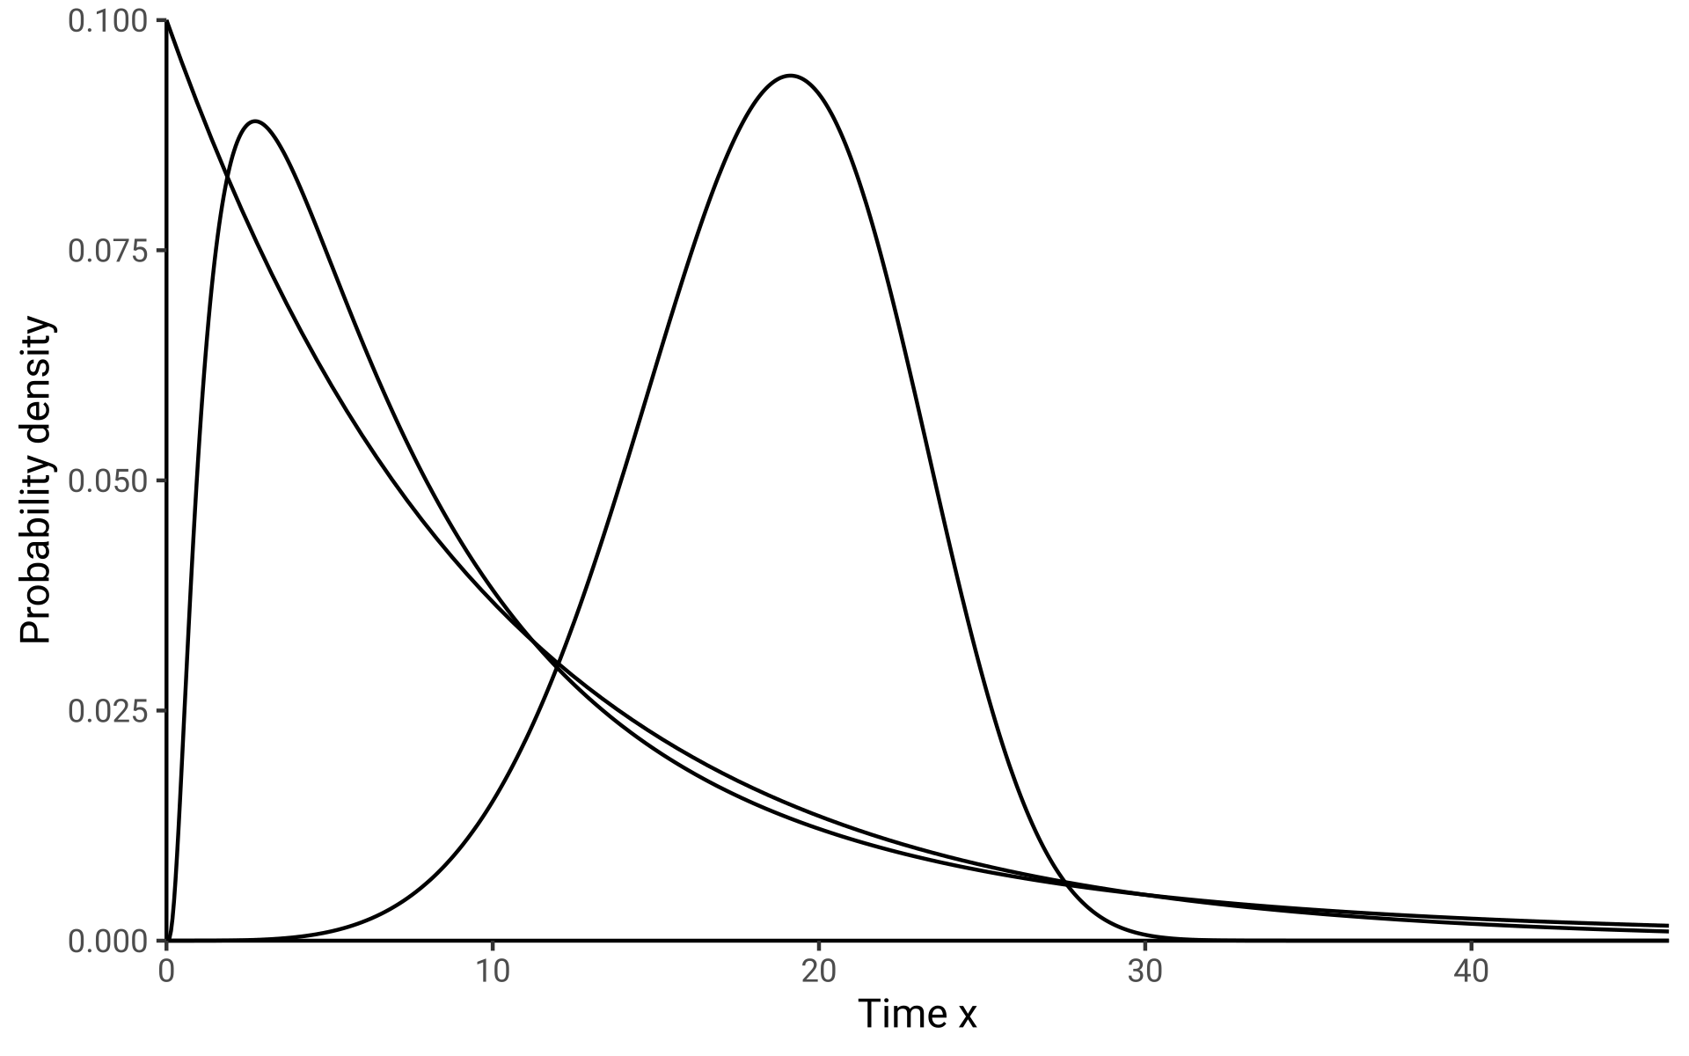
f(x) Density Function
Densities come in many shapes

Slide 11
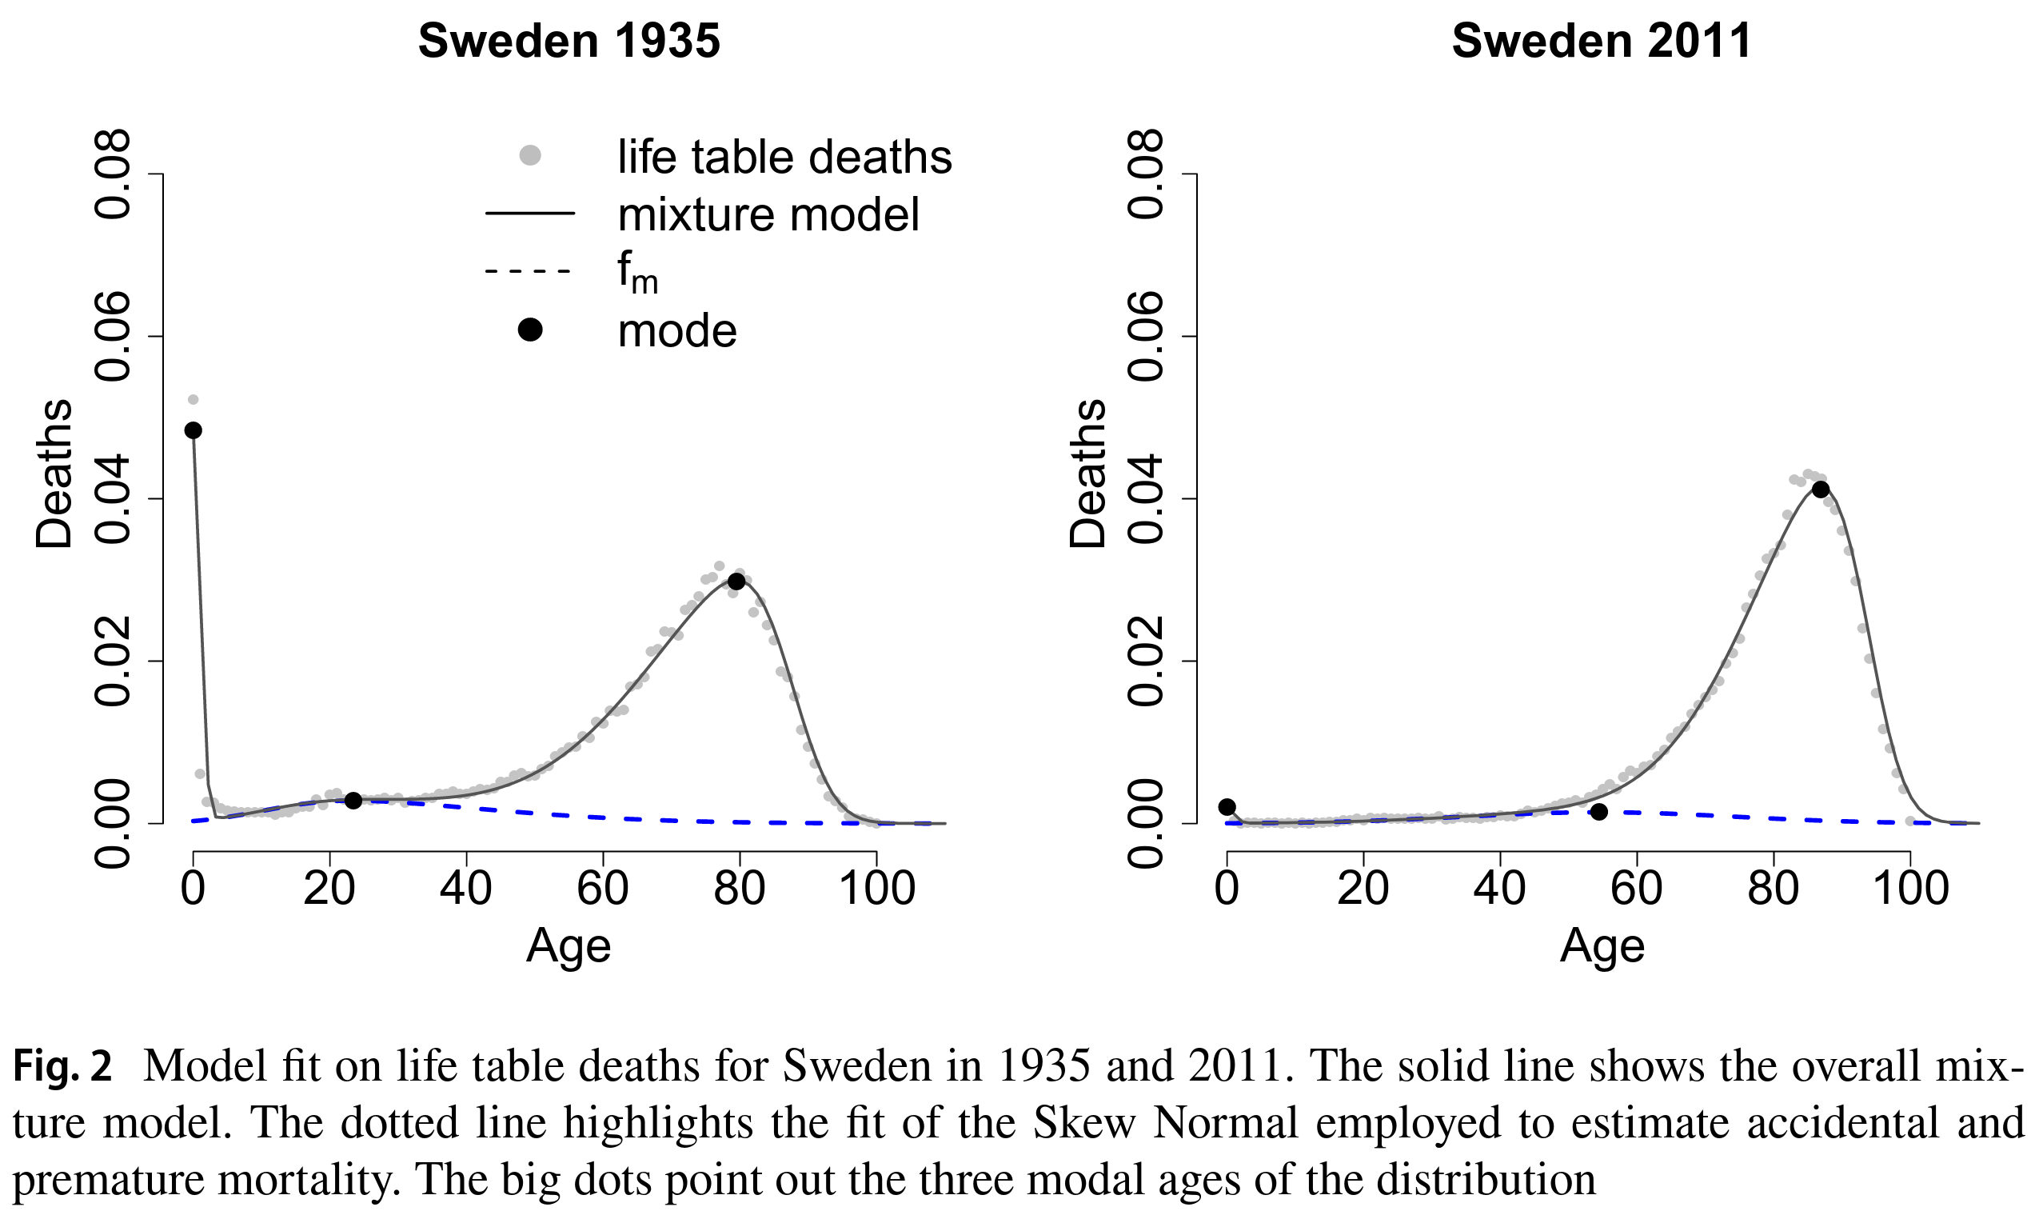
f(x) Density Function
Densities come in many shapes
Here’s the distribution of the
random variable “years until death”
in Sweden.
Zanotto etal. (2021). A Mixture‑Function Mortality Model.

Slide 12
f(x) Density Function
Points on the density function
give us the relative likelihood of
two values. But they don’t give us
probabilities yet. For that we need
to integrate...
f(x=10) = 0.037
f(x=20) = 0.014

Slide 13
f(x) Density Function
For refreshing your understanding of basic calculus watch the series
Integrating the density function
We get probabilities of the event occurring in a given time interval by integrating the density over said interval.
3Blue1Brown (2017). The essence of calculus. YouTube.
The probability of an event occurring between time 10 and 11 is 0.013.
P(10<x<11) =₁₀∫¹¹ f(x) dx = 0.035
P(20<x<21) =₂₀∫²¹ f(x) dx = 0.013

Slide 14
f(x) Density Function
The area under the probability density is always 1.
It is thus certain to experience the event in question at some point.
That’s a modeling assumption.
If the assumption does not fit our research subject,
then we need to adapt the model.
P[0<x<Inf] = 1

Slide 15
F(x) Distribution Function
But what about the probability of an event occurring before time x?
Distribution Function!

Slide 16
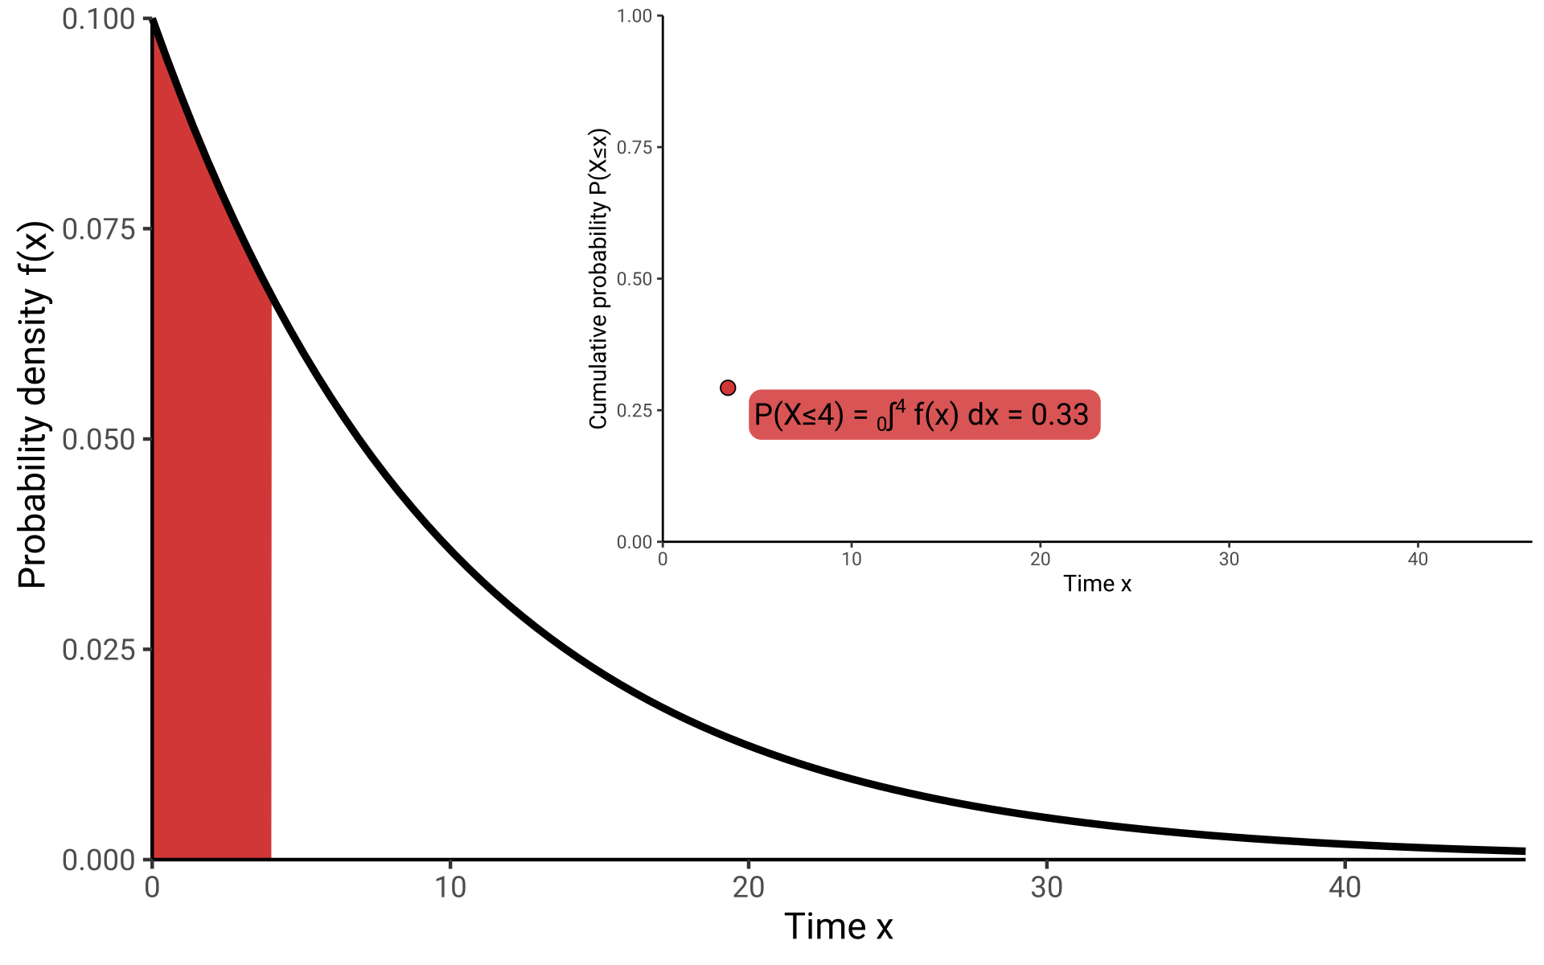
F(x) Distribution Function
The probability of an event occurring before time 4 is 0.33.

Slide 17
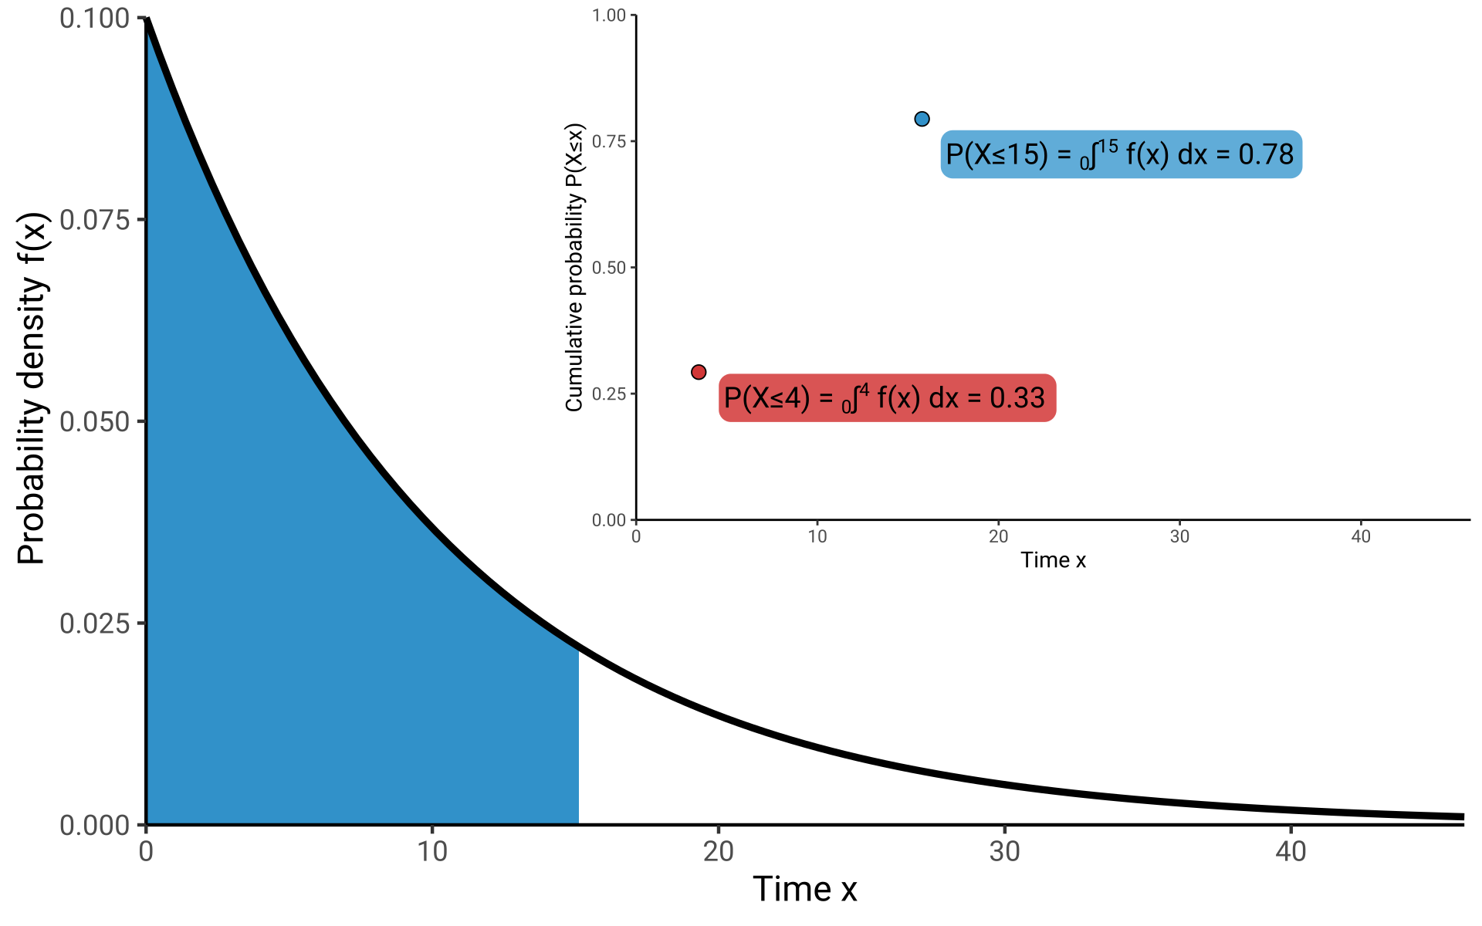
F(x) Distribution Function
The probability of an event occurring before time 15 is 0.78.
The probability of an event occurring before time 4 is 0.33.

Slide 18
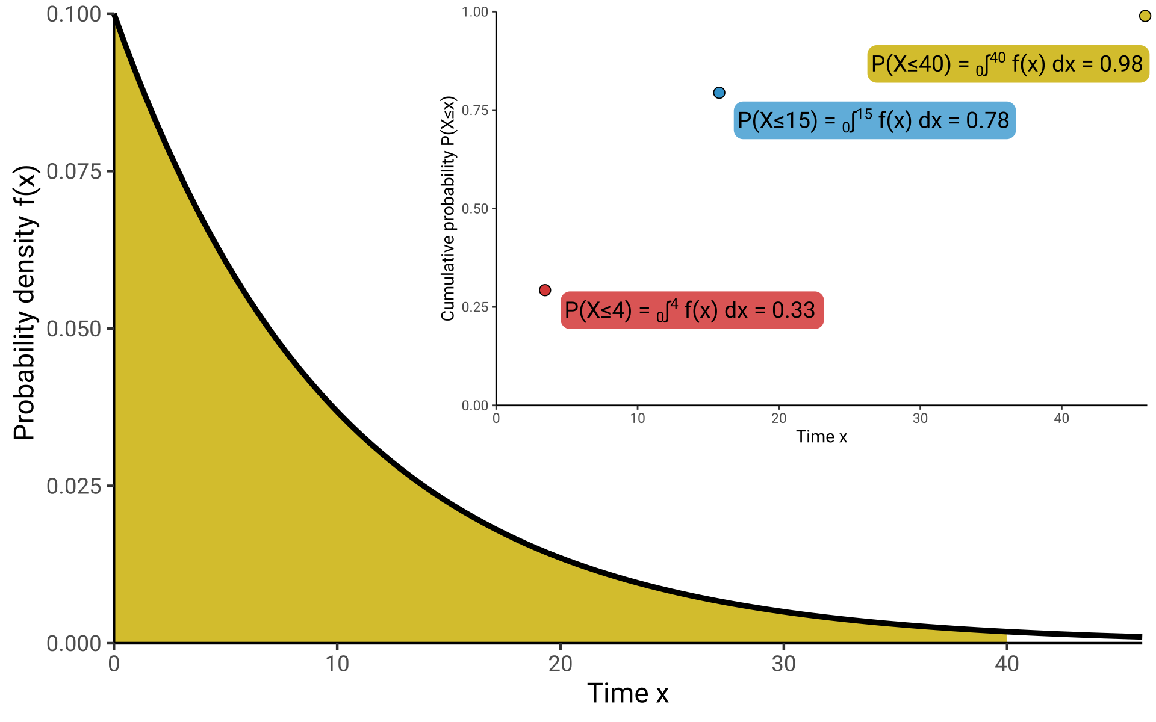
F(x) Distribution Function

Slide 19
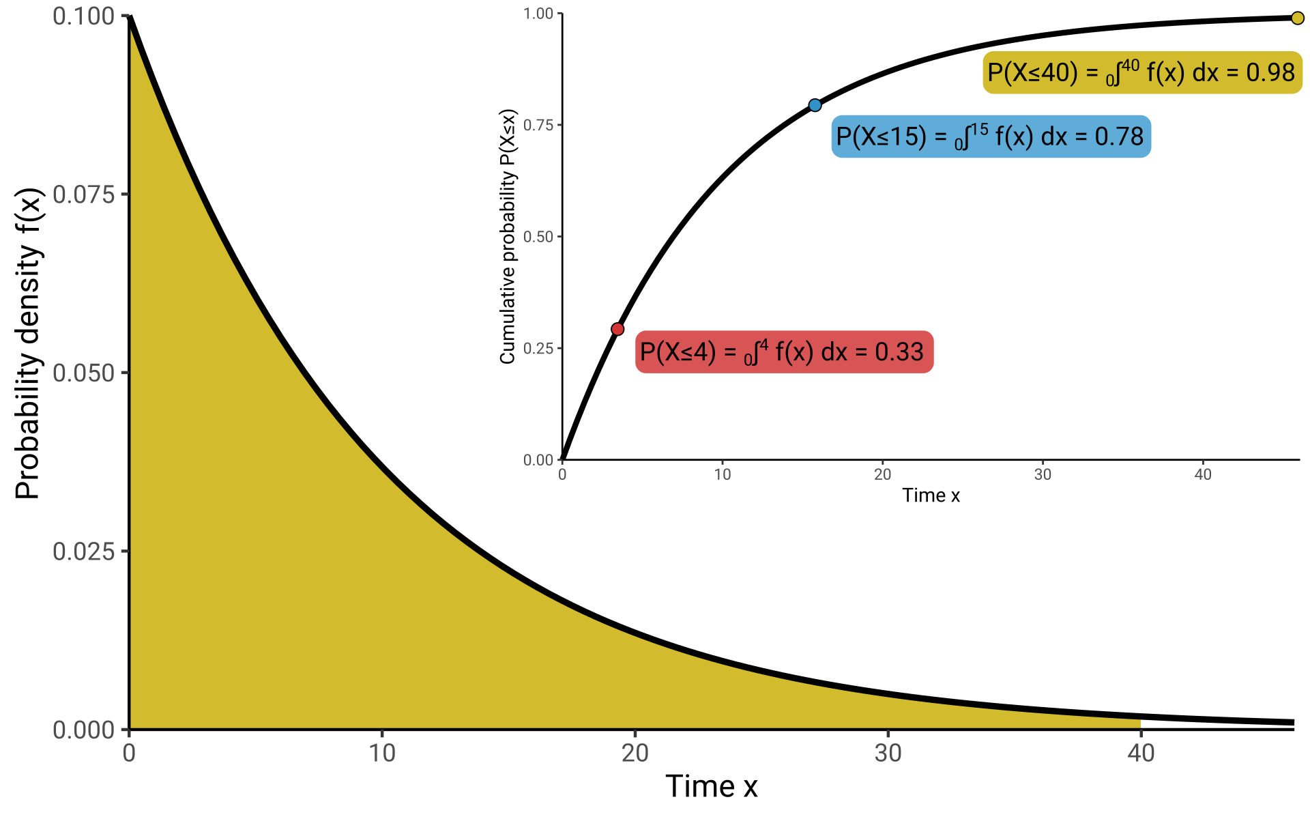
F(x) Distribution Function

Slide 20
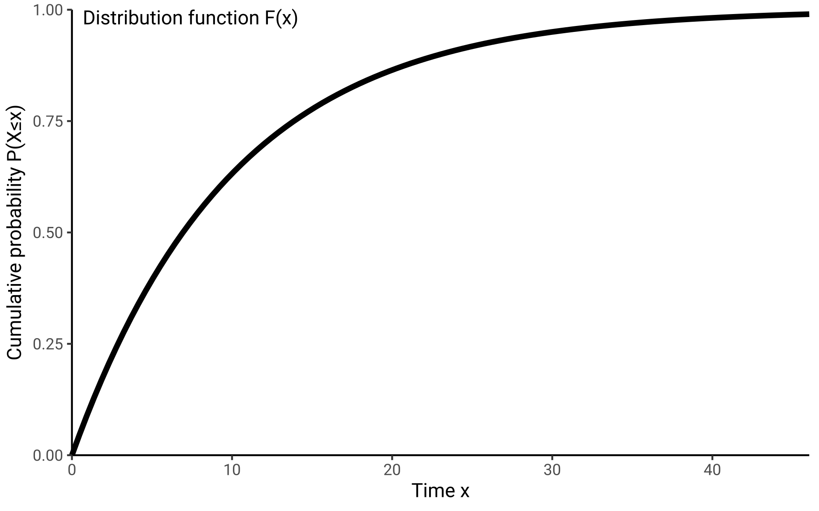
F(x) Distribution Function
X: Time until event
x = 0.1 weeks, 2.3 weeks...
F(x): Distribution function
aka Cumulative function
The probability of
experiencing the event until
time x.
F(x) = P(X≤x) = ₀∫^{x} f(x) dx

Slide 21
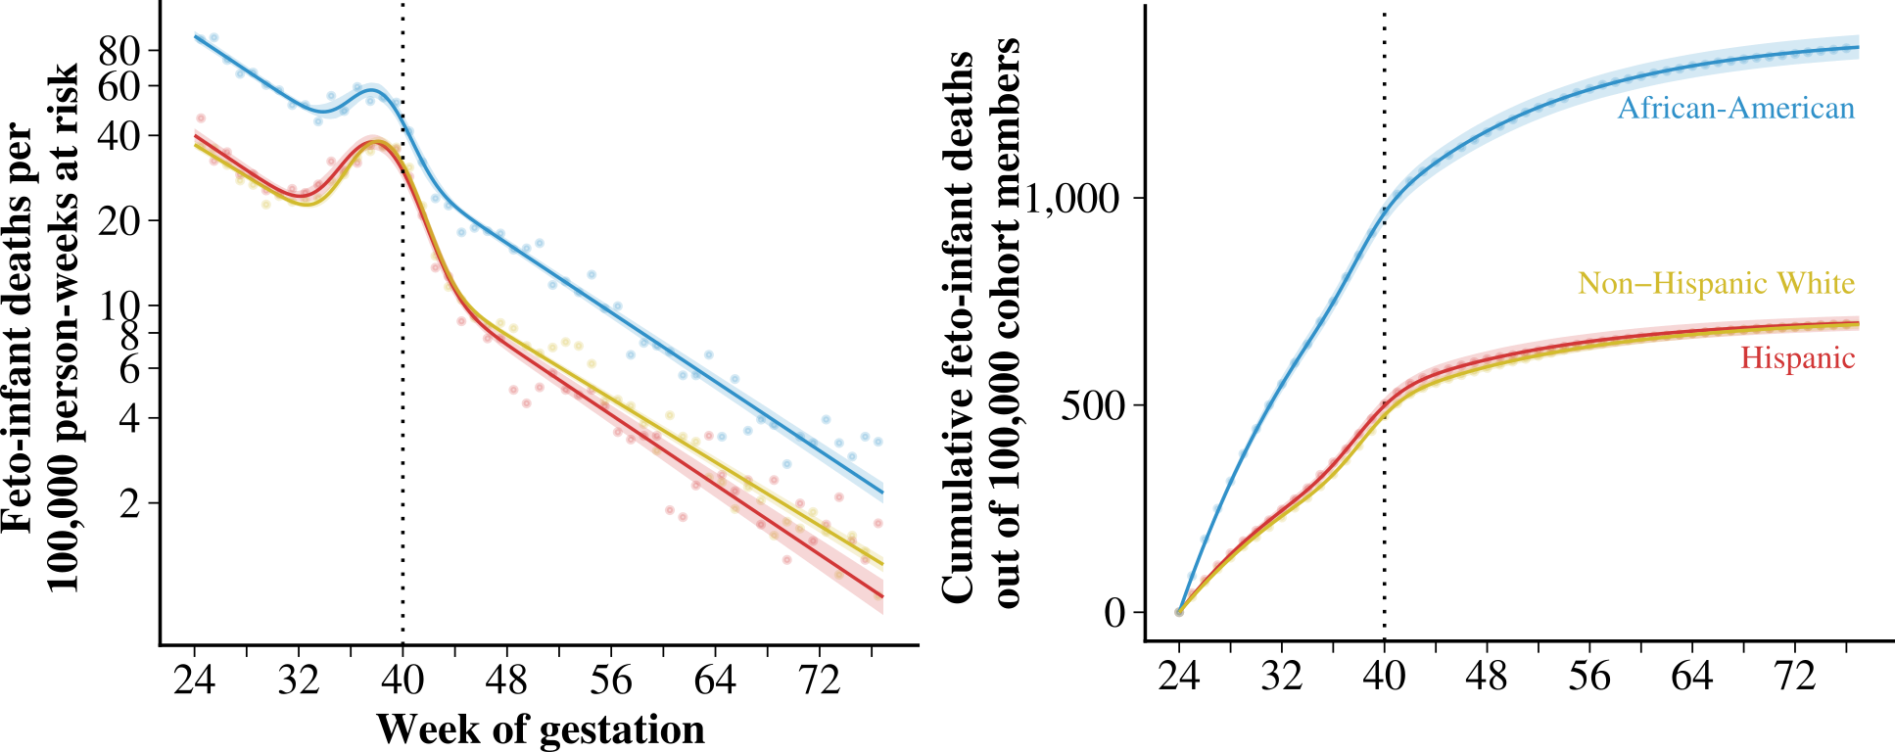
F(x) Distribution Function
X: Time until event
x = 0.1 weeks, 2.3 weeks...
F(x): Distribution function
aka Cumulative function
The probability of
experiencing the event until
time x.
F(x) = P(X≤x) = ₀∫^{x} f(x) dx
Schöley (2020). The dynamics of ontogenescence.

Slide 22
S(x) Survival Function
But what about the probability of an event occurring after time x?
Survival Function!

Slide 23
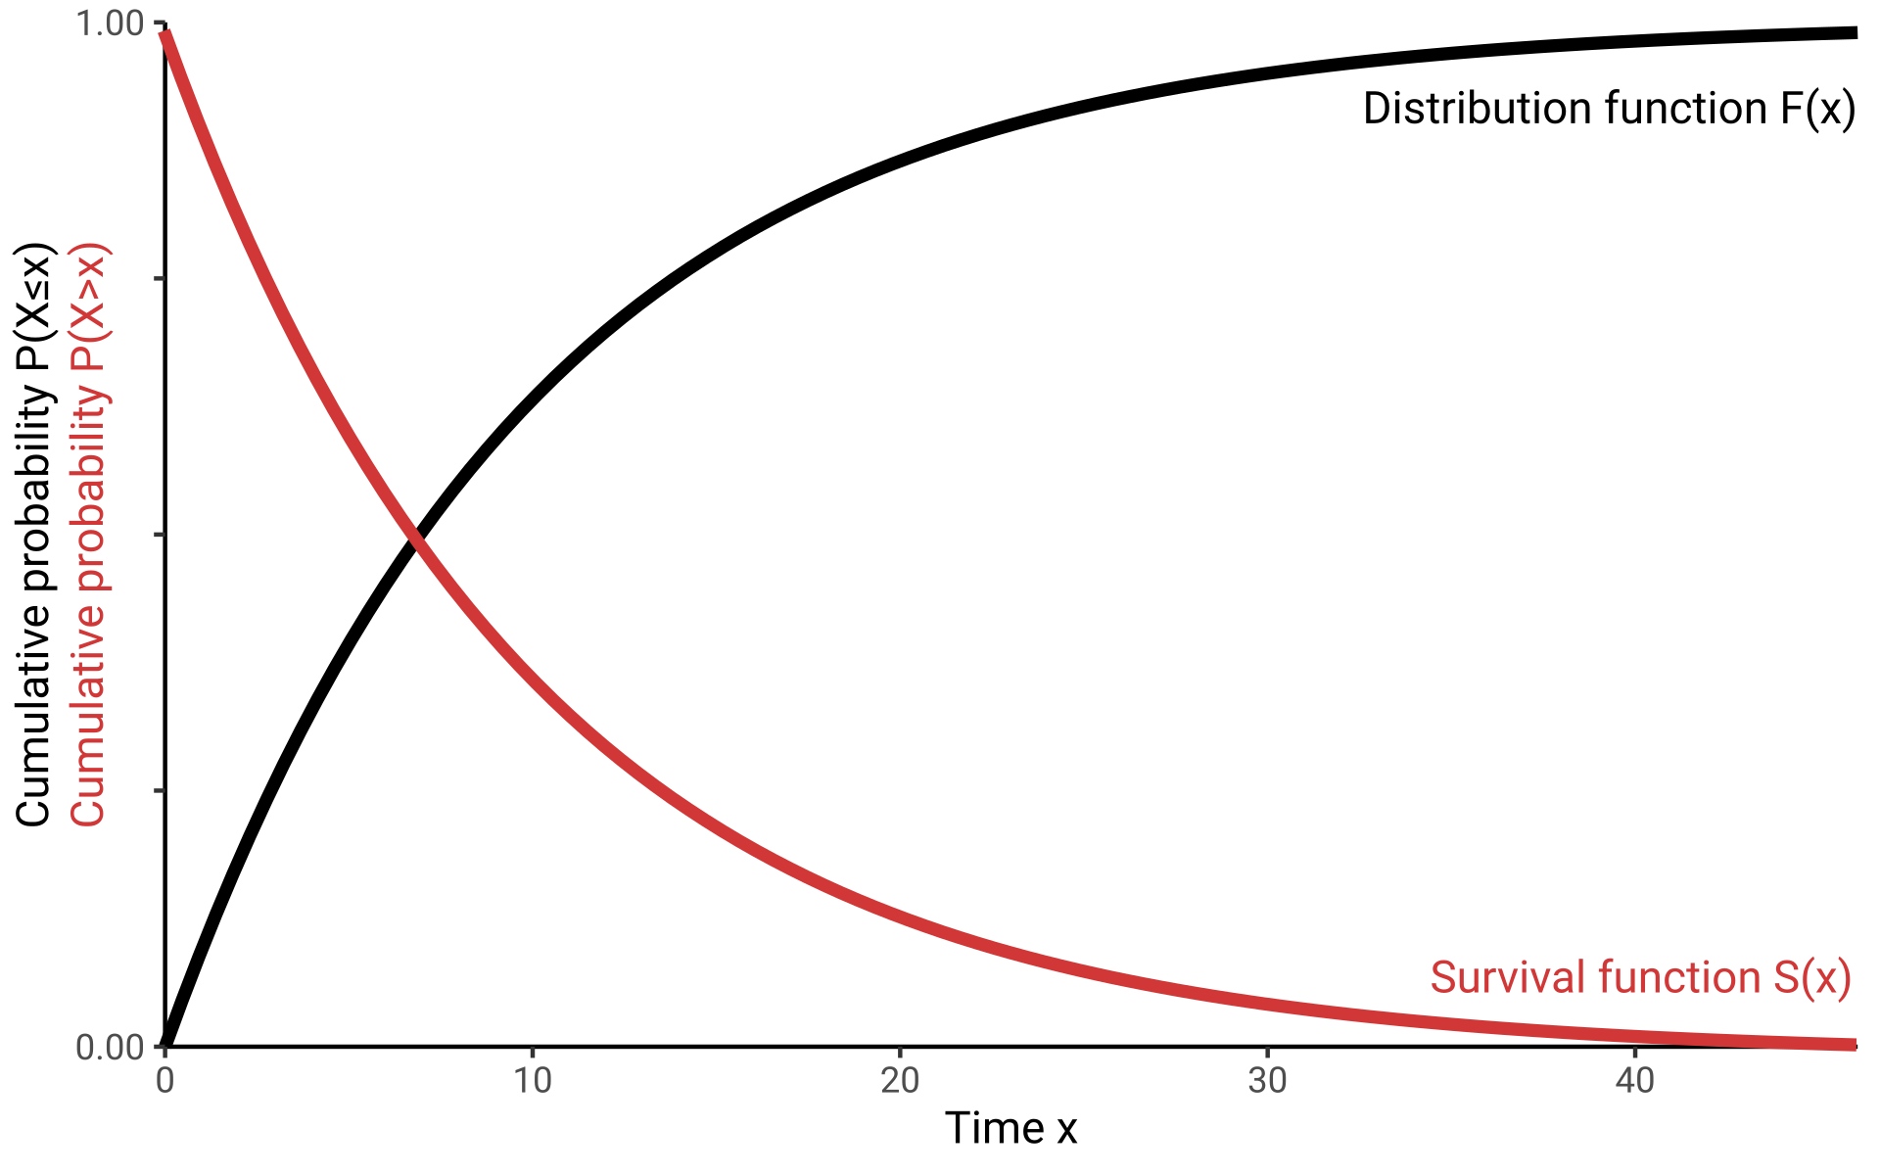
S(x) Survival Function
X: Time until event
x = 0.1 weeks, 2.3 weeks...
S(x): Survival function
The probability of not
experiencing the event until
time x.
S(x) = P(X>x) = _{x}∫^{Inf} f(x) dx
= 1-F(x) = 1-₀∫^{x} f(x) dx

Slide 24
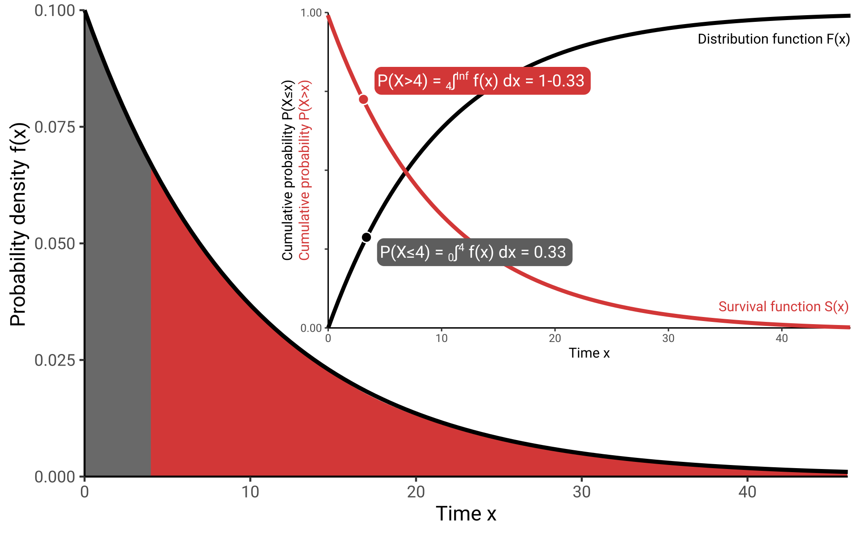
S(x) Survival Function
X: Time until event
x = 0.1 weeks, 2.3 weeks...
S(x): Survival function
The probability of not
experiencing the event until
time x.
S(x) = P(X>x) = _{x}∫^{Inf} f(x) dx
= 1-F(x) = 1-₀∫^{x} f(x) dx

Slide 25
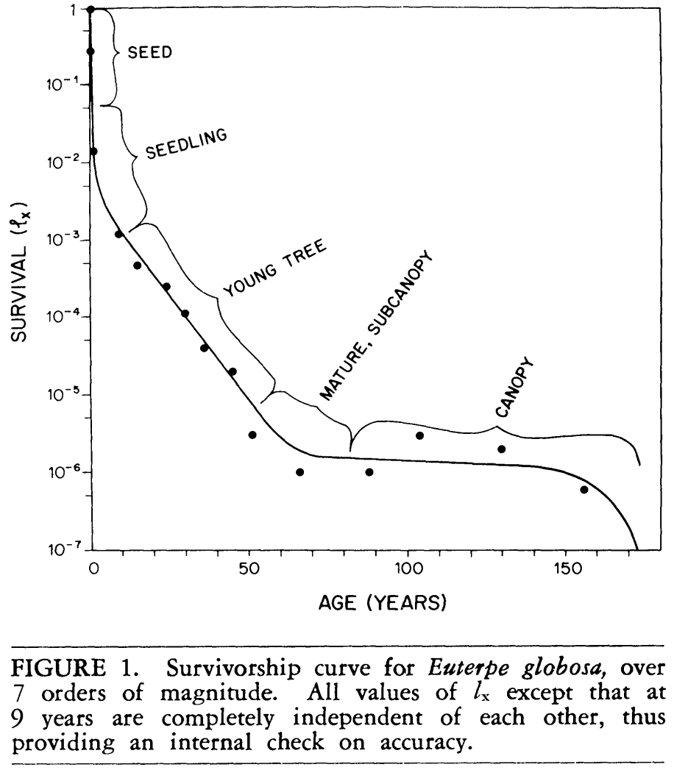
S(x) Survival Function
X: Time until event
x = 0.1 weeks, 2.3 weeks...
S(x): Survival function
The probability of not
experiencing the event until
time x.
S(x) = P(X>x) = _{x}∫^{Inf} f(x) dx
= 1-F(x) = 1-₀∫^{x} f(x) dx
Valen (1975). Life, Death, and Energy of a Tree.

Slide 26
h(x) Hazard Function
But what about the risk of an event occurring around time x, given that it did not occur before?
Hazard Function!

Slide 27
h(x) Hazard Function
X: Time until event
x = 0.1 weeks, 2.3 weeks...
h(x): Hazard function
The instantaneous rate
of new events at time x
among those who did not
experience the event yet.
h(x) = f(x)/S(x)
= lim_{h→0} P(x≤X<x+h|X≥x)/h
Schöley (2020). The dynamics of ontogenescence.

Slide 28
h(x) Hazard Function
We have the rate of events
2428 infections per 100,000 persons per 7 days
2428 infections per 100,000 persons-weeks
0.02428 infections per 1 person-week
X: Time until event
x = 0.1 weeks, 2.3 weeks...
h(x): Hazard function
The instantaneous rate
of new events at time x
among those who did not
experience the event yet.
We want the survival probability
What is the probability of me “surviving” the
whole semester without catching COVID given
current rates?
h(x) = f(x)/S(x)
= lim_{h→0} P(x≤X<x+h|X≥x)/h
Thus, we need to express S(x) in terms of h(x)

Slide 29
h(x) Hazard Function
Thus, we need to express S(x) in terms of h(x)
X: Time until event
x = 0.1 weeks, 2.3 weeks...
h(x) = f(x)/S(x)
= F’(x)/S(x)
= [1-S(x)]’/S(x)
= -S’(x)/S(x)
Remember, F(x)=₀∫^{x} f(x) dx.
Thus, f(x)=d/dx F(x) = F’(x).
h(x): Hazard function
The instantaneous rate
of new events at time x
among those who did not
experience the event yet.
h(x) = f(x)/S(x)
= lim_{h→0} P(x≤X<x+h|X≥x)/h

Slide 30
H(x) Cumulative Hazard Function
Thus, we need to express S(x) in terms of h(x)
X: Time until event
x = 0.1 weeks, 2.3 weeks...
h(x) = f(x)/S(x)
= F’(x)/S(x)
= [1-S(x)]’/S(x)
= -S’(x)/S(x)
Remember, F(x)=₀∫^{x} f(x) dx.
Thus, f(x)=d/dx F(x) = F’(x).
H(x): Cumulative Hazard
The integral of h(x).
₀∫^{x}h(x) = ₀∫^{x} -S’(x)/S(x) dx
= -log S(x)
-₀∫^{x}h(x) = log S(x)
exp[-₀∫^{x}h(x)] = S(x)
Rule for logarithmic derivatives: ∫ g’(x)/g(x) dx = log |g(x)| + C
H(x) = ₀∫^{x} h(x) dx = -log S(x)

Slide 31
The Exponential Distribution
We have the rate of events
2428 infections per 100,000 persons per 7 days
2428 infections per 100,000 persons-weeks
0.02428 infections per 1 person-week
We want the survival probability
What is the probability of me “surviving” the
whole semester without catching COVID given
current rates?
Thus, we need to express S(x) in terms of h(x)
exp[-₀∫^{x}h(x)dx] = S(x)

Slide 32
The Exponential Distribution
We have the rate of events
2428 infections per 100,000 persons per 7 days
2428 infections per 100,000 persons-weeks
0.02428 infections per 1 person-week
We want the survival probability
What is the probability of me “surviving” the
whole semester without catching COVID given
current rates?
Thus, we need to express S(x) in terms of h(x)
exp[-₀∫^{x}h(x)dx] = S(x)
But what shape should h(x) have?

Slide 33
The Exponential Distribution
But what shape should h(x) have?
We have the rate of events
2428 infections per 100,000 persons per 7 days
2428 infections per 100,000 persons-weeks
0.02428 infections per 1 person-week

Slide 34
The Exponential Distribution
But what shape should h(x) have?
We have the rate of events
2428 infections per 100,000 persons per 7 days
2428 infections per 100,000 persons-weeks
0.02428 infections per 1 person-week
Assuming the rate stays constant over time, h(x) is a constant!
h(x) = λ = 0.02428

Slide 35
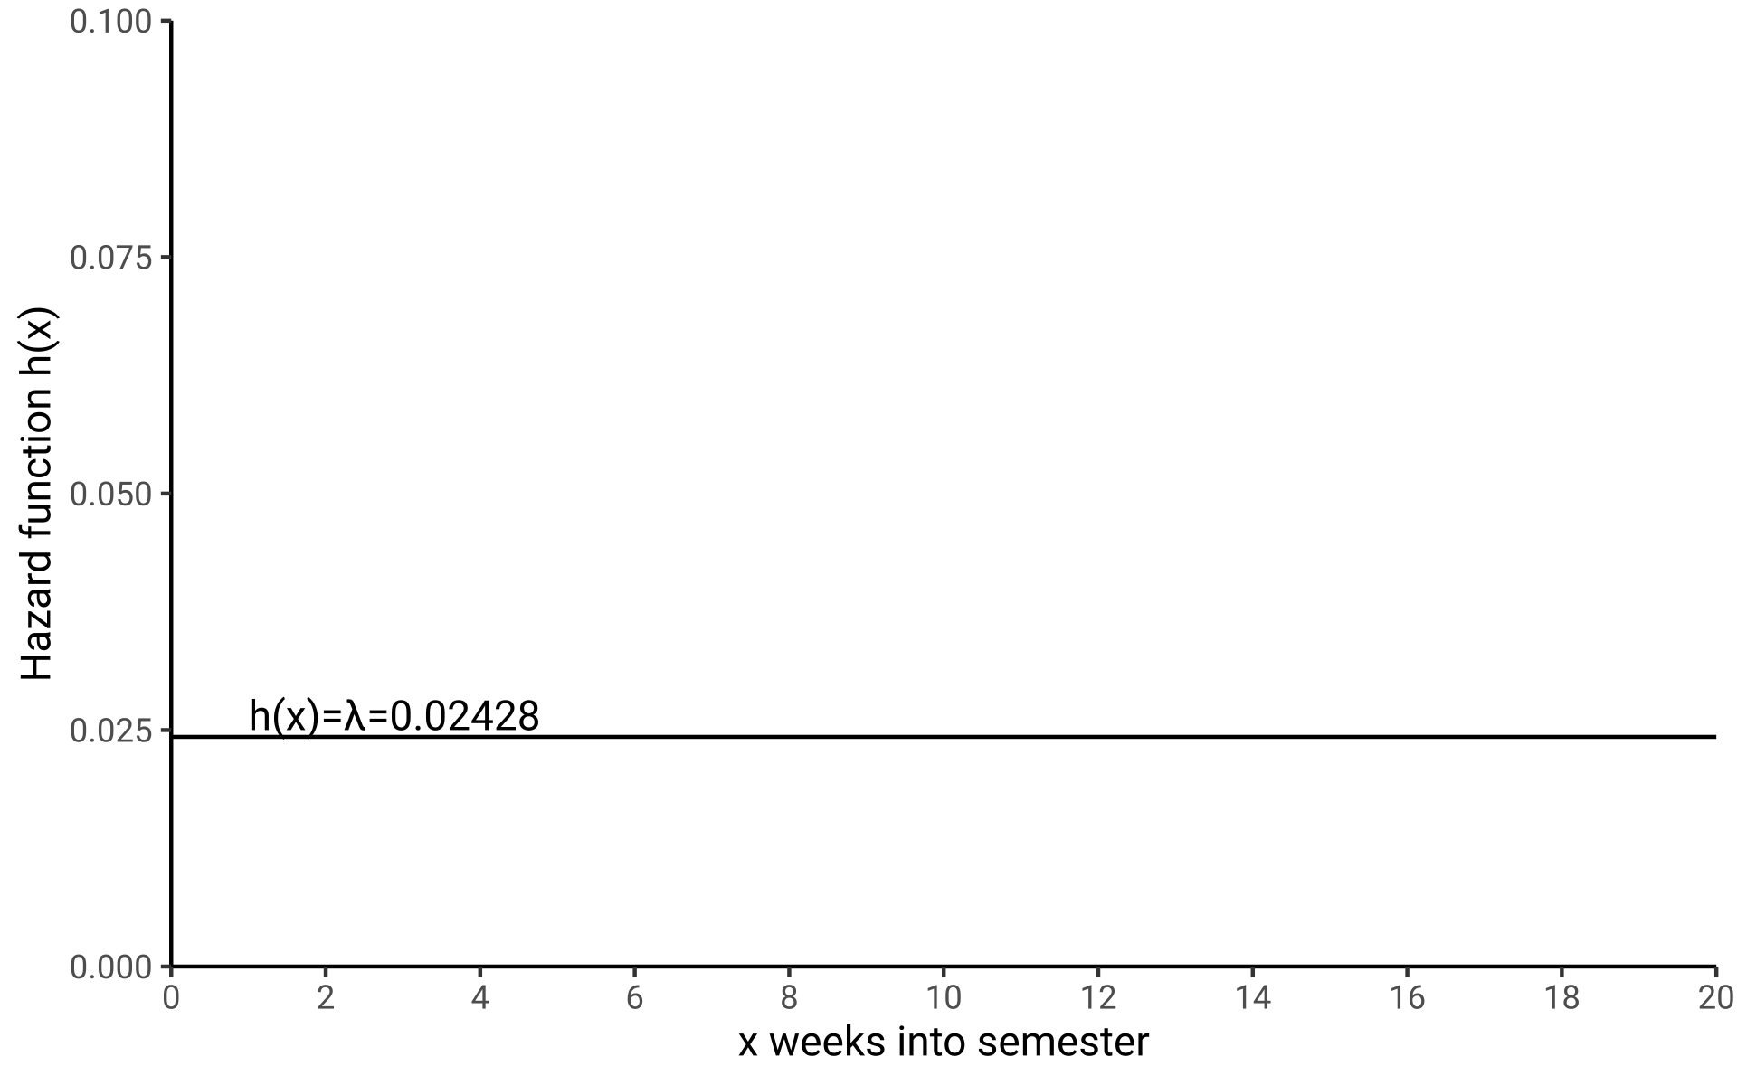
The Exponential Distribution
Assuming the rate stays constant over time, h(x) is a constant!
h(x) = λ = 0.02428

Slide 36
The Exponential Distribution
Assuming the rate stays constant over time, h(x) is a constant!
h(x) = λ = 0.02428
Applying the survival identity from earlier...
exp[-₀∫^{x} h(x) dx] = S(x)
...yields the survival function of the Exponential Distribution
S(x) = exp(-₀∫^{x} λdx) = exp(-λx) = exp(-0.02428x)
Exponential distribution
If the hazard does not
change over time, the time
until event is exponentially
distributed.
h(x) = λ
S(x) = exp(-λx)

Slide 37
The Exponential Distribution
Assuming the rate stays constant over time, h(x) is a constant!
h(x) = λ = 0.02428
Applying the survival identity from earlier...
exp[-₀∫^{x} h(x) dx] = S(x)
...yields the survival function of the Exponential Distribution
S(x) = exp(-₀∫^{x} λdx) = exp(-λx) = exp(-0.02428x)
Exponential distribution
If the hazard does not
change over time, the time
until event is exponentially
distributed.
What is the probability of me “surviving” the
whole semester without catching COVID given
current rates?
h(x) = λ
S(x) = exp(-λx)

Slide 38
Survival Identities
In survival analysis we
consider the random variable
“X: Time until event”
x = 0.1 weeks, 2.3 weeks…

Slide 39
Survival Identities
In survival analysis we
consider the random variable
“X: Time until event”
x = 0.1 weeks, 2.3 weeks…
We express our knowledge about the distribution of X in any of these functions. Knowing any single function we can derive all other via the Survival Identities.

Slide 40
Survival Identities
In survival analysis we
consider the random variable
“X: Time until event”
x = 0.1 weeks, 2.3 weeks…
We express our knowledge about the distribution of X in any of these functions. Knowing any single function we can derive all other via the Survival Identities.
f(x): Density function
The relative likelihood of
experiencing the event
around time x.

Slide 41
Survival Identities
In survival analysis we
consider the random variable
“X: Time until event”
x = 0.1 weeks, 2.3 weeks…
We express our knowledge about the distribution of X in any of these functions. Knowing any single function we can derive all other via the Survival Identities.
f(x): Density function
The relative likelihood of
experiencing the event
around time x.
F(x)=₀∫^{x} f(x) dx
F(x): Distribution function
aka Cumulative function
The probability of
experiencing the event until
time x.
F(x): Distribution function
aka Cumulative function
The probability of
experiencing the event until
time x.
F(x): Distribution function
aka Cumulative function
The probability of
experiencing the event until
time x.
F(x) = P(X≤x)

Slide 42
Survival Identities
In survival analysis we
consider the random variable
“X: Time until event”
x = 0.1 weeks, 2.3 weeks…
We express our knowledge about the distribution of X in any of these functions. Knowing any single function we can derive all other via the Survival Identities.
f(x): Density function
The relative likelihood of
experiencing the event
around time x.
F(x)=₀∫^{x} f(x) dx
S(x)=_{x}∫^{Inf} f(x) dx
F(x): Distribution function
aka Cumulative function
The probability of
experiencing the event until
time x.
S(x): Survival function
The probability of not
experiencing the event until
time x.
F(x): Distribution function
aka Cumulative function
The probability of
experiencing the event until
time x.
F(x): Distribution function
aka Cumulative function
The probability of
experiencing the event until
time x.
S(x)=1-F(x)
F(x) = P(X≤x)
S(x) = P(X>x)

Slide 43
Survival Identities
In survival analysis we
consider the random variable
“X: Time until event”
x = 0.1 weeks, 2.3 weeks…
We express our knowledge about the distribution of X in any of these functions. Knowing any single function we can derive all other via the Survival Identities.
h(x): Hazard function
The instantaneous rate
of new events at time x
among those who did not
experience the event yet.
f(x): Density function
The relative likelihood of
experiencing the event
around time x.
h(x) = lim_{h→0} P(x≤X<x+h|X≥x)/h
F(x)=₀∫^{x} f(x) dx
S(x)=_{x}∫^{Inf} f(x) dx
h(x)=- S’(x)/S(x)
F(x): Distribution function
aka Cumulative function
The probability of
experiencing the event until
time x.
S(x): Survival function
The probability of not
experiencing the event until
time x.
F(x): Distribution function
aka Cumulative function
The probability of
experiencing the event until
time x.
F(x): Distribution function
aka Cumulative function
The probability of
experiencing the event until
time x.
S(x)=1-F(x)
F(x) = P(X≤x)
S(x) = P(X>x)

Slide 44
Survival Identities
In survival analysis we
consider the random variable
“X: Time until event”
x = 0.1 weeks, 2.3 weeks…
We express our knowledge about the distribution of X in any of these functions. Knowing any single function we can derive all other via the Survival Identities.
h(x): Hazard function
The instantaneous rate
of new events at time x
among those who did not
experience the event yet.
f(x): Density function
The relative likelihood of
experiencing the event
around time x.
h(x) = lim_{h→0} P(x≤X<x+h|X≥x)/h
F(x)=₀∫^{x} f(x) dx
S(x)=_{x}∫^{Inf} f(x) dx
h(x)=- S’(x)/S(x)
F(x): Distribution function
aka Cumulative function
The probability of
experiencing the event until
time x.
S(x): Survival function
The probability of not
experiencing the event until
time x.
H(x) = ₀∫^{x} h(x) dx
F(x): Distribution function
aka Cumulative function
The probability of
experiencing the event until
time x.
F(x): Distribution function
aka Cumulative function
The probability of
experiencing the event until
time x.
H(x) = -log S(x)
S(x)=1-F(x)
H(x): Cumulative Hazard
The integral of h(x).
F(x) = P(X≤x)
S(x) = P(X>x)

Slide 45
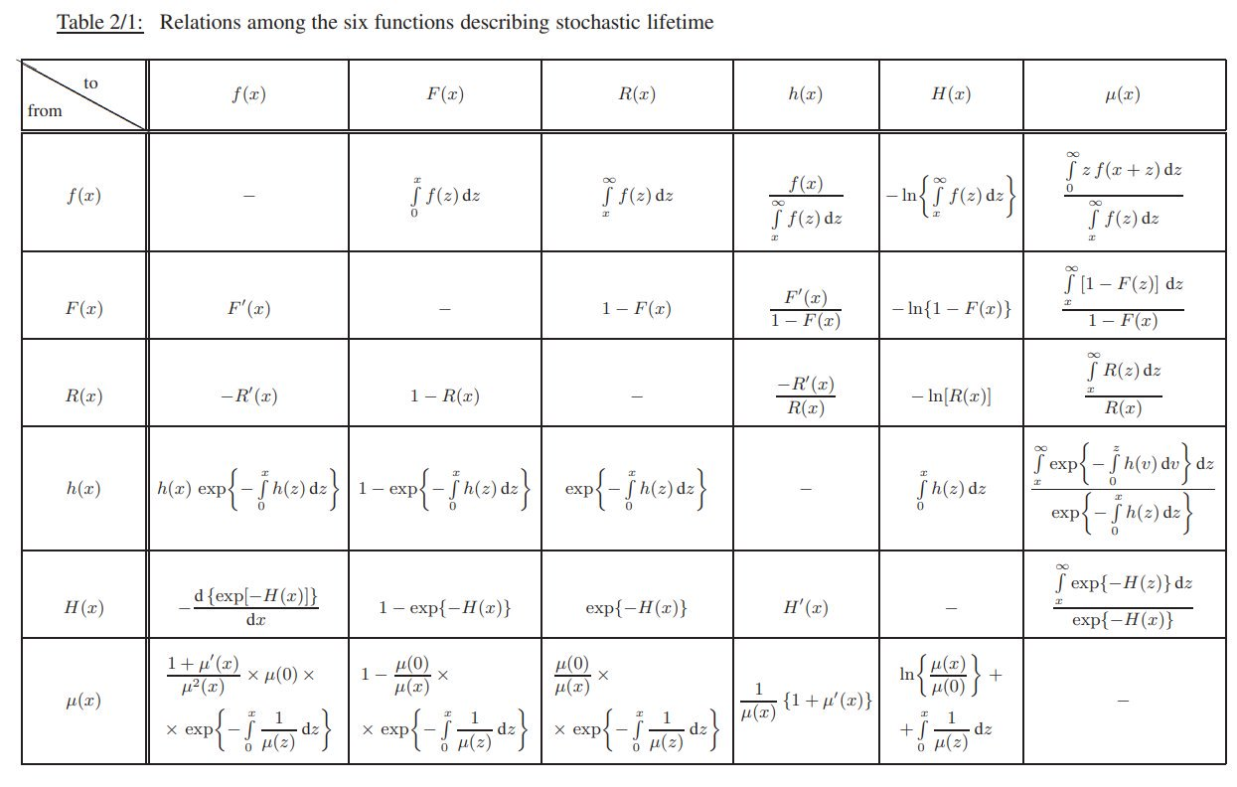
Survival Identities
There are many more identities...
Rinne (2008). The Weibull Distribution.

Slide 46
Recap
For survival distributions and identities read
Klein & Moeschberger (2003). Survival Analysis. Sections 2.1–2.4.
For refreshing your understanding of basic calculus watch the series
3Blue1Brown (2017). The essence of calculus. YouTube.
For refreshing your understanding of random variables and probability distributions watch
Khan Academy (2012). Random variables. YouTube.
Princeton COS 302 (2020). Probability density and mass functions. YouTube.

Slide 47
Homework
Choose a time-to-event setting that interests you and look up a constant rate related to that setting. What is the time scale for your setting? When does the time-to-event start? When have have half of the population experienced the event given the chosen rate?
Example: Today we looked at the time until I catch COVID. I choose the rate 2,428 infections per 100,000 persons per 7 days from the local COVID incidences and assumed this rate to be constant. The timescale was “weeks into the semester” and it starts at the first week of the semester. I used the survival function of the exponential distribution to calculate the time until the probability of catching COVID reached 50%.
S(x) = exp(-₀∫^{x} λdx) = exp(-λx)

Slide 48
Materials for this lecture
github.com/jschoeley/survival_analysis-ur-ss22
Jonas Schöley
@jschoeley
0000-0002-3340-8518
j.schoeley@uni-rostock.de
CC-BY Jonas Schöley 2022

