Slide 1


How well can we predict weekly death counts?
Jonas Schöley
jschoeley@health.sdu.dk
The Interdisciplinary Centre on Population Dynamics
University of Southern Denmark

Slide 2
The forecasting perspective on excess deaths
The credibility of any COVID-19 pandemic excess deaths model
derives from its ability to correctly forecast death counts in non-COVID situations

Slide 3
The challenge
Given 3 years of Danish weekly death counts by age and sex
How well can we predict weekly deaths over the next year?

Slide 4
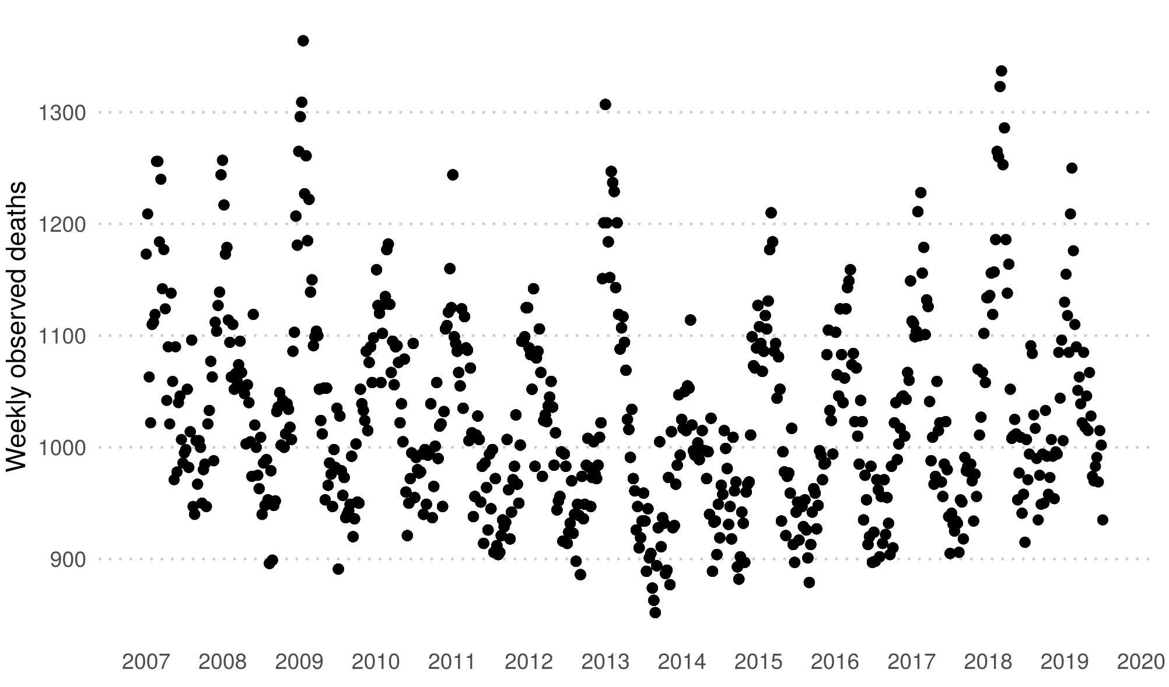
Training-test split of time-series
Weekly death counts Denmark.
Complete population.
Data: HMD.

Slide 5
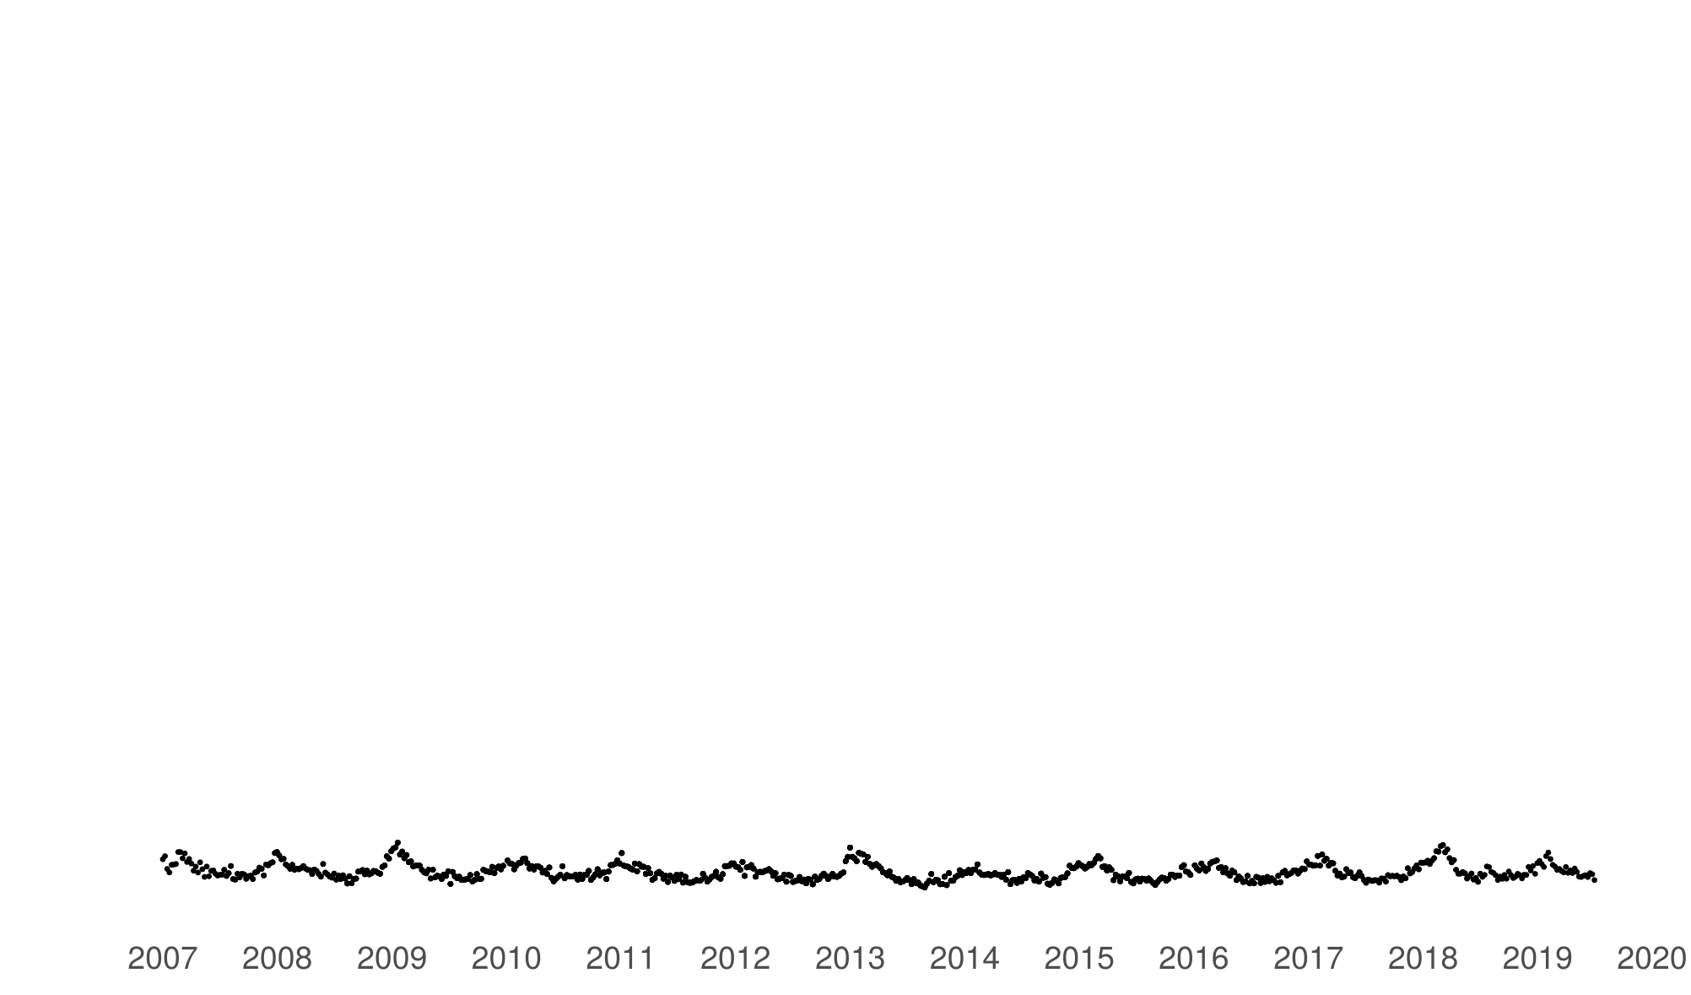
Training-test split of time-series
Weekly death counts Denmark.
Complete population.
Data: HMD.

Slide 6
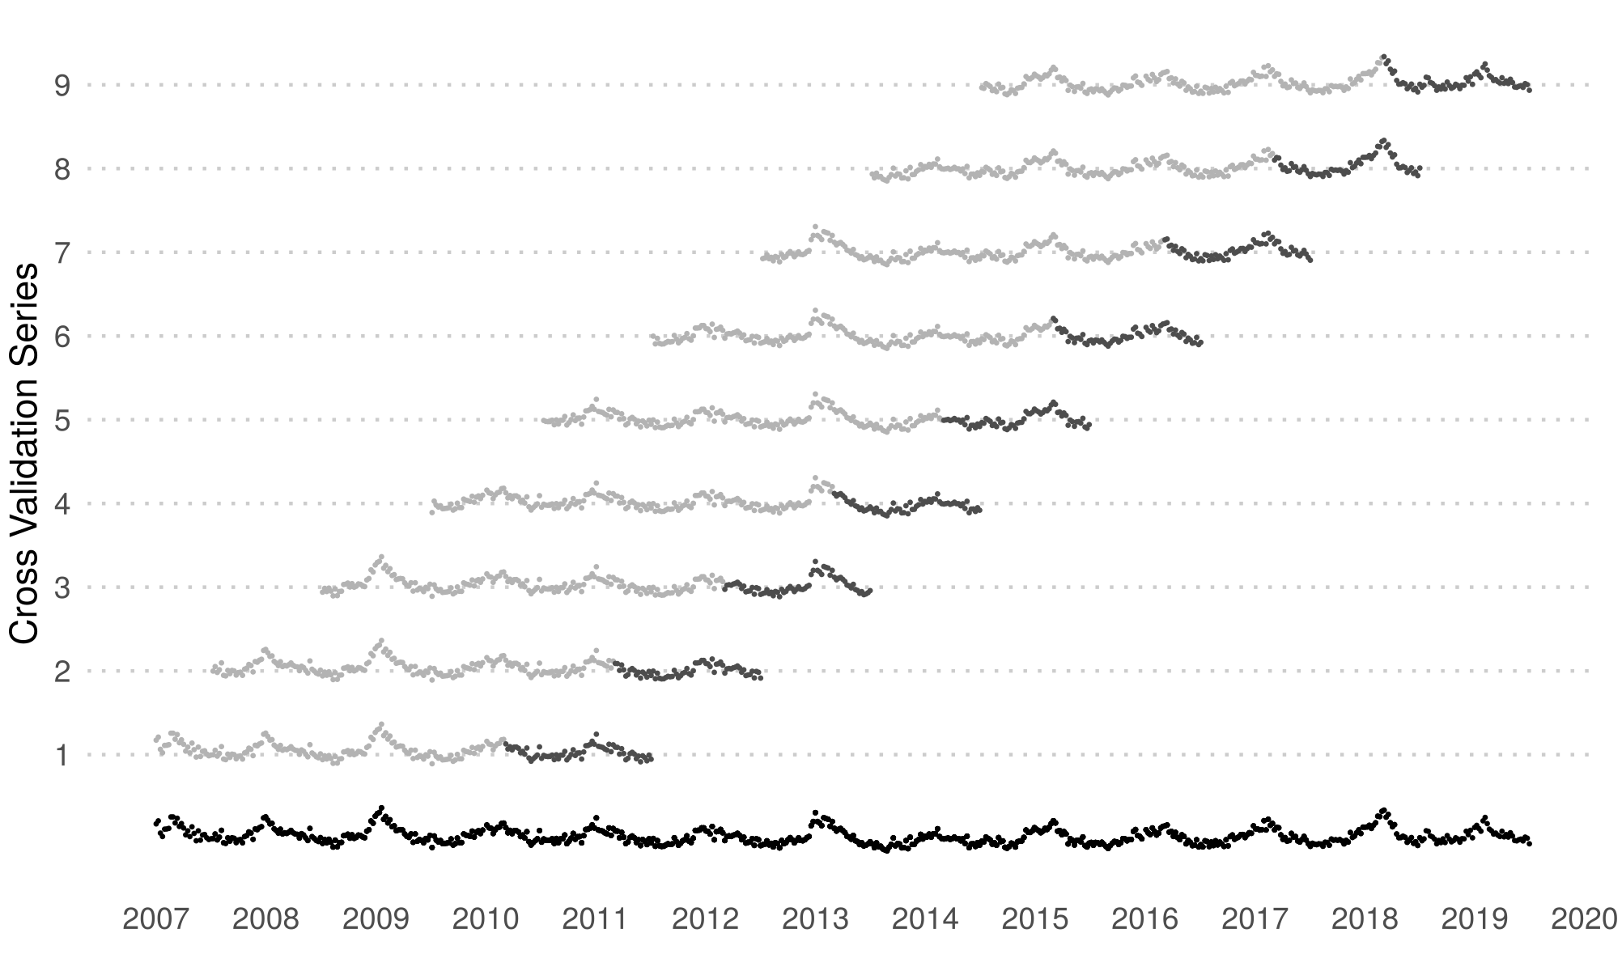
Training-test split of time-series
Weekly death counts Denmark.
Complete population.
Data: HMD.

Slide 7
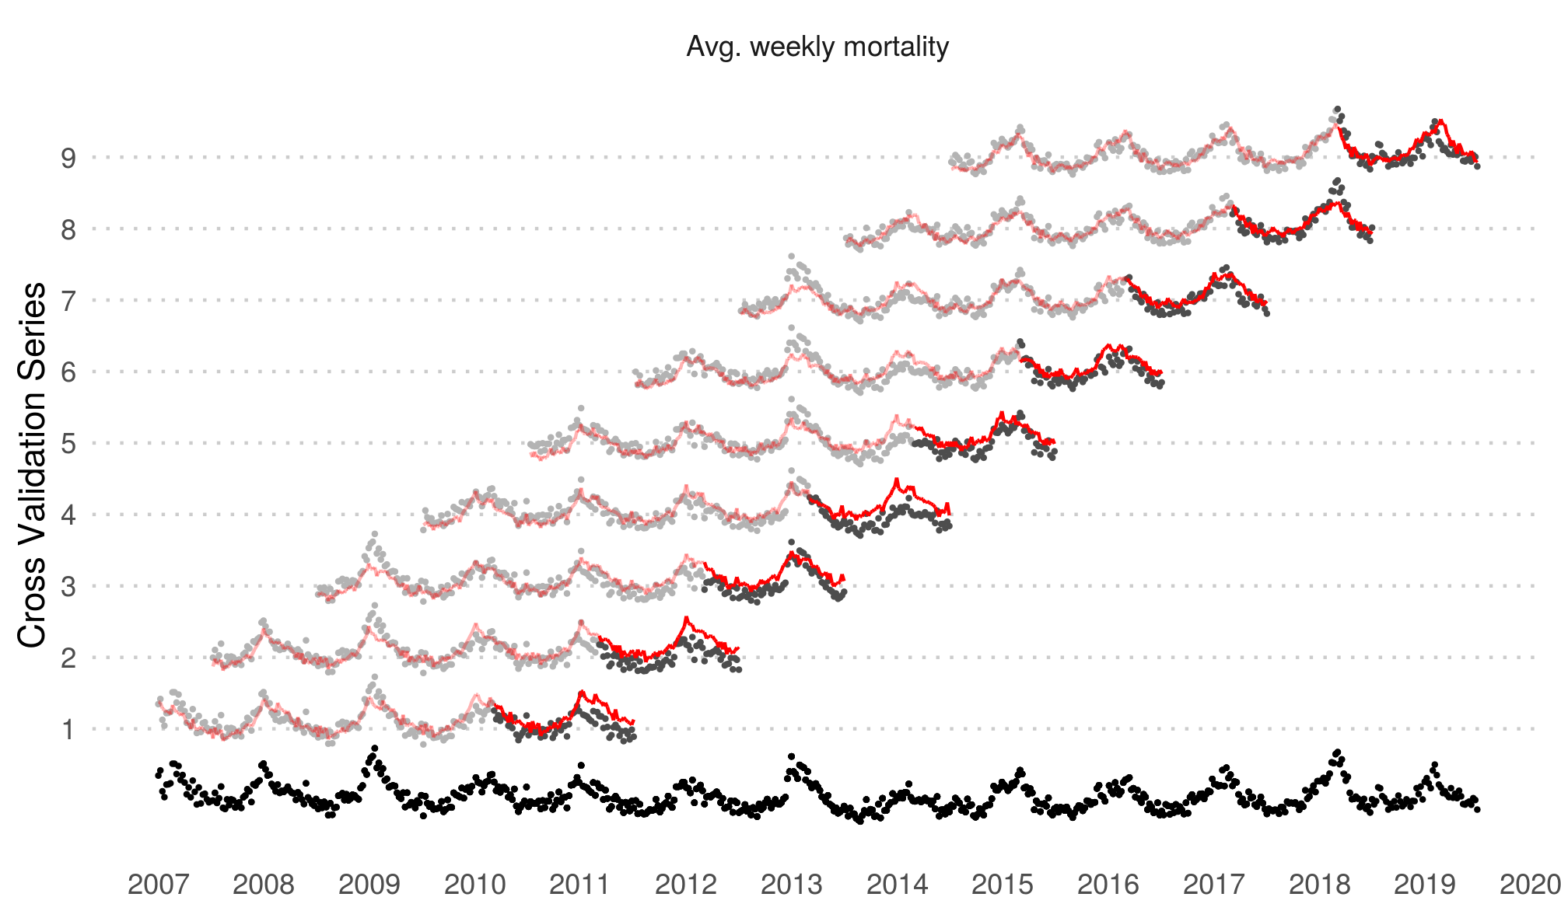
The models
Observed vs. predicted weekly death counts Denmark.
Complete population.
Data: HMD.

Slide 8
The models
'Serfling-Poisson GLM', 'glm', list(
formula = formula(
observed_deaths ~
# log linear long term trend
weeks_since_origin*sex*age_group +
# seasonality
# full year period
sin(2*pi*weeks_into_season_year/(365.25/7))*sex*age_group +
cos(2*pi*weeks_into_season_year/(365.25/7))*sex*age_group +
# half year period
sin(2*pi*weeks_into_season_year/(365.25/2/7))*sex*age_group +
cos(2*pi*weeks_into_season_year/(365.25/2/7))*sex*age_group +
# adjustment for new years eve
new_year*sex*age_group +
# exposures
offset(log(exposure))
),
family = quasipoisson(link = 'log')
)

Slide 9

The models
Observed vs. predicted weekly death counts Denmark.
Complete population.
Data: HMD.

Slide 10
The models
'Poisson GAM', 'gam', list(
formula = formula(
observed_deaths ~
1 + sex + age_group +
# log linear long term trend
weeks_since_origin*sex_age_interaction +
# penalized cyclic spline for seasonality
s(weeks_into_season_year, bs = 'cp', k = 52, by = sex_age_interaction) +
# adjustment for new years eve
new_year*sex_age_interaction +
# exposures
offset(log(exposure))
),
family = quasipoisson(link = 'log')
)

Slide 11
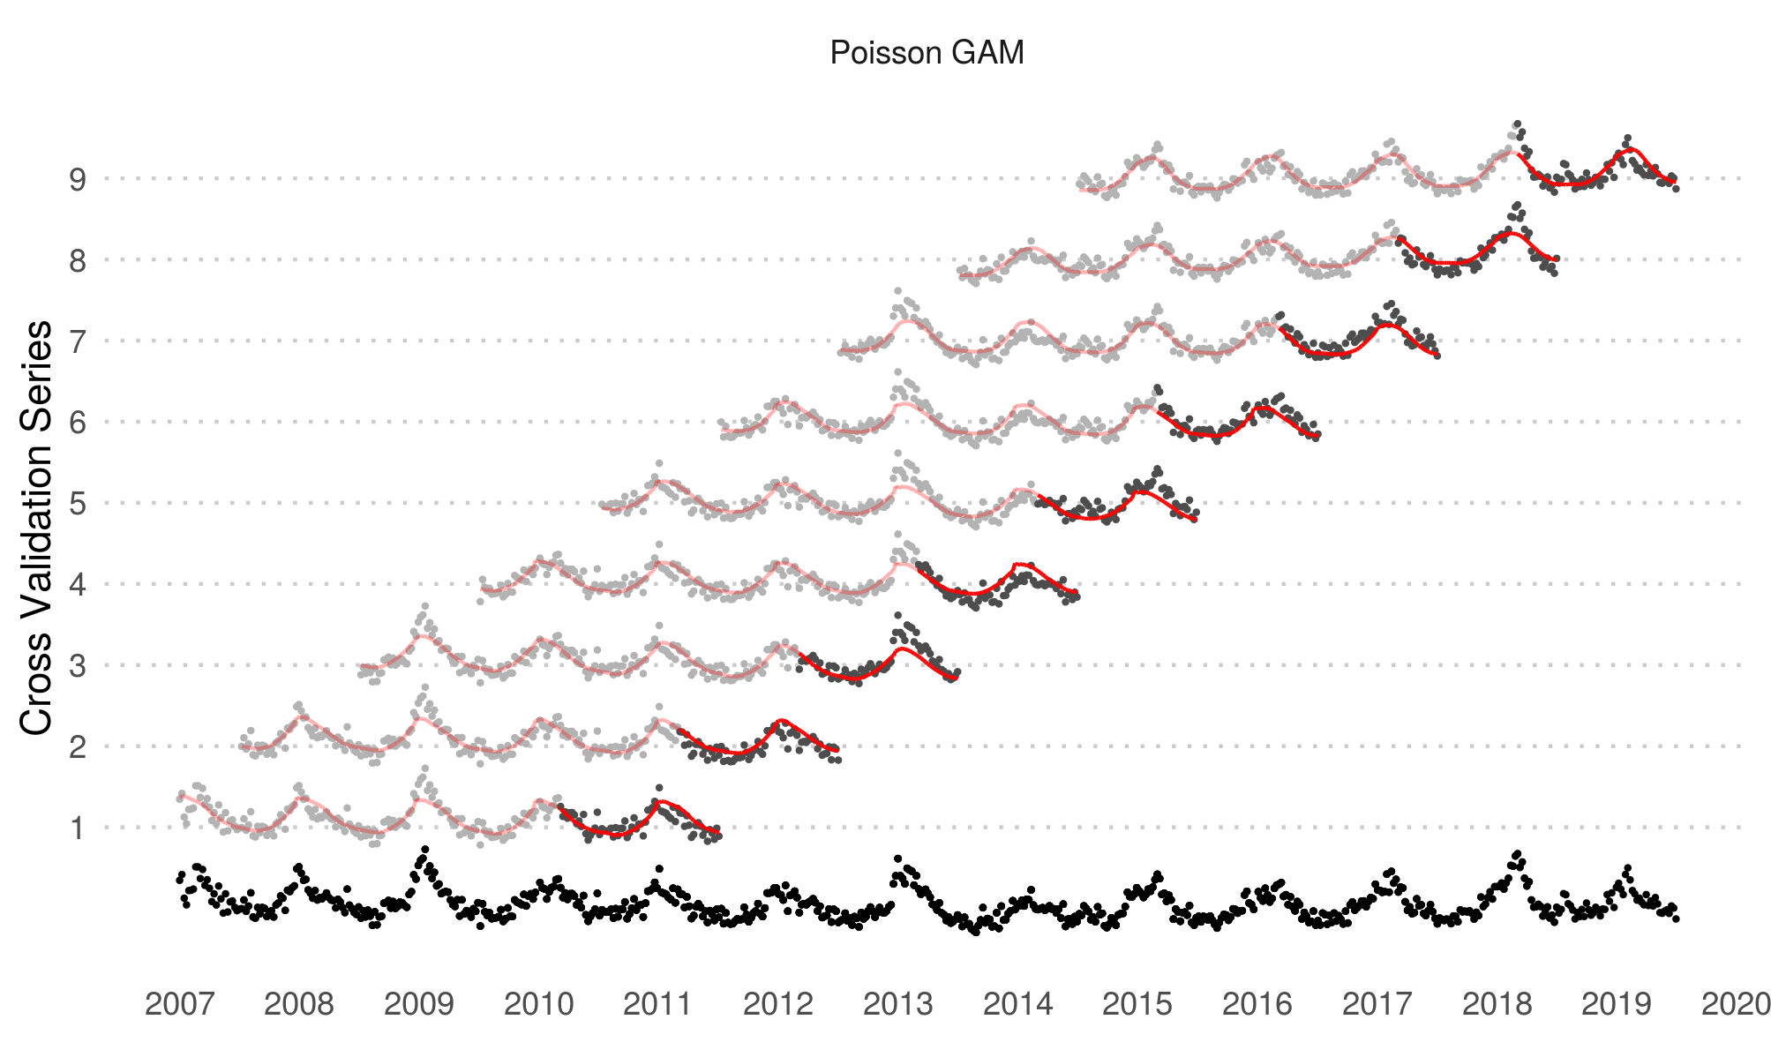
The models
Observed vs. predicted weekly death counts Denmark.
Complete population.
Data: HMD.

Slide 12
The models
'Neg-Bin. GAM', 'gam', list(
formula = formula(
observed_deaths ~
1 + sex + age_group +
# log linear long term trend
weeks_since_origin*sex_age_interaction +
# penalized cyclic spline for seasonality
s(weeks_into_season_year, bs = 'cp', k = 52, by = sex_age_interaction) +
# adjustment for new years eve
new_year*sex_age_interaction +
# exposures
offset(log(exposure))
),
family = nb(link = 'log')
)

Slide 13

The models
Observed vs. predicted weekly death counts Denmark.
Complete population.
Data: HMD.

Slide 14
The models
'Neg-Bin GAM-RE', 'gam', list(
formula = formula(
observed_deaths ~
1 + sex + age_group +
# log linear long term trend
weeks_since_origin*sex_age_interaction +
# penalized cyclic spline for seasonality
s(weeks_into_season_year, bs = 'cp', k = 52, by = sex_age_interaction) +
# adjustment for new years eve
new_year*sex_age_interaction +
# season year random effect adjustment
s(season_year_sex_age_interaction, bs = 're') +
# exposures
offset(log(exposure))
),
family = nb(link = 'log')
)

Slide 15

The models
Observed vs. predicted weekly death counts Denmark.
Complete population.
Data: HMD.

Slide 16
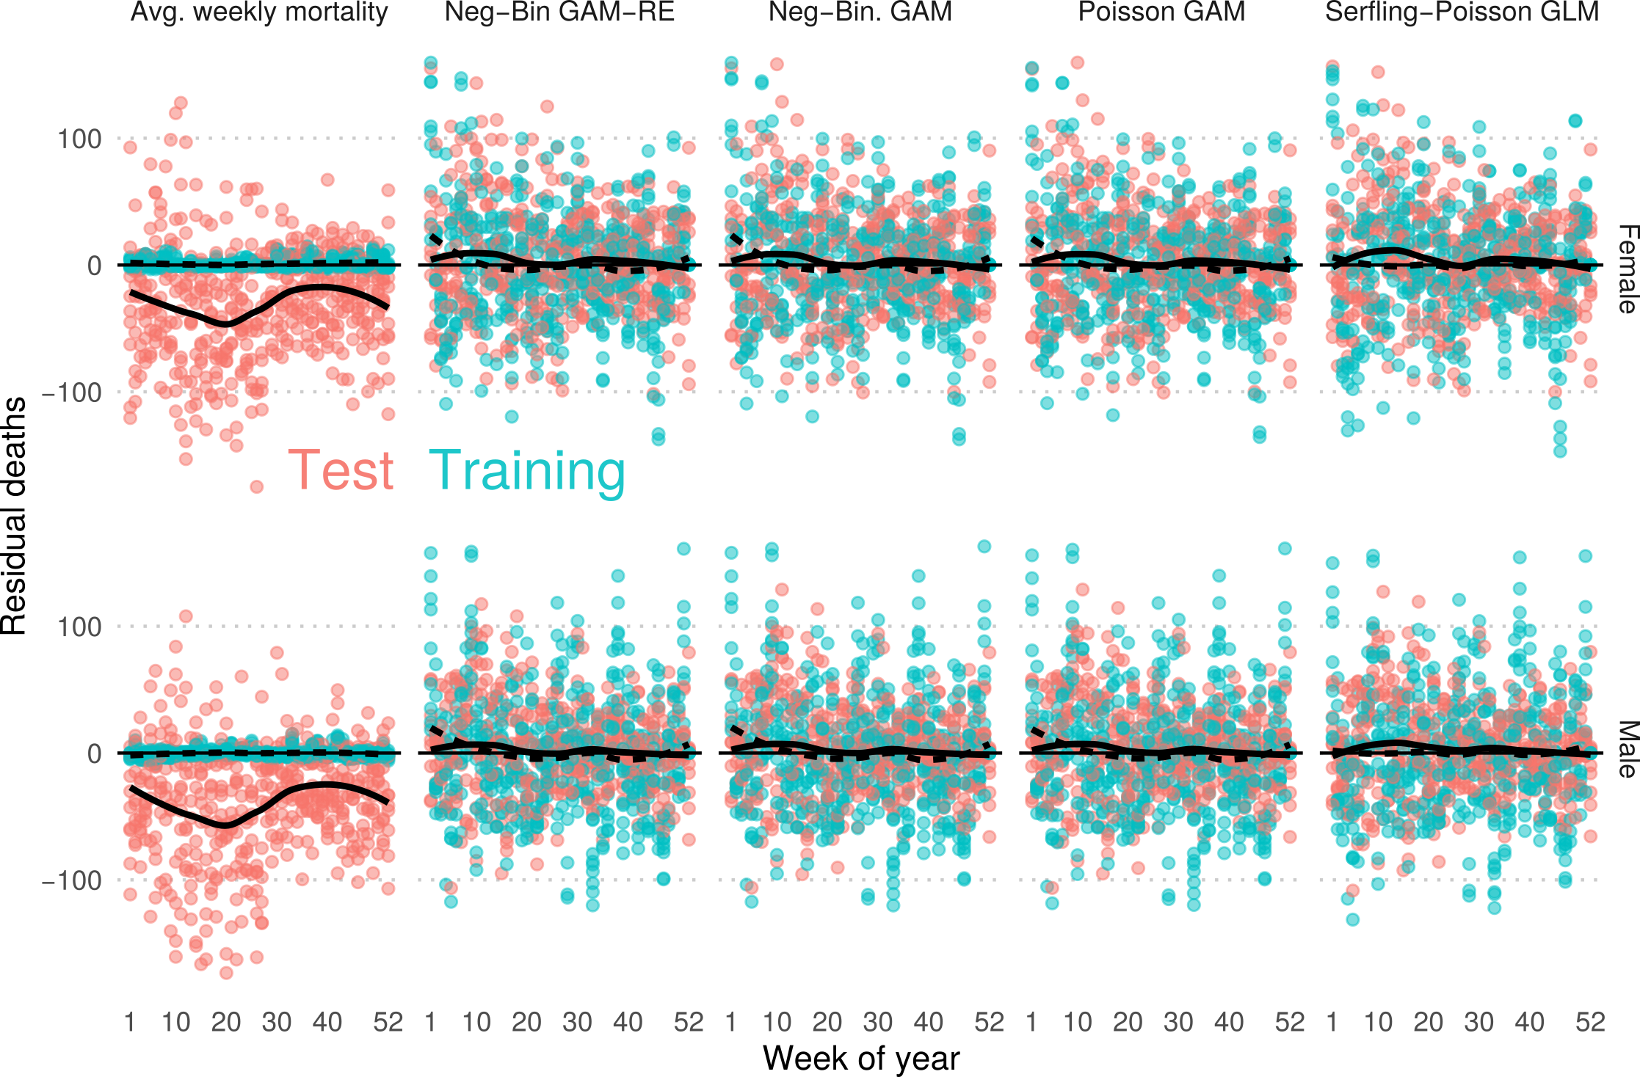
Absolute weekly prediction error over test sets
Observed minus predicted weekly death counts Denmark.

Slide 17
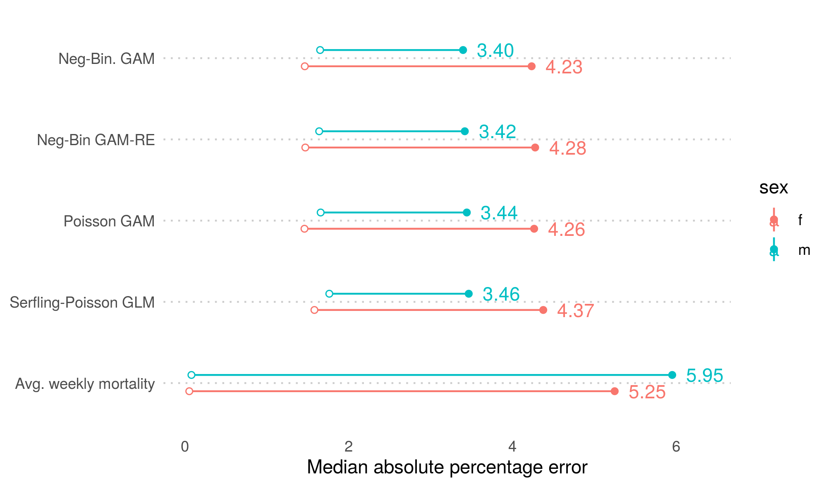
Median absolute prediction error
Median absolute prediction error of death counts on test set.
Complete Danish population by sex.

Slide 18
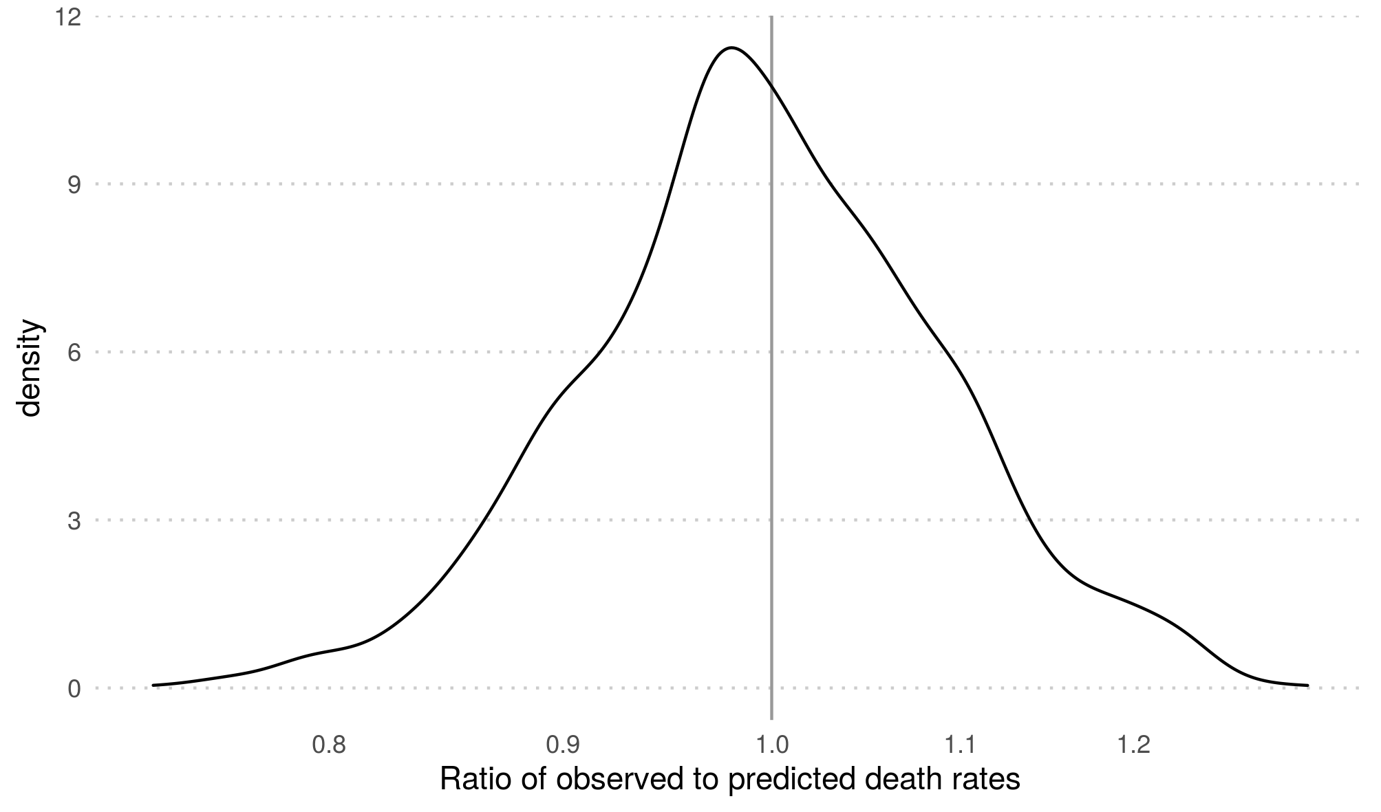
Out-of-sample residual distribution
Relative prediction error of death rates on test set.
Danish males ages 75–85.

Slide 19
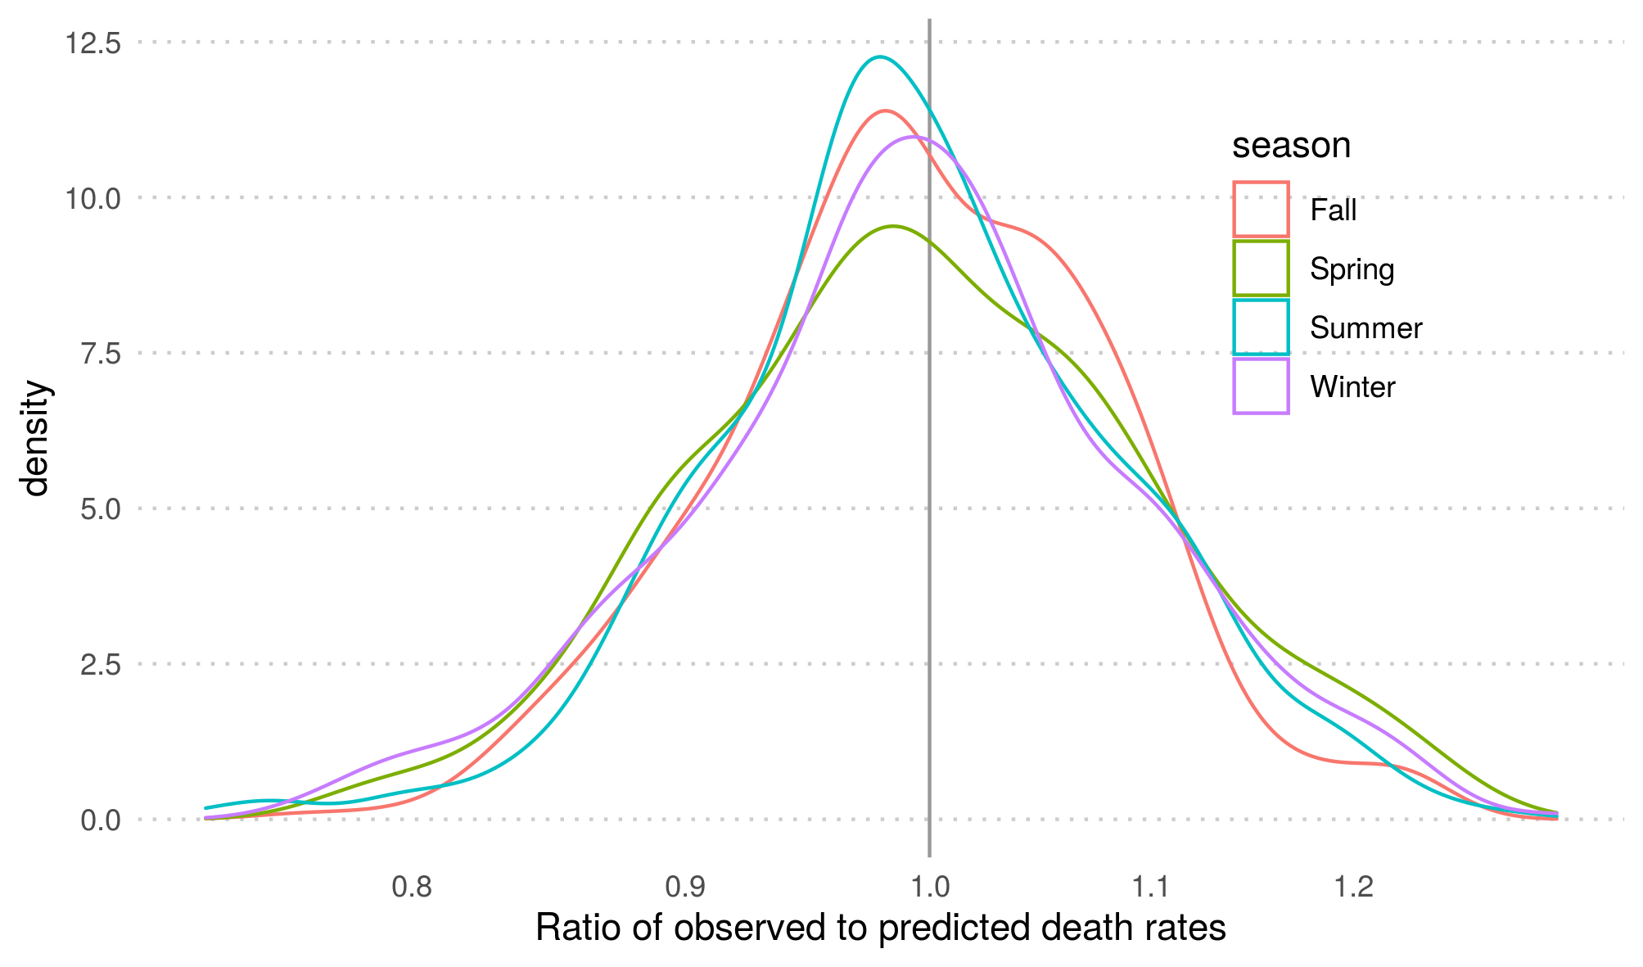
Out-of-sample residual distribution
Relative prediction error of death rates on test set by season.
Danish males ages 75–85.

Slide 20
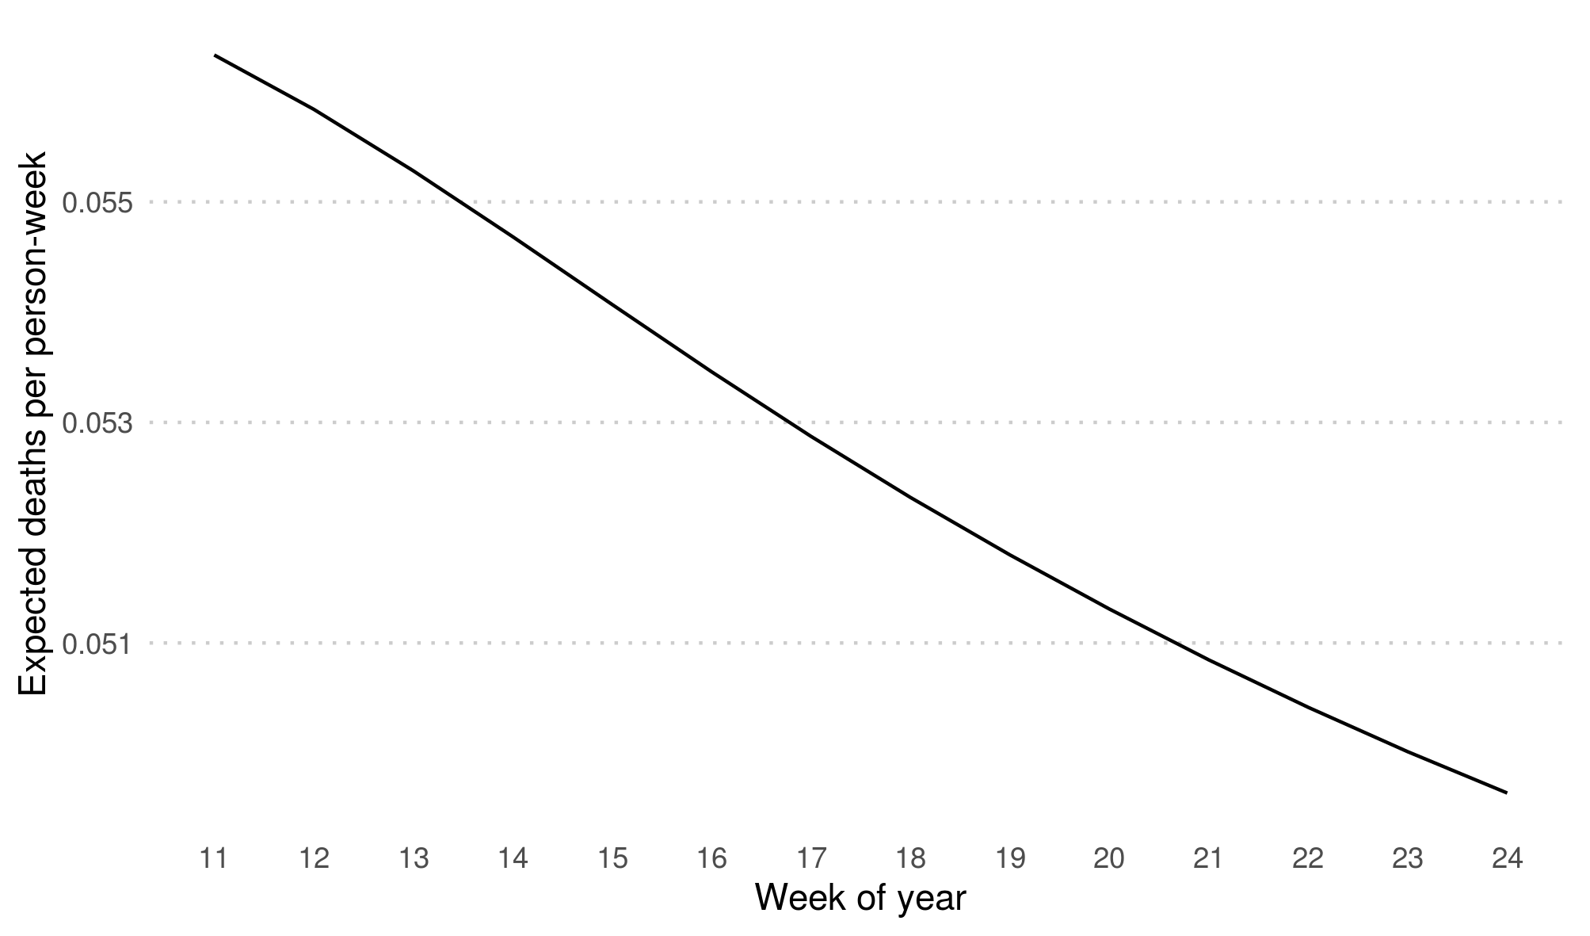
Residual bootstrapping
Expected death rates by week of year.
Danish males ages 75–85, year 2009.

Slide 21
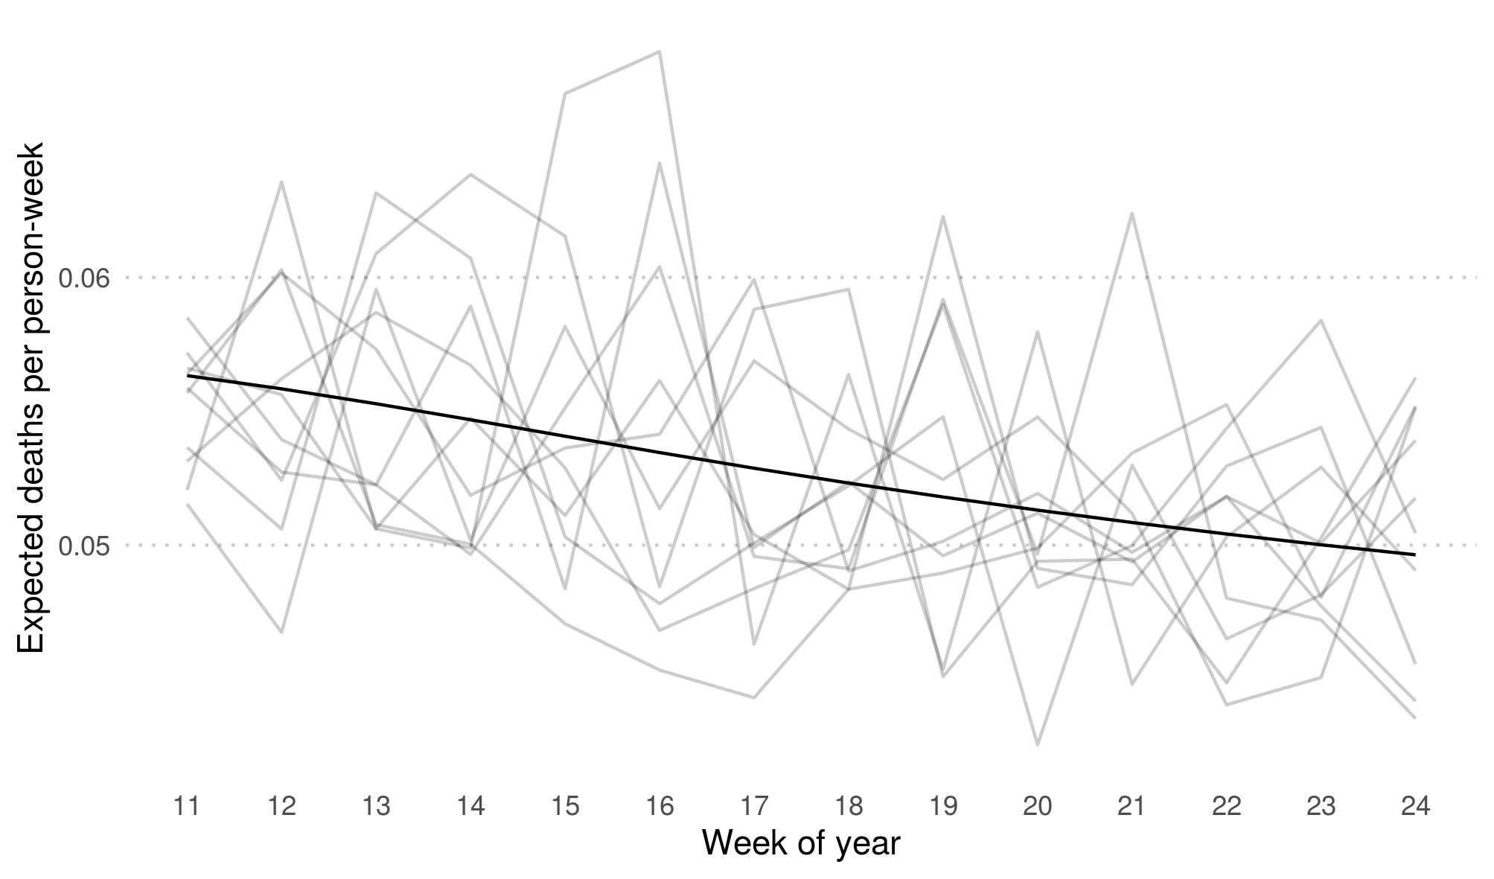
Residual bootstrapping
10 bootstrapped death rates by week of year.
Danish males ages 75–85, year 2009.

Slide 22
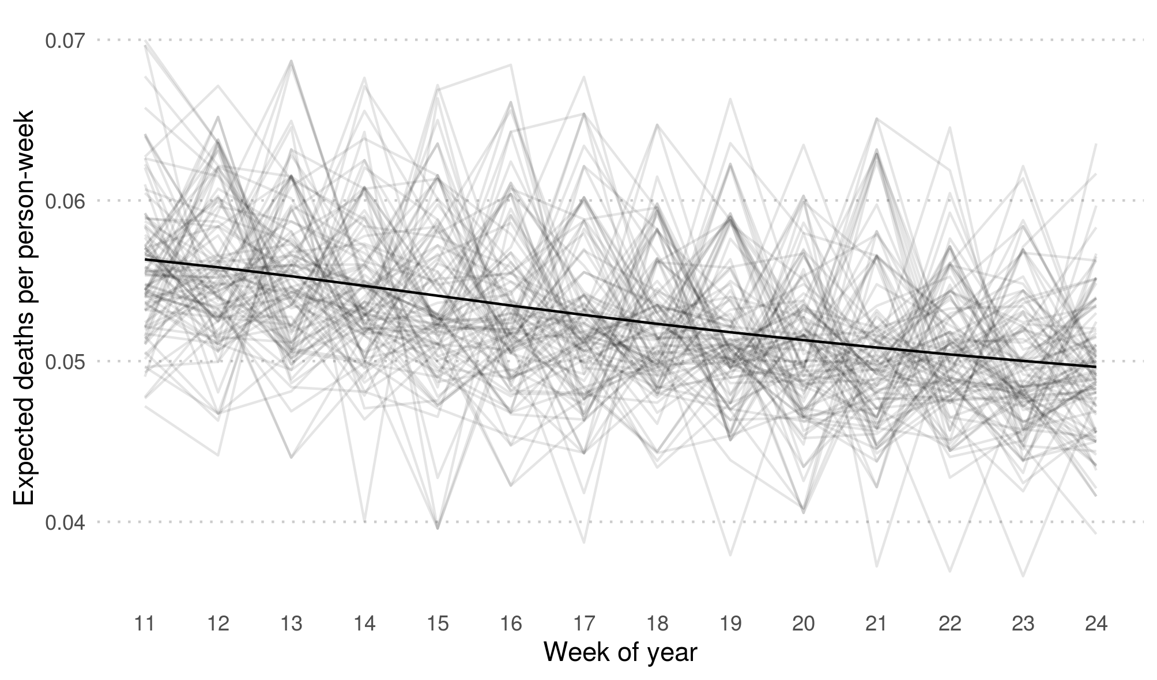
Residual bootstrapping
100 bootstrapped death rates by week of year.
Danish males ages 75–85, year 2009.

Slide 23
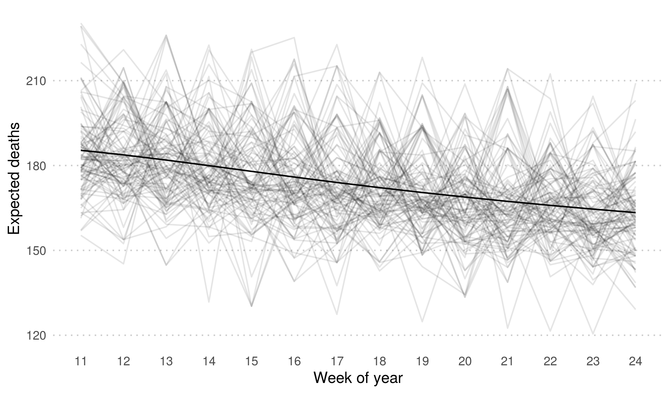
Residual bootstrapping
100 bootstrapped death counts by week of year.
Danish males ages 75–85, year 2009.

Slide 24
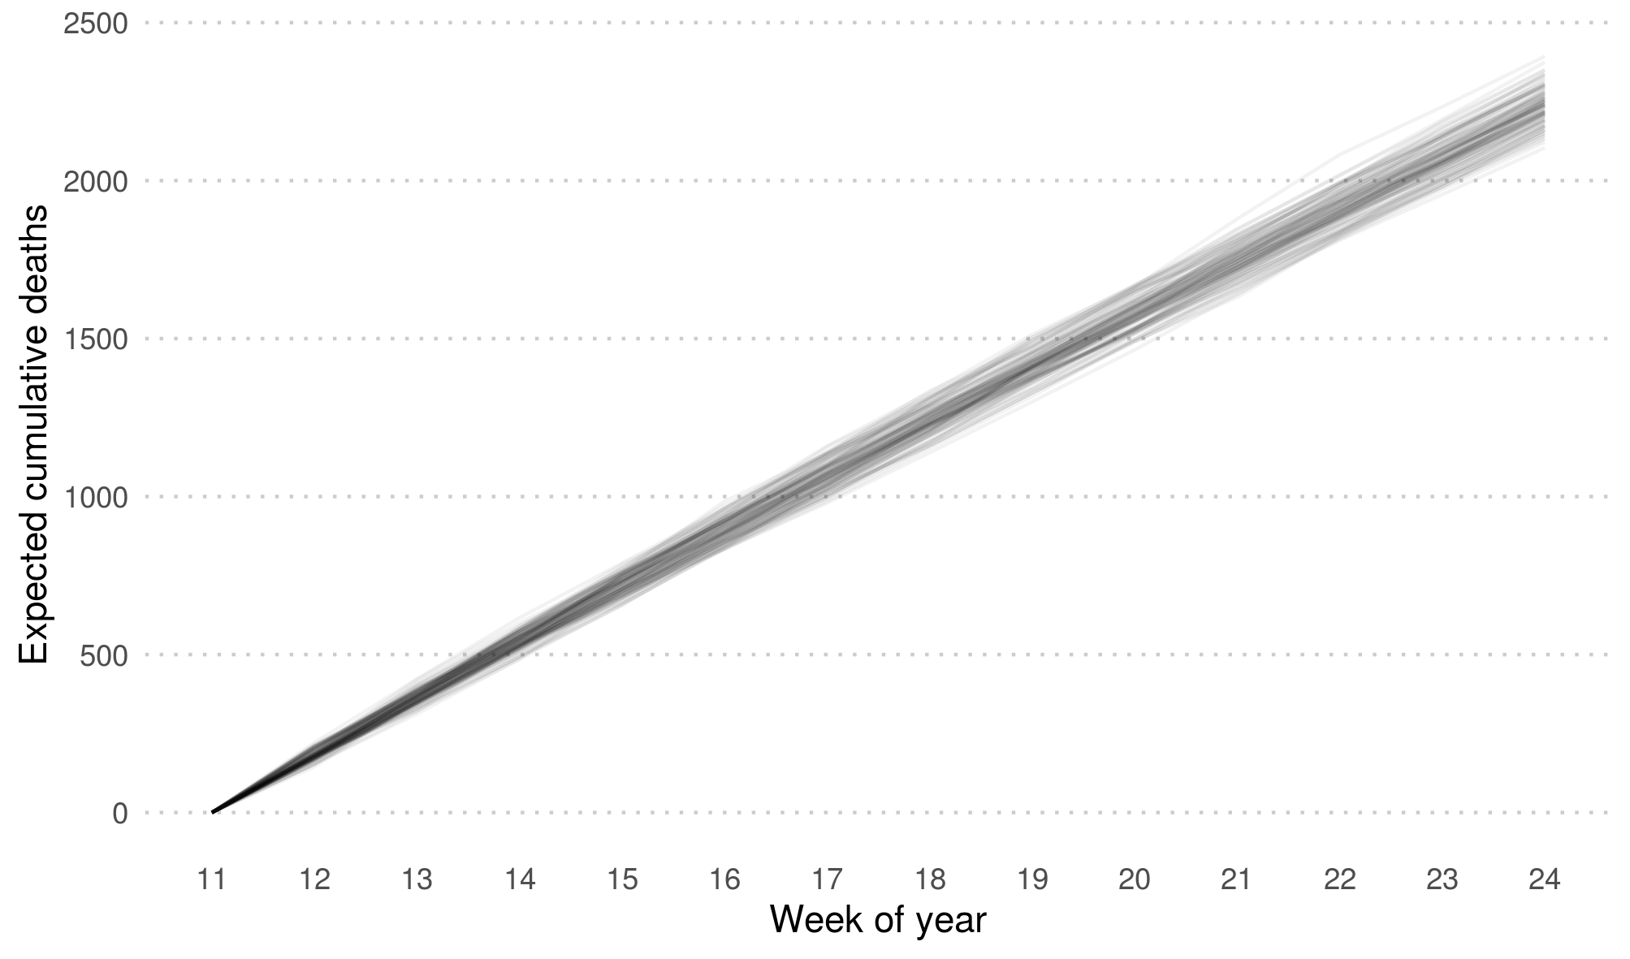
Residual bootstrapping
100 bootstrapped cumulative expected deaths by week of year.
Danish males ages 75–85, year 2009.

Slide 25
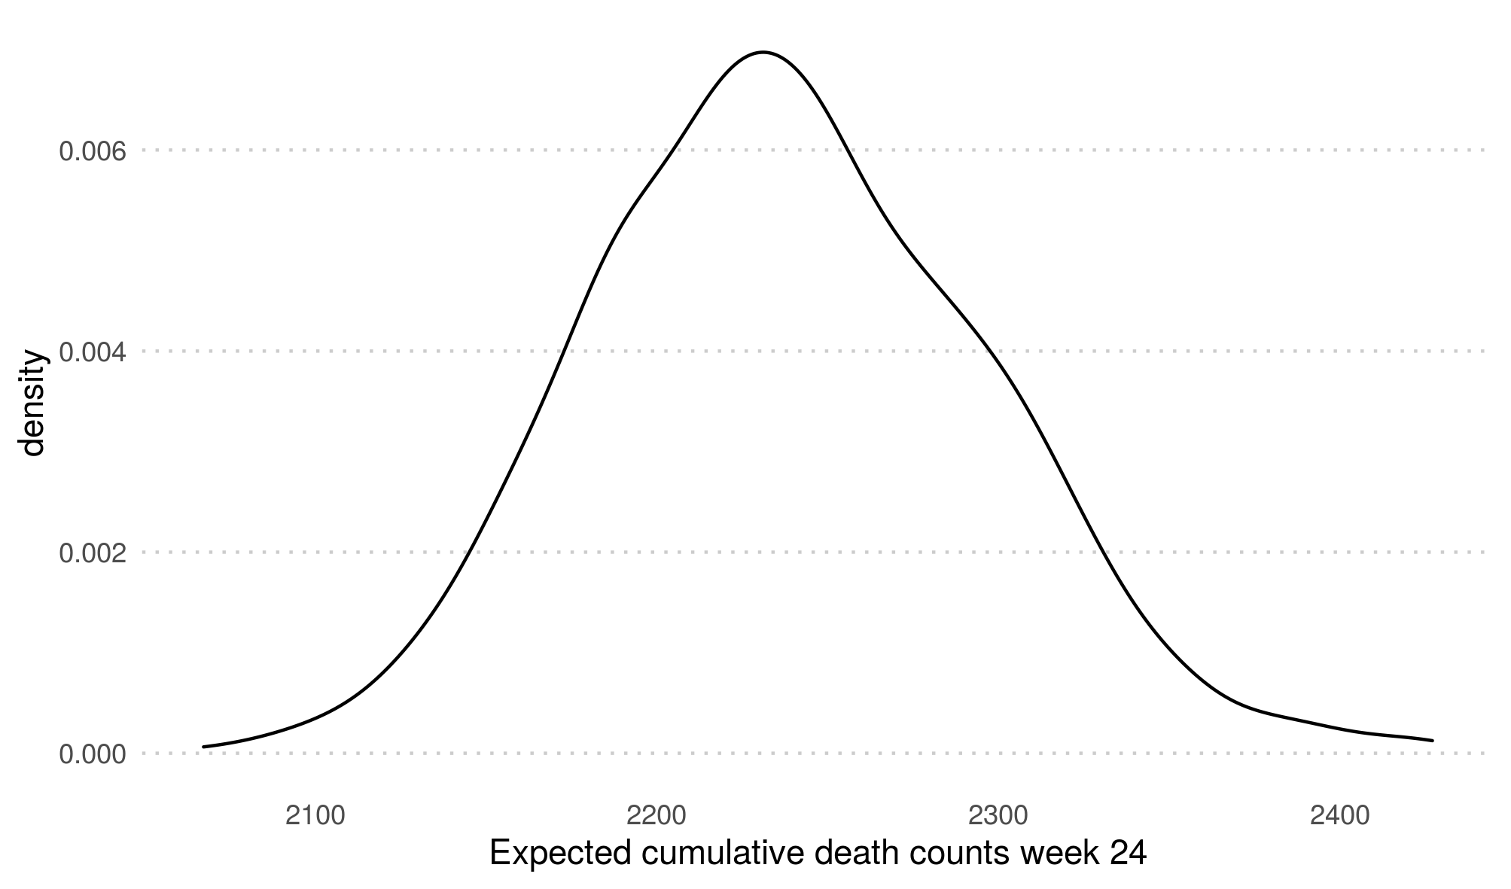
Residual bootstrapping
Distribution of cumulative expected death counts at week 24
Danish males ages 75–85, year 2009.

Slide 26
Reproducible analysis
github.com/jschoeley
Jonas Schöley
jschoeley@health.sdu.dk
Twitter: @jschoeley

