Slide 1
6420 Internet & Web Development
Week 3 Session 1

Slide 2
Storyboard
“The storyboard is an intermediate stage - concept and visualization…”

Slide 3
Storyboards
Storyboards are graphic organizers in the form of illustrations or images displayed in sequence for the purpose of pre-visualizing a motion picture, animation, motion graphic or interactive media sequence.
A storyboard is a sketch of how to organize a story and a list of its contents

Slide 4
History of the storyboarding
It was developed by Walt Disney Productions during the early 1930s, after several years of similar processes being in use at Walt Disney and other animation studios.

Slide 5
Storyboard – where it can be used:
Film
Theatre
Animation
Multimedia
Games
Web development
Design Software Interfaces
Notes:
for any web development project You can have some sort of plan to show like:
here are the goals, here are the objective, this is what we plan to achieve. that is important
you need to have something visual as well , you need to give them a diagram showing the screens that make up the user interface of a system and how you navigate between them. There is when you need storyboard.
you can download some storyboard online, there are many template to choose from.

Slide 6
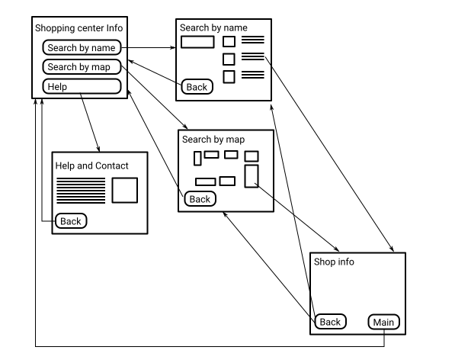
Example
Notes:
The system may functionally do exactly what the user desires but if the path the user takes through the screens doesn't match up with the way they want to work then it can be a rather frustrating experience for the user. Storyboards help us as software developers visualise and optimise this aspect of our system before we dive in and start building.
Here is an example of a simple storyboard for a kiosk in a shopping centre:
As you can see there is a rectangle representing each screen which has a title and minimal detail. Just enough detail to show the intent of the screen. Any buttons or elements which lead to another screen are also shown. These navigation elements are joined to the screen they link to by an arrow.

Slide 7
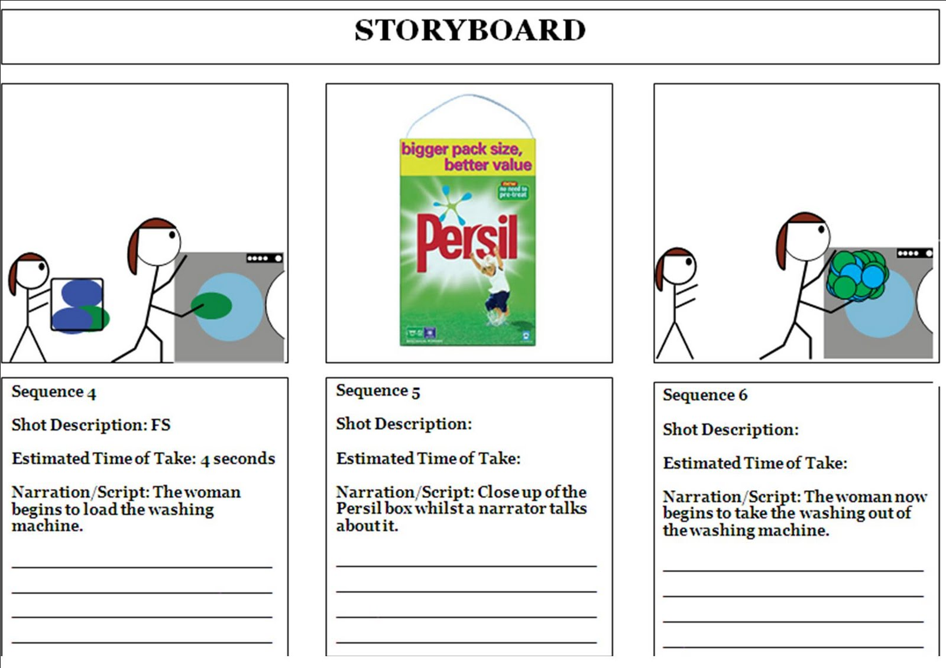
Example

Slide 8
We need Storyboard
to identify the specifications
to illustrate the important steps of the user experience.
to help the user understand exactly how the end product will work
to save time and resources, it is cheaper to make changes to a storyboard

Slide 9
Storyboard Elements
Every storyboard has elements - representation of actual elements of a finished presentation. These are in the form of text, video, sound, images and more...

Slide 10
Work with Elements
Decide what pieces of the story work best in video.
Decide what pieces of the story work best in still photos.
Does the audio work best with video, or will it be combined with still photos?
What part of the story works best in graphics?
Does the story need a map
What part of the story belongs in text?
Make sure the information in each medium is complementary, not redundant.
Interactivity means giving the reader both input and control in a story.

Slide 11
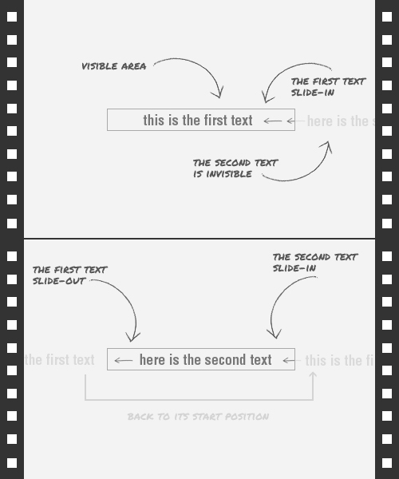

Slide 12
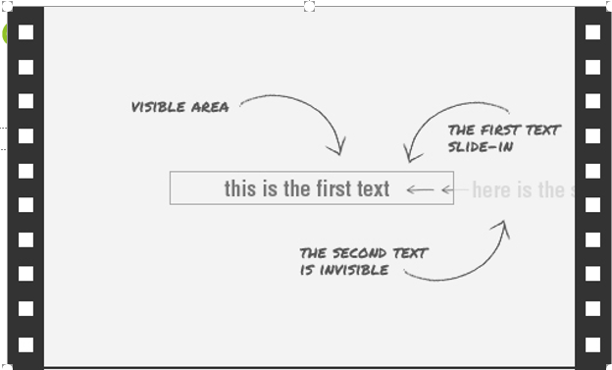
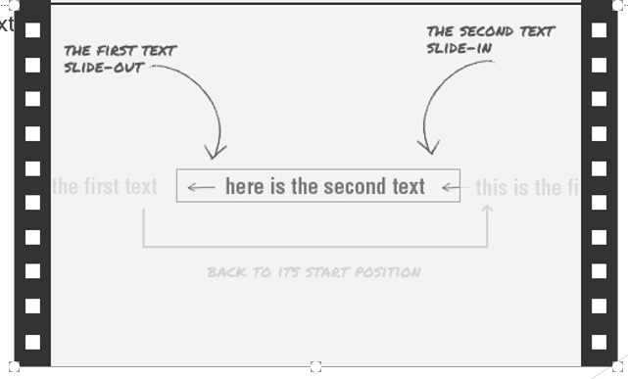
Information on storyboard for each frame:
Description
Name of elements(text, images, sounds, video, link)
Duration
Elements Animation (movement, expanding, fading, colour changing…)
Notes:
If you want to make an animation like with CSS3 that we learnt today. You need to break the entire animation to small pieces. Have you seen those negative film rolls. Something like that.

Slide 13
Important concepts
Keep it Simple
Remember, your focus is on the paths between the pages, not the look of the pages.
The right approach
Make sure your approach to drawing the storyboards allows you to easily modify and tweak them.

Slide 14
Class Activity:
Create storyboard with 3 key frames
Implement your solution using CSS animation
Task 1 – Looking on existing advertisement develop a storyboard, put all necessary details: like duration, delay, length of animation, elements (text, images, links), desired colour schema, etcetera.
Task 2 – Plan your own advertisement banner for your homepage, develop a storyboard, with all necessary details: like duration, delay, length of animation, elements ( text, images, links), desired colour schema, etcetera.

Slide 15
References
http://www.presentationteam.com/presentation-tips/powerpoint-tips/presentation-storyboarding
http://multimedia.journalism.berkeley.edu/tutorials/starttofinish/storyboarding/
http://en.wikipedia.org/wiki/Storyboard
http://mpartogi.wordpress.com/2011/11/
http://jleagueproductions.blogspot.co.nz/2011/05/storyboard-1.html
https://www.youtube.com/watch?v=fTrUcTAXQz8

