Slide 1
JavaScript Basic
Week 3 Session1

Slide 2
Assignment 1
Marking schedule for booking system has been fixed
No longer conflicts with Part 3 instructions for form inputs

Slide 3
Contents of This session
JavaScript Basic
Variable
Operators
If/Loop statement
Function

Slide 4
What is JavaScript?
The programming language of HTML and the Web
We can use it to:
Change HTML content
Change HTML Attribute
Change CSS
Validate Data

Slide 5
How to use JavaScript?
In HTML, JavaScript code must be inserted between <script> and </script> tags
Example:
<script>
document.getElementById("demo").innerHTML = "My First JavaScript";
</script>
You can place any number of scripts in an HTML document

Slide 6
How to use JavaScript?
Scripts can be placed in the <body>, or in the <head> section of an HTML page, or in both.
<!DOCTYPE html> <html>
<head> <script> function myFunction() { document.getElementById("demo").innerHTML = "Paragraph changed.";} </script> </head>
<body>
….
</body> </html>
Example of JS inside a head element

Slide 7
How to use JavaScript?
Scripts can also be placed in external files.
Advantages
It separates HTML and code
It makes HTML and JavaScript easier to read and maintain
Cached JavaScript files can speed up page loads
<!DOCTYPE html> <html> <body> <script src="myScript.js"></script> </body> </html>
Example of External JavaScript

Slide 8
JavaScript Output
JavaScript can "display" data in different ways:
Writing into an alert box, using window.alert().
Writing into the HTML output using document.write().
Writing into an HTML element, using innerHTML.
Writing into the browser console, using console.log().

Slide 9
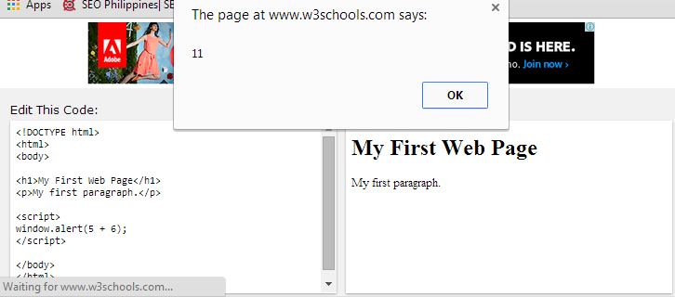
JavaScript Output
Example: Alert Box

Slide 10
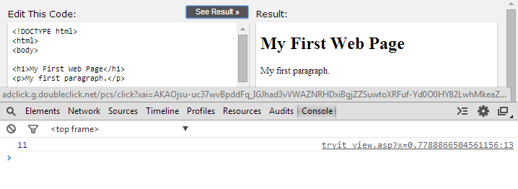
JavaScript Output
Example: Browser console

Slide 11
Comments
Single line comments start with //
Multiple line comments start with /* and end with */
/* The code below will change the heading with id = "myH" and the paragraph with id = "myP" in my web page: */ document.getElementById("myH").innerHTML = "My First Page";
document.getElementById("myP").innerHTML = "My first paragraph.";
// Change heading: document.getElementById("myH").innerHTML = "My First Page";
Example of single line Comments
Example of Multi-line Comments

Slide 12
Variables
JavaScript variables are containers for storing data values
Declare a JavaScript variable with the var keyword
Rules for specifying names for variables
Contain letters, digits, underscores, and dollar signs.
Must begin with a letter
Names are case sensitive (y and Y are different variables)
Can not use Reserved words
var my_number = 5;
Example of a variable declaration

Slide 13
Data types of Variables
JavaScript variables can hold many data types:
Numbers
Strings
Arrays
Boolean
Objects
and more!!

Slide 14
Operators
Let us take a simple expression 4 + 5 is equal to 9. Here 4 and 5 are called operands and ‘+’ is called the operator
Arithmetic Operators
Comparison Operators
Addition +
Subtraction –
Multiplication *
Division /
Modulus %
Increment ++
Equal to ==
Not equal !=
Greater then >
Less than <
Greater than or Equal >=
Less then or Equal <=

Slide 15
Operators
Assignment Operators
Logical Operators
Assignment =
Add and Assignment +=
Subtract and Assignment -=
Multiply and Assignment *=
Divide and Assignment /=
Modules and Assignment %=
Logical AND &&
Logical OR ||
Logical NOT !

Slide 16
Types of comparison
JavaScript has different types of comparators:
Equal to
Equal value and type
==
Example:
var n = 10;
Assert (n == 10) // true
Assert (n == “10”) // true
Assert (n == 11) // false
===
Example:
var n = 10;
Assert (n === 10) // true
Assert (n === “10”) // false
Assert (n === 11) // false

Slide 17
If statement
allows JavaScript to make decisions and execute statements conditionally
Syntax:
if (expression){
Statement(s) to be executed if expression is true
}
You can add else/else if to if statement to allows JavaScript to execute statements in a more controlled way

Slide 18
If statement
Example:
var age = 15;
if( age > 18 ){
document.write("<b>Qualifies for driving</b>");
}
else{
document.write("<b>Does not qualify for driving</b>");
}

Slide 19
Switch statement
Used to perform different actions based on different conditions
Syntax: switch(expression) { case n: code block break; case n: code block break; default: default code block }

Slide 20
Switch statement
Example:
var grade='A';
document.write("Entering switch block<br />");
switch (grade)
{
case 'A': document.write("Good job<br />");
break;
case 'B': document.write("Pretty good<br />");
break;
default: document.write("Unknown grade<br />")
}

Slide 21
For-loop statement
loops through a block of code a number of times
Syntax:
for (initialization; test condition; iteration statement) { code block to be executed }
Example:
for(var count = 0; count < 10; count++){
document.write("Current Count : " + count );
document.write("<br />");
}

Slide 22
While-Loop statement
to execute a statement or code block repeatedly as long as an expression is true
Syntax:
While-do loop
while (expression){
Statement(s) to be executed if expression is true
}
Do-while loop
do{
Statement(s) to be executed;
} while (expression);

Slide 23
While-Loop statement
Example:
var count = 0;
document.write("Starting Loop" + "<br />");
do{
document.write("Current Count : " + count + "<br />");
count++;
}
while (count < 5);

Slide 24
Defining a function
A group of reusable code which can be called anywhere in your program
Syntax:
function function_name(parameter-list)
{
statements
}
Example:
function sayHello()
{
alert("Hello there");
}

Slide 25
Exercise
Exercise – CSS with Javascript.doc
HTML_Javascript_tutorials.zip
3 Exercises to follow in the zip.

Slide 26
End of The Session 1
Week 3

