Slide 1
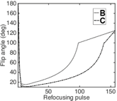
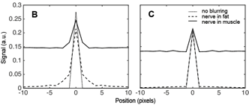
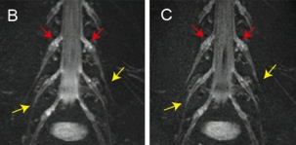
4230 Optimized refocusing flip angle train design for small peripheral nerve imaging with 3D TSE
Barbara Cervantes¹, Jan S. Bauer², Hendrik Kooijman³, Marcus Settles¹, Axel Haase⁴, Ernst J. Rummeny¹, Klaus Wörtler¹, Dimitrios C. Karampinos¹
¹Department of Diagnostic & Interventional Radiology, Technische Universität München, Munich, Germany
²Department of Neuroradiology, Technische Universität München, Munich, Germany
³Philips Healthcare, Hamburg, Germany
⁴Zentralinstitut für Medizintechnik, Technische Universität München, Garching, Germany
Computer No: 22

Slide 2

Declaration of Financial Interests or Relationships
Speaker Name: Barbara Cervantes
I have the following financial interest or relationship to disclose with regard to the subject matter of this presentation:
Company Name: Philips Healthcare
Type of Relationship: Grant Support

Slide 3
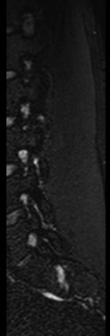
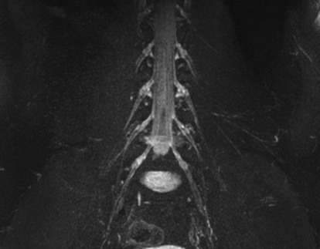
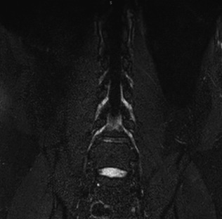

Motivation
High-resolution 3D imaging
Optimize delineation of small nerves with 3D TSE
sag
High isotropic resolution T₂ weighted imaging of peripheral nerves at 3T¹
3D imaging of peripheral nerves:
multi-planar reconstructions
areas with high obliqueness²
Flip angle modulation in 3D TSE to improve image quality^{3,4}
cor
ax
¹Chhabra, AJR 196:583 2011 ²Soldatos, RadioGraphics 33:967 2013
³Yonemaya, Proc. ISMRM p2721 2011 ⁴Busse, Magn Reson Med 60:640 2008

Slide 4
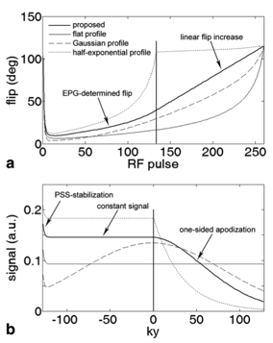
3D TSE imaging of peripheral nerves
Traditional design of flip angle trains
Modulation of flip angles defines shape of MTF
Shape of MTF determines signal intensity and blurring^{1,2}
EPG: compute flip angles from desired MTF^{1,3,4}
Flip angle train
EPG
MTF
Design tissue-specific flip angle trains²
Busse, Magn Reson Med 55:1030 2006
¹Busse, Magn Reson Med 55:1030 2006 ²Busse, Magn Reson Med 60:640 2008
³Weigel, J Magn Reson Imag in press 2014 ⁴Hennig, Magn Reson Med 51:68 2004

Slide 5
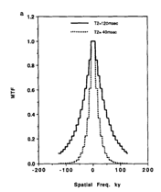
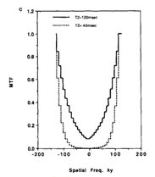
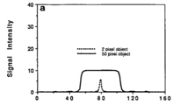
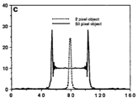
3D TSE imaging of peripheral nerves
Geometry considerations in optimization of flip angle trains
Small objects: blurring of surrounding tissue affects signal¹
Geometry conditions in optimization of flip angle trains²:
tissue- and geometry-specific design
signal of small embedded objects highly sensitive to shape of MTF
constant
Constable, Magn Reson Med 28:9 1992
¹Constable, Magn Reson Med 28:9 1992 ²Chen Proc. Intl. Soc. Mag. Reson. Med. 21 p.3716 2013

Slide 6
Purpose
To include geometry considerations into the design of flip angle trains in 3D TSE to generate optimal delineation of small nerves.

Slide 7
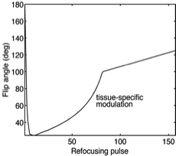
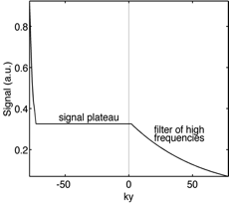
Methods
Computation of flip angle trains
Flip angle train
MTF
Design shape of desired MTF
signal plateau
Sequence parameters
T₁, T₂ of reference tissue
EPG
tissue-specific flip angle train

Slide 8
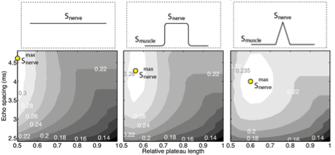
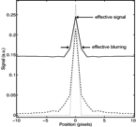
Methods
Signal of embedded nerve:
Signal simulations
infinite nerve
finite width
1-pixel width
Computation of flip angle trains and MTFs in parameter subspace:
echo spacing: [2.5ms,5ms]
signal plateau: [0.5*etl,etl]
Simulated signal profiles:
three nerve geometries
blurring with MTFs
assess signal and width variations induced by blurring of surrounding tissue*
example of simulated signal profile
*Carried out for muscle and suppressed fat

Slide 9
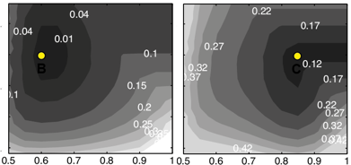
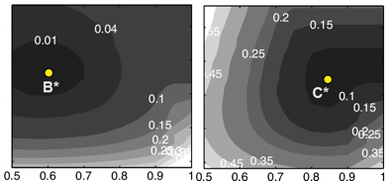
Methods
S: nerve signal
b: nerve width
(i)
1-pixel nerve
(ii)
Flip angle train optimization
Introduced metrics:
deviation from maximum signal:
joint deviation from maximum signal and minimum width:
embedded in muscle
B
C
|S_{max}-S|/S_{max}
(i)
embedded in suppressed fat*
|S_{max}-S|/S_{max} + |b_{min}-b|/b_{min}
(ii)

Slide 10
Methods
1-pixel nerve
Flip angle train optimization
Flip angle trains for nerve in muscle:
B: maximizes nerve signal
C: optimizes signal and blurring
Flip angle trains for nerve in suppressed fat**:
B*
C*
embedded in muscle
B
C
embedded in suppressed fat
**3D TSE in peripheral nerve imaging usually performed with fat suppression

Slide 11
Methods
Flip angle trains:
B: maximum signal
C: optimized
In vivo measurements
Lumbar plexus of 10 healthy volunteers on 3 T Philips Ingenia scanner
T2-weighted 3D TSE with*:
flip angle train B
flip angle train C
Echo spacing=4ms, max. flip angles=[100°125°], 6 initial echoes, FOV=400×400×80mm³, acq. voxel=1.25×1.25×1.4 mm³, reconstruction voxel=0.63×0.63×0.7 mm³, TR/TE=2000/330ms, TSE factor=150, scan duration=4min26s, reference tissue T₁=1010ms and T₂=90 ms, parallel imaging with reduction factor R=2.5, no partial Fourier, fat suppression with SPAIR, flow suppression with iMSDE with VENC=1cm/s
Abstract #101: Power Poster on Monday June 1st 14:15
*Main focus: small nerves embedded in muscle

Slide 12
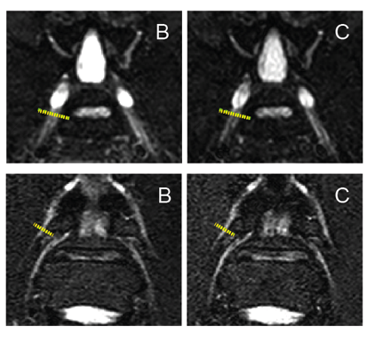
Methods
Flip angle trains:
B: maximum signal
C: optimized
Data analysis
Signal profiles along:
large L5 nerves
small L3 nerves
Nerve signal normalized to muscle
To compare flip angle trains B and C measured:
nerve signal S_{B} and S_{C}
nerve width b_{B} and b_{C}
signal variation* (S_{C}-S_{B})/S_{B}
width variation* (b_{B}-b_{C})/b_{B}
*Relative to flip angle train B

Slide 13
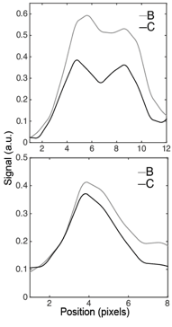
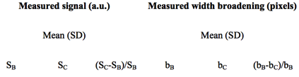

Results
Flip angle trains:
B: maximum signal
C: optimized
Comparison of flip angle trains
example: single profile
...
not relevant
not relevant
large L5 nerves
not relevant
not relevant
small L3 nerves
Flip angle train B:
Large nerves 25% higher signal than small nerves

Slide 14
Results
Flip angle trains:
B: maximum signal
C: optimized
Comparison of flip angle trains
example: single profile
...
not relevant
not relevant
large L5 nerves
not relevant
not relevant
small L3 nerves
Flip angle train C:
Large nerves 11% higher signal than small nerves

Slide 15
Results
Flip angle trains:
B: maximum signal
C: optimized
Comparison of flip angle trains
example: single profile
...
not relevant
not relevant
large L5 nerves
not relevant
not relevant
small L3 nerves
Signal loss with flip angle train C compared to B: mostly large nerves

Slide 16
Results
Flip angle trains:
B: maximum signal
C: optimized
Comparison of flip angle trains
example: single profile
...
not relevant
not relevant
large L5 nerves
not relevant
not relevant
small L3 nerves
Width improvement with flip angle train C compared to B: significant for small nerves

Slide 17
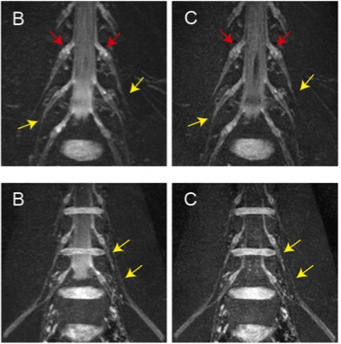
Results
Flip angle trains:
B: maximum signal
C: optimized
Flip angle train C compared to B
Overall reduction of:
signal
blurring
Large nerves: more uniform signal (red arrows)
Small nerves: improved delineation (yellow arrows)
subject 1
subject 2

Slide 18
Discussion
In peripheral nerve imaging with 3D TSE:
Tissue-specific flip angle modulation frequently implemented^{1,2}
Blurring greatly affects delineation of small nerves
Coupling of signal of small nerves and blurring of surrounding tissue
Need to consider geometry-specific blurring effects in flip angle modulation
Optimized flip angle train C: best balance of signal and sharpness of small nerves embedded in muscle
¹Kasper, Eur Radiol 2015 ²Chhabra, Skeletal Radiol 40:1249 2011

Slide 19
Discussion
Optimized flip angle train C:
Significantly improves delineation of small nerves
Generates signal uniformity across all nerve sizes
Also optimizes delineation of nerves in suppressed fat
Limitations:
Signal loss compared to (standard) B:
most signal loss in large nerves
(!) not recommended for scans with low SNR
Optimization in selected parameter space (protocol-dependent)
Limited relaxometry literature in peripheral nerve imaging in humans

Slide 20
Conclusion
An optimized flip angle train in 3D TSE considering geometry-specific blurring effects of the surrounding tissue significantly improves the delineation of small peripheral nerves.
Dedicated flow suppression preparation in peripheral nerve imaging with 3D TSE:
Abstract #101: Power Poster on Monday June 1st 14:15

Slide 21
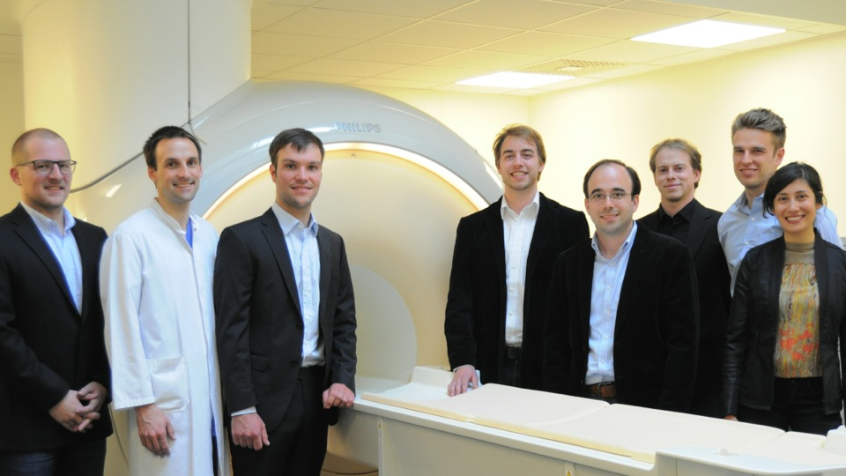


Acknowledgements
Funding: Philips Healthcare

