Slide 1

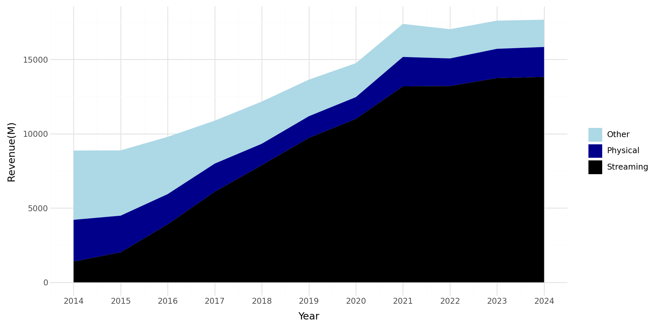

Industry revenue has stagnated due to saturation in streaming services.
Revenue adjusted for inflation
CAGR: 0.5%
CAGR: 10%
Streaming growth has offset losses in Physical and Other* media revenue, resulting in 10% annual growth from 2014-2021.
Growth from 2021 – 2024 has slowed considerably to 0.5% per year, indicating market saturation.
Streaming services drive most industry revenue, accounting for 78% of total revenue in 2024.
*Other Media: SoundExchange Distributions, Synchronization, Ringtones & Ringbacks, Kiosk, Download Album, Download Single, Download Music Video, Other Digital

Slide 2
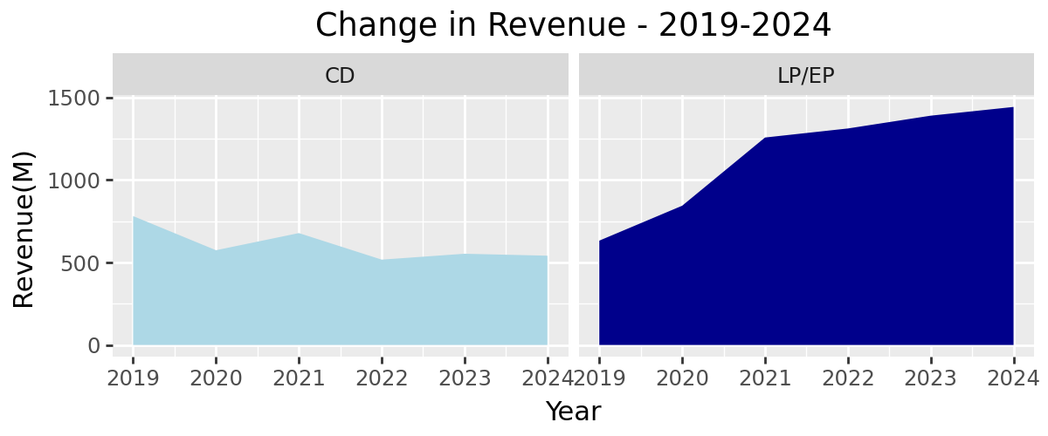
Physical media shows strong growth which can be leveraged to increased revenue.
In 2024, physical media accounted for 11% ($2B) of total revenue.
Why is physical media growing?
Perceived superior audio-quality
Engaging User Experience
Loyalty to favorite artists
How Physical Media can grow revenue.
Physical media drives 3x-6x more revenue per unit than streaming.
  $15-30/album vs $5/album streaming equivalency*.
Higher loyalty and engagement with artists can be leveraged to grow other revenue streams:
  Bundling album sales with streaming services increases likelihood to purchase a paid-tier service.
  Royalties for TV, movie, or advertising use.
  Concert and live performance revenues.
Vinyl dominates physical sales, while CDs remain steady.
  LP/EP accounted for 70% ($1.4 B) of physical media.
  CD accounted for 30% ($540 M) of physical media.
Vinyl growth rate exceeded streaming service growth by 3x over the past 5 years
+42%
+128%
-31%
*Streaming Services earn $.002 - $.004 per stream, 1500 streams is equivalent to an album sale.
Revenue adjusted for inflation

Slide 3
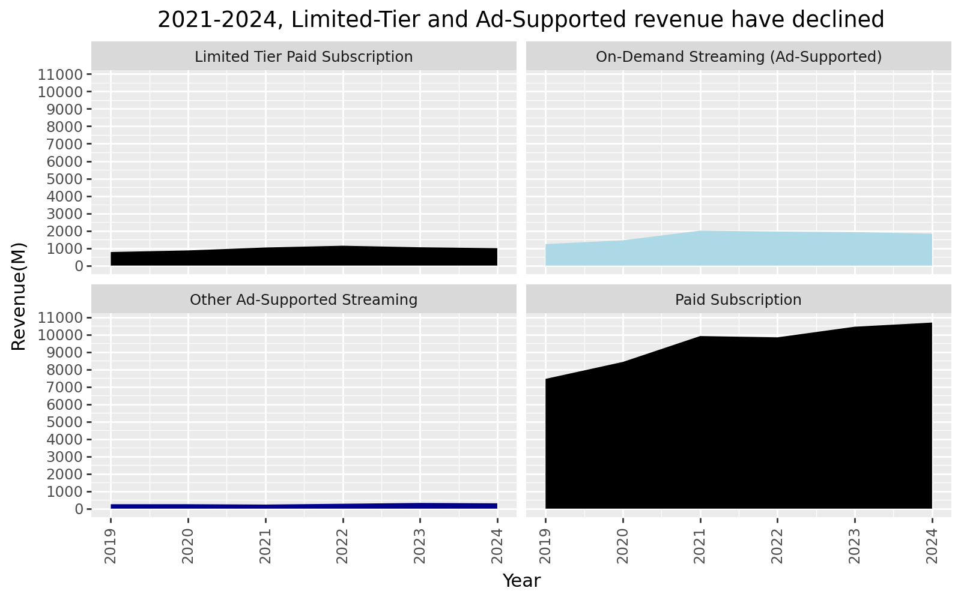
Streaming services need to move subscribers into paid-tiers to grow revenue.
Paid Tier Streaming Services create 9x more revenue than non-paid streaming services.
Within the same user pool, moving 10% of users will yield a $1B revenue increase.
Opportunity:
Draw on lessons from physical media growth. Translate higher loyalty and engagement with artists to higher rates of paid subscriptions.
Paid Subscription revenue continues to grow slowly as users move from Ad-Supported or limited tier plans.
Revenue adjusted for inflation

