Slide 1
Paper figures

Slide 2
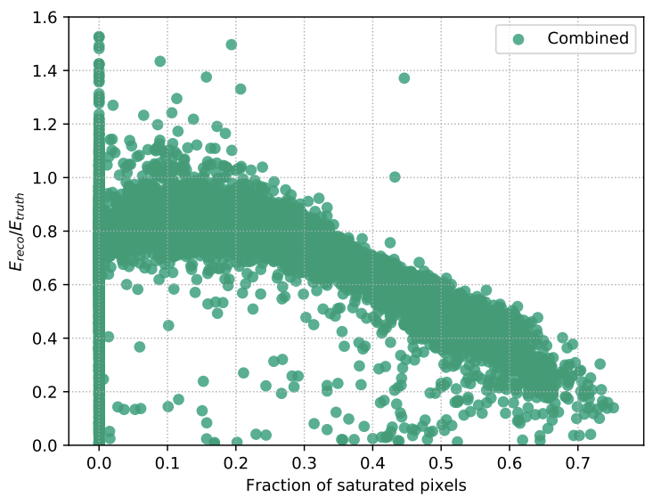
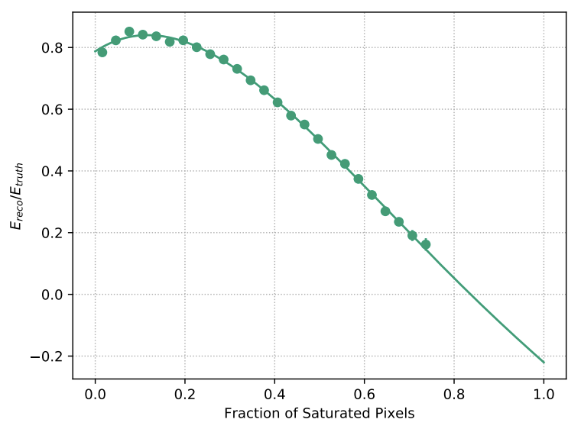
Figure 1
Michael’s correction for saturation. We should show an updated version of this

Slide 3
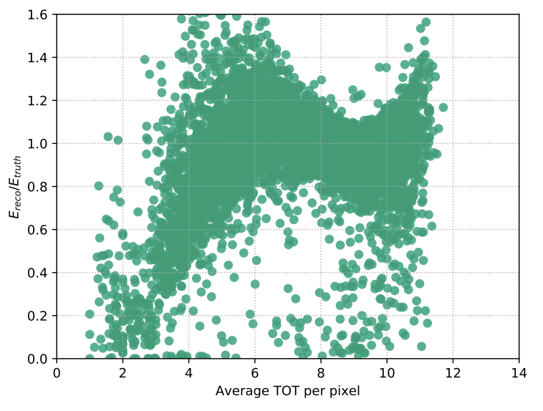
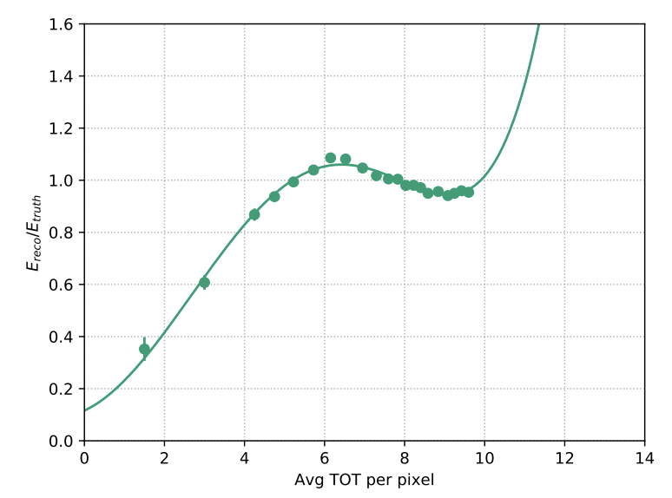
Figure 2
Michael’s correction for threshold. We should show an updated version of this

Slide 4
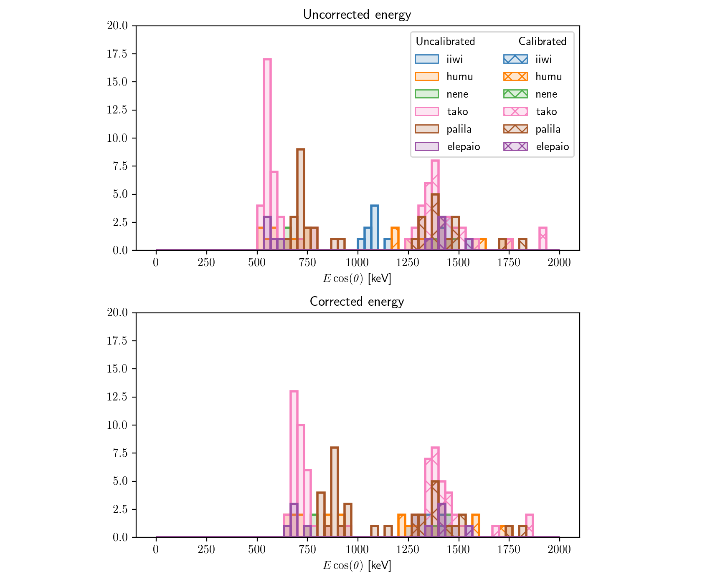
Figure 3
Caption:
Top: Uncalibrated and calibrated energy spectra of calibration source alphas for all 6 modules before applying any energy corrections.
Bottom: Uncalibrated and calibrated energy spectra of calibration source alphas after correcting for charge loss from threshold and saturation.
We scale the energy by cos(theta) to correct for inclination of the track.

Slide 5
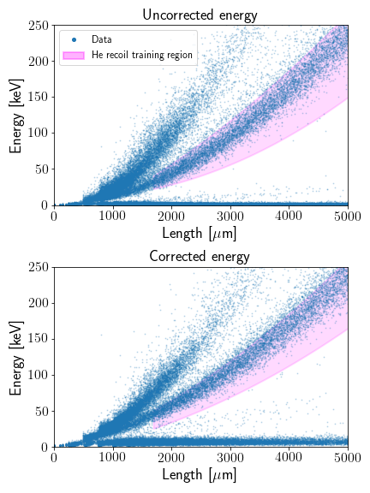
Figure 4
Caption: Track energy vs length of all recoils for one of the four modules included in this comparison. We use the same He recoil training regions in each of the four modules. Different regions are selected for the samples with uncorrected and corrected energy to account for differences in the two energy scales.

Slide 6
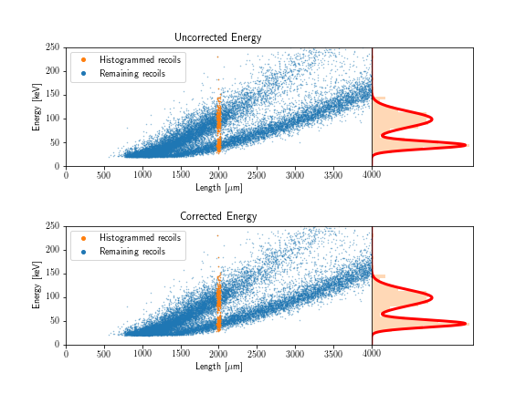
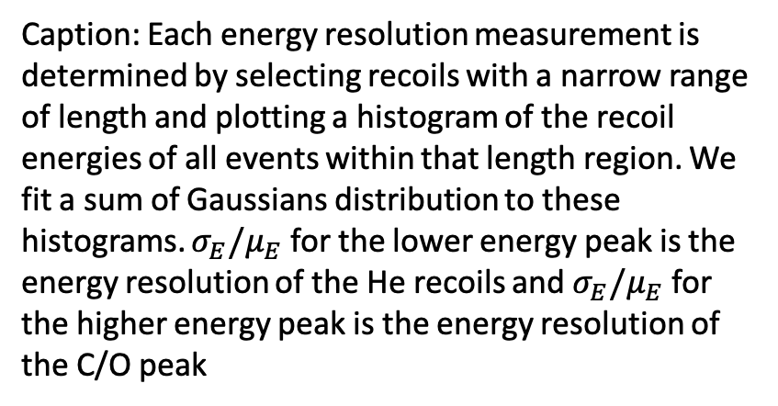
Figure 5
Caption: Each energy resolution measurement is determined by selecting recoils with a narrow range of length and plotting a histogram of the recoil energies of all events within that length region. We fit a sum of Gaussians distribution to these histograms. $σ_{E}/μ_{E}$ for the lower energy peak is the energy resolution of the He recoils and $σ_{E}/μ_{E}$ for the higher energy peak is the energy resolution of the C/O peak

Slide 7
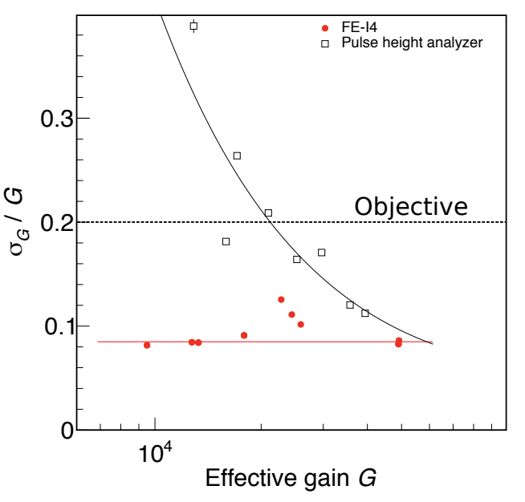
Figure 6
Should include gain resolution as a function of energy instead of this…we could include that result as a dashed line at the bottom of the plots in the figures that follow

Slide 8
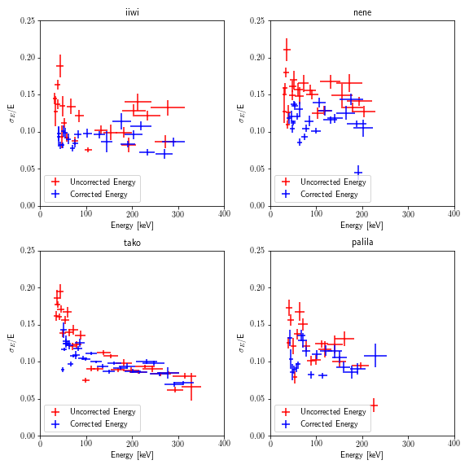
Figure 7
Results for the Helium recoil energy resolutions as a function of recoil energy in each of the four modules. We see that in general, correcting recoil energies for charge loss from threshold and saturation improves the energy resolution of He recoils
Note: Using the double Gaussian fits, this is as high as we can go to measure the Helium recoil energy. If we want to go any higher, we would have to select the Helium recoil band itself

Slide 9
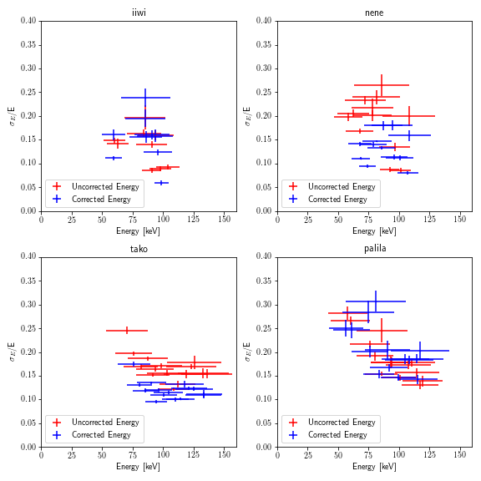
Figure 8
Results for the recoil energy resolutions of the C/O recoil band as a function of recoil energy in each of the four modules. At higher recoil energies we are statistics limited in the C/O band, hence the smaller range of energies sampled as compared to the He recoil band

Slide 10
Backup

Slide 11
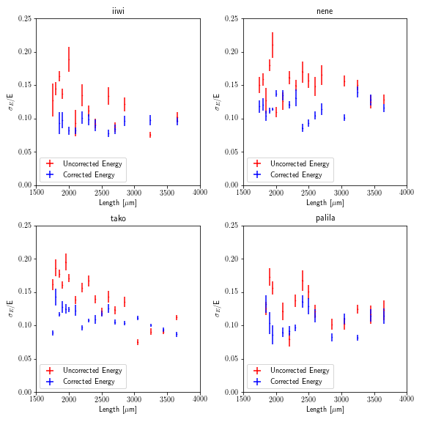
E reso vs L
I think E reso vs E is more interesting to report

