Slide 1
Artificial Intelligence Cheat Sheet
OPTIMIZATION ALGORITHMS

Slide 2
Table of Contents
Gradient Descent
Gradient Descent w/ Momentum
Greedy (Prim’s) Algorithm
Dijkstra’s Algorithm
Bellman-Ford
A*
Bayesian Inference
R*
Kalman Filter
Variational Method
Simplex Algorithm
Map-Reduce
Hadoop
Dynamic Programming
Nonlinear Programming
AVL Tree

Slide 3
Gradient Descent (CS 229, Andrew Ng, Stanford)
Gold Standard
y_{j} ← y_{j} – α ∂_{j} J ( y _{j} )
J – Objective Function (Cost Function)
α – Learning Rate (0.01)

Slide 4
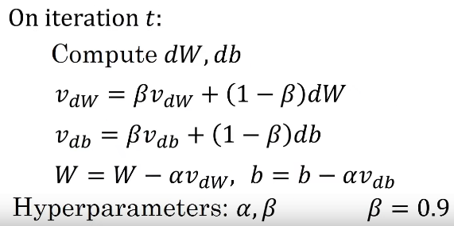

Gradient Descent with Momentum
(Less often used)

Slide 5
Greedy Algorithm (Prim’s Algorithm) (https://www.youtube.com/watch?v=FPEMBWg_WlY) MIT 6.046J
Q ← V
key [ v ] ← ∞, ꓯ v ϵ V
key [ s ] = 0 for arbitrary s ϵ v
While Q ≠ Ø
Do u ← Extract_min ( Q )
For each v ϵ Adj [ u ]
Do if v ϵ Q and u ( v ) < key [ v ]
Then key [ v ] ← w ( u, v )
π [ v ] ← u
MST = { ( v, π [ v ] ) }

Slide 6
Dijkstra’s Algorithm [5] (https://www.youtube.com/watch?v=xhG2DyCX3uA) (MIT 6.046J 2005)
For each v ϵ V – { s }
do d [ v ] ← ∞
d [ s ] ← 0
S ← Ø
Q ← v
While Q ≠ Ø, S ← S U { u }
Do u ← Extract_Min ( Q )
For each v ϵ Adj [ u ]
Do if d [ v ] > d [ u ] + w ( u, v )
Then d [ v ] ← d [ u ] + w ( u, v )

Slide 7
Bellman-Ford
d [ s ] ← 0
For each v ϵ V – { s }
do d [ v ] ← ∞
For I ← 1 to | v | - 1
do for each Edge (u, v) ϵ E
do if d [ v ] > d [ u ] + w ( u, v )
then d [ v ] ← d [ u ] + w ( u, v )
For each edge (u,v) ϵ E
do if d [ v ] > d [ u ] + w ( d, v )
then fail (negative cycle exists)

Slide 8
Dynamic Programming
LCS ( x, y, i, j )
If x [ I ] = y [ j ]
Then c [ i, j ] ← LCS ( x, y, i-1, j-1 ) + 1
Else c [ i, j ] ← max { LCS ( x, y, i-1, j ), LCS ( x, y, i, j-1 ) }
Return c [ i, j ]
LCS – Largest Common Subsequence

Slide 9
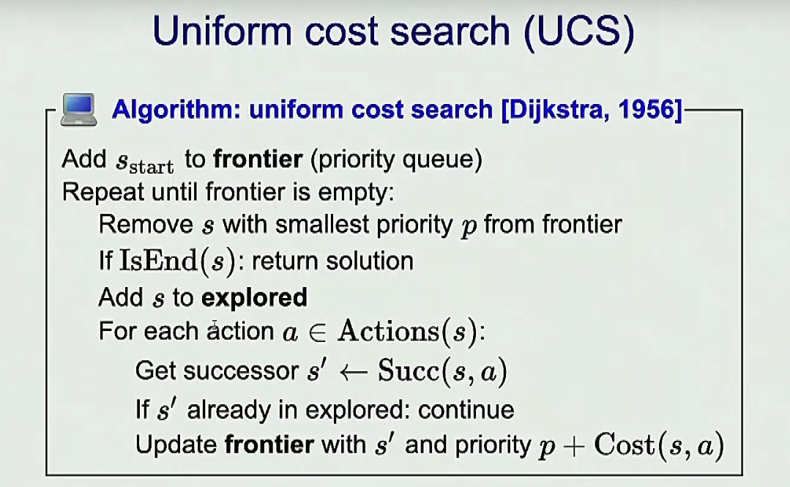
Stanford CS 221 (Fall 2019) (https://www.youtube.com/watch?v=HEs1ZCvLH2s)

Slide 10
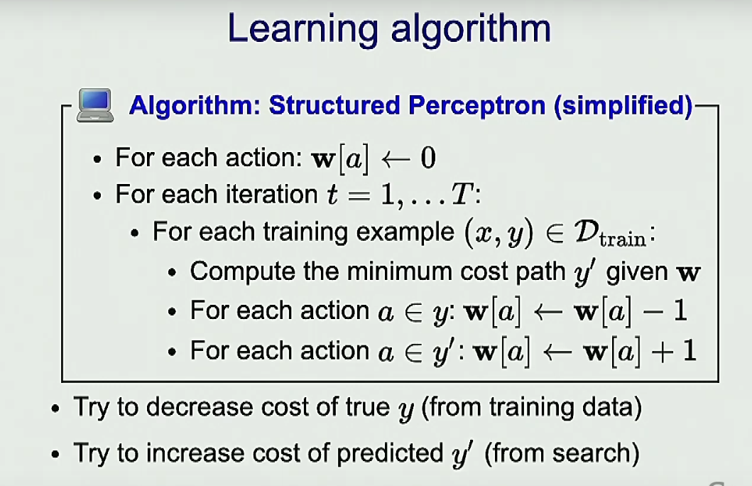
IBID

Slide 11
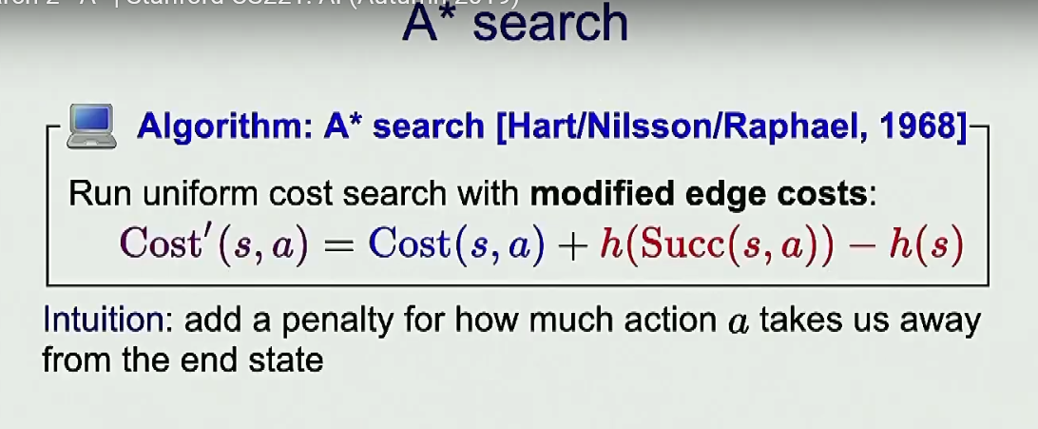
IBID

Slide 12

Linear Quadratic Regulator (LQR) (Andrew Ng, Stanford CS 229, Lecture 18)
R ( s_{t}, a_{t} ) = ||s_{t}||² - ||a_{t}||²
S_{t+1} = A s_{t} + B a_{t}
argmi$\text{n}\text{(}\text{A}\text{,}\text{B}\text{)}$ (1/2) $\sum_{i=1}^{m}{ \sum_{t=1}^{T−1}{ \text{||} \text{s}\text{t}\text{+1 }\text{−} \text{(}\text{Ast}\text{+}\text{Bat}\text{) ||2}} }$
S_{t+1} ≈ f(s_{t},a_{t}) + ($∇\text{s}$f(s_{t}, a_{t})) ^{T} · (s_{t} - s_{t}) + ($∇\text{a}\text{f}$(s_{t}, a_{t})) ^{T} · (a_{t} - a_{t})

Slide 13
Kalman Filter
Predict
s_{t}|y₁,…,y_{t} ~ N ( s_{t|t} , Σ_{t|t} )
s_{t+1|t} = A s_{t|t}
Σ_{t+1|t} = A Σ_{t|t} A^{T} + Σ₀
Update
s_{t+1}|y₁,…,y_{t+1} ~ N ( s_{t+1|t+1} , Σ_{t+1|t+1} )
s_{t+1|t+1} = s_{t+1|t} + K_{t+1} ( y_{t+1} – C s_{t+1|t} )
K_{t+1} = Σ_{t+1|t} C^{T} ( C Σ_{t+1|t} C^{T} + Σ ₀ ) ⁻¹
Σ_{t+1|t+1} = Σ_{t+1|t}- Σ_{t+1|t}C^{T} ( C Σ_{t+1|t} C^{T} + Σ ₀ ) C Σ_{t+1|t}

Slide 14
Linear Quadratic Gaussian (LQG)
w_{t} ~ N ( 0, Σ_{w} )
v_{t} ~ N ( 0, Σ_{v} )
s_{t+1} = A s_{t} + B a_{t} + w_{t}
y_{t+1} = C s_{t} + v_{t}
Use Kalman Filter to estimate state
s _{0|0} = s ₀, Σ_{0|0} = 0 (for s ₀ ~N(s _{0|0}, Σ _{0|0}) )
Predict
S_{t+1|t} = A s_{t|t} + B a_{t}
Σ_{t+1|t} = A Σ_{t|t} A^{T} + Σ_{v}
Compute L_{t}’s using LQR (Assuming observed states)
a_{t} = L_{t} s_{t}

Slide 15
Future Work
Quiksort
Simplex Algorithm
Fibonacci Heap
Binomial Heap
Nonlinear Programming
Stochastic Gradient Descent
Integer Programming
Simulated Annealing

Slide 16
References
Gradient Descent
Momentum
Prim’s Algorithm
Dijkstra’s Algorithm
Bellman-Ford
A*
Bayesian Inference
R*
Simplex Algorithm
Kalman Filter
Variational Method
Dynamic Programming
Nonlinear Programming
Map-Reduce
Hadoop

Slide 17
Presented by
John Schutkeker
NLM Physics Corp.
Royal Oak MI, 48073
April 30, 2021

