Slide 1
Artificial Intelligence Cheat Sheet
OPTIMIZATION ALGORITHMS

Slide 2
Gradient Descent (CS 229, Andrew Ng, Stanford)
Gold Standard
y_{j} ← y_{j} – α ∂_{j} J ( y _{j} )
J – Objective Function (Cost Function)
α – Learning Rate (0.01)

Slide 3
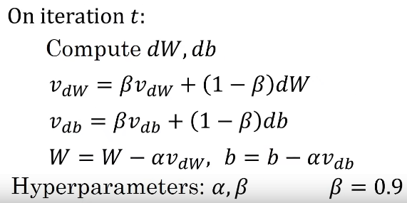

Gradient Descent with Momentum
(Less often used)

Slide 4
Greedy Algorithm (Prim’s Algorithm) (https://www.youtube.com/watch?v=FPEMBWg_WlY) MIT 6.046J
Q ← V
key [ v ] ← ∞, ꓯ v ϵ V
key [ s ] = 0 for arbitrary s ϵ v
While Q ≠ Ø
Do u ← Extract_min ( Q )
For each v ϵ Adj [ u ]
Do if v ϵ Q and u ( v ) < key [ v ]
Then key [ v ] ← w ( u, v )
π [ v ] ← u
MST = { ( v, π [ v ] ) }

Slide 5
Dijkstra’s Algorithm [5] (https://www.youtube.com/watch?v=xhG2DyCX3uA) (MIT 6.046J 2005)
For each v ϵ V – {s}
do d[v] ← ∞
D[s] ← 0
Q ← v
S ← Ø
While Q ≠ Ø, S ← S { u }
do u ← Extract_Min ( Q )
For each v ϵ Adj [ u ]
Do if d [ v ] > d [ u ] + w ( u, v )
Then d [ v ] ← d [ u ] + w ( u, v )

Slide 6
Future Work
Breadth First Search
A*
Bellman-Ford
Bayesian Inference

Slide 7
Presented by
John Schutkeker
NLM Physics Corp.
Royal Oak, MI, 48073
April 4, 2021

