Slide 1
Artificial Intelligence Cheat Sheet
OPTIMIZATION ALGORITHMS

Slide 2
Table of Contents
Gradient Descent
Gradient Descent w/ Momentum
Greedy (Prim’s) Algorithm
Dijkstra’s Algorithm
Bellman-Ford
A*
Bayesian Inference
R*
Kalman Filter
Variational Method
Simplex Algorithm
Map-Reduce
Hadoop
Dynamic Programming
Nonlinear Programming
AVL Tree

Slide 3
Gradient Descent (CS 229, Andrew Ng, Stanford)
Gold Standard
y_{j} ← y_{j} – α ∂_{j} J ( y _{j} )
J – Objective Function (Cost Function)
α – Learning Rate (0.01)

Slide 4
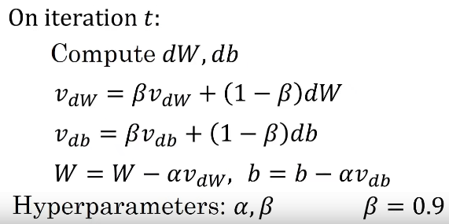

Gradient Descent with Momentum
(Less often used)

Slide 5
Greedy Algorithm (Prim’s Algorithm) (https://www.youtube.com/watch?v=FPEMBWg_WlY) MIT 6.046J
Q ← V
key [ v ] ← ∞, ꓯ v ϵ V
key [ s ] = 0 for arbitrary s ϵ v
While Q ≠ Ø
Do u ← Extract_min ( Q )
For each v ϵ Adj [ u ]
Do if v ϵ Q and u ( v ) < key [ v ]
Then key [ v ] ← w ( u, v )
π [ v ] ← u
MST = { ( v, π [ v ] ) }

Slide 6
Dijkstra’s Algorithm [5] (https://www.youtube.com/watch?v=xhG2DyCX3uA) (MIT 6.046J 2005)
For each v ϵ V – { s }
do d [ v ] ← ∞
d [ s ] ← 0
S ← Ø
Q ← v
While Q ≠ Ø, S ← S U { u }
Do u ← Extract_Min ( Q )
For each v ϵ Adj [ u ]
Do if d [ v ] > d [ u ] + w ( u, v )
Then d [ v ] ← d [ u ] + w ( u, v )

Slide 7
Bellman-Ford
d [ s ] ← 0
For each v ϵ V – { s }
do d [ v ] ← ∞
For I ← 1 to | v | - 1
do for each Edge (u, v) ϵ E
do if d [ v ] > d [ u ] + w ( u, v )
then d [ v ] ← d [ u ] + w ( u, v )
For each edge (u,v) ϵ E
do if d [ v ] > d [ u ] + w ( d, v )
then fail (negative cycle exists)

Slide 8
Dynamic Programming
LCS ( x, y, i, j )
If x [ I ] = y [ j ]
Then c [ i, j ] ← LCS ( x, y, i-1, j-1 ) + 1
Else c [ i, j ] ← max { LCS ( x, y, i-1, j ), LCS ( x, y, i, j-1 ) }
Return c [ i, j ]
LCS – Least Common Subsequence

Slide 9
Future Work
Fibonacci Heap
Binary Heap
Nonlinear Programming
Simplex Algorithm
Integer Programming
Stochastic Gradient Descent
Simulated Annealing

Slide 10
References
Gradient Descent
Momentum
Prim’s Algorithm
Dijkstra’s Algorithm
Bellman-Ford
A*
Bayesian Inference
R*
Simplex Algorithm
Kalman Filter
Variational Method
Dynamic Programming
Nonlinear Programming
Map-Reduce
Hadoop

Slide 11
Presented by
John Schutkeker
NLM Physics Corp.
Royal Oak, MI, 48073
April 5, 2021

