Slide 1
ERCOT Winter Storm Outage Risk
Utility exposure, financial impact, and a URI-like scenario analysis
EIA-861 Reliability | NOAA Storm Events | NOAA GHCN Daily | 6 ERCOT Utilities · 2013–2024

Slide 2
Research Question
"How much can winter storm conditions in ERCOT help explain utility outages, and what do those outages imply for delivery-rate pressure and lost revenue risk?"
Sub-questions
Scope
• Which territories have the largest winter storm exposure?
• How do outage metrics vary across utilities over time?
• How much delivery revenue is at risk when outage duration rises?
• What would a URI-like profile imply for 2024 conditions?
• Geography: ERCOT T&D utilities in Texas
• Storm exposure: 2000–2025
• Outage metrics: 2013–2024 (EIA-861)
• Revenue metrics: 2020–2024 (EIA-861)

Slide 3
The Six ERCOT Delivery Utilities
Utility
Territory
AEP Texas Central
South Texas (Corpus Christi, Rio Grande Valley)
AEP Texas North
West & Panhandle Texas (Abilene, Lubbock area)
CenterPoint Energy
Greater Houston metro
Nueces Electric Coop
Coastal Bend (Corpus Christi fringe)
Oncor Electric
North & Central Texas (DFW, West Texas)
Texas-New Mexico Power
Scattered suburban corridors statewide
Together these utilities serve the majority of the ERCOT transmission and distribution footprint.

Slide 4
Data Sources
EIA Form 861
NOAA Storm Events
NOAA GHCN Daily
• Annual reliability schedules (SAIDI, SAIFI)
• Service territory county mapping
• Delivery revenue & MWh sales
• County-level winter-season storm records
• Property & crop damage estimates
• Direct deaths & injuries
• One representative station per utility
• Freeze days, sub-20°F days
• Snowfall, precip, min temperature
All raw extracts saved to data/raw/; merged outputs to data/processed/

Slide 5
Method
1
Build utility geography
Map ERCOT delivery utilities to Texas counties via EIA service territory data.
2
Build storm & weather exposure
Aggregate NOAA winter storm events and daily weather severity to the utility-year level.
3
Join utility performance data
Merge annual outage metrics (EIA reliability) and delivery revenue (EIA delivery companies).
4
Fit exploratory outage model
Linear regression of SAIDI on winter severity and storm exposure features.
5
Simulate URI-like scenario
Apply 2021 winter feature values to 2024 utility baselines to estimate incremental lost revenue.

Slide 6
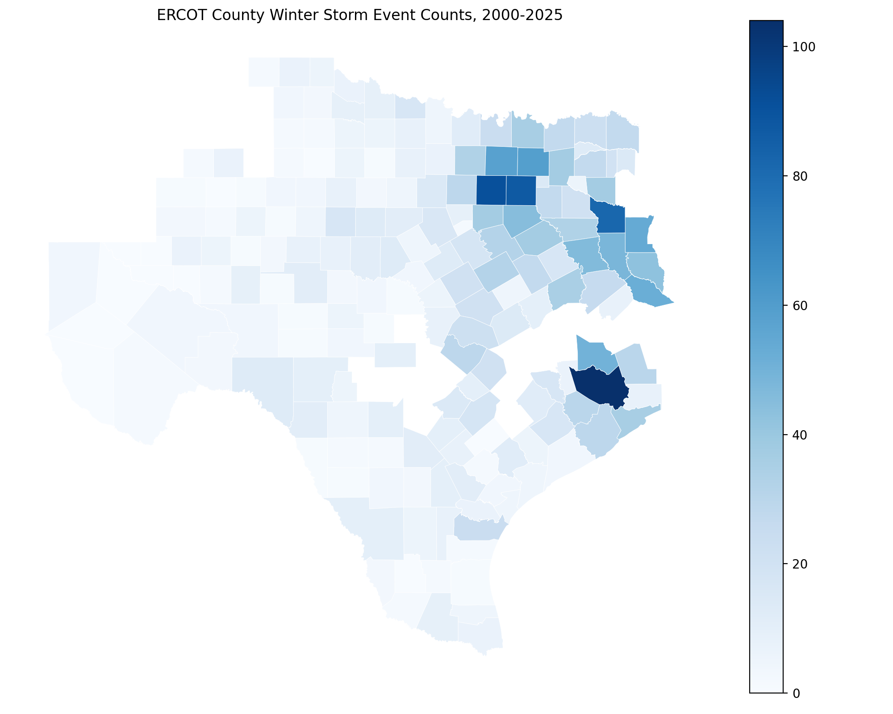
Geographic Winter Storm Exposure
County-level cumulative NOAA winter storm event counts, 2000-2025. Darker = more events.

Slide 7
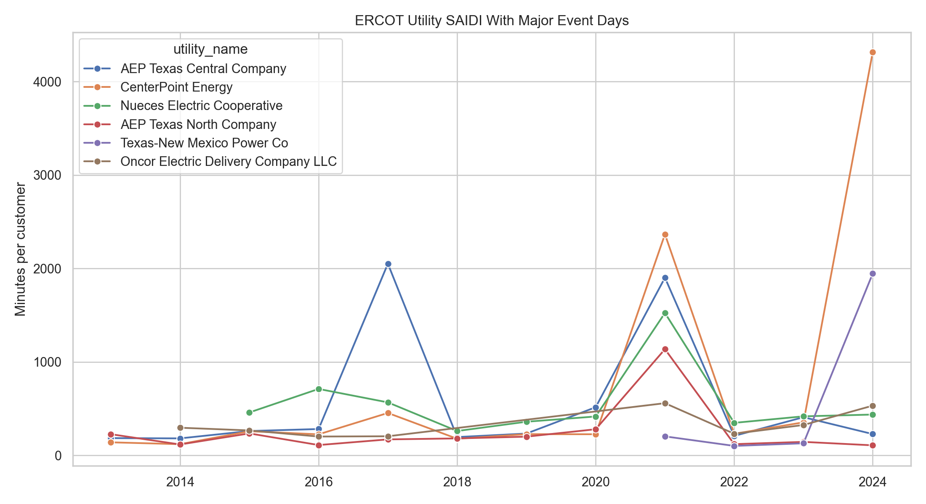
Utility Outage Trends (SAIDI with MED)
SAIDI with Major Event Days. Spikes reflect large discrete events — notably Winter Storm Uri (2021) and Hurricane Beryl / summer storms (2024 CenterPoint & TNMP).

Slide 8
Winter Storm Uri — 2021
Utility
2021 SAIDI (min)
Normal baseline
CenterPoint Energy
2,366
~150
AEP Texas Central
1,901
~170
Nueces Electric Coop
1,524
~170
AEP Texas North
1,137
~110
Oncor
559
~100
Texas-New Mexico Power
204
~105
Uri caused statewide generation failures in February 2021, producing sustained outages across nearly all utilities. Normal baseline is the approximate SAIDI-without-MED for each utility.

Slide 9
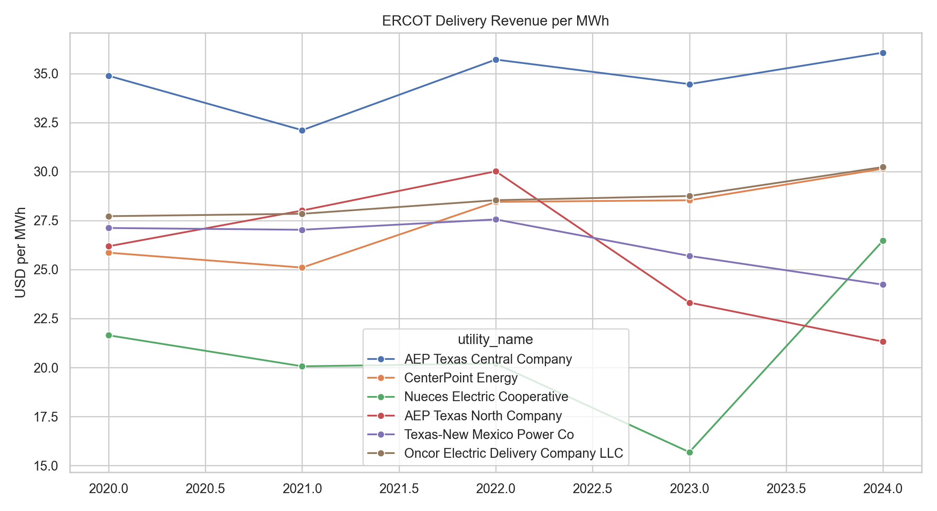
Delivery Revenue per MWh
Delivery revenue ÷ MWh sales from EIA-861 Delivery Company schedules, 2020-2024.

Slide 10
Exploratory Outage Model
Setup
Features
• OLS linear regression
• Dependent variable: SAIDI with MED
• 48 utility-year observations
• 8 winter severity features
• Winter event count
• Storm property damage (USD)
• Freeze days (≤32°F)
• Sub-20°F days
• Precipitation days
• Snow days
• Min temperature (°C)
• Total precipitation (mm)
Performance
• In-sample R² = 0.184
• In-sample MAE = 442 minutes
Model is exploratory — the small panel and annual SAIDI metric limit causal claims.

Slide 11
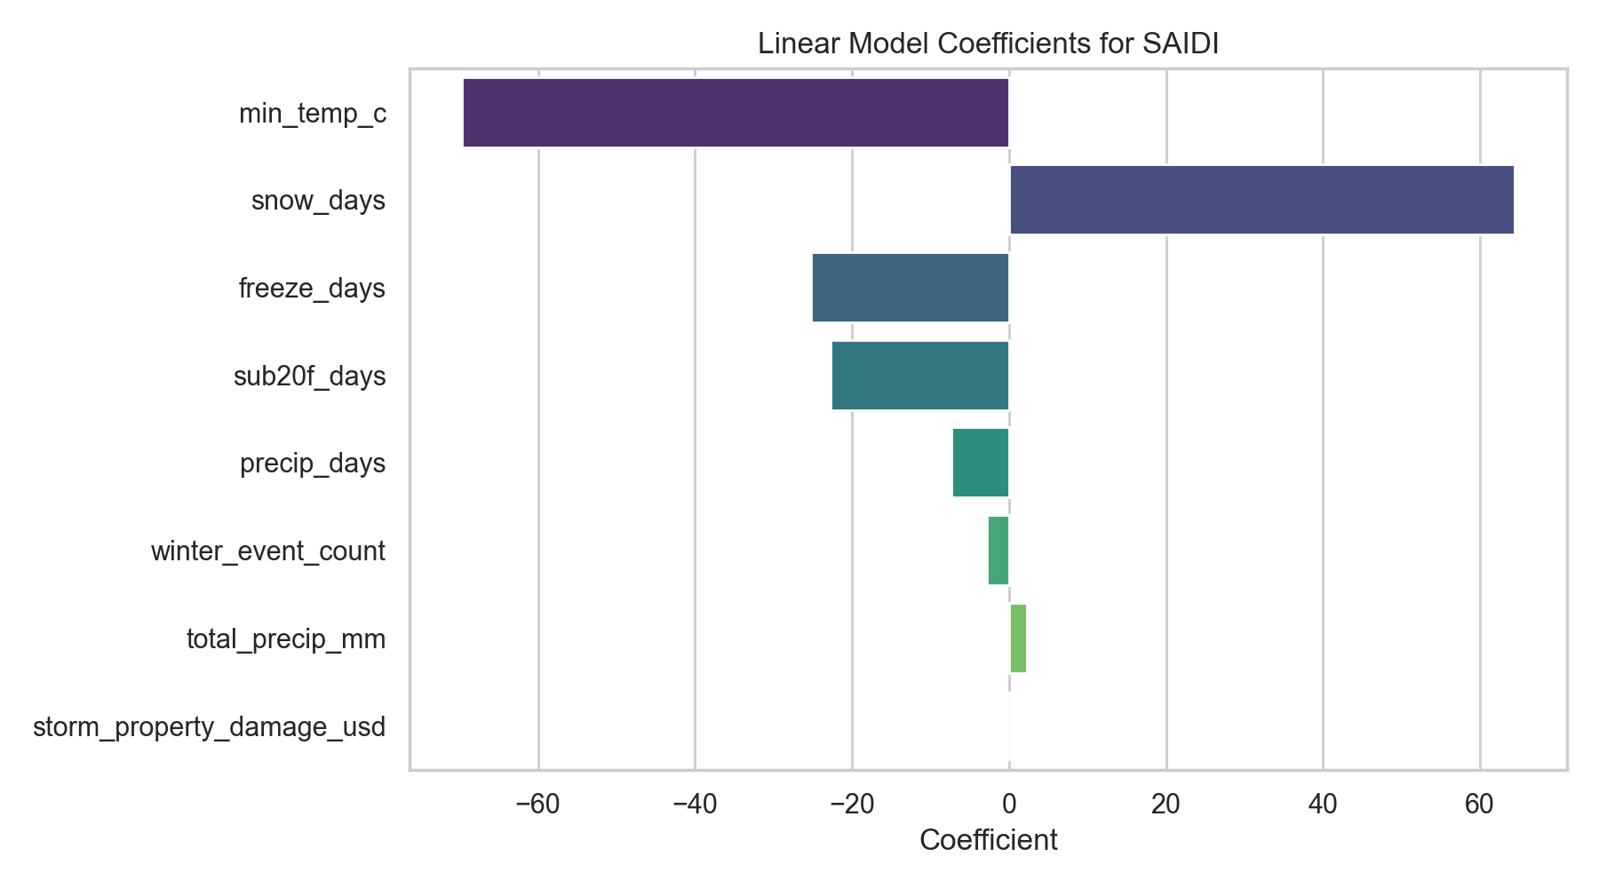
Model Coefficients
Larger absolute coefficients indicate stronger model association with SAIDI. Interpret with caution given low R².

Slide 12
URI-like 2024 Scenario
Apply 2021 winter severity feature values to 2024 utility baselines. Estimate incremental SAIDI and lost revenue.
Utility
2024 SAIDI
URI-like SAIDI
Incremental Lost Revenue
Oncor
532
685
+$1,423,255
AEP Texas Central
229
265
+$78,667
AEP Texas North
108
254
+$64,943
Texas-NM Power
1,946
1,892
−$42,413
CenterPoint
4,316
4,100
−$1,310,112
Nueces
437
—
missing 2021 weather
CenterPoint and TNMP show negative incremental impact because their 2024 SAIDI (driven by Hurricane Beryl / summer storms) already exceeds what a URI-level winter would predict.

Slide 13
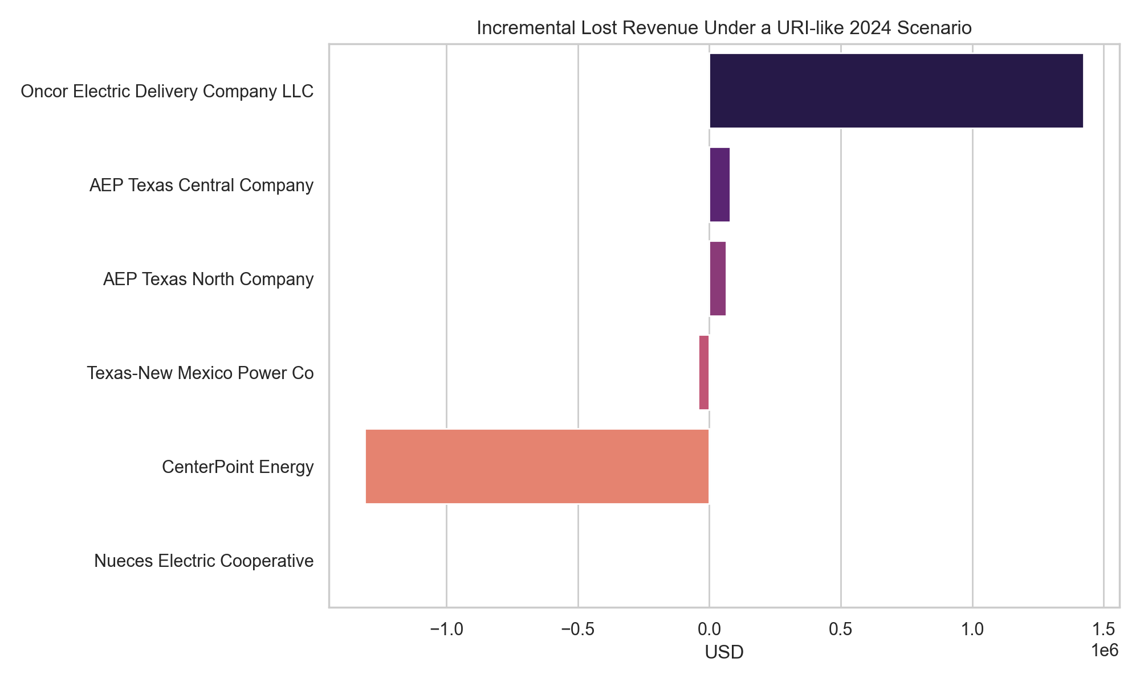
URI-like Incremental Lost Revenue
Incremental lost revenue = URI-like predicted lost revenue minus 2024 baseline lost revenue. Negative values indicate 2024 actual outages already exceed the URI-like prediction.

Slide 14
Limitations
Data
Model
• Annual SAIDI captures all outage causes — hurricanes and summer storms inflate "winter risk" metrics for some utilities
• One weather station per utility is a coarse spatial proxy
• NOAA Storm Events classification does not always align with ERCOT winter hazard definitions
• Small panel (48 obs across 6 utilities)
• Low R² (0.18) — winter features explain limited variance in annual SAIDI
• OLS assumes linear, additive effects; no interaction terms
• Not causal — confounders like infrastructure age are omitted

Slide 15
Next Steps
• Restrict outage metric to winter months only to remove summer storm contamination
• Replace single-station weather proxy with a broader spatial weather surface
• Add a richer outage/event source that ties more directly to utility-specific winter incidents
• Test alternative model forms (fixed effects, log-SAIDI, nonlinear weather terms)
• Tighten the financial model to reflect actual utility recovery and rate mechanisms

Slide 16
ERCOT Winter Storm Outage Risk
A reproducible analytical baseline combining EIA-861, NOAA Storm Events, and NOAA GHCN Daily
scripts/download_data.py · scripts/build_analysis.py · data/processed/ercot_utility_winter_risk_panel.csv · docs/analysis_summary.md

