Slide 1
Unit 9 Assignment
Analyzing Emergency Department Visits
HI560
Joshua Schwarz
May 29, 2025
Professor Zhang

Slide 2
Objective
Identify which counties receive the highest number of emergency visits.
Suggest the priority regions.
features and how to navigate dashboard.

Slide 3
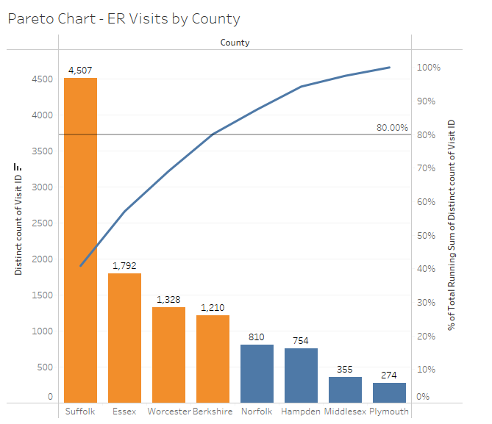
Counties with the Most Emergency Visits
The counties with the highest number of emergency room visits are Suffolk, Essex, Worcester, and Berkshire
All of these areas exemplify populations in heavily populated urban centers.

Slide 4
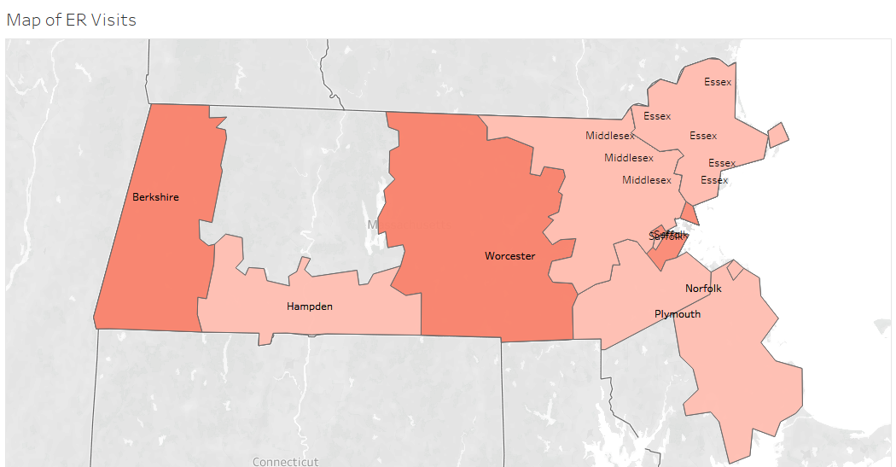
Recommended Focus Regions
Primary Focus: Suffolk, Essex, Worcester, Berkshire
Secondary Focus: Surrounding counties (Middlesex, Norfolk)

Slide 5
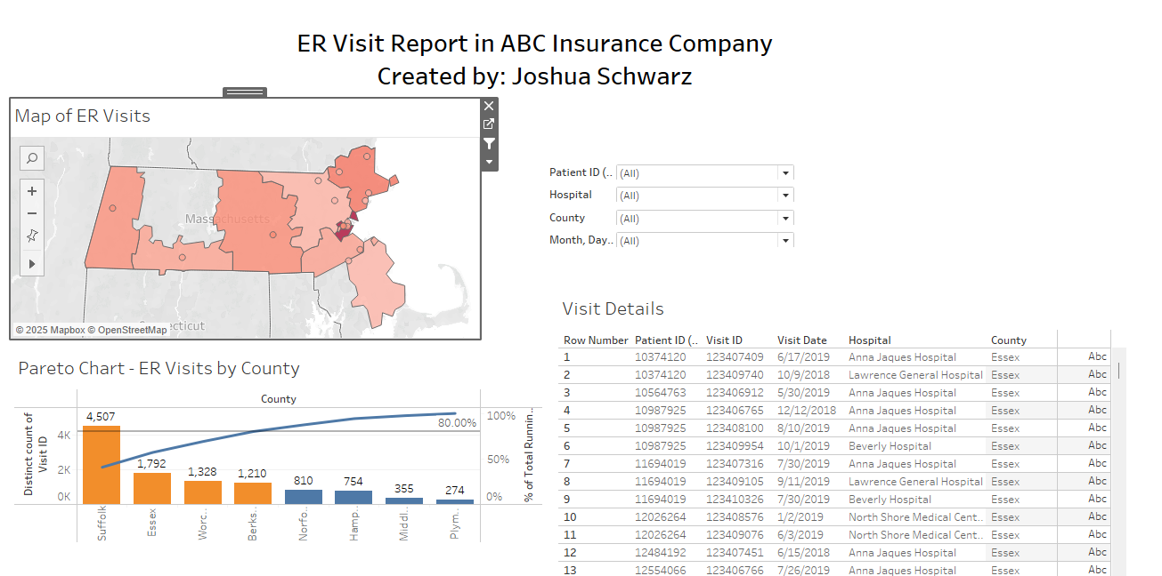
Using the Published Visualizations
Main Points: Choose County Filter: Filter data by location
Hover for Details: see exact visit numbers and visit date
Drop down over time: can see patterns over multiple periods

Slide 6
Conclusion
Worcester and Suffolk are key counties to focus on.
Visualization tools make exploring the data easy.
Strategic planning depends on smart data interpretation.

Slide 7
References
https://public.tableau.com/app/profile/joshua.schwarz2207/viz/U9_Assignment_HI560_JoshuaSchwarz/Dashboard1?publish=yes

