Slide 1
Radio Pair 1
TDD,
OFDM
TDD,
OFDM
Spectrum
Radio Pair 2
Spectrum Sensing,
Control packet
OFDM
Spectrum Sensing,
Control packet
OFDM
Radio Pair 3
Spectrum Sensing,
Control packet
OFDM
Spectrum Sensing,
Control packet
OFDM

Slide 2
S1’
S2
D1’
~R
D2
~R
D1
D2’
S1
~R
S2’

Slide 3
S2
~R
D2
~R
D1
S1
~R

Slide 4
D3
D1
D2
~R₁
~R₁
S1
S3
~R₂
S2

Slide 5
SBX Daughterboard
USRP Motherboard
FPGA
I
I
Gain
×
Digital UP Converter
Ethernet
(from GNU Radio software)
LPF
DAC
Interpolation
Q
Q
LO
SBX Daughterboard
USRP Motherboard
FPGA
I
Ethernet
(to GNU Radio software)
×
Digital Down Converter
I
Gain
LPF
ADC
LPF
Decimation
Q
Q
LO

Slide 6
SBX Daughterboard
USRP Motherboard
FPGA
PC
I
Digital UP Converter
I
LPF
Gain
×
DAC
Interpolation
Q
Q
LO
GNU Radio
SBX Daughterboard
USRP Motherboard
FPGA
×
I
Digital Down Converter
I
Gain
LPF
ADC
LPF
Decimation
Q
Q
LO

Slide 7


Tone 1
to 13
Sub-band 2
Sub-band 7
Tone 254
to 259
Sub-band 10
Sub-band 15
Tone 500
to 512
1 symbol of preamble
●●●
●●●
●●●
●●●
16 symbols of data
$$t$$
Sub-band 1
Sub-band 8
Sub-band 9
Sub-band 16
$$f$$

Slide 8

Tone 1
to 13
Sub-band 2
Sub-band 4
Sub-band 5
Sub-band 7
Tone 500
to 512
1 symbol of preamble
1 symbol of pilot
16 symbols of data
$$t$$
Sub-band 1
Sub-band 3
Tone 254
to 259
Sub-band 6
Sub-band 8
$$f$$

Slide 9
One cooperative cycle
Source
Destination
Spectrum Sensing
Receiving control packet
Stage 1: Sensing
Stage 2: Control packet
Transmitting Control packet
Receiving control packet
Receiving feedback packet
Stage 3: Feedback
Transmitting Feedback packet
Stage 4: Data transmission
Transmitting Data packet
Receiving data packet
t

Slide 10
+

Slide 11



Our signal
Interference
Our signal and Interference
Detection
$$f$$
…
$$t$$
$$180 seconds$$

Slide 12
Our signal
Interference
Our signal and Interference
Detection
$$f$$
…
$$t$$
$$180 seconds$$

Slide 13
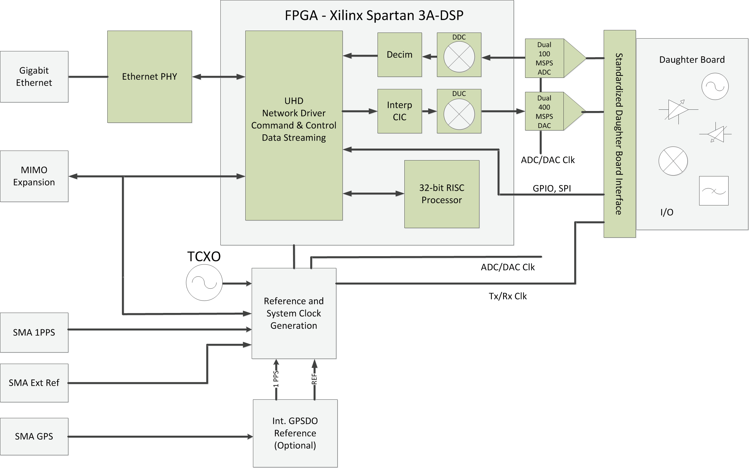

Slide 15
Our signal
Interference
Our signal and Interference
Detection
$$f$$
…
$$t$$
$$180 seconds$$

Slide 16
Our signal
Interference
Our signal and Interference
Detection
$$f$$
…
$$t$$
$$180 seconds$$

Slide 17



Our signal
Interference
Detection
$$f$$
…
$$t$$
$$180 seconds$$

Slide 19
Tone 1
to 13
Sub-band 2
Sub-band 7
Tone 254
to 259
Sub-band 10
Sub-band 15
Tone 500
to 512
●●●
●●●
Sub-band 1
Sub-band 8
Sub-band 9
Sub-band 16
$$f$$

Slide 20
Preprocessing
Base band samples from USRP
Serial to Parallel
512-length FFT and FFT shift
Moving average of each tone across time with window size N
Average tones in each subband
Decision making
| ∙ |²

Slide 21
Energy
Information signal
Side lobe
Side lobe
●●●
noise
Threshold
Frequency
K subbands

Slide 22
Energy
Information signal
Side lobe
Side lobe
●●●
noise
Threshold
Frequency
K subbands

Slide 23




FL
$$fFL$$
FDD
RL
$$fRL$$
TDD
FL
$$fFL\&RL$$
RL
$$t$$

Slide 24
Transmission Flow graph
Data packet from upper layer
GNU Radio Signal Progressing
USRP Transmitter
Tagger
Receiving Flow graph
Data packet to upper layer
GNU Radio Signal Progressing
USRP Receiver
Muter

Slide 25
Tx
Source
Rx
Tx
Destination
Rx
t

Slide 26
Two-way TDD timing adjustment
△t
Tx
Source
Rx
Tx
Destination
Rx
t₀
t₁
t₂
t

Slide 27
One-way TDD timing adjustment
Tx
△t
Source
Rx
Tx
Destination
Rx
t₀
t

Slide 28
Tx
Source
Rx
Tx
Destination
Rx
t

Slide 29
S1
D1
~R₁
~R₂
S2
S3

Slide 30
S1
D1
~R₁
~R₂
~R₁
S2
D2

