Slide 1

FINAL PROJECT MILESTONE 03
Team 03

Slide 2
AGENDA
Introduction of Project
Explanation of Data set
Introduction of the data set
Goals for Data Analysis
Demonstration of goals
Lessons Learned
Conclusion
References to Data set
Soujanya Janapatla

Slide 3






TEAM MEMBERS
Rohith Chittimalla
Manisha Mengani
Soujanya Janapatla
Sai Jyothsna Mathi
Omkar Abhiteja Badda
Nithya Karepe

Slide 4
EXPLANATION OF DATA SET
This is an Academic Data which is regarding Student Placement information where we can observe educational performance of students from ssc to masters and we can also clearly see whether each student is placed in any sector or not.
Manisha Mengani

Slide 5
INTRODUCTION OF ATTRIBUTES
S.No | Column name | Description
1 | Student ID | Unique identifier of the student in the table
2 | Gender | Gender of the student (M/F)
3 | Tenth Percentage | Percentage of the total marks secured in the tenth standard
4 | Intermediate Percentage | Percentage of the total marks secured in intermediate
5 | B.Tech Stream | Branch of the student studies in bachelor of technology
6 | B.Tech Percentage | Percentage of the total marks secured in Bachelor of Technology(EEE, CSE, MECH)
Manisha Mengani

Slide 6
INTRODUCTION OF ATTRIBUTES CONT’D
S.No | Column name | Description
7 | Internship | Mention Yes / No if a student takes an internship
8 | Placement Exam Percentage | Percentage of marks scored in placements examination
9 | M.Tech Percentage | Student percentage of marks secured in Master of technology
10 | Company Sector | Specify the public sector or private sector in which student is working
11 | Status | Mention status of the student as placed or not placed in placements
12 | Salary | Salary of the student if placed in placements and working for any sector
Nithya Karepe

Slide 7
TOTAL NUMBER OF RECORDS AND TOOLS USED IN THE DATA SET
Total number of Records:
Total number of records in the data set are 200.
Data Visualization Tool:
We have used Microsoft Excel to prepare the charts.
Nithya Karepe

Slide 8
GOALS FOR DATA ANALYSIS
Distribution of students with respect to internship and their placement status
Highest percentage in each B.Tech stream
Distribution of placement status of students based on their gender
Rohith Chittimalla

Slide 9
GOALS FOR DATA ANALYSIS CONT’D
Distribution of student’s data based on their B_Tech streams and working sectors
Students who have secured a percent which is greater than or equal to 60 in their placement exam and their placement status
Distribution of students data based on salary greater than 300,000 and company sector
Rohith Chittimalla

Slide 10
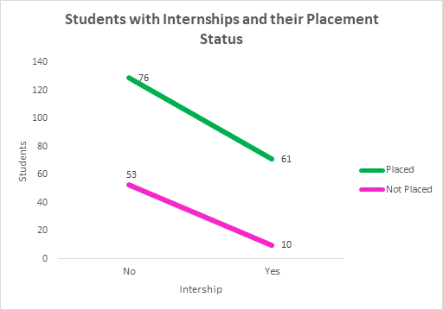
GOAL-1 DEMONSTRATION
Distribution of students with respect to internship and their placement status
Soujanya Janapatla

Slide 11
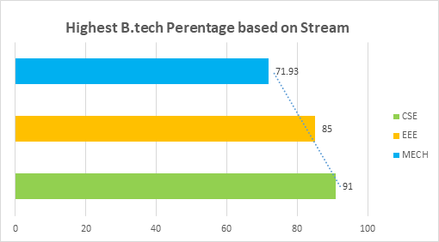
GOAL-2 DEMONSTRATION
Highest percentage in each B_Tech stream
Rohith Chittimalla

Slide 12
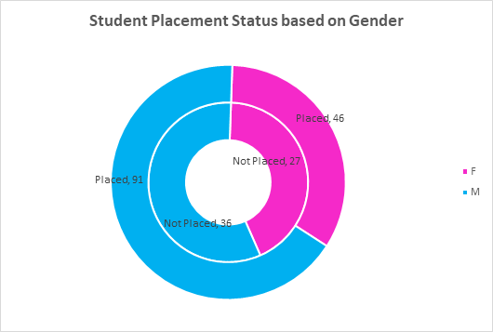
GOAL-3 DEMONSTRATION
Distribution of placement status of students based on their gender
Nithya Karepe

Slide 13
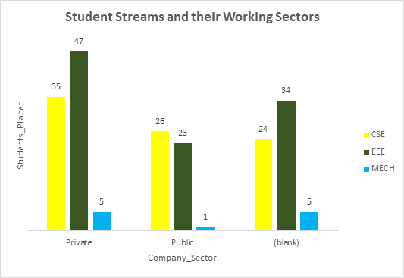
GOAL-4 DEMONSTRATION
Distribution of student’s data based on their B_Tech streams and working sectors
Manisha Mengani

Slide 14
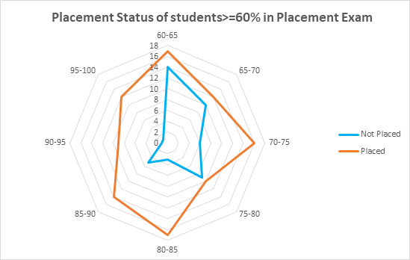
GOAL-5 DEMONSTRATION
Students who have secured a percent which is greater than or equal to 60 in their placement exam and their placement status
Sai Jyothsna Mathi

Slide 15
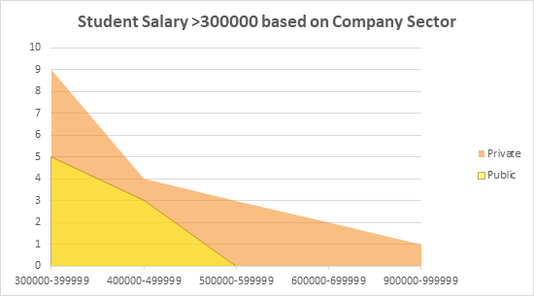
GOAL-6 DEMONSTRATION
Distribution of students data based on salary greater than 300,000 and company sector
Omkar Abhiteja Badda

Slide 16
LESSONS LEARNED
Collecting data
Cleaning the data set
Writing the goals based on data set
Creating the charts, legends, filters, and data filtration with goals using tools
We have gained a great experience of visualizing data by learning data storytelling
Sai Jyothsna Mathi

Slide 17
CONCLUSION
Placement data is analyzed to understand the student job state.
This data also converses regarding student academics from tenth until masters of technology. It gathers that irrespective of attending internship, students with good academics got placed in both public and private sector earns a good number of salary.
Omkar Abhiteja Badda

Slide 18
REFERENCES TO DATA SET
Content in the data set is from
https://www.kaggle.com/benroshan/factors-affecting-campus-placement
Omkar Abhiteja Badda

Slide 19


