Slide 1
acqwire>>

Slide 2
a>>

Slide 3
Navigation Bar
Acqwire Logo About Us Programs Upcoming batches ApplyNow Contact

Slide 4

Banner/Landing Page

Slide 5

About Us

Slide 6

Programs (1)

Slide 7


Programs (2)

Slide 8
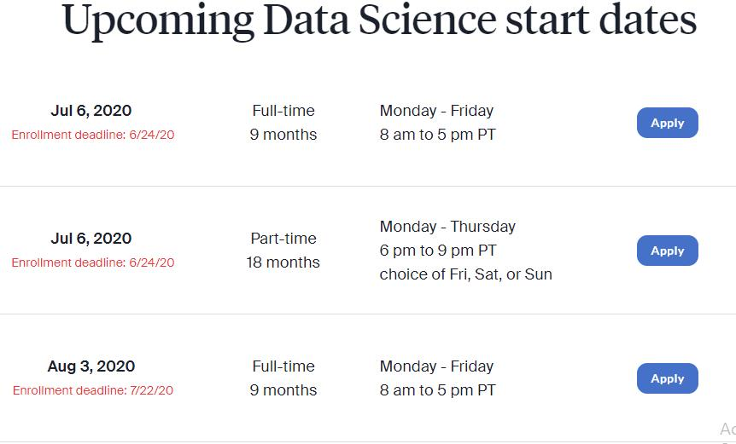
Upcoming Batches

Slide 9
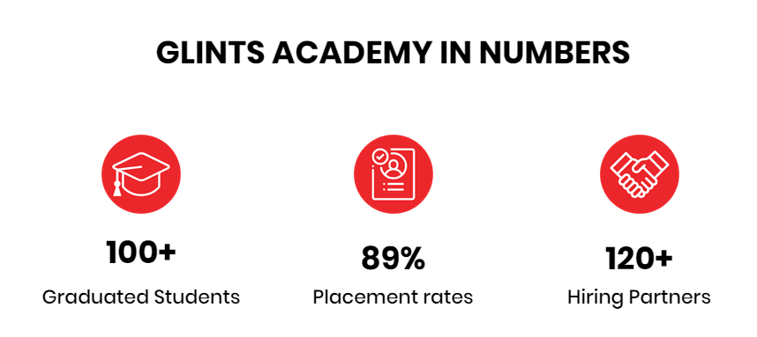


Slide 10

Footer
https://colorlib.com/etc/glint/index.html#about
https://designmodo.com/svg-infographic/
https://designmodo.com/slides/

