Slide 1
Clean Code – TDD Practice
JavaScript TDD Guide

Slide 2
Overview
Introduction
Testing framework
QUnit
Testing Anatomy
Results
Demo

Slide 3
Introduction
This is a simple guide for TDD Practice
Files necessary for this practice are available at https://github.com/jscraftsman/Learn-TDD

Slide 4

Testing Framework: QUnit
QUnit is a powerful, easy-to-use JavaScript unit testing framework.
It's used by the jQuery, jQuery UI and jQuery Mobile projects and is capable of testing any generic JavaScript code, including itself!
There are a lot of JavaScript testing frameworks but for this practice, we will use QUnit since it is easy to setup compared to other frameworks.

Slide 5
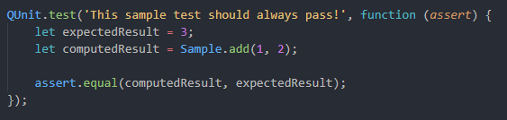
Testing Framework: Testing Anatomy
2. Test Description – Displayed in the test results
1. QUnit.test() is used to add a “test” to run.
3. Function for QUnit to execute.
Notice that this function is passed as a 2nd parameter for QUnit.test()
The “assert” argument contains all of QUnit’s assertion methods.
Ex.
assert.equal()
assert.notEqual()
assert.deepEqual()
assert.throws()
4. Computation - Execute a set statements that will compute a value to be tested.
5. Assertion - Check that the results of your calculation is what you expect it to be.

Slide 6
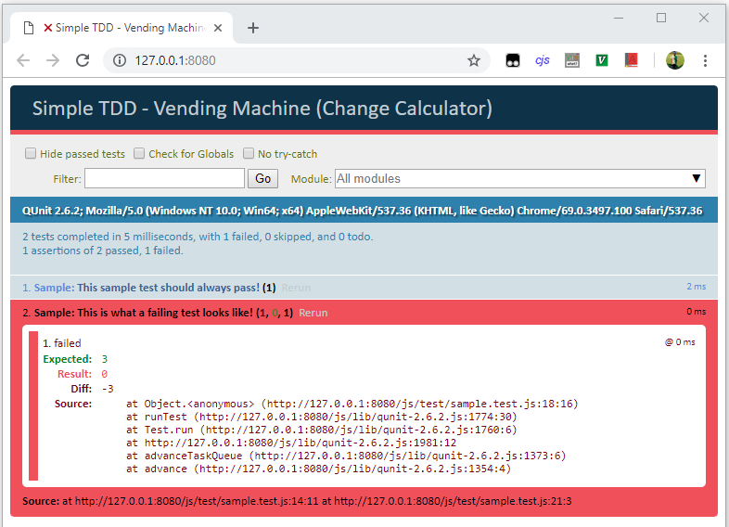
Testing Framework: Results
Passing Test
Failing Test
Failing test are shown as Red
Failed test will show the expected and actual results.
The two will be compared and a diff will be shown.

Slide 7
DEMO

Slide 8
END

